Slide 1
Do Now
What struggles did farmers face in the late 1800s? What solutions existed for those farmers?

Slide 2
6. Populism and the Election of 1896
Mr. Winchell
APUSH 19-20
Period 6

Slide 3
Farmers Plight
Farm Becomes a Factory
Environmental Factors
Drought/Over-farming
Overproduction-Falling Prices
Loans
Railroad Monopolies
Tariffs
Panics

Slide 5
COMBINATIONS
MONOPOLISTS
[Trusts]
Government Policy
FARMERS?
Although the farmers still made up the plurality of the work force in the late 19th century, they were the last to organize as an interest group.
LABORERS
[UNIONS]

Slide 6
Farmers Unite!
Social:
Economic:
Political:
The Grange
Farmers’ Alliances
Populist Party

Slide 7
Populist Party
Some Democrats
Grange
Farmers Alliances
Green-back Labor
Populist Party, 1892

Slide 8
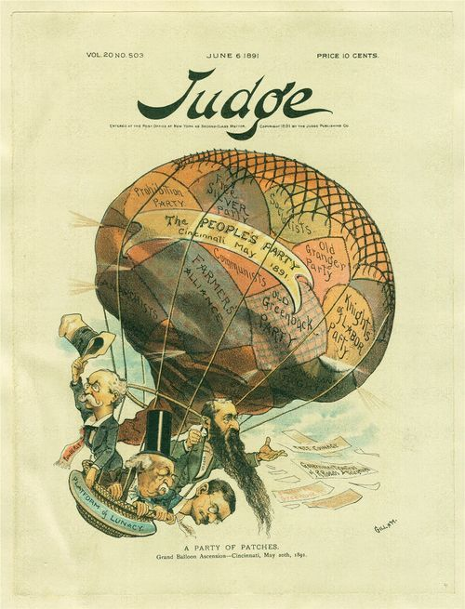
The Populist Movement

Slide 9
The Populist Platform
Political Reform Proposals | Economic Reform Proposals
Graduated [Progressive] Income Tax
Unlimited Coinage of Silver
Nationalization of Railroads
Direct Election of Senators
Ballot Initiatives
Secret Ballot

Slide 10
Omaha Platform-July 4, 1892
Text Analysis
Omaha Platform (July 4, 1892)
Coinage of silver
Direct election of Senators
Graduated income tax
State laws through referendums/initiatives
Government regulation/ownership of infrastructure
8-hour workday
Abolition of national banks
Civil service reform
Notes:
Omaha Platform (July 4, 1892)
Coinage of silver
Direct election of Senators
Graduated income tax
State laws through referendums/initiatives
Government regulation/ownership of infrastructure
8-hour workday
Abolition of national banks
Civil service reform

Slide 11
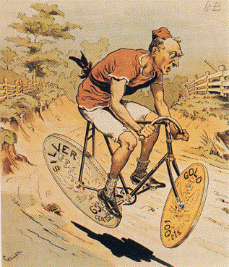
Bimetallic Instability?

Slide 12
Election of 1896
William McKinley
William Jennings Bryan
Republican
Pro-Big Business
Pro-Tariff
Pro-Gold Standard
Coalition of business/skilled workers/rich farmers
HUGE campaign budget
Backed by business (Mark Hanna)
Democrat/Populist
Pro-Farmers
Anti-Tariff
Pro-Silver
Farmers/Unskilled Labor/Immigrants
SMALL budget
‘passing the hat’ at rallies

Slide 13
William Jennings Bryan ‘Cross of Gold’
The gentleman from Wisconsin has said he fears a Robespierre. My friend, in this land of the free you need fear no tyrant who will spring up from among the people. What we need is an Andrew Jackson to stand as Jackson stood, against the encroachments of aggregated wealth’
There are two ideas of government. There are those who believe that if you just legislate to make the well-to-do prosperous, that their prosperity will leak through on those below. The Democratic idea has been that if you legislate to make the masses prosperous their prosperity will find its way up and through every class that rests upon it.
You come to us and tell us that the great cities are in favor of the gold standard. I tell you that the great cities rest upon these broad and fertile prairies. Burn down your cities and leave our farms, and your cities will spring up again as if by magic. But destroy our farms and the grass will grow in the streets of every city in the country.
If they dare to come out in the open field and defend the gold standard as a good thing, we shall fight them to the uttermost, having behind us the producing masses of the nation and the world. Having behind us the commercial interests and the laboring interests and all the toiling masses, we shall answer their demands for a gold standard by saying to them, you shall not press down upon the brow of labor this crown of thorns. You shall not crucify mankind upon a cross of gold.

Slide 14
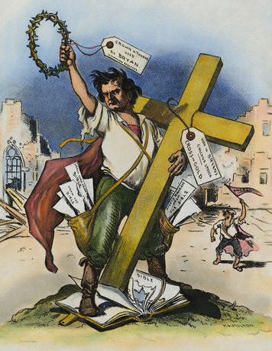

Slide 15
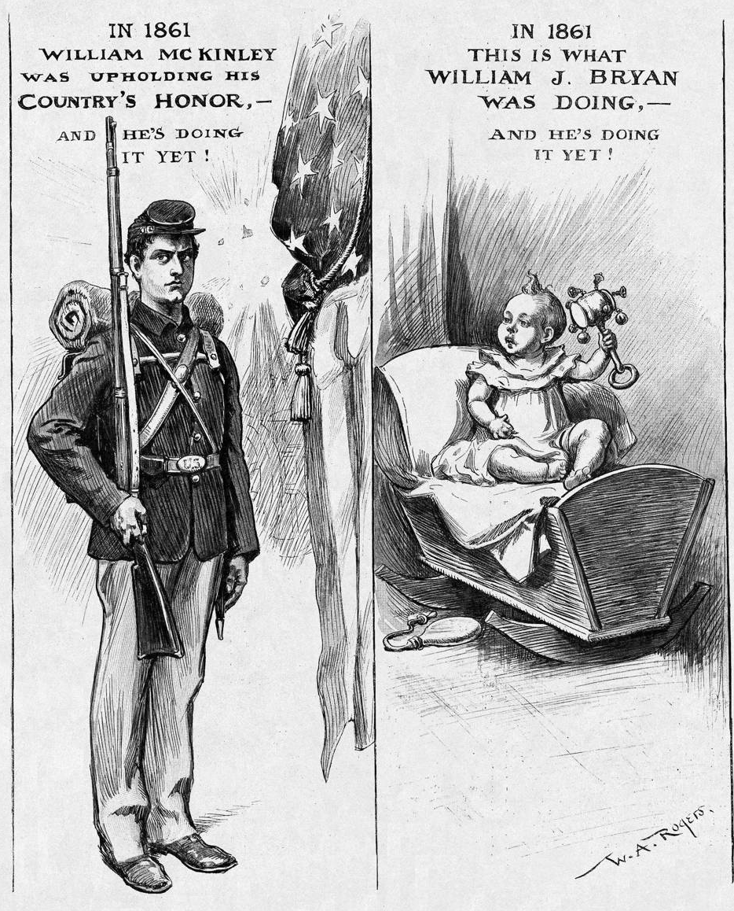

Slide 16
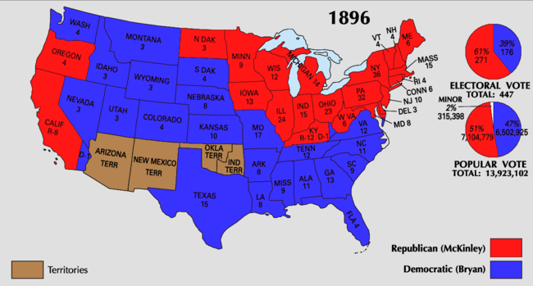
Election of 1896

Slide 17
Why Did Bryan Lose?
His focus on silver undermined efforts to build bridges to urban voters.
He did not form alliances with other groups.
McKinley’s campaign was well- organized and highly funded (BIG BUSINESS BACKS McKINLEY BIG)

Slide 18
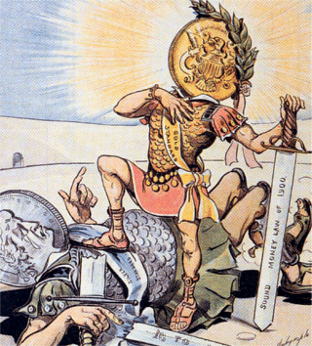
Gold Triumphs Over Silver
1900 → Gold Standard Act
confirmed the nation’s commitment to the gold standard.
A victory for the forces of conservatism.

Slide 19
Impact of Populists
Many of the reforms they advocated eventually became law
A major factor in local, state, and national politics – elected representatives on every level
Failed Presidential bids – W.J. Bryan
Political apparatus and ideals co-opted by Democrats – lost to Republicans in 1896, dooming Populist Party
Major impact: kept small “r” republican tradition (“the producers”) alive and strong in American reform tradition
Both radical and exclusionary aspects – uniters and dividers

Slide 20
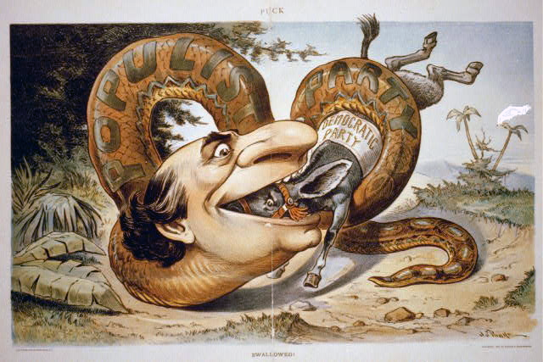
Populism Devours Democratic Party

