Slide 1
Do Now
STOP AND JOT…
“Liberty may be endangered by the abuse of liberty, but also by the abuse of power…”
James Madison

Slide 2
6. The Constitution: Convention, Compromises, and Ratification
Mr. Winchell
APUSH 2019-2020
Period 1-2

Slide 3
AP Prompt
Evaluate the extent to which the Constitution can be labeled ‘a bundle of compromises.’

Slide 4
Outline
The Need for New Government
Principles of a Republic
Compromises in the Constitution
Structures of the New Government
Ratification and Warring Factions-Federalists and Anti-Federalists
The Bill of Rights

Slide 5
Constitutional Reform
American political ideology changed from the beginning of the American Revolution to the late Confederation period:
In the 1770s, American political leaders saw tyranny as the greatest threat to the USA
But…by the mid-1780s, they saw ordinary citizens who lacked virtue as the greatest threat
Thus, states created weak state governors & a weak Articles of Confederation
The problem is an excess of democracy not an excess of tyranny
Shays’ Rebellion will help prove this point to the Founding Fathers
Notes:
17

Slide 6
Constitutional Reform
Congress did not have the tax funds to send an army
Merchants in MA hired their own mercenary militia to end the uprising
By 1787, the fatal flaws of the Articles of Confed were exposed:
Shays’ Rebellion broke out among desperate MA farmers who faced losing their farms or being sent to debtor’s prison
Congress called for a meeting in Philadelphia to discuss revising the Articles & strengthening the national gov’t
Shays’ Rebellion gave nationalists like Washington, Madison, Hamilton the urgency to call for a stronger national gov’t
In Sept 1786, James Madison led the Annapolis Convention to discuss improving American trade
Notes:
18

Slide 7
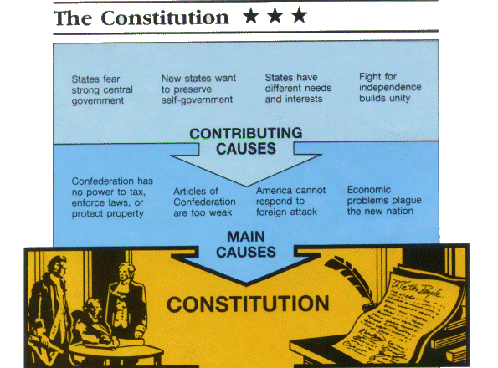

Slide 8
The Constitutional Convention, 1787
Key leaders at the Convention:
George Washington:
President (chairman) of the Convention
Quiet but very respected;
Kept tempers cool
James Madison: “The Father of the Constitution”
Author of the Virginia Plan (three branches of govt)
Kept detailed notes! Brilliant!
Would later write the Bill of Rights
Constitutional Compromises
They had to balance a lot of competing interests.

Slide 9
Inventing a Federal Republic
Delegates incorporated 4 major principles into this new gov’t:
Limited gov’t—even though a stronger gov’t was being created, citizens’ liberty is protected
Republicanism—the people vote for their leaders
Separation of powers—three branches with defined powers
Federalism—the national gov’t shares power with state gov’ts
Notes:
21

Slide 10
Representation?
Virginia Plan
New Jersey Plan
Strong central government
Virtually total legislative control over the states
Bicameral legislature
Proportional representation to each states population in both houses
Lower house directly elected
Lower house elected upper house with input from state legislatures
Both houses chose executive and judicial
Unicameral legislature
Each state with an equal vote
Proposes executive and judicial branches

Slide 11
Great Compromise
Bicameral legislature
Lower house (House of Representatives)
Proportional representation
Directly elected
Upper house (Senate)
Equal representation of 2 senators each
Elected by state legislatures
NOTE: Virginia and New Jersey Plans allowed for Congress to:
pass revenue bills
regulate commerce
supremacy over states
Oliver Ellsworth and Roger Sherman

Slide 12
The 3/5 Compromise
Problems still remained between the northern & southern states regarding how to count population size (do slaves count?)
The Three-Fifths Compromise settled the issue:
Three-fifths of the slave population could be counted toward representation in the House of Representatives
Notes:
22

Slide 14
Compromising with Slavery
Despite the contradiction slavery posed, Southerners threatened to leave the USA anytime the slave question was discussed
As a compromise for the South, the slave trade could continue to 1808 & runaway slaves returned
Slave Trade Compromise: Congress can regulate interstate commerce; in exchange promises to not touch the slave trade for 20 years
“Great as the evil is, a dismemberment of the Union would be worse.”
—James Madison
Notes:
23

Slide 15
Structure of National Government
Separation of Powers
Article I - Congress (Legislative Branch)
House of Representatives
Senate
Article II – President/Agencies (Executive Branch)
Article III - Supreme Court (Judicial Branch)
Checks and Balances
Federalism
Division of powers between national government and states

Slide 16
Three Branches of Government

Slide 17
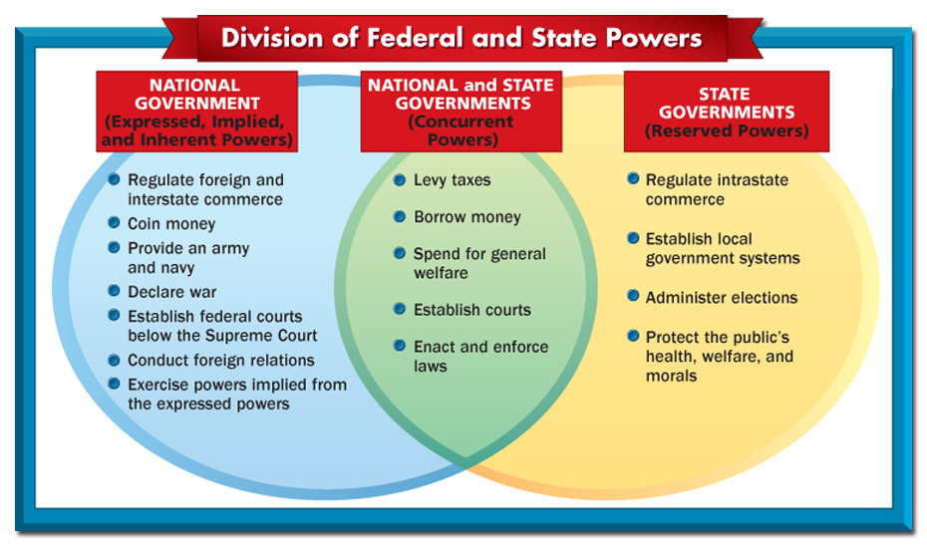
Federalism

Slide 18
Key Ideas of the Constitution
Only Congress can make laws, declare war, create taxes
The “elastic clause” gives Congress implied powers to make laws seen as “necessary & proper”
The Senate ratifies treaties & confirms judicial appointments

Slide 19
Key Ideas of the Constitution
The president can only recommend legislation to Congress but can veto bills
The president oversees the bureaucracy

Slide 20
Key Ideas of the Constitution
The only court mentioned in the Constitution is the Supreme Court

Slide 21
The Struggle for Ratification
The delegates in Philadelphia knew that ratification of the new Constitution would not be easy:
They had no authority to change the Articles of Confederation
They did not inform the public of their ongoing decisions
They fundamentally altered the relationships between the states & the central government
They needed 9/13 states to approve

Slide 22
Federalists & Anti-Federalists
Federalists
Supported ratification of the Constitution
Were well-organized & educated
Used Federalist Papers to argue for ratification
Had the support of the media
Anti-Federalists
Against ratification
Distrusted of a gov’t that removed power from the hands of the people
Claimed the new Constitution favored the upper class
Authored by Madison, Hamilton, & Jay
Anti-Federalists argued for more protection of individual liberties
“The Constitution is itself a Bill of Rights”
Notes:
26

Slide 23
bb
Federalists | Anti-Federalists
Supporters of Constitution Wanted strong national government Thought a strong central government would protect the country from foreign nations Would also provide protection, maintain order, regulate trade, guarantee rights of citizens, guarantee the nation’s debts were paid, and that American money had a stable value Thought a Bill of Rights listing citizen’s rights was unnecessary because the Constitution had already limited the government’s powers Thought that a national government that represented everyone would not be able to ignore the rights of everyone else | Opponents of Constitution Wanted a weak national government and powerful state governments Thought strong central government would endanger people’s liberties Thought having a government so far away wouldn’t meet needs of people > needed governments that were local to protect people’s interests Thought the Constitution needed a Bill of Rights to specifically state the rights of citizens that the government must respect Didn’t like “necessary and proper” statement in Constitution because the wording was open to interpretation and could leave door open for Congress to abuse its power

Slide 25
Fight for Ratification Federalists vs Anti-Federalists
Strong central government
Common good
Well-funded and politically organized
Favored by merchants, urbanites
Alexander Hamilton, James Madison
The Federalist Papers
Federalist No. 10
“Liberty is to faction, what air is to fire, an aliment without which it instantly expires. But it could not be a less folly to abolish liberty, which is essential to political life, because it nourishes faction, than it would be to wish the annihilation of air, which is essential to animal life, because it imparts to fire its destructive agency.”
“Among the numerous advantages promised by a well-constructed Union, none deserves to be more accurately developed than its tendency to break and control the violence of faction.”
“Extend the sphere and you take in a greater variety of parties and interests; you make it less probable that a majority of the whole will have common motive to invade the rights of other citizens.”
Federalist No. 51
“If men were angels, no government would be necessary. If angels were to govern men, neither external nor internal controls on government would be necessary. In framing a government which is to be administered by men over men, the great difficulty lies in this: you must first enable the government to control the governed; and in the next place oblige it to control itself.”
States rights
Argued for a Bill of Rights
Favored by small farmers, western homesteaders
George Mason, Samuel Adams
“I had rather be a free citizen of the free small republic of Massachusetts, than an oppressed subject of the great American empire.” – Antifederalist No. 1
“Antifederalists feared what Patrick Henry termed the "consolidated government" proposed by the new Constitution. They saw in Federalist hopes for commercial growth and international prestige only the lust of ambitious men for a "splendid empire" that, in the time-honored way of empires, would oppress the people with taxes, conscription, and military campaigns. Uncertain that any government over so vast a domain as the United States could be controlled by the people, Antifederalists saw in the enlarged powers of the general government only the familiar threats to the rights and liberties of the people.” – Ralph Ketchum

Slide 26
Adding the Bill of Rights
To win ratification, the Federalists agreed to add a Bill of Rights
With this protection of citizens’ liberty, all 13 states agreed to ratify the Constitution
Constitution became the official the law of the land in 1789
After bitter fight, most Americans chose to support the Constitution
If 1776 was the 1st American Revolution… 1787 was the 2nd American Revolution
Notes:
27

Slide 27
Ratification
Created: September 17, 1787
Ratified: June 21, 1788
“I confess that there are several parts of this Constitution which I do not at present approve, but I am not sure I shall never approve them…I doubt too whether any other Convention we can obtain may be able to make a better Constitution. For when you assemble a number of men to have the advantage of their joint wisdom, you inevitably assemble with those men, all their prejudices, their passions, their errors of opinion, their local interests, and their selfish views. From such an Assembly can a perfect production be expected? It therefore astonishes me, Sir, to find this system approaching so near to perfection as it does; and I think it will astonish our enemies, who are waiting with confidence to hear that our councils are confounded like those of the Builders of Babel; and that our States are on the point of separation, only to meet hereafter for the purpose of cutting one another's throats. Thus I consent, Sir, to this Constitution because I expect no better, and because I am not sure, that it is not the best.“ – Benjamin Franklin, September 17, 1787
"I have often looked at that behind the president without being able to tell whether it was rising or setting. But now I... know that it is a rising...sun.“ – Benjamin Franklin

Slide 28
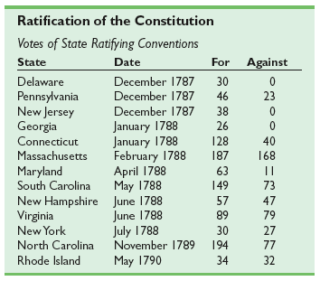

Slide 29
The Constitution Needs a Bill of Rights; The Constitution Does Not Need a Bill of Rights
Patrick Henry – Speech Before the Virginia Ratifying Convention (1788)
Alexander Hamilton – The Federalist No. 84 (1788)
It was expressly declared in our Confederation that every right was retained by the States respectively, which was not given up to the Government of the United States. But there is no such thing here. You therefore by a natural and unavoidable implication, give up your rights to the General Government… A Bill of Rights may be summed up in a few words. What do they tell us? – That our rights are reserved. – Why not say so? Is it because it will consume too much paper?... A Bill of Rights is a favorite thing with the Virginians, and the people of the other States likewise. It may be their prejudice, but the Government ought to suit their geniuses, otherwise its operation will be unhappy. A Bill of Rights, even if its necessity be doubtful, will exclude the possibly of dispute, and with great submission, I think the best way is to have no dispute.
Here, in strictness, the people surrender nothing, and as they retain every thing, they have no need of particular reservations. “We the people of the United States, to secure the blessing of liberty to ourselves and our posterity, do ordain and establish this constitution for the United States of America.”... I go further, and affirm that bills of rights, in the sense and in the extent in which they are contended for, are not only unnecessary in the proposed constitution, but would even be dangerous. They would contain various exceptions to powers which are not granted; and on this very account, would afford a colourable pretext to claim more than were granted. For why declare that things shall not be done which there is no power to do?... The truth is…that the constitution is itself in every rational sense, and to every useful purpose, a Bill of Rights...And the proposed constitution, if adopted, will be the bill of rights of the union.

Slide 30
First Ten Amendments
First Amendment
Establishment Clause
Free Exercise Clause
Speech, Press, Assembly, Petition
Fourth Amendment
Searches and Seizures
Fifth Amendment
Due Process
Sixth Amendment
Speedy and fair trial
Counsel
Tenth Amendment
Reserved powers of the states

Slide 31
A Stronger National Government
Articles Problems
Constitution Solution
No power to tax
No power to regulate interstate and foreign commerce
No executive branch
No judicial branch
Amendments need unanimous consent
Supermajority to pass laws
Lay and collect taxes
Interstate and foreign commerce clause
No export taxes
President
Electoral College
4 year terms
U.S. Supreme Court
Article V – Amendments
2/3 of both houses of Congress
¾ of state legislatures
Presentment Clause
Simple majority by both houses
President’s signature

Slide 32
Historiography “The Constitution: Conflict or Consensus?”
Gordon S. Wood – The Creation of the American Republic, 1776-1787 (1969)
Woody Holton – Did Democracy Cause the Recession That Led to the Constitution? (2005)
Despite all the examples of popular vice in the [1780s], the Federalist confidence in the people remained strong. The Federalists had by no means lost faith in the people, at least in the people’s ability to discern their true leaders. In fact many of the social elite who comprised the Federalist leadership were confident of popular election if the constituency could be made broad enough…Despite prodding by so-called designing and unprincipled men, the bulk of the people remained deferential to the established social leadership... Even if they had wanted to, the Federalists could not turn their backs on republicanism.
The competing economic struggles advanced in the 1780s were rooted in conflicting assessments of popular virtue. Madison and other prominent Federalists believed the 1780s offered farmers a grim lesson about the limits of their own capacity for self-rule. According to this viewpoint, the authors of the Revolution-era state constitutions had placed too much faith in ordinary Americans’ ability and willingness to act wisely and justly… Although [many Americans] agreed that the state legislatures had mismanaged the economy, they traced this failure to elite, not popular, misrule. Consequently, they disputed the Federalists’ assertion that the only way out of the economic bind was to the embrace the restraints on popular influence embodied in the Constitution.

