Slide 1
Do Now
Read and annotate the introductory essay, accounting for key features and developments of the Age of Jackson

Slide 2
The Corrupt Bargain & Jacksonian Democracy
Mr. Winchell
APUSH
Period 4

Slide 3
Updates
Test: Wednesday 10.18
Bootcamp: 10.21

Slide 4
AP Prompt
Compare and contrast Jeffersonian and Jacksonian Democracy, accounting for similarities and differences.

Slide 5
Key Concepts

Slide 6
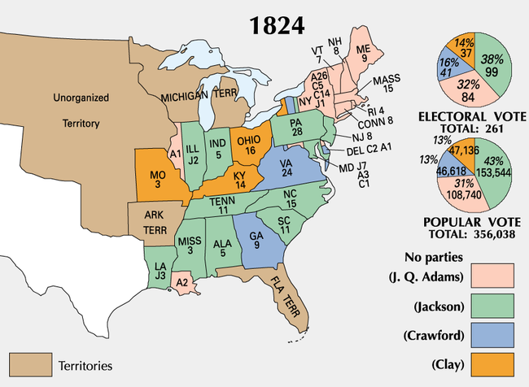
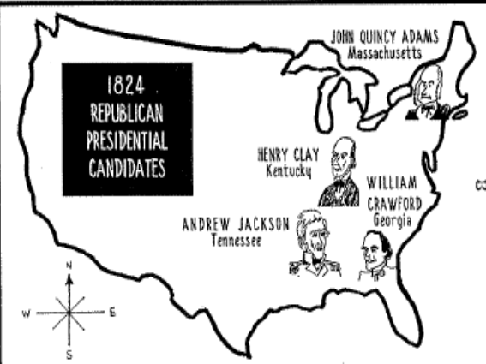
The Election of 1824:
“The Corrupt Bargain”
Jackson ran in a 4-way race for Pres in 1824 (all the same party!)
4 candidates were in the running, each with sectional support: William Crawford (GA), John Quincy Adams (MA), Andrew Jackson (TN), Henry Clay (KY)
In such cases, the top 3 candidates are voted on in House of Representatives, with each state getting 1 vote
Even though Jackson won the popular vote, he didn’t receive a majority of electoral votes.
Henry Clay gives his support to JQ Adams and the House of Reps chooses Adams as President
Adams names Clay Sec. of State 2 weeks later….hmmmm
AJ is furious: The Corrupt Bargain
AJ Publicly supports changes in state laws
about who can vote

Slide 7
A “Corrupt Bargain”?
YEARS | PRESIDENT | SEC OF STATE | VICE PRESIDENT
1789-1797 | George Washington | Thomas Jefferson | John Adams
1797-1801 | John Adams |  | Thomas Jefferson
1801-1809 | Thomas Jefferson | James Madison
1809-1817 | James Madison | James Monroe
1817-1825 | James Monroe | John Quincy Adams
1825-1829 | John Quincy Adams | Henry Clay | John C. Calhoun

Slide 8
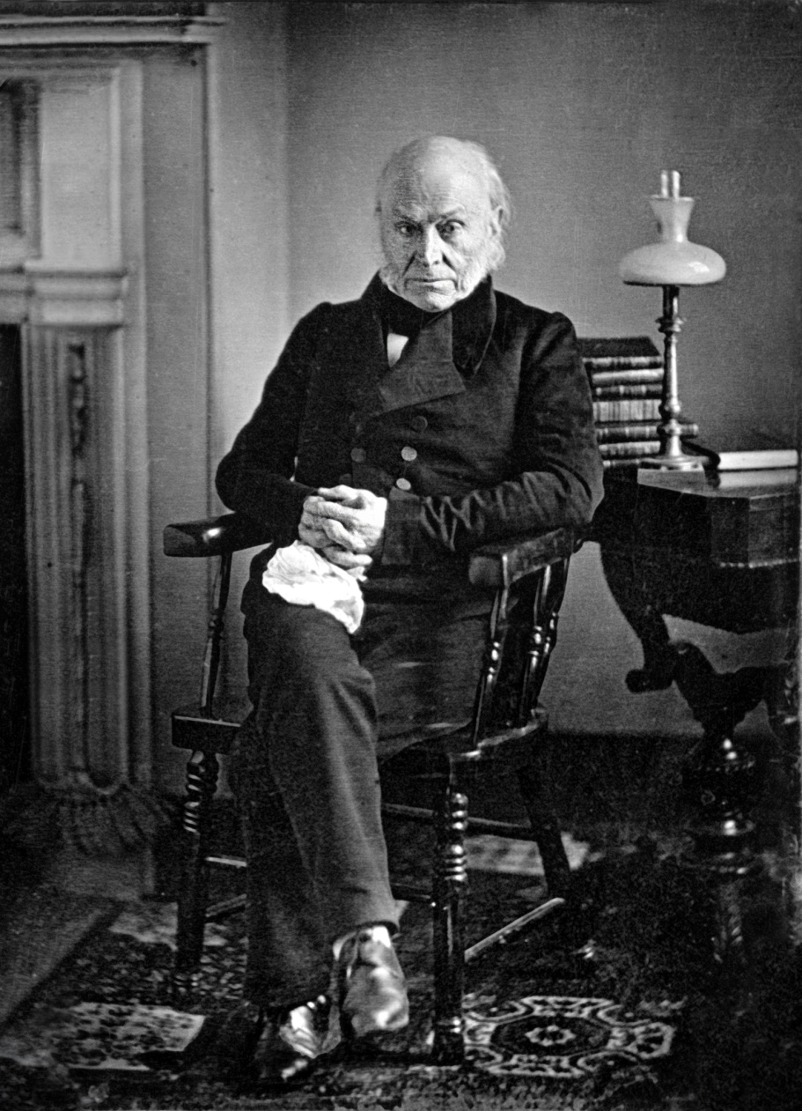
Adams’ Administration
Clay’s American System
1828 “Tariff of Abominations”
Generous Indian policy
All of which angered Jacksonian Democrats

Slide 9
Why John Quincy Adams Sucked

Slide 10
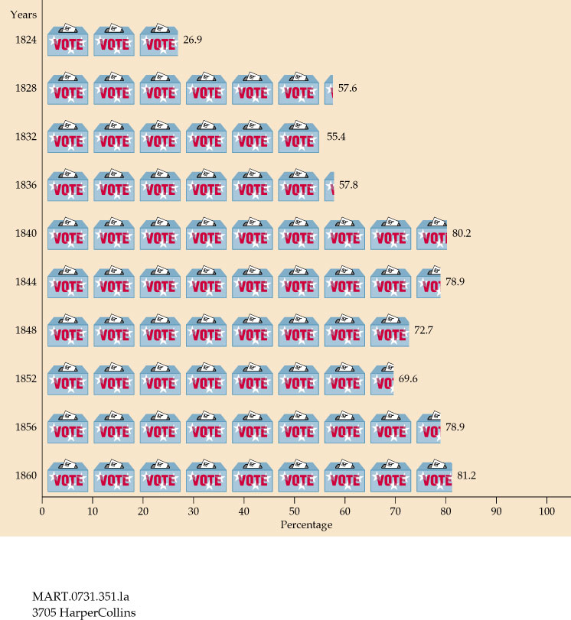
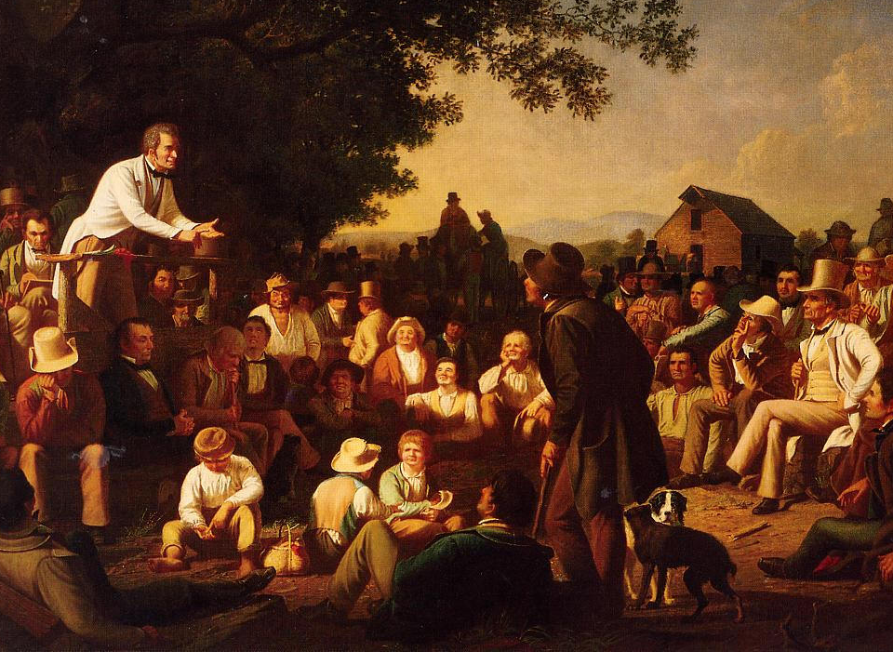
From 1800 to 1840, states removed property and
tax restrictions which allowed 90% of “common” white men to vote (“universal white male suffrage”)

Slide 11
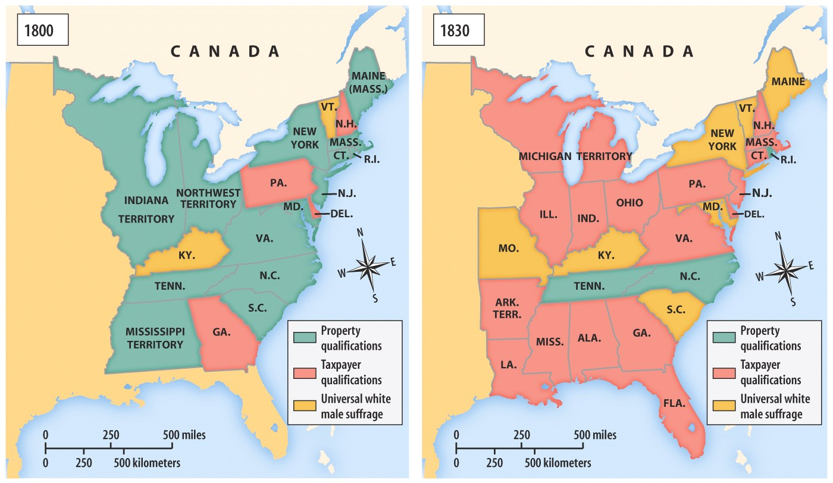
Universal White Male Suffrage

Slide 12
Direct Balloting for President
President
The New System
Direct Election
(Democracy)
The Old System
Indirect Election
(Aristocracy)
Presidential Electors
By 1836, voters in all states except for South
Carolina were casting
direct ballots for presidential electors.
South Carolina continued to select electors indirectly until 1860.
State Legislature
Voters
Notes:
Which arrangements

Slide 13
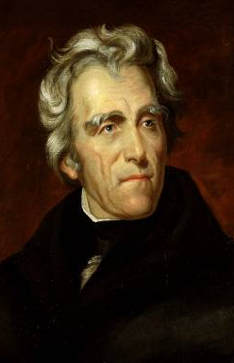
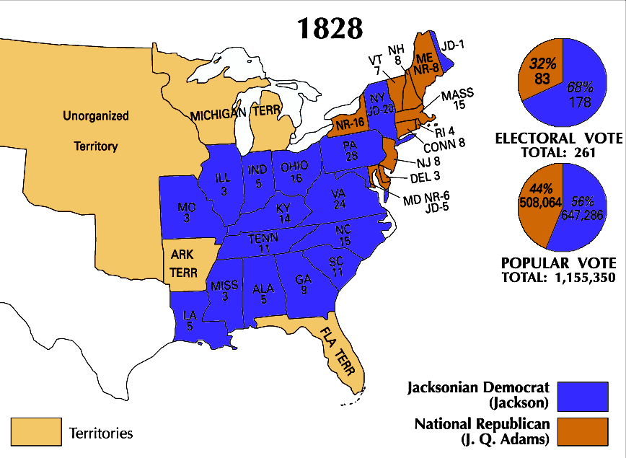
Andrew Jackson’s victory in the
election of 1828 changed American politics

Slide 14
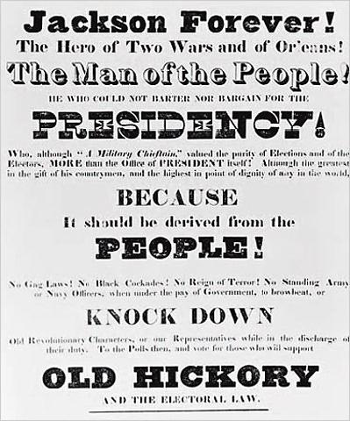
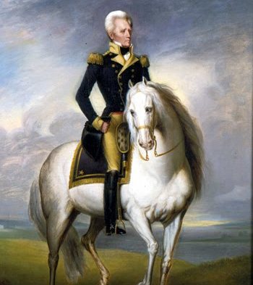
Andrew Jackson was the first “common man” president
He was born poor, uneducated, and from the West

Slide 15
Jacksonian Democracy
When Andrew Jackson was elected president, it represented a new era in American history:
  He was the first president that represented the “common man”
  His party (the Democrats) took advantage of the extension of suffrage to common white men
  He greatly expanded the powers of the presidency
Notes:
Endorsing the view that a fundamental conflict existed between working people and the “non-producing” classes of society, Jackson and his supporters promised to remove any impediments to the ordinary citizen’s opportunities for economic improvement. According to the Jacksonians, inequalities of wealth and power were the direct result of monopoly, favoritism, and special privileges, which made “the rich richer and the powerful more potent.” Only free competition in an open marketplace would ensure that wealth would be distributed in accordance with each person’s “industry, economy, enterprise, and prudence.” The goal of the Jacksonians was to remove all obstacles that prevented farmers, artisans, and small shopkeepers from earning a greater share of the nation’s wealth.

Slide 16
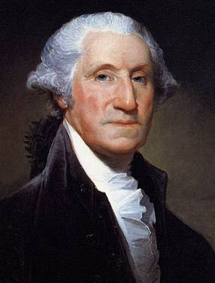
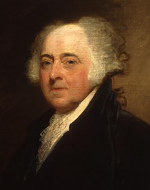
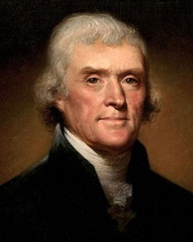
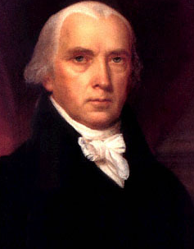
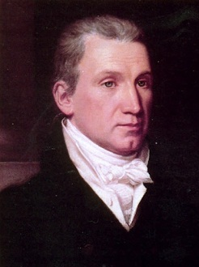
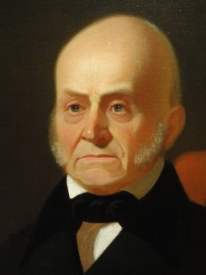
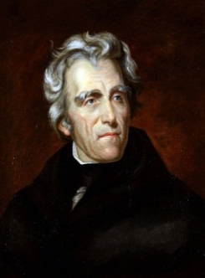
Jackson’s victory split the Democratic-Republicans and led to the formation of the Democratic Party
Jackson and his supporters hoped to return
to the Jeffersonian ideas of states’ rights,
protection of liberty, and westward expansion
8 yrs
George Washington
(1789-1797)
4 yrs
John
Adams
(1797-1801)
8 yrs
Thomas
Jefferson
(1801-1809)
8 yrs
James
Madison
(1809-1817)
8 yrs
James
Monroe
(1817-1825)
4 yrs
John Quincy
Adams
(1825-1829)
8 yrs
Andrew Jackson
(1829-1837)
Federalist Party
Democratic-Republican Party
Democratic Party

Slide 17
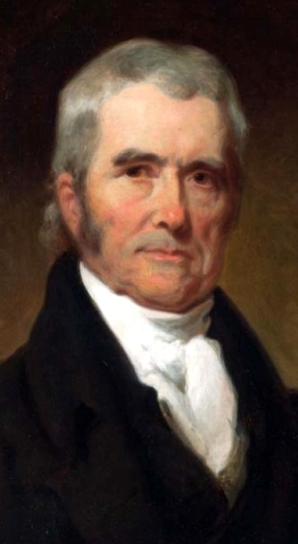
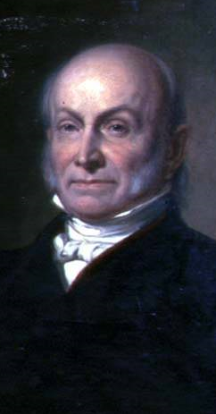
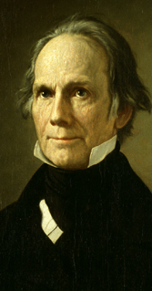

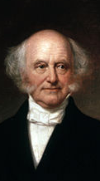
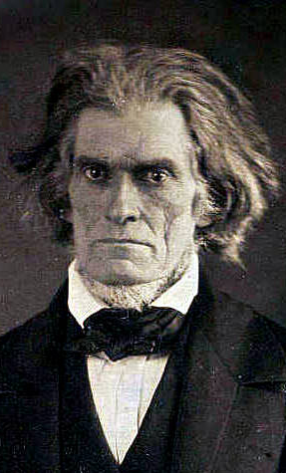
Parties & Leaders
Old Federalists
National Republicans/ Whigs
Jacksonian Democrats
Southern Democrats
John Marshall
John Q. Adams
Henry Clay
Andrew Jackson
Martin Van Buren
John C. Calhoun
National Supremacy States’ Rights

Slide 18
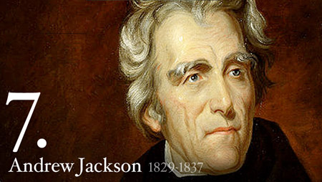
Andrew Jackson’s two term presidency (1829-1837) was defined by three major conflicts and many minor ones, including within his own government
2 Issues for today: Native Americans and Tariffs

Slide 19
Spoils System
When Jackson was elected, he rewarded loyal supporters with gov’t jobs (the spoils system)
  Massive turnover in the civil service had not yet occurred
  Rotation in office began to be seen as a very democratic way to reduce gov’t corruption & incompetence
Jackson was not the 1st to do this… he just extended it to more people!
“Get their rascals out…and our rascals in”

Slide 20
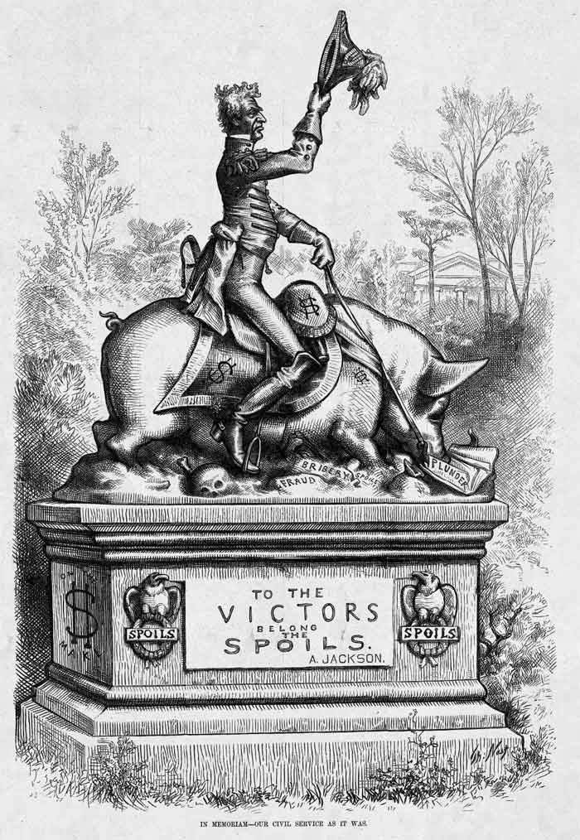

Slide 21
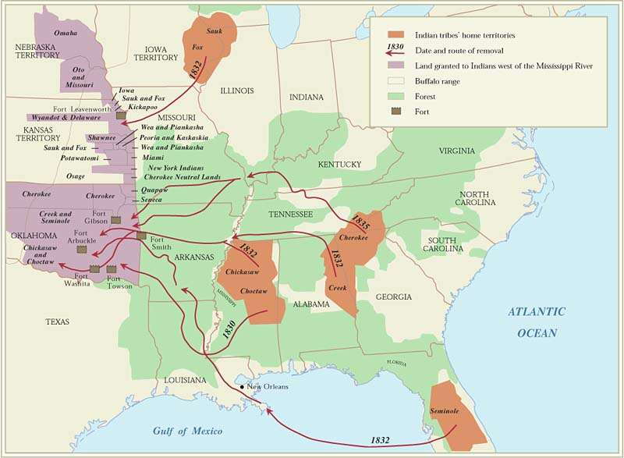
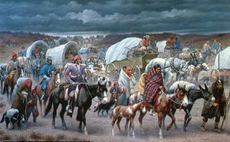
Jackson and Native Removal
Indian Removal Act (1830)
  Negotiate with Native tribes for removal west to lands west of the Mississippi
Cherokee Nation v. Georgia (1831)
  Determined Native tribes not to be “foreign states” but as “domestic dependent nations”
Worcester v. Georgia (1832)
  Determined sovereignty of Native tribes therefore not subject to state laws
  Apocryphal: “John Marshall had made his decision. Now let him enforce it!” - Andrew Jackson
Trail of Tears
  Many died from exposure, disease, starvation
  60,000 removed; 15,000 died
Second Seminole War (1835-1842)
  Dade Massacre (1835)

Slide 22
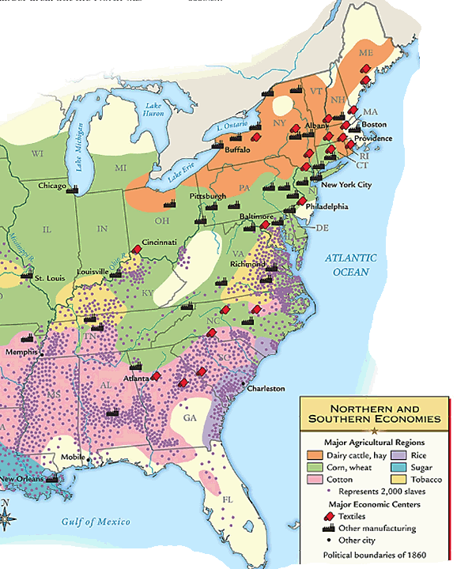
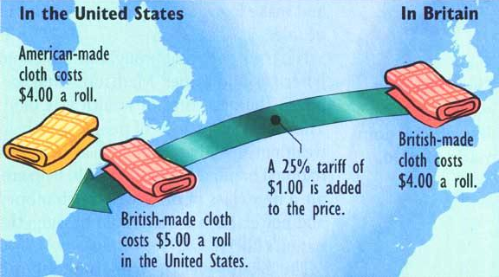
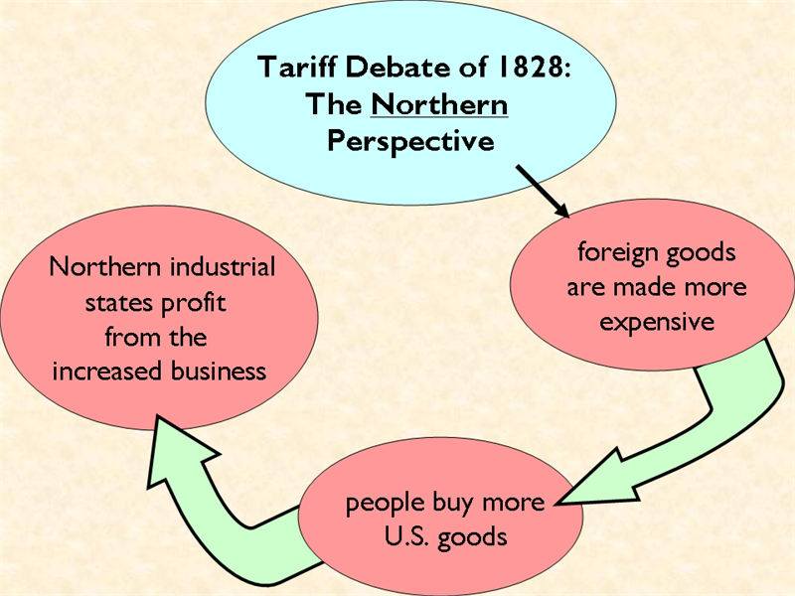
By the 1830s, sectionalism was becoming more obvious, especially over the issue of tariffs
Northern states favored tariffs because they profited when people bought more American-made goods

Slide 23
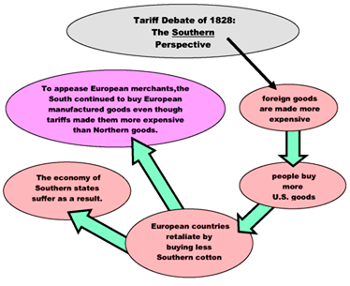
By the 1830s, sectionalism was becoming more obvious, especially over the issue of tariffs

Slide 24
The Tariff of Abominations (1828)
S. Carolina the most vocal opponent
Real issue was fear of federal power
Also of concern - economic distress of the Old South - the seaboard area
Notes:
The underlying issue was a growing fear of federal interference with slavery
The Missouri Compromise fed these fears
A slave rebellion in Charleston in 1822 didn’t help either
South Carolina still had ties with British West Indies & knew that the British govt. was moving toward abolition
The rise of the abolitionist movement in the U.S. underscored the changing tide against the “peculiar institution”
The tariff issue served as an opportunity to take a strong stand on principle against all federal encroachments on states’ rights
Economic health of the Old South was declining
The Northwest, West and Southwest were all expanding
The Old South had damaged its soil by overfarming
Cotton prices falling
Old Southern states (SC in particular) looking for a scapegoat
The tariff was a convenient one

Slide 25
The “Yankee Tariff”
The South thought that the Tariff of 1828 was only making the North rich at the expense of the South
John C. Calhoun (SC) secretly wrote “The South Carolina Exposition and Protest” upholding the sovereignty of the states
  Calls for states’ right to nullify unjust federal laws
Notes:
Because of protections, the South was forced to buy in the American market protected by high tariffs
The south thought that it was making the North rich
The South feared that if the British sold fewer items here they would buy less cotton
The South would suffer as a consumer, producer, importer, and exporter
The South, however, failed to realized that with healthy Northern industries would come an increase in consumption of cotton and other farm products
Calhoun’s South Carolina Exposition boldly denounced the recent tariffs as unjust and unconstitutional
Going beyond the Virginia and Kentucky Resolutions of 1798, the SCE proposed that states should nullify the tariff within their borders
Calhoun was a Unionist and Nationalist but was also a Southern sectionalist
He thought that nullification would actually help to hold the union together
No other state joined South Carolina in its call for nullification

Slide 26
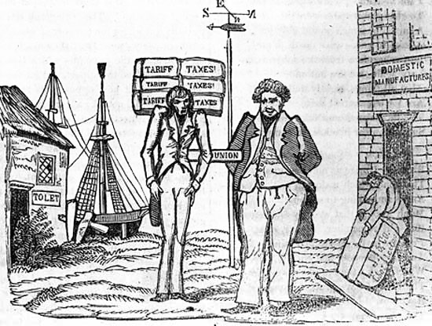

Slide 27
The Webster-Hayne Debate (1830)
Started as an argument over public land policies
Becomes a classic debate between Sen. Daniel Webster (MA) & Robert Hayne (SC)
Real issue - states’ rights
“Liberty and Union, now and forever, one and inseparable.” – Webster
  If the states could pick and choose, there would be no Union
Notes:
Easterners opposed the sale of cheap public lands because the Eastern population was moving west looking for land and siphoning off Eastern influence
Westerners naturally argued for cheap land
The South sided with the West
Robert Hayne of SC spoke for the cause
Hayne was a strong orator who condemned the disloyalty of New England during the War of 1812 and their selfish positions on the tariff issue
He used the occasion to air the grievances of the South, particularly unloading on the Tariff of Abominations
Hayne supported Calhoun’s doctrine of nullification, seeing it as the only means of safeguarding the minority interests of his section
He did not advocate breaking up the union but rather was seeking to protect the South within the Union under the Const.
Webster defended New England but focused on the issue of Union
He argued that the people, not the states, framed the Constitution (not entirely so!)
Argued that either the Supreme Court would judge the Constitutionality of laws or the country would fall into revolution

Slide 28
Impact of the Debate
Webster’s speech reaffirmed the concept of the Union
Convinced people of the value of Union - worth fighting for
Perhaps did more to preserve the Union than the Union Army
Notes:
There was no clear winner in the Webster-Hayne Debate but both sides thought they won
Webster had the greatest impact
His speech was widely reproduced, selling 40,000 copies in three months
His arguments for Union were planted in the minds of Northerners
The speech was printed in school books and was read by thousands of soon-to-be Union soldiers
He most likely did more to arouse upcoming generations of Northerners to fight for the ideal of Union
Many have said that the Union was saved by the thunder of Webster’s replies more than the thunder of Grant’s cannons

Slide 29
Jackson and the ideal of Union
Though a Westerner (and States’ Rights advocate) himself, Jackson was a Unionist
He was a foe of nullification
He would soon be willing to use force, if necessary, to preserve the Union
Notes:
Old Hickory was strangely silent on the Southern Grievances
States rights leaders, at a Jefferson Day banquet in 1830, hoped to get Jackson to come out publicly on the side of nullification
They proposed a series of toasts to Jefferson - a longtime foe of centralization - that would lean toward states’ rights and nullification
They thought Jackson the Southerner would speak out for states’ rights
Jackson was forewarned about the plan and carefully prepared his response
He waited for the proper moment then rose to his feet, stood straight upright, fixed his eyes on Calhoun (their relationship now strained) and dramatically proclaimed, “Our Union: It must be preserved!”
The Southerners were stunned - Calhoun weakly replied, “The Union, next to our liberty, most dear!”
Party over!
In two years time, Jackson would use the threat of force to rein in the states

Slide 30
Nullification Crisis over Tariff of 1828 and 1832
Many in South Carolina viewed the “Tariff of Abominations” as a wedge for federal interference
Updated Tariff of 1832 fell short of meeting Southern demands for lower rates
  Touched off new nullification crisis
Notes:
The Tariff of Abominations continued to rankle hot-blooded South Carolinians
They saw it as not only being economically damaging in the short run, but also as a possible wedge for later federal interference with slavery in the Southern states
The nullifiers -known as “nullies” - tried strenuously to muster the necessary 2/3 vote for nullification in the South Carolina legislature
The measure was blocked by a minority of Unionists who were scorned as “submission men”
Congress touched off the fuse of this bomb by passing the Tariff of 1832
The measure failed to lower rates to levels demanded by the South
The measure did pare away the worst of the “abominations” of 1828, and it did lower the imports to about the level of the more moderate Tariff of 1824
A 10% reduction to roughly 35% duties
The law was still protective and to the South, it suggested a permanent condition.
Nullies in SC were ready for drastic action.

Slide 31
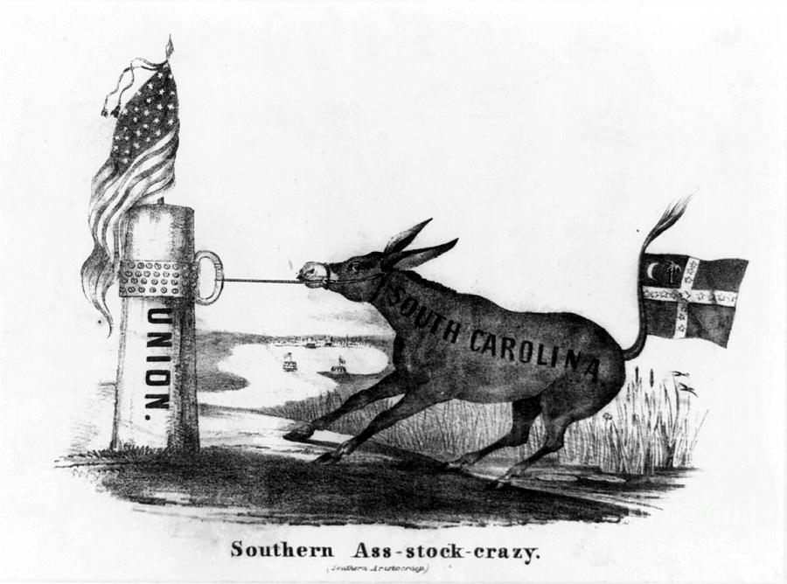

Slide 32
The “Nullies”
After capturing a 2/3 majority in the SC state legislature, the “Nullies” called for a state convention
Declared the tariff null and void within South Carolina
  The states had the right to nullify acts of the federal government they deemed to be unconstitutional
Called for military preparations
Threatened to remove SC from the Union
Notes:
Nullifiers and Unionists clashed in the South Carolina state elections of 1832.
The “Nullies” won a 2/3 majority in the legislature.
The state legislature called for a special state convention, which met in Columbia, SC.
There they declared the existing tariff to be null and void in SC.
The convention also called upon the legislature to undertake any necessary military preparations.
The final act of defiance to the national govt. was to threaten to take SC out of the Union if the “Washington Regime” attempted to collect the customs duties by force.

Slide 33
Jackson’s Reaction
Jackson prepared to respond with force
South Carolina initially refused to back down
If no compromise was reached, it would mean civil war
Notes:
President/General Jackson reacted to the South Carolina convention in anger.
Hating Calhoun and pledging to uphold the Union, Jackson privately threatened to hang the nullifiers.
He dispatched modest naval and military reinforcements to SC and quietly put together a sizable army.
He issued a proclamation against nullification
I consider, then, the power to annul a law of the United States, assumed by one State, incompatible with the existence of the Union, contradicted expressly by the letter of the Constitution, unauthorized by its spirit, inconsistent with every principle on which it was founded, and destructive of the great object to which it was formed. - Andrew Jackson
SC governor Robert Hayne responded with a counter-proclamation asserting South Carolina’s rights.
In order to avoid a civil war, one side would have to surrender, or both would have to compromise.

Slide 34
The Compromise Tariff of 1833
Brokered by Sen. Henry Clay (KY)
Known as the “Olive Branch and the Sword”
  Gradually reduced rates by 10% over 8 years - addressing SC demands
    Hotly debated but passed 2/20/1833
  The face-saving “Force Bill” by Congress
    Authorized force to collect duties
SC able to back away with dignity
Notes:
Clay an old foe of Jackson who had no desire to see his old enemy win new support by crushing the Carolinians and getting Calhoun’s head.
Clay used his influence to broker a compromise bill that would gradually reduce the Tariff of 1832 by about 10% over a period of 8 years.
That would lower the rate to the mildly protective level of the 1816 tariff - about 20% to 25% on the value of dutiable goods.
The measure squeezed through Congress after bitter debate.
Strongest opposition came from New England
Calhoun and the Southern states favored the compromise so Jackson would not have to use guns and ropes in SC
In a face-saving move, Congress passed the Force Bill (AKA in the South as the Bloody Bill), authorizing the President to use the army and navy, if necessary, to collect federal tariff duties
Militant South Carolinians welcomed the opportunity to get out trouble without losing face
No other Southern state had come to their defense, though VA & GA thought about it
The Unionist minority in SC was prepared to go to civil war over the issue
Faced with civil war and invasion by the feds., the Columbia Convention met again and revoked the ordinance of nullification, though not without proclaiming the unnecessary Force Bill nullified.

Slide 35
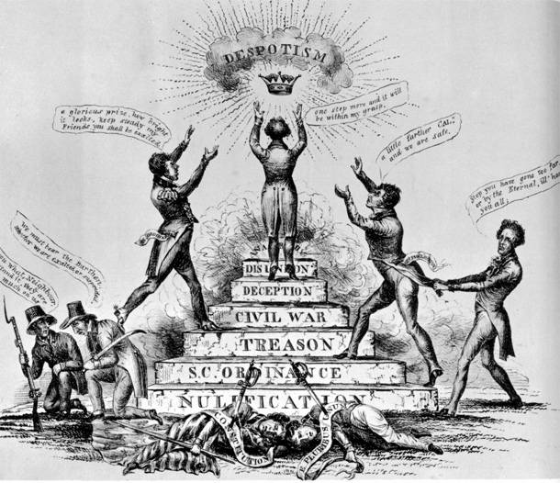

Slide 36
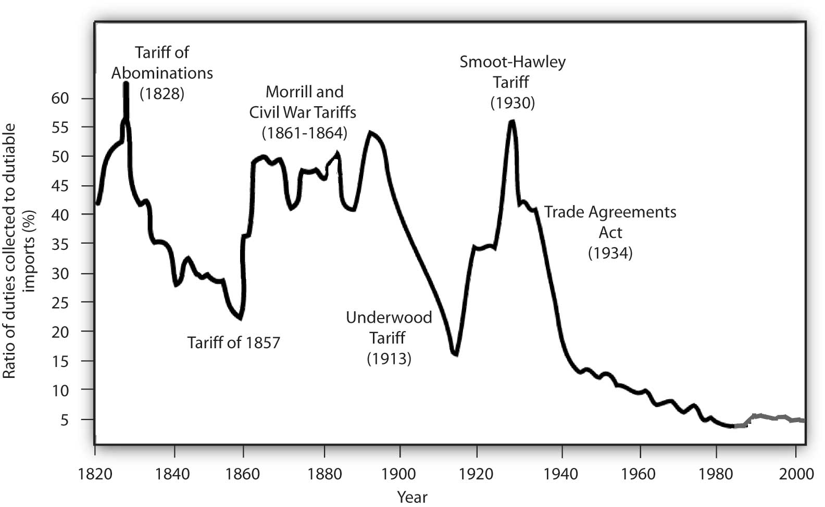
Historical tariff Rates

Slide 37
Jacksonian vs. Jeffersonian Democracy
Jefferson
Capable, well-educated people should govern for the people
Reflected agricultural society
Limited democracy to political aspects
Jackson
People themselves should manage govt. affairs
Reflected agricultural as well as emerging industrial society
Political, economic, and social democracy
Notes:
Democratic aspects in Jackson Era
Most states had removed property & religious qualifications for voting and officeholding
More officials elected rather than appointed
terms of office for some govt. positions shortened to give people more power over officials
Nominating conventions replace caucus system for presidential nomination in 1832
Electors elected by people rather than state legislatures
Jackson used office of the president “vigorously” to serve the interests of the people
Spoils system & rotation in office - prevent emergence of elite bureaucracy
Economic aspects
Cheap land for settlers
Growth of trade unions to represent workers (still weak but growing
Social
Various reform movements (Women’s rights, abolition, etc.)

