Slide 1
Do Now
Evaluate the state of the Union entering the Election of 1860. Identify all reasons for instability/political turmoil.

Slide 2
6. The Election of 1860 and Secession
Mr. Winchell
APUSH
Period 5

Slide 3
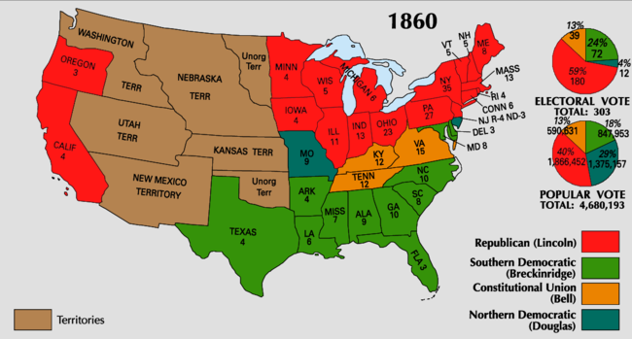
Available Electoral College Votes:
Non-slaveholding North (Including CA): 183
Border South: 32
Middle South: 41 Total Slaveholding South: 120
Deep South: 47
Notes:
South still had majorities in the Supreme Court and Democrats (states’ rights supporters) still had advantage in the House of Representatives.

Slide 4
Election of 1860
Abraham Lincoln (R)
Stephen Douglas (D)
Northern Democrats
John Breckinridge (D)
Southern Democrats
John Bell (CU)
Coalition of Cotton Whigs and Know-Nothing

Slide 6
Southern Secession
Secession Convention held - “Republic of South Carolina” is declared on Dec 20th, 1860.
Question: Can a state legally secede?
Response:
Buchanan’s response - Believed the south couldn’t constitutionally succeed, but…
Lame Duck president and surrounded by pro-slavery advisors – therefore ineffectual.
Last attempt at compromise…Crittenden Compromise- Guaranteed protection south below 36-30 and allow expansion above the line (by popular sovereignty).
Lincoln rejects it!

Slide 7
South Carolina Order of Secession
For twenty-five years this agitation has been steadily increasing, until it has now secured to its aid the power of the common Government. Observing the forms of the Constitution, a sectional party has found within that Article establishing the Executive Department, the means of subverting the Constitution itself. A geographical line has been drawn across the Union, and all the States north of that line have united in the election of a man to the high office of President of the United States, whose opinions and purposes are hostile to slavery. He is to be entrusted with the administration of the common Government, because he has declared that that "Government cannot endure permanently half slave, half free," and that the public mind must rest in the belief that slavery is in the course of ultimate extinction.

Slide 8
Secession Continued
By Feb 1861 - 6 other states had seceded (Fl, Ga, Ms, Al, La, Tx).
Seized all federal property within their boundaries - Forts, arsenals, govt. offices, etc.
Formed Confederate States of America ( Jefferson Davis elected as President).
Montgomery, Al - capital (later moved to Richmond, VA).
March 1861 – Lincoln enters the oval office…NOW WHAT!?
Stay Tuned!

Slide 9
Cornerstone Speech Alexander Stephens (GA)
Outlined causes for Secession and Confederation
“The new constitution has put at rest, forever, all the agitating questions relating to our peculiar institution African slavery as it exists amongst us the proper status of the negro in our form of civilization. This was the immediate cause of the late rupture and present revolution. Jefferson in his forecast, had anticipated this, as the “rock upon which the old Union would split.” He was right. What was conjecture with him, is now a realized fact.”
“Our new government is founded upon exactly the opposite idea; its foundations are laid, its corner- stone rests, upon the great truth that the negro is not equal to the white man; that slavery subordination to the superior race is his natural and normal condition. This, our new government, is the first, in the history of the world, based upon this great physical, philosophical, and moral truth.”

Slide 10
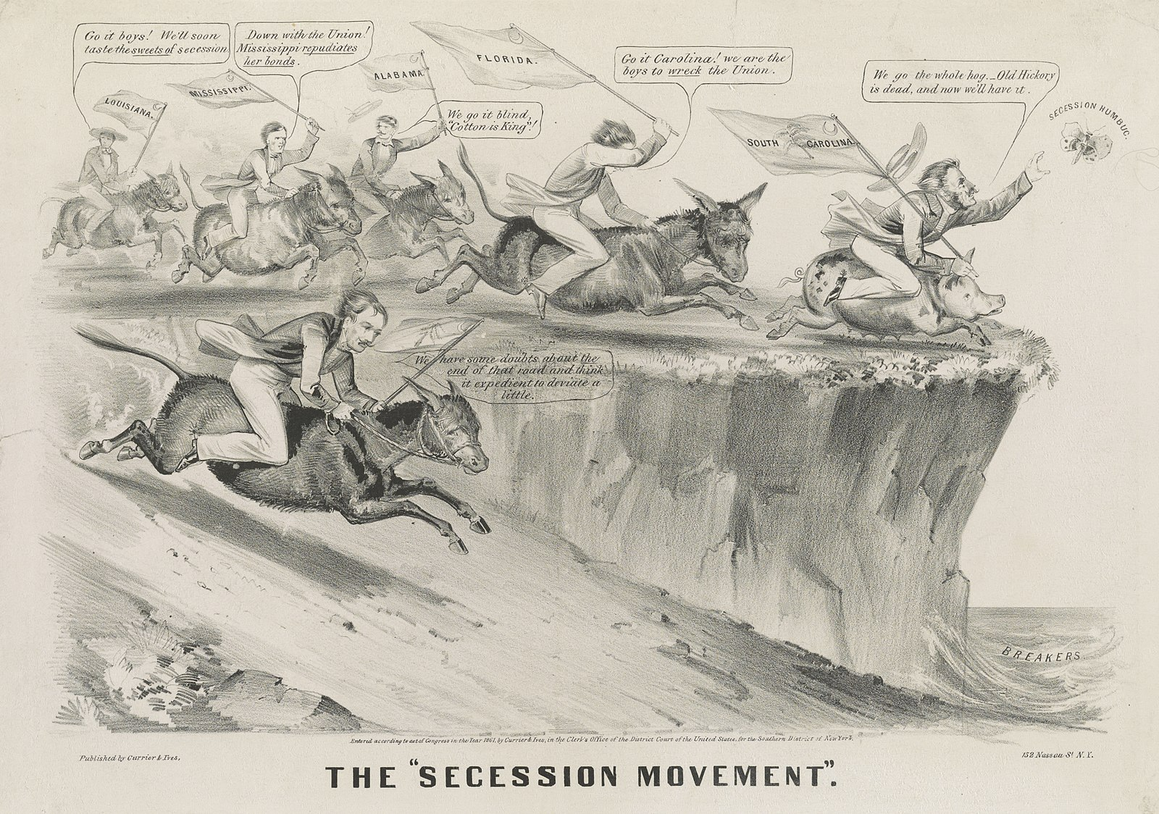

Slide 11
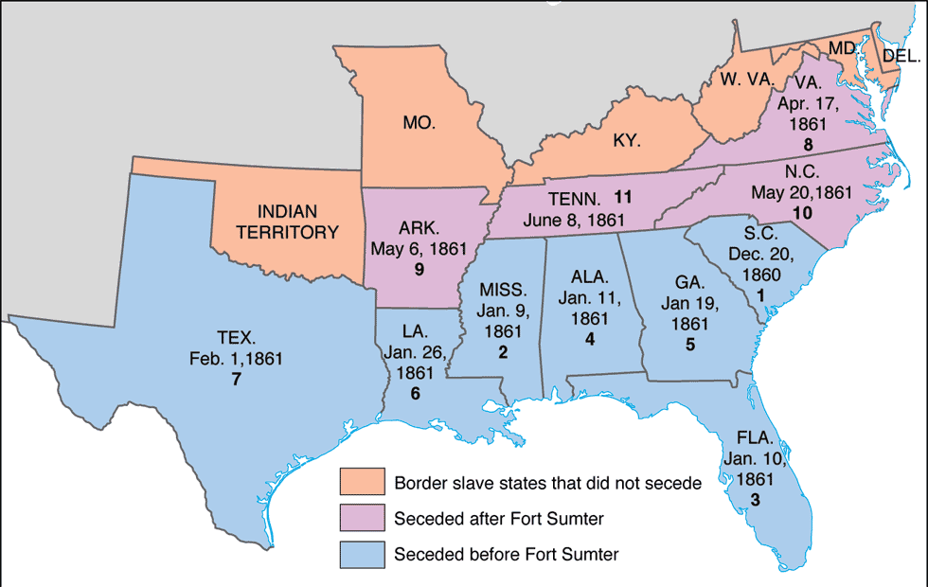

Slide 12
Constitutional Comparison
United States Constitution
Confederate Constitution
We the People of the United States, in Order to form a more perfect Union, establish Justice, insure domestic Tranquility, provide for the common defence, promote the general Welfare, and secure the Blessings of Liberty to ourselves and our Posterity, do ordain and establish this Constitution for the United States of America.
Allows states to determine who can vote in elections.
Presidential veto power
Congress power to tax
Congress power to regulate interstate commerce
Necessary and Proper Clause
Prohibition of importation of slaves
No Bill of Attainder or ex post facto Law shall be passed.
Bill of Rights – First Ten Amendments
Presidential term of four years; unlimited
Privileges and Immunities
Amendment requires two thirds of both houses of Congress to propose and three-fourths of state legislatures to ratify; two-thirds of states may call a national constitutional convention
We, the people of the Confederate States, each State acting in its sovereign and independent character, in order to form a permanent federal government, establish justice, insure domestic tranquillity, and secure the blessings of liberty to ourselves and our posterity — invoking the favor and guidance of Almighty God — do ordain and establish this Constitution for the Confederate States of America.
Specifically prohibits foreign-born and non-citizens from voting.
Grants the President line-item veto
Congress prohibited from levying protective tariffs
Congress strictly prohibited from appropriating funds for internal improvements
Necessary and Proper Clause
Prohibition of importation of slaves
No bill of attainder, ex post facto law, or law denying or impairing the right of property in negro slaves shall be passed.
NEW limits to impose fiscal responsibility and limit federal spending
Bill of Rights guarantees incorporated into Constitution
Single term of six years for President
Privileges and Immunities additionally includes right to transit slaves state to state
NEW Recognizes legality of slavery in territories and new states
Two-thirds of states to ratify an amendment; three states can call a national constitutional convention

