Slide 1
Do Now
I consider, then, the power to annul a law of the United States, assumed by one State, incompatible with the existence of the Union, contradicted expressly by the letter of the Constitution, unauthorized by its spirit, inconsistent with every principle on which it was founded, and destructive of the great object to which it was formed. - Andrew Jackson

Slide 2
The Era of Jackson and the Rise of Modern Democracy
Mr. Winchell
APUSH 2018-2019
Period 4

Slide 3
AP Prompt
Evaluate the extent to which state versus federal created conflict in American politics from 1800-1832.

Slide 4
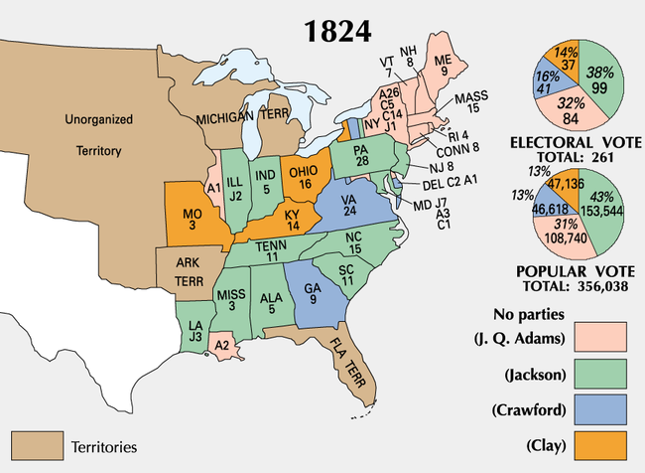
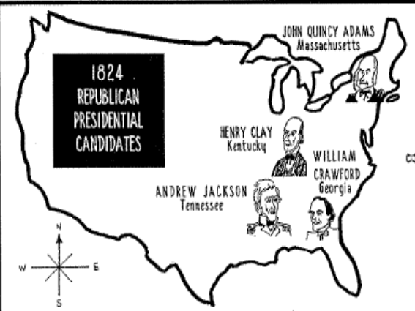
The Election of 1824:
“The Corrupt Bargain”
Jackson ran in a 4-way race for Pres in 1824 (all the same party!)
4 candidates were in the running, each with sectional support: William Crawford (GA), John Quincy Adams (MA), Andrew Jackson (TN), Henry Clay (KY)
In such cases, the top 3 candidates are voted on in House of Representatives, with each state getting 1 vote
Even though Jackson won the popular vote, he didn’t receive a majority of electoral votes.
Henry Clay gives his support to JQ Adams and the House of Reps chooses Adams as President
Adams names Clay Sec. of State 2 weeks later….hmmmm
AJ is furious: The Corrupt Bargain
AJ Publicly supports changes in state laws
about who can vote

Slide 5
A “Corrupt Bargain”?
YEARS | PRESIDENT | SEC OF STATE | VICE PRESIDENT
1789-1797 | George Washington | Thomas Jefferson | John Adams
1797-1801 | John Adams |  | Thomas Jefferson
1801-1809 | Thomas Jefferson | James Madison
1809-1817 | James Madison | James Monroe
1817-1825 | James Monroe | John Quincy Adams
1825-1829 | John Quincy Adams | Henry Clay | John C. Calhoun

Slide 6
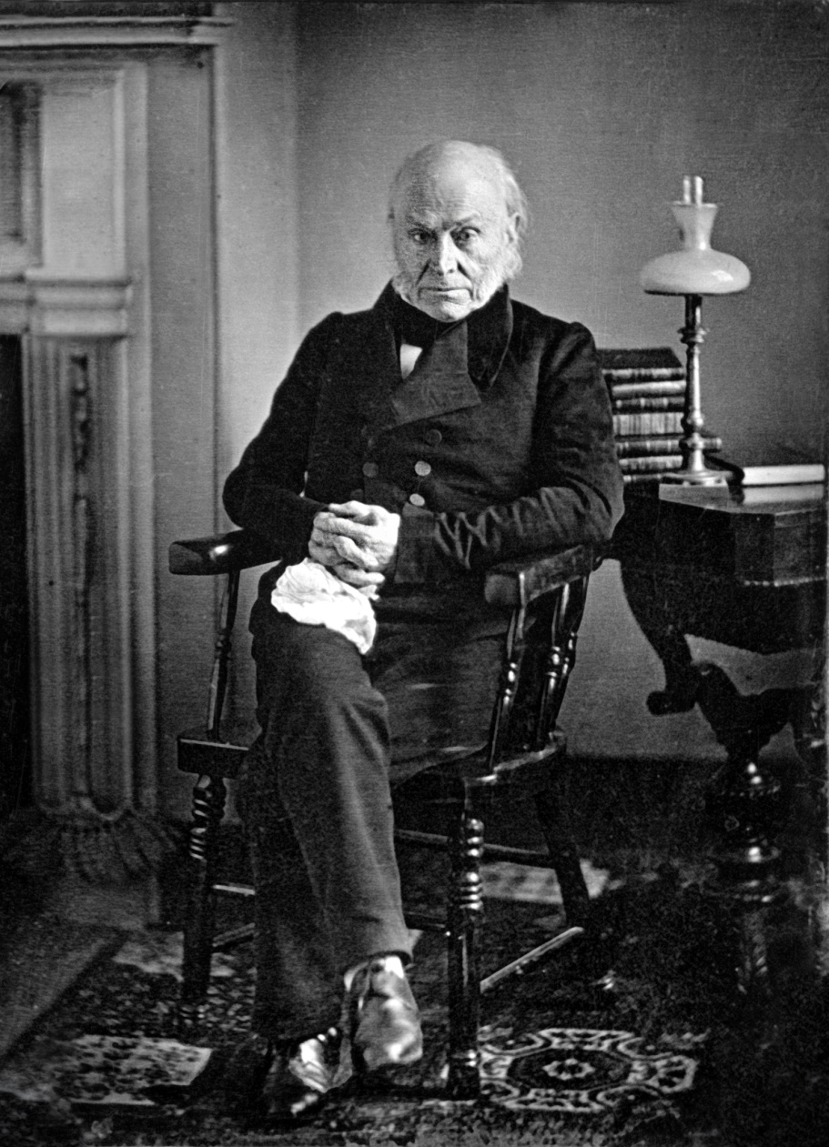
Adams’ Administration
Clay’s American System
1828 “Tariff of Abominations”
Generous Indian policy
All of which angered Jacksonian Democrats

Slide 7
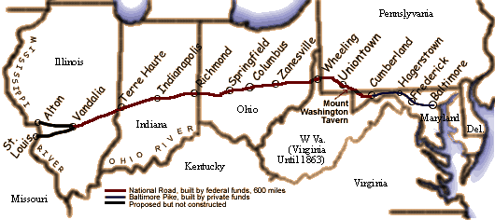
J. Q. Adams' Administration
One exception: the National Road
Adams had a difficult presidency:
  JQ Adams wanted to continue the nationalist programs of the “Era of Good Feelings”
  The depression of 1819 limited the nationalist agenda & few of Adams’ policies became law
  A protective tariff was passed to help farmers & industry, but this angered the South

Slide 8
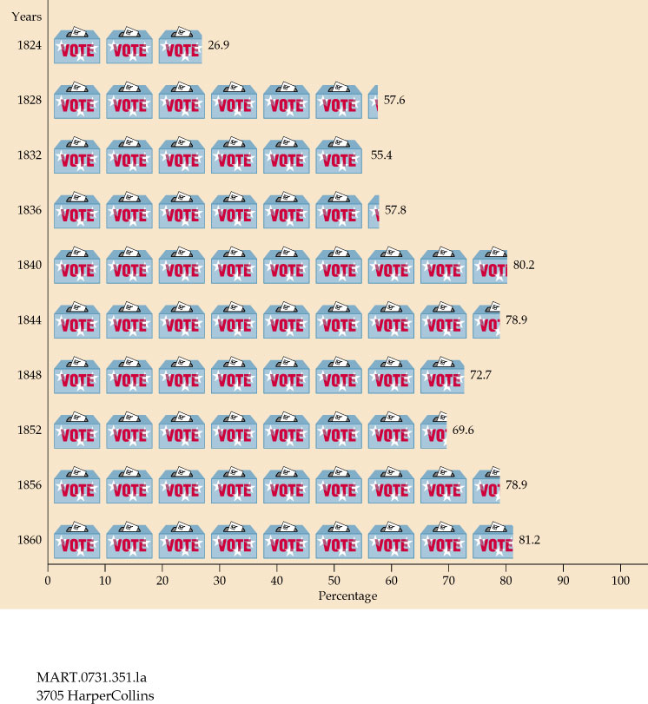
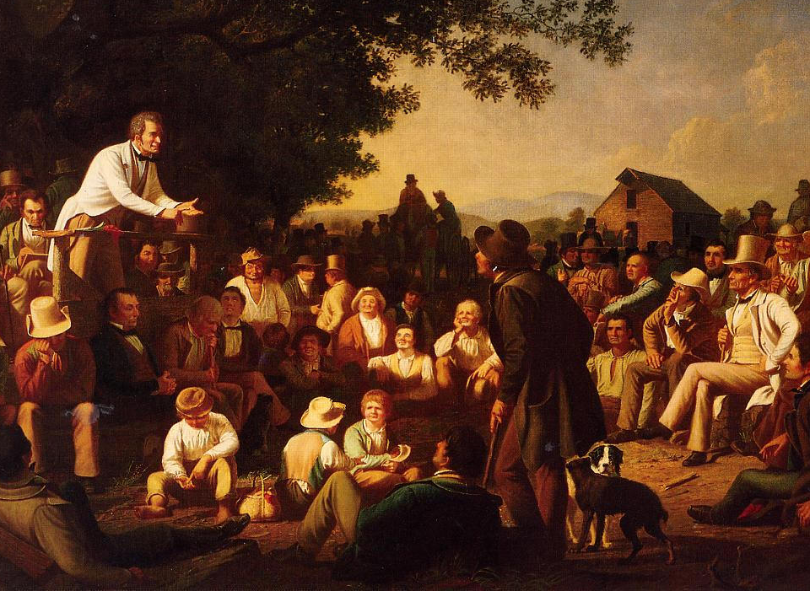
From 1800 to 1840, states removed property and
tax restrictions which allowed 90% of “common” white men to vote (“universal white male suffrage”)

Slide 9
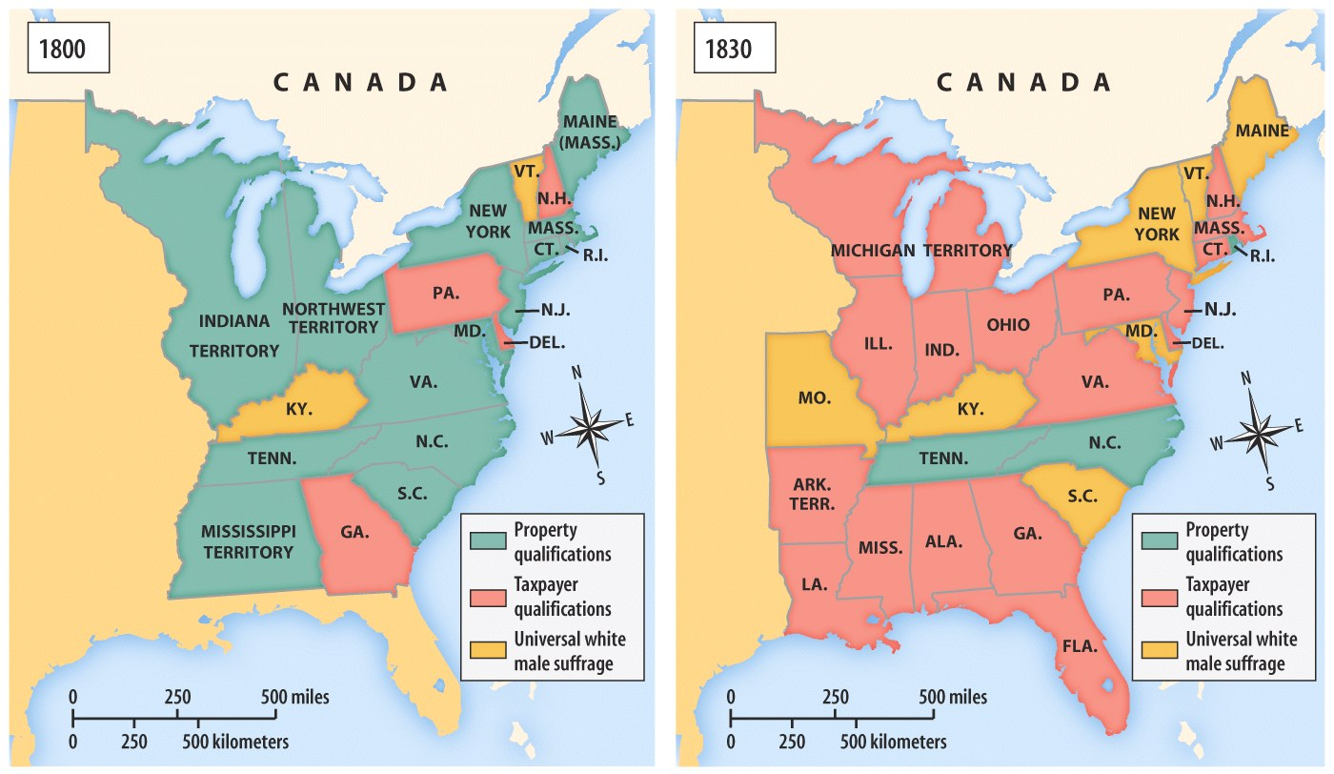
Universal White Male Suffrage

Slide 10
Direct Balloting for President
President
The New System
Direct Election
(Democracy)
The Old System
Indirect Election
(Aristocracy)
Presidential Electors
By 1836, voters in all states except for South
Carolina were casting
direct ballots for presidential electors.
South Carolina continued to select electors indirectly until 1860.
State Legislature
Voters
Notes:
Which arrangements

Slide 11
Jackson Comes to Power
But, these “Jacksonian Democrats” are not going to mirror the “Jeffersonian Republicans”
“Jacksonians” prepared for the election of 1828 by creating a well-organized, national campaign
  Jackson (TN) formed a coalition with Adams’ VP Calhoun (SC), Van Buren (NY), & 2 newspaper editors (KY) to rival JQ Adams
  Formed the basis of 1st modern political party, calling themselves the “Democrats”
“Democrats” distinguished themselves as different from the “Nationalist Republicans” who has strayed from the Jeffersonian ideal

Slide 12
Jackson Comes to Power
Democrats presented Jackson as “Old Hickory,” uneducated, a hero, a dueler & a man of the people
Democrats painted Adams as an out-of-touch aristocrat
The election of 1828 changed American politics:
  Showed the effectiveness of political parties in elections
  It was the 1st election with overt mudslinging & propaganda
  Exciting appeals to average the man (public rallies & barbeques)
Jackson won the election as a “common man of the people”
“Ms. Jackson is a bigamist” & “Ms. Adams is a bastard”

Slide 13
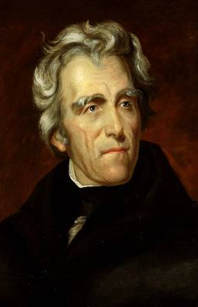
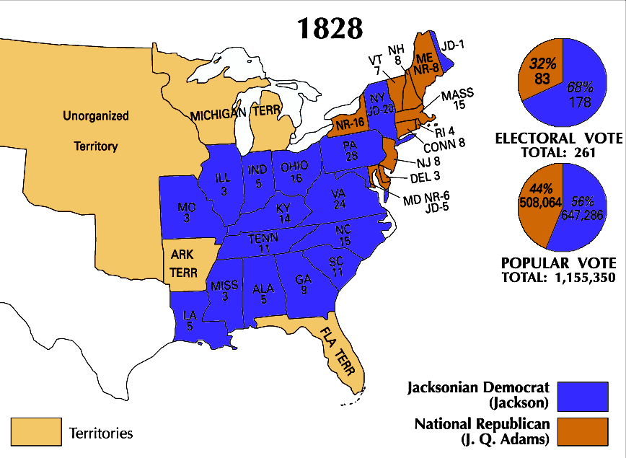
Andrew Jackson’s victory in the
election of 1828 changed American politics

Slide 14
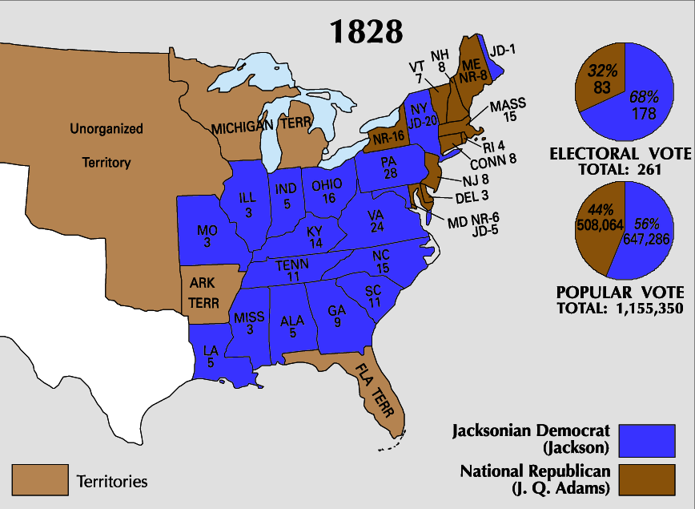
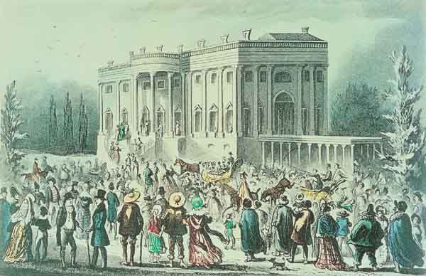
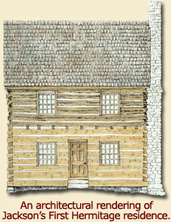
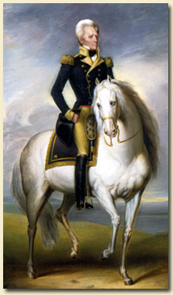
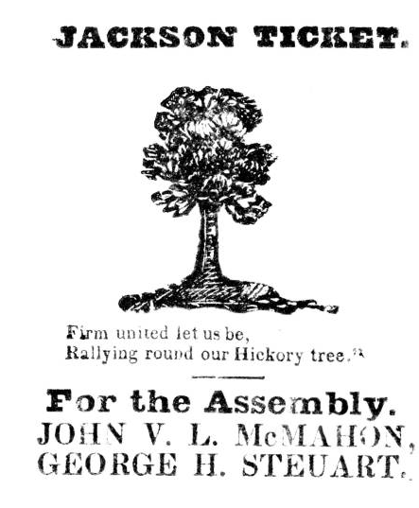
Who is Andrew Jackson?
Jackson’s wild & rowdy inauguration

Slide 15
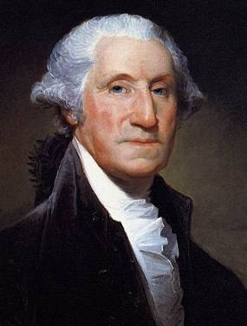
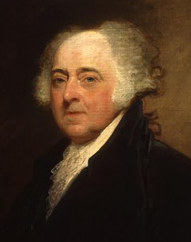
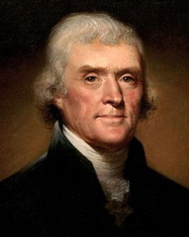
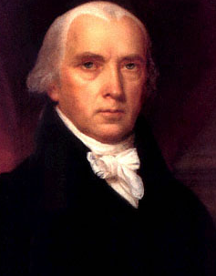
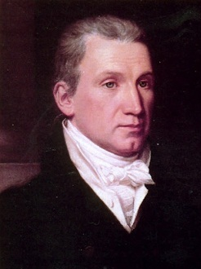
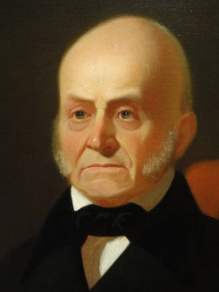
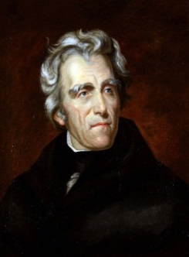
Jackson’s victory split the Democratic-Republicans and led to the formation of the Democratic Party
Jackson and his supporters hoped to return
to the Jeffersonian ideas of states’ rights,
protection of liberty, and westward expansion
8 yrs
George Washington
(1789-1797)
4 yrs
John
Adams
(1797-1801)
8 yrs
Thomas
Jefferson
(1801-1809)
8 yrs
James
Madison
(1809-1817)
8 yrs
James
Monroe
(1817-1825)
4 yrs
John Quincy
Adams
(1825-1829)
8 yrs
Andrew Jackson
(1829-1837)
Federalist Party
Democratic-Republican Party
Democratic Party

Slide 16
Jackson Comes to Power
Jackson was a popular candidate but it was not clear what type of president Jackson would be:
  Jackson’s supporters wanted states’ rights & limited gov’t
  During the campaign, Jackson never clarified his stand on major issues: banks, tariffs, etc.
  Only stood for Indian removal

Slide 17
Jacksonian Democracy
When Andrew Jackson was elected president, it represented a new era in American history:
  He was the first president that represented the “common man”
  His party (the Democrats) took advantage of the extension of suffrage to common white men
  He greatly expanded the powers of the presidency
Notes:
Endorsing the view that a fundamental conflict existed between working people and the “non-producing” classes of society, Jackson and his supporters promised to remove any impediments to the ordinary citizen’s opportunities for economic improvement. According to the Jacksonians, inequalities of wealth and power were the direct result of monopoly, favoritism, and special privileges, which made “the rich richer and the powerful more potent.” Only free competition in an open marketplace would ensure that wealth would be distributed in accordance with each person’s “industry, economy, enterprise, and prudence.” The goal of the Jacksonians was to remove all obstacles that prevented farmers, artisans, and small shopkeepers from earning a greater share of the nation’s wealth.

Slide 18
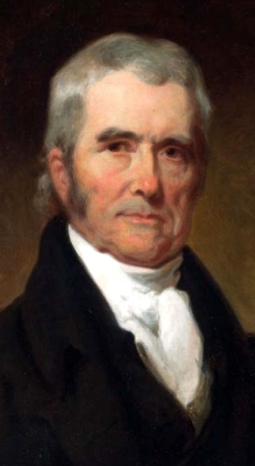
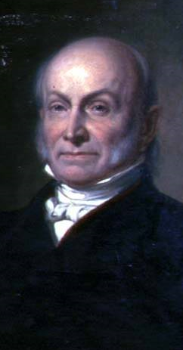
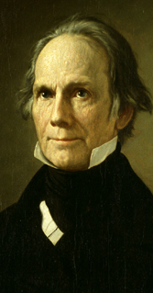

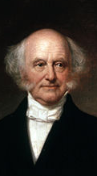
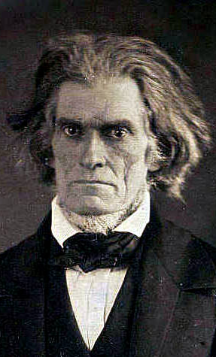
Parties & Leaders
Old Federalists
National Republicans/ Whigs
Jacksonian Democrats
Southern Democrats
John Marshall
John Q. Adams
Henry Clay
Andrew Jackson
Martin Van Buren
John C. Calhoun
National Supremacy States’ Rights

Slide 19
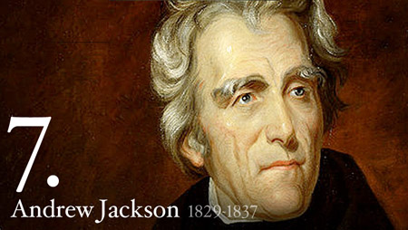
Andrew Jackson’s two term presidency (1829-1837) was defined by three major conflicts and many minor ones, including within his own government
2 Big Issues for today: Native Americans and Tariffs

Slide 20
Spoils System
When Jackson was elected, he rewarded loyal supporters with gov’t jobs (the spoils system)
  Massive turnover in the civil service had not yet occurred
  Rotation in office began to be seen as a very democratic way to reduce gov’t corruption & incompetence
Jackson was not the 1st to do this… he just extended it to more people!
“Get their rascals out…and our rascals in”

Slide 21
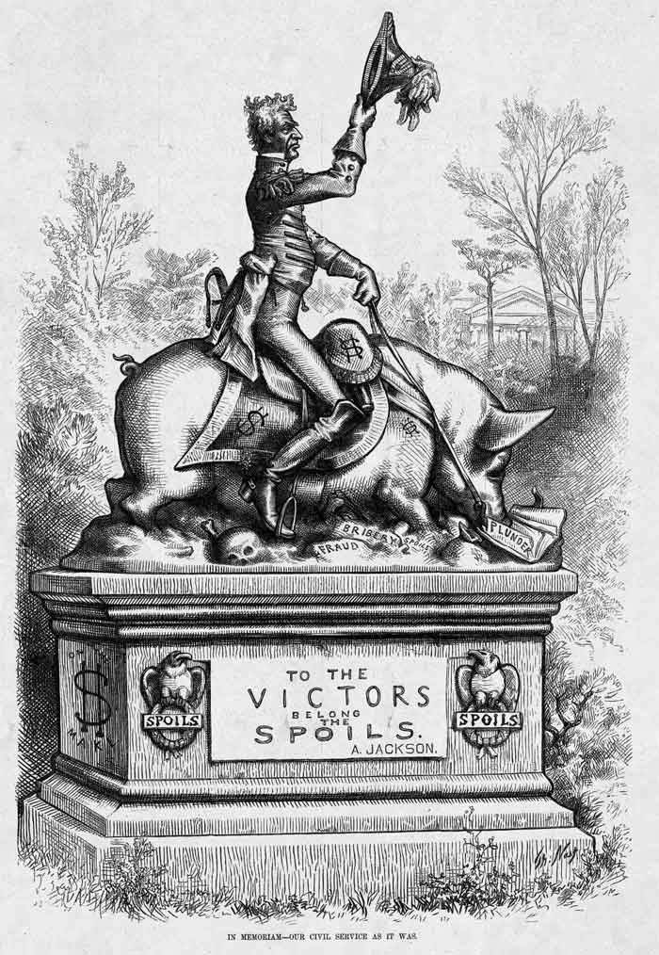

Slide 22
Maysville Road Project
Kentucky was home of Henry Clay, who Jackson never forgave for the “Corrupt Bargain”
The “National” Republicans led by Clay & JQ Adams split with the old-style Democratic-Republicans
President Jackson dealt a blow to the American System:
  He was OK with national projects but did not like spending federal money for state projects
  In 1830, Jackson vetoed funds for the Maysville Road because it was exclusively in Kentucky
Jackson vetoed 7 other bills of public works projects, including roads and canals

Slide 23
Indian Removal
Southerners were disappointed with JQ Adams’ slow movement in dealing with Indians
Jackson promised to act quickly but the Cherokee were a problem:
  They were not “uncivilized” because they had a republican gov’t, an agrarian lifestyle, & a formal alphabet (Sequoyah)
  They refused to move from GA

Slide 24
Indian Removal
Two more John Marshall decisions!!
When gold was discovered in GA, the GA gov’t abolished Cherokee tribal rule & defied the Constitution
  Jackson supported the states & asked Congress for the Indian Removal Act of 1830
  But…the Supreme Court ruled in Cherokee Nation v GA (1831) & Worcester v GA (1832) that the states have no power over tribes
GA defied the Supreme Court’s decisions & continued to take Cherokee lands
Jackson supported GA’s defiance:“Marshall has made his decision, now let him enforce it”

Slide 25
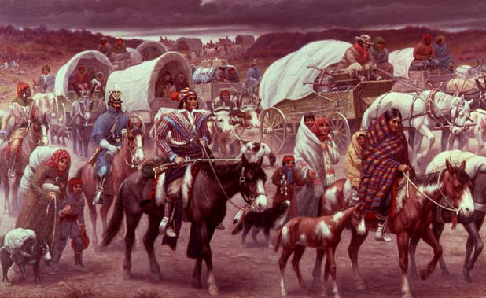
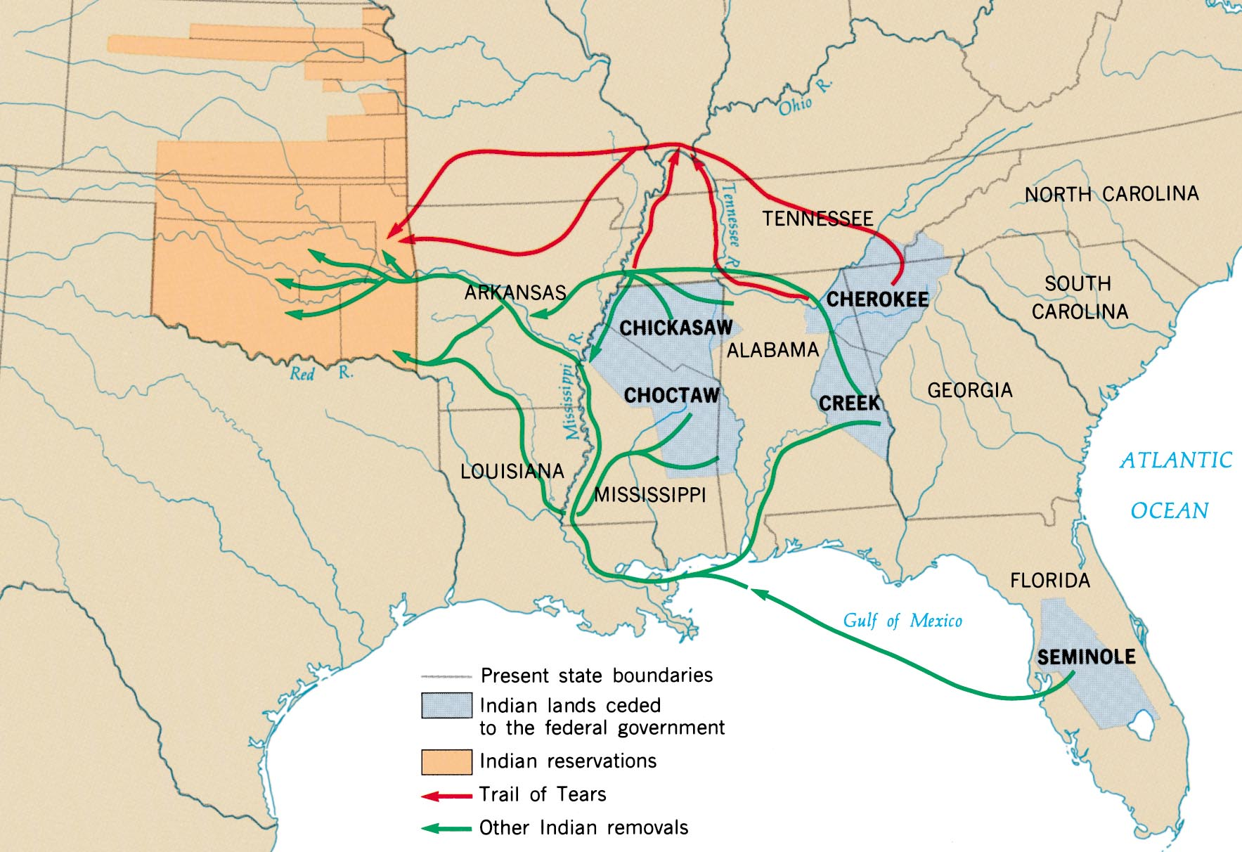
In 1838, the U.S. Army forced the Cherokees west on the “Trail of Tears”

Slide 26
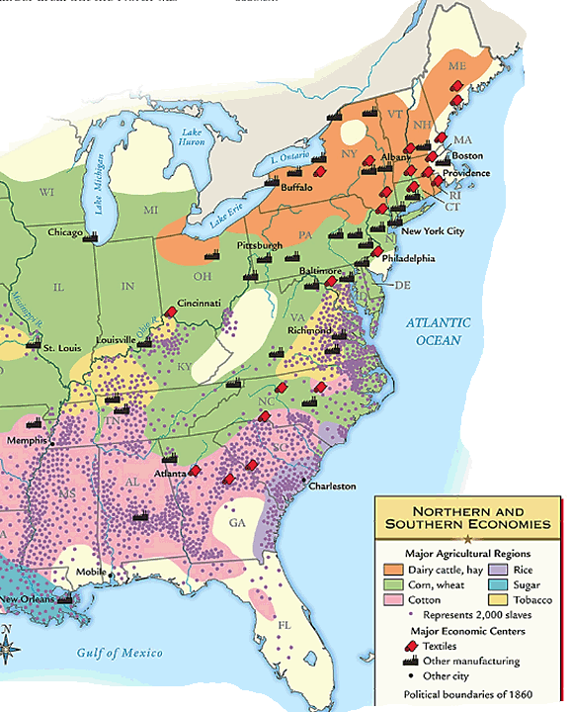
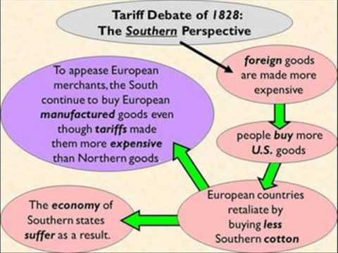
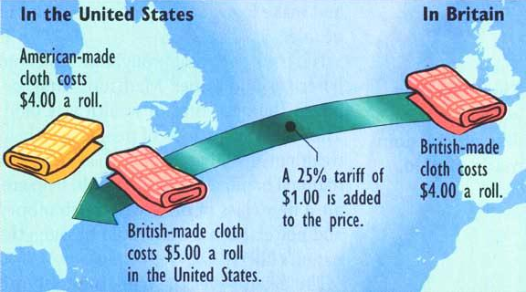
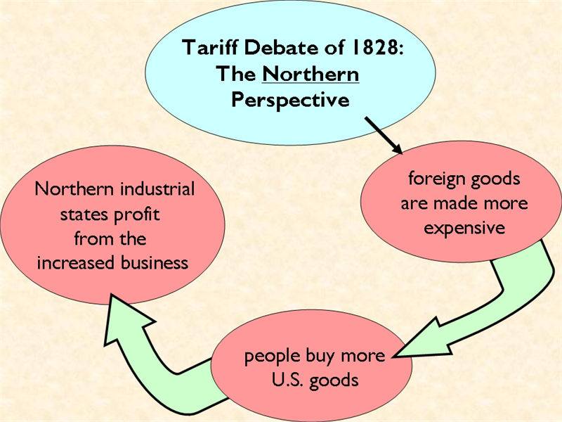
By the late 1820s and 1830s, sectionalism was becoming more obvious, especially over the issue of tariffs
Northern states favored tariffs because they profited when people bought more American-made goods

Slide 27
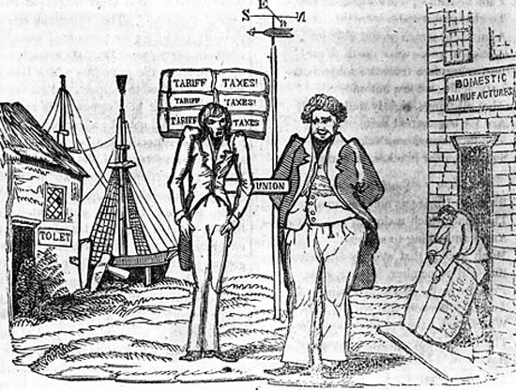

Slide 28
The Nullification Crisis
Southerners hated tariffs for 2 main reasons: tariffs increase the costs of foreign industrial goods (which are usually cheaper than those made in America) so goods are more expensive AND countries reciprocate with high tariffs on American cotton
By 1820, the South was anxious about federal powers over states:
  VP Calhoun became the defender of “states’ rights”
  He wanted to protect slavery & hated industrial protective tariffs
  After the Tariff of 1828 passed, the South affirmed nullification (the right of an individual state to ignore federal laws)
Calhoun (SC) led the argument for nullification in Exposition & Protest in 1828 to protect Southern rights against Northern self-interest

Slide 29
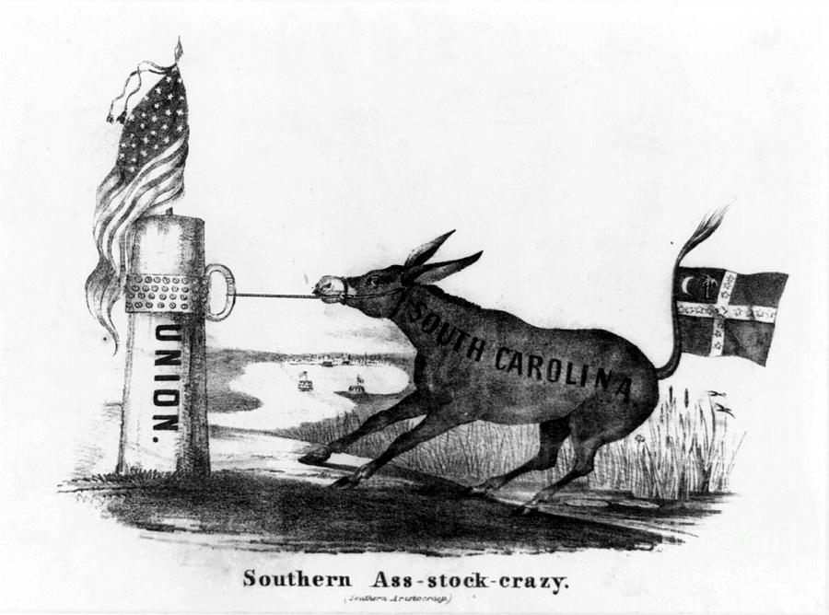

Slide 30
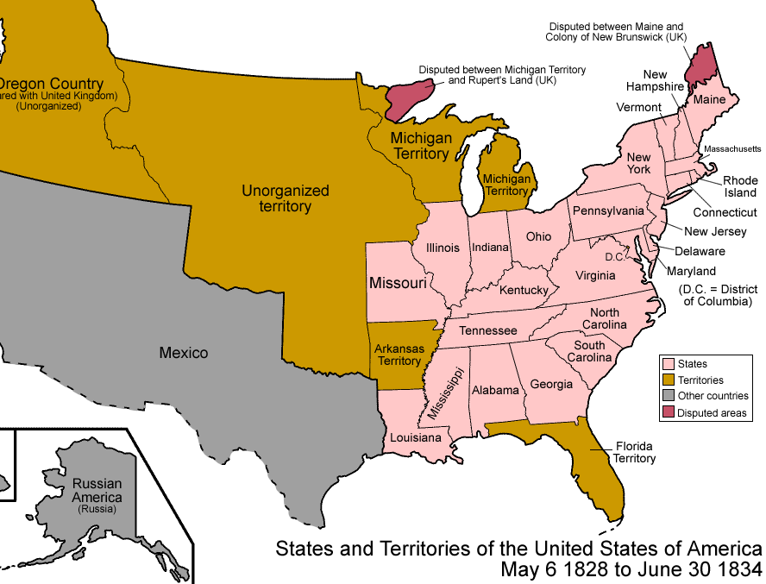
The tariff debates among the North, South, & West increased sectional rivalries in the 1830s
In 1829, a NE Congressmen introduced a bill to slow western land sales (this bill was really an effort to keep NE’s power in Congress from slipping)
Daniel Webster (MA) countered: “Liberty & Union, now & forever, one & inseparable”
Robert Hayne (SC) proposed nullification & an alliance between South & West against NE
This bill led to sectional tensions, culminating in the Webster-Hayne Debate in 1830
“Liberty first & Union afterwards”
Notes:
Daniel Webster of Massachusetts answered Hayne in one of the most famous speeches in American history. The United States, Webster proclaimed, was not simply a compact of the states. It was a creation of the people, who had invested the Constitution and the national government with ultimate sovereignty. If a state disagreed with an action of the federal government, it had a right to sue in federal court or seek to amend the Constitution, but it had no right to nullify a federal law. That would inevitably lead to anarchy and civil war. It was delusion and folly to think that Americans could have “Liberty first and Union afterwards,” Webster declared. “Liberty and Union, now and forever, one and inseparable.”

Slide 31
Text Analysis
Webster-Hayne Debates

Slide 32
Webster-Hayne Debate
Daniel Webster presented one of the most significant arguments against states’ rights & nullification
  The U.S. was more than just a compact of states…it was a creation of the people
  The Constitution gave the national gov’t ultimate power & supremacy over the states
  Nullification would lead to anarchy & civil war

Slide 33
Impact of the Debate
Webster’s speech reaffirmed the concept of the Union
Convinced people of the value of Union - worth fighting for
Perhaps did more to preserve the Union than the Union Army
Notes:
There was no clear winner in the Webster-Hayne Debate but both sides thought they won
Webster had the greatest impact
His speech was widely reproduced, selling 40,000 copies in three months
His arguments for Union were planted in the minds of Northerners
The speech was printed in school books and was read by thousands of soon-to-be Union soldiers
He most likely did more to arouse upcoming generations of Northerners to fight for the ideal of Union
Many have said that the Union was saved by the thunder of Webster’s replies more than the thunder of Grant’s cannons

Slide 34
Nullification Crisis over Tariff of 1828 and 1832
Many in South Carolina viewed the “Tariff of Abominations” as a wedge for federal interference
Updated Tariff of 1832 fell short of meeting Southern demands for lower rates
  Touched off new nullification crisis
Notes:
The Tariff of Abominations continued to rankle hot-blooded South Carolinians
They saw it as not only being economically damaging in the short run, but also as a possible wedge for later federal interference with slavery in the Southern states
The nullifiers -known as “nullies” - tried strenuously to muster the necessary 2/3 vote for nullification in the South Carolina legislature
The measure was blocked by a minority of Unionists who were scorned as “submission men”
Congress touched off the fuse of this bomb by passing the Tariff of 1832
The measure failed to lower rates to levels demanded by the South
The measure did pare away the worst of the “abominations” of 1828, and it did lower the imports to about the level of the more moderate Tariff of 1824
A 10% reduction to roughly 35% duties
The law was still protective and to the South, it suggested a permanent condition.
Nullies in SC were ready for drastic action.

Slide 35
Jackson’s Reaction
Jackson prepared to respond with force
South Carolina initially refused to back down
If no compromise was reached, it would mean civil war
Notes:
President/General Jackson reacted to the South Carolina convention in anger.
Hating Calhoun and pledging to uphold the Union, Jackson privately threatened to hang the nullifiers.
He dispatched modest naval and military reinforcements to SC and quietly put together a sizable army.
He issued a proclamation against nullification
I consider, then, the power to annul a law of the United States, assumed by one State, incompatible with the existence of the Union, contradicted expressly by the letter of the Constitution, unauthorized by its spirit, inconsistent with every principle on which it was founded, and destructive of the great object to which it was formed. - Andrew Jackson
SC governor Robert Hayne responded with a counter-proclamation asserting South Carolina’s rights.
In order to avoid a civil war, one side would have to surrender, or both would have to compromise.

Slide 36
The Compromise Tariff of 1833
Brokered by Sen. Henry Clay (KY)
Known as the “Olive Branch and the Sword”
  Gradually reduced rates by 10% over 8 years - addressing SC demands
    Hotly debated but passed 2/20/1833
  The face-saving “Force Bill” by Congress
    Authorized force to collect duties
SC able to back away with dignity
Notes:
Clay an old foe of Jackson who had no desire to see his old enemy win new support by crushing the Carolinians and getting Calhoun’s head.
Clay used his influence to broker a compromise bill that would gradually reduce the Tariff of 1832 by about 10% over a period of 8 years.
That would lower the rate to the mildly protective level of the 1816 tariff - about 20% to 25% on the value of dutiable goods.
The measure squeezed through Congress after bitter debate.
Strongest opposition came from New England
Calhoun and the Southern states favored the compromise so Jackson would not have to use guns and ropes in SC
In a face-saving move, Congress passed the Force Bill (AKA in the South as the Bloody Bill), authorizing the President to use the army and navy, if necessary, to collect federal tariff duties
Militant South Carolinians welcomed the opportunity to get out trouble without losing face
No other Southern state had come to their defense, though VA & GA thought about it
The Unionist minority in SC was prepared to go to civil war over the issue
Faced with civil war and invasion by the feds., the Columbia Convention met again and revoked the ordinance of nullification, though not without proclaiming the unnecessary Force Bill nullified.

Slide 37
Jackson and the ideal of Union
Though a Westerner (and States’ Rights advocate) himself, Jackson was a Unionist
He was a foe of nullification
He would soon be willing to use force, if necessary, to preserve the Union
Notes:
Old Hickory was strangely silent on the Southern Grievances
States rights leaders, at a Jefferson Day banquet in 1830, hoped to get Jackson to come out publicly on the side of nullification
They proposed a series of toasts to Jefferson - a longtime foe of centralization - that would lean toward states’ rights and nullification
They thought Jackson the Southerner would speak out for states’ rights
Jackson was forewarned about the plan and carefully prepared his response
He waited for the proper moment then rose to his feet, stood straight upright, fixed his eyes on Calhoun (their relationship now strained) and dramatically proclaimed, “Our Union: It must be preserved!”
The Southerners were stunned - Calhoun weakly replied, “The Union, next to our liberty, most dear!”
Party over!
In two years time, Jackson would use the threat of force to rein in the states

Slide 38
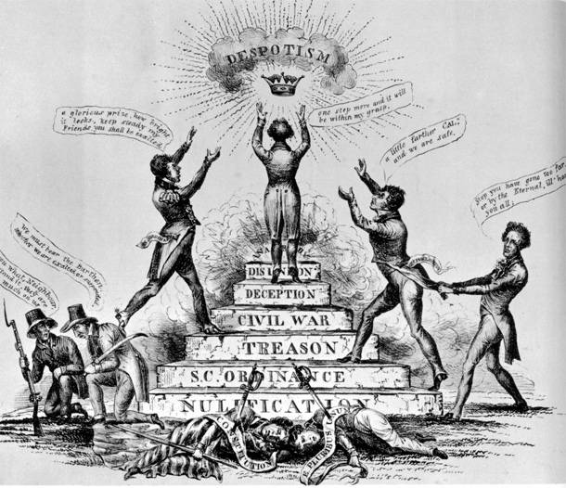

Slide 39
Jacksonian vs. Jeffersonian Democracy
Jefferson
Capable, well-educated people should govern for the people
Reflected agricultural society
Limited democracy to political aspects
Jackson
People themselves should manage govt. affairs
Reflected agricultural as well as emerging industrial society
Political, economic, and social democracy
Notes:
Democratic aspects in Jackson Era
Most states had removed property & religious qualifications for voting and officeholding
More officials elected rather than appointed
terms of office for some govt. positions shortened to give people more power over officials
Nominating conventions replace caucus system for presidential nomination in 1832
Electors elected by people rather than state legislatures
Jackson used office of the president “vigorously” to serve the interests of the people
Spoils system & rotation in office - prevent emergence of elite bureaucracy
Economic aspects
Cheap land for settlers
Growth of trade unions to represent workers (still weak but growing
Social
Various reform movements (Women’s rights, abolition, etc.)

