Slide 1
Do Now
SIT DOWN! Quick day!f

Slide 2
6. Consumerism and Politics of the 1920s
Mr. Winchell
APUSH 2018-2019
Period 7

Slide 3
America in the 1920s
America was changed by the industrialism of the Gilded Age & the economic boom of WWI
During the 1920s:
The USA was the richest & most developed country in the world
Wages rose, hours declined, & Americans had access to new, innovative consumer goods

Slide 4
The Second Industrial Revolution
The increase of national name brands (rather than locally produced goods) linked Americans more than ever
From 1922 to 1929, the U.S. had a 2nd industrial boom:
Mostly in consumer durable goods like appliances, cars, radios, furniture, & clothing
Electricity replaced steam power
Corporations used salaried executives, plant managers, & engineers to increase efficiency

Slide 5
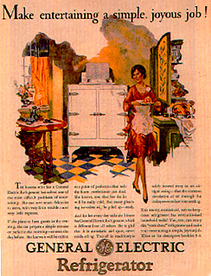
Glenwood Stove Ad
1920s consumerism led to luxury living:
New appliances like refrigerators, washing machines, & vacuums

Slide 6
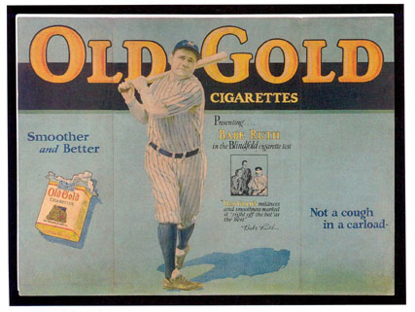
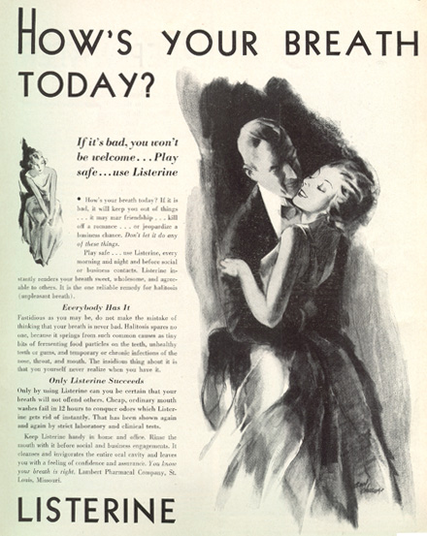
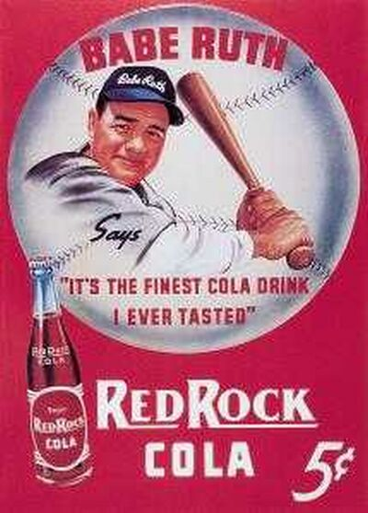
1920s advertising

Slide 7
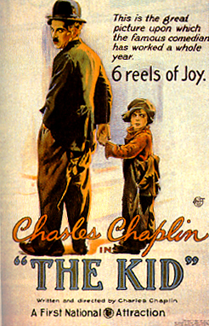
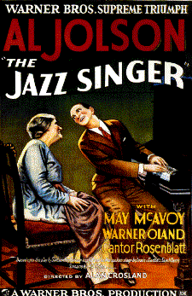
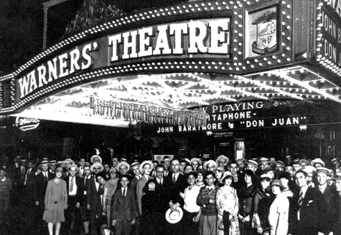
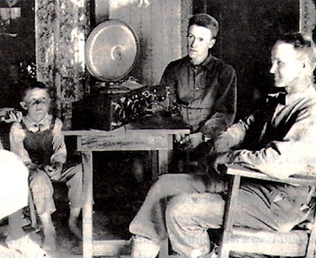
1920s consumerism led to luxury living:
Radios & movies boomed
100 million Americans went to the movies in 1929 per week
The first “talkie”
NBC was the 1st successful radio network

Slide 8
Economic Weaknesses
The “Roaring 20s” was not as prosperous as it appeared:
RR, cotton textile, coal industries suffered due to new competition
Farmers boomed during WWI but a decline in demand after the war deflated farm prices
Farm per capita income of was $273 per year vs. the U.S. average of $681 per year

Slide 9
Consumerism

Slide 10
The Lost Generation-The Flowering of the Arts
“The Waste Land” focused on a sterile U.S. society
The 1920s gave rise to a new class of intellectuals who condemned the new American industrial society & materialism:
Pessimistic Literature: TS Eliot, Ezra Pound, Sinclair Lewis, F Scott Fitzgerald, Hemmingway
Playwrights: Eugene O’Neill
Music: Gershwin & Copland
Poetry discussed a “botched wasteland”
“Main Street”–narrow-minded small towns
“Great Gatsby”—human emptiness
Romantic individualism & violence
Plays of tragic pipedreams

Slide 11
America in the 1920s experienced a decade of change
There was an increase in consumerism…
Government policies favored business and isolationism
Women and African Americans experienced new freedoms while immigrants came under attack
…cars, radios, entertainment

Slide 12
Politics of the 1920s
The 1920s were dominated by Republicans in the White House & in both houses of Congress:
Limited Progressive reforms
Developed a close relationship between the gov’t & business that promoted private enterprise
Advocated a foreign policy based on economic investment of U.S. business in the world
Notes:
Although divided into rural & urban sects, Democrats were setting stage for future dominance, especially among urban voters

Slide 13
Election of 1920
Democrats
James M. Cox
Republicans
Warren G. Harding
“A Return to Normalcy”
Socialist Party
Eugene V. Debs
Received 913,664 votes despite incarceration

Slide 14
Warren G. Harding (R) (1921-1923)
“A Return to Normalcy.”
Budget and Accounting Act (1921)
President required to submit annual budget to Congress
Bureau of the Budget
Emergency Quota Act (1921)
Fordney-McCumber Tariff (1922)
Increase tariff rates, especially on industrial goods
Washington Naval Conference (1922-1923)
Scandalous
Teapot Dome Scandal
Bribes for oil fields
Veteran’s Bureau fraud and bribery
Attorney General bribed by almost everyone
Harding died in office
Calvin Coolidge assumed presidency

Slide 15
Election of 1924
Democrats
John W. Davis
Split primarily over KKK support
Republicans
Calvin Coolidge
Booming economy and conservatism
Progressive Party
Robert La Follette
Liberal alternative to both parties

Slide 16
Calvin Coolidge (R) (1923-1928)
“The business of the American people is business.”
Revenue Acts of 1924, 1926, 1928
Overall decrease in tax rates
National Origins Act (1924)
Kellogg-Briand Pact (1928)

Slide 17
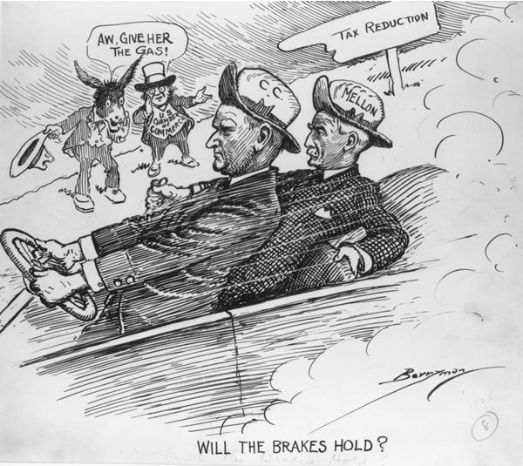

Slide 18
Election of 1928
Democrats
Al Smith
First Catholic major party candidate
Split the party
Smith’s support for Catholics
Smith’s support for anti-Prohibitionist
Smith’s Tammany Hall association
Republicans
Herbert Hoover
Ran on continuing economic prosperity and conservative policies

Slide 19
“A Return to Normalcy” “The Business of America is Business”
“A Return to Normalcy”
Dedication and inspiration for Progressive reform waned
World War I reestablished a conservative and isolationist society
“The Business of America is Business”
A reinvigoration of American business prosperity and consumerism
Social and Cultural Impact
Urban and Rural divisiveness
Reactions to Conservatism

