Slide 1
Do Now
Evaluate the roots of ‘liberalism’ in American politics, especially post Great Depression.
What are the limits of liberalism?

Slide 2
8. The Response to Liberalism-The 1970s and the Rise of the New Right
Mr. Winchell
APUSH 2018-2019
Period 1-2

Slide 3
AP Prompt
Evaluate the extent to which the domestic and foreign policies of the 1970s demonstrated change in American society.

Slide 4
Outline
The New Left and Protest Movements
End of the 1960s Liberalism
Nixon’s Foreign Policy
Nixon’s Domestic Policy
Ford’s Presidency
Carter’s Presidency
The Legacies of the 60s and 70s

Slide 5
America’s Youth Must Lead a New Revolution; Student Rebellion Leaders Are a Disgrace
“Port Huron Statement of the Students for a Democratic Society” (1962)
K. Ross Toole – “An Angry Man Talks Up to Youth” (1970)
Youth around the world have the potential to become a critical force. A youth movement raises the issues about a society in which it will be forced to live. It takes issues to the working class. They do this because, in America, there exists an enormous contradiction around the integration of youth into the system. The period of pre-employment of this highly industrialized society and the lack of jobs. Institutions like the schools, the military, the courts and the police all act to oppress youth in specific ways, as does the work place. The propaganda and socialization processes focused at youth act to channel young people into desired areas of the labor market as well as to socialize them to accept without rebellion the miserable quality of life in America both on and off the job.
Common courtesy and a regard for the opinions of others is not merely a decoration on the pie crust of society, it is the heart of the pie. Too many “youngsters” are egocentric boors. They will not listen, they will only shout down. They will not discuss but, like four-year-olds, they throw rocks and shout… Society, “the Establishment,” is not a foreign thing we seek to impose on the young. We know it is far from perfect. We did not make it; we have only sought to change it. The fact that we have been only minimally successful is the story of all generations, as it will be the story of the generation coming up. Yet we have worked a number of wonders with it. We have changed it. We are deeply concerned about our failures...But we have attacked these things. All our lives we have taken arms against our sea of troubles...But we also have fought with a rational knowledge of the strength of our adversary.

Slide 6
One impact of the 1960s was the rise of the “New Left” – youth and minority movements focusing on liberalism, anti-militarism and awareness of injustices (poor, minorities, adolescences, etc.).
VS.
By the early 70’s these new movements created such upheaval in society - “The Silent Majority” pushes back (conservativism, a return to status quo, middle class mainstream, etc.).
- believed the youth movement was destroying traditional American values.

Slide 7
Sixth Party System (1968-Present)
Republicans
Democrats
Platform
Conservatism
New Federalism
Supply-Side Economics
Privatization
Southern Strategy
Christian Coalition/Moral Majority
Proactive and expanded military
Judicial restraint
Pro-life
Electoral Events
Republican Revolution
1994 Mid-Term Elections
Contract with America
Demographics
Business Professionals/Corporations
Blue-Collar Workers
Bible Belt, Midwest, Rocky Mountains
Platform
Liberalism
Equal opportunity and social welfare
Keynesian economics and progressive taxes
National health insurance
Affirmative action
Environmentalism
Multinational coalitions
Judicial activism
Pro-choice
Electoral Events
1968 Democratic National Convention
2006 Mid-Term Elections
2008 Presidential Election
Demographics
Professionals/Academics
Women, Youth, and Minorities
Urban sectors
Unions
Northeast and Pacific West (Left Coast)

Slide 8
Civil Rights Movement Urban Riots
Los Angeles (1965)
Watts neighborhood
34 deaths, over 1000 injured
Detroit (1967)
National guard and federal troops and tanks sent
43 deaths, over 1000 injured
Kerner Commission
Frustration among impoverished urban blacks due to white racism
Attempt to improve inter-racial communications

Slide 9
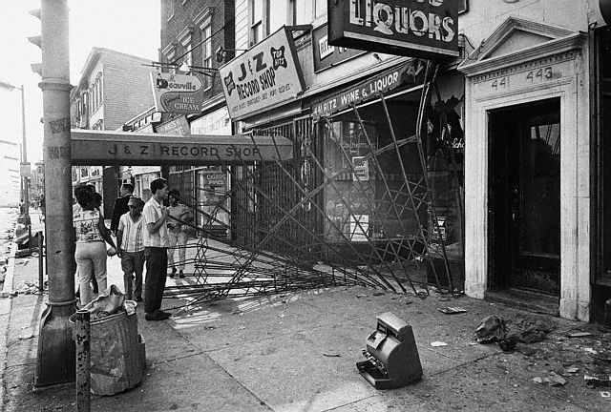
Newark, NJ 1967

Slide 10
LBJ’S Reaction
Johnson told former CIA Director John McCone that these "groups they got really absolutely nothing to live for. Forty percent of them are unemployed. These youngsters, they live with rats and they've got no place to sleep . . . broken homes and illegitimate families and all the narcotics are circulating around them.... And we've isolated them, and they're all in one area, when they move in why we move out."

Slide 11
Protesting the Vietnam War
The most dramatic focus of youthful rebellion was Vietnam:
Mostly led by college students who escaped the draft
Students protested the draft, military research on college campuses, & disproportionate use of black & Hispanic soldiers
Protests got stronger as fighting intensified in Vietnam in 1966

Slide 12
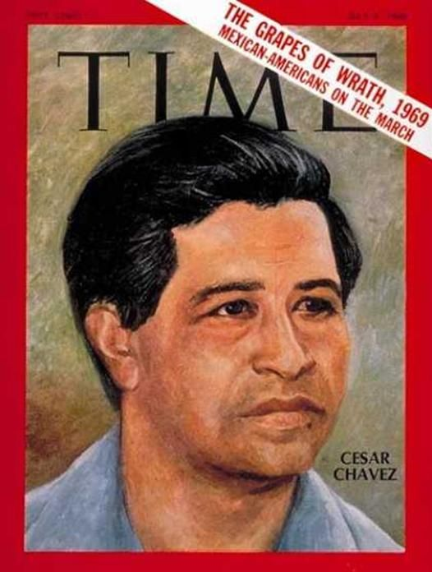
Voices of Protest
Native American Protest
1961
67 tribes created Declaration of Purposes
Criticized termination policies
Lobbied for inclusion with war on poverty
Johnson established National Council on Indian Opportunity 1965
1968
“Red Power”
Younger movement
Mocked Columbus Day
American Indian Movement
Most militant
Occupied Alcatraz for 19 months
Goal to protect way of life
Reassertion of Native American Culture
Hispanic-American
Fastest-growing minority
Impatient
Cesar Chavez 1965
“La Causa”
Non-violence, led agricultural strikes
Chicano/Chicana movement
More militant
Boycotts to demand bilingual classes, more Latino teachers
Spread to other minorities
Notes:
Read ‘La Causa’

Slide 13
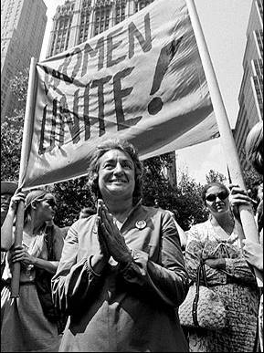
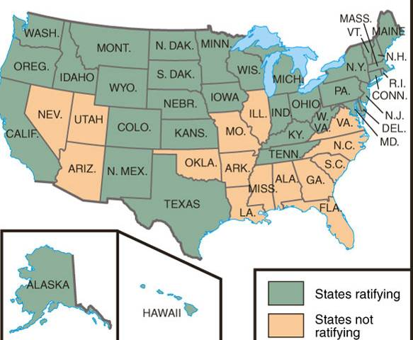
Other Movements – Women’s Liberation
“Pink Power”
Feminism: Started with Betty Freidan publishing Feminine Mystique in 1963 - a dissatisfied housewife who wants equality for all women.
Drew attention to sexual discrimination & unequal pay for women - Betty Freidan co-founded the National Organization of Women (NOW) to advocate for women.
Demanded an Equal Rights Amendment (ERA) to ban sexism - defeated in the 1970s by conservatives & anti-ERA women.
Phyllis Schaffly
Gained abortion rights in Roe v Wade (1973).
Congress passed Title VII to protect women from sexual harassment.
Congress passed Title IX that outlawed sexual discrimination in education programs.
Notes:
READ-Excerpt Feminine Mystique
READ-Phyllis Schlafly

Slide 14
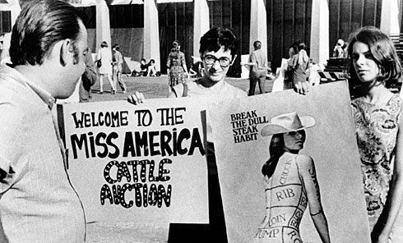

Slide 15
Counter-Culture
Hippies and Drugs
Marijuana
60% of college students tried
No real “evidence” against it
LSD
Films
“Hair” 1967
“Alice’s Restaurant” 1969
Music
Jim Morrison “the Doors”, Bob Dylan
Jefferson Airplane, Rolling Stones, Beatles
Revolt
Surplus military clothing
Torn jeans, tie-dyed shirts
Music Revolution
1960’s College Folk
Bob Dylan
Beatlemania
Woodstock 1969, 800,000 people
Sexual Revolution
“if it feels good, do it”
“the pill” debate
1970 1/3 fetuses aborted
Roe v. Wade (1973)
Publications
Playboy
Gore Vidal’s “Myra Breckenridge” 1969
Films
“Easy Rider”
“Midnight Cowboy”
Divorce rate increased
Cohabitation increased
“open marriages”
Gay Liberation
Public June 1969
Raid on a gay bar in NY
“gay pride”
Supported mainly in cities
Change stigmas
American Psychiatric Association
Not a “mental disorder”
1975 US Civil Service Commission ended ban on employment
Notes:
LISTEN TO-Doors COMPARE TO FOLK/50s

Slide 16
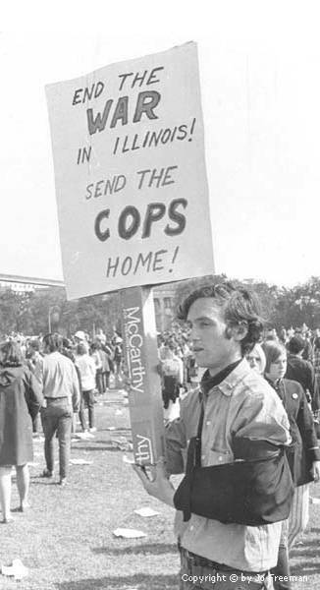
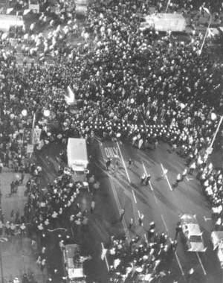
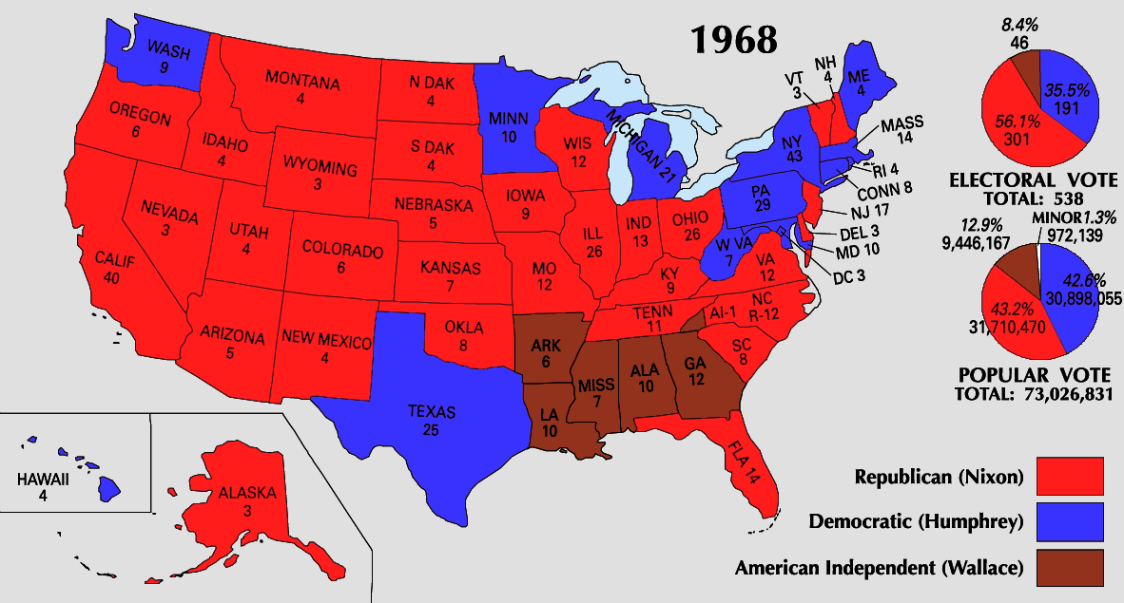
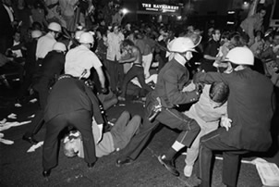
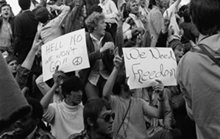
1968 Democratic National Convention
Republicans benefited from the Vietnam disaster & a shattered Democratic party; Nixon won the election as a reconciler

Slide 17
Nixon and World Politics
Vietnamization
When Nixon takes office, 500,000 troops in Vietnam
Nixon Doctrine 1969
US role “helpful partner” not military protector in 3rd world
Support with money, not troops
Called Nixon Doctrine
Gradual withdraw
Vietnam a MESS
Morale, drugs, murder
My Lai massacre 1968
Vietnamization
More S. Vietnamese troops
1972 down to 30,000 US troops
Kissinger sent to negotiate
Nixon’s War
Secret B-52 bombings on Cambodia
Widened Indochina War
America’s longest war ends
1972 “peace at hand”
Snag with demands
Christmas bombing of Hanoi
Paris Accords Jan 1973
Ended hostilities
Left situation unresolved
Results
58,000 dead
300,000 wounded
$150 billion
Psychological effects
“Put Vietnam behind us”
US could care less about Indochina
Détente-’the easing of hostility’
1970 “three-dimensional” game
1972- China
Formal recognition
1972- Moscow
Strategic Arms Limitation Talks

Slide 18
Nixon’s Covert Operations
Despite Nixon’s public détente with the USSR & China, most foreign policy was covert:
CIA funded the leaders of brutal gov’ts in Iran, South Africa, the Philippines, & Nicaragua
CIA assassinated Chilean president Salvador Allende

Slide 19
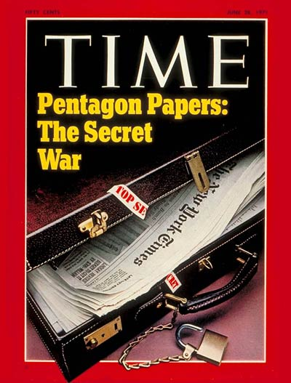
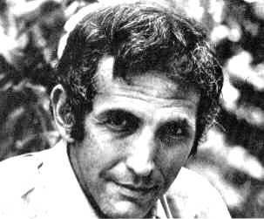
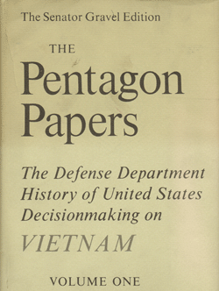
Daniel Ellsberg’s Pentagon Papers

Slide 20
Nixon’s Domestic Policy
Nixon entered office as a moderate who claimed to want to kept LBJ’s Great Society in place
But, Nixon shifted responsibility for social problems to state & local governments
Nixon reshaped the Supreme Court along conservative lines when 4 justices retired
Notes:
named too

Slide 21
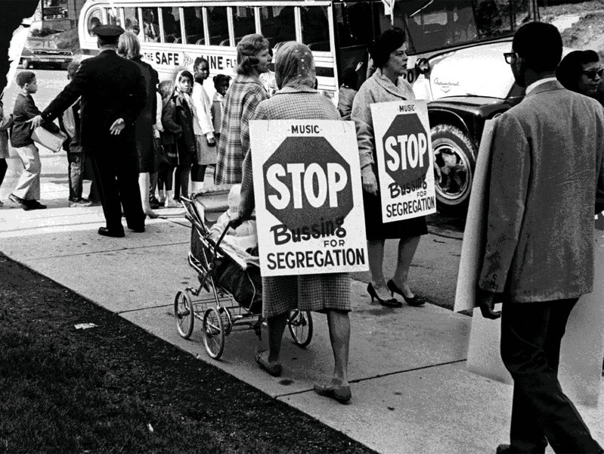
Nixon – Domestic Events
Promoted New Federalism – transfer some federal powers back to the states (ex: de-segregation/busing dealt with at the state level) – most everything passed was vetoed by Nixon!
Expansion of affirmative action – Griggs vs. Duke Power Co (hire more minority workers to avoid charges of discrimination).
Congress created the EPA (Environmental Protection Agency) – a result of new awareness about chemicals and pollution.
Muckraker Rachel Carson’s Silent Spring (exposes the effects of farm pesticides).
Endangered Species and Clean Air Act
Created the Occupational Health and Safety Administration – creates regulations and inspections of work places to ensure safety!
OPEC announces an embargo of oil to the US – triples prices and leads to mass energy crisis!
Expanded Food Stamps, Medicaid but to only certain groups…
Notes:
READ SILENT SPRING EXCERPT

Slide 22
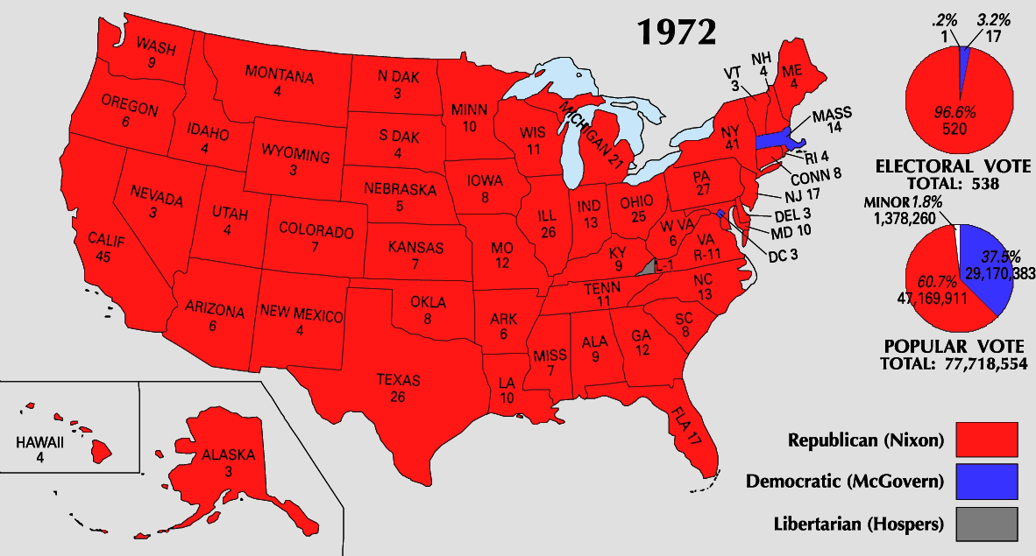
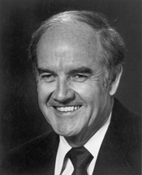
The Election of 1972
In 1972, Nixon ran for re-election
Democrat George McGovern was labeled an “outsider” who supported “acid, abortion, & amnesty”
Nixon won in the 4th largest margin of victory in history
But…the Watergate scandal ended the Nixon presidency

Slide 23
Election 1972
Southern Strategy
Court whites upset with racial equality
Opposed extension of Voting Rights Act
Hindered Fair Housing Act
Slow desegregation
Supreme court nominations
More conservative
Nominated Chief Justice Warren Berger
Shift to the right
Election
Re-election certain
Democrats divided
Wallace shot May 1972
Democratic Nominee
George McGovern
CREEP
Results
Nixon Wins
Less people vote
Watergate, June 1972
Arrest of individuals caught wire-tapping Democratic party center
Paid $400,000 to quiet before election
“Deep Throat”
Bob Woodward/ Carl Bernstein
Feb. 1973
Senate investigation
No solid proof of ordering activities
Guilty of trying to cover it up
Firings/resignations
televised
Disgrace
VP Agnew charged with tax evasion Oct. 1973
House minority leader Gerald R. Ford becomes VP
March ’74
Nixon tapes subpoenaed
July unedited tapes appear
Indicted on 3 articles of Impeachment
Aug 9, 1974 1st president to resign

Slide 24
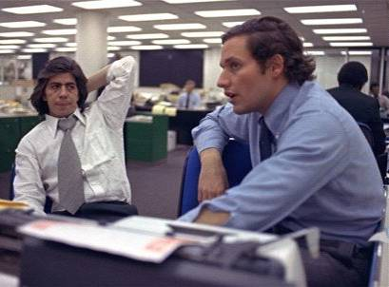
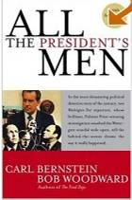
Bob Woodward & Carl Bernstein of the Washington Post broke the Watergate story
Their investigation revealed…

Slide 25
The Watergate Scandal
The Watergate scandal began to unravel in 1973:
The discovery that Nixon recorded conversations proved most damning
The Supreme Court ordered Nixon to turn over all tapes to a Senate investigative committee
The House brought 3 articles of impeachment against president
Obstruction of justice
Abuse of power
Contempt of Congress

Slide 26
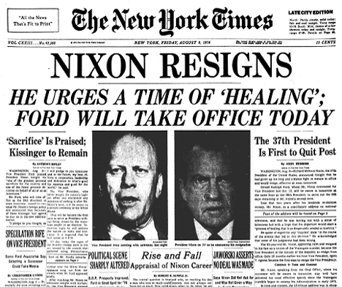
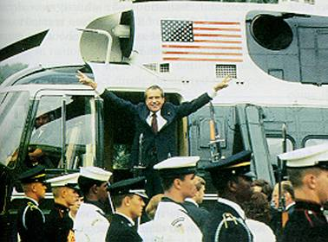
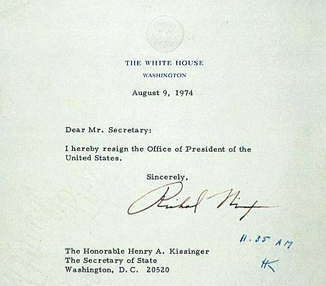
Notes:
May 2005, Deep Throat was revealed as FBI Deputy Secretary W. Mark Felt

Slide 27
Conclusions: Politics After Watergate
The Watergate scandal eroded public trust in their own gov’t
The growing tension between president & Congress prevented strong, effective leadership from meeting foreign & domestic problems in the 1970s
The discontent of the 1960s & 1970s revealed an America at war with itself
This DEFINES the 70’s politically: Watergate + Pentagon Papers + Bad economy + decrease in US global status = MISTRUST and DISALLIONMENT!

Slide 28
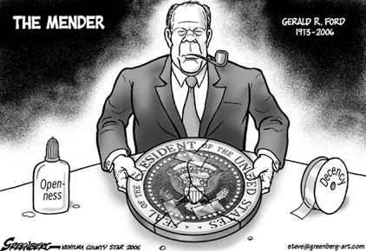
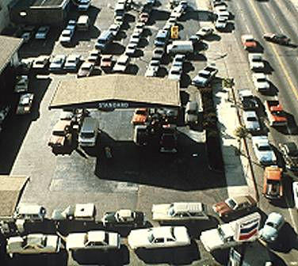
Ford as President
Ford was seen as an “honest man” - hoped to move America past the Watergate scandal.
Grants full pardon to Nixon – enrages Dem’s and hurts his reputation as an honest politician.
Faced a TROUBLED economy - Restricted credit which led to recession and inflation (called Stagflation).
Tried to curb inflation with “tight” money (plan called “WIN” – Whip Inflation Now).
Remember Org. of Petroleum Exporting Countries (OPEC)…economic situation worsens.
In retaliation for American support of Israel, OPEC cut off oil to the U.S. in 1973
Leads to Oil Crisis - Gas prices soared & shortages led to long lines at the pump.
1975 – attends the Helsinki Accords (furthered efforts of détente in Europe).
Also Saigon falls – Vietnam unified under Communist rule.

Slide 29
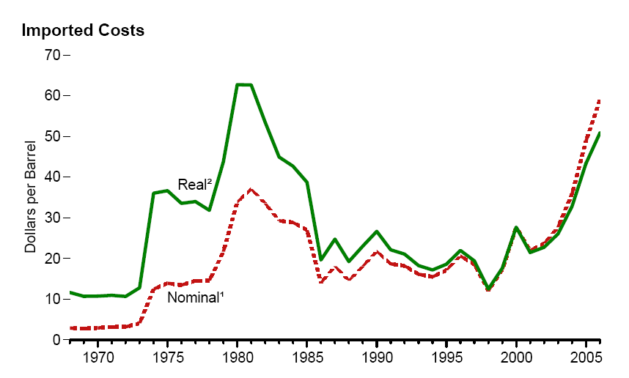
1970s Energy Crisis: Oil Prices

Slide 30
Gasoline Crisis of the 1970s

Slide 31
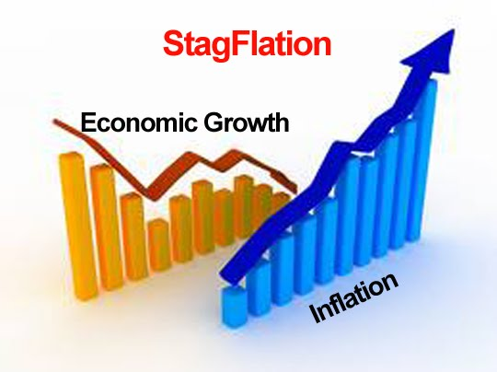
1970s Energy Crisis: Stagflation

Slide 32
Election of 1976
Jimmy Carter (D)
Political outsider
Gerald Ford (R)

Slide 33
Carter – Domestic Events
Election of 1976 - Stagflation and gas crisis continues…
Carter ran as an “outsider” (No involvement in Vietnam, Watergate, or the recession) – it was a close election!
Carter tried to attack the energy crisis, stagflation, & the recession - None of his efforts worked!
Inflation hit 14%, interest rates neared 20% - a new oil embargo in 1979 increased gas prices.
Affirmative Action challenged – Bakke v. Regents (claimed reverse discrimination in college admissions).
Upheld affirmative action, but its image decreases and looks like an “unfair advantage” to minorities.
Three mile island nuclear plant explodes – leads to questioning new energy ideas.
Green movement continues! - protecting the earth, clean energy, solar and wind power, etc.

Slide 34
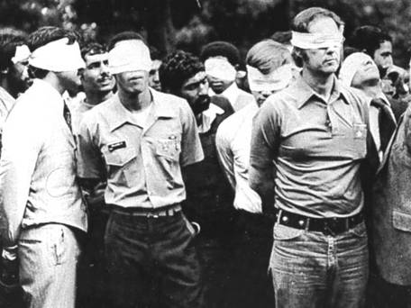
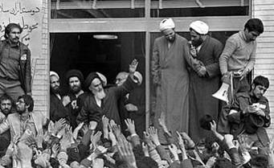
Carter – Foreign Events
Carter stresses “human rights” as basis of U.S. foreign policy - stopped supporting foreign governments that violated human rights.
Brought Egyptian leader Anwar el-Sadat & Israeli leader Menachem Begin to the U.S. for the Camp David Accords in 1977 – started to move towards “peace in the Middle East.”
Then...fundamentalist Islamic cleric Ayatollah Khomeini led the Iranian Revolution.
Over threw the pro US leader the “Shah” and instated a theocratic radical regime – hated the US!
Iranian protests stormed US embassy – held 52 American hostages for 444 days – known as the Iran Hostage Crisis.
Carter tried diplomacy, negotiations, rescues – nothing worked (he looks very weak!)
At the same time…Russia invades Afghanistan – signals détente is ending and the Cold War is “heating up” again!

Slide 35
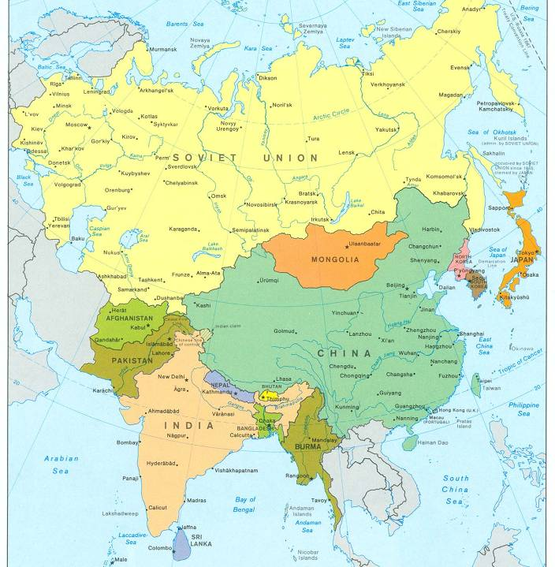
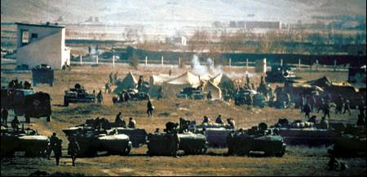
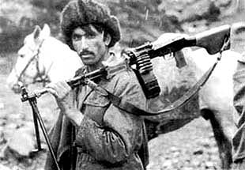
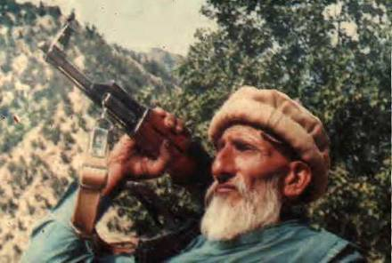
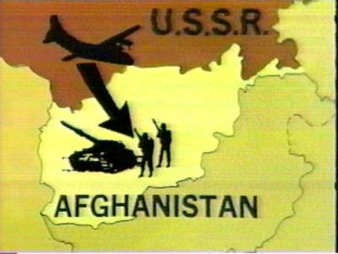
Soviet Invasion of Afghanistan, 1979

Slide 36
The Cold War Resumes
During the Carter years, the Cold War rivalry between the U.S. & USSR grew due to:
A new arms race as the U.S. adopted new MX missiles & Trident submarines
SALT II failed to make lasting arms reduction
Increased U.S.-Chinese relations put the USSR on the defensive

Slide 37
A Failed Presidency
Carter’s failures with inflation, Iran, & Afghanistan overshadowed his foreign policy victories with the Panama Canal & the Middle East
The failures of Johnson, Nixon, Ford, & Carter led to a desire among Americans for a strong leader who could face both domestic & foreign challenges
Carter’s 1980 approval rating was 23%

Slide 38
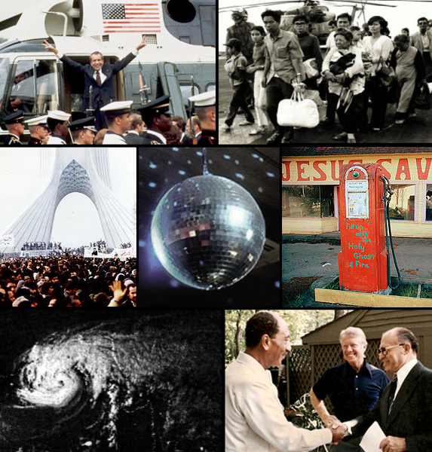
Conclusions on the 60’s and 70’s:
By 1980, the USA seemed to be losing its place as the top nation in the world:
The 1970s presented failures in the Cold War & new problems in the Middle East.
The social protests & counter culture seemed to divide liberals & conservatives.
Stagflation & the economic recession were growing worse, not better .
The failures of Johnson, Nixon, Ford, & Carter left citizens in search of optimism, strong leadership, & conservative policies.

Slide 39
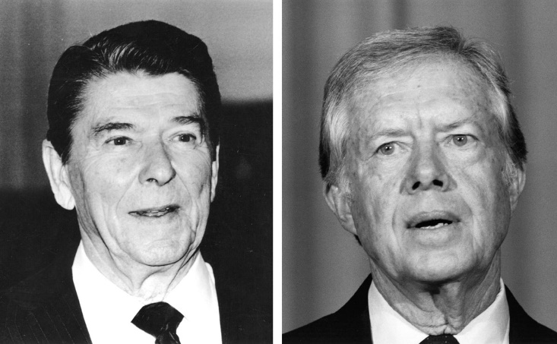
Election of 1980
Ronald Reagan (R)
Jimmy Carter (D)
Campaign
Debate
“Are you better now than you were four years ago?”

