Slide 1
THESIS QUIZ LET’S GOOOO
No context unless you feel like it… just thesis:
Evaluate the impact of political, economic and social change on America in the 1920s:

Slide 2
6. The Stock Market Crash and Great Depression-Causes, Consequences, and Hoover to the…Rescue?
Mr. Winchell
APUSH 19-20
Period 7

Slide 3
AP PROMPT
Evaluate the short and long-term causes of the Great Depression

Slide 4
The Great Crash
Prelude to the stock market crash
  In 1927, the economy had a recession but gov’t & business leaders ignored warning signs
  The Federal Reserve lowered interest rates for loans to stimulate the economy, but this easy credit led speculators to buy stock “on-the-margin”
Notes:
The Great Depression came as a shock to Americans, but there were warning signs:
In 1927, the economy had a recession but gov’t & business leaders failed to respond
The Federal Reserve lowered interest rates for loans to stimulate the economy, but this easy credit led speculators to buy stock “on-the-margin”

Slide 5
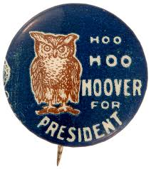
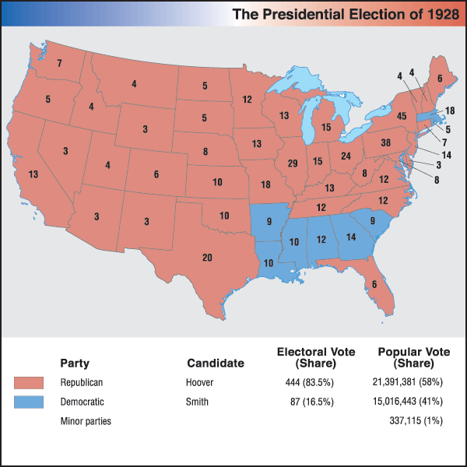
Election of 1928
Democrats
  Al Smith
    First Catholic major party candidate
    Split the party
      Smith’s support for Catholics
      Smith’s support for anti-Prohibitionist
      Smith’s Tammany Hall association
Republicans
  Herbert Hoover
  Ran on continuing economic prosperity and conservative policies

Slide 6
Hoover’s Views…
August 11, 1928
"Unemployment in the sense of distress is widely disappearing. . . . We in America today are nearer to the final triumph over poverty than ever before in the history of any land. The poor-house is vanishing from among us. We have not yet reached the goal, but given a change to go forward with the policies of the last eight years, and we shall soon with he help of God be in sight of the day when poverty will be banished from this nation. There is no guarantee against poverty equal to a job for every man. That is the primary purpose of the economic policies we advocate:
—Herbert Hoover, speech accepting the Republican nomination, Palo Alto, California.

Slide 7
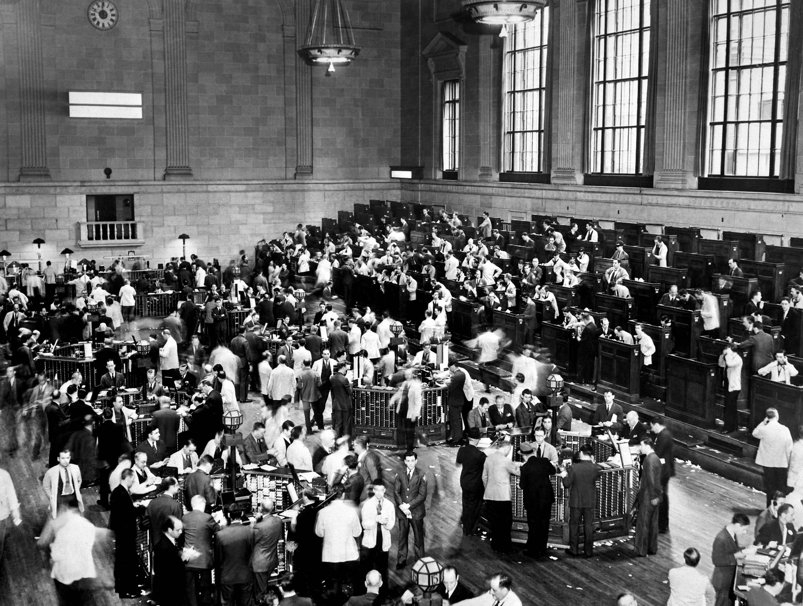
The Stock Market in the 1920s
A stock is a percentage – a piece - of a company →
The value of the stock market overall is based on confidence in the total market for stocks, not the actual profits of one company.
The overall value of stocks increased 120% from 1925-1929.
What would make Apple stock go up or down?
Notes:
A stock is a percentage of a company. IF you buy stock in a company, you basically own little pieces of that company. If the company is doing well, people have confidence in it, it may not be the actual profits of the company, or if people predict that company will do well. So more and more people were buying stock from 1925-1929.

Slide 8
The Upward Spiral
(or so it seemed…)
Americans borrowed money not just to buy goods, but also to buy stocks
Borrowing Money
Desire to invest in more stocks and enjoy more goods
More Spending on Goods and Stocks
Economic Confidence!
Notes:
It seemed like Americans were on an upward spiral, or so it seemed. Americans were borrowing money not just to buy goods, but to buy stocks in companys. If you borrow money, you are in debt to people. However, it increases yoru spending. IF peope are spending money, the economy looks good so people have confidence in the economy. If the economy has confidence, people want to invest in stock, here’s the cycle, then people are gonna borrow more money, and get in more debt.

Slide 9

Hoover’s Bull Market of 1929
During 1st 6 mos. of Hoover admin.
  Height of stock prices
Aug. 1929, 300 billion shares bought on margin
“Get rich quick” gamble
  Money normally earned off dividends
  Margin buyers looking to buy low then sell high
    Only works if stock price goes up!

Slide 10
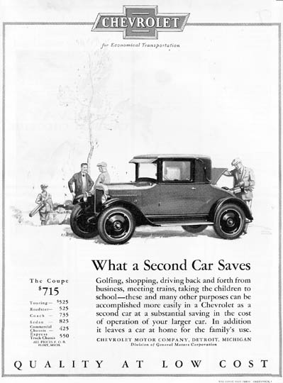
All was calm on the surface
Prosperity of 1920s seemed endless
  Strong economy
  Supportive government
  Happy consumers
Good standard of living
  More families had electricity and appliances
  More variety of products
  Chain stores offered low prices and installment plans (credit)
  Advertising more sophisticated
    Market research, catchy images & slogans

Slide 11
But there was danger ahead…
  Agriculture
    Overproduction and overextension (in debt)
    World market price and demand both down
    Congressional assistance vetoed by Coolidge
Several key industries were faltering:
  Railroads
    strict controls, competition w/ cars, trucks, and busses
  Textiles
    Union wages drove mills South for cheaper labor
    Foreign competition drove prices down
  Coal
    Alternatives (oil, natural gas, hydroelectric) available

Slide 12
Economic Trouble
Unfortunately for Hoover, the economy tumbled
Trouble in key industries (mentioned earlier)
Economy slowly slipping for a few years
Key indicators began showing weakness
  New construction down – meant less biz for related industries
  Consumer purchases dropped off
    Left huge surpluses (incl. farming)
Surplus = low prices & less profit

Slide 13
The Coming Depression
  -Overproduction of consumer durable goods & agriculture
  The post-war conditions in Europe decreased foreign trade
  Unequal distribution of wealth, high consumer debt, stock market over speculation led to an overall decrease in consumer purchase power
Consumers already owned durable goods & were not buying more
Notes:
Economic conditions in Europe, Agricultural decline since 1919, corporate mismanagement, excessive speculation all contributed to the GD as well

Slide 14
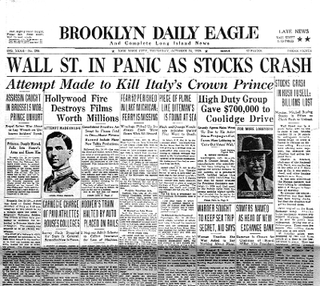
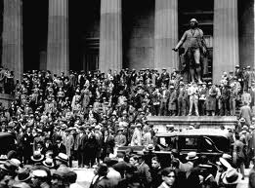
Wall Street Takes Notice
A stock sell-off soon began
  Stocks = certificates of partial ownership in a biz
Investors looking to take what profits they could before stock prices went too low
Many continued to buy until Oct. 21, 1929
  A sharp dip in market – stock prices plummet
  Those who bought on margin sold to cover debts
Oct. 29 – 16 million shares of stock sold in one day

Slide 15
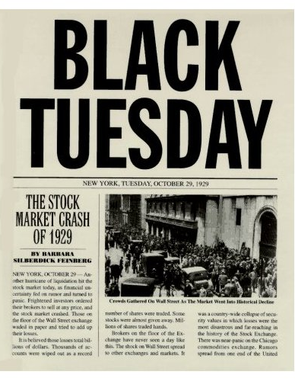
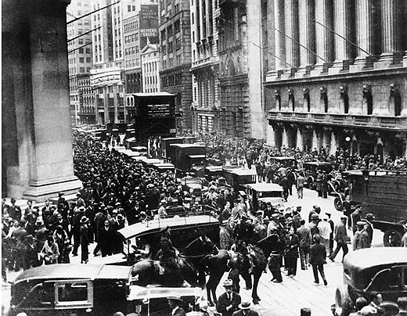
The Crash
The Market sell-off of Oct. 29 known as “Black Tuesday”
Frantic effort to sell stocks before prices hit rock bottom
Self-fulfilling – fear of low prices = sell-off = low prices
Bottom fell out of the market & the prosperity of the 20s ended

Slide 16
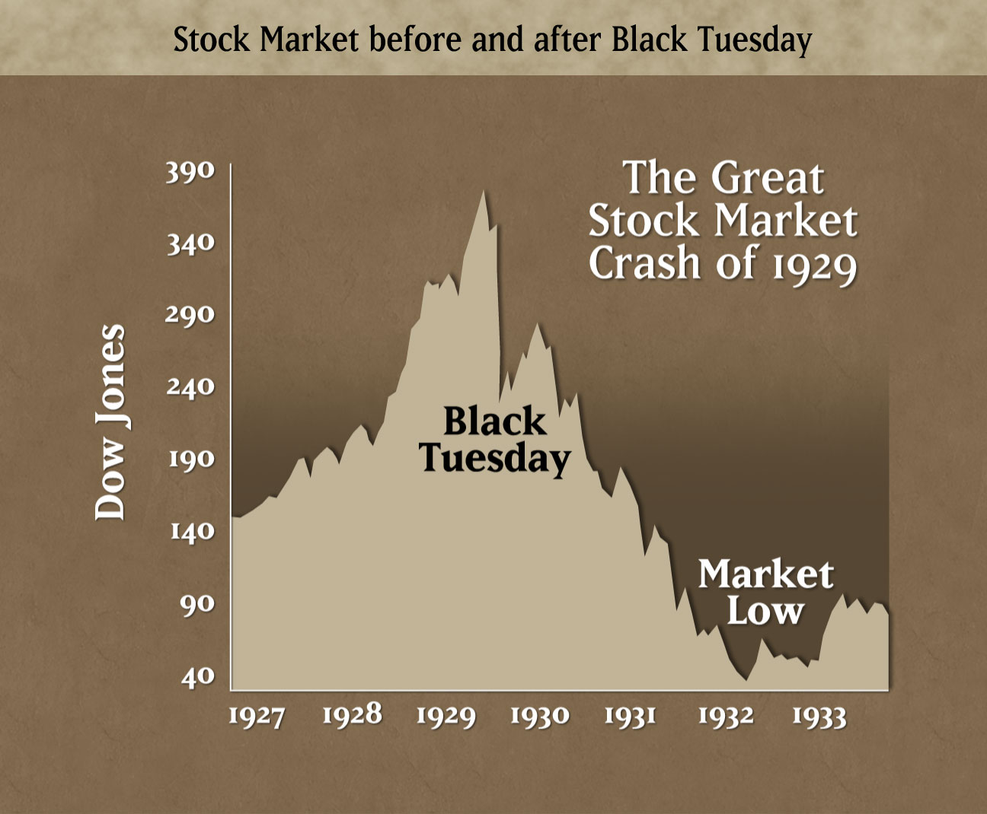
The 1929 Stock Market Crash

Slide 17
Thesis Check
Evaluate the causes for the Great Depression, accounting for short and long term factors.

Slide 18
Causes of the Great Depression
Political Policies
  “The business of the American people is business.”
  Mellon’s Revenue Acts (Tax Bills)
    “The history of taxation shows that taxes which are inherently excessive are not paid. The high rates inevitably put pressure upon the taxpayer to withdraw his capital from productive business.” (1924)
  Fordney-McCumber Tariff (1922)
Financial Practices
  Assumption of Debt
    Installment plans
    “Buying on Margin”
  Crash of 1929
  The Fed’s tight money policy
  Banking panics (1930-1931)
  Dawes Plan and Post-WWI lending
Economic Situations
  Agricultural overproduction and low prices
  Industrial overproduction
    Welfare capitalism and consumer confidence
Socioeconomic Conditions
  Top 1% owned 35% of nation’s wealth
  Bottom 20% owned 4% of nation’s wealth

Slide 19
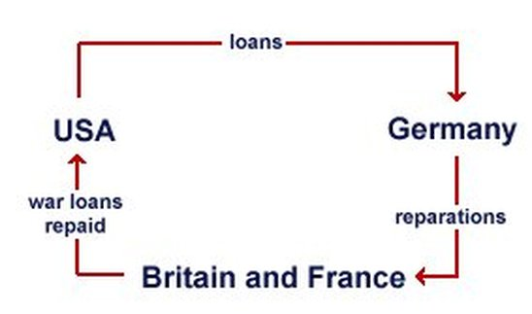
Causes of the Great Depression
Political Policies
  “The business of the American people is business.”
  Mellon’s Revenue Acts (Tax Bills)
    “The history of taxation shows that taxes which are inherently excessive are not paid. The high rates inevitably put pressure upon the taxpayer to withdraw his capital from productive business.” (1924)
  Fordney-McCumber Tariff (1922)
Financial Practices
  Assumption of Debt
    Installment plans
    “Buying on Margin”
  Crash of 1929
  The Fed’s tight money policy
  Banking panics (1930-1931)
  Dawes Plan and Post-WWI lending
Economic Situations
  Agricultural overproduction and low prices
  Industrial overproduction
    Welfare capitalism and consumer confidence
Socioeconomic Conditions
  Top 1% owned 35% of nation’s wealth
  Bottom 20% owned 4% of nation’s wealth

Slide 20
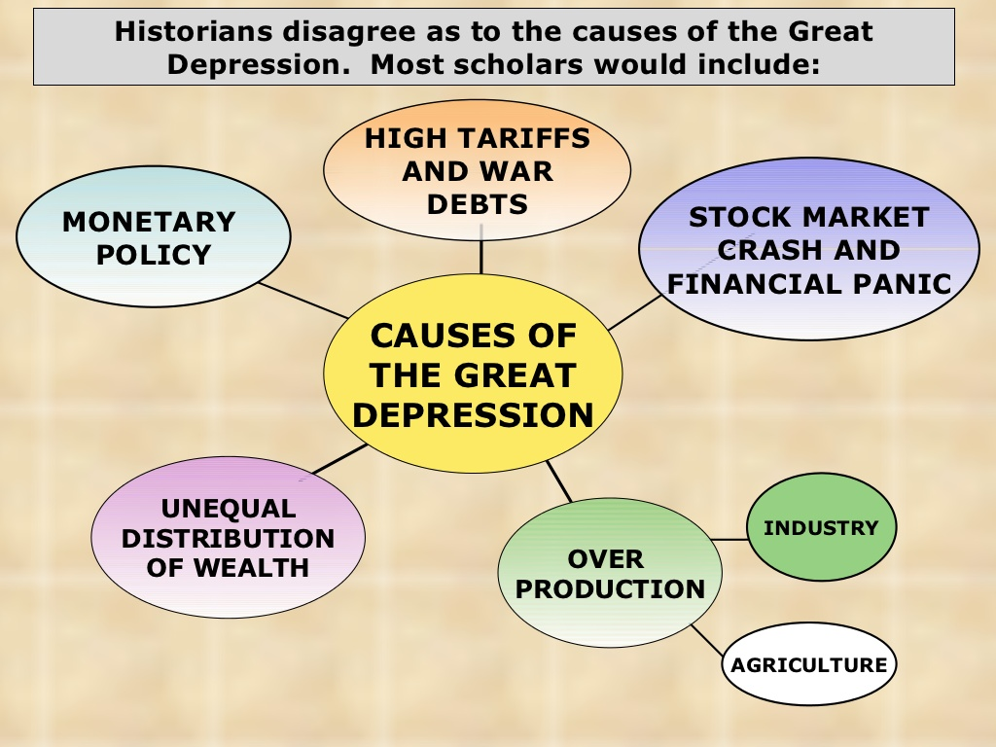

Slide 21
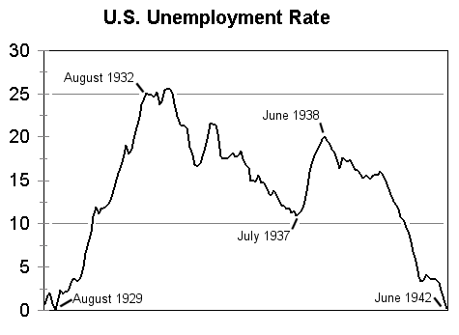
The Downward Spiral
UNEMPLOYMENT
Businesses lay off workers
Less money to spend
Businesses can’t afford to pay workers
Businesses lose profit
Notes:
This is the unemployment cycle. People have less money to spend, so they don’t spend it in businesses. Businesses lose profit. Businesses can’t afford to pay workers. Businesses then lay off workers, so more and more people keep losing money.

Slide 22
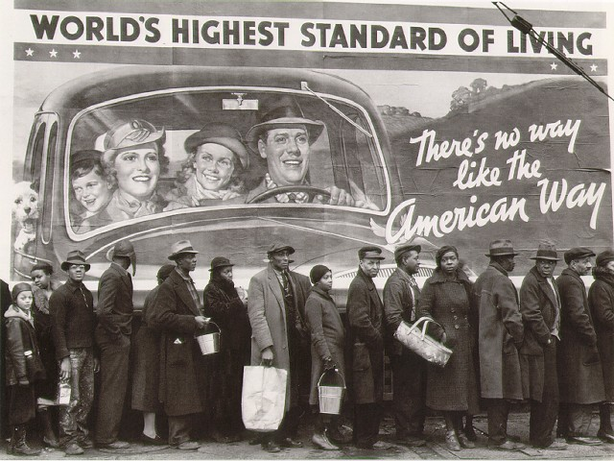
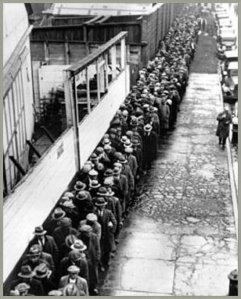
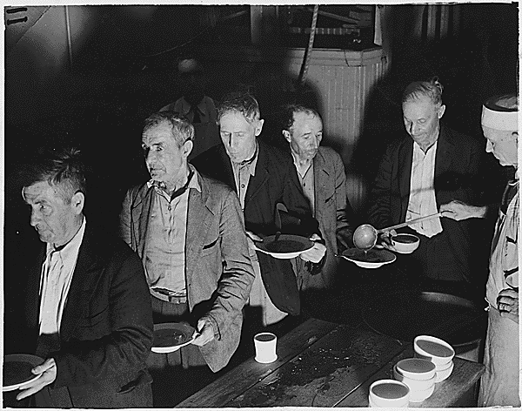

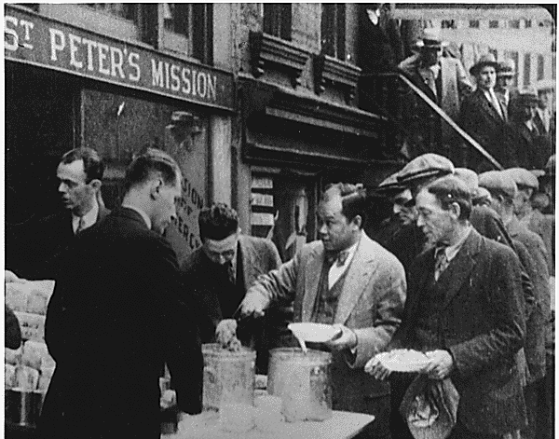
Soup Kitchens & Breadlines

Slide 23
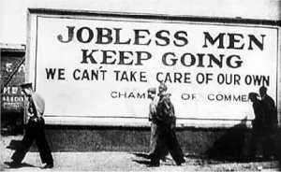
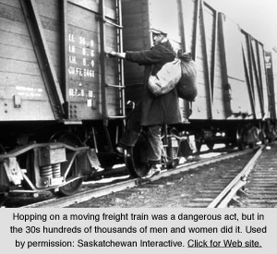
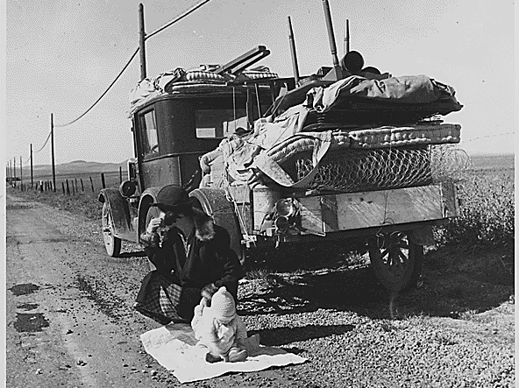

Slide 24
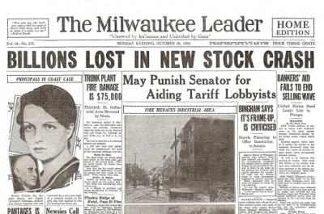
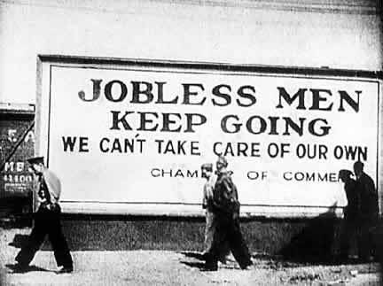
Consequences of the Crash
Within 1 year - 1,300 banks failed
  5,000 more within 3 years
9 million savings accounts vanish
85K businesses & factories closed
Unemployment (25%!)
Mortgage foreclosures
  400K farms lost
Collapse of foreign markets

Slide 25
Depression by Numbers
Dow Jones Industrial Average
  1929: 381.17
  1932: 41.22
  The average of stock prices dropped over 90%
Price Indices
  Consumer prices fell 25%
  Wholesale prices fell 32%
Unemployment
  1929: 3.2%
  1933: 24.9%
  Unemployment rates higher in specific regions, among different groups
    Toledo, OH: 90%
GDP
  1929: $103.6B
  1933: $56.4B
Bank Failures
  1929: 659 banks ($200,000,000)
  1930: 1,300 banks ($853,000,000)
  1931: 2,294 banks ($1,700,000,000)
Income
  National income fell $80B to $50B
  Salaries declined 40%
    Manufacturing wages down 60%
  Farmers’ income declined 55%
Industrial production
  Down 26% in 1930; 51% by 1932
Investments
  $10B in 1929; $1B in 1932
Fertility Rates
  1928: 93.8
  1933: 76.3

Slide 26
Text Analysis
A Black Man’s Perspective on the Great Depression

Slide 27
Hoover’s Plan:
Hoover favored neither laissez-faire nor govt. intervention in economy
  Preached doctrine of volunteerism
    Cooperative, socially responsible economic order to be achieved through voluntary action of capitalist leaders, not govt. coercion
Cooperation between private & public sector
  Govt. supports but does not control private organizations
Overestimated altruism of biz
Opposition to govt. econ. intervention will cause him trouble later

Slide 28
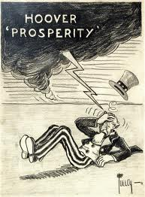
Hoover believed in “rugged individualism”
People should be free to succeed alone – limited govt. intervention
  Finding solutions outside of govt. builds character & self-govt.
When the Crash occurred, Hoover blamed it on lack of confidence
Characteristic of the Recession phase of biz cycle

Slide 29
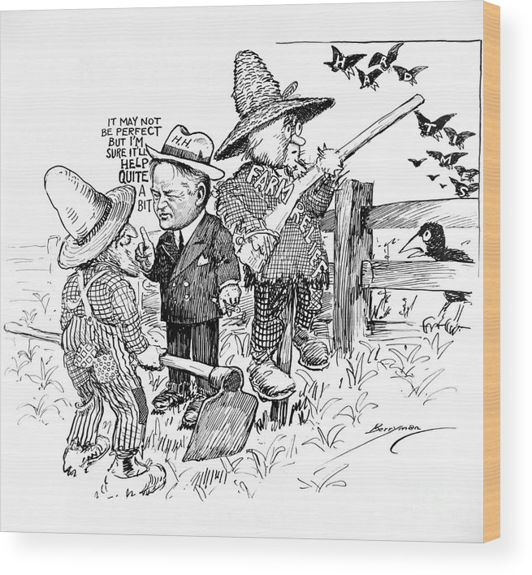
Like many in his day, Hoover believed in the business cycle
  The classical theory of the business cycle
The market is a self-regulating system governed by natural laws of supply and demand
  Beyond anyone’s control
4 phases to the cycle – each contains seeds of the next

Slide 30
Hoover and Voluntarism
President Hoover’s initial response was to reassure Americans that prosperity would return
Hoover rejected bold gov’t action & called for volunteerism among charities, local gov’t, & business
As the depression worsened, Hoover called for gov’t projects like the Reconstruction Finance Corps (RFC) which loaned money to failing businesses
“Rugged individualism”

Slide 31
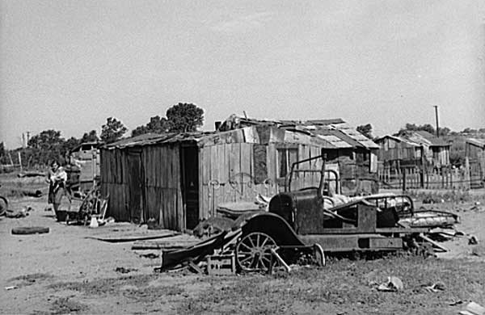
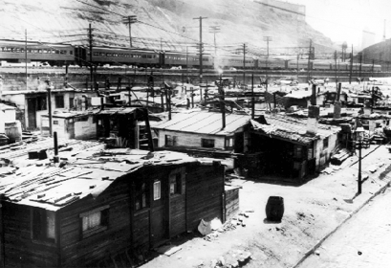
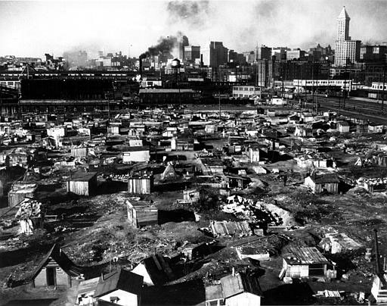
“Hoovervilles” & “Hoover Flags”

Slide 32
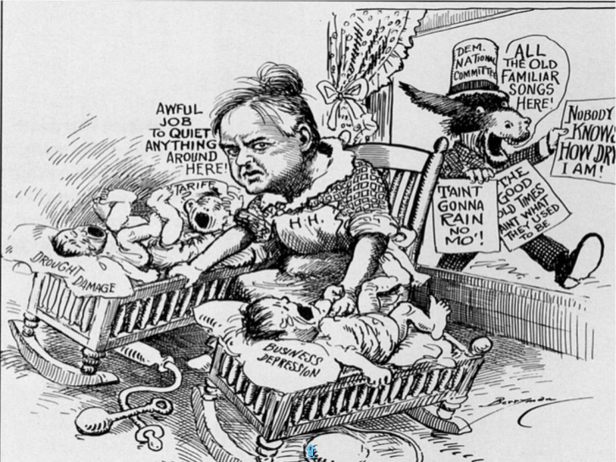

Slide 33
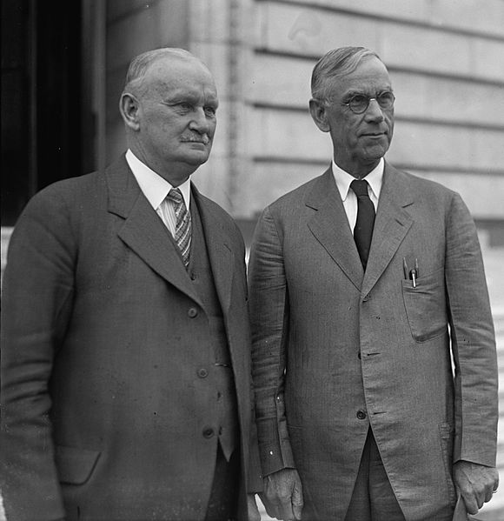
1930 – Hawley-Smoot Tariff
  (highest in U.S. history) passed to protect domestic industry
    On over 20,000 imported goods
  33 countries retaliated with tariffs
H-S Tariff was ruinous to struggling foreign economies

Slide 34
Hoover and Voluntarism
In 1932, Hoover’s presidency suffered two final blows:
  When 22,000 war veterans marched to the capital to demand their WW1 bonus checks early, Hoover ordered this Bonus Army to be forcibly removed
  The steady rise of bank failures led to a complete collapse of the U.S. banking system

Slide 35
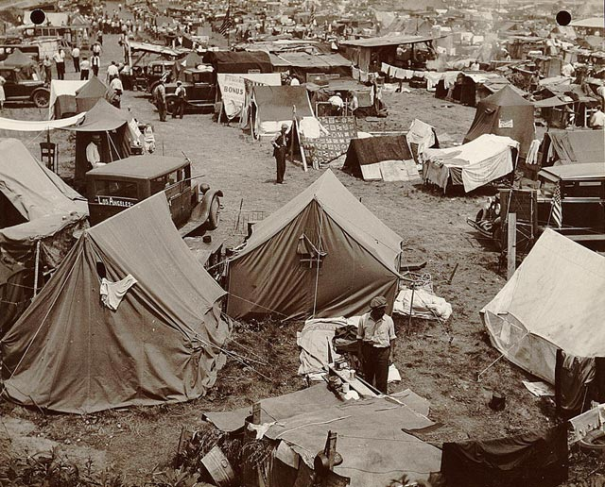
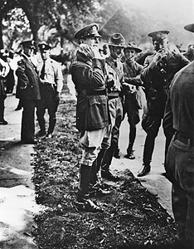
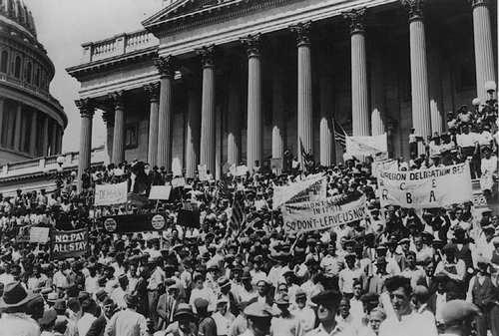
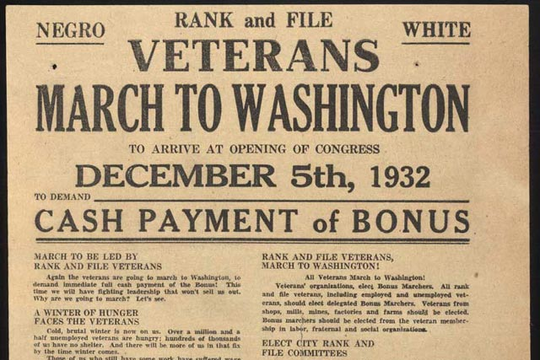
Bonus Army
Douglas MacArthur
Dwight Eisenhower

Slide 36
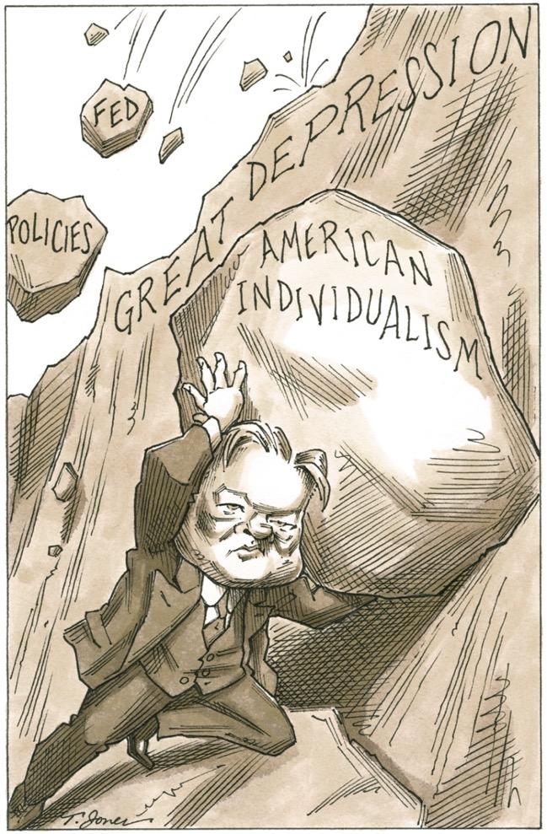

Slide 37
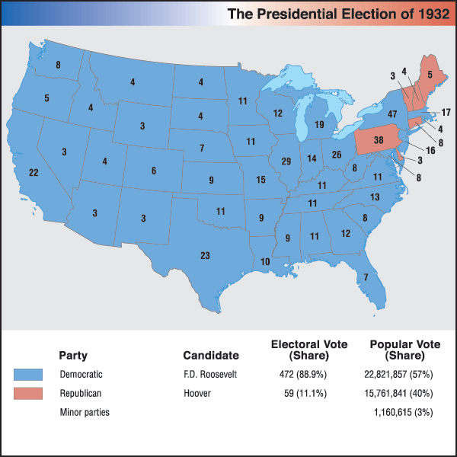
Election of 1932
Franklin Delano Roosevelt (FDR) (D)
  Campaign promise of a “new deal” and help for the “forgotten man”
  New Deal Coalition
Herbert Hoover (R)
A Realignment Election
  End of the Republican dominance of the Fourth Party System
  Begin of the Democrat dominance of the Fifth Party System

