Slide 1
Do Now
OPINION… What role SHOULD the government play in supporting Americans in times of struggle? Why?

Slide 2
7. FDR and the New Deal-The Creation of the Welfare State
Mr. Winchell
APUSH 19-20
Period 7

Slide 3
AP PROMPT
Evaluate the extent to which the New Deal demonstrate change in the role of government from 1932-1940.

Slide 4
The New Deal
Notes:
START PART 1 @14:26
ELECTION OF 1932 @9:56
STOP AT 5:00

Slide 5
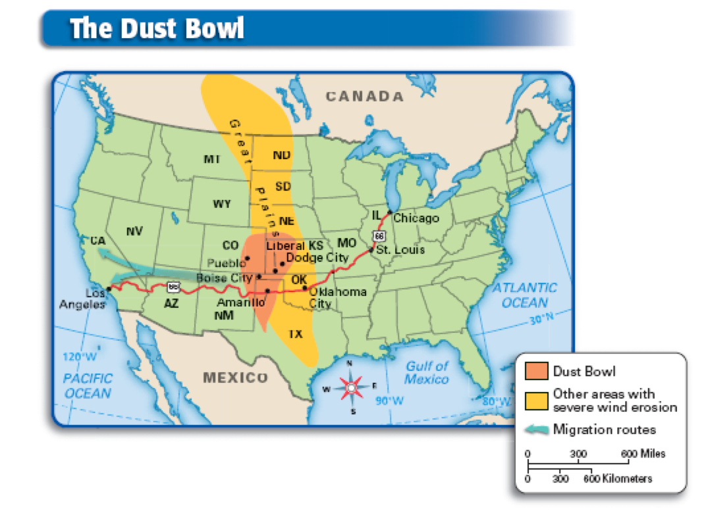
The Dust Bowl (1930-1936)
Causes
Overgrazing
Improper farming techniques
Increased cultivation
Drought in 1934
Effects
Dust storms
Black Sunday - April 14, 1935
300 million tons of topsoil blown across southern Plains region
Migration west
“Okies”
Mexican Repatriation

Slide 6
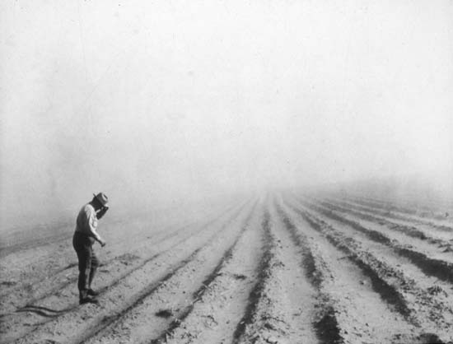
Dust Turns Day Into Night

Slide 7
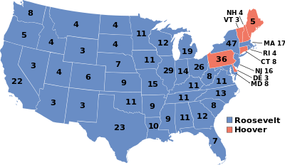
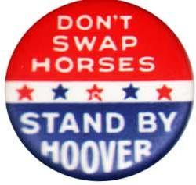
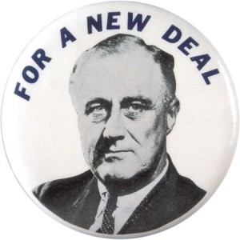
The Election of 1932
Republicans re-nominate Hoover
Democrat platform brief and vague
“Wet” and “govt. responsibility for human welfare”
Democrats nominate Franklin Roosevelt (FDR)
Captured nomination from Al Smith
He promised “Bold Action”
A “New Deal”
Notes:
Going into the election of 1932, the Republicans were saddled with the image of being responsible for the Depression
The Democrats seemed a shoe-in for the presidential race. They ran Franklin D. Roosevelt on a brief and purposefully vague platform. The only two issues cited were a commitment to repeal Prohibition and a principle of “continuous responsibility of government for human welfare”
The Republicans re-nominated Hoover.
He promised a public referendum on Prohibition and defended his policies for economic recovery.
He dismissed FDR as a demagogue(appealing to emotions and prejudice of populace)
FDR promised bold action and stressed a “New Deal” for the “forgotten man” without clearly indicating specific measures of his program.
He accused the Repubs. of favoring the special interests and emphasized that the Democratic party believed it to be the responsibility of govt. to promote the well being of the great masses.

Slide 8
Fifth Party System (1932-1968)
Democrats
New Deal Coalition
Catholics
Jews
Blacks
Progressive Intellectuals
Urban Machines
Populist Farmers
White Southerners
Labor Unions
Low-Income
Immigrants
Philosophy
Social liberalism/social democracy
Social justice
Keynesian economics
Dominated Congress and American public for the next 36 years
Republicans
Pro-business
Economic conservatives
Social conservatives
Northeast, parts of the Midwest

Slide 9
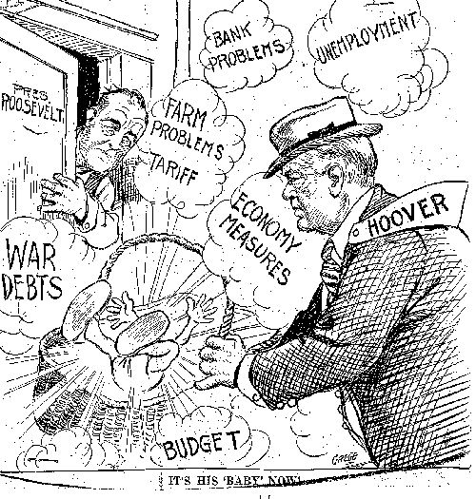

Slide 10
The New Deal: The Three R’s
Relief
Halt the effects of the Depression
Provide immediate relief to unemployed
Prime the pump and reduce unemployment
Recovery
Restore the economy to full employment
Restart consumer demand and investment
Reform
Target the causes of the Depression
Prevent any future economic catastrophes

Slide 11
The Hundred Days
When FDR took over in 1933, the U.S. economy was on the brink of collapse:
Unemployment was at 25%
38 states had total bank failure
FDR requested from Congress broad executive power to begin his “New Deal” program of economic relief, recovery & reform
FDR asked for “broad executive power that would be given to me if we were in fact invaded by a foreign foe.”

Slide 12
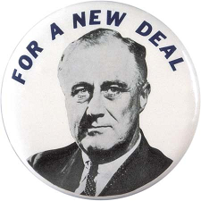
Federal government used posters, songs, advertisements, literature to promote and support FDR’s New Deal programs among the American public

Slide 13
The Hundred Days
In his 1st hundred days, FDR began his 1st New Deal (1934-35)
FDR’s 1st order of business was to restore confidence in banking:
Declared a 4-day bank holiday: closed or funded weak banks & opened new gov’t-aided banks
Glass-Steagall Act created the FDIC which guaranteed all bank deposits over $5,000
Banks were regulated (not nationalized); the economic system was reformed
(not drastically changed)
Now, the FDIC insures deposits up to $100,000
Emergency Banking Act of 1933
Notes:
The First Hundred Days
Americans voted for Franklin Delano Roosevelt in 1932 on the assumption that the Democrats would dole out more federal assistance than Hoover and the Republicans had. Indeed, immediately after taking the oath of office, FDR set out to provide relief, recovery, and reform in his bundle of programs known as the New Deal.
Roosevelt drew much of his inspiration for the New Deal from the writings of British economist John Maynard Keynes, who believed that a government’s deficit spending could prime the economic pump and jump-start the economy. With the support of a panicked Democratic Congress, Roosevelt created most of the “alphabet agencies” of the First New Deal within his landmark First Hundred Days in office.
The Banking Acts
On March 6, 1933, two days after becoming president, Roosevelt declared a five-day national bank holiday to close banks temporarily. During Hoover’s presidency, roughly 1,500 banks had closed each year, and FDR hoped that a short break would give the surviving banks time to reopen on more solid footing. Several days later, Congress passed the Emergency Banking Relief Act, which gave Roosevelt the power to regulate banking transactions and foreign exchange.
Several months later, Congress passed the Glass-Steagall Banking Reform Act to protect savings deposits. The act, in turn, created the Federal Deposit Insurance Corporation (FDIC), which insured an individual’s savings of up to $5,000 (today, it insures deposits of up to $100,000). The act also regulated lending policies and forbade banks from investing in the stock market. After the banking crisis was resolved, Roosevelt aired the first of his “fireside chats” to over 50 million radio listeners, encouraging Americans to redeposit their money in the newly opened banks.
The president quickly pushed ahead on other fronts. The Federal Emergency Relief Act pumped $500 million into state-run welfare programs. The Homeowners Loan Act provided the first federal mortgage financing and loan guarantees. By the end of Roosevelt's first term, the Homeowners Loan Act provided more than 1 million loans totaling $3 billion. The Glass-Steagall Act provided a federal guarantee of all bank deposits under $5,000, separated commercial and investment banking, and strengthened the Federal Reserve's ability to stabilize the economy.
In addition, Roosevelt took the nation off the gold standard, devalued the dollar, and ordered the Federal Reserve System to ease credit. Other important laws passed during the 100 days included the Agricultural Adjustment Act--the nation's first system of agricultural price and production supports; the National Industrial Recovery Act--the first major attempt to plan and regulate the economy; and the Tennessee Valley Authority Act--the first direct government involvement in energy production.

Slide 14
“Capitalism was saved in eight days”

Slide 15
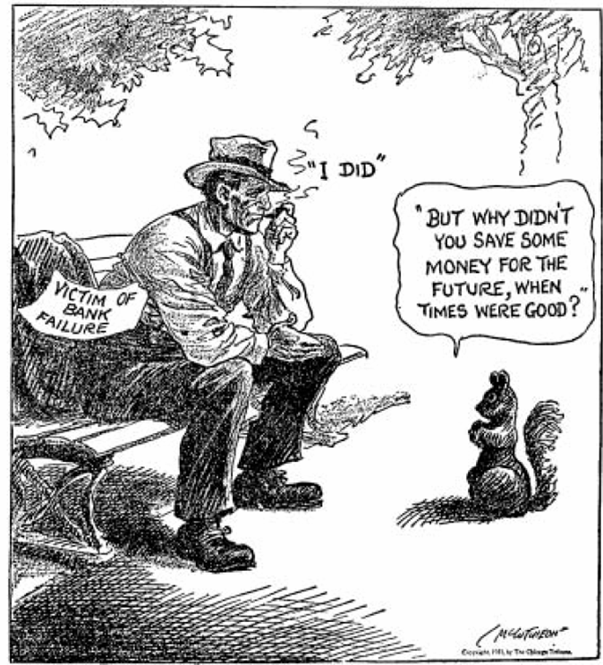

Slide 16
First 100 Days
The National Industrial Recovery Act (NIRA) was the 1st attempt at economic recovery:
Created the National Recovery Admin (NRA) set max hours & minimum wages for workers & stimulated industry by fixing prices & setting production limits
Created the Public Works Admin (PWA) to build public roads, bridges, & buildings
Additional attempts to stimulate the economy include taking the U.S. off the gold standard & ending prohibition (21st amendment)
Notes:
The National Industrial Recovery Act
The 1933 National Industrial Recovery Act was the federal government’s first attempt to revive the economy as a whole. The bill created the National Recovery Administration (NRA) to stimulate industrial production and improve competition by drafting corporate codes of conduct. The NRA also sought to limit production of consumer goods to drive up prices. Furthermore, the act helped set up the Public Works Administration (PWA) to construct public roads, bridges, and buildings. In accordance with Keynesian economic theories, Roosevelt believed that improving the public infrastructure would put more money into the economy.

Slide 17
First 100 Days
FERA-Relief for the poor. $500 million for soup kitchens and people’s needs
CCC-Put men to work on conservation
AAA-Control farm prices by setting quotas to reduce production
NIRA-Government money to build infrastructure
TVA-Build dams on the Tennessee River to conserve the valley and sell electricity

Slide 18
The Hundred Days
Some of FDR’s First New Deal focused on long-term reforms
Tennessee Valley Authority (TVA) created dams in 7 states to provide cheap hydroelectric power & create jobs
Glass Steagall Act-guaranteed bank deposits and regulated investments by banks
Securities & Exchange Commission (SEC) to regulate the stock market & prevent another stock market crash
Notes:
The Tennessee Valley Authority
Congress also created the Tennessee Valley Authority (TVA), whose goal was to modernize and reduce unemployment in the Tennessee River valley, one of the poorest and hardest-hit regions in the country. The agency hired local workers to construct a series of dams and hydroelectric power plants, which brought cheap electricity to thousands of people. The public corporation also created affordable employee housing, manufactured cheap fertilizer, and drained thousands of acres for farming. The TVA, like the AAA, was highly controversial. Many conservatives claimed that government production of electricity was a mild form of socialism and that it disrupted market prices too much. Competing electric companies also attacked the TVA for selling cheaper electricity and lowering their profits. Still, the TVA had such a profound impact on the economy and quality of life in the Tennessee River valley region that the federal government initiated similar projects throughout the West and South. Within a decade, many major U.S. rivers were set up to produce hydroelectric power that provided both electricity and jobs.
Restructuring American Finance
Finally, Roosevelt also lobbied Congress to establish new regulations on the financial sector of the economy. After taking office, he took the country off the gold standard, which allowed citizens and foreign countries to exchange paper money for gold. To prevent people from hoarding the precious metal, the president also ordered all private gold stocks to be turned over to the U.S. Treasury in exchange for paper dollars. Congress also created the Securities and Exchange Commission (SEC) to regulate trading on Wall Street and curb the out-of-control speculation that had led to the Crash of 1929.

Slide 19
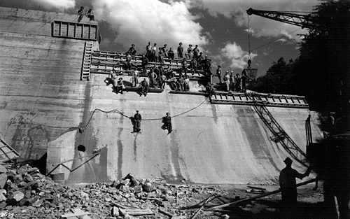
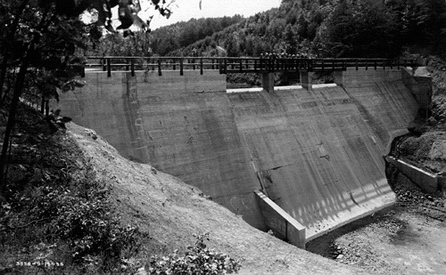
The Tennessee Valley Authority
Critics claimed the TVA was too socialistic; Competing electric companies attacked the TVA for selling cheaper electricity & eliminating competition

Slide 20
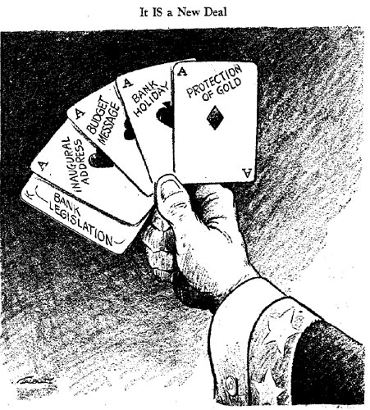
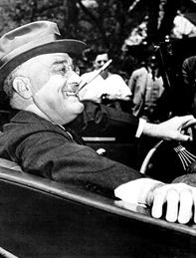
The Hundred Days
“The whole country is with him, just so he does something. If he burned down the capitol we would cheer and say ‘well, we at least got a fire started anyhow.’”
—Will Rogers
“Even the hand of an iron dictator is in preference to a paralytic stroke”
—Alf Landon (Repub nominee in 1936)
Notes:
Alf Landon ran against FDR as a Republican candidate in 1936

Slide 21
Revenue Acts
Revenue Act of 1932 (Hoover)
Increased corporate tax rates and income tax rates
Top rate of 25% to 63%
Corporate tax rate from 12% to 13.75%
Estate tax
Revenue Act of 1934
Increased rates on higher incomes; top rate at 63%
Revenue Act of 1935
Wealth Tax / “Soak the Rich” Tax
Raised top income rate to 75%
Corporate tax rate up to 15%
Revenue Act of 1936
Raised top income rate to 79%
Levied tax on corporate undistributed profits
Purpose
Generate revenue for spending programs
Alleviate tax burden on middle class
Criticism
Wealthy and corporations overburdened
Limited incentives for work, investment, entrepreneurship

Slide 22
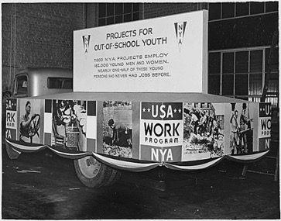
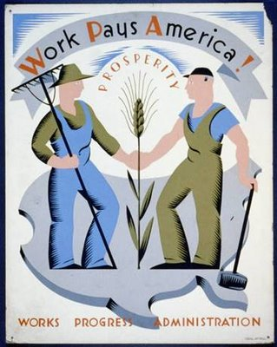
The Second New Deal Works Progress Administration (WPA)
Congress appropriated $5 billion
Purpose to employ unemployed people until the economy recovered
Established a national work relief program through large-scale public works projects
Employed more than 8 million
850 airports; 651,000 miles of road; 110,000 libraries, schools, and hospitals
National Youth Administration (NYA)
Provide work-relief and education for Americans 16-25 years old

Slide 23
The Second New Deal Social Security Act
Created a fund to provide for old-age pensions, disabilities, and unemployment compensation
Funded by a payroll tax on workers and employers
Administered by Social Security Administration through state-federal cooperation

Slide 24
Labor Legislation
Wagner Act (1935) created the Nat’l Labor Relations Board to oversee labor-management affairs
Mandated management to negotiate with unions regarding pay, hours, conditions if majority of workers vote for a union
Fair Labor Standards Act (1938) created 1st minimum wage & maximum hour laws (aimed at helping non-unionized workers)
The “Magna Carta” for labor
40 hours per week
40¢ per hour

Slide 25
Challenges to FDR
By 1935, signs of discontent with the New Deal were evidenced as 3 critics gained national attention:
Father Charles Coughlin called for nationalizing U.S. banks; used anti-Semitism in radio sermons
Francis Townsend appealed to the elderly with a $200/mo payment plan to anyone over 60 in order to stimulate the economy
Louisiana Sen. Huey Long-Share the Wealth
Tax the rich to give away $2,500 to each American
American Liberty League
Industrialists opposed to dictatorial policies

Slide 26
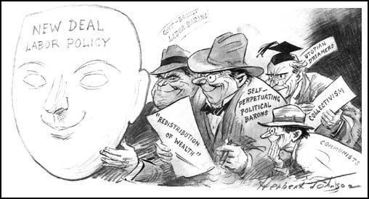

Slide 27
Election of 1936
Franklin D. Roosevelt (D)
Alfred Landon (R)

Slide 28
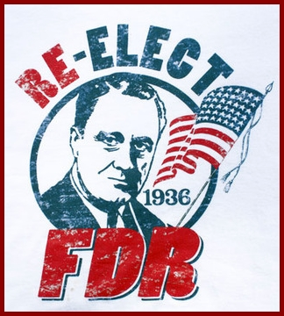
1936 Election
FDR v Alfred Landon
Both sides avoided real issues
Republicans attacked New Deal as socialistic
But have no alternative plan
FDR win 46 out of 48 states (523 to 8) - a mandate!
Notes:
1936 campaign marked by a vigorous defense and a bitter denunciation of the New Deal.
Dems renominated FDR without opposition
Repubs had little confidence of victory to begin with, regardless of their candidate. The party chose the centrist Governor of Kansas, Alfred M. Landon
Neither candidate debated the core issues that separated their parties
Merits of direct federal aid
Centralization of power in national govt.
Delegation of unusual authority to the president
Deficit spending and the unbalance budget
Dems simply defended their record
Repubs attacked the ND as socialistic and reckless experimentation but offered no alternative plan of their own.
Their campaign was sloppy and hesitant while the Democrats ran a confident and focused campaign.
Landon was dull while FDR was dynamic.
FDR easily won a second term with 46 of 48 states.
The landslide victory gave FDR a mandate to continue the New Deal

