Slide 1
Jackson’s 2nd Term and the 2nd Two Party System
Mr. Winchell
APUSH
Period 4

Slide 2
Review
Jackson on Indian Removal
Jackson on States’ Rights
  Jackson on Nullification v. Union
Jackson v. Clay

Slide 3
The Bank War
In 1828, the national gov’t coined only a limited supply of hard money & printed no paper money at all
These state-chartered banks had tendency to issue more loans than they could support with their “hard currency” reserves
The major political issue of Jackson’s reign was his killing of the Second Bank of the U.S.:
  The BUS held ~$10 million in gov’t money & made loans to people & businesses
  The BUS helped control America’s 329 private, state-chartered banks by forcing them to be smart when issuing loans
All of America’s paper bank notes which financed land purchases, businesses, & economic growth came from these private, state-chartered banks
The 2nd BUS had 30 branches & was biggest bank in America
Notes:
The banking system at the time Jackson assumed the presidency was completely different than it is today. At that time, the federal government coined only a limited supply of hard money and printed no paper money at all. The principal source of circulating currency, paper bank notes, was private commercial banks (of which there were 329 in 1829), chartered by the various states. These private, state-chartered banks supplied the credit necessary to finance land purchases, business operations, and economic growth. The notes they issued were promises to pay in gold or silver, but they were backed by a limited amount of precious metal and they fluctuated greatly in value. In 1816, the federal government had chartered the Second Bank of the United States partly in an effort to control the notes issued by state banks. By demanding payment in gold or silver, the national bank could discipline over-speculative private banks. But the very idea of a national bank was unpopular for various reasons. Many people blamed it for causing the Panic of 1819. Others resented its political influence. For example, Senator Daniel Webster was both the bank’s chief lobbyist and a director of the bank’s Boston branch. Wage earners and small-business owners blamed it for economic fluctuations and loan restrictions. Private banks resented its privileged position in the banking industry.

Slide 4
The Bank War
But the BUS was controversial:
  Many blamed it for a depression in 1819 by overextending credit & too quickly calling in loans
  Many people still viewed the BUS as an unconstitutional monopoly that gave too much power to the upper class
  BUS manager Nicholas Biddle was effective, but seen as arrogant, vain, & “aristocratic”

Slide 5
The Bank Veto
Since entering office in 1828, Jackson disliked the BUS
Clay, Webster, & Biddle worried about the future of the BUS whose expiration was up in 1836
Congress re-chartered the BUS in 1832 but Jackson vetoed it:
  Claimed it unconstitutional, a violation of states’ rights, & “dangerous to people’s liberties”
Congress was unable to override the veto
Jackson’s veto did not immediately kill the BUS…its charter would not end for 4 years
Jackson frequently attacked the bank as an agency through which speculators & monopolists cheated honest farmers
Notes:
In 1832, Henry Clay, Daniel Webster, and other Jackson opponents in Congress, seeking an issue for that year’s presidential election, passed a bill rechartering the Second Bank of the United States. The bank’s charter was not due to expire until 1836, but Clay and Webster wanted to force Jackson to take a clear pro-bank or anti-bank position. Jackson had frequently attacked the bank as an agency through which speculators, monopolists, and other seekers after economic privilege cheated honest farmers and mechanics. Now, his adversaries wanted to force him either to sign the bill for recharter, alienating voters hostile to the bank, or veto it, antagonizing conservative voters who favored a sound banking system.
Jackson vetoed the bill in a forceful message that condemned the bank as a privileged “monopoly” created to make “rich men...richer by act of Congress.” The bank, he declared, was “unauthorized by the Constitution, subversive of the rights of the States, and dangerous to the liberties of the people.” In the presidential campaign of 1832, Henry Clay tried to make an issue of Jackson’s bank veto, but Jackson swept to an easy second-term victory, defeating Clay by 219 electoral votes to 49.

Slide 6
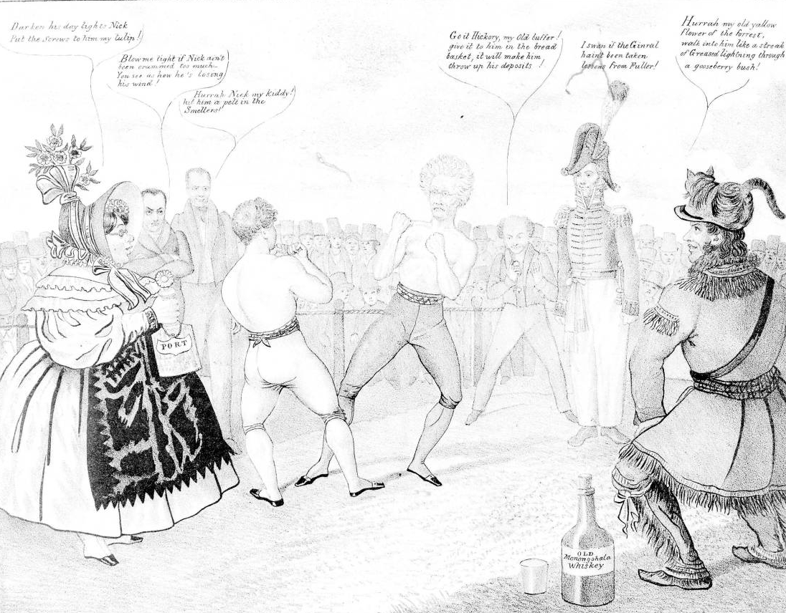
National Bank Crisis
Upper classes
Military Veterans
Andrew Jackson
Lower classes
Daniel Webster
Nicholas Biddle
Martin Van Buren

Slide 7
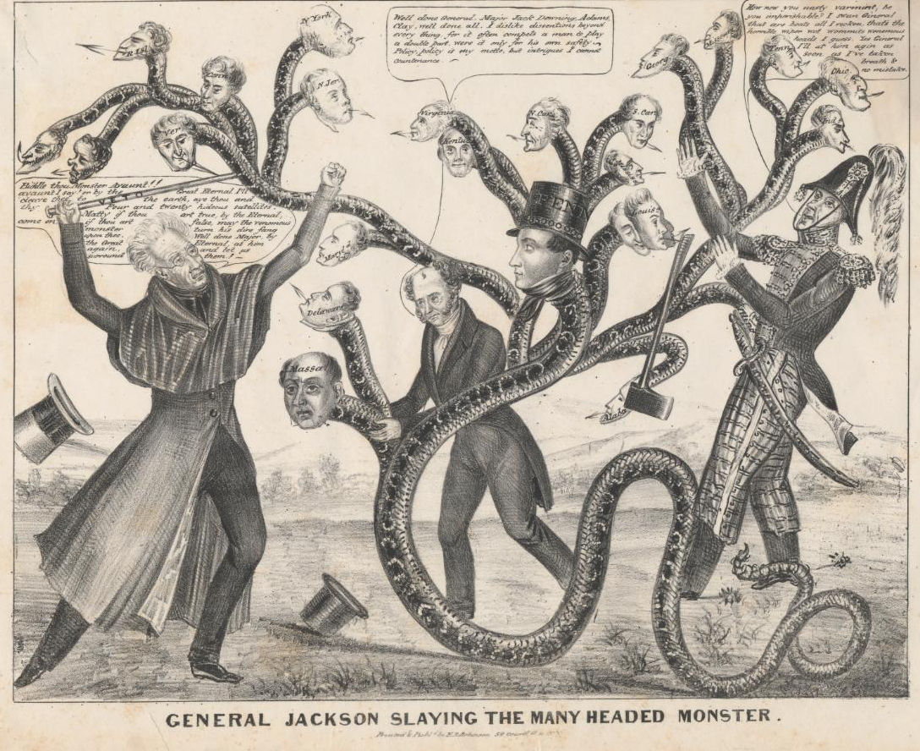


Slide 8
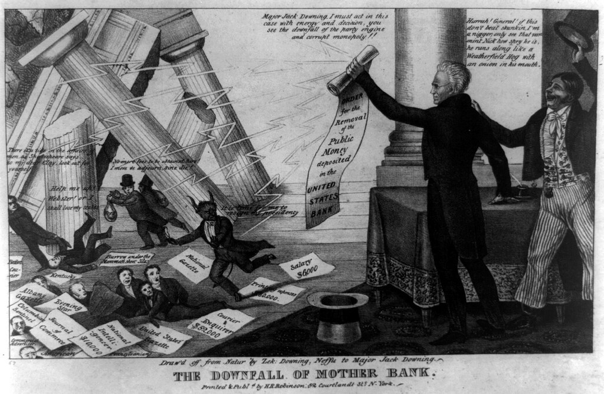

Slide 9
The Election of 1832
Jackson’s veto surprised the financial community but was very popular in the South & West
Jackson made the BUS a key issue in the election of 1832:
  Jackson defeated Henry Clay
  Jackson viewed his win as a mandate by the people to continue his war against the BUS

Slide 10
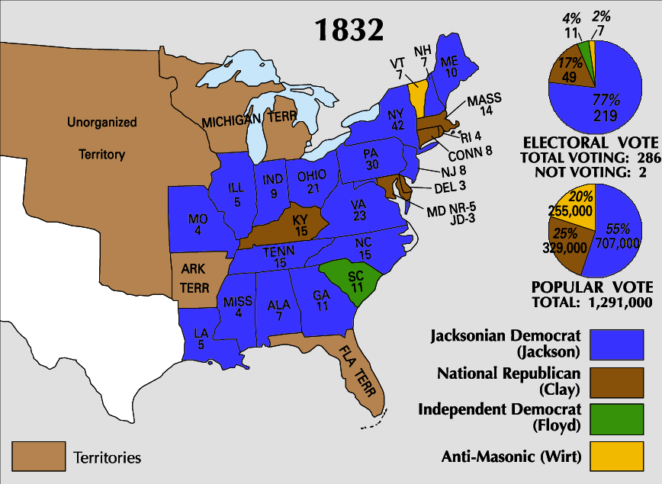

Slide 11
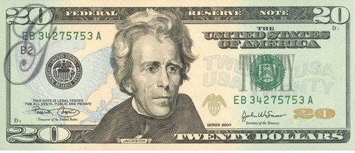
The Bank War
Jackson took his election win as a MANDATE by the American people and attacked the BUS by withdrawing all federal money & moved the funds to 23 state banks
Jackson’s opponents argued that he overstepped his authority:
  Unpopular in Jackson’s cabinet
  Some who supported his veto of the re-charter now questioned whether Jackson had gone too far & overstepped his powers
Favorable state banks were called “pet” or “wildcat” banks
Irony?
This move effectively ended Henry Clay’s American System
Notes:
Jackson interpreted his reelection as a mandate to undermine the bank still further. In September 1833, he ordered his Treasury secretary to divert federal revenues from the Bank of the United States to selected state banks, which came to be known as “pet” banks. The secretary of the Treasury and his assistant resigned rather than carry out the president’s order. It was only after Jackson appointed a second new secretary that his order was implemented. Jackson’s decision to divert federal deposits from the national bank prompted his adversaries in the Senate to formally censure the president’s actions as arbitrary and unconstitutional. The bank’s president, Nicholas Biddle, responded to Jackson’s actions by reducing loans and calling in debts. “This worthy President,” said Biddle, “thinks that because he has scalped Indians and imprisoned Judges he is to have his way with the Bank. He is mistaken.” Jackson retorted: “The Bank...is trying to kill me, but I will kill it.”

Slide 12
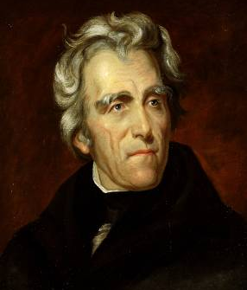
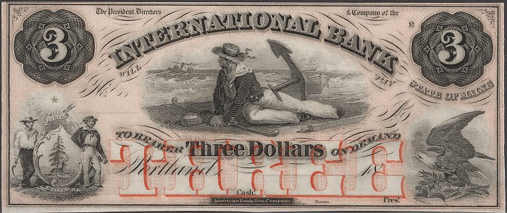
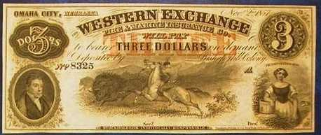
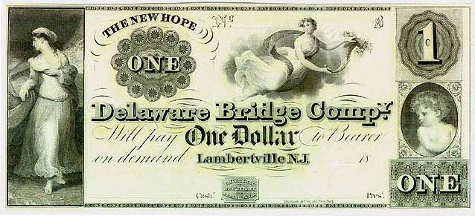
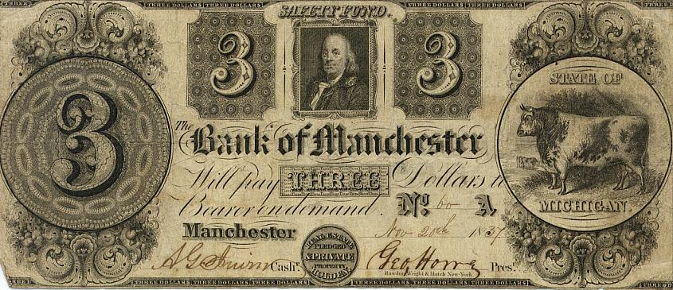
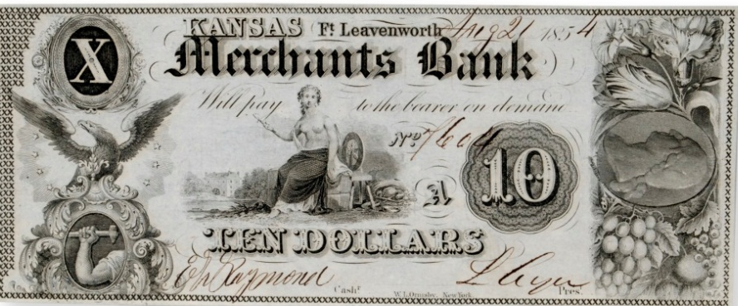
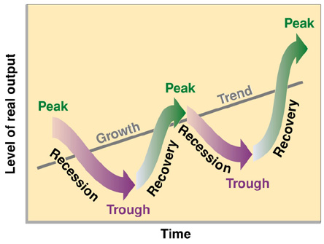
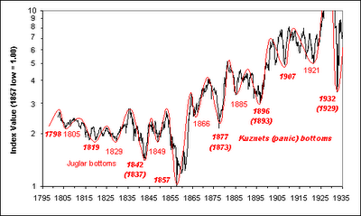
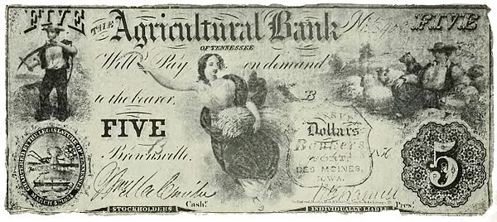
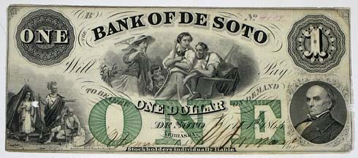
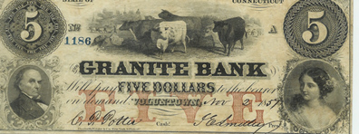
In 1833, Jackson ordered all federal money to be removed from the BUS and put the funds in 23 “pet” state banks
This action killed the BUS
Without the BUS, banking went unregulated from 1833 to 1913 and the economy entered a number of “panics” (depressions)

Slide 13
The Emergence of the Whigs
In 1834, an anti-Jackson coalition formed a new party, the Whigs:
  Supported by ex-Federalists, “Clay Republicans,” commercial farmers in the West & South, industrialists in the North
  Supported a strong national gov’t & economic regulation
The Whigs gained support during the Panic of 1837 & the recession
Were strongly opposed to “King Andrew”
Notes:
Although it took a number of years for Jackson’s opponents to coalesce into an effective national political organization, by the mid-1830s the Whig party, as the opposition came to be known, was able to battle the Democratic party on almost equal terms throughout the country.
The Whig party was formed in 1834 as a coalition of National Republicans, Anti-Masons, and disgruntled Democrats, who were united by their hatred of “King Andrew” Jackson and his “usurpations” of congressional and judicial authority, came together in 1834 to form the Whig party. The party took its name from the seventeenth-century British Whig group that had defended English liberties against the usurpations of pro-Catholic Stuart Kings.
Whigs tended to be educators and professionals; manufacturers; business-oriented farmers; British and German Protestant immigrants; upwardly aspiring manual laborers; free blacks; and active members of Presbyterian, Unitarian, and Congregational churches.
The Whig coalition included supporters of Henry Clay’s American System, states’ righters, religious groups alienated by Jackson’s Indian removal policies, and bankers and businesspeople frightened by the Democrats’ anti-monopoly and anti-bank rhetoric.
Whereas the Democrats stressed class conflict, Whigs emphasized the harmony of interests between labor and capital, the need for humanitarian reform, and leadership by men of talent. The Whigs also idealized the “self-made man,” who starts “from an humble origin, and from small beginnings rise[s] gradually in the world, as a result of merit and industry.” Finally, the Whigs viewed technology and factory enterprise as forces for increasing national wealth and improving living conditions.

Slide 14
The Second Two Party System
1
1790-1816 | Federalists | Republicans [Jeffersonian or Democratic]
1816-1824 | “Republicans”
1828-1833
1833-1854
National Republicans
Democratic Republicans
2
“Whigs”
“Democrats”

Slide 15
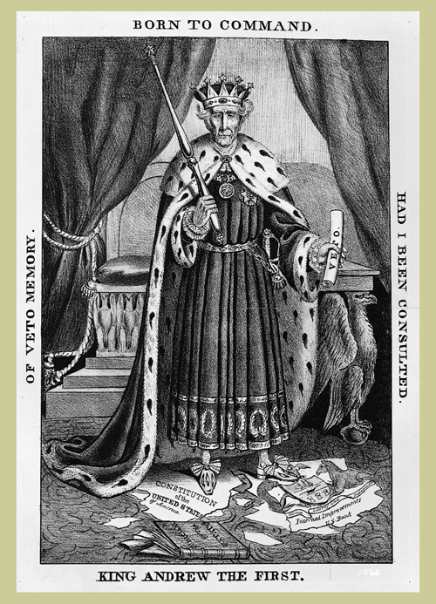

Slide 16
Killing the Bank
Jackson issued the Specie Circular in 1836 to move U.S. away from paper money by accepting only gold or silver (specie) for land sales
The economy sank & Panic of 1837 led to a 6-year recession due to:
  Price inflation & the inconsistent extension of credit by “pet” banks
  Drop in worldwide cotton prices
  This decrease in spending power led many industries/manufacturers to fail as well, leading to a nationwide financial crisis
…and Jackson’s successor, Martin Van Buren, will have to deal with
Notes:
Jackson’s decision to divert funds drew strong support from many conservative businesspeople who believed that the bank’s destruction would increase the availability of credit and open up new business opportunities. Jackson, however, hated all banks, and believed that the only sound currencies were gold and silver. Having crippled the Bank of the United States, he promptly launched a crusade to replace all bank notes with hard money. Denouncing “the power which the moneyed interest derives from a paper currency,” the president prohibited banks that received federal deposits from issuing bills valued at less than $5. Then, in the Specie Circular of 1836, Jackson prohibited payment for public lands in anything but gold or silver. That same year, in another anti-banking measure, Congress voted to deprive pet banks of federal deposits. Instead, nearly $35 million in surplus funds was distributed to the states to help finance internal improvements.
To Jackson’s supporters, the presidential veto of the bank bill was a principled assault on a bastion of wealth and special privilege. His efforts to curtail the circulation of bank notes was an effort to rid the country of a tool used by commercial interests to exploit farmers and working men and women. To his critics, the veto was an act of economic ignorance that destroyed a valuable institution that promoted monetary stability, eased the long-distance transfer of funds, provided a reserve of capital on which other banks drew, and helped regulate the bank notes issued by private banks. Jackson’s effort to limit the circulation of bank notes was a misguided act of a “backward-looking” president, who failed to understand the role of a banking system in a modern economy.
The effect of Jackson’s banking policies remains a subject of debate. Initially, land sales, canal construction, cotton production, and manufacturing boomed following Jackson’s decision to divert federal funds from the bank. At the same time, however, state debts rose sharply and inflation increased dramatically. Prices climbed 28 percent in just three years. Then in 1837, just after the election of Jackson’s successor Democrat Martin Van Buren, a deep financial depression struck the nation. Cotton prices fell by half. In New York City, 50,000 people were thrown out of work and 200,000 lacked adequate means of support. Hungry mobs broke into the city’s flour warehouse. From across the country came “rumor after rumor of riot, insurrection, and tumult.” Not until the mid-1840s would the country fully pull out of the depression.
Who was to blame for the Panic of 1837? One school of thought holds Jackson responsible, arguing that his banking policies removed a vital check on the activities of state-chartered banks. Freed from the regulation of the second Bank of the United States, private banks rapidly expanded the volume of bank notes in circulation, contributing to the rapid increase in inflation. Jackson’s Specie Circular of 1836, which sought to curb inflation by requiring that public land payments be made in hard currency, forced many Americans to exchange paper bills for gold and silver. Many private banks lacked sufficient reserves of hard currency and were forced to close their doors, triggering a financial crisis.

Slide 17
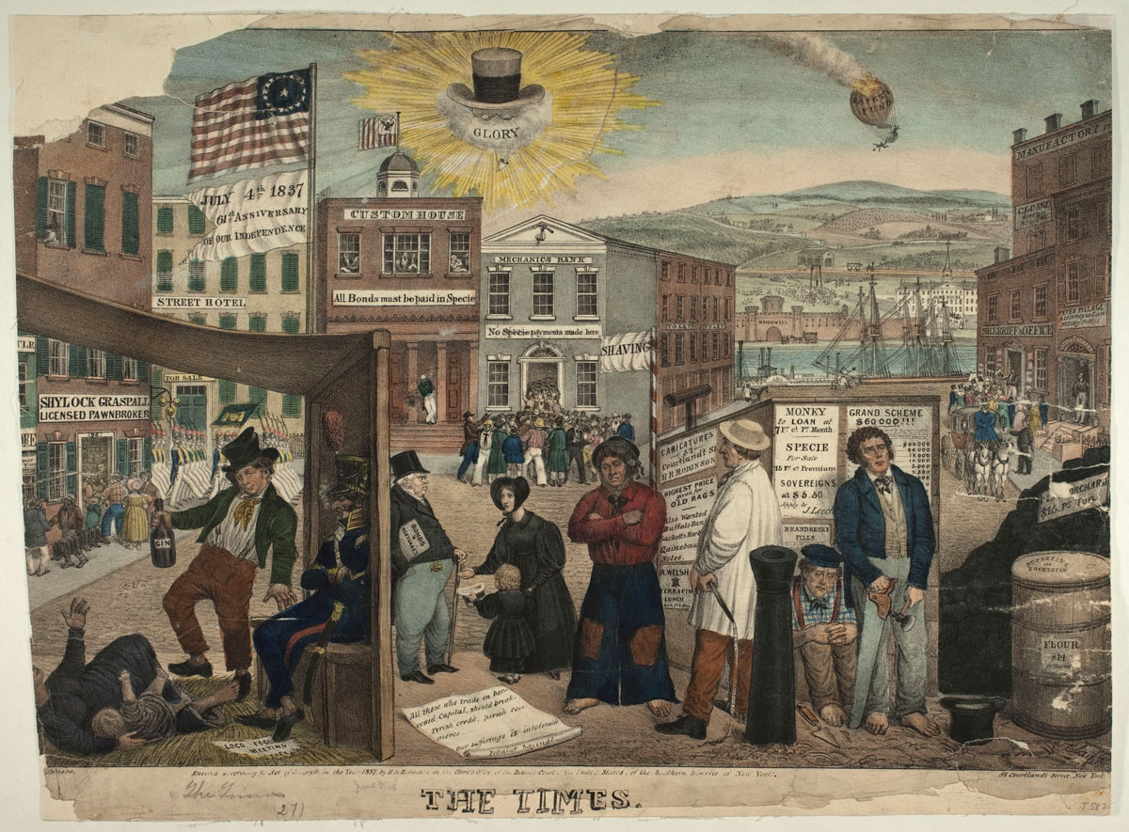
Notes:
A commentary on the depressed state of the American economy, particularly in New York, during the financial panic of 1837. Again, the blame is laid on the treasury policies of Andrew Jackson, whose hat, spectacles, and clay pipe with the word "Glory" appear in the sky overhead. Clay illustrates some of the effects of the depression in a fanciful street scene, with emphasis on the plight of the working class. A panorama of offices, rooming houses, and shops reflects the hard times. The Customs House, carrying a sign "All Bonds must be paid in Specie," is idle. In contrast, the Mechanics Bank next door, which displays a sign "No specie payments made here," is mobbed by frantic customers. Principal figures are (from left to right): a mother with infant (sprawled on a straw mat), an intoxicated Bowery tough, a militiaman (seated, smoking), a banker or landlord encountering a begging widow with child, a barefoot sailor, a driver or husbandman, a Scotch mason (seated on the ground), and a carpenter. These are in contrast to the prosperous attorney "Peter Pillage," who is collected by an elegant carriage at the far right. In the background are a river, Bridewell debtors prison, and an almshouse. A punctured balloon marked "Safety Fund" falls from the sky. The print was issued in July 1837. A flag flying on the left has the sarcastic words, "July 4th 1837 61st Anniversary of our Independence."

Slide 18
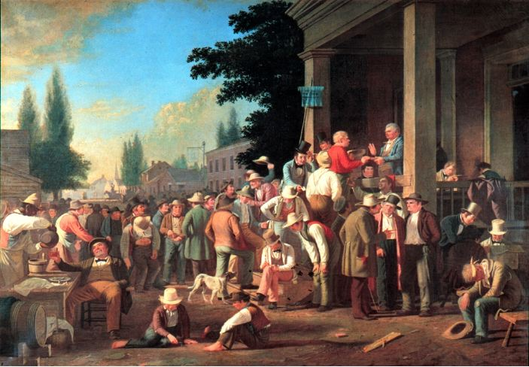
Jacksonian Democracy
The “Common Man”
Universal male suffrage
Strict constructionism
Laissez-faire economics
Democratization of nominations for elected office
  Party caucuses to national conventions
Increase in local and state elected offices
Spoils system
Manifest Destiny
Industrial Revolution
Market Revolution
Transportation Revolution
“County Election”
George Caleb Bingham
1852

Slide 19
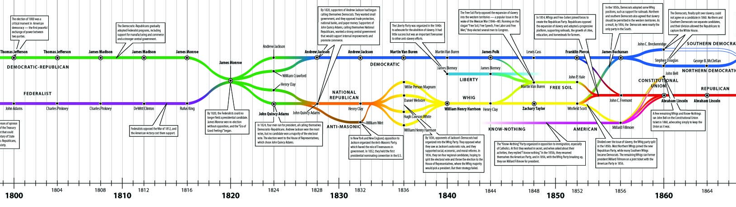
But, during his eight years in office, Andrew Jackson greatly expanded presidential power
Opposition to Jackson led to the formation of the Whig Party and the return of the two-party system

Slide 20
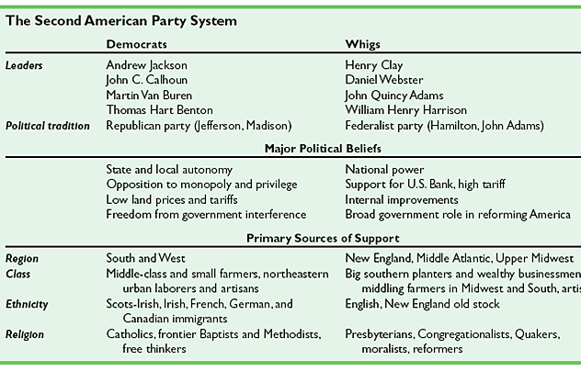
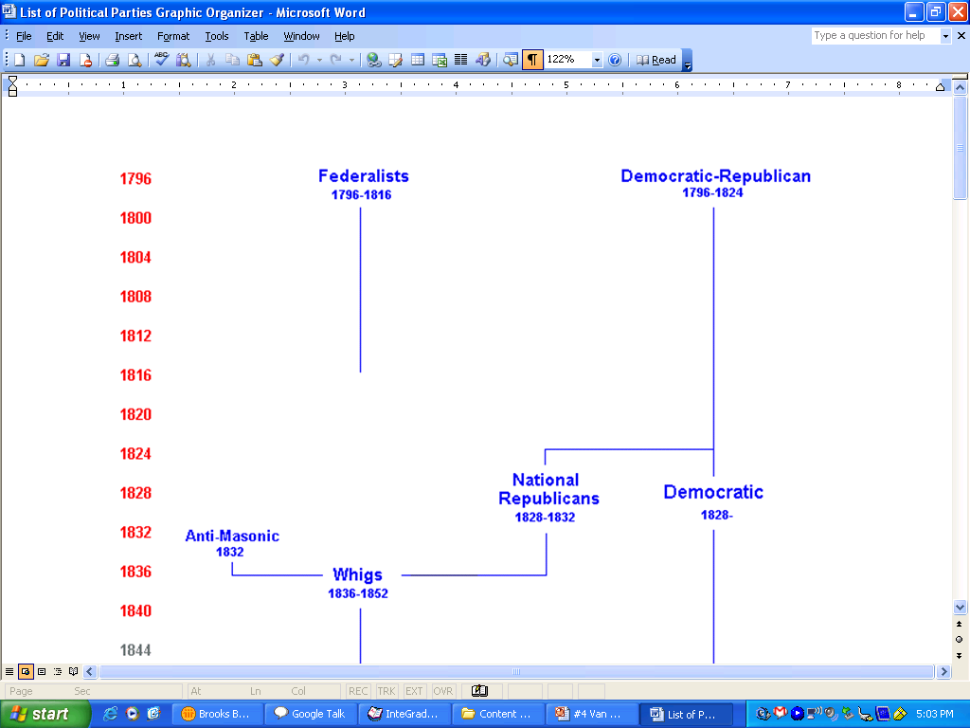

Slide 21
The (Jacksonian) Democrats
Were very similar to the Jeffersonians
Favored limited government
  Wanted equal political and economic opportunities for all (that is, white males)
  Opposed elitist, big government policies such as the National Bank and high tariffs that protected Northern manufacturers (anything seen as supporting the wealthy)
Most strong in the South and the West, also in the working classes of the North

Slide 22
The Whigs
Were very similar to the Federalists
Pushed for policies that would lead to a powerful
and active federal government
  Supported the policies of Clay’s American System
  Opposed anything associated with “immigrants”
    Crime, immoral acts (drinking, gambling), radical government that empowered the lower classes
Were strongest in the New England region and in the upper classes of all regions, also with pious Protestants

Slide 23
Martin Van Buren
1837-1841

Slide 24
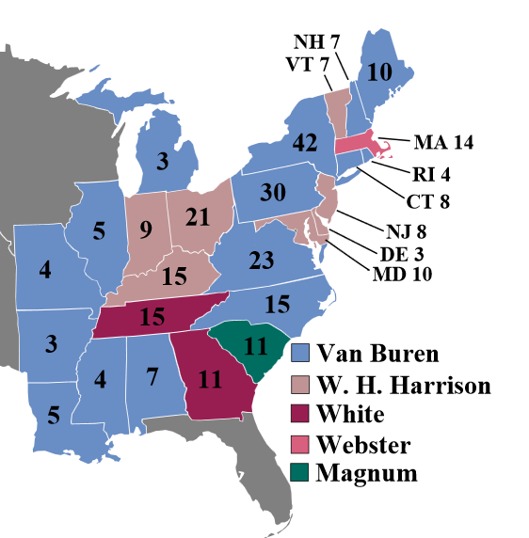
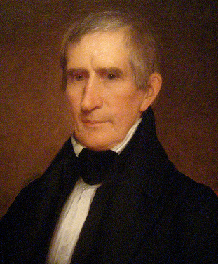
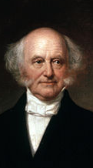
Election of 1836
William H. Harrison
Whig
Martin Van Buren
Democrat

Slide 25
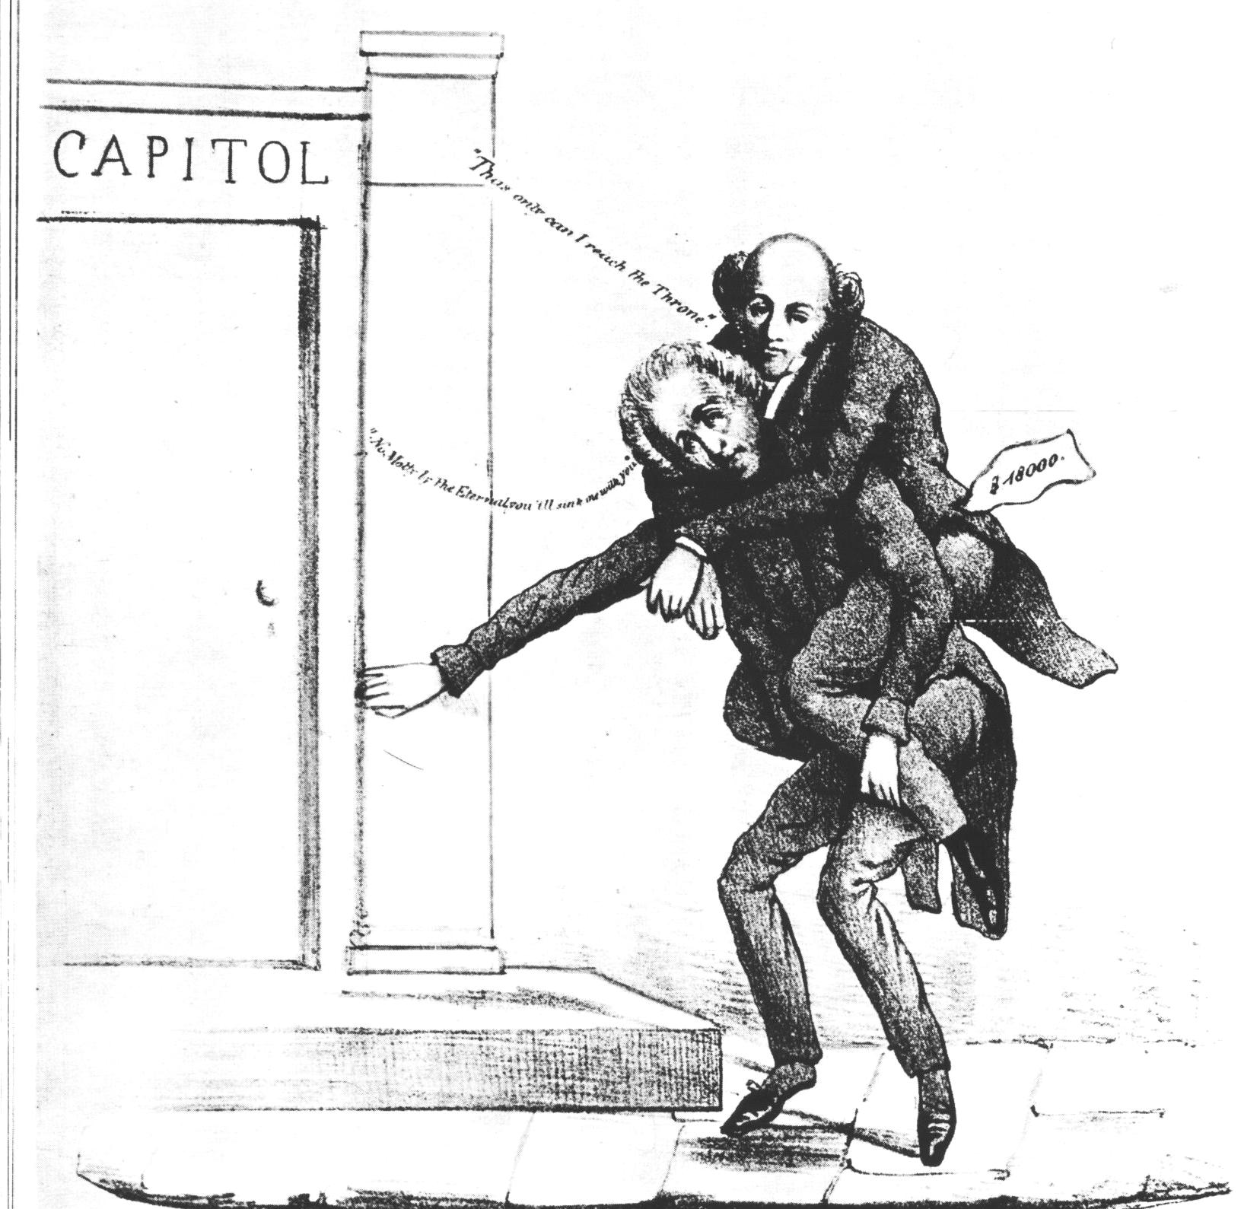
Jackson Carries Van Buren

Slide 26
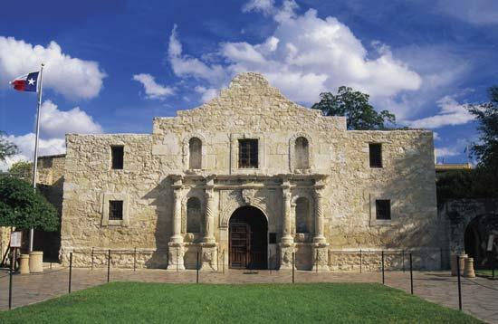
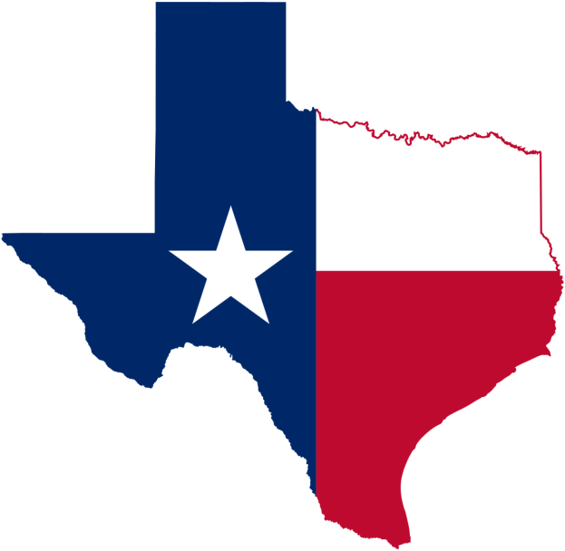
Texas War for Independence
1836-1837
“Remember the Alamo”
Controversies
  U.S.-Mexico relations
  Expansion of slavery into west
Van Buren opposed annexation
  Most Democrats supported annexation

Slide 27
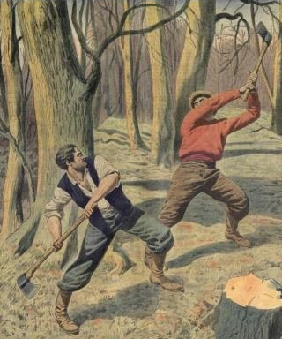
U.S.-Canadian Border Conflict
Aroostook (Pork and Beans) War, 1838-1839
  “lumberjack war”
Webster-Ashburton Treaty, 1842
  Settled U.S.-Canadian border

Slide 28
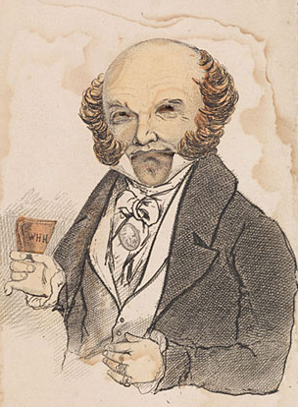
“Martin Van Ruin”
Unpopular president
  Economic recession
  Border conflicts
  Angered Democrats by opposing Texas annexation
  Weak leadership compared to Jackson

Slide 29
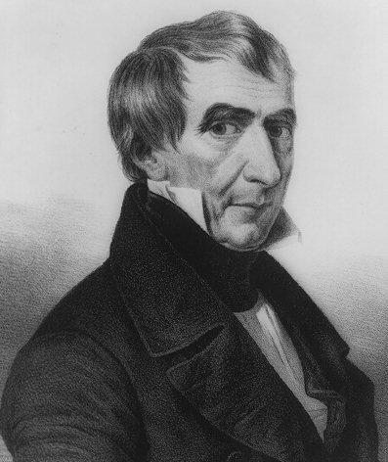
Election of 1840
Elitist Whigs Regroup
Tippecanoe and Tyler Too!
The “Log Cabin” Campaign
Whigs beat the Democrats at their own game.
William Henry
Harrison

Slide 30
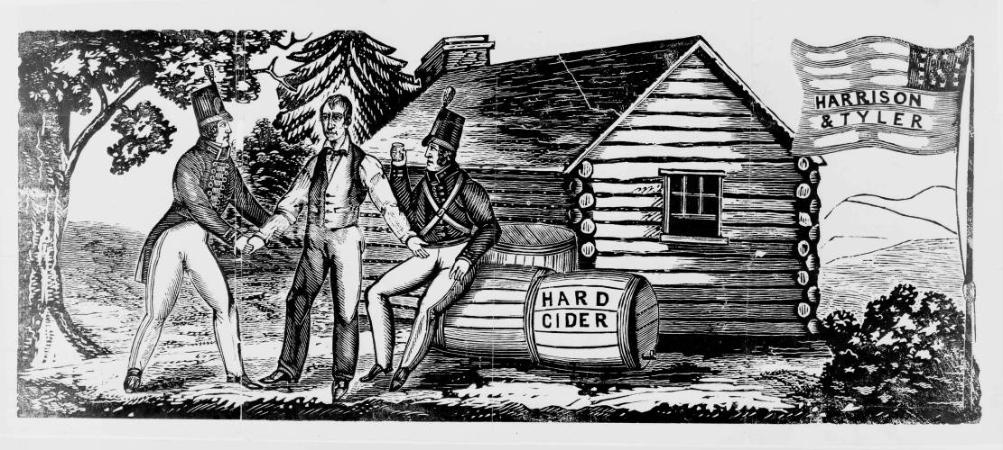
Looks like democracy…
smells like democracy…
tastes like democracy…

Slide 31
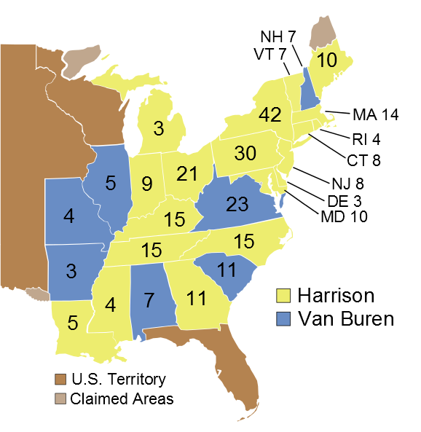


1840
73
47%
53%
234
Popular Vote
(2,411,187 Votes)
Electoral Vote
View Electoral Vote
View Popular Vote
1820
1824
1828
1832
1836
1840

Slide 32
Whigs Gain Power
The Election of 1840
  With his image hurt by the financial crisis that had embraced the country, Van Buren faced an uphill battle for reelection as president in 1840
  The Whigs chose as their candidate the war hero William Henry Harrison (“Ol’ Tippecanoe”)
    The Whigs stole a play from the Jackson playbook and portrayed Harrison as a common man (they played on his being born in a log cabin and being raised on hard cider)
  Harrison swept the electoral vote and the Whigs won the election, bringing and end to the age of Jackson…
    And then Harrison died. 32 DAYS LATER!

