Slide 1
True or False w/ your partner!
President Nixon & Sec. of State Kissinger's diplomacy attempted to play China & the USSR off one another.
Nixon attempted to reverse what he called the Warren Court’s “judicial activism”.
Richard Nixon was impeached as a result of the Watergate scandal.
The 1973 Arab-Israeli War and the OPEC oil embargo added to the inflation that began in the wake of the Vietnam War.

Slide 2
Resurgence of Conservatism-Reagan and the 1980s
Mr. Winchell
APUSH
Period 9

Slide 3
https://www.facebook.com/cspanhistory/videos/965422186904662/

Slide 4
Segregation Terms!
De facto: by tradition
De jure: by law

Slide 5
Conservative Backlash, 1965-1980
Conservatives react against changes in America during the 1960s
American foreign policy
“Lost Vietnam”
Affirmative Action
Women’s liberation

Slide 6
The Growing Backlash
1978: Regents of U.C. v. Bakke
“Quotas” in college admissions were unconst.
1976: Hyde Amendment
Limited Medicaid funds for Abortion
Moral Majority, 1978
Southern Democrats become Republicans
Many working class Anglos in industrialized urban areas, and new suburbanites blamed immigrants and the poor for their condition, as well as economic decline of “Americans”

Slide 7
American Malaise
Soft America and “decline” of American power
OPEC and Oil Embargo
Stagflation
De-Industrialization
Iranian Hostage Crisis (Nov. 1979)
Ayatollah Khomeini overthrew Shah of Iran
50 Hostages for over a year
Failed rescue effort
USSR invaded Afghanistan (Dec. 1979)

Slide 8
The Three Parts of the Republican Party
A. Economic Conservatives & Laissez-Faire: Low Taxes, Low Govt. Spending, Reduce Welfare
B. Cultural Conservatives & the Religious Right: Anti-Abortion, Anti-Gay Rights
C. Military Conservatives & War Hawks: Aggressive Military Spending

Slide 9
Political Trends
1932-1968: 28/36 Years = Democratic Presidents (FDR, Truman, JFK, LBJ)
1968-2008: 28/40 Years = Republican Presidents (Nixon, Ford, Reagan, Papa Bush, Baby Bush)

Slide 10
What caused this shift in American political thought?

Slide 11
Ronald Reagan
CA. Governor Reagan
Anti-communist
“Black and white”
“New Day in America”
Charismatic
Channeled anger of mainstream white America at minorities, immigrants, feminists, taxes, affirmative action, big government

Slide 12
With the close election victory in 1980, the Reagan revolution would bring a significant shift in the political direction of the nation.
“Reaganomics” – Sometimes called the theory of Supply-side economics.
Rests on the assumption that if taxes are reduced, people will work more and have more money to spend, causing the economy to grow.
The government will then collect more taxes.
But in order to cut taxes and balance the budget, Reagan would need to reduce federal spending on programs favored by both democrats and republicans.

Slide 13
Economic Recovery Act of 1981 – Reduced taxes by 25% over 3 years.
Richest Americans received the biggest tax cut. Why?
Would use the money they saved to invest back in the economy in the form of new businesses.
Cut $40 billion from federal budget. Mostly on social programs.
Deregulation – removal of governmental control over industry. Deregulated airline, tele-communications, and banking industries. Also cut funding for federal agencies that oversaw many other agencies.
Despite Reagan’s economic policies, the economy experienced a severe recession from 1980 – 1982. 10% unemployment!
Loss of blue collar jobs, and farms to oversea competitions.
Policies to fight inflation from the 1970s
Increase in immigration, both legal and illegal

Slide 14
Reaganomics
Benefits of “Reaganomics”
Inflation, unemployment, & the trade deficit all declined by 1990
Growth in service sector jobs
Disadvantages of “Reaganomics”
Industry jobs fell as companies used off-shore manufacturers with cheaper labor costs
Increased social inequalities
Huge federal deficits
16 million new jobs, unemployment below 6%, inflation fell to 4%

Slide 15
Social Programs
The Reagan administration opposed major social reforms:
High school dropout rates & crime increased in the 1980s
Affirmative action & school busing programs to assist African-Americans were limited
Women’s abortion rights were attacked
But…Reagan appointed the 1st female Supreme Court justice, Sandra Day O’Conner
In Univ of California v Bakke (1978) ruled in favor of affirmative action but not purely quota systems

Slide 16
Reaganomics: “Trickle-Down”
DOD spending up 45%
$3 trillion debt, 1981-9
Rising # of Fortune 500 companies
Expansion of “working poor”
Decline in real wages
Household debt
Deregulation and Savings & Loan Crisis $500 b
Ketchup is a vegetable
Tax cuts boosted elite incomes
Privatization and deregulation

Slide 17
The War on Drugs
Mid-1980's--crack cocaine introduced
addiction spread through all classes
exploding crime rate
Reagan attempts interdiction of supply
Bush, Clinton continue Reagan policy
At the end of the century there seemed to be no end to the war on drugs

Slide 18
The War on Drugs
In the 1980s, cocaine use boomed, especially with the creation of “crack” cocaine
The Reagan administration declared a “war on drugs”:
Nancy Reagan’s “Just Say No” program helped educate kids
The federal gov’t failed to stop the flow of drugs into the U.S.
DEA, Customs, & Coast Guard attempts to keep drugs out
Negotiations with Peru, Bolivia, Colombia failed to limit drug smuggling
Notes:
&

Slide 20
The AIDS Epidemic
The 1st documented cases of AIDS occurred in the 1980s:
1st cases were among gay men in San Francisco & NY in 1981
As cases were found in drug abusers & hemophiliacs, people worried about a contaminated national blood supply
Lack of sympathy for gays, budget cuts, & ignorance about HIV led to a limited government response
2,800 known AIDS cases by 1983
12,000 AIDS cases by 1985
50,000 AIDS cases by 1987
982,498 AIDS cases by 2006
Notes:
http://www.avert.org/usa-statistics.htm

Slide 21
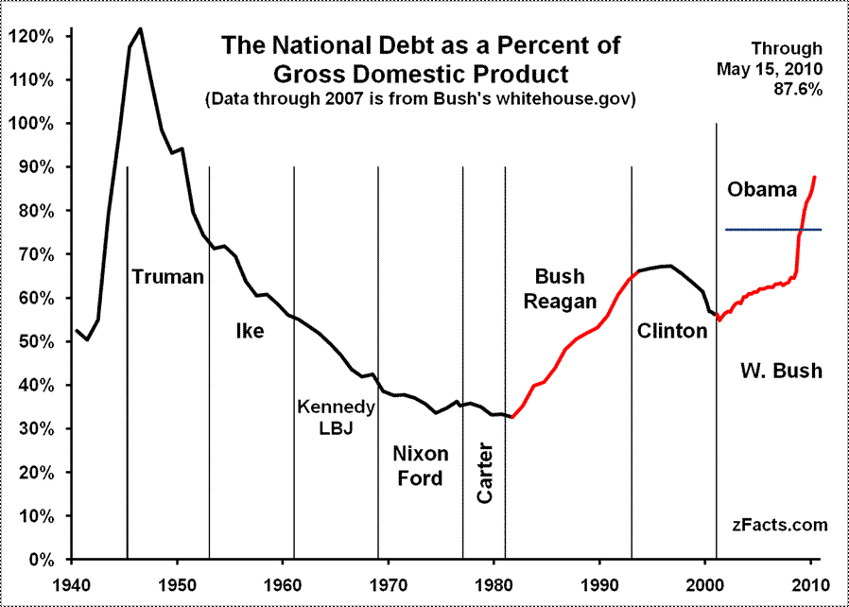
Did Reagan’s Style Equal Substance?
A. Reagan as an Economic Conservative?
Tax Cuts But Bigger Debt

Slide 22
Reagan's Economic Legacy
The large deficits of the Reagan years were financed by many foreign countries, esp. Japan
Greater dependence on foreign investment for domestic economic stability – legacy?
By appearing to make new social spending both practically and politically impossible for the foreseeable future, though, the economic deficits served their purpose
They achieved Reagan's highest political objective: the containment of the welfare state

Slide 23
Reagan & Foreign Policy
Reagan was committed to restoring America’s supremacy in the world
Blamed Carter for allowing U.S. prestige to drop to an all-time low
Increased military spending
Confronted challenges in the Middle East & in Latin America
Ended the Cold War with the Soviet Union

Slide 24
Trouble Spots in Latin America
Reagan attempted to resist Communism in Latin America
U.S. Marines invaded Grenada in 1983 to keep a radical regime from turning over an airfield to Cuba or the USSR
In 1979, Nicaraguan Sandinista rebels led a coup against a U.S.-backed regime
In 1983, Congress denied Reagan’s request to aid Nicaraguan efforts to overthrow the Sandinista gov’t (Contras)

Slide 25
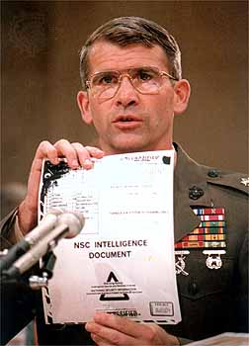
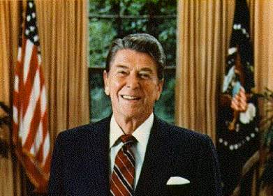
The Iran-Contra Affair
In 1987, the Iran-Contra Affair rocked the Reagan administration:
To free 6 U.S. hostages in Iran, the NSC & CIA covertly sold missiles to Khomeini’s gov’t
Profits from missile sales were used to aid Nicaragua Contras
Reagan avoided implication through “plausible deniability”
The “Teflon President”

Slide 26
American hostages in Lebanon
Communist Sandinistas in Nicaragua
American weapons sold to Iran – hostages released
$$$ from Iran funneled to Contras in Nicaragua
Reagan denies knowledge - Why no 2nd Watergate?

Slide 27
Challenging the "Evil Empire"
Reagan viewed the USSR as the "focus of evil in the modern world” & as a threat to U.S. security
Maintained a hard-line approach
Sent 572 nukes within range of Moscow to match USSR ICBMs aimed at NATO nations
Began the Strategic Defense Initiative, an anti-missile laser system in space to defend U.S.
SDI was dubbed the “Star Wars” program

Slide 28
Ending the Cold War
Gorbachev cut the Soviet defense budget, withdrew Soviet troops from Afghanistan, & promoted the democratization of former satellite nations in Eastern Europe
Introducing moderate capitalism into the Soviet economy such as legalization of small private business cooperatives, relaxed laws prohibiting land ownership, & approval of foreign investment within the USSR
Reagan’s most important foreign policy triumph was working with new USSR leader Mikhail Gorbachev to end the Cold War:
In 1985, Mikhail Gorbachev began perestroika & glasnost & eased Cold War tensions
The Reagan-Gorbachev summits from 1986 to 1988 led to a reduction of nuclear arms
“Political openness” led to freedom of press, assembly, travel, & religion; the 1st working legislature; the 1st competitive elections; & liberation of hundreds of political prisoners
Notes:
In 1982, 75-year-old Soviet party leader Leonid Brezhnev died. Growing stagnation, corruption, and a huge military buildup had marked his regime. Initially, the post-Brezhnev era seemed to offer little change in U.S.-Soviet relations. KGB leader Yuri Andropov succeeded Brezhnev, but died after only 15 months in power. Another Brezhnev loyalist, Konstantin Chernenko, who died just a year later, replaced him. In 1985, Soviet party leadership passed to Mikhail S. Gorbachev, a 54-year-old agricultural specialist with little formal experience in foreign affairs. Gorbachev pledged to continue the policies of his predecessors.
Within weeks, however, Gorbachev called for sweeping political liberalization (glasnost) and economic reform (perestroika). He allowed wider freedom of press, assembly, travel, and religion. He persuaded the Communist party leadership to end its monopoly on power; created the Soviet Union's first working legislature; allowed the first nationwide competitive elections in 1989; and freed hundreds of political prisoners. In an effort to boost the sagging Soviet economy, he legalized small private business cooperatives, relaxed laws prohibiting land ownership, and approved foreign investment within the Soviet Union.
In foreign affairs, Gorbachev completely reshaped world politics. He cut the Soviet defense budget, withdrew Soviet troops from Afghanistan and Eastern Europe, allowed a unified Germany to become a member of NATO, and agreed with the United States to destroy short-range and medium-range nuclear weapons. Most dramatically, Gorbachev actively promoted the democratization of former satellite nations in Eastern Europe. For his accomplishments in defusing Cold War tensions, he was awarded the 1990 Nobel Peace Prize.

Slide 29
The End of the Cold War
In 1989, Gorbachev’s promotion of democratization in Eastern Europe inspired the overthrow of 40 years of communist rule
Countries of the former USSR by 2000
In 1990, following the example of Eastern Europe, many Soviet republics within the USSR demanded independence, leading to…
Notes:
For 40 years, Communist Party leaders in Eastern Europe had ruled confidently. Each year their countries fell further behind the West; yet, they remained secure in the knowledge that the Soviet Union, backed by the Red Army, would always send in the tanks when the forces for change became too great. But they had not bargained on a liberal Soviet leader like Mikhail Gorbachev.
As Gorbachev moved toward reform within the Soviet Union and détente with the West, he pushed the conservative regimes of Eastern Europe outside his protective umbrella. By the end of 1989, the Berlin Wall had been smashed. All across Eastern Europe, citizens took to the streets, overthrowing 40 years of Communist rule. Like a series of falling dominos, Communist parties in Poland, East Germany, Hungary, Czechoslovakia, Romania, and Bulgaria fell from power.
Gorbachev, who had wanted to reform communism, may not have anticipated the swift swing toward democracy in Eastern Europe. Nor had he fully foreseen the impact that democracy in Eastern Europe would have on the Soviet Union. By 1990, leaders of several Soviet republics began to demand independence or greater autonomy within the Soviet Union.
Gorbachev had to balance the growing demand for radical political change within the Soviet Union with the demand by Communist hardliners. The hardliners demanded that he contain the new democratic currents and turn back the clock. Faced with dangerous political opposition from the right and the left and with economic failure throughout the Soviet Union, Gorbachev tried to satisfy everyone and, in the process, satisfied no one.
In 1990, following the example of Eastern Europe, the three Baltic states of Lithuania, Latvia, and Estonia announced their independence, and other Soviet republics demanded greater sovereignty. Nine of the 15 Soviet republics agreed to sign a new union treaty, granting far greater freedom and autonomy to individual republics. But in August 1991, before the treaty could be signed, conservative Communists tried to oust Gorbachev in a coup d'etat. Boris Yeltsin, the President of the Russian Republic, and his supporters defeated the coup, undermining support for the Communist Party. Gorbachev fell from power. The Soviet Union ended its existence in December 1991, when Russia and most other republics formed the Commonwealth of Independent States.

Slide 30
Conclusions
Reagan was the 1st president to serve 2 full terms since Eisenhower
Reagan’s supporters claim he restored the economy, military, patriotism, family values, & America’s place as a world power
Reagan’s detractors claim he removed social safety-nets, skirted Congress in foreign policy, & tripled the national debt
Notes:
In the presidential election of 1984, Ronald Reagan and Vice President George Bush won in a landslide over Walter Mondale and Geraldine Ferraro. Ferraro was the first woman nominated for vice president on a major party ticket. Although Reagan's second term was plagued by the Iran-Contra scandal, he left office after eight years more popular than when he arrived. He could claim the distinction of being the first president to serve two full terms since Dwight Eisenhower.
Ronald Reagan could also point to an extraordinary string of accomplishments. He dampened inflation, restored public confidence in government, and presided over the beginning of the end of the Cold War. He doubled the defense budget, named the first woman to the Supreme Court, launched a strong economic boom, and created a heightened sense of national unity. In addition, his supporters said that he restored vigor to the national economy and psyche, rebuilt America's military might, regained the nation's place as the world's preeminent power, restored American patriotism, and championed traditional family values.
On the other hand, his detractors criticized him for a reckless use of military power and for circumventing Congress in foreign affairs. They accused Reagan of fostering greed and intolerance. His critics also charged that his administration, in its zeal to cut waste from government, ripped the social safety net and skimped on the government's regulatory functions. The administration, they further charged, was insensitive on racial issues. Reagan's detractors were particularly concerned about his economic legacy. During the Reagan years, the national debt tripled, from $909 billion to almost $2.9 trillion (the interest alone amounted to 14 percent of the federal budget). The deficit soaked up savings, caused interest rates to rise, and forced the federal government to shift more and more responsibilities onto the states. Corporate and individual debt also soared. During the early 1990s, the American people consumed $1 trillion more goods and services than they produced. The United States also became the world's biggest debtor nation, as a result of a weak dollar, a low level of exports, and the need to borrow abroad to finance budget deficits.

Slide 31
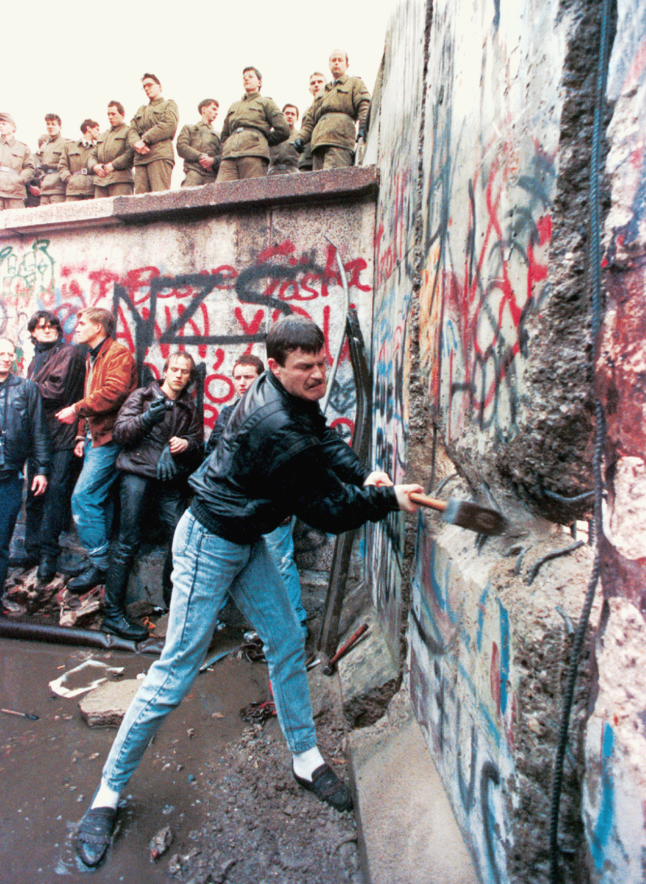

Slide 33
Conclusions
History is who we are
Multiple perspectives
Evidence, sources, argument
Skepticism and free thinking
People make history
Resistance and criticism are healthy
Multiple views of patriotism
Justice, equality, human rights

