Slide 1
Do Now
Read and annotate the ‘Do-Everything Congress’ article!

Slide 2
The End and Impact of Civil War…What Next?
Mr. Winchell
APUSH
Period 5

Slide 3
Key Concepts

Slide 4
AP Prompt
Evaluate the extent the Civil War impacted the political, social, and economic landscape of the United States?

Slide 5
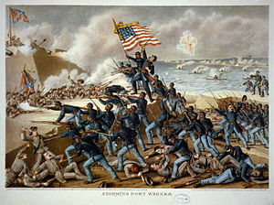
The Union and Blacks/Slaves
The idea of ending slavery was difficult for Lincoln
  Border states were slave states, ex. Kentucky
  Slavery is constitutional
  Racism in the North and among Democrats
  Re-election in 1864?
Emancipation Proclamation (January 1, 1863)
  “freed” slaves in Confederate states
  Slavery became an “official” cause of war
Army of Freedom
  54th Massachusetts (Glory) - unequal pay
  200,000 participants; 37,000 casualties
Thirteenth Amendment (December 1865)
  “If slaves will make good soldiers, our whole theory of slavery is wrong.” - Georgia general

Slide 6
Thirteenth Amendment
Standing in the way of full emancipation was the U.S. Constitution
Process was started on passing an amendment (passed after Lincoln’s death)
Simply stated: “Neither slavery nor involuntary servitude, except as punishment for crime whereof the party shall have been duly convicted, shall exist within the United States, or any place subject to their jurisdiction.”

Slide 7
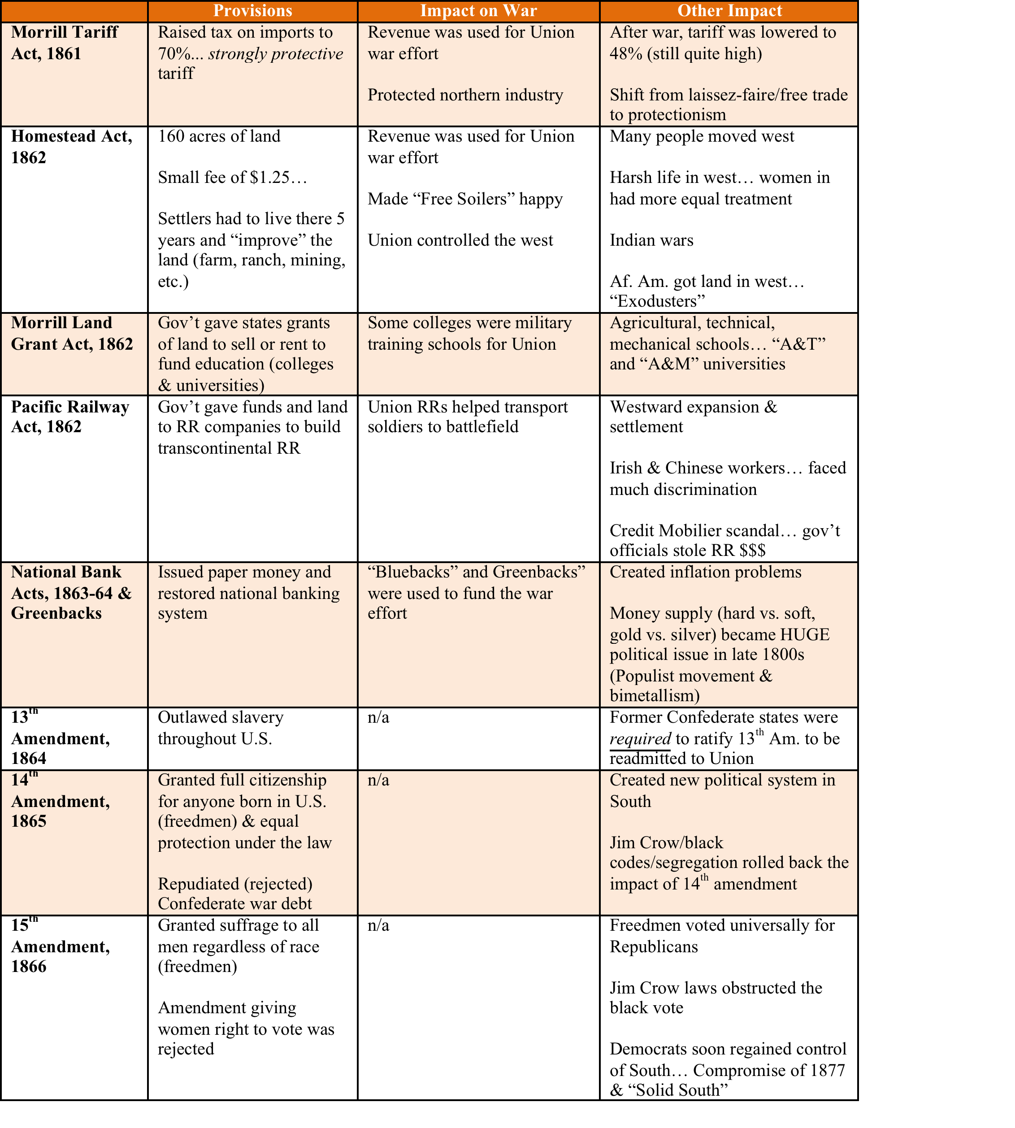

Slide 8
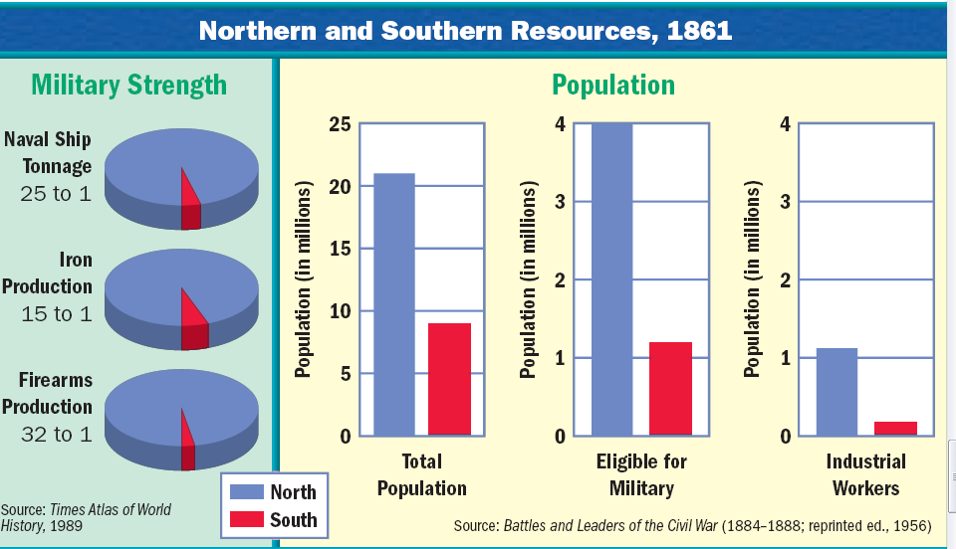
Lincoln’s War Machine
& the Impact of Railroads

Slide 9
The Tide of the War Turns in 1863
By 1863, the Confederacy was having difficulty sustaining the fight:
  Attempts to lure Britain and France into the war had failed
  The Union blockade, limited Southern manufacturing, and lack of grain fields left CSA soldiers ill-supplied
  To pay for the war, the CSA printed money leading to massive inflation

Slide 10
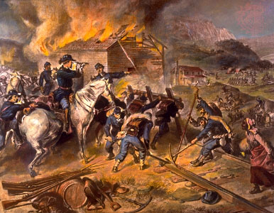
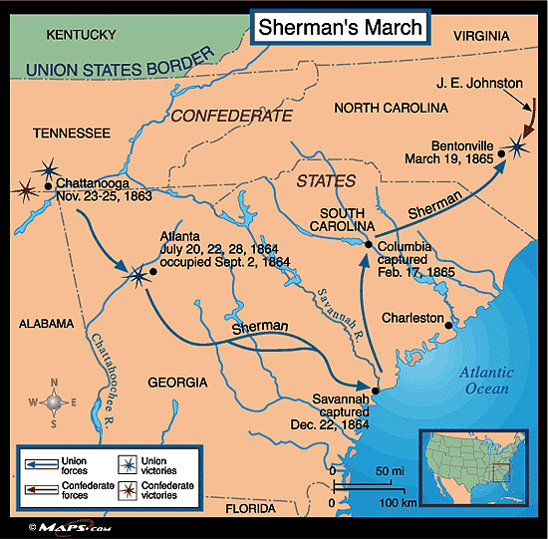
Total War
General Ulysses S. Grant
General Sheridan and “The Burning”
General Sherman’s March to the Sea

Slide 11
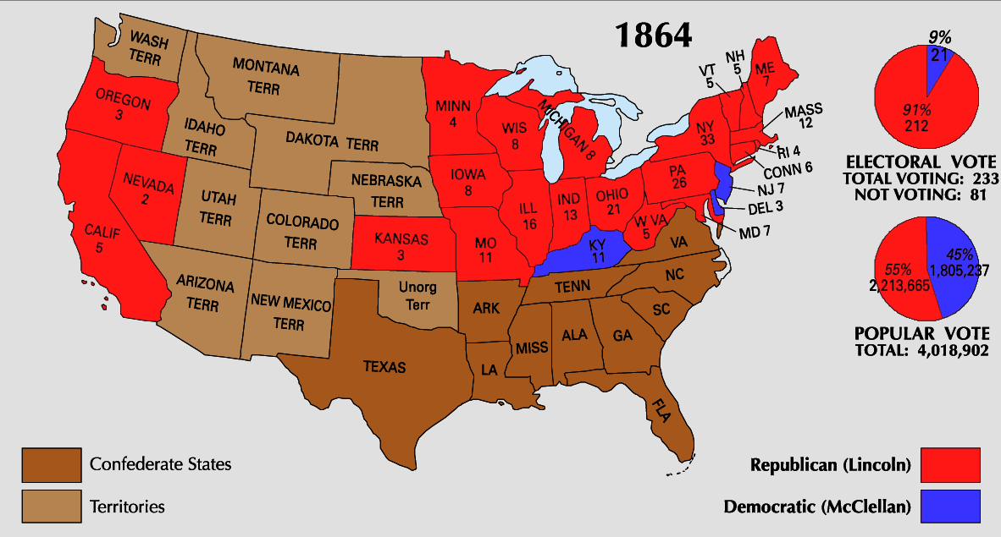
Lincoln faced a tough
re-election campaign against George McClellan
When Atlanta fell during Sherman’s “March to
the Sea,” Lincoln was overwhelmingly reelected
The North’s war failures were the key election issue
In his 2nd inaugural address, Lincoln promised a Reconstruction Plan for the Union with “malice towards none and charity for all”

Slide 12
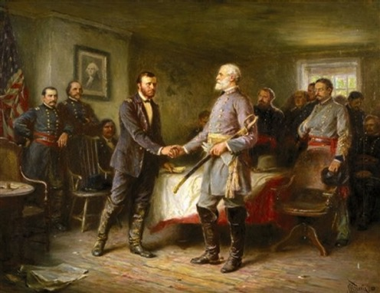
Peace
Appomattox - April 9, 1865
  Lee surrenders to Grant
Confederates until the very end…
  Guerilla tactics and “The South will rise again!”

Slide 13
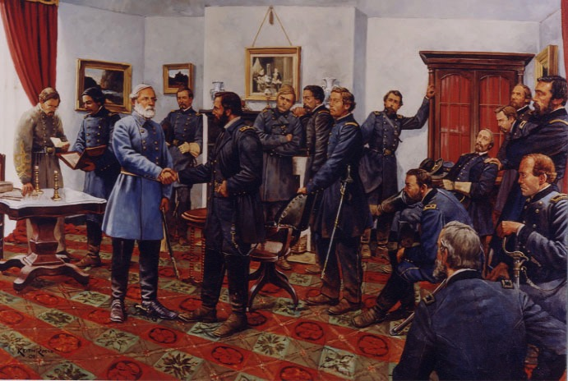
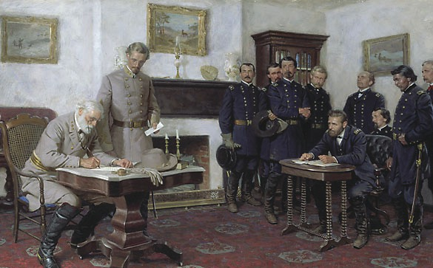
On April 9, 1865, Lee surrendered
to Grant at Appomattox Courthouse, ending the fighting of Civil War

Slide 14
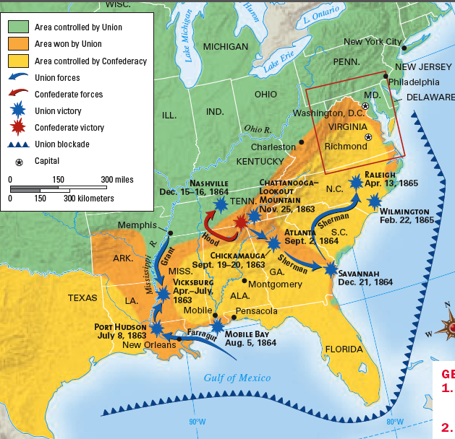
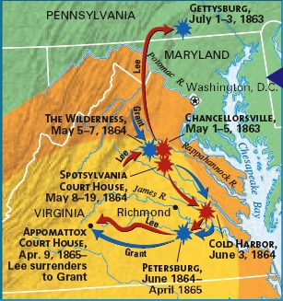
From 1863-1865, the lack of
Southern resources & unity as well as the Northern advances into the South led to the end of the Civil War
Notes:
How did North win; recap 1863-1865 burning richmond? Total war
Lack of unity in south

Slide 15
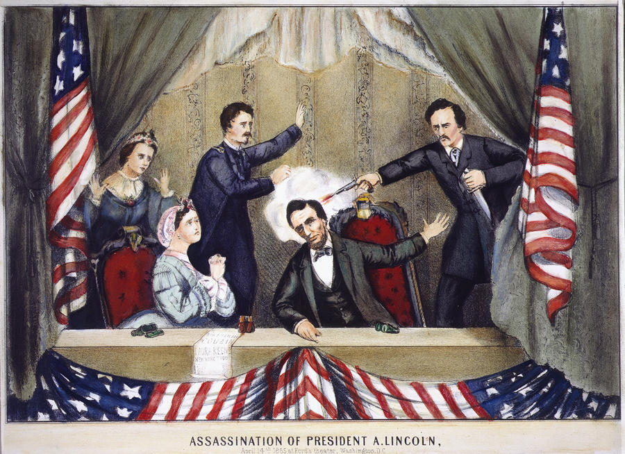

Northern celebration was short lived; On April 14, 1865, Lincoln was shot by John Wilkes Booth ….

Slide 16
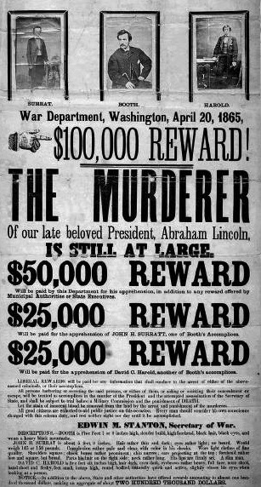

Slide 17
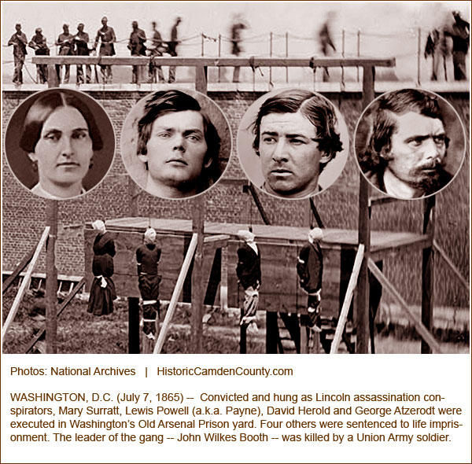
The Execution

Slide 18
Cost of the War
Union:
  110,000 KIA
  250,000 Died from war effects
  275,200 wounded
Confederacy:
  93,000 KIA
  167,000 Died from war effects
  137,000 wounded
TOTAL DEAD: 625,000*
North Cost: $2.3B ($54B)
South Cost: $1B ($23B)
South Destruction: $1.5B ($35B)
American Revolution: 4,435
War of 1812: 2,260
Mexican-American War: 13,283
Spanish-American War: 2,446
World War I: 116,516
World War II: 405,399
Korea: 36,574
Vietnam: 58,220
Persian Gulf War: 383
Iraq War: 4,486
Afghanistan: 2,145
TOTAL: 646,147

Slide 19
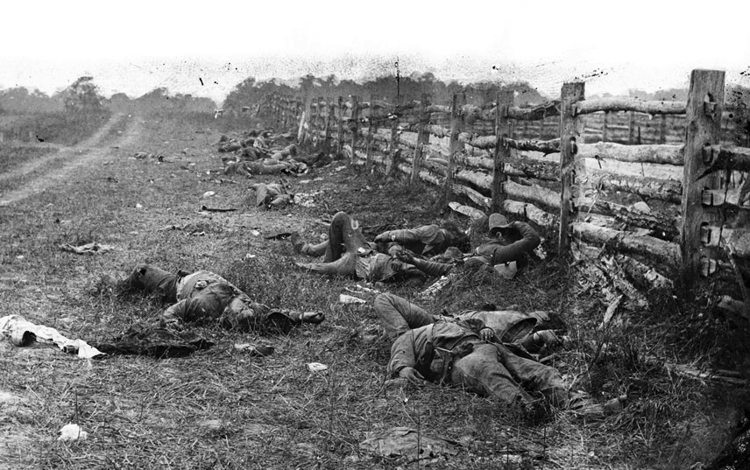
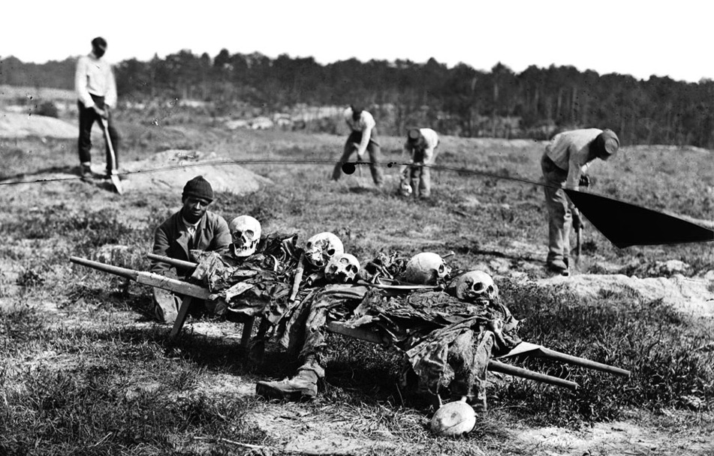
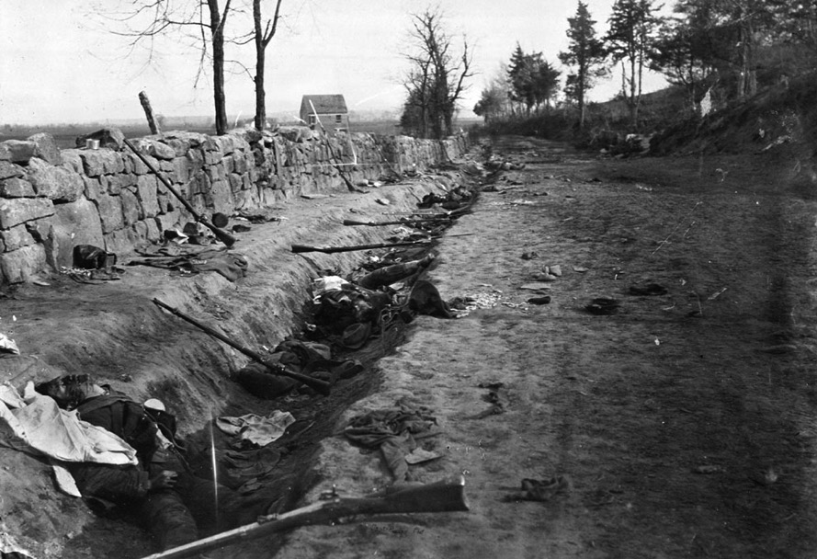
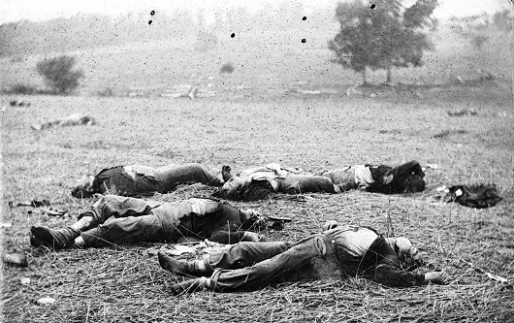
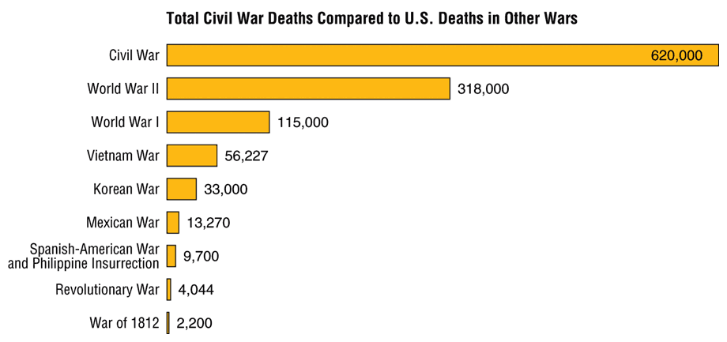
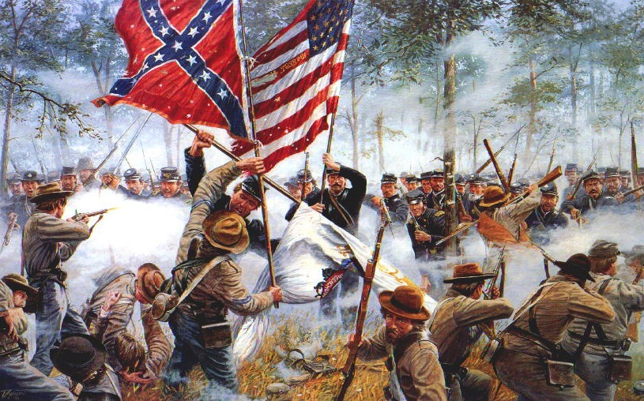
Old tactics such as massed formations and frontal assaults
Led to huge casualty rates

Slide 20
Effects of the War
Political changes:
  The Civil War established that the national gov’t is supreme over the states
  With no Southern opposition, Republicans passed new laws: Homestead Act (1862), Morrill Act (1862), a protective tariff, land grants to RR companies, & a national banking system
  Long-term effects: balance of power shifted between the North and South
Notes:
gave free land to western settlers
created new colleges

Slide 21
North/West: Political Effects
Republican Congress pushed through their agenda unopposed
  Homestead Act of 1862
    Any one could claim up to 160 acres of land and buy it for a cheap price after living/farming it for 5 years
  Morill Land Grant of 1862
    Set public land aside for public education (Land-Grant Colleges)
  Tariff Bills
    Without the South to resist the North jacked up tariffs to protect America’s growing industry
  Construction began on the Transcontinental Railroad
  National Bank Act
    Banks could join national banking system
      Could then buy gov’t bonds and issue paper currency
    Created first national banking system since Jackson killed the Bank of the US in 1836
Infringement on Civil Liberties
  “supervised” voting
  Writ of Habeas Corpus
  Freedom of Speech
Abolishment of Slavery
  Confiscation Acts: Union army could confiscate any Confederate property including slaves (essentially freed slaves when the Union army took over)
  Emancipation Proclamation: freed all slaves in CSA territory
  13th Amendment: banned slavery
Massive Expansion of Federal Power
  Aggressively enforce laws
  Protect Civil Rights
    14th Amendment granted citizenship to all African-Americans
  1st Social Welfare program (Freedmen’s Bureau)
  Print currency
  Conscription

Slide 22
Economic Effects
North financed the war ($2.6 BILLION) by the sale of government bonds. Still not enough:
  Raising tariffs (Morrill Tariff); adding excise taxes; and instituting the first income tax
  Greenbacks: issued by U.S. Treasury but not redeemable for gold; led to inflation
Modernizing northern economy: no real significant change; CON: workers’ wages did not keep up w/ inflation; PRO: modernized and consolidated the industries

Slide 23
Economic Effects
Republicans in Congress passed ambitious economic programs:
  National banking system
  Morrill Tariff Act: raise revenue & protect American businesses
  Homestead Act: promoted settlement in Great Plains by offering 160 acres if ind/family farmed it for 5 years
  Morrill Land Grant: encouraged states to use sale of federal lands to maintain ag & tech colleges
  Pacific Railway Act: transcontinental RR

Slide 24
Social Effects
Women:
  Filled in for men who were off fighting (fields, factories, offices, stores, gov) in North & South
  Served as military nurses
Effects:
  Field of nursing opened to women
  Opened the door for equal voting rights

Slide 25
Social Effects
Biggest group impacted: former slaves (3.5 in South, 500K in border states)
  13th Amendment banned slavery
Tragic human loss as result of war:
  620K men died
  $15 billion in war costs & damaged property
  Destroyed slavery and southern economy
Catalyst for transformation to modern industrial society

Slide 26
The Aftermath of the Nightmare
    The extreme states’ righters were crushed
    The national government, tested in the fiery furnace of war, emerged unbroken
    Nullification and secessions were laid to rest
    The Civil War was the supreme test of American democracy
    The preservation of democratic ideals was subconsciously one of the major objectives of the North

Slide 27
Let’s Laugh…

Slide 28
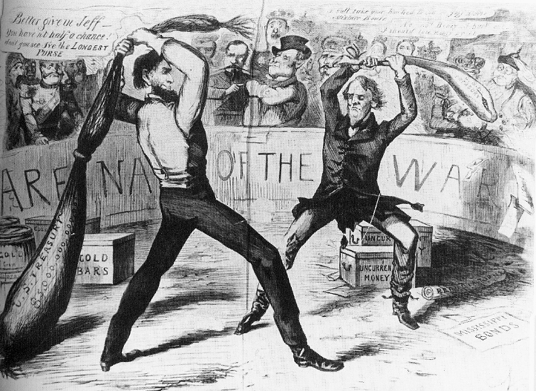

Slide 29
What Was Settled?
Slavery
Secession
State v. Federal Supremacy

Slide 30
What Wasn’t Settled?
Extent of States’ Rights
Civil Rights
Civil Liberties During Wartime
Reach of the Federal Government

Slide 31
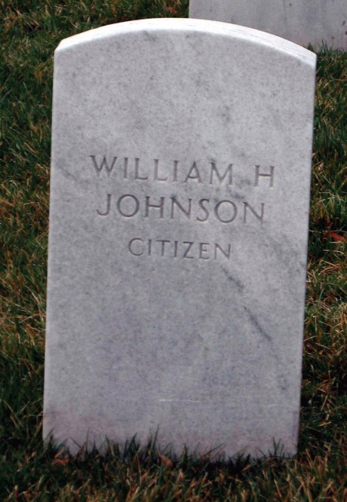
p461
Notes:
Grave of William H. Johnson, 1864 Johnson was a free
black man who worked as Lincoln’s personal valet in
Springfield and accompanied him to Washington, D.C. when
he assumed the presidency. When lighter-skinned mulatto
White House staffers rejected him for his dark skin, Lincoln
helped Johnson find other employment in the Treasury and
Navy Departments, writing “The bearer of this card, William
Johnson (colored), came with me from Illinois, and is a worthy
man, as I believe. A. Lincoln.” In November 1863 Lincoln
requested that Johnson accompany him to deliver his famous
address at Gettysburg, where they both contracted smallpox.
Lincoln recovered in a few days Johnson, with a more severe
case, died in January 1864. Lincoln arranged for him to be
buried at Arlington National Cemetery and wrote the one word
epitaph for his tombstone: “Citizen,” a succinct and
stinging rebuke of the racist reasoning of the Dred Scott
decision.

Slide 32
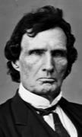
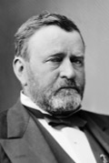
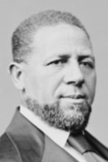
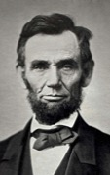
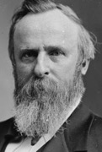
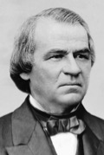
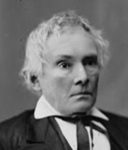
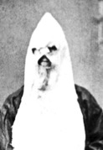
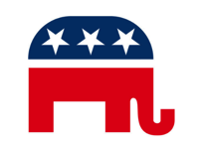
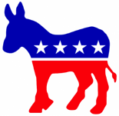
Political Spectrum of Reconstruction
Radicals
Moderates
Unionists
Redeemers
KKK
Federal Supremacy
Black Civil Rights
Military Occupation
States’ Rights
Blacks as Second-Class Citizens
Home Rule

Slide 33
AP Prompt
Evaluate the extent the Civil War impacted the political, social, and economic landscape of the United States?

