Slide 1
Do Now
Read, Respond, Discuss
“When you assemble a number of men to have the advantage of their joint wisdom, you inevitably assemble with those men, all their prejudices, their passions, their errors of opinion, their local interests, and their selfish views”
Benjamin Franklin: Closing Speech-Constitutional Convention

Slide 2
The Nation Under Washington: New Government, New Institutions, and a New Party System
Mr. Winchell
APUSH 2018-2019
Period 3

Slide 3
AP Prompt
Evaluate the causes of the growth of the first two-party system in American politics.

Slide 4
BIG IDEAS-College Style
Washington’s Presidency and Precedents
What legacy did he leave?
Hamilton vs. Jefferson and the Birth of Political Parties
How did early issues facing the nation lead to two such opposing views on power and the Constitution?
Constitution vs. Articles of Confederation
How was the Constitution different in practice than the Articles of Confederation were?

Slide 6
George Washington (1789-1797)
Washington unanimously elected
John Adams as VP
The Cabinet
Secretary of State Thomas Jefferson
Secretary of the Treasury Alexander Hamilton
Secretary of War Henry Knox
Attorney General Edmund Randolph
Judiciary Act of 1789
Established lower federal courts
Federal district court in each state
Attorney General
Whiskey Rebellion (1794)
Foreign Policy
French Revolution
Jay Treaty and Pinckney Treaty
Farewell Address

Slide 7
The Cabinet
“The President shall be Commander in Chief of the Army and Navy of the United States, and of the Militia of the several States, when called into the actual Service of the United States; he may require the Opinion, in writing, of the principal Officer in each of the executive Departments, upon any Subject relating to the Duties of their respective Offices, and he shall have Power to grant Reprieves and Pardons for Offenses against the United States, except in Cases of Impeachment.”
Article 2 Clause 1

Slide 8
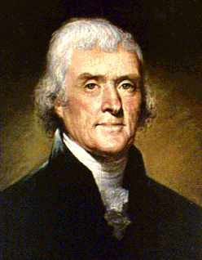
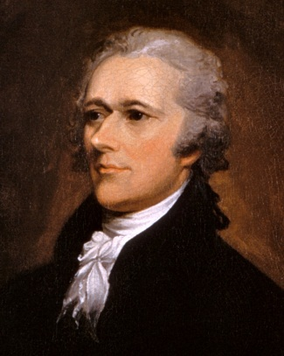
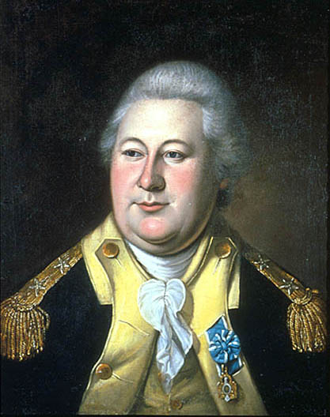
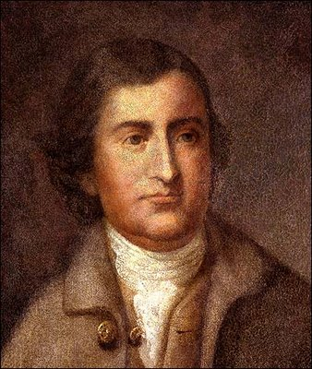
The Departments & Leadership
Department of State
Sec. of State - T. Jefferson
Department of Treasury
Sec. of Treasury - A. Hamilton
War Department
Sec. of War - Henry Knox
Attorney General Edmund Randolph

Slide 9
The Courts
Congress created effective courts under the Judiciary Act of 1789
Judiciary Act organized the Supreme Court with a chief justice & 5 associates
Established federal district & circuit courts
Created office of Attorney General

Slide 10
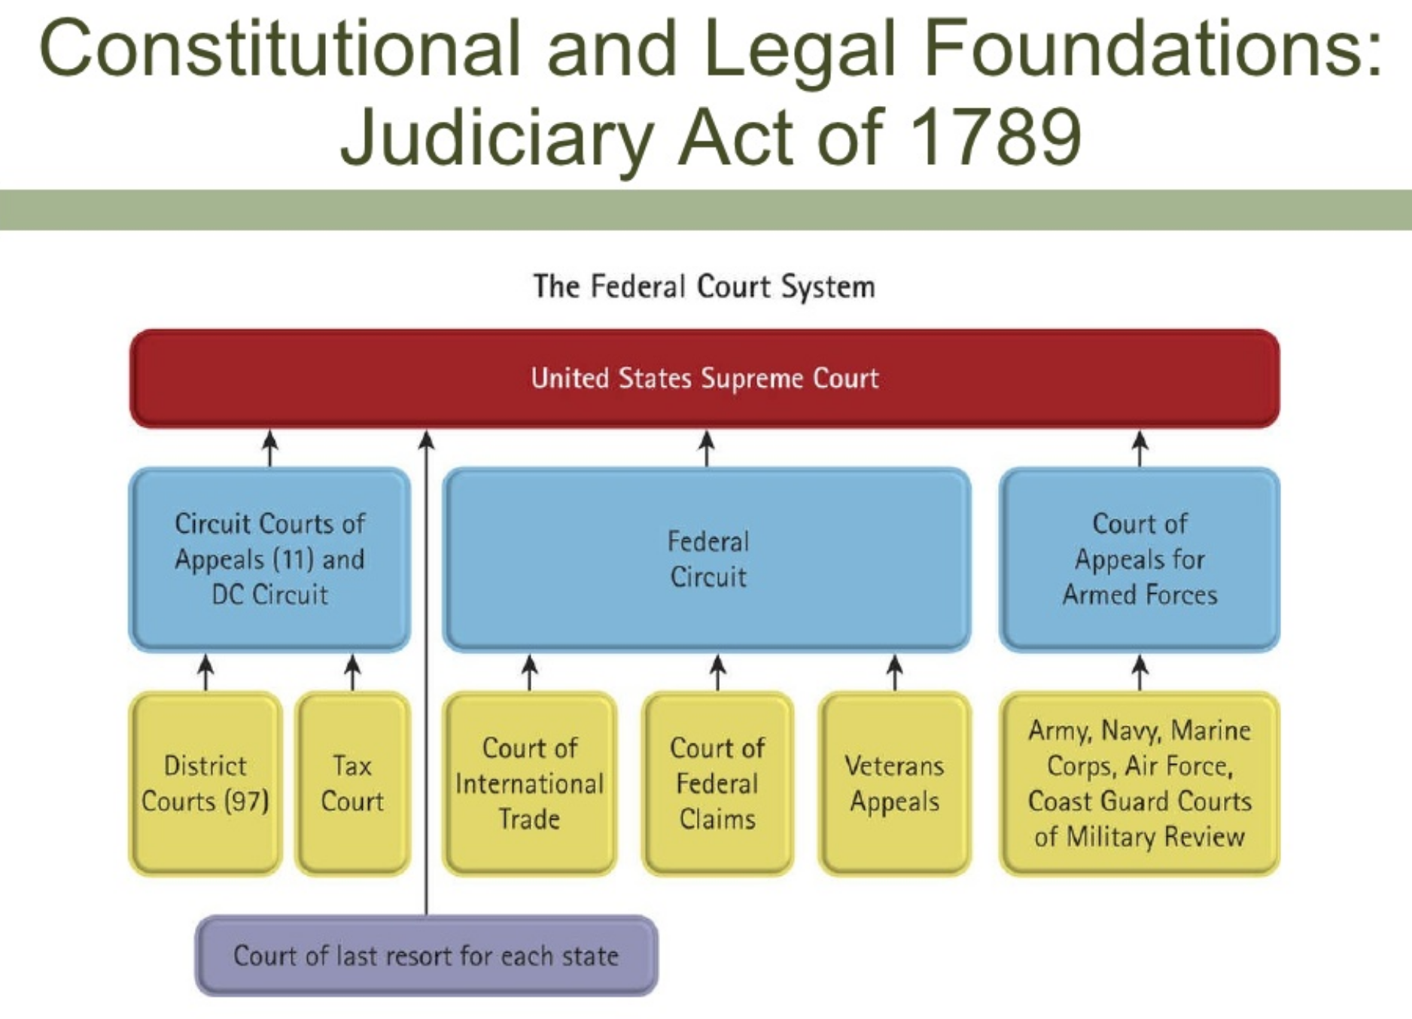

Slide 11
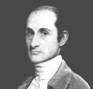
1st Chief Justice
John Jay (NY)
Collaborated w/ Madison on Federalist Papers
A seasoned diplomat
Served as CJ until 1795

Slide 12
Washington’s Foreign Policy
Europe
French Revolution
Citizen Genet (1793)
Proclamation of Neutrality (1793)
John Adams Neutrality
Jay’s Treaty (1796)
Most-favored trade status to Britain
Removed British from Northwest forts
Did not end British impressment of U.S. sailors
Pinckney’s Treaty (1796)
Established boundaries with Spain
Unrestricted trade access on the Mississippi River
Natives
Treaty of Greenville (1795)
Battle of Fallen Timbers (1794)
Formal recognition/cession of Northwest Territory by Natives

Slide 13
Washington’s Foreign Policy
Pro-French
Pro-British
Thomas Jefferson
French Revolution
Citizen Genet
Proclamation of Neutrality (1793)
“Whereas it appears that a state of war exists between Austria, Prussia, Sardinia, Great Britain, and the United Netherlands, of the one part, and France on the other; and the duty and interest of the United States require, that they should with sincerity and good faith adopt and pursue a conduct friendly and impartial toward the belligerant Powers;”
John Adams Neutrality
Alexander Hamilton
Jay’s Treaty (1796)
“Art. 1: There shall be a firm inviolable and universal Peace, and a true and sincere Friendship between His Britannick Majesty, His Heirs and Successors, and the United States of America; and between their respective Countries, Territories, Cities, Towns and People of every Degree, without Exception of Persons or Places.”
“Damn John Jay! Damn everyone that won't damn John Jay! Damn every one that won't put lights in his window and sit up all night damning John Jay!”

Slide 14
Watch this video clip from HBO’s John Adams series As you watch, identify as many things as you can that Jefferson and Hamilton disagree about
Alexander Hamilton
Thomas Jefferson

Slide 15
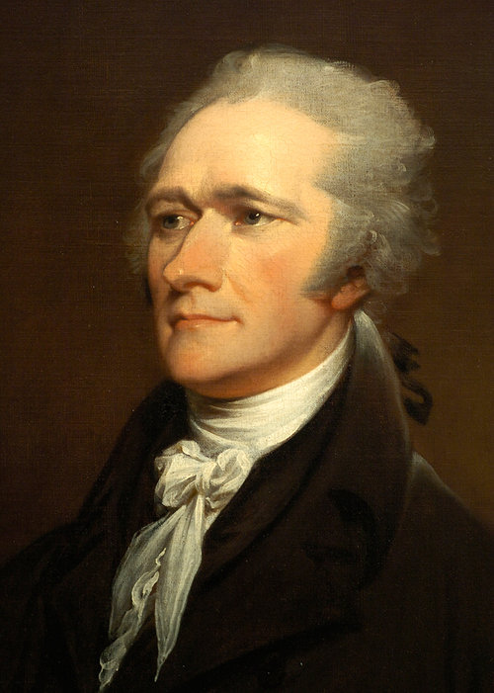
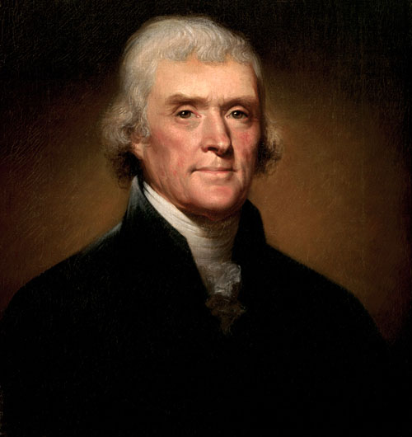
What should be the focus of the American economy?
Alexander Hamilton Thomas Jefferson
Hamilton
The government should promote banking and the growth of American industry so the USA does not have to rely on Britain
Jefferson
The government should promote an economy of self-sufficient farmers who do not need a powerful national gov’t

Slide 16
What was their view on the Constitution?
Alexander Hamilton Thomas Jefferson
Hamilton
Supported the Constitution because it included a president and more power to the national government
Constitution can be “loosely” interpreted (“Elastic Clause”)
Jefferson
Supported the Constitution because of the Bill of Rights
Constitution should be “strictly” interpreted with powers not given to the gov’t are reserved to the states

Slide 17
What political party did he form and what were the core ideals of the party?
Alexander Hamilton Thomas Jefferson
Hamilton
Federalist Party
Strong national government and fewer states’ rights
Jefferson
Democratic-Republican Party
Limited national government with more rights reserved to the states

Slide 18
Should power be in the hands of the “elite” or the “common man”?
Alexander Hamilton Thomas Jefferson
Hamilton
People are motivated by self-interests
Power should be in the hands of the “elite”
Jefferson
The “common man” should be trusted to make good decisions
Corruption occurs when power is in the hands of the “elite”

Slide 19
Hamilton vs. Jefferson and the Birth of Political Parties
Issues:
Constitutional Interpretation
Bank & Credit
French Revolution
Taxes
Whiskey Rebellion (Rebellion in general)

Slide 20
Hamilton’s Financial Plan/Report on Manufactures
Text Analysis

Slide 21
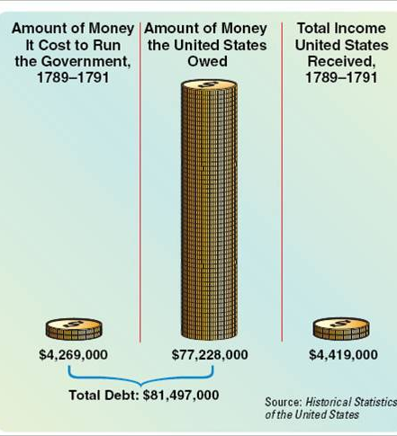
Among their biggest disagreement was over Hamilton’s Financial Plan
In 1789, Hamilton proposed a financial plan that would guide the future of the U.S. economy
1. Hamilton proposed funding and assumption of all state debts incurred during the Revolutionary War
Congress and Washington approved Hamilton’s plan for funding and assumption
By taking the state debts, the USA government would reinforce federal supremacy
By repaying all debts, the USA would gain foreign credit

Slide 22
2. Establishment of a National Bank
Bank would hold govt. funds
Circulate uniform natl. currency
Lend $ to the govt.
To be privately owned & managed
U.S. would have 20% ownership
Wealthy biz interests - 80%
Proposal caused huge debate

Slide 23
Bank of the U.S.
Jefferson opposed the bank
Not authorized in the Constitution
Powers not granted to Federal govt reserved for states (soon-to-be 10th Amendment)
States should charter banks
A strict interpretation of the Constitution

Slide 24
Bank of the U.S.
Hamilton invoked “necessary & proper” clause which allowed Fed to pass laws necessary for running govt. (Article 1, Sec. 8, par. 18)
A loose interpretation
GW accepted H’s argument and signed the measure into law
Becomes a sectional rift - N vs. S
Hamilton’s financial programs contributed to creation of political parties

Slide 25
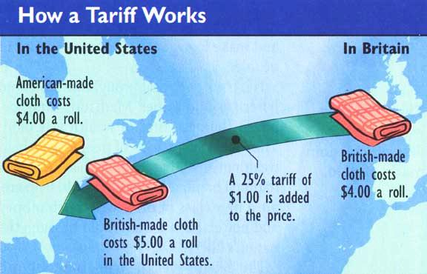
3. To raise money for the new nation, Hamilton proposed a tax on whiskey and a creating a protective tariff on foreign manufactured goods that would promote American industry

Slide 26
Whiskey Rebellion (1791-1794)
Excise tax on domestic whiskey
Western Pennsylvanian farmers attacked federal tax collectors
Washington and Hamilton led federal troops and quashed the rebels
Asserted federal authority over lawlessness
Public could denounce and protest laws
Thomas Jefferson and Opposition
Overuse of federal military
Jefferson caters to western farmers

Slide 27
“Whenever the government appears in arms [against a riot or insurrection], it ought to appear like Hercules, and inspire respect by the display of strength”
“A little rebellion now and then is a good thing, and necessary in the political world as storms in the physical. It is a medicine necessary for the sound health of government”

Slide 28
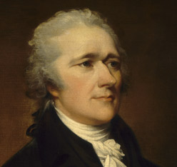
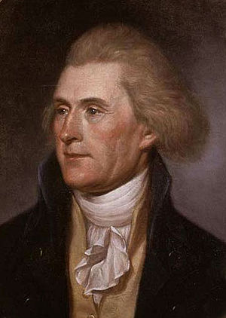
First Political Party System (1789-1824)
Alexander Hamilton
Thomas Jefferson
Federalists
National policies
Strong central government
Loose constructionists
Commerce and manufacturing
Urban
The rich, the well-born, the able; merchants, bankers
Pro-British
Anti-French revolution
Northeast
Democratic-Republicans
States rights
Strong local/state governments
Strict constructionists
Agricultural
Rural
Small farmers, plantation owners, artisans
Anti-British
Pro-French Revolution
West and South

Slide 29
Washington’s Farewell Address (1796)
Political Parties
Entangling Alliances
“I have already intimated to you the danger of parties in the State, with particular reference to the founding of them on geographical discriminations. Let me now take a more comprehensive view, and warn you in the most solemn manner against the baneful effects of the spirit of party generally. This spirit, unfortunately, is inseparable from our nature, having its root in the strongest passions of the human mind. It exists under different shapes in all governments, more or less stifled, controlled, or repressed; but, in those of the popular form, it is seen in its greatest rankness, and is truly their worst enemy. The alternate domination of one faction over another, sharpened by the spirit of revenge, natural to party dissension, which in different ages and countries has perpetrated the most horrid enormities, is itself a frightful despotism. But this leads at length to a more formal and permanent despotism. The disorders and miseries which result gradually incline the minds of men to seek security and repose in the absolute power of an individual; and sooner or later the chief of some prevailing faction, more able or more fortunate than his competitors, turns this disposition to the purposes of his own elevation, on the ruins of public liberty. Without looking forward to an extremity of this kind (which nevertheless ought not to be entirely out of sight), the common and continual mischiefs of the spirit of party are sufficient to make it the interest and duty of a wise people to discourage and restrain it.”
“The great rule of conduct for us in regard to foreign nations is in extending our commercial relations, to have with them as little political connection as possible. So far as we have already formed engagements, let them be fulfilled with perfect good faith. Here let us stop. Europe has a set of primary interests which to us have none; or a very remote relation. Hence she must be engaged in frequent controversies, the causes of which are essentially foreign to our concerns. Hence, therefore, it must be unwise in us to implicate ourselves by artificial ties in the ordinary vicissitudes of her politics, or the ordinary combinations and collisions of her friendships or enmities… It is our true policy to steer clear of permanent alliances with any portion of the foreign world; so far, I mean, as we are now at liberty to do it; for let me not be understood as capable of patronizing infidelity to existing engagements. I hold the maxim no less applicable to public than to private affairs, that honesty is always the best policy. I repeat it, therefore, let those engagements be observed in their genuine sense. But, in my opinion, it is unnecessary and would be unwise to extend them. Taking care always to keep ourselves by suitable establishments on a respectable defensive posture, we may safely trust to temporary alliances for extraordinary emergencies. Harmony, liberal intercourse with all nations, are recommended by policy, humanity, and interest. But even our commercial policy should hold an equal and impartial hand; neither seeking nor granting exclusive favors or preferences; consulting the natural course of things; diffusing and diversifying by gentle means the streams of commerce, but forcing nothing;”

Slide 30
Washington’s Precedents
Two terms
“Mr. President”
Cabinet
Neutrality
Special Relationship with Great Britain
Farewell Address

Slide 31
Evaluate the causes of the growth of the first two-party system in American politics
Context:
Thesis:

Slide 32
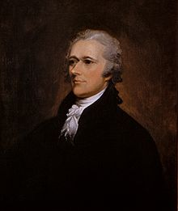
Hamilton’s Economic Plans
Reports on the Public Credit
Debt Problems
$75M debt between national government and states government
Worthless national currency
Little to no foreign credit
The Debt Plan
Federal government assumes national and state debts
Report on a National Bank
Manage revenues, currency, and debt
Private institution
“necessary and proper”
Sources of Revenue
Tariffs
Excise taxes
Report on Manufactures
Protective tariffs
Promotion of domestic industries
Opposition to Hamilton’s Debt and Bank Plans
Thomas Jefferson and James Madison
Unconstitutional
Mostly British financial investments
Undermine state governments and state banks
Favors bankers, merchants, speculators, business, northern commercial interests
Weakens farmers, western settlers, southern agrarian interests
Compromise
“Dinner Table Bargain”
Approval of Assumption Plan and National Bank
National capital in the South
Washington, D.C.
John Adams Debate

