Slide 1
Do Now
Rebirth of Conservatism in the 70s and 80s

Slide 2
7. The Resurgence of Conservatism-Reagan and the 1980s
Mr. Winchell
APUSH 2018-2019
Period 1-2

Slide 3
AP Prompt
Evaluate the extent to which Lyndon Johnson’s Great Society and Ronald Reagan’s “New Right” Revolution represented contrasting views on social issues, the role of the federal government, and foreign policy goals

Slide 4
Outline
Reagan’s Domestic Policies
Reagan’s Foreign Policies
The End of the Cold War
Legacies of a Century of Change

Slide 5
America Is Facing a Crisis of Confidence; The American Spirit Remains Strong
Jimmy Carter – “Crisis of Confidence Speech” (1979)
Ronald Reagan – “Acceptance Speech at the Republican National Convention” (1980)
The threat is nearly invisible in ordinary ways. It is a crisis of confidence. It is a crisis that strikes at the very heart and soul and spirit of our national will. We can see this crisis in the growing doubt about the meaning of our own lives and in the loss of a unity of purpose. The erosion of our confidence in the future is threatening to destroy the social and the political fabric of America… We are at a turning point in our history. There are two paths to choose. One is a path I’ve warned about tonight, the path that leads to fragmentation and self-interest. Down that road lies a mistaken idea of freedom, the right to grasp for ourselves some advantage over others. That path would be one of constant conflict between narrow interests ending in chaos and immobility, It is a certain route to failure. All the traditions of our past, all the lesson of our heritage, all the promises of our future point to another path, the path of common purpose and the restoration of American values. That path leads to true freedom for our Nation and ourselves. We can take the first steps down that path as we begin to solve our energy problem. Energy will be the immediate test of our ability to unite this Nation and it can also be the standard around which we rally.
Never before in our history have Americans been called upon to face three grave threats to our very existence, any one of which could destroy us. We face a disintegrating economy, a weakened defense, and an energy policy based on the sharing of scarcity… Tonight, let us dedicate ourselves to renewing the American Compact. I ask you not simply to “Trust me,” but to trust your values – our values – and to hold me responsible for living up to them. I ask you to trust the American spirit which knows no ethnic, religious, social, political, regional, or economic boundaries, the spirit that burned with zeal in the hearts of millions of immigrants from every corner of the earth who came here in search of freedom. Some say that spirit no longer exists. But I have seen it – I have felt it – all across the land, in the big cities, in the small towns, in rural America. The American spirit is still there, ready to blaze into life if you and I are willing to do what has to be done, the practical, down-to-earth things that will stimulate our economy; increase productivity, and put American back to work.

Slide 6
The Cold War Resumes
During the Carter years, the Cold War rivalry between the U.S. & USSR grew due to:
A new arms race as the U.S. adopted new MX missiles & Trident submarines
SALT II failed to make lasting arms reduction
Increased U.S.-Chinese relations put the USSR on the defensive

Slide 7
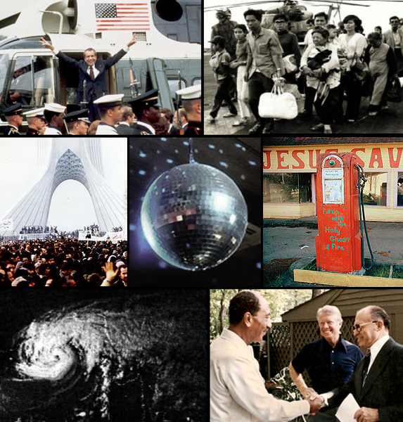
Conclusions on the 60’s and 70’s:
By 1980, the USA seemed to be losing its place as the top nation in the world:
The 1970s presented failures in the Cold War & new problems in the Middle East.
The social protests & counter culture seemed to divide liberals & conservatives.
Stagflation & the economic recession were growing worse, not better .
The failures of Johnson, Nixon, Ford, & Carter left citizens in search of optimism, strong leadership, & conservative policies.

Slide 8
The Sunbelt and Rustbelt
Why the Sunbelt?
Low taxes, warmer climates, defense industries, right-to-work, immigrants
Rustbelt
Deindustrialization due to globalization, domestic policies, demographics. migration

Slide 9
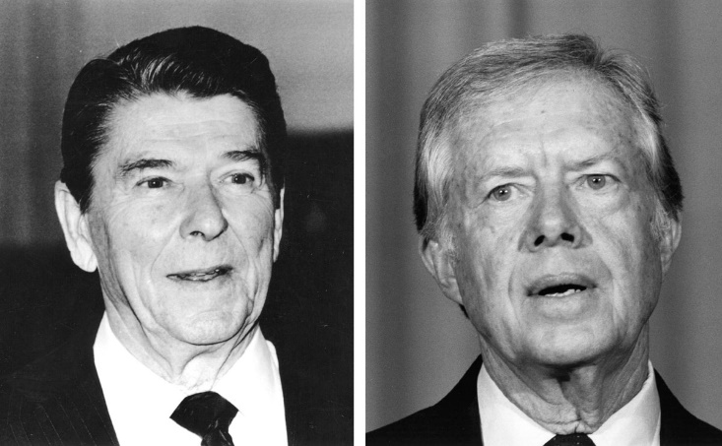
Election of 1980
Ronald Reagan (R)
Jimmy Carter (D)
Campaign
Debate
“Are you better now than you were four years ago?”

Slide 10
Conservative Backlash, 1965-1980
Conservatives react against changes in America during the 1960s
American foreign policy
“Lost Vietnam”
Affirmative Action
Women’s liberation

Slide 11
What caused this shift in American political thought?

Slide 12
The Growing Backlash
1978: Regents of U.C. v. Bakke
“Quotas” in college admissions were unconst.
1976: Hyde Amendment
Limited Medicaid funds for Abortion
Moral Majority, 1978
Southern Democrats become Republicans
Many working class whites in industrialized urban areas, and new suburbanites blamed immigrants and the poor for their condition, as well as economic decline of “Americans”

Slide 13
American Malaise
Soft America and “decline” of American power
OPEC and Oil Embargo
Stagflation
De-Industrialization
Iranian Hostage Crisis (Nov. 1979)
Ayatollah Khomeini overthrew Shah of Iran
50 Hostages for over a year
Failed rescue effort
USSR invaded Afghanistan (Dec. 1979)

Slide 14
The Three Parts of the Modern Republican Party
A. Economic Conservatives & Laissez-Faire: Low Taxes, Low Govt. Spending, Reduce Welfare
B. Cultural Conservatives & the Religious Right: Anti-Abortion, Anti-Gay Rights
C. Military Conservatives & War Hawks: Aggressive Military Spending

Slide 15
Supply-Side Economics “Reaganomics”
Cut taxes to put more money into the hands of businesses
Cut taxes on the wealthiest Americans
Lower taxes = more investment in the “supply side” of the economy
Would:
promote and create new jobs
encourage capital investment, and
lead to stimulated industrial growth
Economic Recovery Act of 1981 – Reduced taxes by 25% over 3 years.
Richest Americans received the biggest tax cut. Why?
Would use the money they saved to invest back in the economy in the form of new businesses.
Cut $40 billion from federal budget. Mostly on social programs.

Slide 16
Reaganomics
Benefits of “Reaganomics”
Inflation, unemployment, & the trade deficit all declined by 1990
Growth in service sector jobs
Disadvantages of “Reaganomics”
Industry jobs fell as companies used off-shore manufacturers with cheaper labor costs
Increased social inequalities
Huge federal deficits
16 million new jobs, unemployment below 6%, inflation fell to 4%

Slide 17
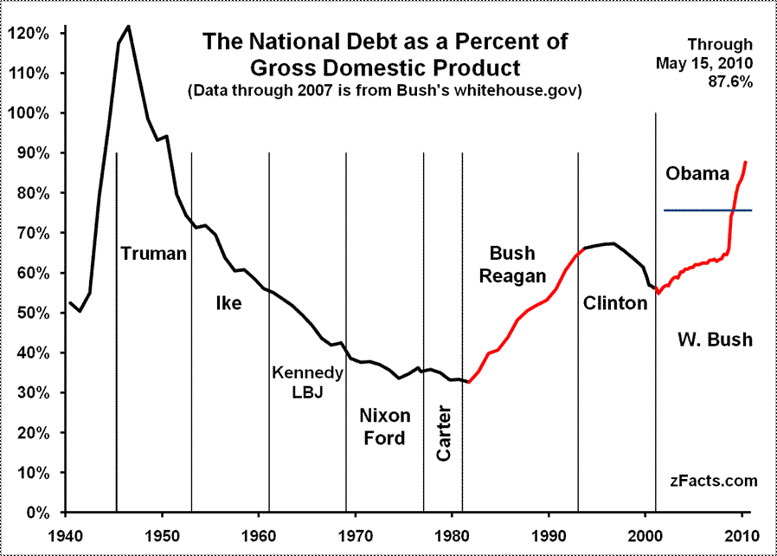
Did Reagan’s Style Equal Substance?
Reagan as an Economic Conservative?
Tax Cuts But Bigger Debt

Slide 18
Reagan: Economic Recession, and Recovery
1981-1982 Recession, them recovery
Inflation slowed, consumer spending increased
Stock market grew
Federal deficit grew even as domestic spending decreased
National debt = $909 billion in 1980 --- $3.2 trillion in 1990

Slide 19
Social Programs
The Reagan administration opposed major social reforms:
High school dropout rates & crime increased in the 1980s
Affirmative action & school busing programs to assist African-Americans were limited
Women’s abortion rights were attacked
But…Reagan appointed the 1st female Supreme Court justice, Sandra Day O’Conner
In Univ of California v Bakke (1978) ruled in favor of affirmative action but not purely quota systems
Notes:
Anti Reagan Hip Hop

Slide 20
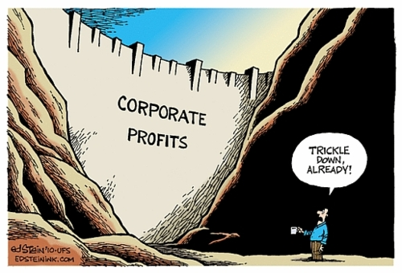

Slide 21
The War on Drugs
Mid-1980's--crack cocaine introduced
addiction spread through all classes
exploding crime rate
Reagan attempts interdiction of supply
Bush, Clinton continue Reagan policy
At the end of the century there seemed to be no end to the war on drugs

Slide 22
The War on Drugs
In the 1980s, cocaine use boomed, especially with the creation of “crack” cocaine
The Reagan administration declared a “war on drugs”:
Nancy Reagan’s “Just Say No” program helped educate kids
The federal gov’t failed to stop the flow of drugs into the U.S.
DEA, Customs, & Coast Guard attempts to keep drugs out
Negotiations with Peru, Bolivia, Colombia failed to limit drug smuggling
Notes:
‘How do you stop the Black Panthers? Ronald Reagan cooked up an answer…’

Slide 24
The AIDS Epidemic
The 1st documented cases of AIDS occurred in the 1980s:
1st cases were among gay men in San Francisco & NY in 1981
As cases were found in drug abusers & hemophiliacs, people worried about a contaminated national blood supply
Lack of sympathy for gays, budget cuts, & ignorance about HIV led to a limited government response
2,800 known AIDS cases by 1983
12,000 AIDS cases by 1985
50,000 AIDS cases by 1987
982,498 AIDS cases by 2006
Notes:
http://www.avert.org/usa-statistics.htm

Slide 25
Election of 1984
Ronald Reagan (R)
Walter Mondale (D)
Geraldine Ferraro as VP
Rainbow Coalition
Campaign`
Morning in America
Reagan’s Age

Slide 26
Reagan's Economic Legacy
The large deficits of the Reagan years were financed by many foreign countries, esp. Japan
Greater dependence on foreign investment for domestic economic stability – legacy?
By appearing to make new social spending both practically and politically impossible for the foreseeable future, though, the economic deficits served their purpose
They achieved Reagan's highest political objective: the containment of the welfare state

Slide 27
Trouble Spots in Latin America
Reagan attempted to resist Communism in Latin America
U.S. Marines invaded Grenada in 1983 to keep a radical regime from turning over an airfield to Cuba or the USSR
In 1979, Nicaraguan Sandinista rebels led a coup against a U.S.-backed regime
In 1983, Congress denied Reagan’s request to aid Nicaraguan efforts to overthrow the Sandinista gov’t (Contras)

Slide 28
The Iran-Contra Affair
In 1987, the Iran-Contra Affair rocked the Reagan administration:
To free 6 U.S. hostages in Iran, the NSC & CIA covertly sold missiles to Khomeini’s gov’t
Profits from missile sales were used to aid Nicaragua Contras
Reagan avoided implication through “plausible deniability”
The “Teflon President”

Slide 29
American hostages in Iran/Lebanon
Communist Sandinistas in Nicaragua
American weapons sold to Iran – hostages released
$$$ from Iran funneled to Contras in Nicaragua
Reagan denies knowledge - Why no 2nd Watergate?

Slide 30
Reagan & Rollback (1981-1989) Soviet Union and Gorbachev
“Evil Empire”
Strategic Defense System (SDI) - “Star Wars”
Brandenburg Gate
"Mr. Gorbachev, Tear Down This Wall."
Mikhail Gorbachev’s Reforms
Glasnost
Openness and freedom of expression
Perestroika
Gradual capitalist reforms

Slide 31
Challenging the "Evil Empire"
Reagan viewed the USSR as the "focus of evil in the modern world” & as a threat to U.S. security
Maintained a hard-line approach
Sent 572 nukes within range of Moscow to match USSR ICBMs aimed at NATO nations
Began the Strategic Defense Initiative, an anti-missile laser system in space to defend U.S.
SDI was dubbed the “Star Wars” program

Slide 32
Ending the Cold War
Gorbachev cut the Soviet defense budget, withdrew Soviet troops from Afghanistan, & promoted the democratization of former satellite nations in Eastern Europe
Introducing moderate capitalism into the Soviet economy such as legalization of small private business cooperatives, relaxed laws prohibiting land ownership, & approval of foreign investment within the USSR
Reagan’s most important foreign policy triumph was working with new USSR leader Mikhail Gorbachev to end the Cold War:
In 1985, Mikhail Gorbachev began perestroika & glasnost & eased Cold War tensions
The Reagan-Gorbachev summits from 1986 to 1988 led to a reduction of nuclear arms
“Political openness” led to freedom of press, assembly, travel, & religion; the 1st working legislature; the 1st competitive elections; & liberation of hundreds of political prisoners
Notes:
In 1982, 75-year-old Soviet party leader Leonid Brezhnev died. Growing stagnation, corruption, and a huge military buildup had marked his regime. Initially, the post-Brezhnev era seemed to offer little change in U.S.-Soviet relations. KGB leader Yuri Andropov succeeded Brezhnev, but died after only 15 months in power. Another Brezhnev loyalist, Konstantin Chernenko, who died just a year later, replaced him. In 1985, Soviet party leadership passed to Mikhail S. Gorbachev, a 54-year-old agricultural specialist with little formal experience in foreign affairs. Gorbachev pledged to continue the policies of his predecessors.
Within weeks, however, Gorbachev called for sweeping political liberalization (glasnost) and economic reform (perestroika). He allowed wider freedom of press, assembly, travel, and religion. He persuaded the Communist party leadership to end its monopoly on power; created the Soviet Union's first working legislature; allowed the first nationwide competitive elections in 1989; and freed hundreds of political prisoners. In an effort to boost the sagging Soviet economy, he legalized small private business cooperatives, relaxed laws prohibiting land ownership, and approved foreign investment within the Soviet Union.
In foreign affairs, Gorbachev completely reshaped world politics. He cut the Soviet defense budget, withdrew Soviet troops from Afghanistan and Eastern Europe, allowed a unified Germany to become a member of NATO, and agreed with the United States to destroy short-range and medium-range nuclear weapons. Most dramatically, Gorbachev actively promoted the democratization of former satellite nations in Eastern Europe. For his accomplishments in defusing Cold War tensions, he was awarded the 1990 Nobel Peace Prize.

Slide 33
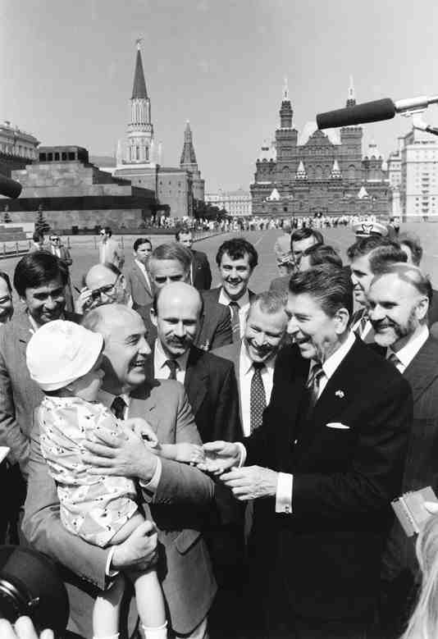
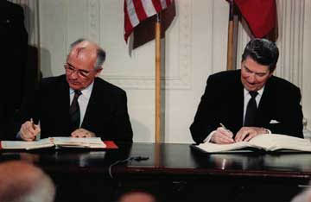
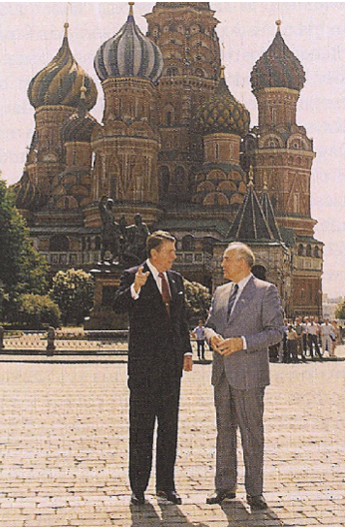
In 1987, Reagan & Gorbachev signed the INF Treaty eliminating ICBMs in Europe

Slide 34
The End of the Cold War
In 1989, Gorbachev’s promotion of democratization in Eastern Europe inspired the overthrow of 40 years of communist rule
In 1990, following the example of Eastern Europe, many Soviet republics within the USSR demanded independence, leading to…
Notes:
For 40 years, Communist Party leaders in Eastern Europe had ruled confidently. Each year their countries fell further behind the West; yet, they remained secure in the knowledge that the Soviet Union, backed by the Red Army, would always send in the tanks when the forces for change became too great. But they had not bargained on a liberal Soviet leader like Mikhail Gorbachev.
As Gorbachev moved toward reform within the Soviet Union and détente with the West, he pushed the conservative regimes of Eastern Europe outside his protective umbrella. By the end of 1989, the Berlin Wall had been smashed. All across Eastern Europe, citizens took to the streets, overthrowing 40 years of Communist rule. Like a series of falling dominos, Communist parties in Poland, East Germany, Hungary, Czechoslovakia, Romania, and Bulgaria fell from power.
Gorbachev, who had wanted to reform communism, may not have anticipated the swift swing toward democracy in Eastern Europe. Nor had he fully foreseen the impact that democracy in Eastern Europe would have on the Soviet Union. By 1990, leaders of several Soviet republics began to demand independence or greater autonomy within the Soviet Union.
Gorbachev had to balance the growing demand for radical political change within the Soviet Union with the demand by Communist hardliners. The hardliners demanded that he contain the new democratic currents and turn back the clock. Faced with dangerous political opposition from the right and the left and with economic failure throughout the Soviet Union, Gorbachev tried to satisfy everyone and, in the process, satisfied no one.
In 1990, following the example of Eastern Europe, the three Baltic states of Lithuania, Latvia, and Estonia announced their independence, and other Soviet republics demanded greater sovereignty. Nine of the 15 Soviet republics agreed to sign a new union treaty, granting far greater freedom and autonomy to individual republics. But in August 1991, before the treaty could be signed, conservative Communists tried to oust Gorbachev in a coup d'etat. Boris Yeltsin, the President of the Russian Republic, and his supporters defeated the coup, undermining support for the Communist Party. Gorbachev fell from power. The Soviet Union ended its existence in December 1991, when Russia and most other republics formed the Commonwealth of Independent States.

Slide 35
Conclusions
Reagan was the 1st president to serve 2 full terms since Eisenhower
Reagan’s supporters claim he restored the economy, military, patriotism, family values, & America’s place as a world power
Reagan’s detractors claim he removed social safety-nets, skirted Congress in foreign policy, & tripled the national debt
Notes:
In the presidential election of 1984, Ronald Reagan and Vice President George Bush won in a landslide over Walter Mondale and Geraldine Ferraro. Ferraro was the first woman nominated for vice president on a major party ticket. Although Reagan's second term was plagued by the Iran-Contra scandal, he left office after eight years more popular than when he arrived. He could claim the distinction of being the first president to serve two full terms since Dwight Eisenhower.
Ronald Reagan could also point to an extraordinary string of accomplishments. He dampened inflation, restored public confidence in government, and presided over the beginning of the end of the Cold War. He doubled the defense budget, named the first woman to the Supreme Court, launched a strong economic boom, and created a heightened sense of national unity. In addition, his supporters said that he restored vigor to the national economy and psyche, rebuilt America's military might, regained the nation's place as the world's preeminent power, restored American patriotism, and championed traditional family values.
On the other hand, his detractors criticized him for a reckless use of military power and for circumventing Congress in foreign affairs. They accused Reagan of fostering greed and intolerance. His critics also charged that his administration, in its zeal to cut waste from government, ripped the social safety net and skimped on the government's regulatory functions. The administration, they further charged, was insensitive on racial issues. Reagan's detractors were particularly concerned about his economic legacy. During the Reagan years, the national debt tripled, from $909 billion to almost $2.9 trillion (the interest alone amounted to 14 percent of the federal budget). The deficit soaked up savings, caused interest rates to rise, and forced the federal government to shift more and more responsibilities onto the states. Corporate and individual debt also soared. During the early 1990s, the American people consumed $1 trillion more goods and services than they produced. The United States also became the world's biggest debtor nation, as a result of a weak dollar, a low level of exports, and the need to borrow abroad to finance budget deficits.

Slide 36
Election of 1988
George H.W. Bush (R)
Michael Dukakis (D)
Campaign
“Read my lips. No new taxes.”
Dukakis in the Tank
Willie Horton ad

Slide 37
George H.W. Bush (R) (1989-1993)
American with Disabilities Act (1990)
Recession (1990-1991)
Savings and Loan Crisis
27th Amendment (1992)
Foreign Developments
Persian Gulf War (1991)

Slide 38
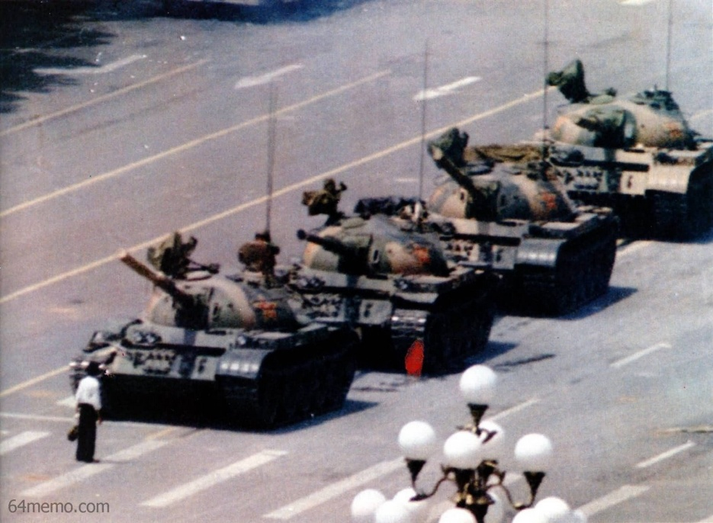
George H.W. Bush (R) (1989-1993) End of Cold War
Iron Curtain Falls
Germany
Berlin Wall falls (1989) and Reunification (1990)
Eastern Europe
Poland and Solidarity
Soviet Union
Dissolution (1991)
START I (1991) and START II (1993)
China and Tiananmen Square (1989)

Slide 39
H.W. Bush & End of Cold War (1989-1993) Panama and Persian Gulf War and Somalia
Operation Just Cause (1989-1990)
Invasion of Panama
Operation Desert Storm (1991)
Iraq invaded Kuwait
Coalition victory over Iraq
Operation Restore Hope (1992-1993)
Somalia
Continued through Clinton administration

Slide 40
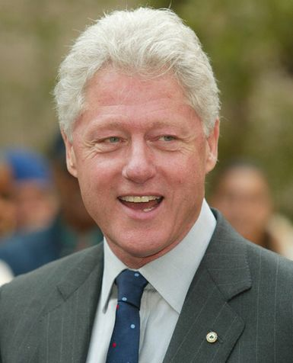
Bill Clinton (D) (1993-2001) Foreign Policy
North American Free Trade Agreement (NAFTA) (1993)
Bosnia (1995-1999)
Globalization
World Trade Organization (WTO)
World Bank
International Monetary Fund (IMF)
Group of 8 (G-8)
Foreign Policy Shifter, 1994
Seattle Post-Intelligencer

Slide 41
Bill Clinton (D) (1993-2001)
North Atlantic Free Trade Agreement (NAFTA) (1994)
Republican Revolution (1994)
Contract with America
Newt Gingrich
Welfare Reform Act (1996)
Lewinski Scandal and Impeachment
Social and Cultural Developments
Internet
Foreign Developments
Bosnia

Slide 42
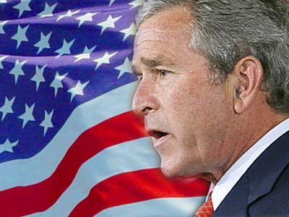
George W. Bush (R) (2001-2009) War on Terror
9/11
Bush Doctrine
Afghanistan
Iraq
Homeland Security
USA PATRIOT Act

Slide 43
Barack Obama (D) (2009-2017)
Great Recession (2007-2009)
American Recovery and Reinvestment Act (2009)
Patient Protection and Affordable Care Act (2010)
“Obamacare”
Tea Party and 2010 Mid-Term Elections
Social and Cultural Developments
Gay Rights
Repeal of “Don’t Ask, Don’t Tell”
Same-sex marriage and DOMA
Foreign Developments
Arab Spring
ISIL

Slide 44
Great Recession and Recovery

