Slide 1
Do Now
Washington’s Farewell Address…
What specifically is he warning Americans against? Why?

Slide 2
Adams’ Presidency: The End of Federalist Control and the Alien & Sedition Acts
Mr. Winchell
APUSH 2018-2019
Period 3

Slide 3
AP Prompt
Evaluate the causes for the fall of the Federalist Party from power, accounting for financial and political factors.

Slide 4
First Political Parties
 | Federalists | Democratic-Republicans
Leaders | John Adams and Alexander Hamilton | Thomas Jefferson
National Govt | Believed in a strong national government | Believed in a weak national government
Economy | Industrial economy | Agricultural economy
Supporters | Bankers and business interests in the Northeast. | Farmers, artisans, and frontier settlers in the South

Slide 6
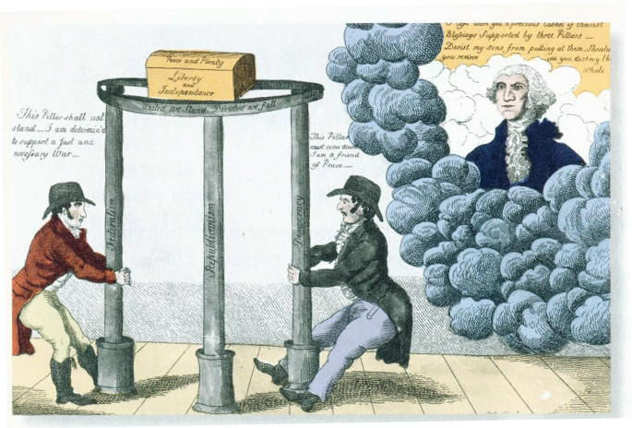

Slide 7
The French Question
During Washington’s first term (1788-1792), the French Monarchy was overthrown by the people in an attempt to establish their own republic.
French declared themselves a “republic” but carnage heavier than in American Rev.
Jeffersonians thought it unfortunate, but probably necessary
Hamiltonians thought it downright frightening
FEAR OF MOB RULE
During the Revolution, the US formed an alliance with the French monarchy
The British attempted to take advantage of the situation and also began a war with France.

Slide 8
The French Question
Republicans pushed for the US gov to honor the alliance and come to the aid of the French
The Federalists stated that the alliance had been formed with the French Monarchy, and therefore no longer existed.
They actually openly supported the British as they did not want to support a bloody and violent revolution in fears of it happening again in the US

Slide 9
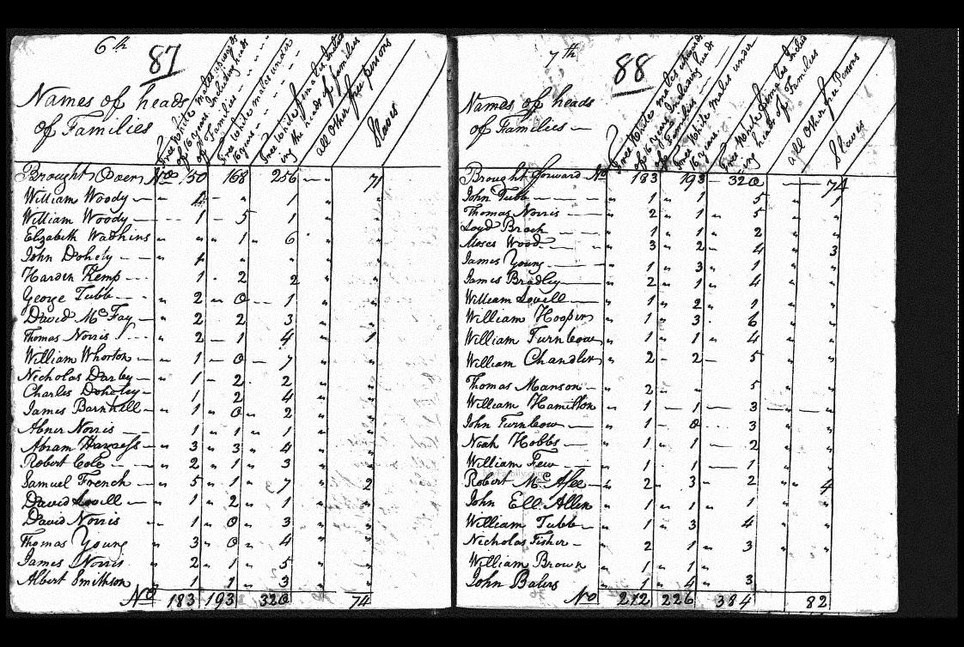
America in 1790
Population nearly 4 million
doubling every 25 years
90% of Americans lived on farms
Public debt large ($52 million) – revenue low.
Threats from GB and Spain threatened fragile unity of US

Slide 10
Women in the New Republic
Limited political and property rights
Increased marital rights
“Republican motherhood”
Raise virtuous citizens
Increased educational opportunities
James Peale, The Artist and His Family (1795)

Slide 11
Blacks and Slaves in the New Republic
Thomas Jefferson, Declaration of Independence (1776)
Benjamin Banneker, Letter to Thomas Jefferson (1791)
We hold these truths to be self-evident, that all men are created equal, that they are endowed by their Creator with certain unalienable rights, that among these are life, liberty, and the pursuit of happiness.
…Sir, how pitiable is it to reflect, that although you were so fully convinced of the benevolence of the Father of Mankind, and of his equal and impartial distribution of these rights and privileges, which he hath conferred upon them, that you should at the same time counteract his mercies, in detaining by fraud and violence so numerous a part of my brethren, under groaning captivity and cruel oppression, that you should at the same time be found guilty of that most criminal act, which you professedly detested in others, with respect to yourselves.

Slide 12
Percentage of Free Blacks of Total Black Population (1800)
Massachusetts - 100%
7,378 Free Blacks
Vermont - 100%
557 Free Blacks
New Hampshire - 99%
855 Free Blacks
Rhode Island - 90%
3,304 Free Blacks
Pennsylvania - 89%
14,564 Free Blacks
Connecticut - 85%
5,300 Free Blacks
Delaware - 57%
8,268 Free Blacks
New York - 33%
10,374 Free Blacks
New Jersey - 26%
4,402 Free Blacks
Maryland - 16%
19,587 Free Blacks
Virginia - 6%
20,124 Free Blacks
North Carolina - 5%
7,043 Free Blacks
South Carolina - 2%
3,185 Free Blacks
Georgia - 2%
1,019 Free Blacks
Kentucky - 2%
741 Free Blacks
Tennessee - 2%
309 Free Blacks
United States - 11%
108,395 Free Blacks
Total U.S. Population:
5.3 million
Total Black Population:
1 million

Slide 13
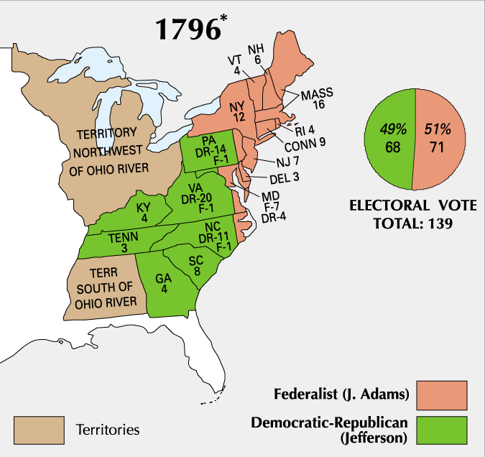
Election of 1796
Notes:
Electoral College Explanation

Slide 14
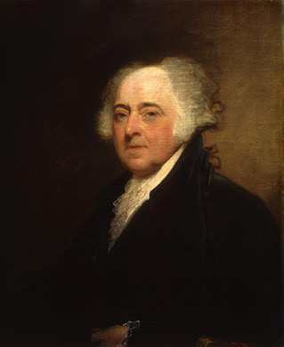
A New President
John Adams
Boston
Federalist

Slide 15
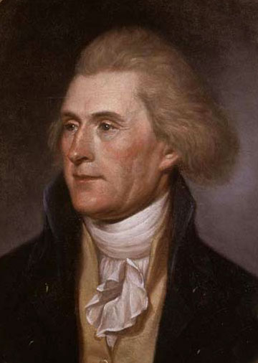
Vice President
Thomas Jefferson
Virginian
Republican (Democratic-Republican)
Became VP because he received second-most votes
At odds with Adams

Slide 16
Relations with France
France very upset about Jay’s Treaty
Saw it as a precursor to an alliance with Britain
France wanted the U.S. to honor the Franco-American Alliance of 1778
France began to attack U.S. ships and seizing American cargo
300 ships and $20 million of cargo was lost

Slide 17
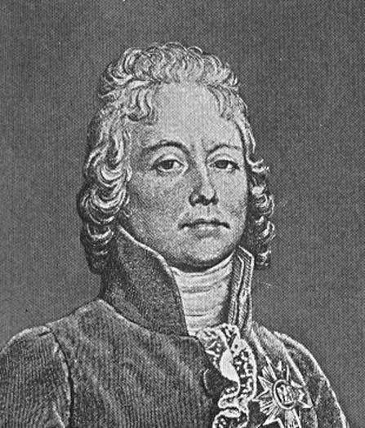
XYZ Affair (1797)
Delegation sent to France to meet with French Foreign Minister Charles Talleyrand
Three French delegates X, Y, & Z demanded $12 million loan & a cash bribe just for a meeting
Americans insulted & came home
Report published & started Anti-French sentiment at home

Slide 18
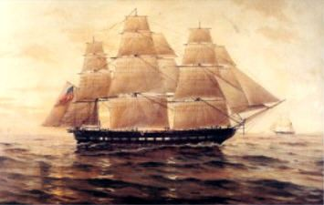
Quasi-War (1798-1800)
U.S. began an undeclared war against France
Was purely navel – fought mainly in the Caribbean
Adams had to quickly expand the 3 ship navy & an army of 10,000 men was authorized

Slide 19
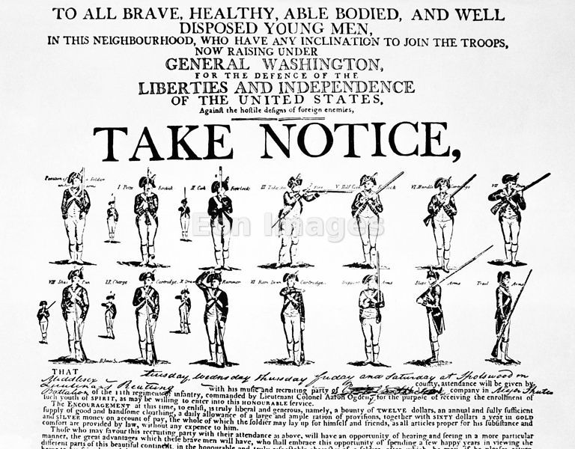
War Avoided
John Adams sent new envoy to France in 1800
Napoleon accepted – more bent on European conquest, not war with US
Improved Relations made Louisiana Purchase possible 3 years later.
Adams felt dodging this bullet was his finest achievement.

Slide 20
President Adams’ handling of the conflict with France led to criticisms by Democratic-Republicans
Federalists in Congress passed the Alien & Sedition Acts
The laws made it a crime to criticize government leaders, restricted citizenship for new immigrants, and made deporting immigrants easier
This attack on free speech and citizenship backfired and badly damaged President Adams and the Federalist Party

Slide 21
Alien & Sedition Acts
Four Bills
Naturalization Act
Alien Friends Act
Alien Enemies Act
Sedition Act

Slide 22
Naturalization Acts
 | 1790 | 1795 | 1798
Notice time | no notice required | 3 years | 5 years
Residence period | 2 years | 5 years | 14 years
Target: potential English & Irish immigrants who would likely vote for the Jeffersonian Republicans

Slide 23
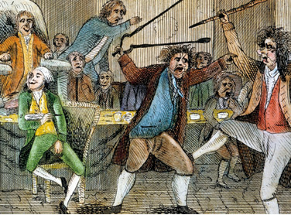
Alien and Sedition Acts (1798)
Purpose: to reduce power of Jeffersonians and silence anti-war opposition
Alien Act
Attack on pro-Jeffersonian “aliens”
Raised residency requirements for US citizenship from 5 yrs to 14 yrs.
President could deport “dangerous” foreigners.
Sedition Act
Anyone who impeded policies of the gov’t or falsely criticized its officials would get heavy fine and imprisonment.
Direct violation of 1st Amendment
Expired day before Adams left office.

Slide 24
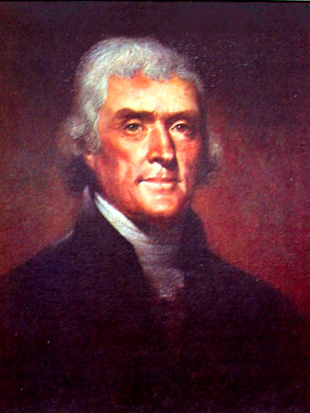
Nullification
Jefferson and many states oppose the Alien & Sedition Acts
Virginia & Kentucky Resolutions call the act “null and void”
States vs. federal government: who wins?...
…principle remained untested because Adams lost next election to Jefferson

Slide 25
Constitutional Theories
Contract Theory
Compact Theory

Slide 26
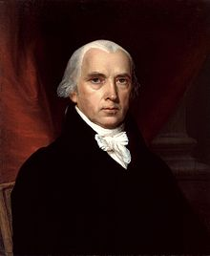
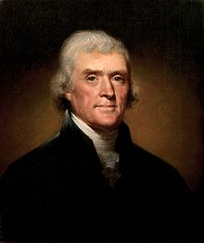
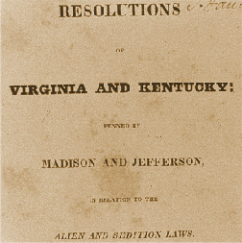
Virginia and Kentucky Resolutions (1798)
Republicans felt Alien and Sedition Acts were unconstitutional
Jefferson and Madison secretly penned two resolutions that asserted that states have the right to nullify unconstitutional laws passed by Congress.
Federalists retorted that the people, not states created Constitution and that the Supreme Court and not states determined the constitutionality of laws.
No other states but VA and KY adopted resolutions, but southern states would use this later in 19th century to support nullification and secession.

Slide 27
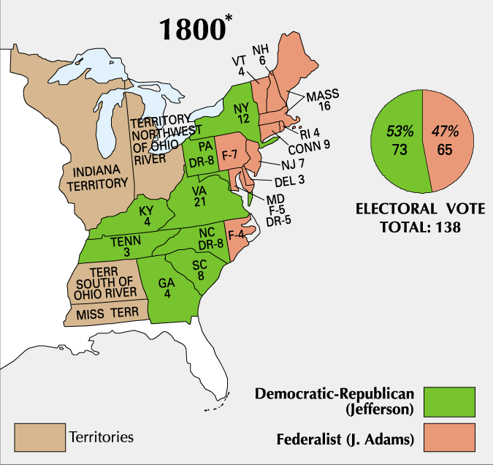
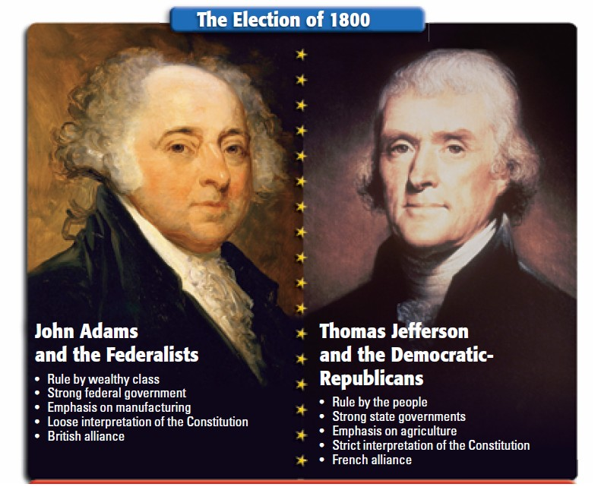
Adams and his Federalist Party were unpopular by the election of 1800
Republican Jefferson defeated Adams in the election of 1800
The 1800 election marked the first time in U.S. history when one political party transferred power to another political party
Jefferson’s victory over Adams marked the beginning of 30 years of dominance by the Democratic-Republican Party

Slide 28
The End of the Federalist Era
Though their time in power was a brief 12 years, the Federalist Party left a significant legacy
Strengthened the national government.
Established a solid financial system
Encouraged American industry growth
Avoided war with both Britain and France, signed key treaties with Britain and Spain

Slide 29
Federalist Loss Factors
Political Base of Power
Economic Base of Power
Regional Base of Power
Alien & Sedition Acts

Slide 30
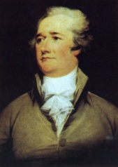
The First Two-Party System
Issue
Government: State or national?
Interpretation of the Constitution: Strict or Loose?
Tariffs, Banks & Business or farming?
Banks: National or State?
Defense: Standing Army or Militias?
Foreign Policy: Support Britain or Support France?
Regions of Support: N, S, E, W?
Nullification
More important: Order or Liberty?
Party Leaders & Presidents
Federalists Democratic-Republicans
National
State
Questions
Why does the Electoral College encourage a two-party system rather than a multiparty system?
Explain how Thomas Jefferson’s election in the “revolution” of 1800 changed the way the federal (national) government operated.

Slide 32
Thesis Write
AP Prompt
Evaluate the causes of the downfall of the Federalist Party, accounting for financial and political factors.

