Slide 1
Do Now
What was the general theme and purpose of Lincoln’s First Inaugural Address? Why?

Slide 2
8. Social Change in Civil War America: War as a Catalyst for Progress
Mr. Winchell
APUSH
Period 5

Slide 3
AP Prompt
Evaluate the extent to which military actions and events created political change during the Civil War.

Slide 4
Outline
Move Towards Emancipation
Responses to Emancipation
Gettysburg and the Address
Towards Hard War-Sherman and Grant’s Civil War
The Election of 1864
The Collapse of the Confederacy

Slide 5
Outline
Today’s Texts!
Douglass on Slavery & the War
Emancipation Proclamation
Gettysburg Address
Lincoln’s Second Inaugural Address

Slide 6
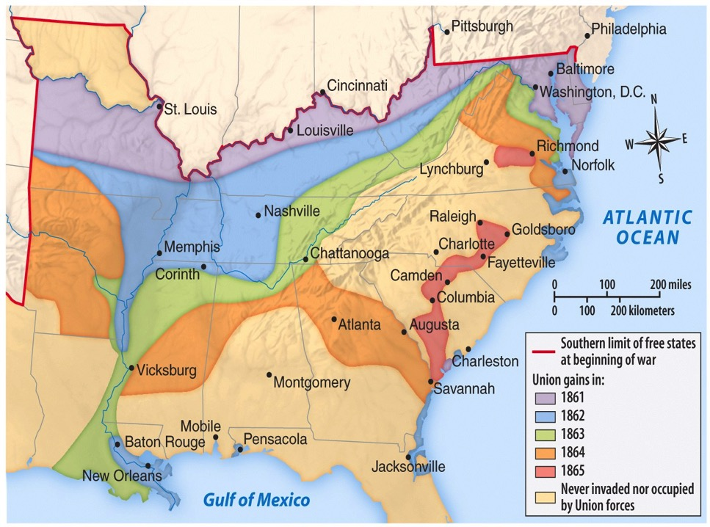
Eastern Theater
Western Theater

Slide 7
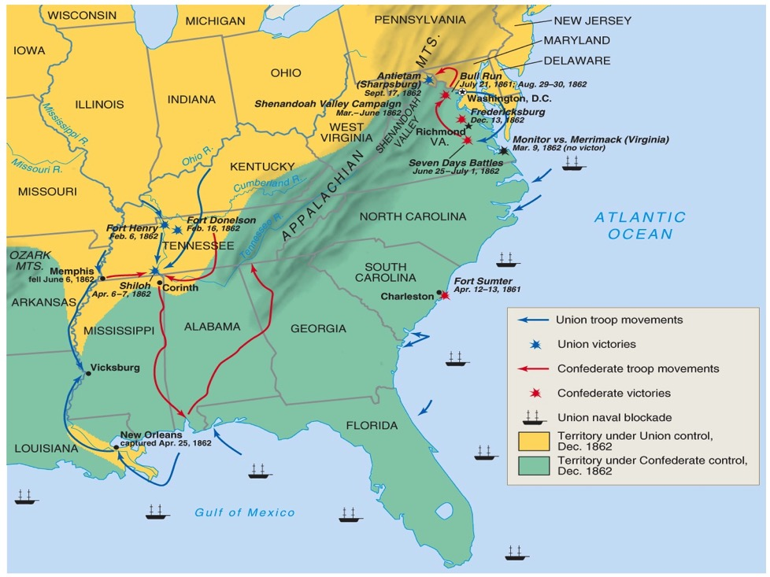
Theater/Battles 1862

Slide 8
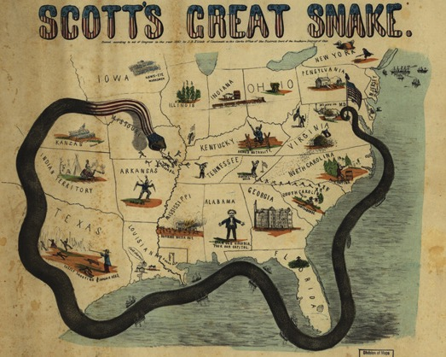
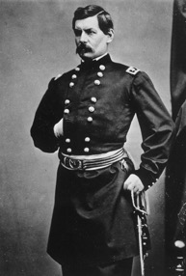
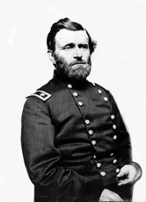
Winfield Scott’s Anaconda Plan
Southern strategy was an “offensive defense”: drag out the war & strategically attack the North to destroy Northern morale
Take the CSA capital at Richmond
Take control of the Mississippi River
George McClellan was in charge of Army of the Potomac
Ulysses Grant in the West
Divide the West from South
Blockade the Southern coast
Notes:
This plan maximized the North’s industrial advantages but required better leadership than North had

Slide 9
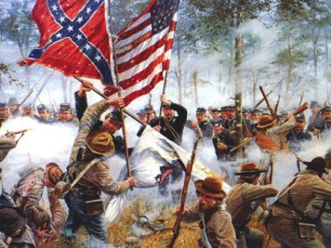
Turning Points of the Civil War
First Battle of Bull Run (July 1861)
First major battle of the war
Union significantly defeated by Confederates
Myth of quick war leads to realization of long and costly war
Antietam (September 1862)
Robert E. Lee defeated by George McClellan
Bloodiest day in war: 22,000 killed or wounded
Lincoln soon issues Emancipation Proclamation
Vicksburg (May-July 1863)
Union control of the Mississippi River, cutting the CSA in two
Gettysburg (July 1863)
CSA’s Lee’s offensive into Pennsylvania to force peace by the Union or earn foreign support
Pickett’s Charge and failure and near destruction of CSA military
Deadliest battle of the entire war: over 50,000 casualties
Widely considered the turning point of the war for a Union victory

Slide 10
Frederick Douglass
The Reasons for Our Troubles (FTR 581)

Slide 11
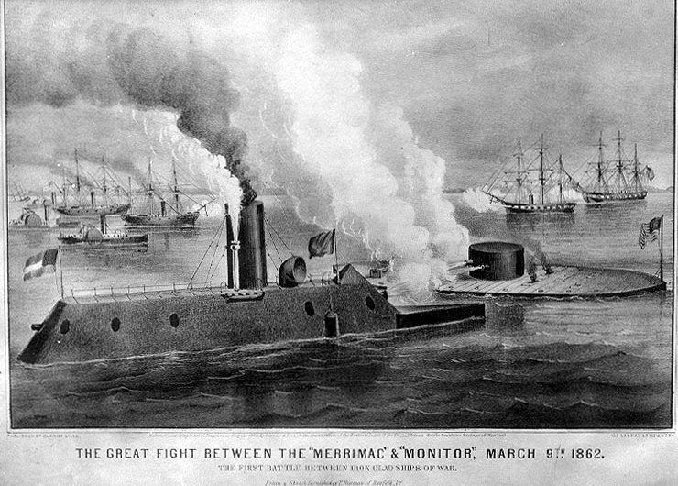
Early Activity (1861-2) – The South is Winning!
The war at Sea
North blockaded the southern ports (made it harder to get supplies internationally to support their war effort).
Southern response:
Illegal blockade running – hunted by Union ships.
Updated new ships wooden ships called “Ironclads” – took RR metal and covered ships to prepare for battle.
Two most famous in battle: Southern Merrimack vs. Northern Monitor.

Slide 12
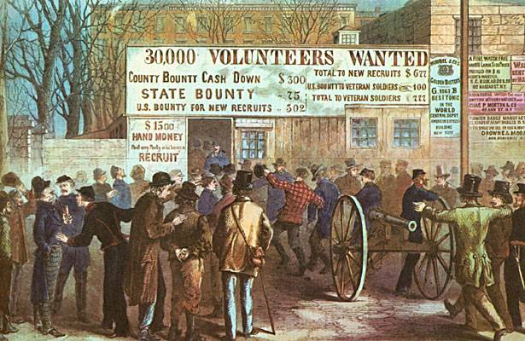
Early Mobilization - Conscription
At 1st – both sides called for volunteers only, but…
Eventually drafts (conscription) were installed:
North - you could pay someone else to take your spot or pay a fee to the government to not draft you, can be exempt due to medical reasons or a office holder.
South - those who owned large numbers of slaves were exempt.
A rich man’s war – A poor man’s fight!
Caused wide opposition (esp. in the North) - large-scale draft riots in northern cities (ex: Gangs of New York).
Most opposition came from laborers, immigrants, and Democrats.

Slide 13
Text Analysis
Frederick Douglass “The Reason for Our Troubles”

Slide 14
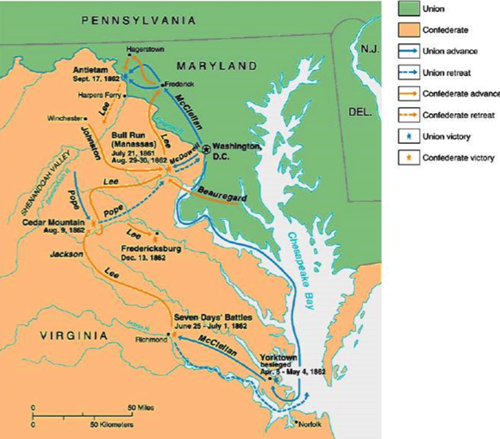
Battle of Antietam

Slide 15
Battle of Antietam
Battle | Date | CSA General | USA General | Winner | Significance
Battle of Antietam | Sept. 1862 | Lee | McClellan | USA | Union foiled Lee’s invasion of the North Lincoln issued Emancipation Proclamation Ended hopes of foreign aid for CSA McClellan didn’t pursue, so Lincoln permanently revoked McClellan’s command

Slide 16
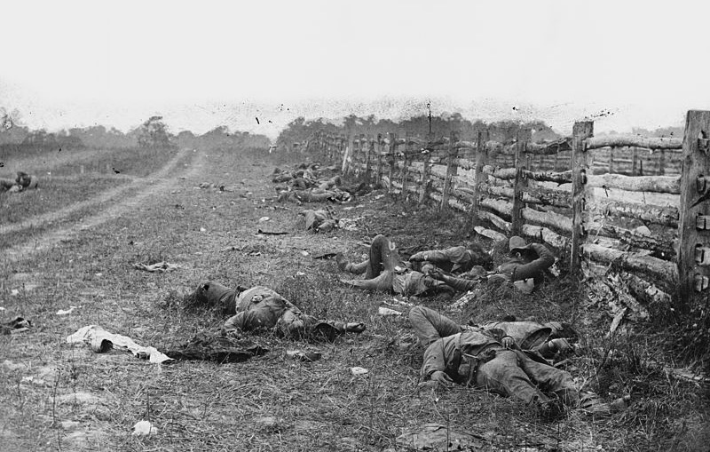
Battle of Antietam

Slide 17
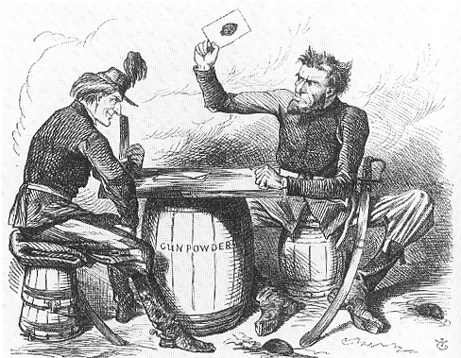

Slide 18
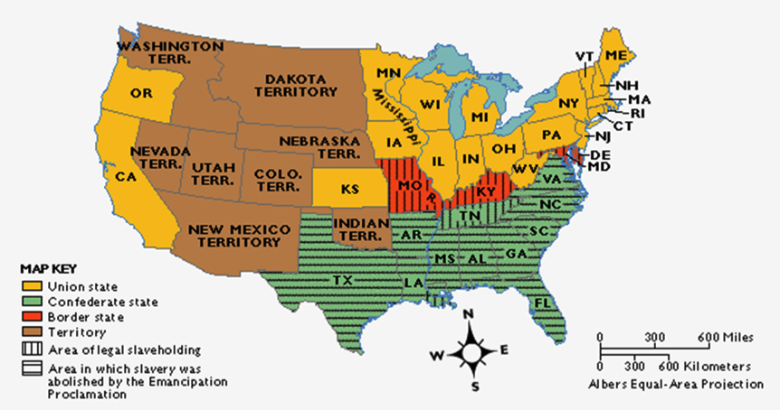
Emancipation Proclamation
The border states could keep their slaves (until 13th amendment passed in 1865)

Slide 19
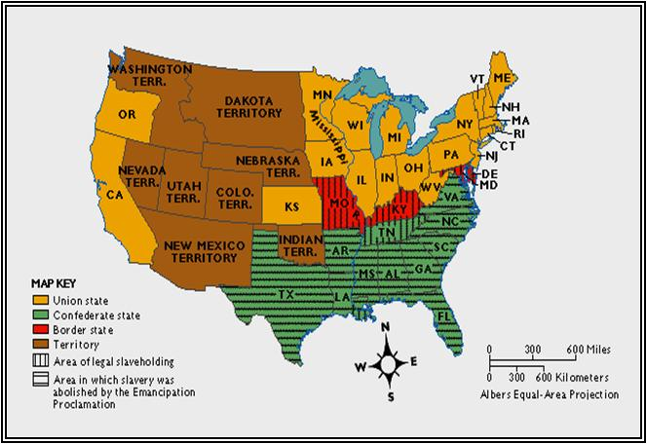
EMANCIPATION PROCLAMATION
Kept Great Britain from siding with the South
and becoming an ally.
War was now a war to
abolish slavery
destroy the South
preserve the Union
ALSO…no chance of a negotiated settlement
Notes:
On January 1, 1863, Lincoln said,
“the character of the war will be changed. It will be one of subjugation . . . .The (

Slide 20
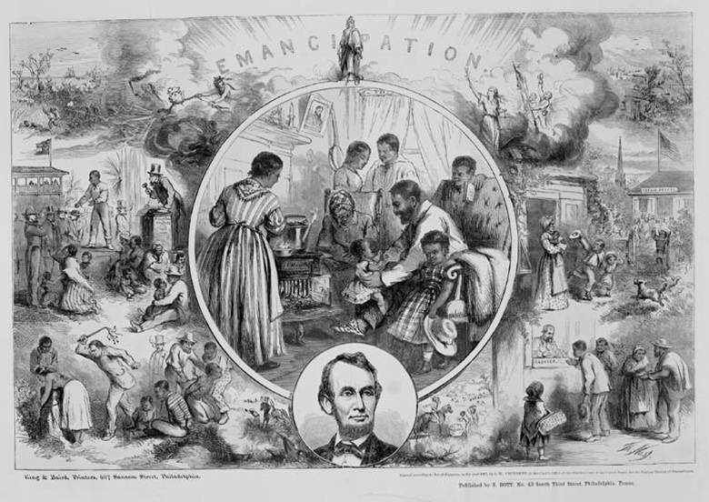

Slide 21
Foner on Lincoln’s Failures

Slide 22
Politics and the Civil War
Radical Republicans
Believed Lincoln to be too lenient with Confederacy
Demanded abolitionism and equality as major goals of the war
Conservative Republicans
Do not support Lincoln’s evolution to make slavery a cause of the war
War Democrats
Unionists who supported aggressive policies toward the Confederacy
Andrew Johnson (D-TN)
Copperheads/Peace Democrats
Jackson Democrat-types who supported an immediate peace settlement with the Confederacy
Concentrated in the Ohio River Valley and urban wards
Clement Vallandigham (OH)
"To maintain the Constitution as it is, and to restore the Union as it was"
George H. Pendleton (OH)
Fernando Wood (NY)
Horatio Seymour (NY)

Slide 23
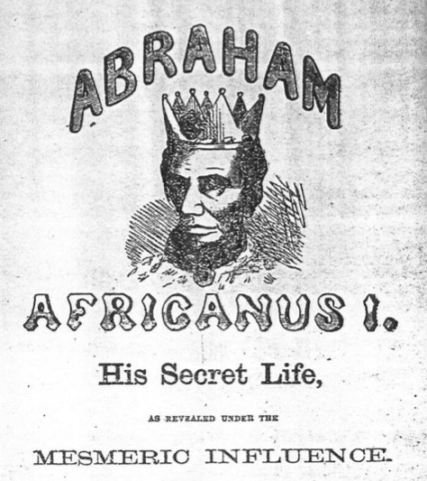
Copperhead Propaganda

Slide 24
Riots Over the Draft

Slide 25
The Union and Blacks/Slaves
The idea of ending slavery was difficult for Lincoln
Border states were slave states, ex. Kentucky
Slavery is constitutional
Racism in the North and among Democrats
Re-election in 1864?
Confiscation Acts (1861, 1862)
Captured fugitive slaves not to be returned to owners and forfeited to the Union army (contraband)
Emancipation Proclamation (January 1, 1863)
“freed” slaves in Confederate states
Slavery became an “official” cause of war
Army of Freedom
54th Massachusetts (Glory) - unequal pay
200,000 participants; 37,000 casualties
Thirteenth Amendment (December 1865)
“If slaves will make good soldiers, our whole theory of slavery is wrong.” - Georgia general

Slide 26
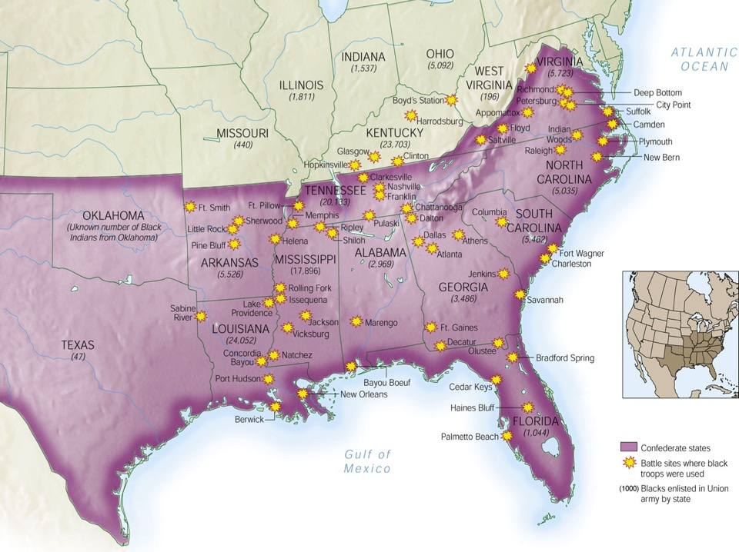
African Americans in Civil War

Slide 27
Battle of Gettysburg
Battle | Date | CSA General | USA General | Winner | Significance
Battle of Gettysburg | July 1863 | Lee | Meade | USA | Union foiled Lee’s 2nd invasion of the north Confederacy could not continue to replace large losses of soldiers HIGH POINT OF THE CSA Lincoln’s Gettysburg Address redefined the meaning of the war

Slide 28
Gettysburg Address
Four score and seven years ago our fathers brought forth on this continent a new nation, conceived in liberty, and dedicated to the proposition that all men are created equal. Now we are engaged in a great civil war, testing whether that nation, or any nation, so conceived and so dedicated, can long endure. We are met on a great battle-field of that war. We have come to dedicate a portion of that field, as a final resting place for those who here gave their lives that that nation might live. It is altogether fitting and proper that we should do this.
But, in a larger sense, we can not dedicate, we can not consecrate, we can not hallow this ground. The brave men, living and dead, who struggled here, have consecrated it, far above our poor power to add or detract. The world will little note, nor long remember what we say here, but it can never forget what they did here. It is for us the living, rather, to be dedicated here to the unfinished work which they who fought here have thus far so nobly advanced. It is rather for us to be here dedicated to the great task remaining before us—that from these honored dead we take increased devotion to that cause for which they gave the last full measure of devotion—that we here highly resolve that these dead shall not have died in vain—that this nation, under God, shall have a new birth of freedom—and that government of the people, by the people, for the people, shall not perish from the earth.

Slide 29
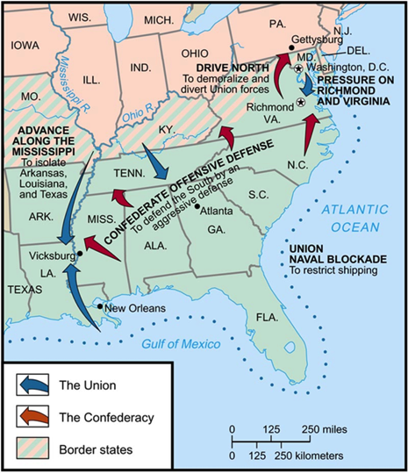
Siege of Vicksburg

Slide 30
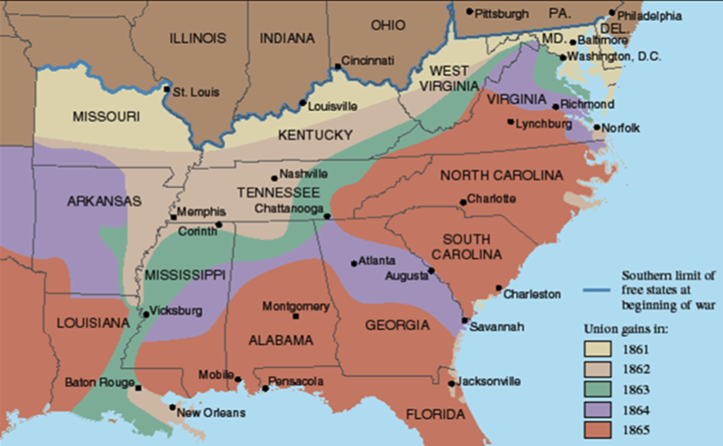
Slow Progress of the War

Slide 31
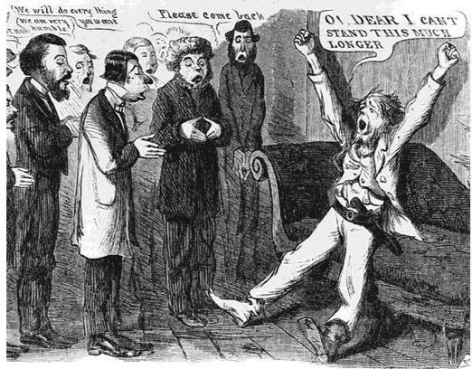
“Peace” Democrats
Opposed emancipation
Wanted immediate end to war
Wanted to restore Confederacy to the Union through negotiation
Nicknamed “Copperheads”

Slide 32
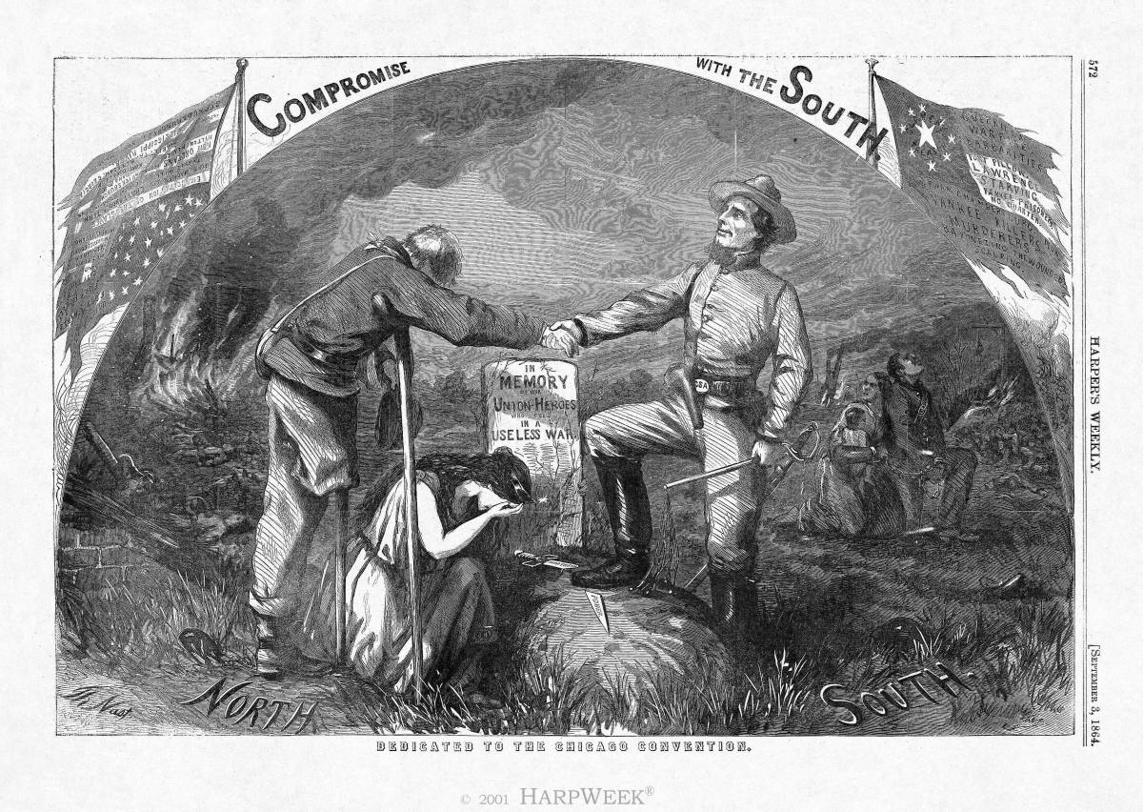
Lincoln’s Politics and Civil War
Lincoln and Congress
Radical Republicans
Conservative Republicans
War Democrats
Copperheads/Peace Democrats
Clement Vallandigham (OH) and Fernando Wood (NY)
Constitutional Powers and Rights
Ex parte Merryman (1861)
Suspension of habeas corpus by Lincoln unconstitutional
Ex parte Milligan (1866)
Civilians cannot be tried in military courts if civil courts still operating
Copperhead Propaganda

Slide 33
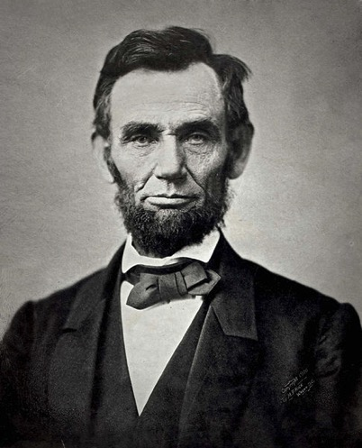
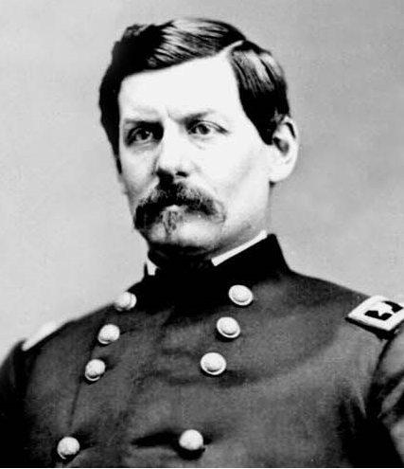
Election of 1864
Abraham Lincoln
Republican
George McClellan
Democrat

Slide 34
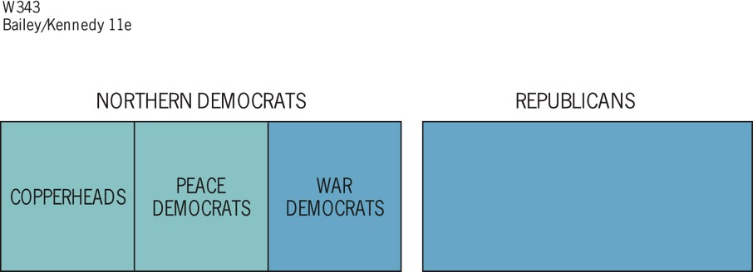
Notes:
Figure 21.1 Union Party, 1864 The blue area
represents the Union party.

Slide 35
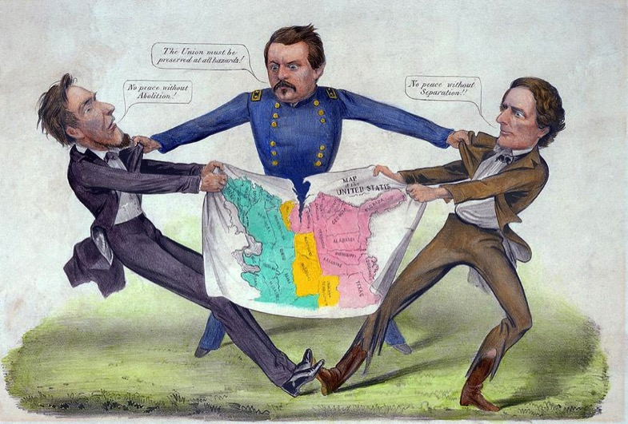
McClellan the Peacemaker?

Slide 36
Sherman Scorches Georgia
Georgia’s conquest:
It was entrusted to General William Tecumseh Sherman
He captured Atlanta in September 1864, burned the city in November 1864
Sherman with 6000 troops cut a sixty-mile swath of destruction through Georgia
Major purposes of Sherman’s march:
destroy supplies destined for the Confederate army
weaken the morale of the men at the front by waging war on their homes

Slide 37
Sherman Scorches Georgia
Sherman was a pioneer practitioner of “total war”:
His success in “Shermanizing” the South was attested by increasing numbers of Confederate desertions
All his methods were brutal
He probably shortened the struggle and hence saved lives
The discipline of his army at times broke down
After seizing Savannah as a Christmas present for Lincoln, his army veered north into South Carolina, where the destruction was even worse:
Sherman’s conquering army rolled deep into North Carolina by the time the war ended

Slide 38
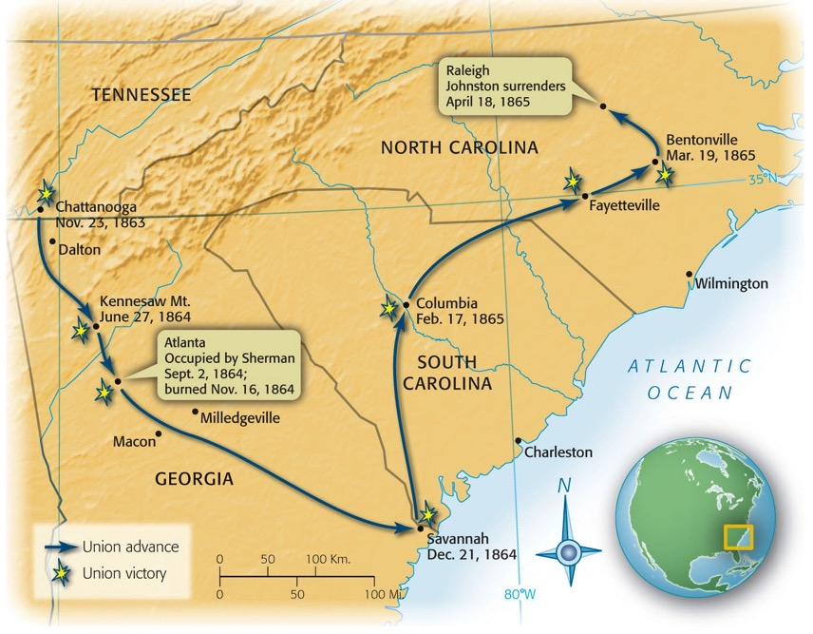
Map 21-6 p450
Notes:
Map 21.6 Sherman’s March, 1864–1865

Slide 39
Election of 1864
Abraham Lincoln (R)
Ran as National Union Party
Andrew Johnson (D) as VP running mate
Fall of Atlanta ensured re-election
George McClellan (D)

Slide 40
Lincoln’s 2nd Inaugural

Slide 41
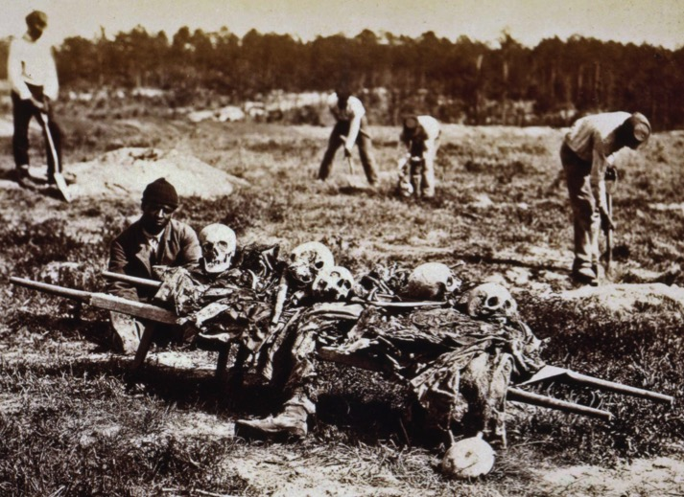
War of Attrition

Slide 42
War of Attrition
Battle | Date | USA casualties | CSA casualties
The Wilderness | May 1864 | 17,666 | 11,033
Spotsylvania | May 1864 | 18,399 | 12,687
Cold Harbor | June 1864 | 12,737 | 5,287
Richmond-Petersburg | June 1864-March 1865 | 42,000 | 28,000

Slide 43
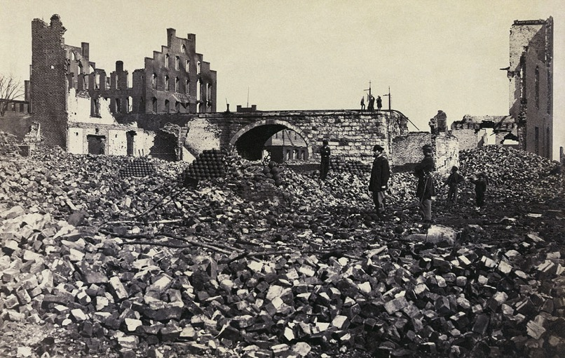
The Ruins of Richmond

Slide 44
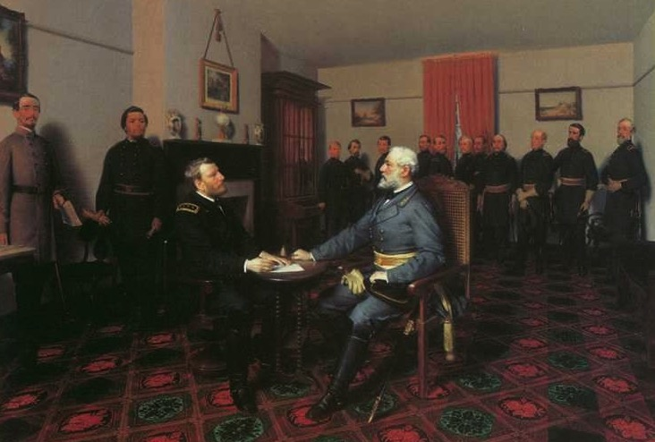
Lee Surrenders to Grant

Slide 45
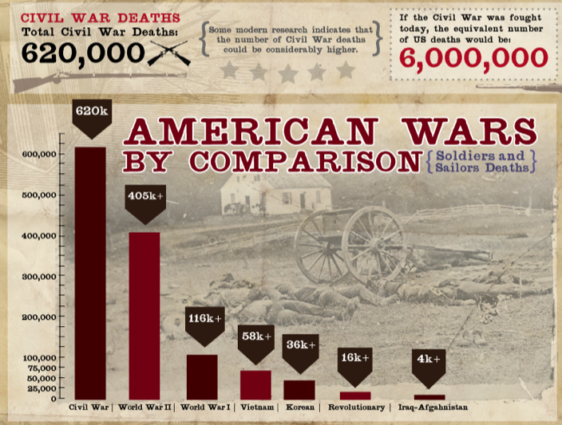
Deaths

Slide 46
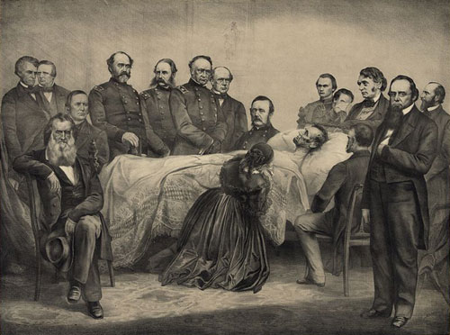
Death of Lincoln

Slide 47
AP Prompt
Evaluate the extent to which military actions and events created political change during the Civil War.

