Slide 1
Do Now
What ‘problems’ existed in antebellum America? Why?
Brainstorm with your partner while you get out Chapter 15

Slide 2
8. The 2nd Great Awakening & Antebellum Reform-Perfecting a Growing Society
Mr. Winchell
APUSH 2019-2020
Period 4

Slide 3
AP Prompt
Evaluate the extent to which reform movements in the US led to an expansion of democratic ideals from 1825 to 1860.
Evaluate the causes for Antebellum Reform movements, accounting for economic and social factors.

Slide 4
Democracy in America (1840)
AMONG the novel objects that attracted my attention during my stay in the United States, nothing struck me more forcibly than the general equality of condition among the people. I readily discovered the prodigious influence that this primary fact exercises on the whole course of society; it gives a peculiar direction to public opinion and a peculiar tenor to the laws; it imparts new maxims to the governing authorities and peculiar habits to the governed. I soon perceived that the influence of this fact extends far beyond the political character and the laws of the country, and that it has no less effect on civil society than on the government; it creates opinions, gives birth to new sentiments, founds novel customs, and modifies whatever it does not produce. The more I advanced in the study of American society, the more I perceived that this equality of condition is the fundamental fact from which all others seem to be derived and the central point at which all my observations constantly terminated. I then turned my thoughts to our own hemisphere, and thought that I discerned there something analogous to the spectacle which the New World presented to me. I observed that equality of condition, though it has not there reached the extreme limit which it seems to have attained in the United States, is constantly approaching it; and that the democracy which governs the American communities appears to be rapidly rising into power in Europe.

Slide 5
The Second Great Awakening Growth and Impact
Protestant revivalism
Reaction to Calvinist/Puritanical doctrine
Emotionalism
Inspired perfectionism
Denominational Growth
Baptists and Methodists
Increase of women in churches
Afro-Christianity
New Denominations
Millennialism
Seventh-Day Adventist Church
Mormonism
Inspired social reform movements
Temperance
Abolitionism

Slide 6
The Rise of Evangelicalism
By the early 1800s, the end of “established churches” presented the opportunity to convert citizens
In the early 19th century, church membership was low & falling
New evangelists in the early 1800s led religious revivals using mass appeal techniques & preached that people were capable of self-improvement
The American Revolution helped facilitate the separation of church & state
Just like Jacksonian politicians
Notes:
At the end of the 18th century, church membership was low and falling. In 1775, there were probably only 1,800 ministers in a population of 2.5 million. According to one estimate, just one American in 20 was a church member. One observer thought that "infidelity is very general among the higher classes."
Few of the nation's founders were particularly religious. They were men of the Enlightenment, who valued rational inquiry and rejected religious enthusiasm. Many leaders of the revolutionary generation distrusted the clergy, doubted the divine origins of the Bible, and questioned the Biblical accounts of miracles.
George Washington's views were not unusual among the founders. He believed that a benevolent divine force governed the universe, but was skeptical of many specific church doctrines. Thomas Jefferson considered himself a Christian and in a work prepared in 1798-99 revered the teachings of Jesus Christ as "the most perfect and sublime that has ever been taught by man." At the same time, he apparently did not believe in the divinity of Jesus Christ or in the authenticity of Biblical miracles.
But during the 1790s, a wave of religious revivals began that would continue until the Civil War.
The chief vehicle behind this outpouring of religious faith was the religious revival. Highly emotional meetings were held by preachers in all sections of the country, which sought to awaken Americans to their need for religious rebirth. So widespread were the revivals that the early 19th century acquired the name the "Second Great Awakening."
The Second Great Awakening had its symbolic beginnings in a small frontier community in central Kentucky. Between August 6 and 12, 1801, thousands of people--perhaps 25,000--gathered at Cane Ridge to pray. At the time, the state's largest city only had 1,795 residents.
There was not one minister at Cane Ridge; there were more than a dozen. They came from many denominations: Presbyterian, Baptist, and Methodist. There was at least one African American minister. The people who attended the meeting came from all social classes. Perhaps two-thirds were women. A minister left a vivid first-person description of the scene:
Sinners [were] dropping down on every hand, shrieking, groaning, crying for mercy...agonizing, fainting, falling down in distress. In the course of six months, 100,000 frontier Kentuckians joined together in search of religious salvation. One observer estimated in 1811 that three to four million Americans attended camp meetings annually.

Slide 7
The Second Great Awakening
The renewed religious revivalism became known as the Second Great Awakening (1800-1830s):
Highly emotional meetings began in the West & spread to all sections of the country
Evangelists sought to awaken Americans to the need for “rebirth” & stressed salvation through repentance
Charles Finney
Free will/Salvation for All/Perfectionism/ Women
No more Puritan original sin
Notes:
At the end of the 18th century, church membership was low and falling. In 1775, there were probably only 1,800 ministers in a population of 2.5 million. According to one estimate, just one American in 20 was a church member. One observer thought that "infidelity is very general among the higher classes."
Few of the nation's founders were particularly religious. They were men of the Enlightenment, who valued rational inquiry and rejected religious enthusiasm. Many leaders of the revolutionary generation distrusted the clergy, doubted the divine origins of the Bible, and questioned the Biblical accounts of miracles.
George Washington's views were not unusual among the founders. He believed that a benevolent divine force governed the universe, but was skeptical of many specific church doctrines. Thomas Jefferson considered himself a Christian and in a work prepared in 1798-99 revered the teachings of Jesus Christ as "the most perfect and sublime that has ever been taught by man." At the same time, he apparently did not believe in the divinity of Jesus Christ or in the authenticity of Biblical miracles.
But during the 1790s, a wave of religious revivals began that would continue until the Civil War.
The chief vehicle behind this outpouring of religious faith was the religious revival. Highly emotional meetings were held by preachers in all sections of the country, which sought to awaken Americans to their need for religious rebirth. So widespread were the revivals that the early 19th century acquired the name the "Second Great Awakening."
The Second Great Awakening had its symbolic beginnings in a small frontier community in central Kentucky. Between August 6 and 12, 1801, thousands of people--perhaps 25,000--gathered at Cane Ridge to pray. At the time, the state's largest city only had 1,795 residents.
There was not one minister at Cane Ridge; there were more than a dozen. They came from many denominations: Presbyterian, Baptist, and Methodist. There was at least one African American minister. The people who attended the meeting came from all social classes. Perhaps two-thirds were women. A minister left a vivid first-person description of the scene:
Sinners [were] dropping down on every hand, shrieking, groaning, crying for mercy...agonizing, fainting, falling down in distress. In the course of six months, 100,000 frontier Kentuckians joined together in search of religious salvation. One observer estimated in 1811 that three to four million Americans attended camp meetings annually.
Lesson #23 in RM’s book

Slide 8
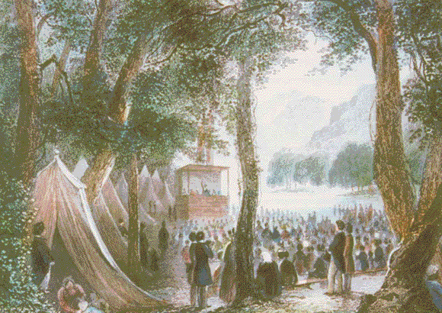
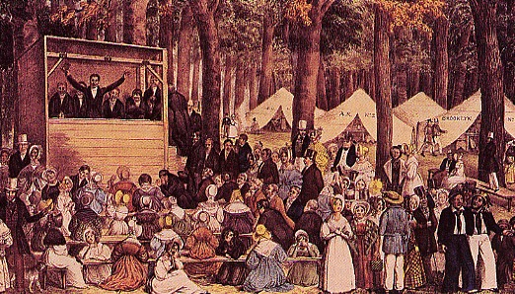
Stressed new revival techniques: extended meetings, public prayer for women, emotionalism
Notes:
Evangelical revivalism was the dominant form of religious expression in early 19th century America. The word evangelical refers to a belief that all people must recognize their depravity and worthlessness, repent their sins, and undergo a conversion experience and a rebirth of religious feelings.
What explains the rapid rise of revivalism?
In part, revivals were a response to the growing separation of church and state that followed the Revolution. But revivals also reflected the hunger of tens of thousands of ordinary Americans for a more emotional religion. Even in the late 18th century, Americans were not as indifferent to religion as church membership statistics might suggest. Many Americans were put off by genteel clergy with aristocratic pretensions. They were also alienated by the older denominations' stress on decorum, formality, and unemotional sermons.
Revivals also meet a growing need for community and communal purpose. At a time when the country was becoming more mobile, commercial, and individualistic, revivals ensured that Americans would remain committed to higher values.
In the South, revivals largely attracted the dispossessed, including many slaves and free blacks. In the North, revivals appealed to upwardly mobile groups. Middle-class women were especially attracted to the revivals. The revivals provided many women with avenues of self-expression--through church societies and charitable and benevolent organizations.
The revivals left a lasting imprint on pre-Civil War America. The rituals of evangelical religion--the camp meeting, group prayer, and mass baptisms along rivers and creeks--were the truly distinctive American experience in the decades before the Civil War. The revivals contributed to a conception of the United States as a country with a special mission to lead the world to a golden age of freedom and equality. When Abraham Lincoln in his Gettysburg Address and Second Inaugural spoke about bloody sacrifice, rebirth, and national mission, his words echoed revivalist sermons.
A key concept for the revivalists was that each person had a duty to combat sin. For the revivalists, sin was not an abstraction. It was concrete. Dueling, profanity, and drinking hard liquor were sins. In the future, many northern evangelicals regarded slavery as the sum of all sins.

Slide 9
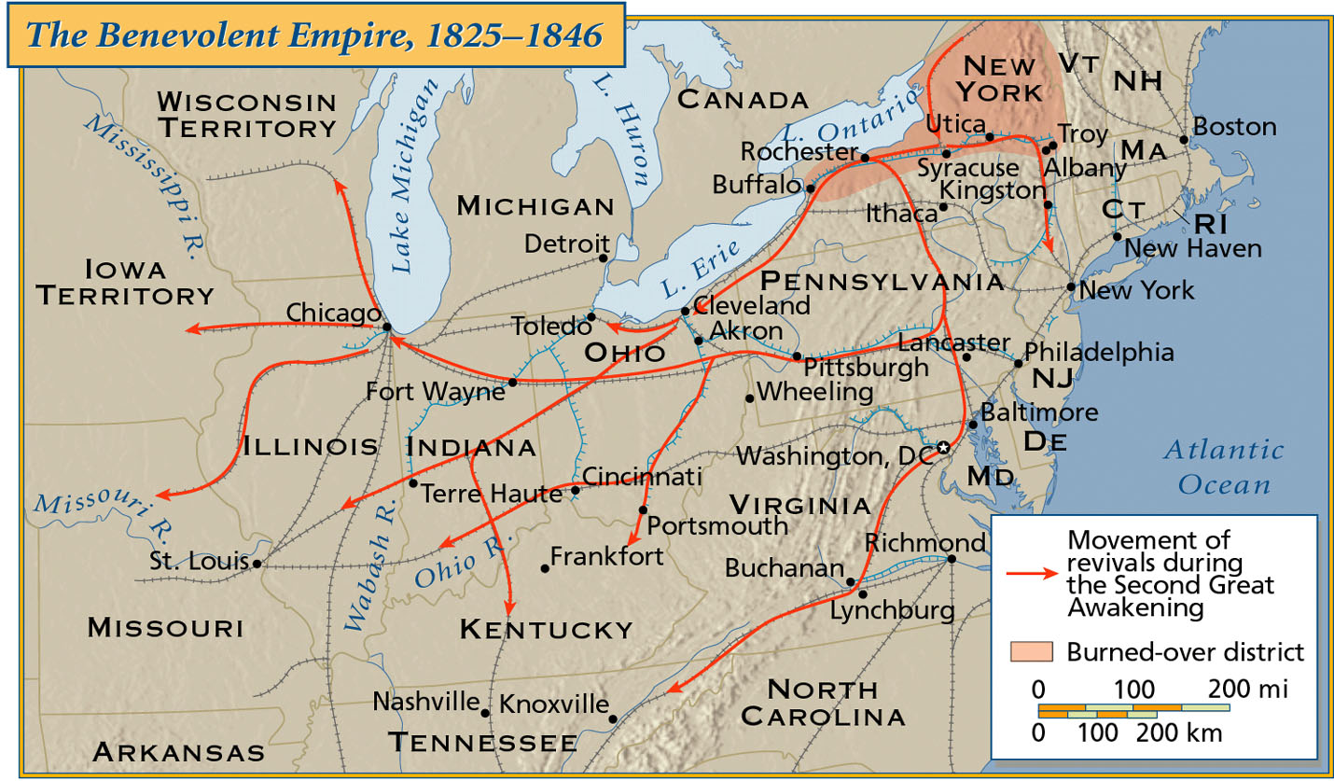
The Spread of Religious Revivals
The “burned-over district” was so heavily evangelized that it had no fuel (unconverted population) left to burn (convert)
Notes:
The burned-over district was a name coined by historian Whitney Cross in a 1950 book to describe an area in central and western New York during the Second Great Awakening. The name was given because the area was so heavily evangelized during the revivalism of antebellum America so as to have no fuel (unconverted population) left to burn (convert). When religion is related to reform movements of the period, such as abolition, women's rights, and utopian social experiments, the region expands to include areas of central New York that were important to the aforementioned reform movements.
Western New York still had a frontier quality during the early canal boom, making professional and established clergy scarce, lending the piety of the area many of the self-taught qualities that proved susceptible to folk religion. Besides producing many mainline Protestant converts, especially in nonconformist sects, the area spawned a number of innovative religious movements, all founded by laypeople during the early 19th century. These include:
Mormonism (whose main branch is The Church of Jesus Christ of Latter-day Saints). Joseph Smith, Jr. lived in the area and was led by the angel Moroni to golden plates from which he translated the Book of Mormon near Palmyra, New York.
The Millerites. William Miller was a farmer who lived in Low Hampton, New York, who preached that the literal Second Coming would occur "October 22, 1844." Millerism became extremely popular in western New York State. Other groups, including Sabbatarian Adventists and Advent Christians, remained active in the region during the late 1840s and 1850s.
The Fox sisters of Hydesville, New York conducted the first table-rapping séances in the area, leading to the American movement of Spiritualism (centered in Lily Dale) that taught communication with the dead.
The Shakers were very active in the area, with several of their communal farms located there.
The Oneida Society was a large sectarian group that established a successful community in central New York that subsequently disbanded. It was known for its unique interpretation of group marriage which had mates chosen by committee and offspring of the community raised in common.
Finney himself preached at many revivals in the area. His preaching style was an early precursor of Pentecostalism which emphasized a living, practical faith marked by emphasis of the Holy Spirit over formal theology.
In addition to religious activity, the region including the burned-over district was famous for social radicalism. Elizabeth Cady Stanton, the early feminist, was a resident of Seneca Falls, New York in central New York where she and others in the community initiated the seminal Seneca Falls Convention devoted to women's suffrage.

Slide 10
Second Great Awakening
Impact of the 2nd Great Awakening
New reform-minded churches were formed in the North & helped grow the Baptists & Methodists in the South
The revivalists taught that each person had a duty to combat sin; this led to an era of social reform in the 1830s
Dueling, profanity, & drinking hard liquor were seen as sins. Many northern evangelicals regarded slavery as the sum of all sins
Notes:
The revivals left a lasting imprint on pre-Civil War America. The rituals of evangelical religion--the camp meeting, group prayer, and mass baptisms along rivers and creeks--were the truly distinctive American experience in the decades before the Civil War. The revivals contributed to a conception of the United States as a country with a special mission to lead the world to a golden age of freedom and equality. When Abraham Lincoln in his Gettysburg Address and Second Inaugural spoke about bloody sacrifice, rebirth, and national mission, his words echoed revivalist sermons.
A key concept for the revivalists was that each person had a duty to combat sin. For the revivalists, sin was not an abstraction. It was concrete. Dueling, profanity, and drinking hard liquor were sins. In the future, many northern evangelicals regarded slavery as the sum of all sins.

Slide 11
From Revivalism to Reform
Northern revivals, unlike in the South, inspired social reform among middle-class participants
Led to a “benevolent empire" of evangelical reform movements:
Religious conversion
Morality crusaders attacked prostitution, gambling, & slavery
Temperance advocates hoped to end alcohol abuse

Slide 12
Text Analysis
Charles Finney, 2nd Great Awakening Preacher

Slide 13
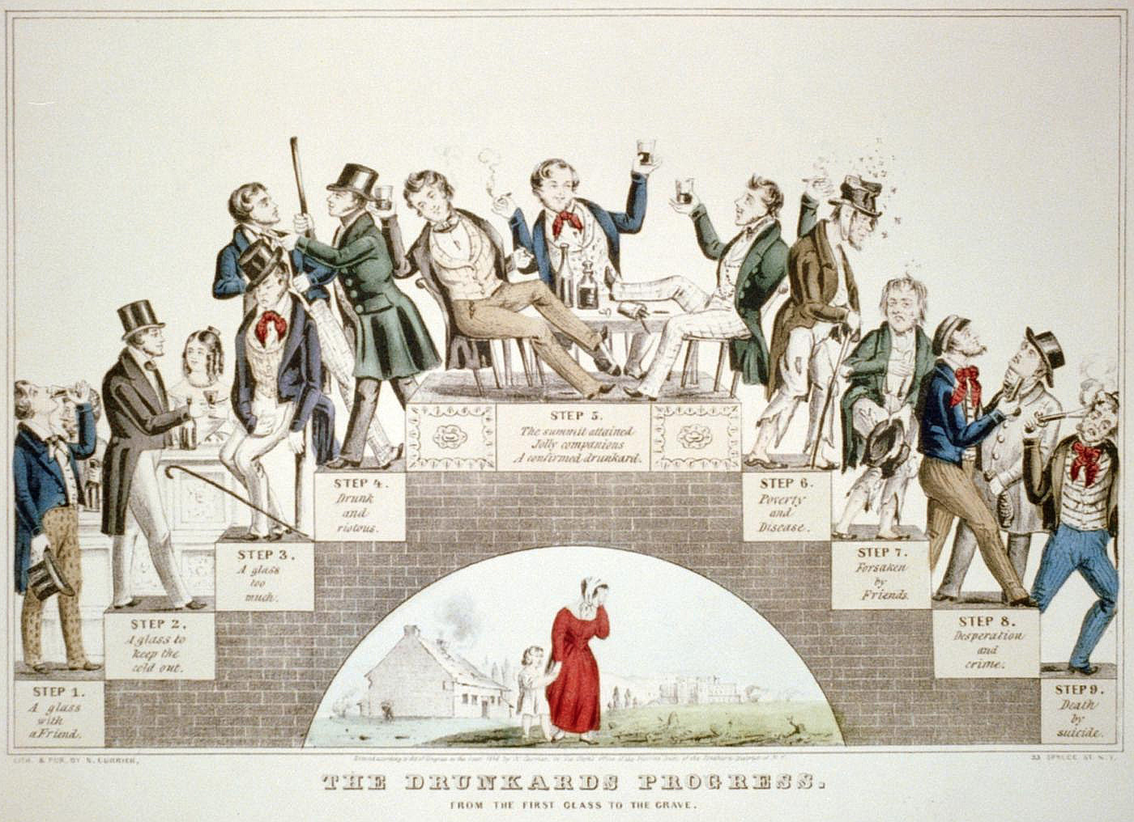

Slide 14
Temperance was the era’s most successful reform

Slide 15
Educational Reform
Women and Education
Enlightenment philosophy
Tabula rasa: blank slate
Political philosophy
Civic virtue & informed citizenry
Socio-economic factors
Industrialization & child labor
Catharine Beecher
Kindergarten
Physical education
Music education
Emma Willard
Women’s education
Elizabeth Blackwell
Medicine
OBERLIN COLLEGE

Slide 16
The Extension of Education
Reading
‘Riting
‘Rithmetic
Free public schools grew rapidly from 1820 to 1850 to provide educational & moral training:
Middle-class Americans saw education as a means for social advancement, teaching “3 R’s” & instilling a Protestant ethic
Horace Mann argued that schools “save” immigrants & poor kids from parents’ “bad” influence to create good citizens
Prior to 1820, public schools were well developed in NE, but not in South
America’s most famous advocate of public education

Slide 17
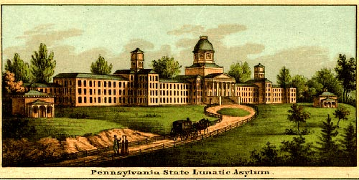
Asylum Reform
Reformers believed that all problems were correctable & built state-supported prisons, asylums, poorhouses:
The most famous asylum reformer was Dorothea Dix who publicized inhumane treatment of mental institution patients
As a result, 15 states improved their penitentiaries & hospitals

Slide 18
Abolitionism
Former slaves, like Frederick Douglass & Sojourner Truth, became important abolitionists:
They were able to relate the realities of slavery through Freedom’s Journal & North Star
Blacks were the leaders in the Underground Railroad
Blacks formed vigilante groups to protect fugitive slaves in North

Slide 19
Abolitionism
Moderate anti-slavery supporters backed emigration to Liberia to avoid a race war when slaves were gradually emancipated
But radical abolitionists, led by William Lloyd Garrison, called for immediate slave emancipation via his American Anti-Slave Society & The Liberator newsletter

Slide 20
Abolitionism
Abolitionists most appealed to small town people in the North
Not all Northerners supported abolition; Opposition came from:
Urban areas & from people who lived near the Mason-Dixon line
Racism, fears of interracial marriage, & fear of economic competition from freed blacks

Slide 21
Abolitionism
Radical abolitionists were hurt by in-fighting & many people criticized Garrison for his views:
He elected a woman to the executive committee of his American Anti-Slave Society
Called for Northern secession & boycotts of political elections
Some abolitionists broke off & formed the Liberty Party in 1840

Slide 22
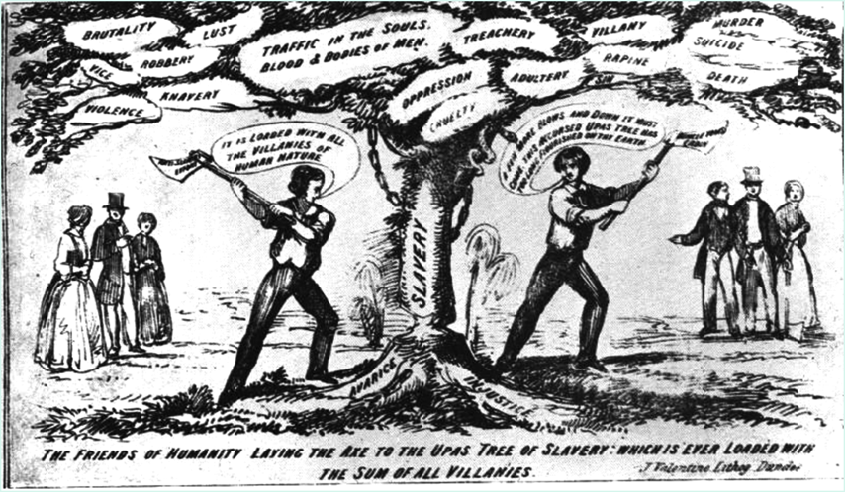
Christian Abolitionism

Slide 23
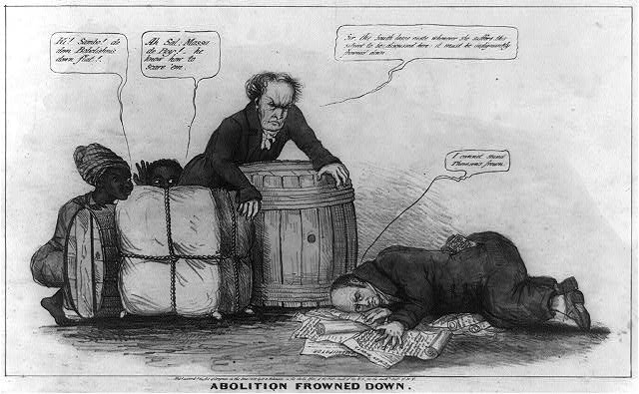
Gag Rule, 1836
Notes:
http://www.loc.gov/pictures/resource/cph.3a12359/

Slide 24
Women in Revolt
Women in America:
Nineteenth century was still a man’s world
Women in American had it better than in Europe
Women were still “the submerged sex” in America
Women now avoided marriage—10 % of adult women remained “spinsters” at the time of the Civil War
Gender differences were strongly emphasized in 1800s America:
Because the burgeoning market economy separated women and men into distinct economic roles.
The home was a woman’s special sphere, the centerpiece of the “cult of domesticity.”

Slide 25
Changes in the American Family
Legally, the husband was the unchallenged head of household
Evangelicalism brought changes to white, middle-class families:
Child rearing seen as essential preparation for a Christian life
Wives became “companions” (not servants) to their husbands
“Cult of Domesticity” redefined women’s duty to promote piety, ethics, & character in children
Virtue became more important as more men left home to work
# of children per family dropped 25% from 1800 to 1850; Increased conscience of the resources necessary to raising a child
Notes:
http://www.mccord-museum.qc.ca/scripts/projects/CH/animCH.php?tourID=VQ_P1_6_EN&Lang=1&type=quicktime
For a good Canadian video in Cult of Domesticity

Slide 26
Women's Rights
Involvement in abolitionism raised awareness of women’s inequality
Lucretia Mott & Elizabeth Cady Stanton organized the 1st feminist national meeting, the Seneca Falls Convention in 1848
To demand the right to vote
Rejected the cult of domesticity (separate roles for sexes) in favor of total gender equality

Slide 27
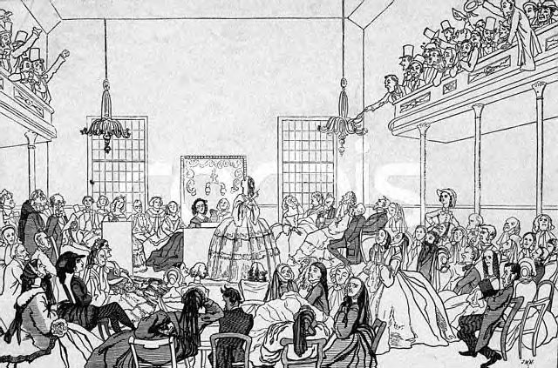
The Seneca Falls Convention, 1848
Produced the Declaration of Sentiments: “We hold these truths to be self-evident…that all men & women are created equal.”

Slide 28
Historiography “Antebellum Reform: Evolving Causes and Strategies”
Mary Hershberger – Mobilizing Women, Anticipating Abolition: The Struggle against Indian Removal in the 1830s (1999)
Lori D. Ginzberg – “Moral Suasion is Moral Balderdash”: Women, Politics, and Social Activism in the 1850s (1986)
To block [Indian] removal, Catherine Beecher and Lydia Sigourney organized the first national women’s petition campaign and flooded Congress with antiremoval petitions, making a bold claim for women’s place in national political discourse… Protesting Indian removal encouraged antiremovalists to challenge slavery directly. The Indian Removal Act made abolitionists bolder in acting against slavery and more determined to achieve their goals… It also ushered in a new age of popular politics that saw energized antiremovalists transfer their techniques of removal protest to the struggle against slavery: massive and continuous pamphleting and petitioning by both women and men, persistent reports in periodicals that sought to present slavery from the perspective of the slave, and a willingness to challenge laws that they believed were deeply unjust.
As a result of the Second Great Awakening of the 1820s and early 1830s, a millennial spirit pervaded efforts at transforming United States society. Abolitionists, vegetarians, temperance activists, and crusaders against “male lust”…sought not merely social change but spiritual transformation, the moral regeneration of the world... American middle-class radicalism of the 1830s and 1840s evolved in a religious context, one in which the regeneration of individuals would precede – and assure – the salvation of society. Women played a central role both in the ideology and in the means of the proposed national transformation. Viewed as inherently moral, women were to instruct by example and to participate in movements for social, or moral, change.

Slide 29
Utopian Communities
Some reformers grew tired of trying to change society & created their own “ideal” communities:
Robert Owen & Charles Fourier created socialist communities
Shakers—believed in sexual equality & 2nd coming of Christ
Oneida Community—Christ’s 2nd coming already occurred; no need for moral rules (“free love”)
Notes:
http://en.wikipedia.org/wiki/Oneida_Society

Slide 30
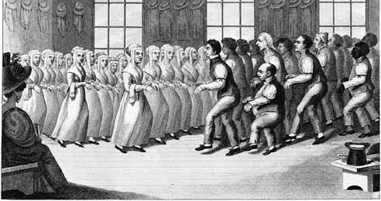
Shakers
'Tis the gift to be simple, 'Tis the gift to be free, 'Tis the gift to come down where you ought to be, And when we find ourselves in the place just right, 'Twill be in the valley of love and delight. When true simplicity is gained To bow and to bend we shan't be ashamed, To turn, turn will be our delight, 'Till by turning, turning we come round right.

Slide 31
Transcendentalism
Transcendentalism—literary & philosophical idea that individuals can transcend reality & connect with universal spiritual forces:
led by Ralph Waldo Emerson
George Ripley founded a utopian community at Brook Farm; focused on education
Henry David Thoreau’s Walden Pond advocated a “utopia of 1”

Slide 32
Transcendentalism
Ralph Waldo Emerson
Self-Reliance (1841)
“Nothing is at last sacred, but the integrity of your own mind.”
The American Scholar (1837)
Despite cultural heritage, instinctive creative genius of individual could lead to greatness
Henry David Thoreau (Walden, On Civil Disobedience)
“I went to the woods because I wished to live deliberately, to front only the essential facts of life, and see if I could not what it had to teach, and not, when I came to die, discover that I had not lived.”
Passive resistance
A public refusal to obey unjust laws

Slide 33
Conclusions
Americans in the 1830s & 1840s seemed ready to improve the nation, but in different ways:
Political parties (Dems & Whigs) hoped to improve politics
Industrialists hoped to increase the market revolution
Religious reformers hoped to convert the masses
Reform crusaders hoped to remove all moral & social evils

