Slide 1
Do Now
‘The years of war tried our devotion to the Union; the time of peace may test the sincerity of our faith in democracy.’
Herman Melville, 1866

Slide 2
The Goals of Reconstruction-How to Win the War and the Peace
Mr. Winchell
APUSH
Period 5

Slide 3
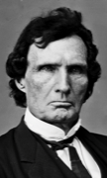
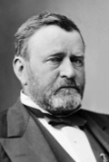
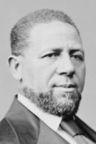
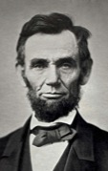
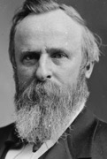
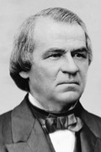
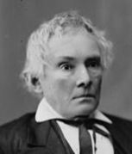
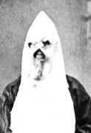
Political Spectrum of Reconstruction
Radicals
Moderates
Unionists
Redeemers
KKK
Federal Supremacy
Black Civil Rights
Military Occupation
States’ Rights
Blacks as Second-Class Citizens
Home Rule

Slide 4
Key Concepts
5.3.II: Reconstruction and the Civil War ended slavery, altered relationships between the states and the federal government, and led to debates over new definitions of citizenship, particularly regarding the rights of African Americans, women, and other minorities.

Slide 5
AP Prompt
Evaluate the extent the Civil War impacted the political, social, and economic landscape of the United States?
Evaluate the extent to which Reconstruction maintained continuity and fostered change in American politics and society?

Slide 6
Textual Analysis-Reconstruction
Southern Defiance vs. Freedmen Convention

Slide 7
3 Phases of Reconstruction
Presidential Reconstruction (1863-1866)
Congressional (or Radical) Reconstruction (1867-1877)
Redemption (1877-1900)

Slide 8
President Lincoln’s Plan
Ten Percent Plan
Proclamation of Amnesty and Reconstruction (1863)
Full presidential pardons to southerners who:
Took an oath of allegiance to the Union and the Constitution
Accepted the emancipation of slaves
State governments could be reestablished as soon as 10% of the population took the oath

Slide 9
Wade-Davis Bill (Radical Republican Plan)
Required 50% of the number of 1860 voters to take an “iron clad” oath of allegiance
Required a state constitutional convention before the election of state officials
Enacted specific safeguards of freedmen’s liberties
Based on two ideas:
“State Suicide” Theory [MA Senator Charles Sumner]
“Conquered Provinces” Position [PA Congressman Thaddeus Stevens]
Lincoln vetoed this bill, Congress enacted a similar version of it later.

Slide 10
Reconstruction, Phase 1 Lincoln’s Plan
Proclamation of Amnesty and Reconstruction (1863)
Full presidential pardons for
1. Oath of allegiance,
2. Accept end of slavery
Ten Percent Plan
Confederate state reestablished once 10% of voters affirmed allegiance and loyalty
Wade-Davis Bill (1864)
Second Inaugural Address
“with malice toward none; with charity for all”
Lincoln’s Assassination
April 14, 1865

Slide 11
Freedmen’s Bureau
Bureau of Refugees, Freedmen, and Abandoned Lands in March 1865
Food, shelter, medicine for freed blacks and displaced whites
Education of blacks and colleges
Viciously attacked and ridiculed by Northern racists and bitter Southerners

Slide 12
Andrew Johnson (D) (1865-1869)
Politics
War Democrat
Defender of Poor Whites
Resented planter class
White supremacist
Major Issues
Reconstruction
Impeachment

Slide 13
Reconstruction, Phase 2 Andrew Johnson’s Plan
Reconstruction Plan
Pardons for loyalty oath
No pardons for Confederate leaders who owned $20,000 taxable property
Admitted Confederate states with appointed governors who established voting procedures for state legislatures
States must abolish slavery and secession clauses from state constitutions
Effects
Former confederates elected to office
Black codes enacted
Vetoes
Civil Rights Act of 1866
Freedmen’s Bureau extension

Slide 14
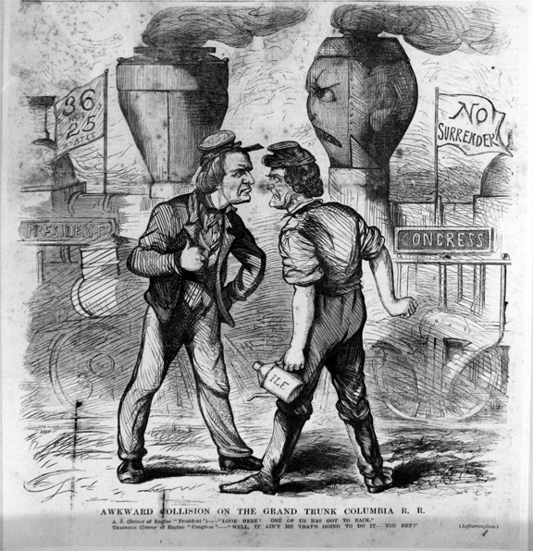
Awkward Collision on the Grand Trunk Columbia R.R.
November, 1866

Slide 15
The Radical Republicans
Radicals
Thaddeus Stevens
Charles Sumner
Midterm Election of 1866
“Not every Democrat was a rebel, but every rebel was a Democrat!”
Won supermajorities in both houses of Congress
Anti-Radical Republican propaganda
Pennsylvania, 1866

Slide 16
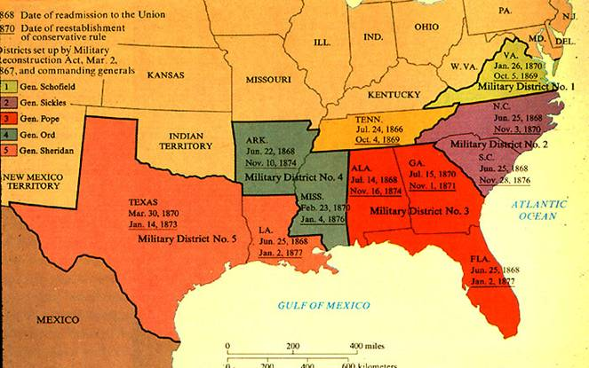
Reconstruction, Phase 3 Radical Republican Plan
Reconstruction Acts of 1867
Military districts
New state constitutions approved by Congress
Black suffrage guarantees
Ratification of the 14th Amendment
Fourteenth Amendment (1868)
Anyone born or naturalized was American citizen (Citizenship Clause)
“nor shall any State deprive any person of life, liberty, or property, without due process of law” (Due Process Clause)
“nor deny to any person within its jurisdiction the equal protection of the laws” (Equal Protection Clause)
Disavowed Confederate leaders; states responsible for own war debt; loss of electoral votes for disenfranchisement
Impeachment of Andrew Johnson (1868)
Fifteenth Amendment (1869)
Right to vote for blacks

Slide 17
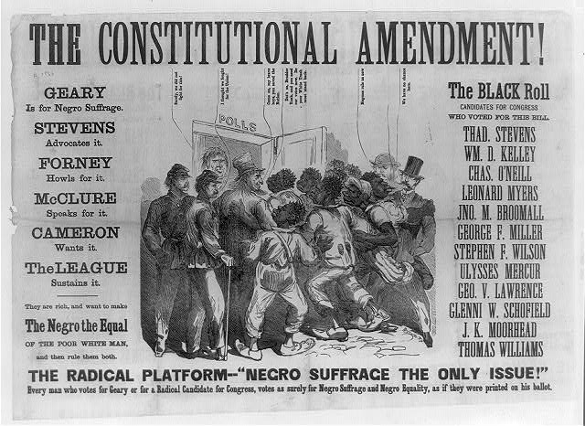

Slide 18
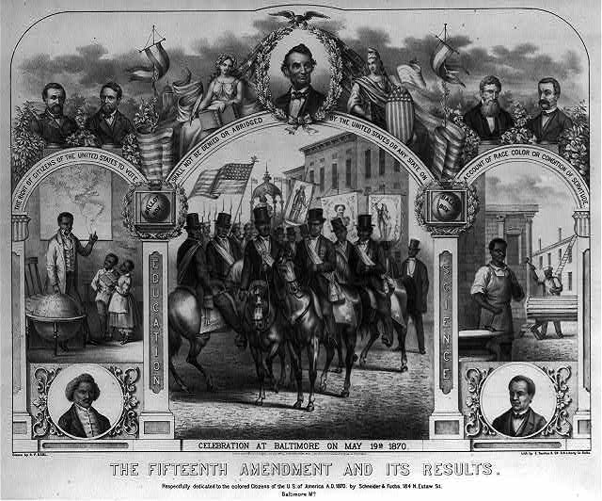

Slide 19
The South Is a Separate, Conquered Nation; The South Is Not a Separate, Conquered Nation
Report of the Joint Committee on Reconstruction (1866)
Andrew Johnson, State of the Union Address (1867)
It must not be forgotten that the people of these States, without justification or excuse, rose in insurrection against the United States. They deliberately abolished their State governments so far as the same connected them politically with the Union as members thereof under the Constitution. They deliberately renounced their allegiance to the Federal government, and proceeded to establish an independent government for themselves…Finally they opened hostilities, and levied war against the Government. They continued this war for four years with the most determined and malignant spirit, killing in battle and otherwise large numbers of loyal citizens on the sea and on the land, and entailing on the Government an enormous debt, incurred to sustain its rightful authority. Whether legally and constitutionally or not, they did, in fact, withdraw from the Union and made themselves subjects of another government of their own creation... The question before Congress is, then, whether conquered enemies have the right, and shall be permitted at their own pleasure and on their own terms, to participate in making laws for theur conquerors... The conclusion of your committee therefore is, that the so-called Confederate States are not present entitled to representation in Congress of the United States; that, before allowing such representation, adequate security for future peace and safety should be required; that this can only be found in such changes of the organic law as shall determine the civil rights and privileges of all citizens in all parts of the Republic...
It is clear to my apprehension that the States lately in rebellion are still members of the National Union. When did they cease to be so? The “ordinances of secession” adopted by a portion of their citizens were mere nullities. If we admit now that they were valid and effectual for the purpose intended by their authors, we sweep from under our feet the while ground upon which we justified the war. Were those States afterwards expelled from the Union by the war? The direct contrary was averred by this Government to be its purpose, and was so understood by all those who gave their blood and treasure to aid in its prosecution. It can not be that a successful war, waged for the preservation of the Union, had the legal effect of dissolving it… This is so plain that it has been acknowledged by all branches of the Federal Government. The Executive (my predecessor as well as myself) and the heads of all the Departments have uniformly acted upon the principle that the Union is not only undissolved, but indissoluble... Indiscriminate vengeance upon classes, sects, and parties, or upon whole communities, for offenses committed by a portion of them against the governments to which they owed obedience was common in barbarous ages of the world...The punitive justice of this age, and especially of this country, does not consist in stripping whole States of their liberties and reducing all their people, without distinction, to the condition of slavery.

Slide 20
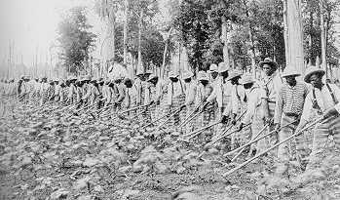
Freedmen in the South
Political Recognition
Voting Rights
Affiliated with Republican Party
Public Office
2 U.S. Senators
14 U.S. Representatives
630 black state legislators
Black governor of Louisiana
Desire for Autonomy and Opportunity
Independent churches
Public schools
Slavery By Another Name
Sharecropping
Convict leasing

Slide 21
White Southern Resistance
White Supremacy Paramilitary Groups
The South Will Rise Again!
White League
Ku Klux Klan (1867)
Nathaniel Bedford Forrest
“invisible empire”
Enforcement Acts (1870, 1871)
“The Union as it Was”
Thomas Nast, Harper’s Weekly
October 1874

Slide 22
Black Codes of Mississippi

Slide 23
Sharecropping
50% white farmers and 75% black farmers
Crop-lien system
Tenant farming
Exodusters

Slide 24
Northern Influence on the South
Scalawags
Southern Republicans fostering American System-type programs
Cooperated with Northern politics and economics
Carpetbaggers
Northerners investing in “New South,”
Reformers/provide aid
Squatters and plunderers
The Man with the (Carpet) Bags
Thomas Nast, 1872
Depicts Carl Schurz, a Liberal Republican critical of Grant’s Reconstruction policies

Slide 25
