Slide 1
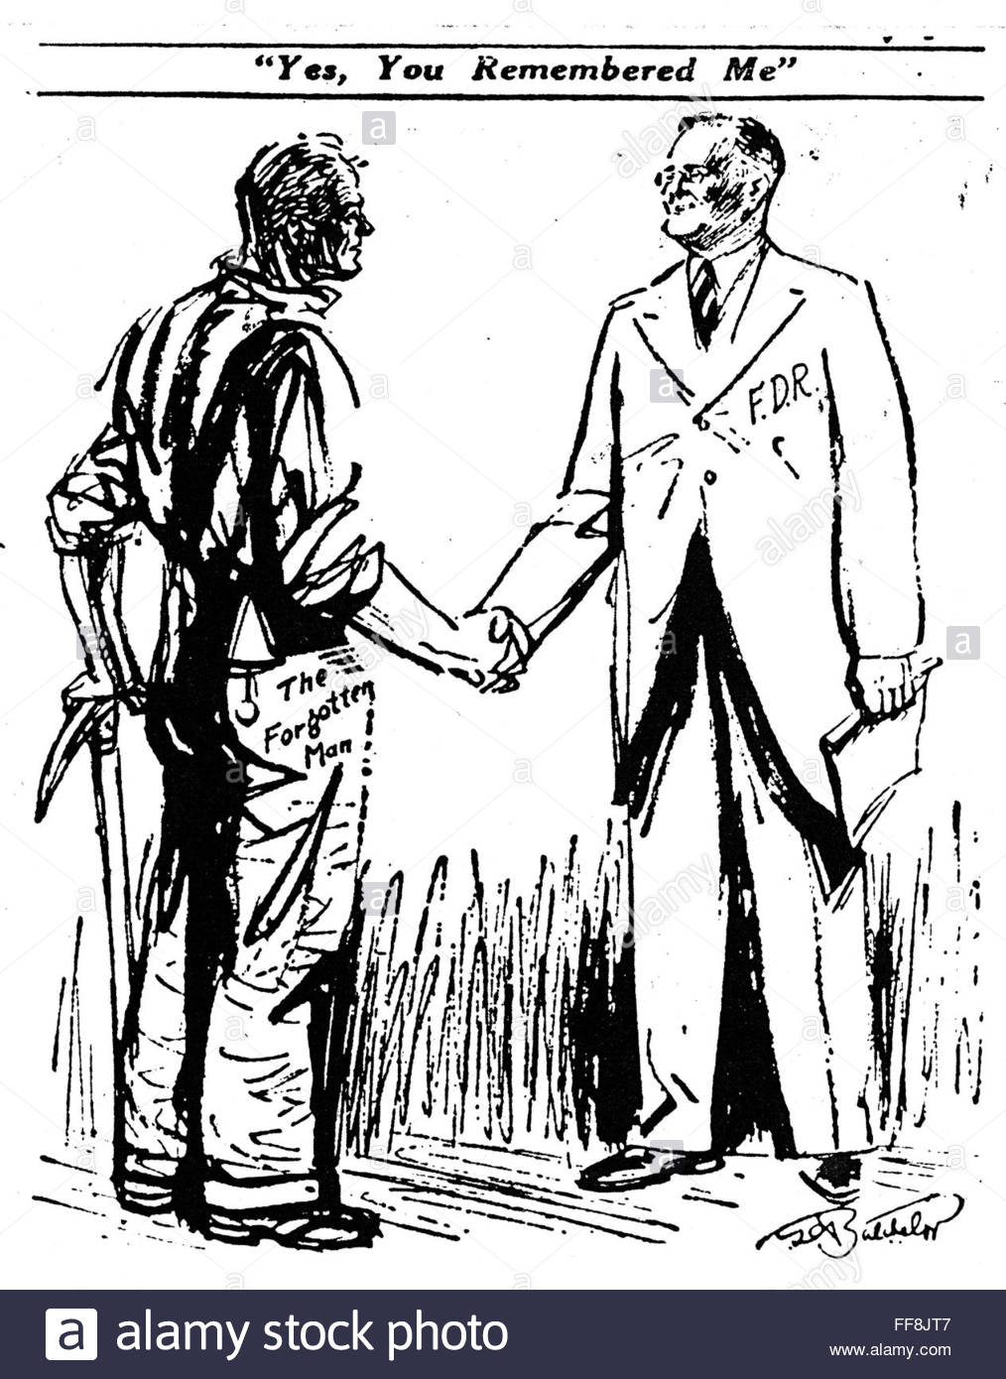

Slide 2
8. The New Deal’s Critiques and Legacies: Foreign Policy in the Shadow of WWII
Mr. Winchell
APUSH 19-20
Period 7

Slide 3
AP PROMPT
Evaluate the impact of FDR’s New Deal on U.S. society.

Slide 4
Outline
Reactions to the New Deal- Too Much? Not Enough?
Court Packing and Credibility
The New Deal ‘Ends’
Legacy of the New Deal
Isolationism in a Volatile World

Slide 5
Challenges to FDR
By 1935, signs of discontent with the New Deal were evidenced as 3 critics gained national attention:
Father Charles Coughlin called for nationalizing U.S. banks; used anti-Semitism in radio sermons
Francis Townsend appealed to the elderly with a $200/mo payment plan to anyone over 60 in order to stimulate the economy
Louisiana Sen. Huey Long-Share the Wealth
Tax the rich to give away $2,500 to each American
American Liberty League
Industrialists opposed to dictatorial policies

Slide 6
Election of 1936
Franklin D. Roosevelt (D)
Alfred Landon (R)

Slide 7
New Deal Programs-Need to Know
Social Security
Works Progress Administration
Civilian Conservation Corps
Tennessee Valley Authority
Securities and Exchange Commission
AAA/NRA
Wagner Act/National Labor Relations Board

Slide 8
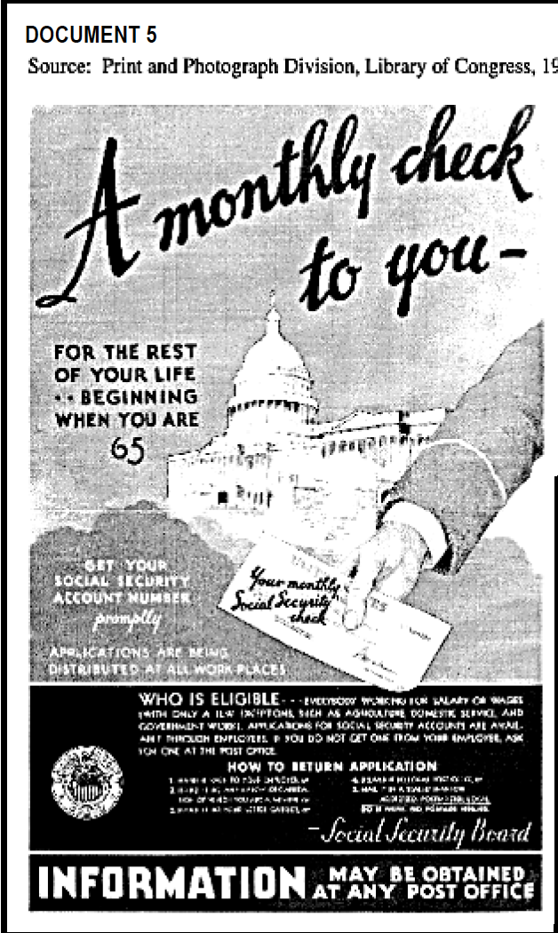
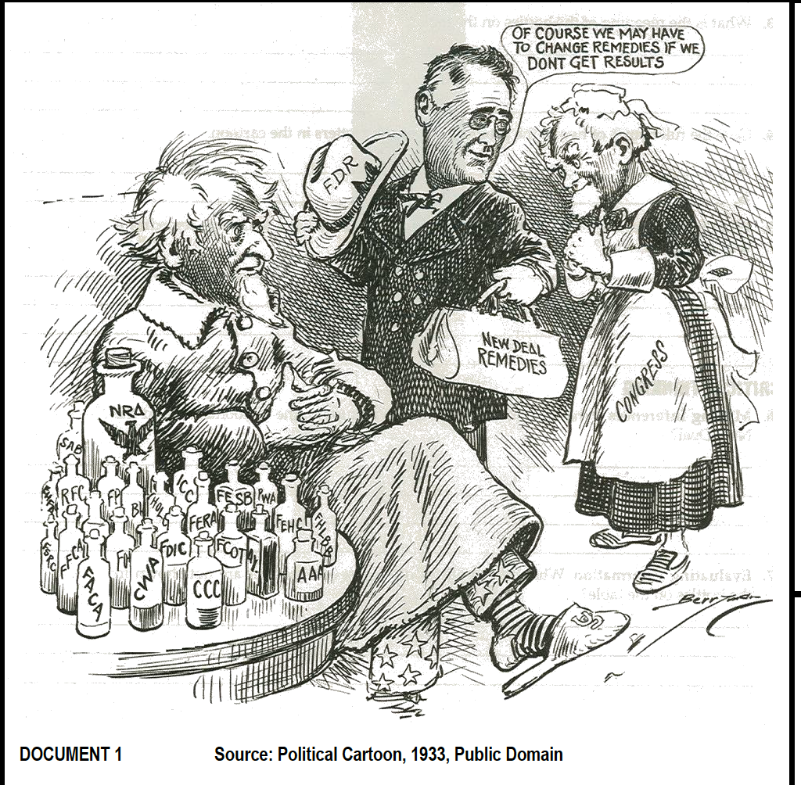

Slide 9
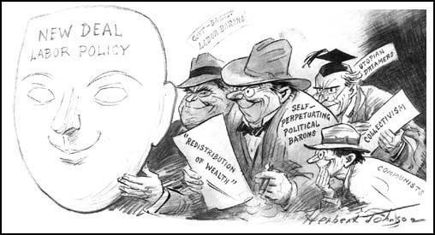

Slide 10
Packing the Supreme Court
Schechter v. U.S.
(1935)
U.S. v. Butler
(1936)
The Supreme Court was FDR’s last obstacle to overcome:
The Court ruled the NRA & AAA were unconstitutional
FDR’s solution was to ask Congress to appoint 1 new justice for each justice over 70 yrs old
This controversial “court packing” plan would add 6 new justices
All 9 justices were old, white men; Only 3 were sympathetic to the New Deal; 2 were unpredictable; 4 wanted to block New Deal
Justice Willis Van Devanter planned to retire in 1932, but stayed on because he felt FDR was “unfitted & unsafe for the presidency”

Slide 11
Packing the Supreme Court
The court-packing scheme was legal but set a scary precedent:
The Senate strongly resisted FDR & the Court defended itself against “ageism” attacks
The crisis ended when the Court declared the Wagner Act & Social Security constitutional & Judge Van Devanter resigned
FDR eventually appointed 5 justices to the Supreme Court in his 4 terms

Slide 12
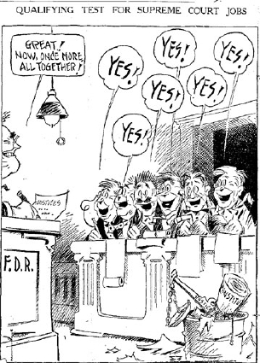
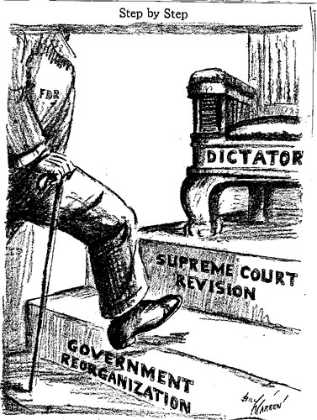
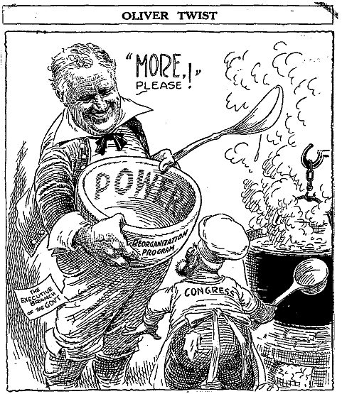

Slide 13
Decline of New Deal Reform after 1937
Reasons for decline of New Deal reform after 1937:
Court-packing plan made Congress irritable.
Recession of 1937-38 weakened confidence in New Deal measures. Republicans gained strength in both houses.
Attempted purge of Democratic party failed.
Conservative Democrats were elected to office. Resentful of attempted party purge, they joined ranks with Republicans to block New Deal legislation.
Increasing focus on foreign affairs.

Slide 14
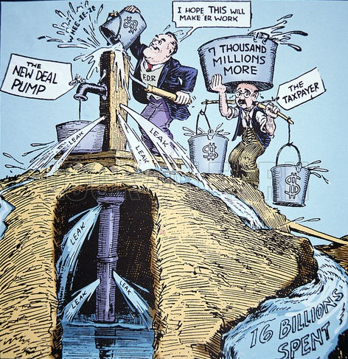
By 1937, President Roosevelt faced criticisms that the New Deal was too expensive, did not eliminate unemployment, or end the depression
FDR backed off government funded job programs and unemployment quickly rose
The New Deal was not stimulating the economy enough to end the Great Depression
The “First” New Deal
The “Second” New Deal

Slide 15
The End of the New Deal
1938 saw the end of the New Deal
Other than the Fair Labor Standards Act, FDR’s 2nd term saw no new New Deal programs
FDR’s court-packing plan hurt his relationship with Congress
The “Roosevelt Recession” of 1937 was the result of FDR’s attempt to reduce gov’t spending & balance the budget
Notes:
FDR’s attempt to balance budget & reduce WPA spending led to 2 more years of Depression hardships

Slide 16
End of the New Deal
Roosevelt Recession (1937-1938)
Cutback in deficit spending and elimination of some New Deal programs
International Concerns
Totalitarian governments spawned defensive preparations

Slide 17
Unemployment, 1929-1942

Slide 18
Impact of the New Deal
Physical Rehabilitation of the Nation as a priority (TVA, AAA)
Human Rehabilitation (WPA, Social Security)
Political Rehabilitation (Executive Branch as a place for answers)
Maintenance and evolution of Democracy – The system could be flexible to meet changing needs of society!

Slide 19
The New Deal and American Life
First Hundred Days
Second Hundred Days
The New Deal lasted only 5 years (1933-1938); The majority of laws came in 2 bursts in 1933 & 1935:
The New Deal was moderately successful economically:
Helped relieve suffering but did not end the Depression
American wealth remained unequally distributed
10 million were still unemployed in 1939
12 million were unemployed when FDR took office in 1933

Slide 20
Thesis Check
Evaluate the impact of FDR’s New Deal on American society.

Slide 21
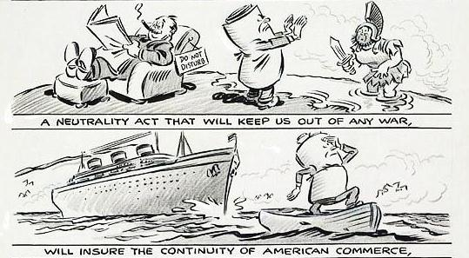
Congress passed a series of Neutrality Acts (1935-1937) that, in case of a war, made it illegal for companies to sell weapons or transport goods to any nation at war

Slide 22
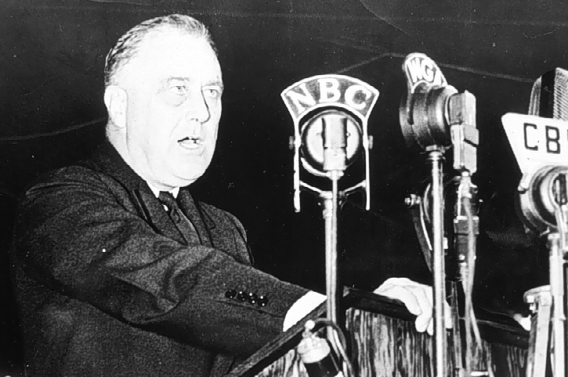
President Franklin Roosevelt wanted a more active response to stop dictators, but failed to convince world leaders to “quarantine” aggressor nations in 1937

Slide 23
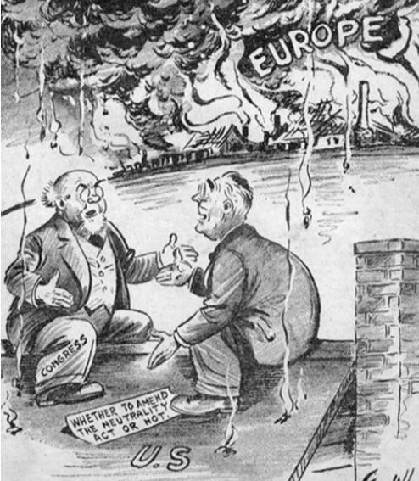
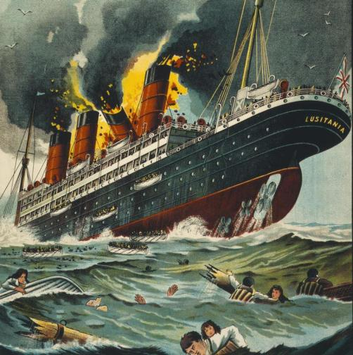
When the war started, Congress amended the Neutrality Acts and allowed U.S. companies to sell weapons to the Allies on a “cash and carry” basis
Allied nations could buy U.S.-made war goods but had to pay in cash and had to transport goods on their own ships
Remember Germany’s unrestricted submarine warfare?
The cash-and-carry policy allowed the USA to aid the Allies while remaining neutral and avoid the causes of American entry into the first world war

Slide 24
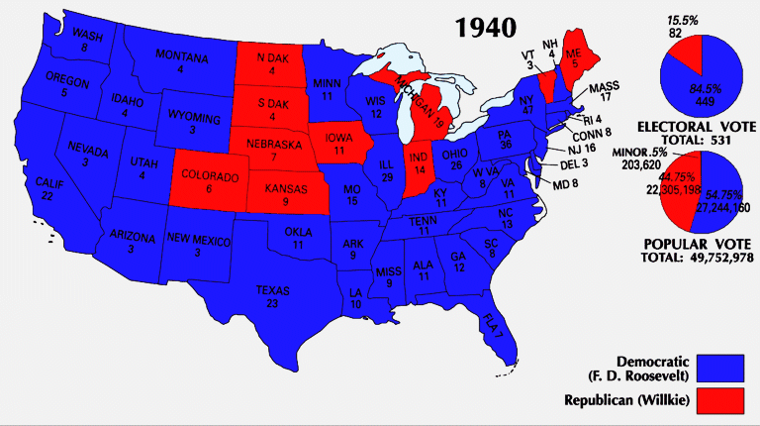
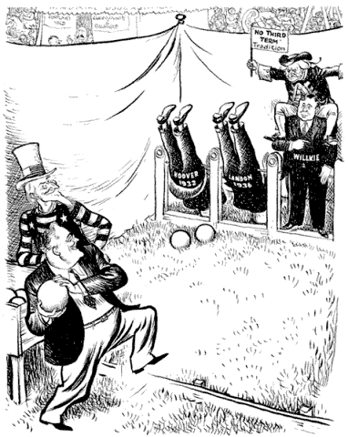
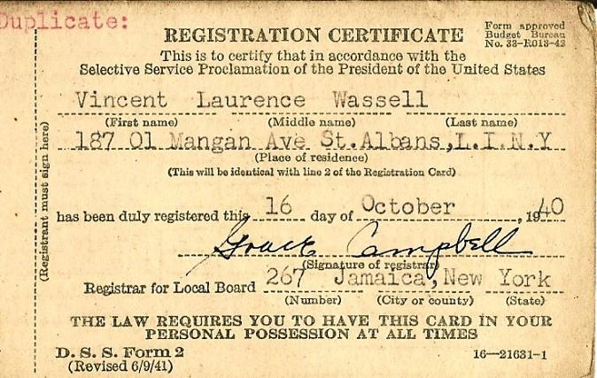
In 1940, Franklin Roosevelt was elected to an unprecedented third term as president
He campaigned on a platform of neutrality but with “preparedness”
FDR prepared for possible entry into the war by calling for the first peacetime draft

Slide 25
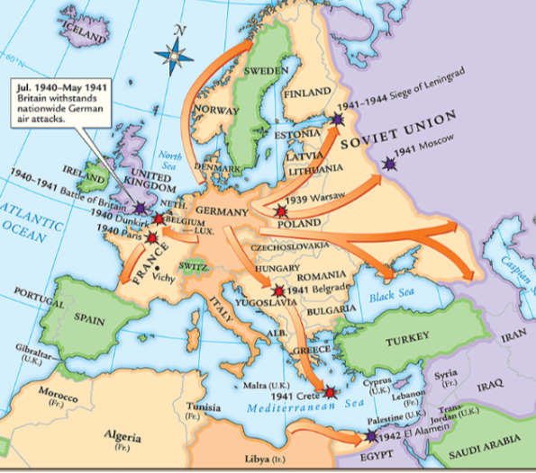
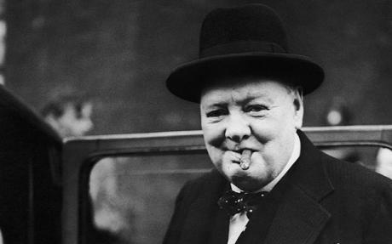
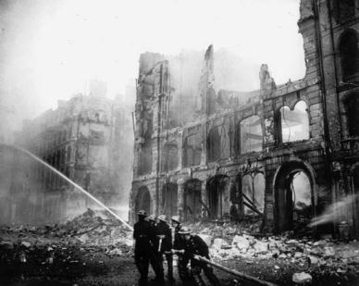
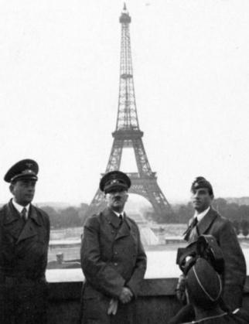
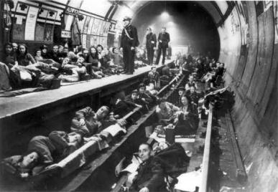
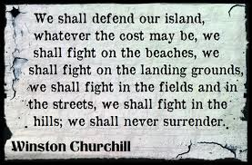
The fall of France in 1940 worried Americans that the Axis Powers might win World War II
German Luftwaffe attacks on Britain meant that England needed U.S. aid more than ever

Slide 26
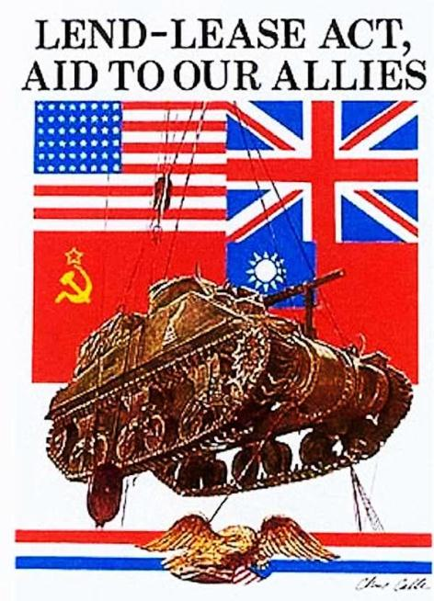
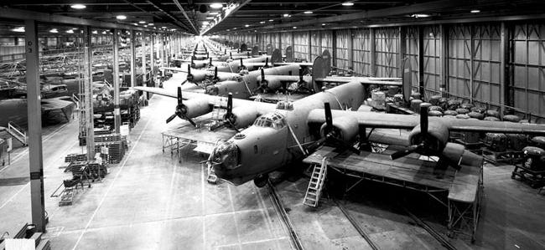
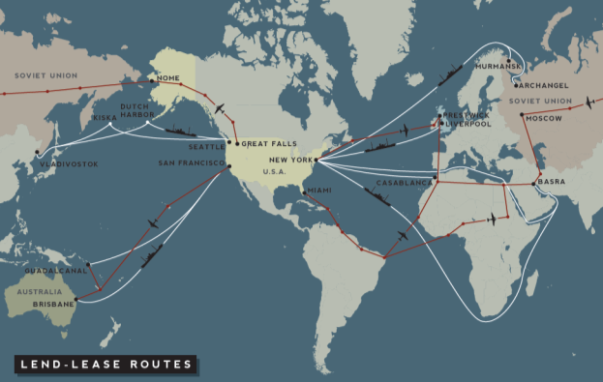
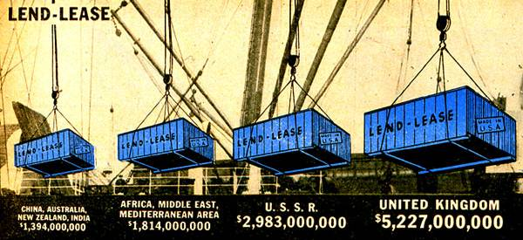
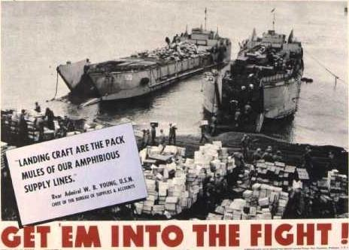
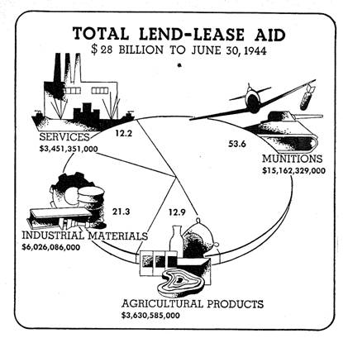
The USA responded with the Lend-Lease Act in 1941
The Lend-Lease Act allowed the USA to send war supplies to Allied nations and transport war-related goods to Europe on armed ships
The Lend-Lease Act was used throughout WWII, transformed the USA into an “arsenal of democracy,” and helped end the depression in America

Slide 27
