Slide 1
Think About It
Evaluate to what extent foreign issues and developments helped to maintain continuity and foster change in American foreign policy from 1920 to 1945.
Evaluate the impact of World War II on the growth and power of the federal government.
To what extend did World War II help to maintain continuity and foster change in the social experiences of women and minorities from 1940 to 1945.

Slide 2
The US in WWII
Mr. Winchell
APUSH
Period 7

Slide 3
Factors that Contributed to Hitler’s Rise
Economic depression
Treaty of Versailles (Peace Treaty Germany and Allies World War I)
Striped Germany of land (East Prussia, Danzig and empire)
Striped Germany of military, navy, air force
Allies had a right to intervene (Saar Basin Rhineland, many resources)
German had to take explicit blame for the war
Pay War Repartitions
Socialists/Communists vs Right Wing groups were fighting for control
Created conditions for popularity of Nazis for some German voters

Slide 4
United States Status After WWI
After WWI US is considered Isolationist by many, because of the desire to stay out of international politics (not a member of League of Nations…Wilson and Republicans)
The Neutrality Act of 1935- members of congress, wanted to keep America out of war
Neutrality Act 1936- forbade loans to belligerent countries
Neutrality Act 1937- response to the Spanish Civil War
Goods from the US to warring nations had to be paid for in cash (2 years only)
European Appeasement

Slide 5
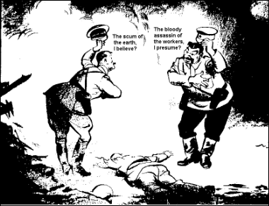
Non-Aggression Pact

Slide 6
United States Reacts to War Debate 1940: Isolationist or Internationalist
Isolationists
America First Committee
Charles A Lindberg
“Intervention is detrimental to American interests”
Internationalists
Committee to Defend America
Best way to keep US out of war is to Help allies fight the Germans
Roosevelt is sympathetic

Slide 7
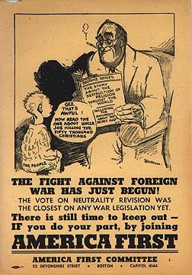
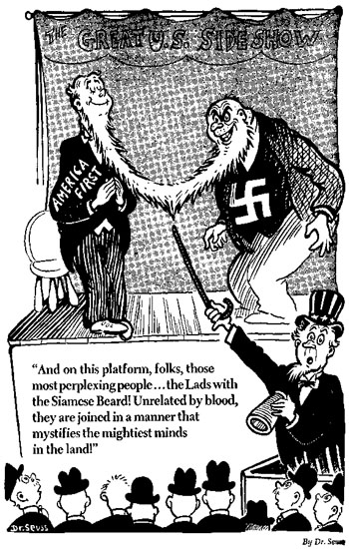

Slide 8
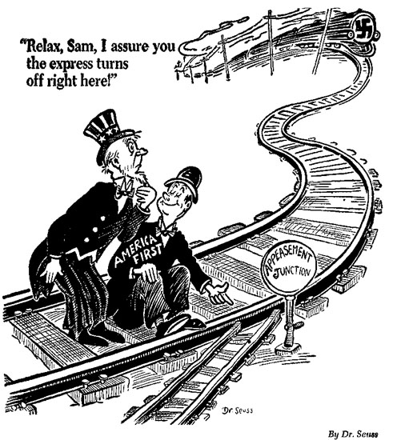

Slide 9
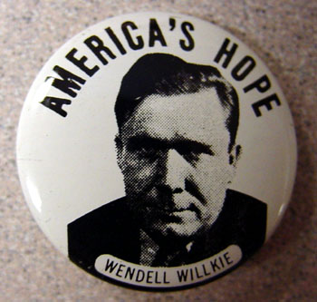
Election of 1940
FDR decides to run for a third term
‘The nation needs him’…emergency situation:
War in Europe
Problems in Asia
Wants to protect New Deal reforms
Ran against Wendell Willkie
FDR Wins- then begins the process
Prepare for War:
Draft
Armament build up

Slide 10
FDR Wins Unprecedented 3rd Term

Slide 11
FDR Aids the Allies
Summer 1940 FDR asks congress to allow trade of 50 destroyers in exchange for 99 year leases for bases in the Atlantic
Although population does not want to enter the war, 73% support aid to Britain.

Slide 12
“Arsenal of Democracy”
Lend-Lease Act (1941)
Provide arms to Great Britain on credit and decisively pro-British “neutrality”
Atlantic Charter (1941)
Promote and secure self-determination and free trade
No pursuit of territorial expansion
Blueprint for United Nations

Slide 13
1941 Lend Lease
1941 Lend-Lease:
Program to offer aid to Brits
FDR in a “Fireside Chat” “If a neighbor’s home were on fire…”
“lease, lend or otherwise dispose of” any items not vital to the nation’s defense.
US is closer to the War- (US Ships secretly were supporting the British Navy by searching and reporting on U-boat locations)
Hitler afraid to attack American Ships

Slide 14
What Comes Next for FDR…
Atlantic Charter
FDR Churchill meet in secret
Selective Service Act
Four Freedoms Speech
Freedom of Speech and Expression
Freedom of Worship
Freedom from Want
Freedom From Fear

Slide 15
Significance of “Four Freedoms” Speech
Represents FDR’s view that America needs to prepare for war and support Britain.
FDR Prepares for War
Increased Military appropriations
Aliens are fingerprinted
Peace time draft to raise 2 million troops
4 Freedoms Speech

Slide 16
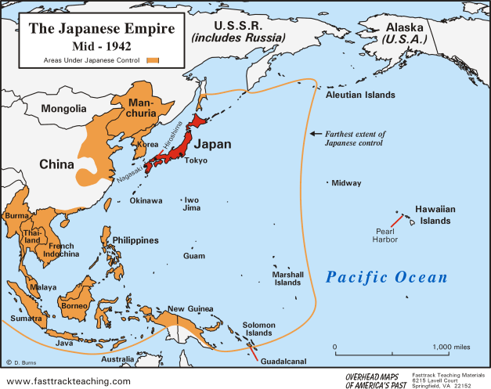
Pearl Harbor
U.S. Embargoes on Japan
Prohibited trade of steel and oil
Required Japan’s halt on expansion and removal from China
December 7, 1941
Japanese surprise attack on U.S. naval base at Pearl Harbor in Hawaii
2,400 Americans killed
“a date that will live in infamy”
United States enters WWII
U.S. declares war on Japan (12/8/41)
Germany and Italy declare on U.S.
German invasion of Soviet Union (1942)
Allies
U.S., Great Britain, Soviet Union
Axis
Germany, Italy, Japan

Slide 17
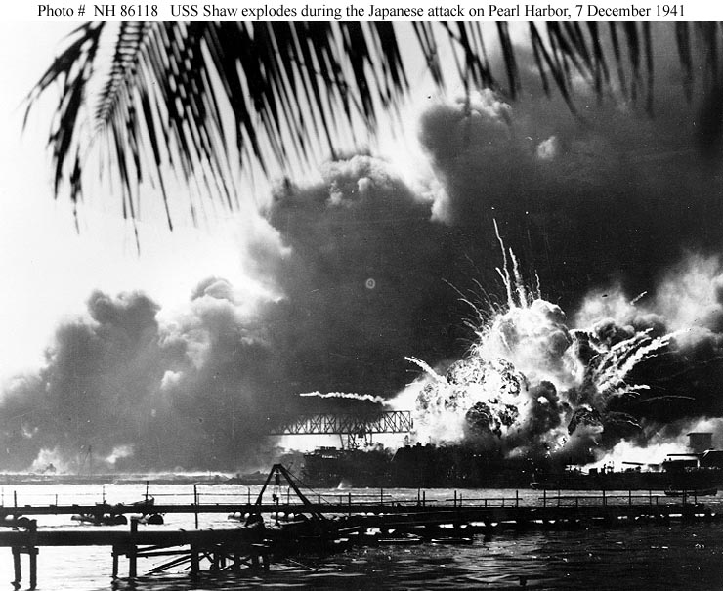

Slide 18
Japan Offensive
Hitler and Mussolini both declared war on the United States as a sign of support for the Japanese.
Japan Attacks Polynesian Asia immediately following the attack on Pearl Harbor. Japanese forces began a systematic invasion of the Pacific. Malaysia, Singapore, Burma, French Indochina, and the Philippines were overrun. American forces in the Philippines were outnumbered and overwhelmed by Japanese forces.
Douglas MacArthur: “I shall return”
12,000 American prisoners were taken in the fall of the last Philippine strong hold called Bataan.
“Bataan Death March”

Slide 19
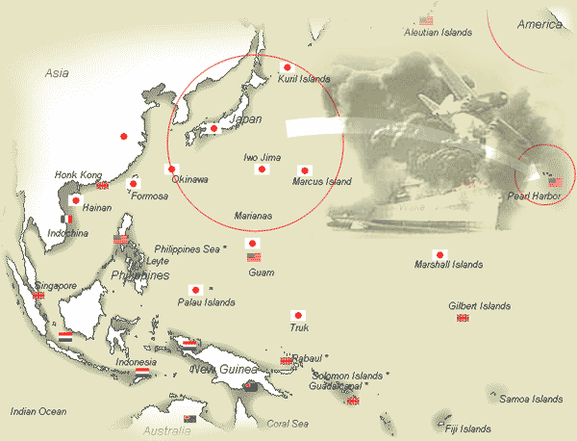

Slide 20
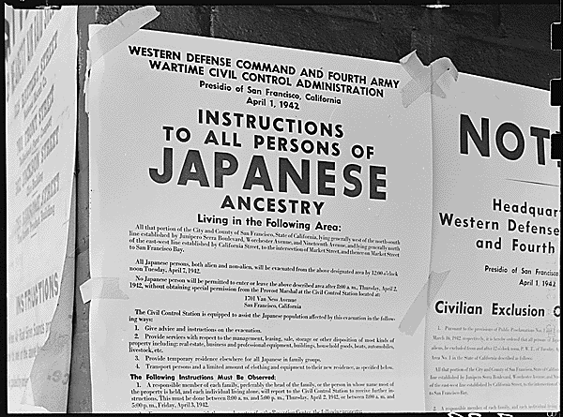
Japanese in World War II
Japanese internment camps
Executive Order 9066
Over 100,000 Japanese immigrants (isei) and Americans (nisei)
Korematsu v. United States (1944)
Supreme Court ruled internment camps constitutional in wartime
442nd Infantry

Slide 21
The Internment of Japanese Americans Was Justified; The Internment of Japanese Americans Was Not Justified
Hugo Black – Majority Opinion in Korematsu v. United States (1944)
Frank Murphy – Dissenting Opinion in Korematsu v. United States (1944)
[W]e are not unmindful of the hardships imposed by it upon a large group of American citizens. But hardships are part of war, and war is an aggregation of hardships. All citizens alike, both in and out of uniform, feel the impact of war in greater or lesser measure. Citizenship has its responsibilities as well as its privileges, and in time of war the burden is always heavier. Compulsory exclusion of large groups of citizens from their homes, except under circumstances of direct emergency and peril, is inconsistent with our basic governmental institutions. But when under conditions of modern warfare our shores are threatened by hostile forces, the power to protect must be commensurate with the threatened danger.
This exclusion of “all persons of Japanese ancestry, both alien and non-alien,” from the Pacific Coast area on a plea of military necessity in the absence of martial law ought not to be approved. Such exclusion goes over “the very brink of constitutional power” and falls into the ugly abyss of racism… Being an obvious racial discrimination, the order deprives all those within its scope of equal protection of the laws as guaranteed by the Fifth Amendment...[T]his order also deprives them of all their constitional rights to procedural due process. Yet no reasonable relation to an “immediate, imminent, and impending” public danger is evident to support this racial restriction which is one of the most sweeping and complete deprivations of constitutional rights in the history of this nation in the absence of martial law.

Slide 22
American “Arsenal of Democracy”
America Mobilizes for War= (WPB)
War Production Board- goal is to transform industrial production to War production, organize all industrial output
Board had much power to control resources:
Limited civilian goods- Rationing of food, fuel…
Cars stopped being produced
Conservation and recycle movement, rubber, metal, grease,

Slide 23
“Arsenal of Democracy”
$320 Billion government spending- 1940-1945
Huge amount was 6 times that of Roosevelt’s first two terms.

Slide 24
The Economy and World War II
Economic Recovery and Growth
GDP
$103.6B - 1929
$56.4B - 1933
$101.4B - 1940
$223.1B - 1945
Unemployment
17 million new jobs
3.2% - 1929
24.9% - 1933
14.6% - 1940
1.2% - 1944
Fiscal Policy
War cost $304B
$136B from tax revenue
Revenue Act of 1942
$168B from war bonds
National Debt
$25B in 1918
$20B in 1933
$39.65B in 1939
$251B in 1945
Industry
Factories converted for war production
Doubled industrial production
Real wages increased by 50%
Agriculture
Net farm income doubled
$20B increase in land value
$11B savings accumulated
17% decline in farm population
Labor Unions
National War Labor Board
Smith-Connally War Act (1943)
Union membership
9 million – 1940
14.8 million - 1945

Slide 25
War bonds helped the
government finance the
war
Any Bonds Today?
The Ducktators

Slide 26
War Productions Board

Slide 27
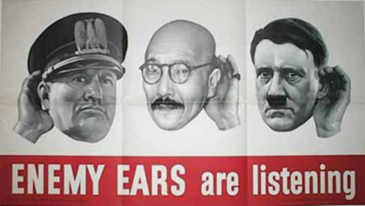
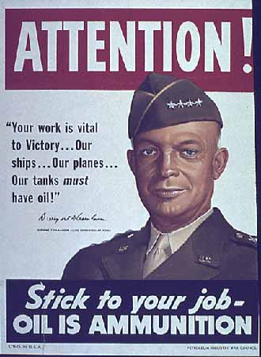
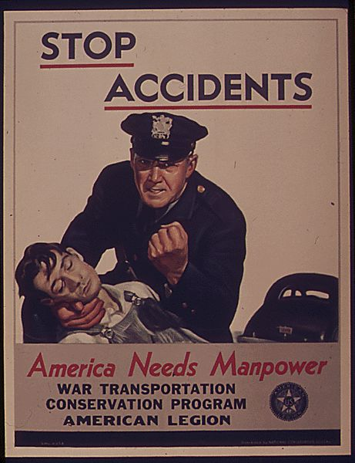
Office of War Information

Slide 28
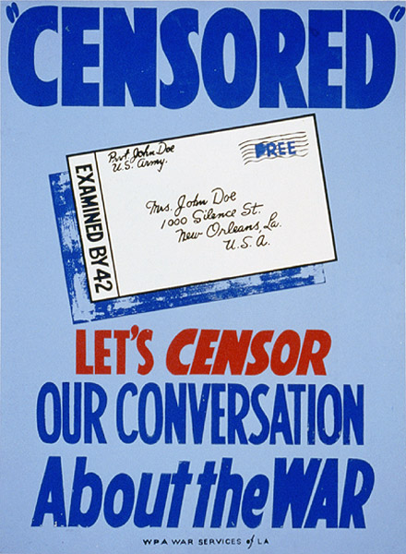
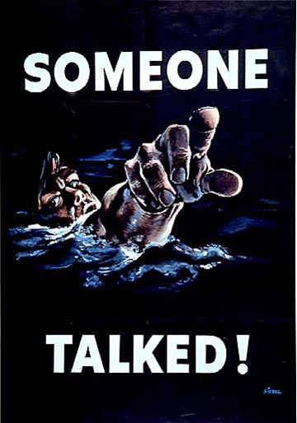
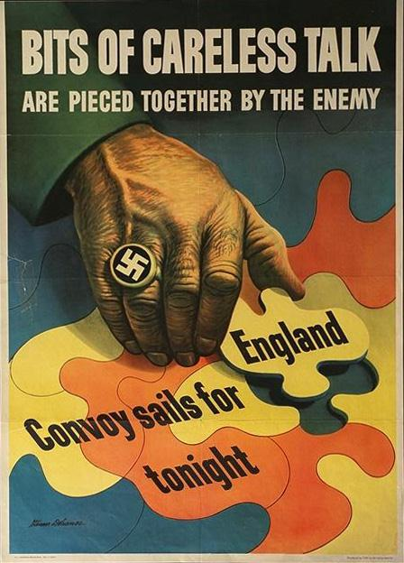
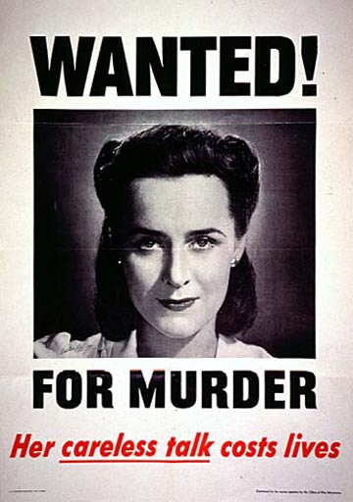
Office of Censorship

Slide 29
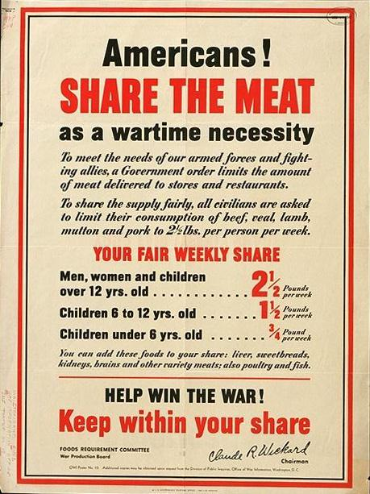
Office of Price Administration (OPA) and Ration Books

Slide 30
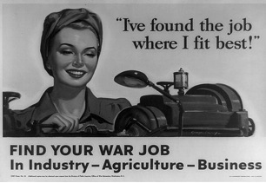
Women and World War II
Women in Armed Forces
350,000 served in military
Women’s Army Corps (WAC)
Women Appointed for Voluntary Emergency Service (WAVES)
“Rosie the Riveter”
“A woman is a substitute, like plastic instead of metal.” – War Department brochure
Women in the Workforce
1940 – 27%
1945 – 37%
Earned 65% of what men earned
Domestic sphere included the home front
American Family
Marriage and birth rates increased
Divorce rates increased
High school enrollment decreased
“At Boeing I found a freedom and an independence I had never known. After the war I could never go back to playing bridge again, being a clubwoman and listening to a lot of inanities when I knew there were things you could use for your mind. The war changed my life completely.” – Inez Sauer

Slide 31
African Americans and World War II
1.2 million served during the war
Tuskegee Airmen
Double V Campaign
Great Migration
Detroit Race Riot (1943)
March on Washington (1941)
A. Phillip Randolph
Executive Order 8802
Desegregation of national defense industry
Committee on Fair Employment Practice
Congress of Racial Equality (CORE)

Slide 32
Economic Impact of World War II

Slide 33
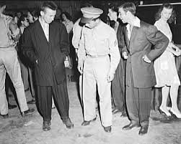
Other Minorities in World War II
Mexicans
Braceros program
Zoot Suit Riots (June 1943)
Natives
Navajo Code Talkers
25,000 enlisted

Slide 34
Election of 1944
Franklin D. Roosevelt (D)
Harry S. Truman as VP
War success boosted popularity
Thomas E. Dewey (R)
Campaigned for smaller government and less regulation

