Slide 1
Do Now
What was the significant cause and effect of the 2nd Great Awakening?

Slide 2
Antebellum Reform Movements & Seneca Falls
Mr. Winchell
APUSH
Period 4

Slide 3
AP Prompt
Evaluate the extent to which 19th century religious and reform movements expanded democratic ideals.

Slide 4
Key Concepts

Slide 5
Alice Walker Reads Sojourner Truth
https://www.youtube.com/watch?v=EsjdLL3MrKk

Slide 6
The Second Great Awakening Growth and Impact
Protestant revivalism
Reaction to Calvinist/Puritanical doctrine
Emotionalism
Inspired perfectionism
Denominational Growth
Baptists and Methodists
Increase of women in churches
Afro-Christianity
New Denominations
Millennialism
Seventh-Day Adventist Church
Mormonism
Inspired social reform movements
Temperance
Abolitionism

Slide 7
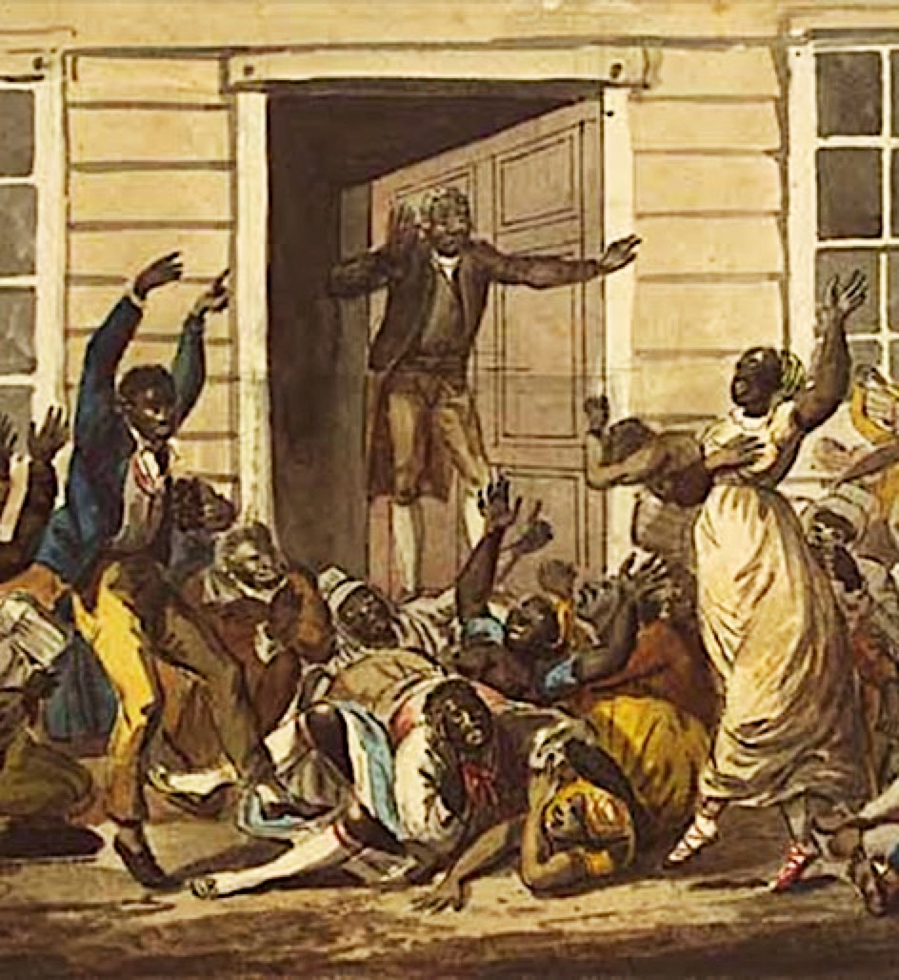
African-American Religion
Church was center of community
Call-and-response
Exodus story
Some female preachers

Slide 8
“Perfectionism”
New nation
Democratization
Political & moral reform movements
Religious revivals
Millenarianism & Utopianism

Slide 9
Women
Abolition
Temperance
Education
Asylums & Prisons
Women’s rights

Slide 10
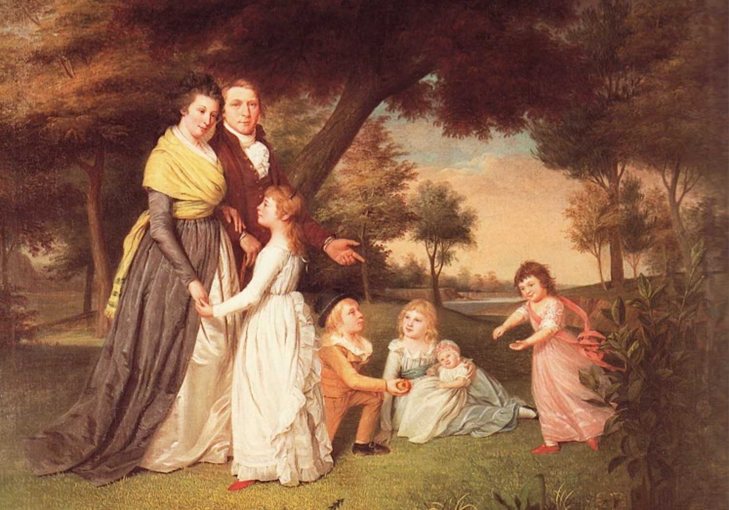
Republican Motherhood

Slide 11
Cult of Domesticity
Separate Spheres
Public sphere – men
Private sphere – women; their “proper sphere”
“Cult of True Womanhood”
Piety
Purity
“the man bears rule over his wife’s person and conduct. She bears rule over his inclinations: he governs by law; she by persuasion… The empire of women is the empire of softness, her commands are caresses, her menaces are tears.”
Submissiveness
“She feels herself weak and timid. She needs a protector. She is in a measure dependent. She asks for wisdom, constancy, firmness, perseveredness, and she is willing to repay it all by the surrender of the full treasure of her affection. Women despise in men everything like themselves except a tender heart. It is enough that she is effeminate and weak; she does not want another like herself.” -George Burnap, The Sphere and Duties of Woman.
Domesticity
“There is more to be learned about pouring out tea and coffee than most young ladies are willing to believe.” – Godey’s Ladies Book

Slide 12
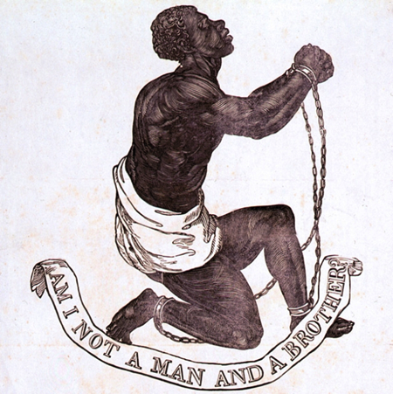
Christian Abolitionism
2nd Great Awakening
“Slaveholding is sinful”

Slide 13
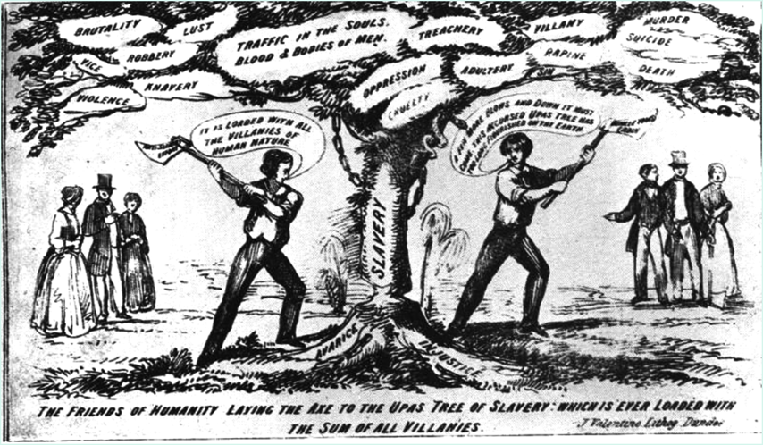
Christian Abolitionism

Slide 14
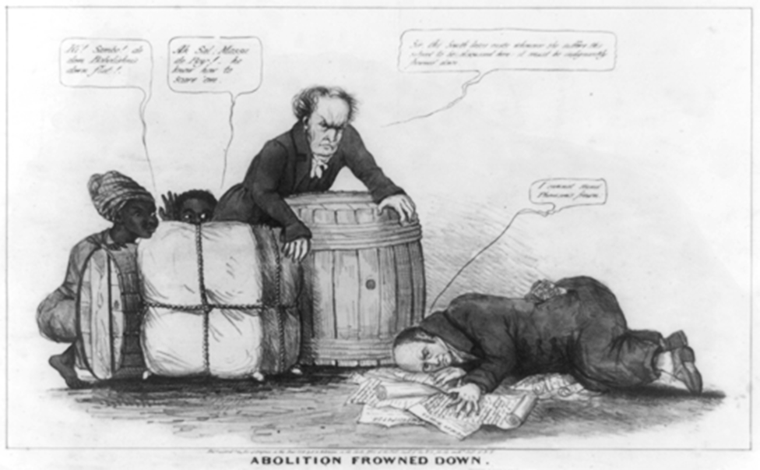
Gag Rule, 1836

Slide 15
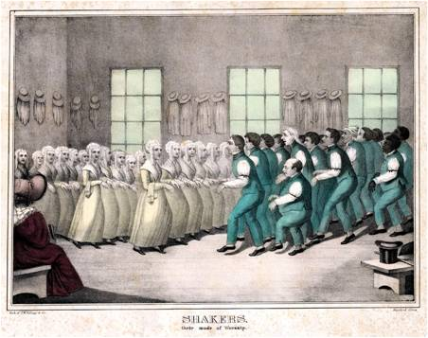
Communal Societies
Brook Farm
Share equally in labor and leisure
Robert Owen’s New Harmony
Utopian socialist
“Village of Cooperation”
Shakers
Common ownership and shared rewards
Strict celibacy
Against vices
“separate but equal”
Oneida Community
“perfectionists”
Married to all
Children raised communally

Slide 16
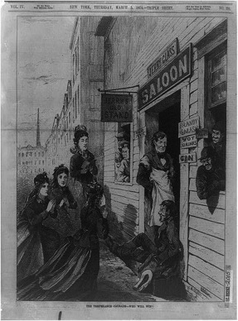
Reform Movements Temperance
Social Problems of Alcohol
Organizations
American Temperance Society
Washingtonians

Slide 17
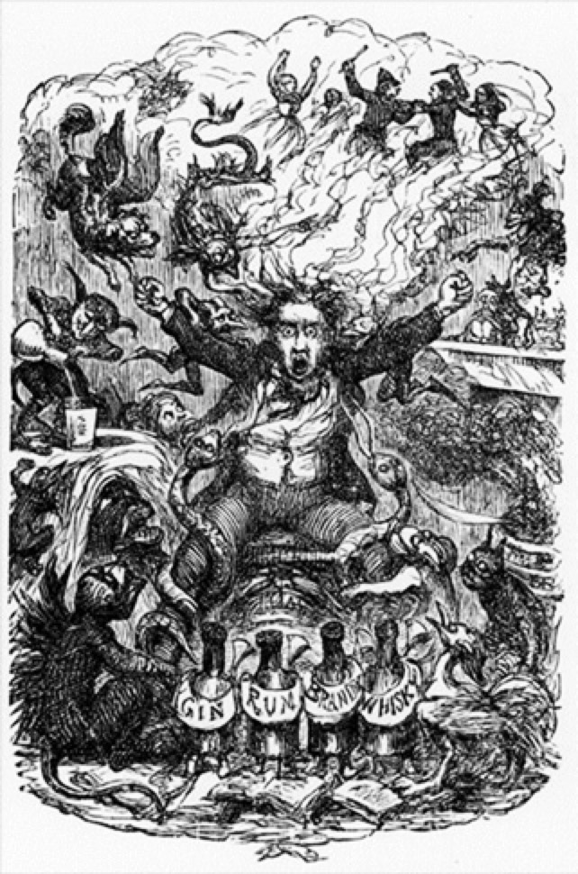
Temperance & Women
Domestic neglect & abuse
Infidelity & disease
Lost wages
Abstinence pledges

Slide 18
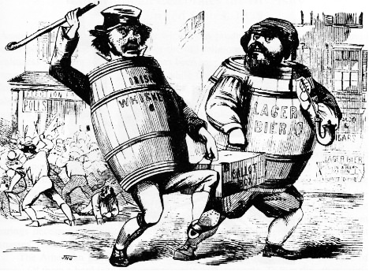
Temperance & Immigration
Nativist issue
Irish whisky
German beer
Italian wine, etc.

Slide 19
Educational Reform
Enlightenment philosophy
Tabula rasa: blank slate
Political philosophy
Civic virtue & informed citizenry
Socio-economic factors
Industrialization & child labor

Slide 20
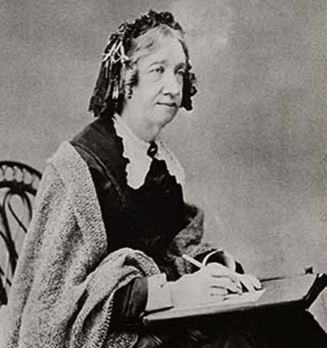
Women & Education
Catharine Beecher
Kindergarten
Physical education
Music education
Emma Willard
Women’s education
Elizabeth Blackwell
Medicine
OBERLIN COLLEGE

Slide 21
Reform Movements Education
Public Education
Massachusetts
Horace Mann
“Education, then, beyond all other devices of human origin, is the great equalizer of the conditions of men, — the balance-wheel of the social machinery. I do not here mean that it so elevates the moral nature as to make men disdain and abhor the oppression of their fellow-men. This idea pertains to another of its attributes. But I mean that it gives each man the independence and the means by which he can resist the selfishness of other men. It does better than to disarm the poor of their hostility towards the rich: it prevents being poor.”
“It is well to think well. It is divine to act well.”
“An educated electorate is essential to the working of a free Political system.”
Compulsory education
State-run teacher training programs

Slide 22
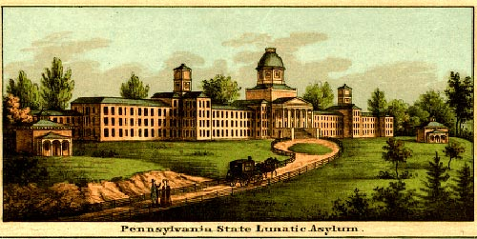
Reform Movements Rehabilitation
Dorothea Dix
“Man is not made better by being degraded.”
Prisons and Asylums
Penitentiary System

Slide 23
Penny Press
Growth
Steam-powered printing press machines
State-mandated public education
Affordable
Simple vocabulary and diction
Impact
Increased literacy rates
More opinionated American public

Slide 24
Transcendentalism
Stressed intuition/instinct, emotionalism, feelings over reason and logic
Promotion of the Individual
Finding spiritual enlightenment through Nature
Reject materialism doctrine

Slide 25
Transcendentalism
Ralph Waldo Emerson
Self-Reliance (1841)
“Nothing is at last sacred, but the integrity of your own mind.”
The American Scholar (1837)
Despite cultural heritage, instinctive creative genius of individual could lead to greatness
Henry David Thoreau (Walden, On Civil Disobedience)
“I went to the woods because I wished to live deliberately, to front only the essential facts of life, and see if I could not what it had to teach, and not, when I came to die, discover that I had not lived.”
Passive resistance
A public refusal to obey unjust laws

Slide 26
Romanticism
Nostalgia
Emotionalism
Glorification of Nature
Sublime
Individualism
Myth and Folklore
Spiritualism
Immigrants Crossing the Prairie
Albert Bierstadt

Slide 27
Historiography “Antebellum Reform: Evolving Causes and Strategies”
Mary Hershberger – Mobilizing Women, Anticipating Abolition: The Struggle against Indian Removal in the 1830s (1999)
Lori D. Ginzberg – “Moral Suasion is Moral Balderdash”: Women, Politics, and Social Activism in the 1850s (1986)
To block [Indian] removal, Catherine Beecher and Lydia Sigourney organized the first national women’s petition campaign and flooded Congress with antiremoval petitions, making a bold claim for women’s place in national political discourse… Protesting Indian removal encouraged antiremovalists to challenge slavery directly. The Indian Removal Act made abolitionists bolder in acting against slavery and more determined to achieve their goals… It also ushered in a new age of popular politics that saw energized antiremovalists transfer their techniques of removal protest to the struggle against slavery: massive and continuous pamphleting and petitioning by both women and men, persistent reports in periodicals that sought to present slavery from the perspective of the slave, and a willingness to challenge laws that they believed were deeply unjust.
As a result of the Second Great Awakening of the 1820s and early 1830s, a millennial spirit pervaded efforts at transforming United States society. Abolitionists, vegetarians, temperance activists, and crusaders against “male lust”…sought not merely social change but spiritual transformation, the moral regeneration of the world... American middle-class radicalism of the 1830s and 1840s evolved in a religious context, one in which the regeneration of individuals would precede – and assure – the salvation of society. Women played a central role both in the ideology and in the means of the proposed national transformation. Viewed as inherently moral, women were to instruct by example and to participate in movements for social, or moral, change.

Slide 28
Women in Revolt
Women in America:
Nineteenth century was still a man’s world
Women in American had it better than in Europe
Women were still “the submerged sex” in America
Women now avoided marriage—10 % of adult women remained “spinsters” at the time of the Civil War
Gender differences were strongly emphasized in 1800s America:
Because the burgeoning market economy separated women and men into distinct economic roles.
The home was a woman’s special sphere, the centerpiece of the “cult of domesticity.”

Slide 29
The Legal Status of Women
Legal status of women largely unchanged since the Revolution
No suffrage on a national level
Subordinate to husband
Origin of women’s rights movement - abolition
Notes:
The official status of women during this period remained much as it had been in the colonial era.
Legally, a woman was unable to vote, except in some states, and after marriage, a woman was denied legal control of her property and even of her children
A wife could not make a will, sign a contract, or bring a suit in court without her husband’s permission.
Her legal status was similar to that of a minor.
Gradually, more and more women begin to complain about their status.
The organized movement for women’s rights had its origins in 1840, when the American Anti-slavery movement split over the question of participation of women in the movement.
American women decided that they needed to organize on behalf of their own emancipation too.

Slide 30
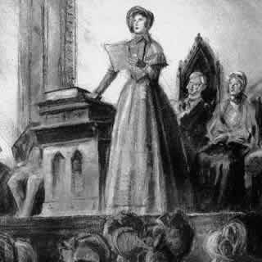
Seneca Falls Declaration of Sentiments
Lucretia Mott & Elizabeth Cady Stanton
Modeled on Declaration of Independence
“All men and women are created equal”
List of grievances against patriarchal society

Slide 31
Seneca Falls Declaration
“We hold these truth to be self-evident; that all men and women are created equal…”
“…establishment of an absolute tyranny over her.”
“He has never permitted her to exercise her inalienable right to the elective franchise…thereby leaving her without representation…he has oppressed her on all sides.”
“He has withheld from her rights which are given to the most ignorant and degraded men – both natives and foreigners.”
“He has made her, if married, in the eye of the law, civilly dead.”
“He has taken from her all right in property, even to the wages she earns.”
“He has made her, morally, an irresponsible being, as she can commit many crimes with impunity, provided they be done in the presence of her husband…compelled to promise obedience…he becoming to all intents and purposes, her master…”
“He has monopolized nearly all profitable employments…[as] a teacher of theology, medicine, or law, she is not known.”
“He has denied her the facilities for obtaining a thorough education…”
“He allows her in Church, as well as State, but a subordinate position, claiming Apostolic authority for her exclusion from the ministry…”
“He has created a false public sentiment by giving to the world a different code of morals for men and women…”
“He has endeavored, in every way that he could, to destroy her confidence in her own powers, to lessen her self-respect and to make her willing to lead a dependent and abject life.”
“Resolved, That the speedy success of our cause upon the zealous and untiring efforts of both men and women, for the overthrow of the monopoly of the pulpit, and for the securing to women an equal participation with men in various trades, professions, and commerce.”
“Resolved, therefore, That, being invested by the Creator with the same capabilities, and the same consciousness of responsibility for their exercise, it is demonstrably the right and duty of woman, equally with man, to promote every righteous cause by every righteous means…”

