Slide 1
Do Now
Evaluate and compare the differing perspectives and opinions of the Federalists like Alexander Hamilton and the Democratic Republicans like Thomas Jefferson.

Slide 2
9. The Adams Administration and the Peaceful Revolution of 1800
Mr. Winchell
APUSH 2019-2020
Period 1-2

Slide 3
AP Prompt
Evaluate the causes of the fall of the Federalist Party, accounting for economic and political factors.

Slide 4
BIG IDEAS-College Style
Washington’s Presidency and Precedents
What legacy did he leave?
Hamilton vs. Jefferson and the Birth of Political Parties
How did early issues facing the nation lead to two such opposing views on power and the Constitution?
Constitution vs. Articles of Confederation
How was the Constitution different in practice than the Articles of Confederation were?
The Adams Administration and the Legacies of the Federalist Party
How did the ideology and actions of the Federalists lead to their fall from power?

Slide 6
George Washington (1789-1797)
Washington unanimously elected
John Adams as VP
The Cabinet
Secretary of State Thomas Jefferson
Secretary of the Treasury Alexander Hamilton
Secretary of War Henry Knox
Attorney General Edmund Randolph
Judiciary Act of 1789
Established lower federal courts
Federal district court in each state
Attorney General
Whiskey Rebellion (1794)
Foreign Policy
French Revolution
Jay Treaty and Pinckney Treaty
Farewell Address

Slide 7
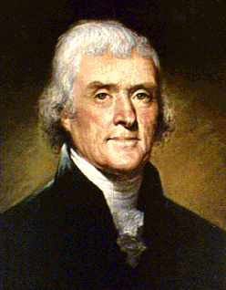
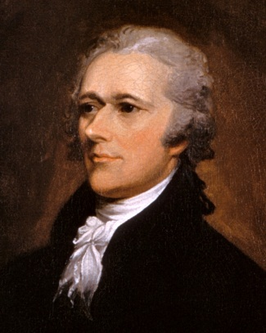
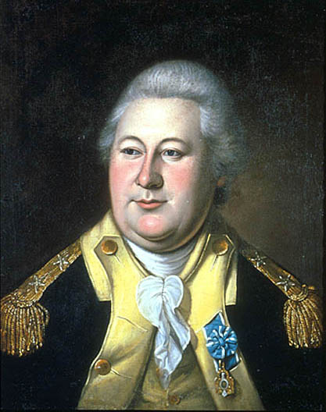
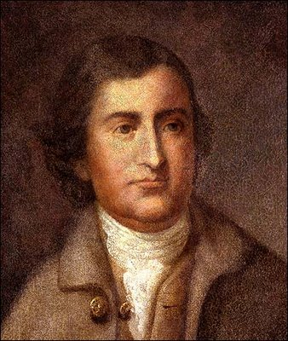
The Departments & Leadership
Department of State
Sec. of State - T. Jefferson
Department of Treasury
Sec. of Treasury - A. Hamilton
War Department
Sec. of War - Henry Knox
Attorney General Edmund Randolph

Slide 8
The Courts
Congress created effective courts under the Judiciary Act of 1789
Judiciary Act organized the Supreme Court with a chief justice & 5 associates
Established federal district & circuit courts
Created office of Attorney General

Slide 9
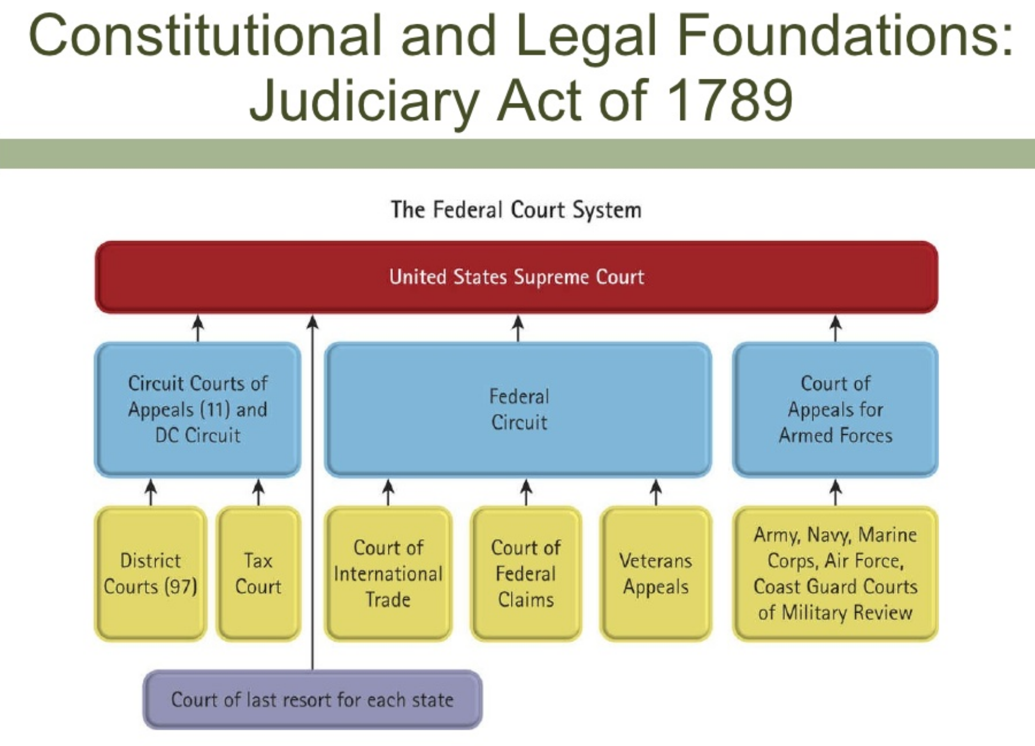

Slide 10
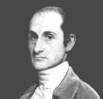
1st Chief Justice
John Jay (NY)
Collaborated w/ Madison on Federalist Papers
A seasoned diplomat
Served as CJ until 1795

Slide 11
Washington’s Foreign Policy
Pro-French
Pro-British
Thomas Jefferson
French Revolution
Citizen Genet
Proclamation of Neutrality (1793)
“Whereas it appears that a state of war exists between Austria, Prussia, Sardinia, Great Britain, and the United Netherlands, of the one part, and France on the other; and the duty and interest of the United States require, that they should with sincerity and good faith adopt and pursue a conduct friendly and impartial toward the belligerant Powers;”
John Adams Neutrality
Alexander Hamilton
Jay’s Treaty (1796)
“Art. 1: There shall be a firm inviolable and universal Peace, and a true and sincere Friendship between His Britannick Majesty, His Heirs and Successors, and the United States of America; and between their respective Countries, Territories, Cities, Towns and People of every Degree, without Exception of Persons or Places.”
“Damn John Jay! Damn everyone that won't damn John Jay! Damn every one that won't put lights in his window and sit up all night damning John Jay!”

Slide 12
The French Question
During Washington’s first term (1788-1792), the French Monarchy was overthrown by the people in an attempt to establish their own republic.
French declared themselves a “republic” but carnage heavier than in American Rev.
Jeffersonians thought it unfortunate, but probably necessary
Hamiltonians thought it downright frightening
FEAR OF MOB RULE
During the Revolution, the US formed an alliance with the French monarchy
The British attempted to take advantage of the situation and also began a war with France.

Slide 13
The French Question
Democratic Republicans pushed for the US gov to honor the alliance and come to the aid of the French
The Federalists stated that the alliance had been formed with the French Monarchy, and therefore no longer existed.
They actually openly supported the British as they did not want to support a bloody and violent revolution in fears of it happening again in the US

Slide 14
Watch this video clip from HBO’s John Adams series As you watch, identify as many things as you can that Jefferson and Hamilton disagree about
Alexander Hamilton
Thomas Jefferson

Slide 15
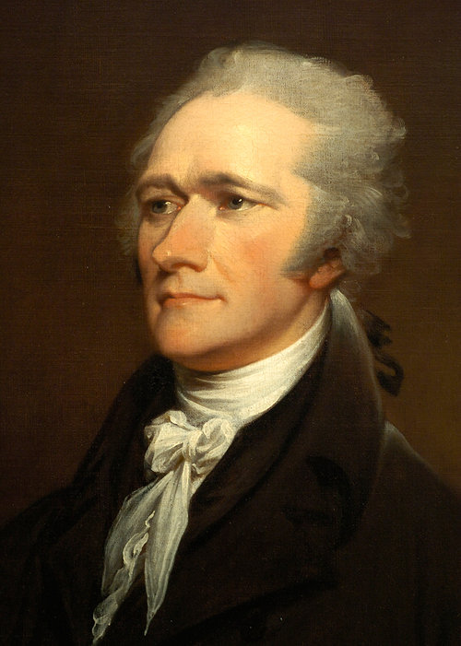
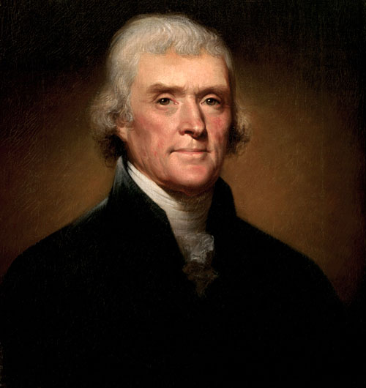
What should be the focus of the American economy?
Alexander Hamilton Thomas Jefferson
Hamilton
The government should promote banking and the growth of American industry so the USA does not have to rely on Britain
Jefferson
The government should promote an economy of self-sufficient farmers who do not need a powerful national gov’t

Slide 16
What was their view on the Constitution?
Alexander Hamilton Thomas Jefferson
Hamilton
Supported the Constitution because it included a president and more power to the national government
Constitution can be “loosely” interpreted (“Elastic Clause”)
Jefferson
Supported the Constitution because of the Bill of Rights
Constitution should be “strictly” interpreted with powers not given to the gov’t are reserved to the states

Slide 17
What political party did he form and what were the core ideals of the party?
Alexander Hamilton Thomas Jefferson
Hamilton
Federalist Party
Strong national government and fewer states’ rights
Jefferson
Democratic-Republican Party
Limited national government with more rights reserved to the states

Slide 18
Should power be in the hands of the “elite” or the “common man”?
Alexander Hamilton Thomas Jefferson
Hamilton
People are motivated by self-interests
Power should be in the hands of the “elite”
Jefferson
The “common man” should be trusted to make good decisions
Corruption occurs when power is in the hands of the “elite”

Slide 19
Hamilton vs. Jefferson and the Birth of Political Parties
Issues:
Constitutional Interpretation
Bank & Credit
French Revolution
Taxes
Whiskey Rebellion (Rebellion in general)

Slide 20
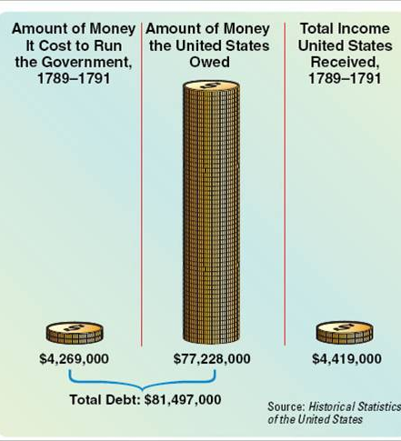
Among their biggest disagreement was over Hamilton’s Financial Plan
In 1789, Hamilton proposed a financial plan that would guide the future of the U.S. economy
1. Hamilton proposed funding and assumption of all state debts incurred during the Revolutionary War
Congress and Washington approved Hamilton’s plan for funding and assumption
By taking the state debts, the USA government would reinforce federal supremacy
By repaying all debts, the USA would gain foreign credit

Slide 21
2. Establishment of a National Bank
Bank would hold govt. funds
Circulate uniform natl. currency
Lend $ to the govt.
To be privately owned & managed
U.S. would have 20% ownership
Wealthy biz interests - 80%
Proposal caused huge debate

Slide 22
Bank of the U.S.
Jefferson opposed the bank
Not authorized in the Constitution
Powers not granted to Federal govt reserved for states (soon-to-be 10th Amendment)
States should charter banks
A strict interpretation of the Constitution

Slide 23
Bank of the U.S.
Hamilton invoked “necessary & proper” clause which allowed Fed to pass laws necessary for running govt. (Article 1, Sec. 8, par. 18)
A loose interpretation
GW accepted H’s argument and signed the measure into law
Becomes a sectional rift - N vs. S
Hamilton’s financial programs contributed to creation of political parties

Slide 24
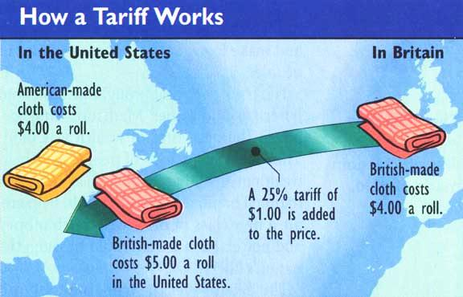
3. To raise money for the new nation, Hamilton proposed a tax on whiskey and a creating a protective tariff on foreign manufactured goods that would promote American industry

Slide 25
Whiskey Rebellion (1791-1794)
Excise tax on domestic whiskey
Western Pennsylvanian farmers attacked federal tax collectors
Washington and Hamilton led federal troops and quashed the rebels
Asserted federal authority over lawlessness
Public could denounce and protest laws
Thomas Jefferson and Opposition
Overuse of federal military
Jefferson caters to western farmers

Slide 26
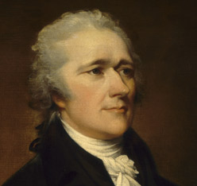
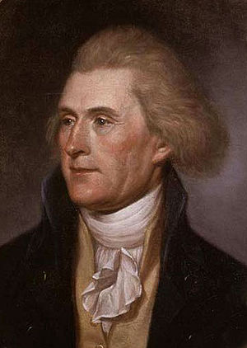
First Political Party System (1789-1824)
Alexander Hamilton
Thomas Jefferson
Federalists
National policies
Strong central government
Loose constructionists
Commerce and manufacturing
Urban
The rich, the well-born, the able; merchants, bankers
Pro-British
Anti-French revolution
Northeast
Democratic-Republicans
States rights
Strong local/state governments
Strict constructionists
Agricultural
Rural
Small farmers, plantation owners, artisans
Anti-British
Pro-French Revolution
West and South

Slide 27
Washington’s Farewell Address (1796)
Political Parties
Entangling Alliances
“I have already intimated to you the danger of parties in the State, with particular reference to the founding of them on geographical discriminations. Let me now take a more comprehensive view, and warn you in the most solemn manner against the baneful effects of the spirit of party generally. This spirit, unfortunately, is inseparable from our nature, having its root in the strongest passions of the human mind. It exists under different shapes in all governments, more or less stifled, controlled, or repressed; but, in those of the popular form, it is seen in its greatest rankness, and is truly their worst enemy. The alternate domination of one faction over another, sharpened by the spirit of revenge, natural to party dissension, which in different ages and countries has perpetrated the most horrid enormities, is itself a frightful despotism. But this leads at length to a more formal and permanent despotism. The disorders and miseries which result gradually incline the minds of men to seek security and repose in the absolute power of an individual; and sooner or later the chief of some prevailing faction, more able or more fortunate than his competitors, turns this disposition to the purposes of his own elevation, on the ruins of public liberty. Without looking forward to an extremity of this kind (which nevertheless ought not to be entirely out of sight), the common and continual mischiefs of the spirit of party are sufficient to make it the interest and duty of a wise people to discourage and restrain it.”
“The great rule of conduct for us in regard to foreign nations is in extending our commercial relations, to have with them as little political connection as possible. So far as we have already formed engagements, let them be fulfilled with perfect good faith. Here let us stop. Europe has a set of primary interests which to us have none; or a very remote relation. Hence she must be engaged in frequent controversies, the causes of which are essentially foreign to our concerns. Hence, therefore, it must be unwise in us to implicate ourselves by artificial ties in the ordinary vicissitudes of her politics, or the ordinary combinations and collisions of her friendships or enmities… It is our true policy to steer clear of permanent alliances with any portion of the foreign world; so far, I mean, as we are now at liberty to do it; for let me not be understood as capable of patronizing infidelity to existing engagements. I hold the maxim no less applicable to public than to private affairs, that honesty is always the best policy. I repeat it, therefore, let those engagements be observed in their genuine sense. But, in my opinion, it is unnecessary and would be unwise to extend them. Taking care always to keep ourselves by suitable establishments on a respectable defensive posture, we may safely trust to temporary alliances for extraordinary emergencies. Harmony, liberal intercourse with all nations, are recommended by policy, humanity, and interest. But even our commercial policy should hold an equal and impartial hand; neither seeking nor granting exclusive favors or preferences; consulting the natural course of things; diffusing and diversifying by gentle means the streams of commerce, but forcing nothing;”

Slide 28
Washington’s Precedents
Two terms
“Mr. President”
Cabinet
Neutrality
Special Relationship with Great Britain
Farewell Address

Slide 29
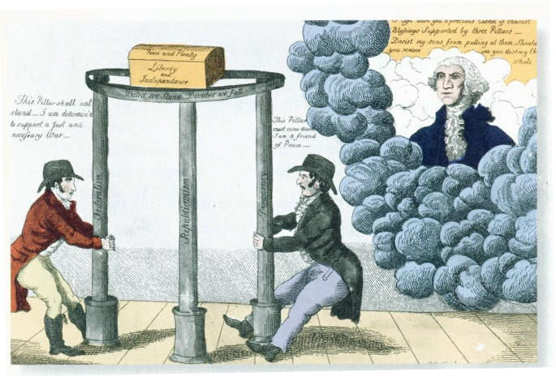

Slide 30
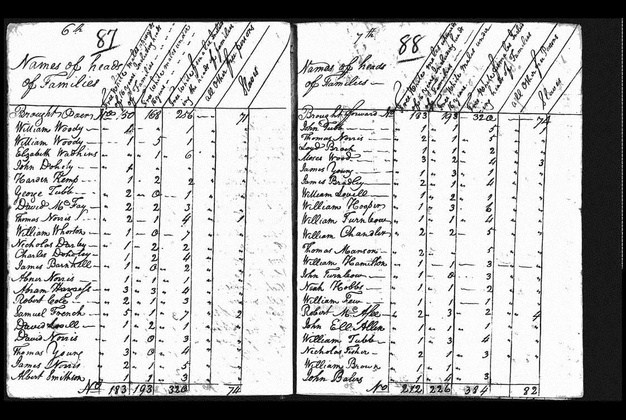
America in 1790
Population nearly 4 million
doubling every 25 years
90% of Americans lived on farms
Public debt large ($52 million) – revenue low.
Threats from GB and Spain threatened fragile unity of US

Slide 31
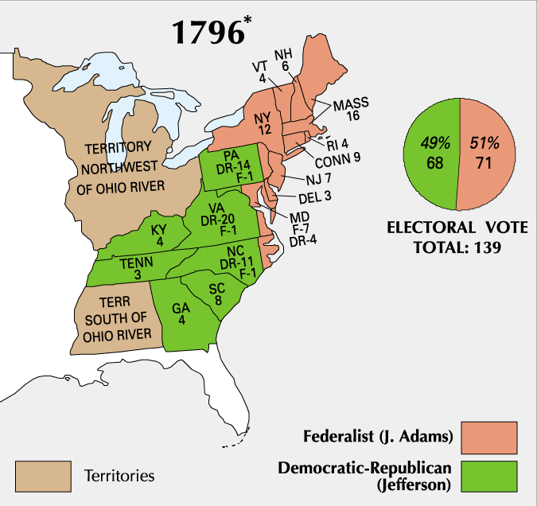
Election of 1796
Notes:
Electoral College Explanation

Slide 32
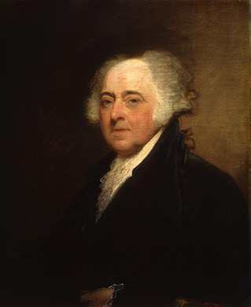
A New President
John Adams
Boston
Federalist

Slide 33
Vice President
Thomas Jefferson
Virginian
Republican (Democratic-Republican)
Became VP because he received second-most votes
At odds with Adams

Slide 34
Relations with France
France very upset about Jay’s Treaty
Saw it as a precursor to an alliance with Britain
France wanted the U.S. to honor the Franco-American Alliance of 1778
France began to attack U.S. ships and seizing American cargo (IMPRESSMENT)
300 ships and $20 million of cargo was lost

Slide 35
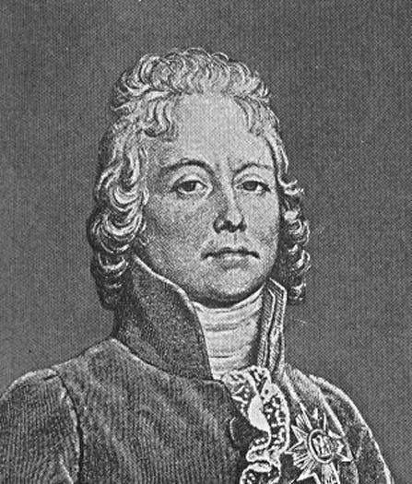
XYZ Affair (1797)
Delegation sent to France to meet with French Foreign Minister Charles Talleyrand
Three French delegates X, Y, & Z demanded $12 million loan & a cash bribe just for a meeting
Americans insulted & came home
Report published & started Anti-French sentiment at home

Slide 36
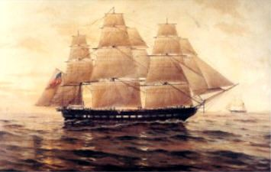
Quasi-War (1798-1800)
U.S. began an undeclared war against France
Was purely navel – fought mainly in the Caribbean
Adams had to quickly expand the 3 ship navy & an army of 10,000 men was authorized

Slide 37
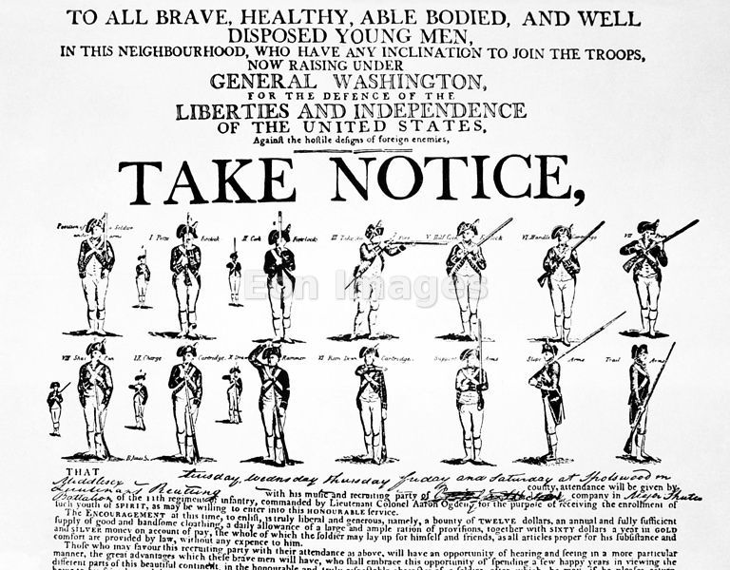
War Avoided
John Adams sent new envoy to France in 1800
Napoleon accepted – more bent on European conquest, not war with US
Improved Relations made Louisiana Purchase possible 3 years later.
Adams felt dodging this bullet was his finest achievement.

Slide 38
President Adams’ handling of the conflict with France led to criticisms by Democratic-Republicans
Federalists in Congress passed the Alien & Sedition Acts
The laws made it a crime to criticize government leaders, restricted citizenship for new immigrants, and made deporting immigrants easier
This attack on free speech and citizenship backfired and badly damaged President Adams and the Federalist Party

Slide 39
Alien & Sedition Acts
Four Bills
Naturalization Act
Alien Friends Act
Alien Enemies Act
Sedition Act

Slide 40
Naturalization Acts
 | 1790 | 1795 | 1798
Notice time | no notice required | 3 years | 5 years
Residence period | 2 years | 5 years | 14 years
Target: potential English & Irish immigrants who would likely vote for the Jeffersonian Republicans

Slide 41
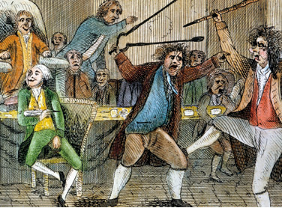
Alien and Sedition Acts (1798)
Purpose: to reduce power of Jeffersonians and silence anti-war opposition
Alien Act
Attack on pro-Jeffersonian “aliens”
Raised residency requirements for US citizenship from 5 yrs to 14 yrs.
President could deport “dangerous” foreigners.
Sedition Act
Anyone who impeded policies of the gov’t or falsely criticized its officials would get heavy fine and imprisonment.
Direct violation of 1st Amendment
Expired day before Adams left office.

Slide 42
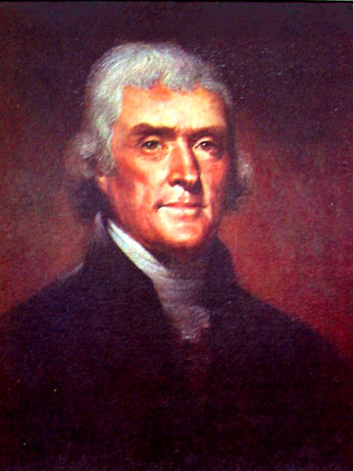
Nullification
Jefferson and many states oppose the Alien & Sedition Acts
Virginia & Kentucky Resolutions call the act “null and void”
States vs. federal government: who wins?...
…principle remained untested because Adams lost next election to Jefferson

Slide 43
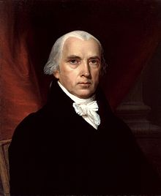
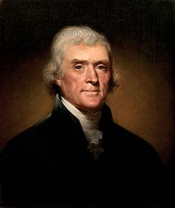
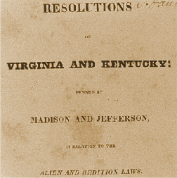
Virginia and Kentucky Resolutions (1798)
Republicans felt Alien and Sedition Acts were unconstitutional
Jefferson and Madison secretly penned two resolutions that asserted that states have the right to nullify unconstitutional laws passed by Congress.
Federalists retorted that the people, not states created Constitution and that the Supreme Court and not states determined the constitutionality of laws.
No other states but VA and KY adopted resolutions, but southern states would use this later in 19th century to support nullification and secession.

Slide 44
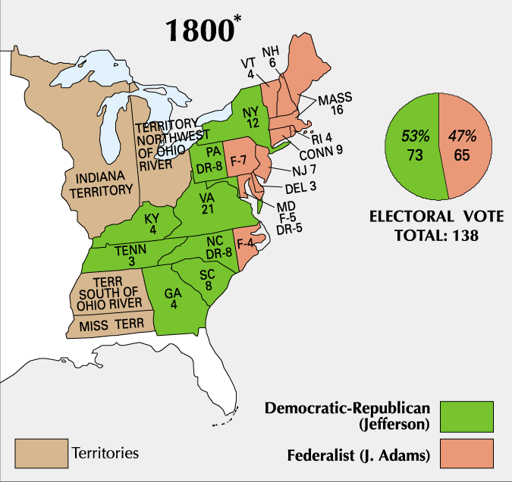
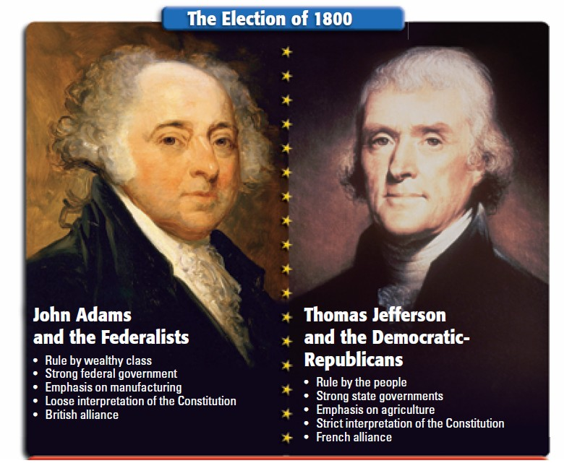
Adams and his Federalist Party were unpopular by the election of 1800
Republican Jefferson defeated Adams in the election of 1800
The 1800 election marked the first time in U.S. history when one political party transferred power to another political party
Jefferson’s victory over Adams marked the beginning of 30 years of dominance by the Democratic-Republican Party

Slide 45
The End of the Federalist Era
Though their time in power was a brief 12 years, the Federalist Party left a significant legacy
Strengthened the national government.
Established a solid financial system
Encouraged American industry growth
Avoided war with both Britain and France, signed key treaties with Britain and Spain

Slide 46
Federalist Loss Factors
Political Base of Power
Economic Base of Power
Regional Base of Power
Alien & Sedition Acts

