Slide 1
9. The Military Fronts of World War II
Mr. Winchell
APUSH 19-20
Period 7

Slide 2
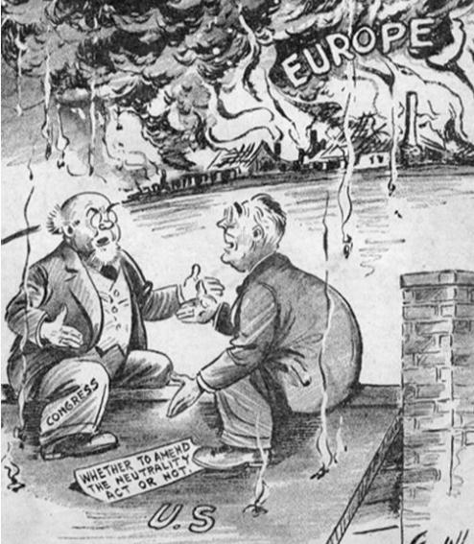
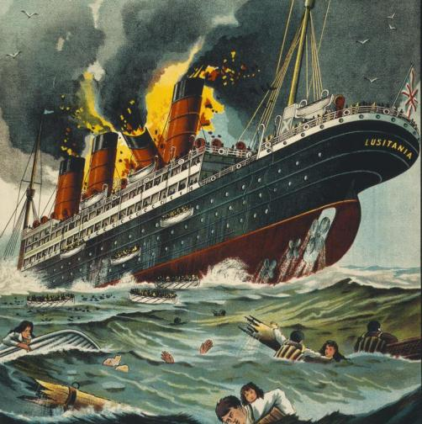
When the war started, Congress amended the Neutrality Acts and allowed U.S. companies to
sell weapons to the Allies on a “cash and carry” basis
Allied nations could buy U.S.-made war goods but had to pay in cash and had to transport goods on their own ships
Remember Germany’s
unrestricted submarine warfare?
The cash-and-carry policy allowed the USA to aid the Allies while remaining neutral and avoid the causes of American entry into the first world war

Slide 3
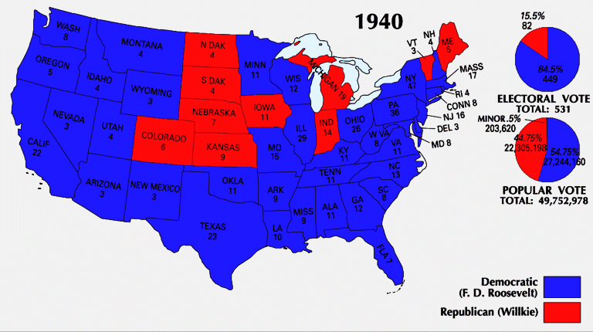
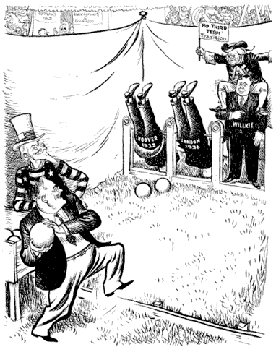
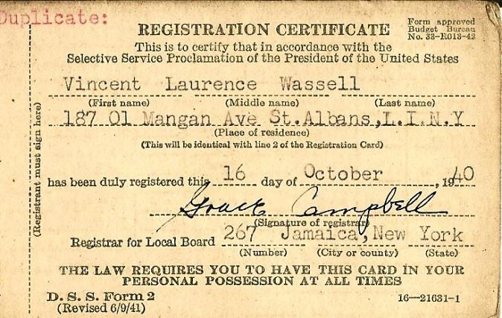
In 1940, Franklin Roosevelt was elected to an unprecedented third term as president
He campaigned on a platform of neutrality but with “preparedness”
FDR prepared for possible entry into the war by calling for the first peacetime draft

Slide 4
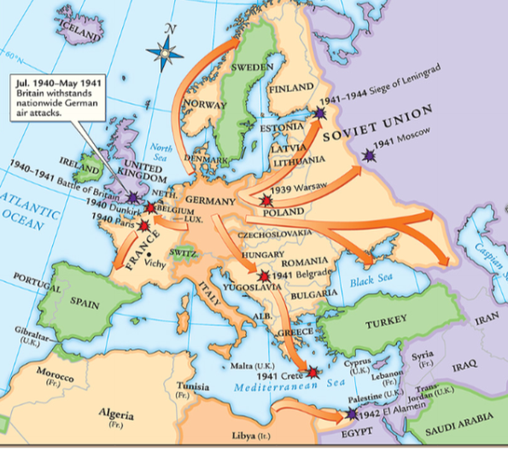
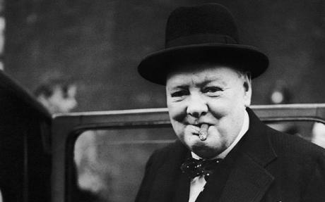
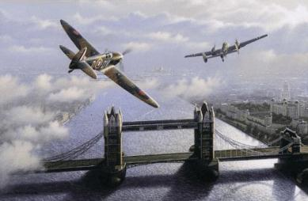
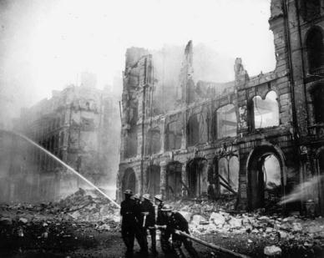
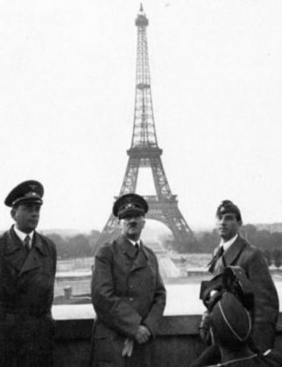
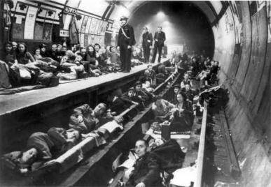
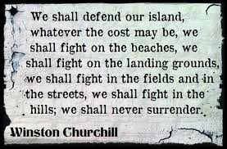
The fall of France in 1940 worried Americans that the Axis Powers might win World War II
German Luftwaffe attacks on Britain meant that England needed U.S. aid more than ever

Slide 5
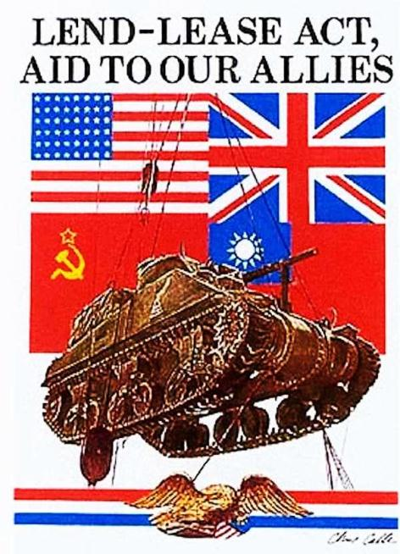
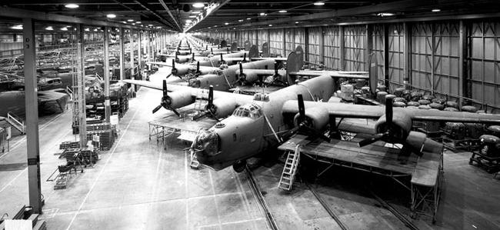
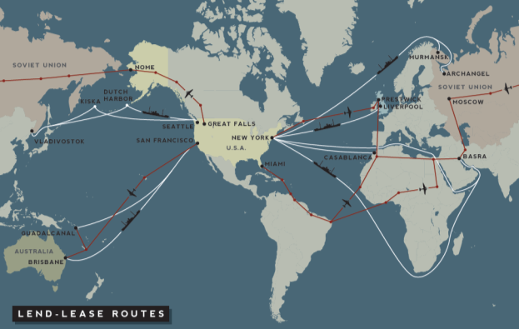
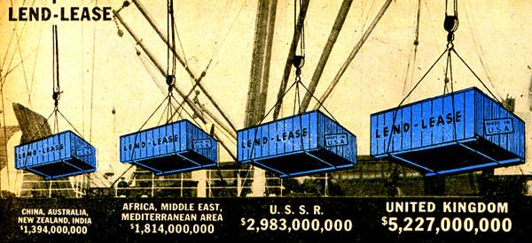
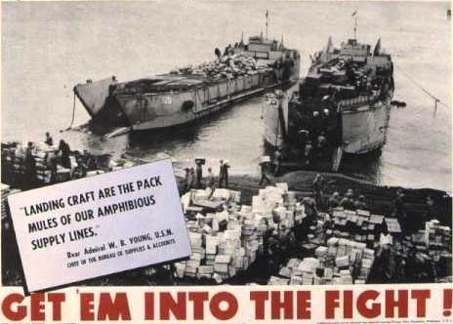
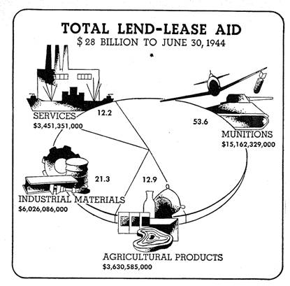
The USA responded with the Lend-Lease Act in 1941
The Lend-Lease Act allowed the USA to send war supplies to Allied nations and transport
war-related goods to Europe on armed ships
The Lend-Lease Act was used throughout WWII, transformed the USA into an “arsenal of democracy,” and helped end the depression in America

Slide 6
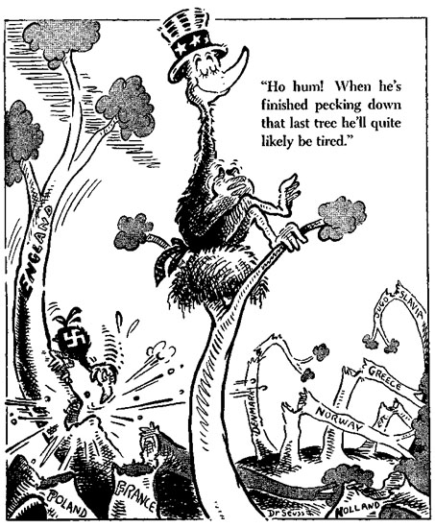

Slide 7
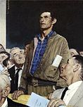
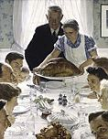
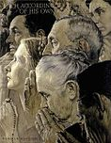
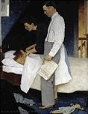
What we’re fighting for:
FDR’s Four Freedoms
Speech
From Want
Worship
From Fear

Slide 8
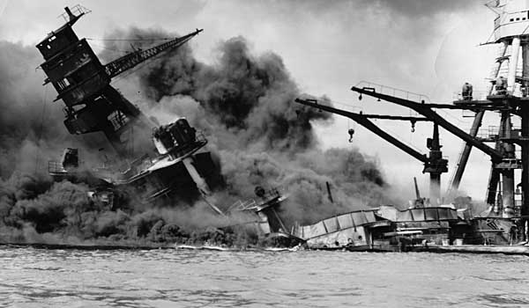
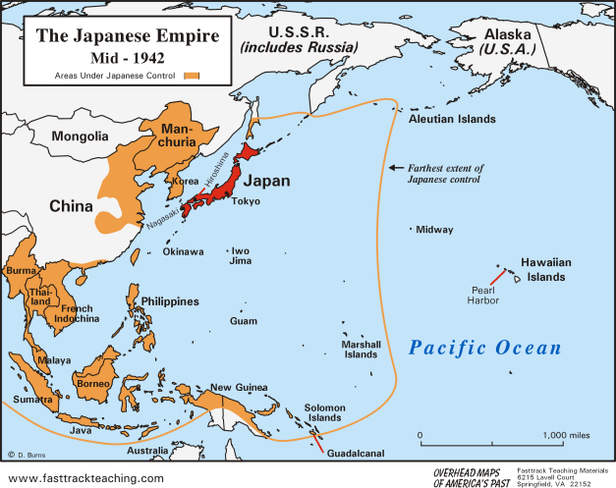
Pearl Harbor
U.S. Embargoes on Japan
  Prohibited trade of steel and oil
  Required Japan’s halt on expansion and removal from China
December 7, 1941
  Japanese surprise attack on U.S. naval base at Pearl Harbor in Hawaii
  2,400 Americans killed
  “a date that will live in infamy”
United States enters WWII
  U.S. declares war on Japan (12/8/41)
  Germany and Italy declare on U.S.
  German invasion of Soviet Union (1942)
  Allies
    U.S., Great Britain, Soviet Union
  Axis
    Germany, Italy, Japan

Slide 9
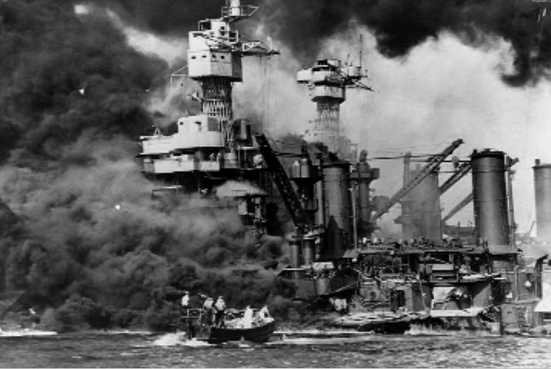
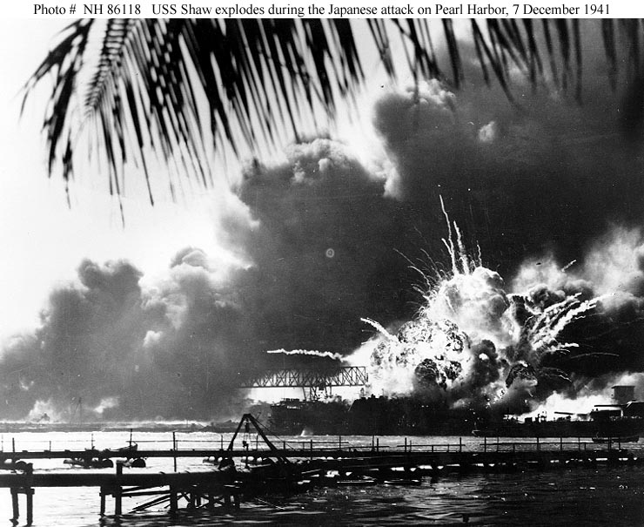
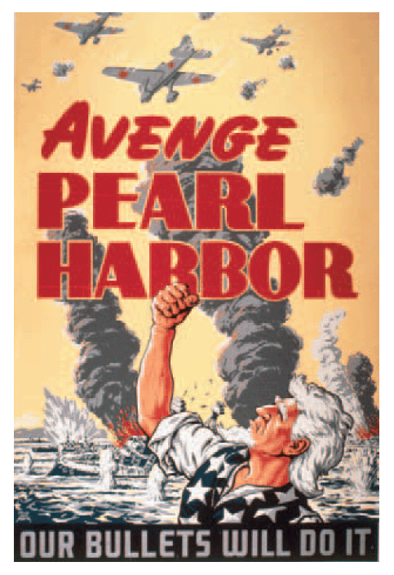
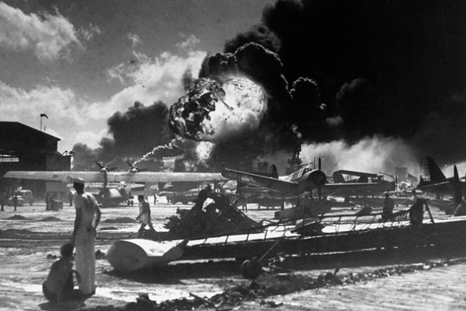
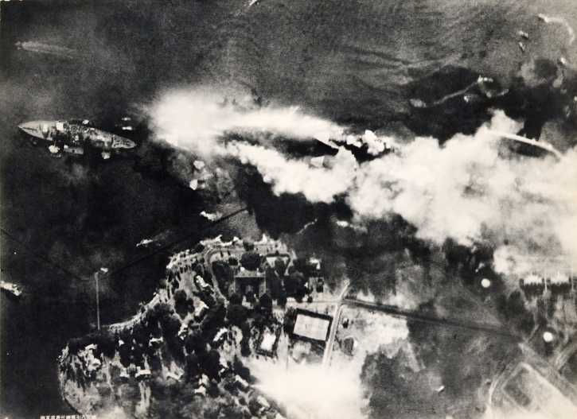
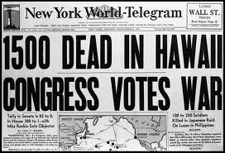
On Dec 7, 1941, the U.S. naval fleet in the Pacific was crippled by the attack; 8 battleships were sunk & 2,400 Americans were killed
Notes:
On Dec 7, 1941, the U.S. naval fleet in the Pacific was crippled by the surprise attack; 8 battleships were sunk & 2,400 Americans were killed

Slide 10
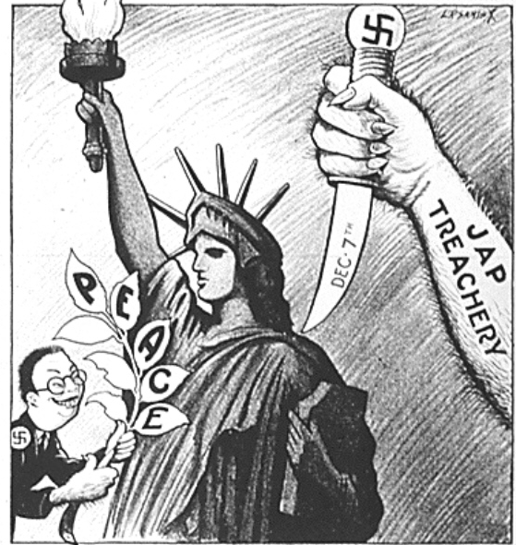

Slide 11
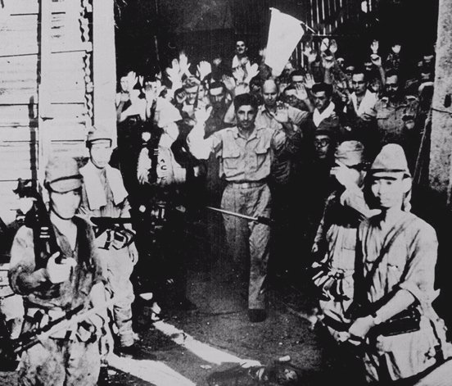
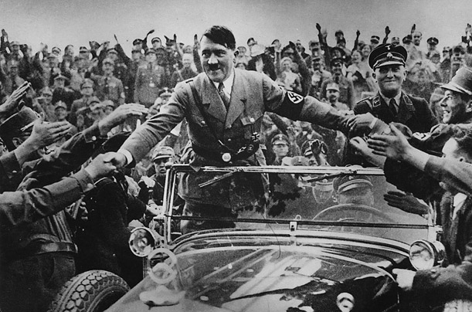
“It is all bad.”
Nazis rolling across Europe and N. Africa
Japanese capturing the Pacific islands and vast sections of continental Asia
U.S. forces vanquished in Philippines
  MacArthur - “I shall return!”
  11K U.S. prisoners of war
    Bataan Death March
Japan at peak of its territorial control
Captured American troops - Corregidor, Philippines

Slide 12
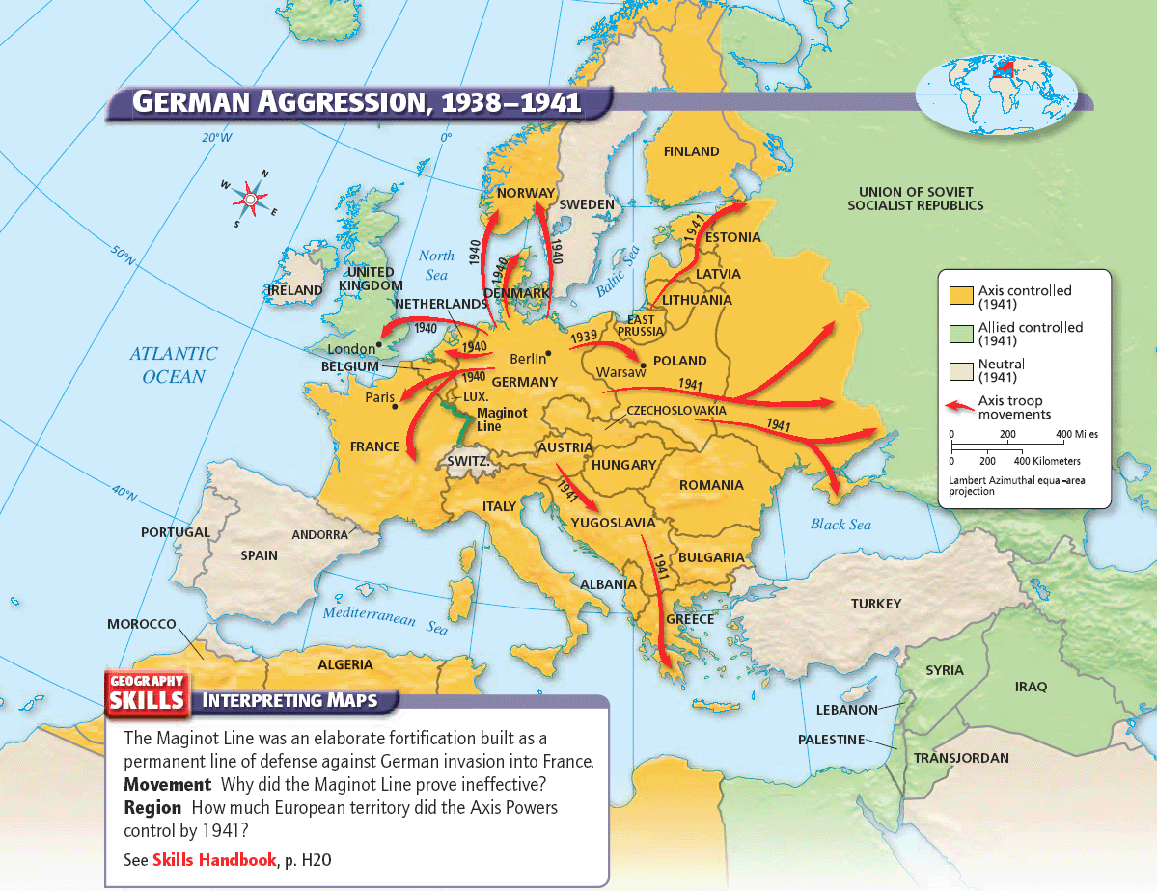

Slide 13
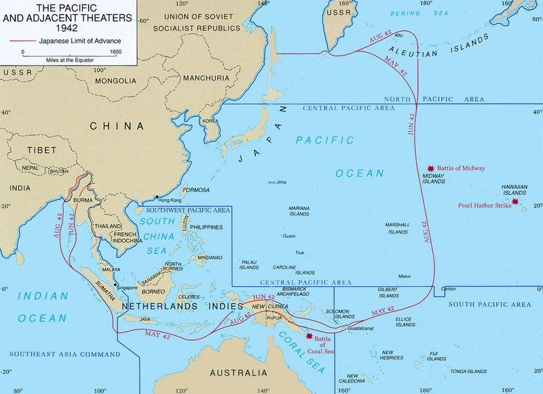

Slide 14
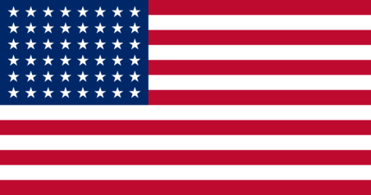
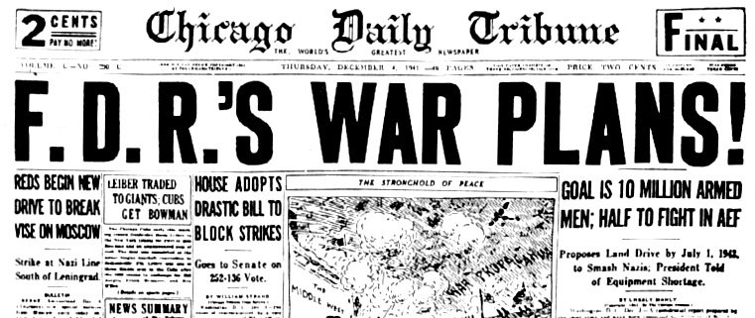
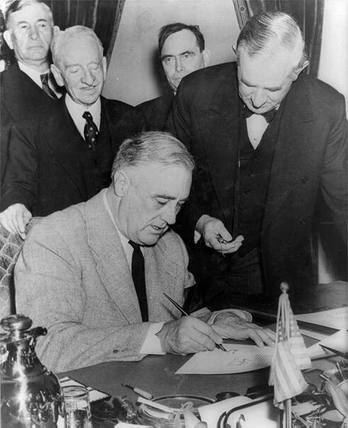
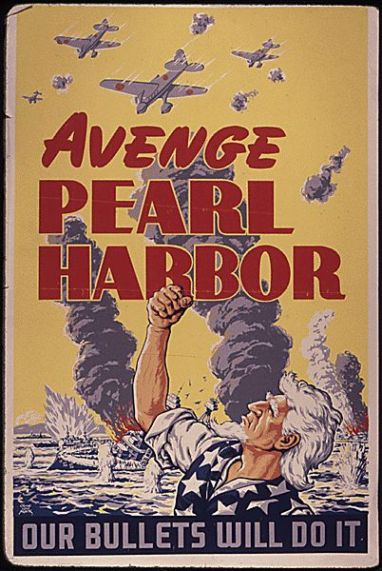
U.S. Enters the War
Allied strategy: “Germany first”

Slide 15
Gloomy Prospects for the Allied Powers
By the end of 1942, the Allies faced defeat.
  The chain of spectacular victories disguised fatal weaknesses within the Axis alliance:
    Japan and Germany fought separate wars, each on two fronts. They never coordinated strategies.
  The early defeats also obscured the Allies’ strengths:
    The manpower of the Soviet Union and the productive capacity of the United States.

Slide 16
Invasion of the Soviet Union
It was then that Hitler made his pivotal mistake. He invaded the Soviet Union.
  The obliteration of Bolshevism was a key element of Hitler’s ideology; however, it was a gigantic military mistake.
On June 22, 1941, Hitler launched Operation Barbarossa, consisting of an attack army of 4 million men spread out along a 2,000-mile front in three massive offensives.
The German army quickly advanced, but at a terrifying cost. For the next three years, 90 percent of German deaths would happen on the eastern front.

Slide 17
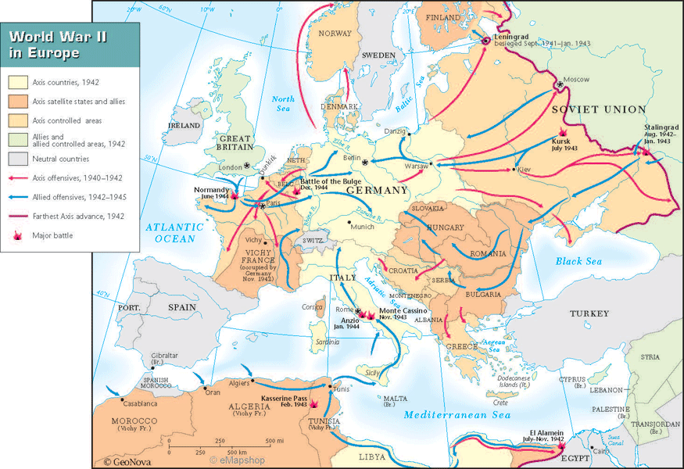
Atlantic Theater
Battle of Stalingrad (1942-1943)
Operation Torch (1942)
  North Africa
Operation Avalanche (1943)
  “soft underbelly of the Axis”
Operation Overlord/D-Day (June 6, 1944)
  Allied Western front opens
Battle of the Bulge (1944-1945)
V-E Day (May 7, 1945)

Slide 18
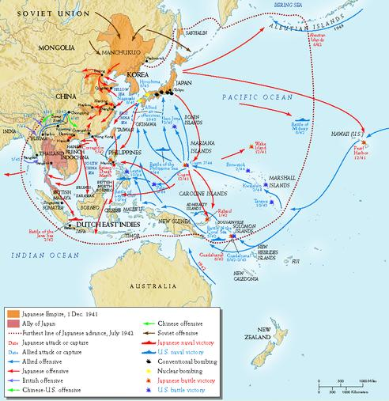
Pacific Theater
Battle of Coral Sea (May 1942)
Battle of Midway (June 1942)
Island-hopping
Not without a fight…
  Guadalcanal (Aug 1942-Feb 1943)
  Leyte Gulf (Oct 1944)
    kamikazes
  Iwo Jima (Feb-Mar 1945)
  Okinawa (Apr-June 1945)

Slide 19
Atom Diplomacy
FDR had funded the top-secret Manhattan Project to develop an atomic bomb
Dr. Robert Oppenheimer successfully tested in the summer of 1945.
FDR had died on April 12, 1945, and the decision was left to Harry Truman.
An amphibious invasion could cost over 350,000 Allied casualties. (conservative estimate)

Slide 20
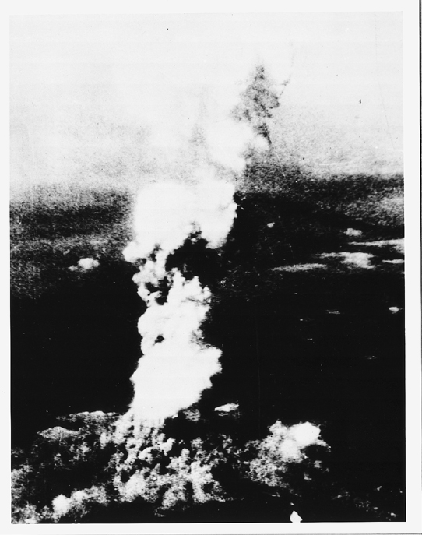
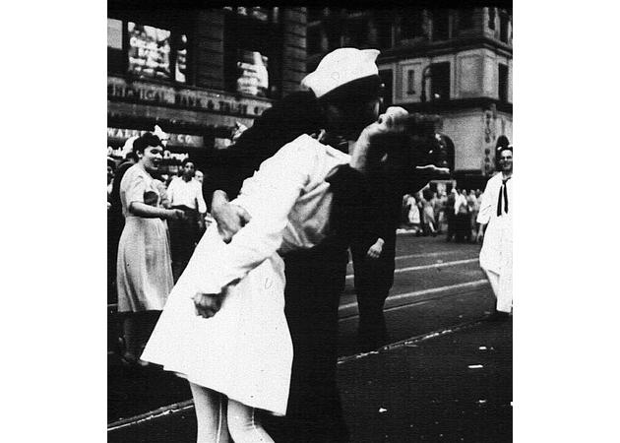
Turning Points of the War: The Pacific
August 6, 1945 – Enola Gay drops bomb on Hiroshima
  140,000 dead; tens of thousands injured; radiation sickness; 80% of buildings destroyed
August 9, 1945 – Nagasaki
  70,000 dead; 60,000 injured
Emperor Hirohito surrenders on Aug. 14, 1945. (V-J Day)
  Formal surrender signed on September 2 onboard the battleship Missouri in Tokyo Bay

Slide 21
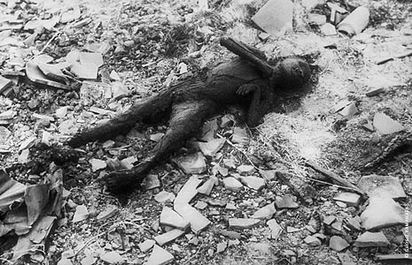

Slide 22
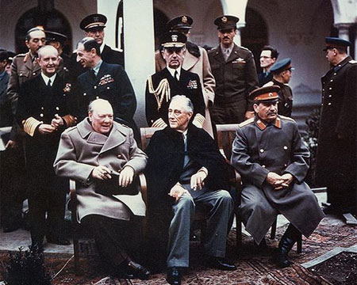
War Conferences
Casablanca (Jan 1943)
Teheran (Nov 1943)
  Agree to open western front against Germany (Operation Overlord)
  Soviet invasion of eastern Germany
  Unconditional surrender of Germany
Yalta (Feb 1945)
  German occupation zones
  Free elections in Soviet-occupied Eastern European nations
  Soviet Union will attack Japan three months after defeat of Germany
  New peace organization - United Nations
    Security Council with veto power for P5
Potsdam (July-Aug 1945)
  Japanese unconditional surrender or “prompt and utter destruction”
  German and Berlin occupation zones
  Nuremberg Trials and Purge of Nazism
  Recognition of communist government in Poland
  Partition of Vietnam at Da Nang

Slide 23
Postwar Efforts at Peace
The United Nations – There was some hope when, in 1945, the United Nations was created; an organization to promote international stability
  A General Assembly where representatives from all countries could debate international issues.
  The Security Council had 5 permanent members – U.S., Soviet Union, Britain, France, and China could veto any question of substance. There were also 6 elected members.
  Key: the U.S. joined in contrast to League of Nations

Slide 24
Restoration of U.S. Prosperity
World War II ended the Great Depression.
Factories run at full capacity
  Ford Motor Company – one bomber plane per hour
People save money (rationing)
Army bases in South provide economic boom (most bases in South b/c of climate)
The national debt grew to $260 billion (6 times its size on Dec. 7, 1941)

