Slide 1
Winning WWII-The War and It’s Legacy
Mr. Winchell
APUSH
Period 7

Slide 2
A Grand Alliance
The Big Three
  Great Britain (Winston Churchill)
  The U.S. (FDR)
  The Soviet Union (Joseph Stalin)
Strategies for War
  Defeat Germany first
  Deal with Japan later

Slide 3
Gloomy Prospects for the Allied Powers
By the end of 1942, the Allies faced defeat.
  The chain of spectacular victories disguised fatal weaknesses within the Axis alliance:
    Japan and Germany fought separate wars, each on two fronts. They never coordinated strategies.
  The early defeats also obscured the Allies’ strengths:
    The manpower of the Soviet Union and the productive capacity of the United States.

Slide 4
Invasion of the Soviet Union
It was then that Hitler made his pivotal mistake. He invaded the Soviet Union.
  The obliteration of Bolshevism was a key element of Hitler’s ideology; however, it was a gigantic military mistake.
On June 22, 1941, Hitler launched Operation Barbarossa, consisting of an attack army of 4 million men spread out along a 2,000-mile front in three massive offensives.
The German army quickly advanced, but at a terrifying cost. For the next three years, 90 percent of German deaths would happen on the eastern front.

Slide 5
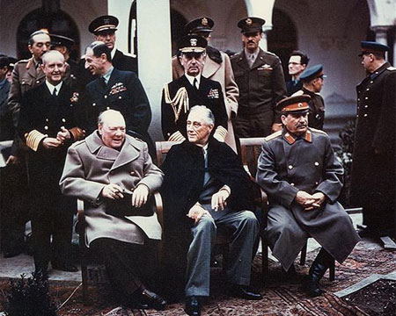
War Conferences
Teheran (Nov 1943)
  Agree to open western front against Germany (Operation Overlord)
Yalta (Feb 1944)
  German unconditional surrender and occupation zones
  Soviet Union conditional plans against Japan
  New peace organization - United Nations
Potsdam (July-Aug 1945)
  Japanese unconditional surrender
  War crimes trial - Nuremberg Trials
  Disputes over “spheres of influence” between U.S. and Soviet Union

Slide 6
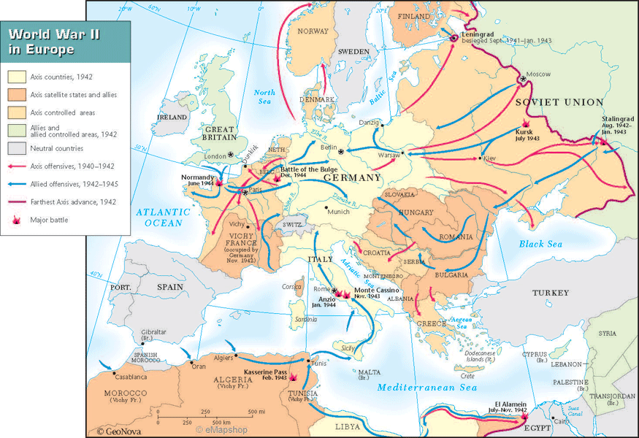
Atlantic Theater
Battle of Stalingrad (1942-1943)
Operation Torch (1942)
  North Africa
Operation Avalanche (1943)
  “soft underbelly of the Axis”
Operation Overlord/D-Day (June 6, 1944)
  Allied Western front opens
Battle of the Bulge (1944-1945)
V-E Day (May 7, 1945)

Slide 7
The Turn of the Tide in Europe
Defeat of the Axis Powers
    The turning point of the war came in 1942-43.
    Allied victory in North Africa was followed by an invasion of Italy, which stopped the Axis powers’ string of victories.
    The decisive theater of war, however, was the eastern front.

Slide 8
Turning Points of the War: The Battle of Stalingrad
The Battle of Stalingrad was the turning point of the war. The German Army (Wehrmacht) had already lost 2 million men on the eastern front.
In 1942-43, a German army of over 300,000 was defeated and captured at the Battle of Stalingrad.
The Germans then lost the battle of Kursk and began a long retreat.
The Red Army crossed into Poland in January 1944.

Slide 10
Turning Points of the War: Western Front
Operation Torch (1943)
  Allied victory in North Africa and invasion of Italy.
D-Day: Operation Overlord
  The Allied needed to establish a second front.
  General Dwight Eisenhower launched an invasion of Normandy on June 6, 1944.
  An invasion fleet of some 4,000 ships and 150,000 men (57,000 U.S.)
  Invasion successful. 5,000 killed and wounded Allied troops.
  It allowed them to gain a foothold on the continent from which they could push Germany back.

Slide 11
Race to Berlin
D-Day was the turning point of the western front. Stalingrad was the turning point of the eastern front.
The British, U.S., and Free French armies began to press into western Germany as the Soviets invaded eastern Germany.
Both sides raced to Berlin.

Slide 12
Victory in Europe
Mussolini was captured and killed by Italian partisans and Hitler committed suicide in April 1945, as the Russian troops took Berlin.
Germany surrendered unconditionally on May 7, 1945 (V-E Day).
Fighting in the Pacific would continue until August.

Slide 13
The Pacific Theater:
Early Battles
American Forces halted the Japanese advances in two decisive naval battles.
  Coral Sea (May 1942)
    U.S. stopped a fleet convoying Japanese troops to New Guinea
    Japanese designs on Australia ended
  Midway (June 1942)
    Japanese Admiral Yamamoto hoped to capture Midway Island as a base to attack Pearl Harbor again
    U.S. Admiral Chester Nimitz caught the Japanese by surprise and sank 3 of the 4 aircraft carriers, 332 planes, and 3500 men.

Slide 14
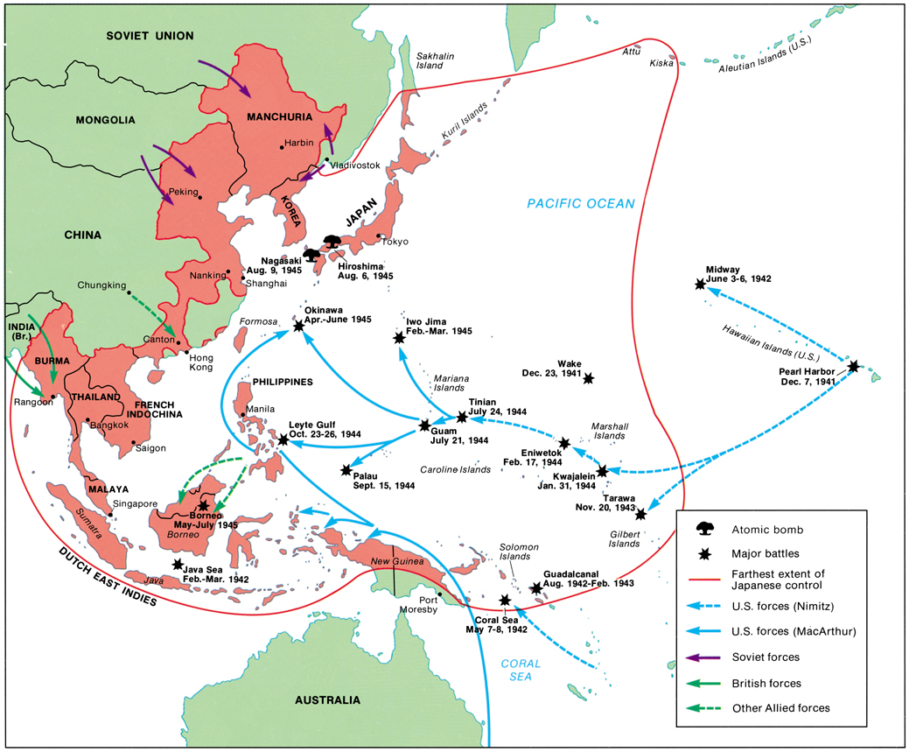

Slide 15
Importance of Midway
The Japanese defeat at Midway was the turning point in the Pacific.
  Japanese advances stopped.
  U.S. assumes initiative.
  Japanese have shortage of able pilots.
Censorship and Propaganda
  News of the defeat was kept from the Japanese public.

Slide 16
The Beginning of the End in the Pacific
Yamamoto is assassinated by the U.S. (April 1943)
Loss of Saipan (August 1944)
  “the naval and military heart and brain of Japanese defense strategy”
  Political crisis in Japan
    The government could no longer hide the fact that they were losing the war.
    Tōjō resigns on July 18, 1944
Intensive air raids over Japan
  Iwo Jima (February, 1945)
    American marines invaded this island, which was needed to provide fighter escort for bombings over Japan

Slide 17
A Grinding War in the Pacific
In 1945, the U.S. began targeting people in order to coerce Japan to surrender
  66 major Japanese cities bombed
  500,000 civilians killed
Battle for Leyte Gulf
  Total blockade of Japan
  Japanese navy virtually destroyed
  Kamikaze (divine wind) flights begin
Okinawa (April, 1945)
  All 110,000 Japanese defenders killed
  U.S. invaded this island, which would provide a staging area for the invasion of the Japanese islands.

Slide 18
Atom Diplomacy
FDR had funded the top-secret Manhattan Project to develop an atomic bomb
Dr. Robert Oppenheimer successfully tested in the summer of 1945.
FDR had died on April 12, 1945, and the decision was left to Harry Truman.
An amphibious invasion could cost over 350,000 Allied casualties.

Slide 19
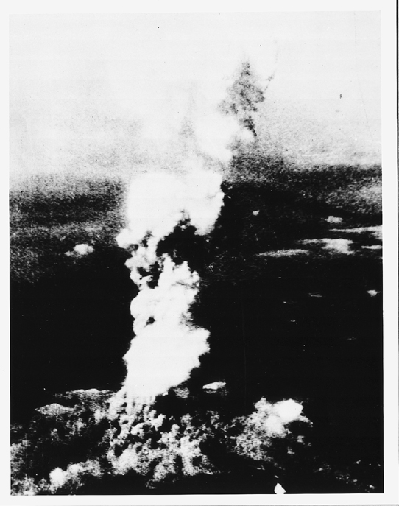
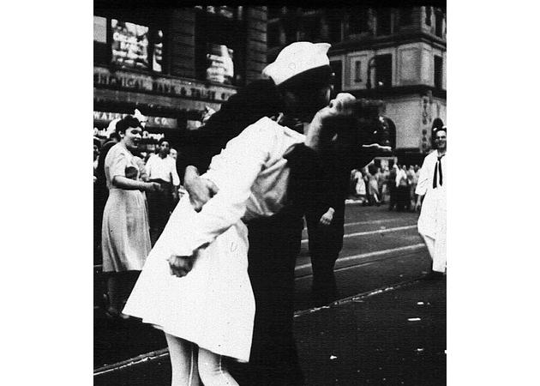
Turning Points of the War: The Pacific
August 6, 1945 – Enola Gay drops bomb on Hiroshima
  140,000 dead; tens of thousands injured; radiation sickness; 80% of buildings destroyed
August 9, 1945 – Nagasaki
  70,000 dead; 60,000 injured
Emperor Hirohito surrenders on Aug. 14, 1945. (V-J Day)
  Formal surrender signed on September 2 onboard the battleship Missouri in Tokyo Bay

Slide 20
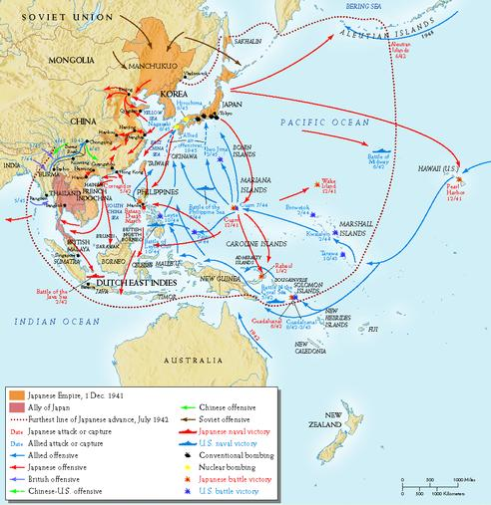
Pacific Theater
Battle of Coral Sea (May 1942)
Battle of Midway (June 1942)
Island-hopping
Not without a fight…
  Guadalcanal (Aug 1942-Feb 1943)
  Leyte Gulf (Oct 1944)
    kamikazes
  Iwo Jima (Feb-Mar 1945)
  Okinawa (Apr-June 1945)

Slide 21
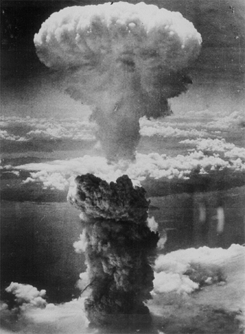
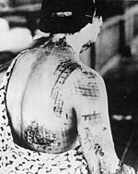
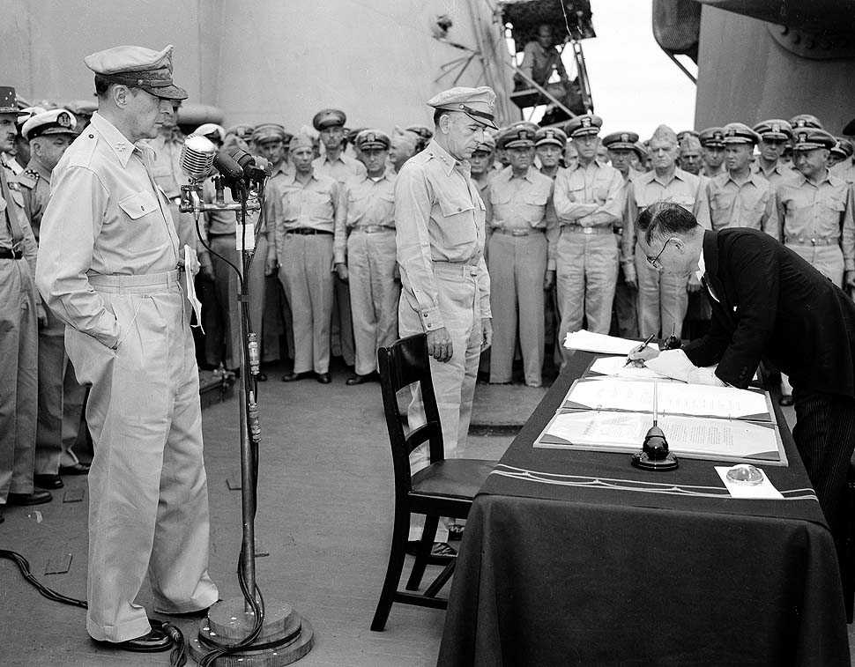
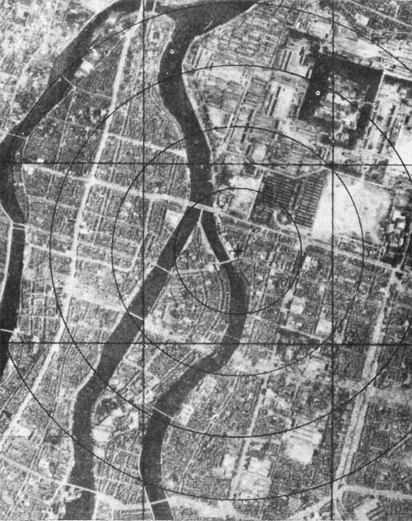
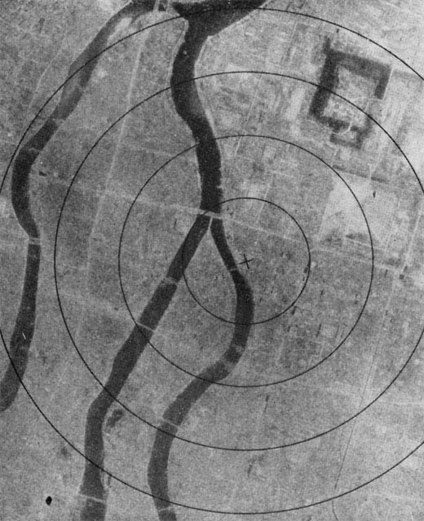
Japanese Surrender
Manhattan Project
Hiroshima (Aug. 6, 1945)
  70,000-80,000 killed
  4.7 sq. mi. destroyed
Nagasaki (Aug 9, 1945)
  50,000-75,000 killed
V-J Day (September 2, 1945)

Slide 22
Cost of War
Germany- 3 million combat deaths (3/4ths on the eastern front)
Japan – over 1.5 combat deaths; 900,000 civilians dead
Soviet Union - 13 million combat deaths
U.S. – 300,000 combat deaths, over 100,000 other deaths
When you include all combat and civilian deaths, World War II becomes the most destructive war in history with estimates as high as 60 million, including 25 million Russians.

Slide 23

Postwar Efforts at Revenge
The Nuremberg Trials of 1945-46
  After, WWII the Allied powers decided to place on trial the highest-ranking Nazi officers for “crimes against humanity”
  Allied forces had attempted to do this after WWI, but had released them on the grounds that they “were just following orders”
  Hitler, Goebbels, and Himmler were dead; but, 22 Nazi leaders (including Goring) were tried at an international military tribunal at Nuremburg, Germany. 12 were sentenced to death. Similar trials occurred in the east and throughout the world.
    The Tokyo Trial (1946-48)

Slide 24
Postwar Efforts at Peace
The United Nations – There was some hope when, in 1945, the United Nations was created; an organization to promote international stability
  A General Assembly where representatives from all countries could debate international issues.
  The Security Council had 5 permanent members – U.S., Soviet Union, Britain, France, and China could veto any question of substance. There were also 6 elected members.
  Key: the U.S. joined in contrast to League of Nations

Slide 25
Wartime
Agreements
Unlike WWI, there was no Peace of Paris to reshape Europe.
  Instead, the Yalta agreement of February 1945, signed by Roosevelt, Churchill, and Stalin, turned the prevailing military balance of power into a political settlement.
  Potsdam Conference, in suburban Berlin (July 1945)—Truman, Stalin, Churchill – Finalized plans on Germany. Germany would be demilitarized and would remain divided.

Slide 26
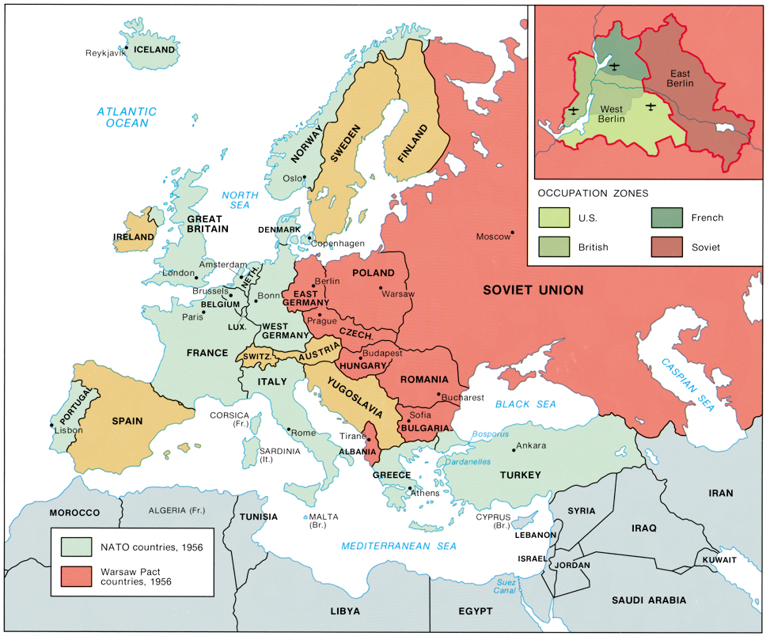

Slide 27
Postwar Reality:
Soviet Control of Eastern Europe
Europe was politically cut in half; Soviet troops had overrun eastern Europe and penetrated into the heart of Germany.
During 1944-1945, Stalin starts shaping the post-war world by occupying SE Europe with Soviet troops that should have been on the Polish front pushing toward Berlin.
Roosevelt did not have postwar aims because he still had to fight Japan; Stalin did have postwar aims.

Slide 28
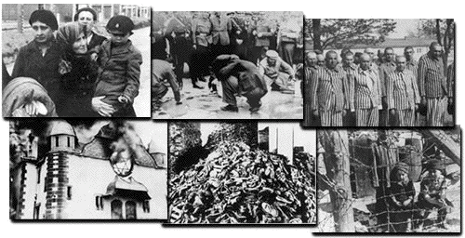
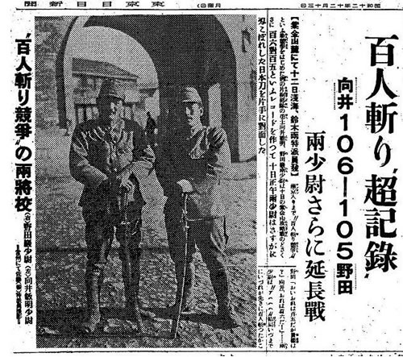
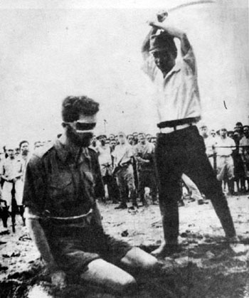
World War II Costs
70 million deaths or 4% of world population
  25 million military
  45 million civilians
  Genocides and War Crimes
    Holocaust
    Nanking Massacre
    Bataan Death March
United States
  Over 400,000 casualties
  $306 billion cost

Slide 29

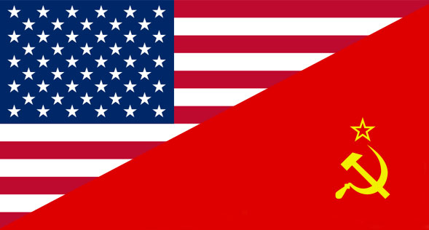
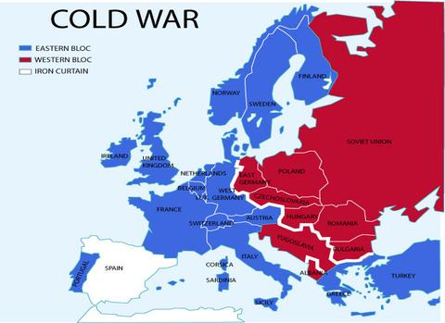
World War II Legacy
G.I. Bill (1944)
  Provided living allowances, tuition fees to support veterans
United Nations
Superpowers and Cold War
  United States and Soviet Union
    Capitalism and Communism
    Individualism and Collective Society

Slide 30
Mobilization In the U.S.
The war effort required all of America’s huge productive capacity and full employment of the workforce.
  Government expenditures soared.
U.S. budget increases
  1940 $9 million
  1944 $100 million
  Expenditures in WWII greater than all previous government budgets combined (150 years)
  GNP 1939 91 billion 1945 166 million

Slide 31
Restoration of U.S. Prosperity
World War II ended the Great Depression.
Factories run at full capacity
  Ford Motor Company – one bomber plane per hour
People save money (rationing)
Army bases in South provide economic boom (most bases in South b/c of climate)
The national debt grew to $260 billion (6 times its size on Dec. 7, 1941)

