Slide 1
Do Now
Why was the American public hesitant to join WWI?
What is ‘total war’?

Slide 2
The US IN WWI
Mr. Winchell APUSH Period 7

Slide 3
Essential Question:
  How did American efforts at home help win the war and transform the American economy & society?
  Why was WWI referred to as the ‘War to End All Wars’?

Slide 4
The “MAIN” Causes of WWI
The underlying causes that created a powder keg in Europe that was ready to explode.
Militarism: The large European powers began an industrial military arms race.
Alliances: an intricate system of national treaties and alliances developed in Europe that would compel most of the world to declare war at the slightest incident.
Imperialism: A growing rivalry over European trade, colonies, and spheres of influence in Africa and Asia
Nationalism: (love of country and willingness to sacrifice and even die for it ) among the countries of the world
The Immediate cause of WWI (the spark that lit the keg’s fuse)
The assassination of Archduke Ferdinand of Austria-Hungary

Slide 5
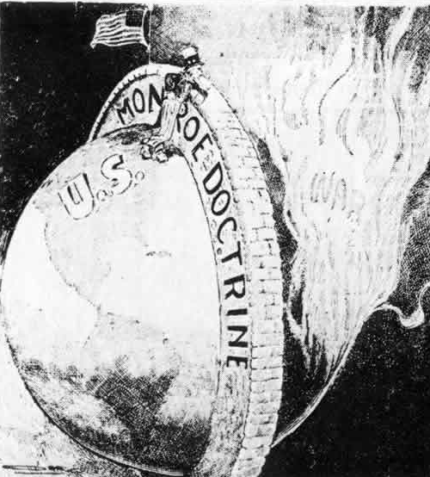
Why did it take so long for America to get involved in the war?
    America was isolationist.
      “Why should I get involved in someone else’s problems?”
    The Monroe Doctrine (1823) sought to isolate “the American continents” from European influences and problems.
    Immigration made it difficult for the US to identify with either side.

Slide 6
WWI: A Boom to the US Economy
Britain and France bought products in great amounts.
American bankers gave private loans to Allies.
  British Navy kept this possible

Slide 7
German Threats Escalate
Germans kept out of American trade by the British blockade.
Began submarine warfare around British isles to break through blockade.
Germans warned US might sink merchant ships.

Slide 8
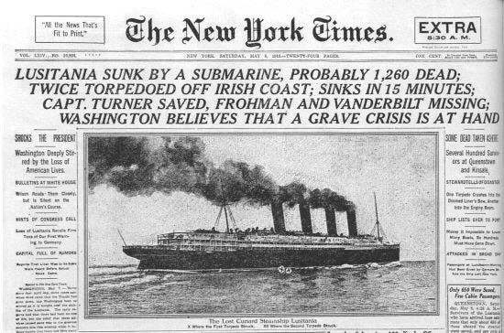
Submarine Warfare
The Germans warned Americans their merchant ships might be hit.
Reaches a crisis point after Lusitania is torpedoed in 1915—128 Americans died.
After sinking of British and French liners, Germans promised they would not sink unarmed ships without warning→ SUSSEX PLEDGE

Slide 9
The Lusitania
Germans warned British their passenger liners were in danger
England still sailed Lusitania from New York to England
German U-boat torpedoed Lusitania in May 1915
  Sunk in 18 minutes
  2,000 on board, 1200 died including 128 Americans
  Ship was carrying secret cargo of war materials.
Wilson still wanted US to stay neutral

Slide 10
Wilson Wins Reelection (1916)
Progressives die out in election after Roosevelt refuses to run again.
Wilson wins over Charles Evans Hughes with his promise “He Kept Us Out of War.”
Very close election, Wilson’s victory linked to his promise of further neutrality.

Slide 11
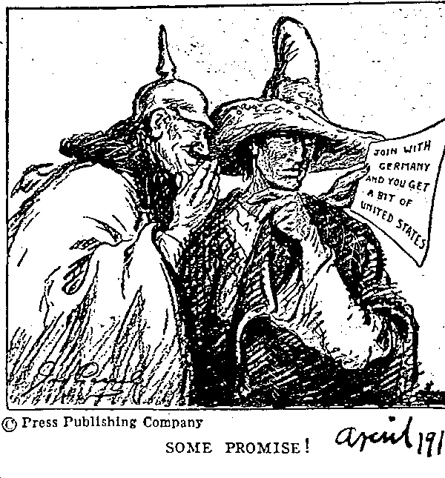

Slide 12
The Zimmermann Telegram
Germany’s foreign secretary (Zimmermann) sent a secret note to Mexico (February 1917)
Germany urged Mexico to attack the U.S. and in return, Mexico would gain back territory previously lost to the U.S.
Americans and Wilson are outraged by the Zimmermann telegram

Slide 13
America Enters the War
1917—Germany announced unrestricted submarine warfare.
US finds Zimmerman Note on 1917.
“Overt” acts—German U-boats sank four unarmed American merchant vessels in two weeks.
April 6, 1917: US declares war because of these German actions.

Slide 14
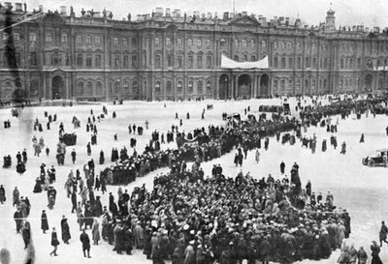
How was the war looking for the allies?
Not Good...
Russia left the war after its communist revolution in 1917. (LEADS TO RED SCARE AT HOME!)
Russia’s withdrawal allowed Germany to fight a one- front war with all its troops concentrated on France (remember this point when you study WWII!).
Calling for a Communist revolution, anti-Tsarist protesters gather outside the Winter Palace in Petrograd, Russia, February 1917.

Slide 15
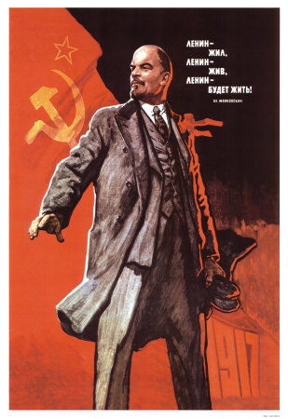
Russia Leaves the War
The Bolsheviks, who were communists, overthrow the Russian government
The Bolsheviks were led by Vladimir Lenin
1918- the Russians signed the Treaty of Brest-Litovsk with the Central Powers

Slide 16
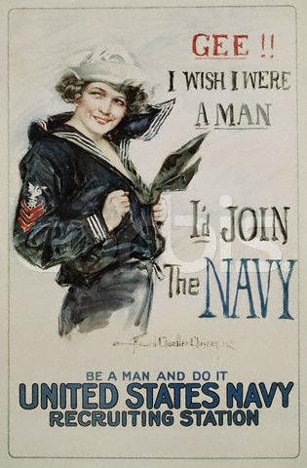
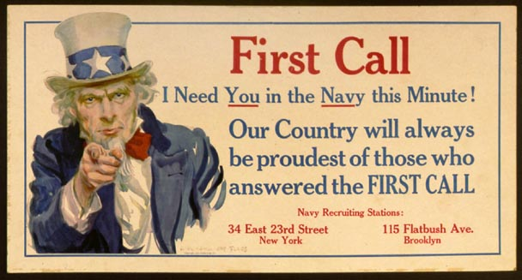
Convincing the American People
PROPAGANDA

Slide 17
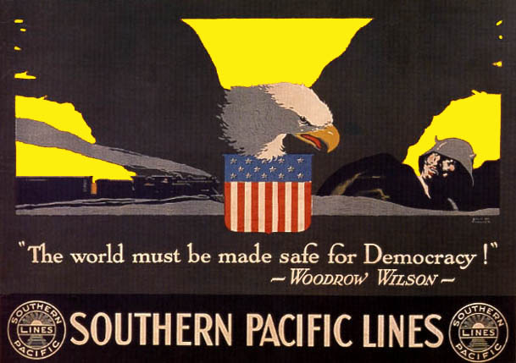
Getting Public Support for the War
Difficult given traditions of isolationism and neutrality.
Wilson cast war in moral terms— “making the world safe for democracy”
This played on people’s ideas of America as the savior.

Slide 18
U.S. Entry Into WWI
U.S. Position
  Most Americans wanted to stay neutral at first (why fight a war that was 3,000 miles away)
  U.S. tried to maintain trade with both Allied and Central Powers
  Americans eventually supported our involvement on the side of the Allies for two reasons:
    Ensure Allied repayment of debts to the U.S.
    Prevent Germans from threatening U.S. shipping
Notes:
18

Slide 19
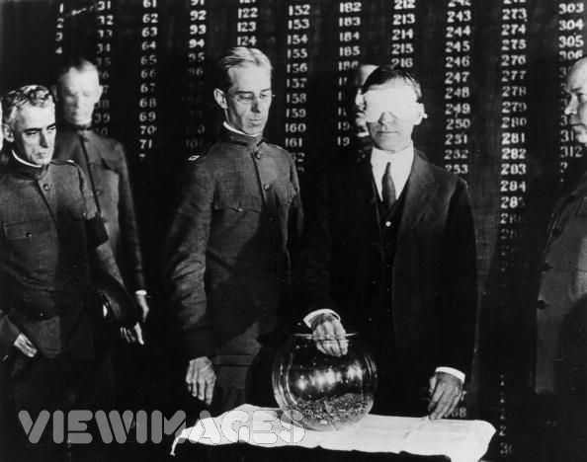
U.S. Mobilizes for War
Selective Service Act is passed in Congress- men between 21 and 30 can be drafted
War Industries Board meets war demand
Raise taxes and issue liberty bonds

Slide 20
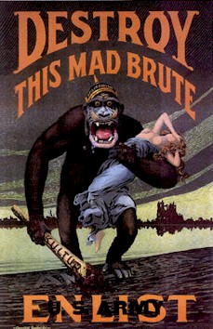
The “Mad Brute”

Slide 21
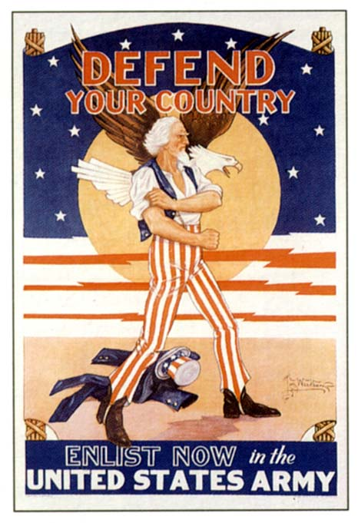

Slide 22
Government Excess & Threats to the Civil Liberties of Americans
1. Espionage Act – 1917
- forbade actions that
obstructed recruitment or
efforts to promote
insubordination in the military.
- ordered the Postmaster General
to remove Leftist materials
from the mail.
- fines of up to $10,000 and/or
up to 20 years in prison.

Slide 23
Government Excess & Threats to the Civil Liberties of Americans
2. Sedition Act – 1918
- it was a crime to speak against the
purchase of war bonds or willfully
utter, print, write or publish any
disloyal, profane, scurrilous, or
abusive language about this form of US
Govt., the US Constitution, or the US
armed forces or to willfully urge, incite,
or advocate any curtailment of
production of things necessary or
essential to the prosecution of the
war…with intent of such curtailment to
cripple or hinder, the US in the
prosecution of the war.

Slide 24
Government Excess & Threats to the Civil Liberties of Americans
3. Schenck v. US – 1919
- in ordinary times the mailing of the
leaflets would have been protected by the 1st Amendment.
- BUT, every act of speech must be judged according to the circumstances in which it was spoken.
- If an act of speech posed a clear and
present danger, then Congress had
the power to restrain such speech.

Slide 25
A Bureaucratic War
To coordinate the war effort, 5,000 new gov’t agencies were created:
  War Industries Board (WIB) oversaw all factories, determined priorities, fixed consumer prices
  Food Admin supplied food to soldiers by appealing to civilians
  Fuel Admin rationed coal & oil
  RR Admin, War Shipping Board, & War Trade Board helped move resources to troops
Imposed “gasless” days & shut down factories for days to divert or conserve fuel
WIB director Bernard Baruch became the “dictator of the American economy”
Asked for a spirit of self-sacrifice, imposed “meatless” & “wheat-less” days & encouraged Americans to plant “victory gardens”
Notes:
18

Slide 26
Workers in the War
The war called for more laborers:
  8 million women found new, better-paying jobs in war industry (but few housewives entered the workforce, unlike WW2)
  450,000 Southern blacks moved north for new industrial jobs & better pay (led to race riots)
  100,000 Mexican laborers worked in SW farms & ranches
Notes:
20

Slide 27
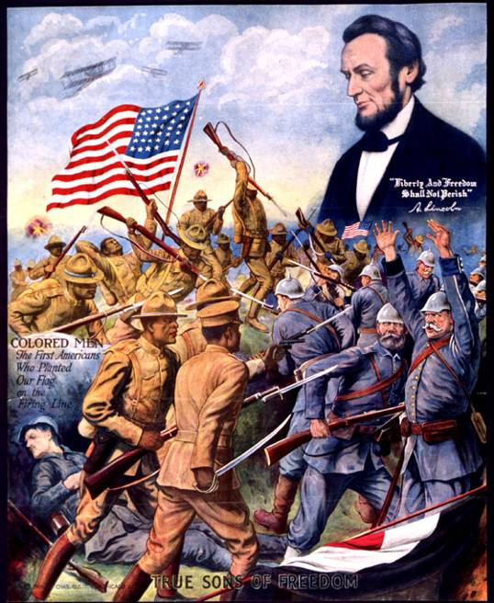
The True Sons of Freedom
Du Bois’ New Negro:
“We return. We return from fighting. We return fighting.”
Returning black soldiers: “I’m glad I went. I done my part & I’m going to fight right here until Uncle Sam does his.”

Slide 28
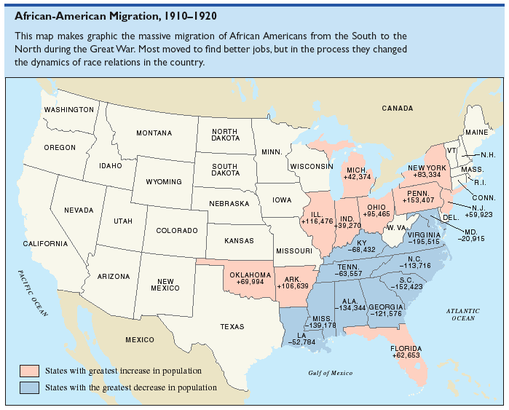

Slide 29
Big Picture Results
Unemployment virtually disappeared.
Expansion of “big government.”
Excessive govt. regulations in economy.
Unprecedented opportunities for disadvantaged groups. (Women and Minorities– we will discuss next week)

Slide 30
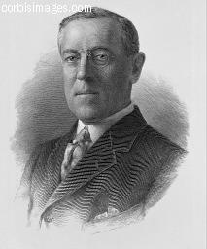
“I can predict with absolute certainty
that within another generation there will
be another world war if the nations of
the world do not concert the method
by which to prevent it."
Woodrow Wilson, 1919

Slide 31
Why did the US Reject the Treaty of Versailles?
Critics of the Treaty believed that the League would drag the US into future European wars (Senator Henry Cabot Lodge)
Americans were “war weary” and wanted to return to isolationism
Wilson suffered a stroke and was unable to sell the treaty to the people
The US refused to join the League of Nations, making the League a “paper tiger” or weak on the world stage.

Slide 32

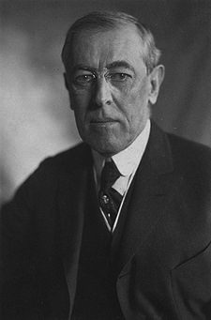
Treaty of Versailles Disaster
U.S. helps win war for allies
  Not much military success
    More the prospect of endless troops
  20 million people dead!
  Now what?
Wilson’s 14 Points
  Supported democracy, freedom & openness
  Self-determination
  League of Nations
Treaty of Versailles - more about punishment
  Reparations?
  Colonial status quo
  German territory
Treaty is a disaster - led to WW2
  U.S. rejects at home
  Wilson has a stroke trying for passage

Slide 33
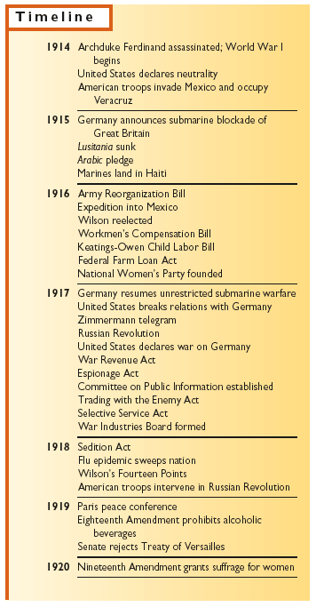
Causes of WWI
Nationalistic pride
Competition for colonies
Military buildup
Tangled web of alliances
Assassination of Franz Ferdinand
Effects of WWI
Destruction in Europe
Boom in American economy
Suppression of dissent in the U.S.
Allied victory
Defeated empires lose their colonies
The U.S. emerges from the war as a
world leader and an economic giant

Slide 34
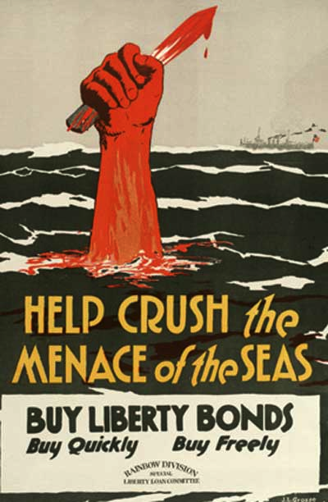
Impact of War
Women got suffrage!
Prohibition Passes - grain shortages for alcohol?
Committee on Public Information: promoted war and demonized enemy
Curtailing dissent:
  Espionage Act: Post office could ban treasonable stuff from mail
  Sedition Act: Can’t say “disloyal or profane” language against the government
    Debs arrested
    Constitutional? (Schenck v. U.S.) justified?

