Slide 1
Do Now-DISCUSS
From your reading, what motivated American Imperialism in the late 19th/early 20th centuries?
How did the large-scale industrialization of America cause American Imperialism?

Slide 2
American Imperialism
Mr. Winchell
APUSH
Period 7-Day 1

Slide 3
College Board Standards
Analyze the major aspects of domestic debates over US expansionism in the late 19th and early 20th century.
Analyze the goals of US policymakers in major international conflicts, such as the Spanish-American War.
Analyze how debates over political values (such as democracy, freedom, and citizenship) and the extension of American ideals abroad contributed to the ideological clashes and military conflicts of the 19th and early 20th century.

Slide 4
Essential Question-Proving Behavior Thesis Response
Evaluate the extent to which America’s imperialist policies maintained continuity as well as fostered change in American foreign policy.

Slide 5
QUOTES!!
“We are Anglo-Saxons, and must obey our blood and occupy new markets, and if necessary, new lands.”
Senator Albert Beveridge, April 27, 1898
“Our form of government, our traditions, our present interests, and our future welfare, all forbid our entering upon a career of conquest.”
William Jennings Bryan, December 13, 1898

Slide 6
Origins of American Imperialism
The US was not part of Europe’s Imperialistic expansion in the mid 1800s
Still expansionist however.
Louisiana Purchase/Monroe Doctrine
Annexation of Texas
Mexican American War
GADSDEN PURCHASE!!
1867: Seward’s purchase of Alaska for $7.2 million from Russia

Slide 7
Main Causes of Imperialism
Thirst for new economic markets/raw materials
Desire for military strength
Safety valve/closing of the frontier
Belief in Anglo-Saxon superiority
Moral obligation to civilize other nations

Slide 8
Causes for Imperialism: Industry
As the US industrialized in the late 19th century, it also intensified its foreign involvement.
Sources of raw materials
Need for worldwide markets for its industrial and agricultural products.
Intensified by the Panic of 1893.

Slide 9
Causes for Imperialism: International Darwinism
Darwin’s concept of survival of the fittest was applied not only to competition in business, but also to competition among nations and races for military advantage, colonies, and spheres of influence.
American Imperialists saw this as an extension of the idea of manifest destiny into the Caribbean, Central America, and the Pacific Ocean.
Spreading of Christianity and democracy to ‘lesser’ people.

Slide 10
Causes for Imperialism: Military Expansion
The Influence of Sea Power Upon History (1890).
Argued that a strong Navy was crucial to a country’s ambitions of securing foreign markets and becoming a world power.
Using arguments in Mahan’s book, US naval strategists persuaded Congress to finance the construction of modern steel ships and encouraged the acquisition of overseas islands (Samoa) for fueling stations.
By 1900, the US had the 3rd largest navy in the world

Slide 11
Cuban Revolt: America to the Rescue?
Cuba vs. Spain: Cubans revolt against Spanish rule. Spain responds harshly. Cubans placed in concentration camps.
America Backs Cuba: Sentimental-Cuba is the underdog. Economic- American business trade over $100 mil/year. Political- Spain is a dying empire in America’s sphere of influence. Whoever controls Cuba controls Western trade and a potential Panama Canal.
Yellow Journalism: Hearst vs. Pulitzer. 2 main newspapers in NYC. Each report on the atrocities in Cuba. Sensationalized news equals more readers.

Slide 13
Teller Amendment
After the sinking of the USS Maine, public outrage pushed President McKinley to ask Congress to declare war.
Congress agreed, with part of the resolution, the Teller Amendment, stating that the US had no intention of taking political control of Cuba and once peace was restored, the Cuban people would control their own government.

Slide 14
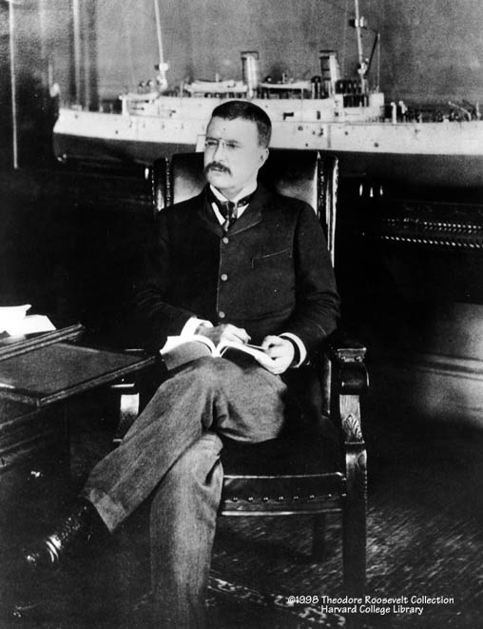
Theodore Roosevelt
Assistant Secretary of the Navy in the McKinley administration.
Imperialist and American nationalist.
Criticized President McKinley as having the backbone of a chocolate éclair!
Resigns his position to fight in Cuba.

Slide 15
Spanish-American War (1898)
“A splendid little war.”
Treaty of Paris, 1898
American Acquisitions
Puerto Rico
Guam
Philippines
Cuba
American military occupation (1898-1902)
Platt Amendment (1901)
Treaties required American approval
US will protect (control) Cuba
Guantanamo Bay

Slide 17
Imperialists and Anti-Imperialists
Proponents
Most from Republican Party
Theodore Roosevelt (R)
John Hay (R)
James G. Blaine (R)
Reasons
Economic expansion
Political security
International prestige
Humanitarian ‘efforts’
Capt. Alfred Thayer Mahan
The Influence of Sea Power upon History (1890)
Social Darwinism
Jingoism
“White Man’s Burden”
Insular Cases (1901-1903)
Supreme Court ruled constitutional guarantees granted only by Congress to U.S. territories
“Constitution does not necessarily follow the flag”
Opponents
Mostly from Democratic Party
Anti-Imperialist League
Grover Cleveland (D)
William Jennings Bryan (D)
Senator Ben Tillman (D-SC)
Samuel Gompers (AFL)
Mark Twain
Andrew Carnegie
Jane Addams
Reasons
Undemocratic
Violated republicanism
“consent of the governed”
To prevent influx of“inferior races”

Slide 18
The Philippines…?
What to do with the Philippines:
Give the islands back to Spain?
Misrule
Leave the islands and not give them any help
Irresponsible and Germany/Japan would seize them, resulting in another war
Annexation by the US
McKinley opts for annexation, Senate approves treaty by one vote
Bitterness and Rebellion:
Filipinos wanted independence, fight against US control.
US sends 126,000 troops.
Both sides commit atrocities, US creates reconcentration camps, commits acts of torture
Results: Fighting lasts until 1902.
4,234 Americans killed
600,000 Filipinos killed.
Philippines not granted independence until July 4, 1946

Slide 19
The Philippines
Philippine-American War (1899-1902)
Filipinos expected their independence after being rid of the Spanish
US refuses, leading to three years of fighting
Atrocities
Torture by both sides
Concentration camps
Casualties
12,000-20,000 Filipino soldiers
4,165 Americans
200,000-1,000,000 Filipino civilians
Americanization
Freedom of religion
English as official language

Slide 20
When you raise the flag over the Philippine Islands as an emblem of dominion and acquisition, you take it down from Independence Hall…Over every clause, syllable, and letter of the Constitution the Declaration of Independence pouts its blazing torchlight…The power to conquer alien peoples and hold them in subjection is nowhere expressly granted.
Senator George Hoar (R-Massachusetts)

Slide 21
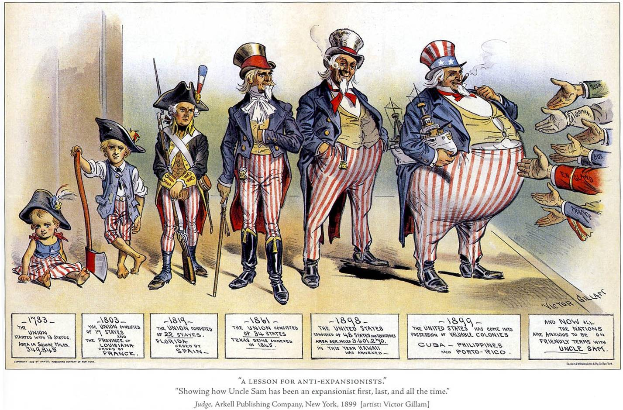

Slide 22
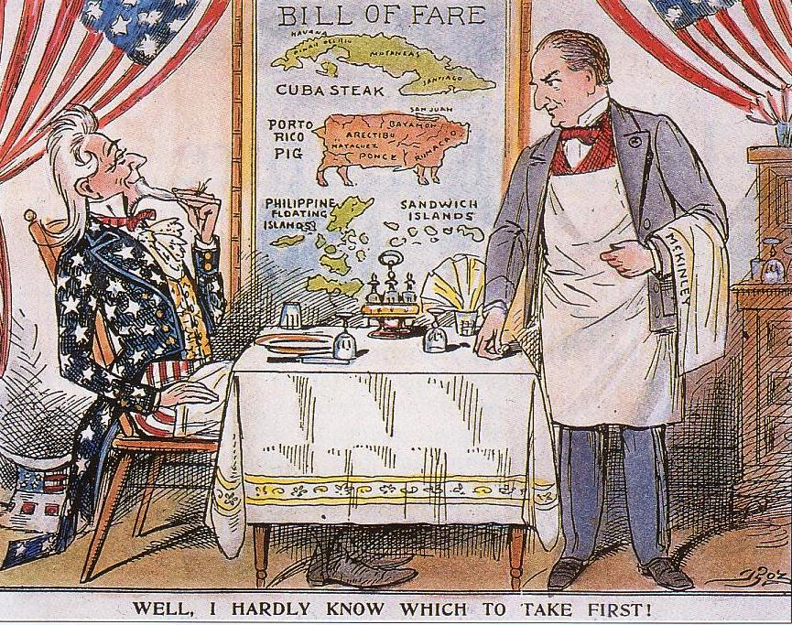

Slide 23
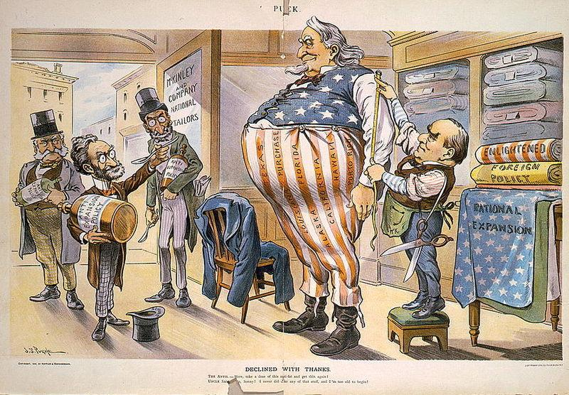

Slide 24
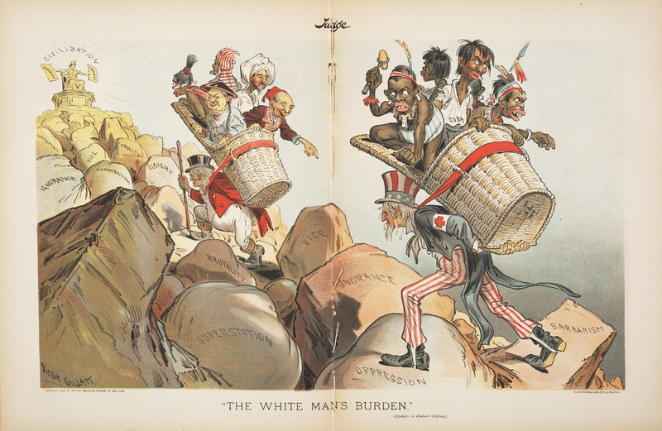

Slide 25
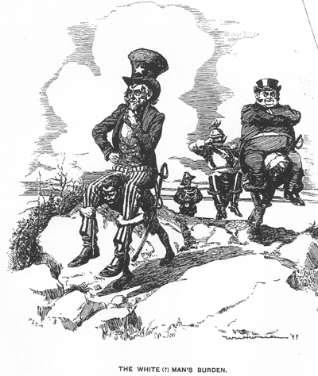

Slide 26
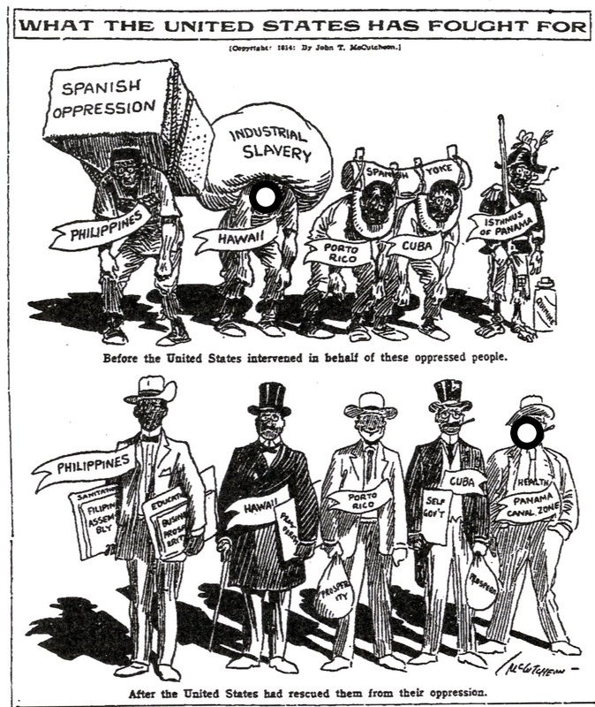

Slide 27
America Should Retain the Philippines; America Should Not Rule the Philippines
Albert J. Beveridge – “U.S. Senate Speech” (1900)
Joseph Henry Crooker – “The Menace to America” (1900)
The times call for candor. The Philippines are ours forever, “territory belonging to the United States,” as the Constitution calls them. And just beyond the Philippines are China’s illimitable markets. We will not retreat from either. We will not repudiate our duty in the archipelago. We will not abandon our opportunity in the Orient. We will not renounce our part in the mission of or race, trustee, under God, of the civilization of the world. And we will move forward with to our work, not howling our regrets like slaves whipped to their burdens, but with gratitude for a task worthy of our strength, and thanksgiving to Almighty God that He has marked us as His chosen people, henceforth to lead in the regeneration of the world.
The policy advocated is the suppression of American principles, the surrender of our sublime ideals, and the end of our beneficent ministry of liberty among the nations. Just because I want to see America expand I condemn the policy as unpatriotic. Let us not deceive ourselves; the expansion of military rule and sordid commercialism is not the expansion of our real strength or true glory. Let us not mistake the renunciation of American ideals for the expansion of American institutions. Wherever the flag goes, there the constitution must go. Wherever the flag waves, there the whole of the flag must be present. Wherever the constitution is extended, there the entire constitution must rule. If any one does not wish to accept these consequences, then let the flag be brought back to the spot where it can represent true Americanism, and Americanism in its entirety.

