Slide 1
DO NOW!
Brought to you by:
Arturo Huesca
What is manifest destiny?
Using your assigned reading and lecture from our previous class, what were two reasons American settlers moved into the Texas region of Mexico?
Predict: Consider one reason people in the North would NOT want Texas annexed into the Union?

Slide 2
The Annexation of Texas
Mr. Winchell
APUSH
Westward Expansion Unit

Slide 3
Objective
Students will be able to analyze the validity of reasons for the annexation of Texas by utilizing prior knowledge, guided notes, and primary source analysis. Students will synthesize their analysis by taking one of the views and writing a persuasive paragraph expressing their beliefs.

Slide 4
Essential Questions
Today: Was the United States justified in annexing Texas into the Union?
Unit: How did the continuing push westward contribute to growing tensions between the North and South?

Slide 5
Why Texas?
Since gaining independence from Spain in 1821, Mexico struggled to become a strong, stable nation.
Mexico’s northern provinces (Texas, New Mexico, California) were sparsely populated.
Texas’ land was much better for farming than the western areas of the United States at the time.

Slide 6
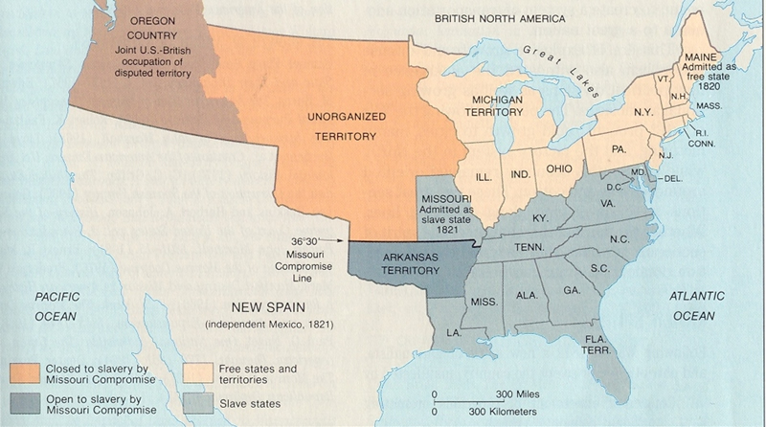

Slide 7
Why Texas?
The Mexican Government happily welcomed American settlers into Texas in the 1820’s to populate and develop their northern territory.
American settlers flooded into Texas for cheap land, just like they had earlier into Louisiana, Mississippi, and Alabama.
Like in those areas, many of the new settlers brought their slaves and looked to establish a culture similar to that of the Deep South.

Slide 8
Texas in the 1830’s
35,000 American settlers lived in Texas while 8,000 Mexicans lived in Texas.
The Americans did not attempt to fit in with the Mexican culture, making little effort to learn Spanish, do business, or become anything other than American settlers.
This worried the Mexican government, as it looked and seemed as if Texas was part of America, not Mexico.

Slide 9
The Mexican Government Responds
The Mexican Government gave up their practice of salutary neglect, just as the British Government had 60 years prior, and decided to pay attention to Texas.
Banned further immigration from the US to Texas in 1830.
Outlawed slavery in the territory.
When these laws were ignored, the Mexican military occupied Texas to attempt to force the American settlers to follow Mexican rule.

Slide 10
Reflection!
Do you see similarities in the Mexican treatment of American settlers and the British treatment of American colonists? How do you think the settlers in Texas will respond to being forced to follow Mexican laws?
In situations like this, who is right? The government for passing laws in reaction to the settlers or the settlers for wanting to govern themselves? Why?

Slide 11
WAR! Kind of…
Upon the Mexican military’s occupation of Texas, small uprisings and protests began among the American settlers, led by Stephen F. Austin.
The petitioned in 1832 and 1833 to the Mexican government to remove the restrictions, but the Mexican government did not respond.
By 1836, the conflict had led to a brief war, in which the Texans defeated the Mexican government and claimed their independence as the ‘Lone Star Republic.’
Despite this, the Mexican government refused to recognize the ‘Lone Star Republic’ as an independent nation.

Slide 12
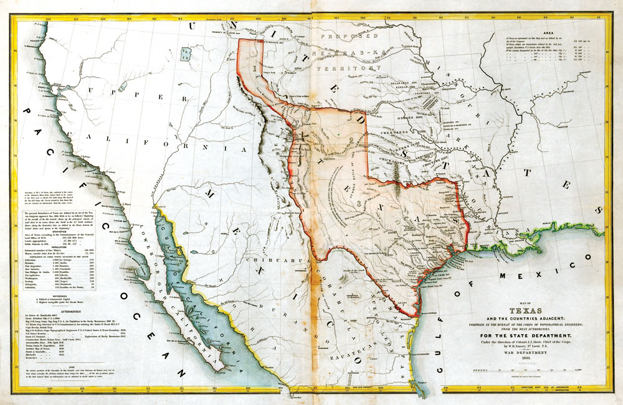

Slide 13
Now What?
Many former American settlers in Texas pushed for immediate inclusion into the United States.
President Andrew Jackson was hesitant at first to annex Texas, because he did not want to upset the balance in Congress between North and South by adding what could be one or multiple slave states.
President Martin van Buren, Jackson’s successor, was hesitant to annex Texas because he did not want war with Mexico.

Slide 14
Now What?
President John Tyler made the annexation of Texas his top priority.
Mexican diplomats in the United States became aware that there were high-level discussions regarding annexing Texas and became furious.
Further, Northern anti-slavery groups were highly opposed to the annexation of Texas, seeing the move as strengthening the South’s hold on slavery.

Slide 15
Conflict Over Texas
Much of the South wanted to annex Texas, seeing it as potentially up to 4 individual slave-holding states.
Some Southerners however did not want conflict with Mexico, as the South bordered Mexico and war might have inflicted damage on their properties.
Most in the North did NOT want to annex Texas, as it would increase political and economic power in the South.

Slide 16
Reflection
What were the reasons the United States was hesitant to annex Texas?
What were the reasons some people wanted to annex Texas?
Are either of these arguments convincing enough for you to have supported the annexation of Texas? Why?

Slide 17
The Annexation of Texas
The United States formally voted to annex Texas into the United States in 1845, causing Mexico to end diplomatic relations with the United States.
President James K. Polk openly and publicly insisted on taking over the rest of Mexico’s northern territories, including California.
This, combined with the US’ taking over a territory that Mexico still claimed made war inevitable, or unavoidable.

Slide 18
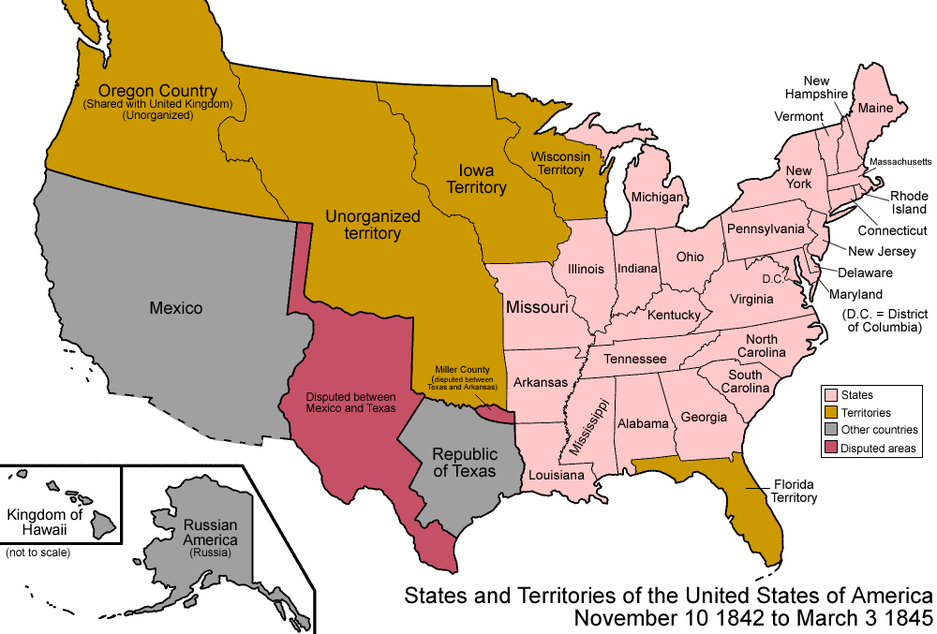

Slide 19
Reflection
How did the conflict over annexing Texas reflect the growing divide between North and South?

Slide 20
Quiz Time!
  Quiz yourself to decide if you know enough about the annexation of Texas to move on to document analysis!

Slide 21
Document Analysis
APPARTS
Pro and Con Annexation of Texas
Argumentative Paragraph (Support, Modify, Refute Format)
Choice Assessment-Multiple Choice or Short Answer

Slide 22
Assessment
If you would like to take a multiple choice test, go to
  bit.ly/texas1112mc
  If you would like to take a short answer test, go to
  bit.ly/texas1112sa

