Slide 1
APUSH REVIEW FOR YOU Period 3
Mr. Winchell
Review 2017-2018
Notes:
Approx. 12% of the Exam and covers 1754-1800 and covers the FI War, the End of Salutary Neglect & New Colonial Policy, The Road to Revolution and Revolutionary War, the Articles of Confederation and the Constitution, as well as the presidencies of GW and JA

Slide 2
Big Ideas
New Colonial Policy
Colonial Escalating Reaction
New Nation, New Problems

Slide 3
1754 - 1763
French and Indian (7 Years War) was caused by English encroachment onto French lands
Most natives (except Iroquois – split) sided with the French
Great Britain wins the war, France is removed from North America
Conflicts emerge between American colonists and Natives as colonists seek to expand

Slide 4
What resulted
Pontiac’s Rebellion
A reaction to colonial settlement in the Ohio River Valley
The Proclamation Line of 1763
Restricted colonial settlement
Passage of the Sugar Act (1764)
To help pay for the War

Slide 5
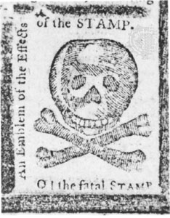
1763 - 1776
Britain is in debt from the war, ends
salutary neglect, takes a more active role in colonial affairs
Stamp Act, Townshend Acts, Quartering Act, Boston Massacre, Intolerable Acts, etc.
Colonists resist this new control (taxation w/out representation):
Stamp Act Congress, Committees of Correspondence, Sons/Daughters of Liberty, First Continental Congress, Boston Tea Party, Lexington & Concord
Notes:
Stamp: Tax requiring a tax on printed goods

Slide 6
3 Reasons for Resistance
English Common Law
Centuries old body of legal rules and procedures.
Magna Carta
Liberties and Privileges
Natural Rights
Enlightenment
Separation of Powers
Glorious Revolution
Constitutional Monarchy took away power from the King to just levy taxes at will.

Slide 7
1776 - 1783
Common Sense:
Thomas Paine, urged America to break away
Helped influence the Declaration of Independence
Declaration of Independence:
Grievances against KG3, justification for breaking away
Inspired by Common Sense and other Enlightenment ideas – natural rights, consent of the governed, etc.
Why did the colonists win the war?
Familiarity with the land
Military leadership (Washington)
Strong beliefs (natural rights)
Foreign Aid – France after Saratoga

Slide 8
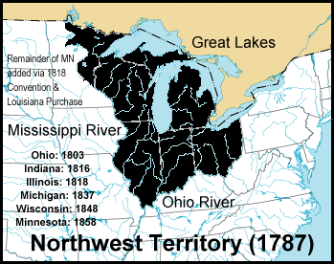
1783 – 1800
Fear of centralized power helped
create the Articles of Confederation
Weak central government, could not tax,
no executive branch, most power left to
states
Trade issues emerged between states
Northwest Land Ordinance (1787):
Provided a process for admitting new states
Once a territory reached 60,000 people, it could apply for statehood
Banned slavery in NW Territory (MI, OH, IN, IL, WI)
Tensions emerged in different areas of the country (west v. east)
Paxton Boys - PA
Shays’ Rebellion - MA
Notes:
Each state retains its “sovereignty, freedom, and independence”
Unicameral legislature and weak national government
No executive or judicial system
Could not regulate interstate commerce
Limited taxation
Voting and Ratification
Each state received one vote
No new tax or amendments without unanimous consent

Slide 9
State Constitutions
States drafted new constitutions
Defined citizens’ rights
Conservative state constitutions
Bicameral legislatures and strong governors
Property requirements for voting
i.e. Massachusetts, New York, Virginia
Liberal state constitutions
Unicameral legislatures and weak governors
Universal manhood suffrage
i.e. New Jersey, New Hampshire

Slide 10
Constitutional Convention
Constitution created a limited government that embodied federalism and separation of powers
Federalism – division of power between state and federal governments
Constitutional compromises
Great Compromise (Connecticut Compromise) – Roger Sherman
3/5 Compromise:
BOTH THE GREAT COMPROMISE AND 3/5 COMPROMISE SETTLED THE ISSUE OF REPRESENTATION
Ratification of the Constitution
Federalists (favored) vs. anti-Federalists
Federalist Papers (Hamilton, Madison, and Jay) – written to advocate the ratification of the Constitution
Why was it finally ratified?
Notes:
Federalists promised to add a Bill of Rights that protected individual rights and restricted powers of the federal government (no quartering troops – 3rd; no search and seizure without warrant – 4th)

Slide 11
A Stronger National Government
Articles Problems
Constitution Solution
No power to tax
No power to regulate interstate and foreign commerce
No executive branch
No judicial branch
Amendments need unanimous consent
Supermajority to pass laws
Lay and collect taxes
Interstate and foreign commerce clause
No export taxes
President
Electoral College
4 year terms
U.S. Supreme Court
Article V – Amendments
2/3 of both houses of Congress
¾ of state legislatures
Presentment Clause
Simple majority by both houses
President’s signature

Slide 12
Washington’s Presidency
Washington unanimously elected
John Adams as VP
The Cabinet
Secretary of State Thomas Jefferson
Secretary of the Treasury Alexander Hamilton
Secretary of War Henry Knox
Attorney General Edmund Randolph
Judiciary Act of 1789
Established lower federal courts
Federal district court in each state
Attorney General
Whiskey Rebellion (1794)
Foreign Policy
French Revolution
Jay Treaty (1794) and Pinckney Treaty (1795)
Farewell Address

Slide 13
Hamilton’s Financial Plan
Reports on the Public Credit
Debt Problems
$75M debt between national government and states government
Worthless national currency
Little to no foreign credit
The Debt Plan
Federal government assumes national and state debts
Report on a National Bank
Manage revenues, currency, and debt
Private institution
“necessary and proper”
Sources of Revenue
Tariffs
Excise taxes
Report on Manufactures
Protective tariffs
Promotion of domestic industries

Slide 14
First 2 Political Parties
Federalists
Democratic Republicans
Strong Federal Government
Strong Executive Branch
Loose Interpretation (Elastic/Necessary and Proper Clause)
Commerce/Manufacturing
Northeast Merchants/Urban Elite
Pro-Britain
Bank/Tariff
Pro Order
Stronger State Governments
Weak Executive
Strict Interpretation (10th Amendment)
Southern Small Farmers/ Rural Westerners
Pro-France
No Bank/No Tariff
Pro Liberty

Slide 15
Washington
Farewell Address
Precedents
Retired after two terms
Preserve treaties and avoid alliances
Condemned political parties and partisan conflicts
Warned of sectionalism and to preserve unity
Religion and morality and diffusion of knowledge (education)
Two terms
“Mr. President”
Cabinet
Neutrality
Special Relationship with Great Britain
Farewell Address

Slide 16
Adams Presidency
XYZ Affair
Quasi War
Alien and Sedition Acts
Virginia and Kentucky Resolutions
Notes:
Deport or jail foreign citizens believed to be threats
Increase Residency Requirement
Criticism of Government Prohibited
VA/KY-Jefferson and Madison: Nullification

Slide 17
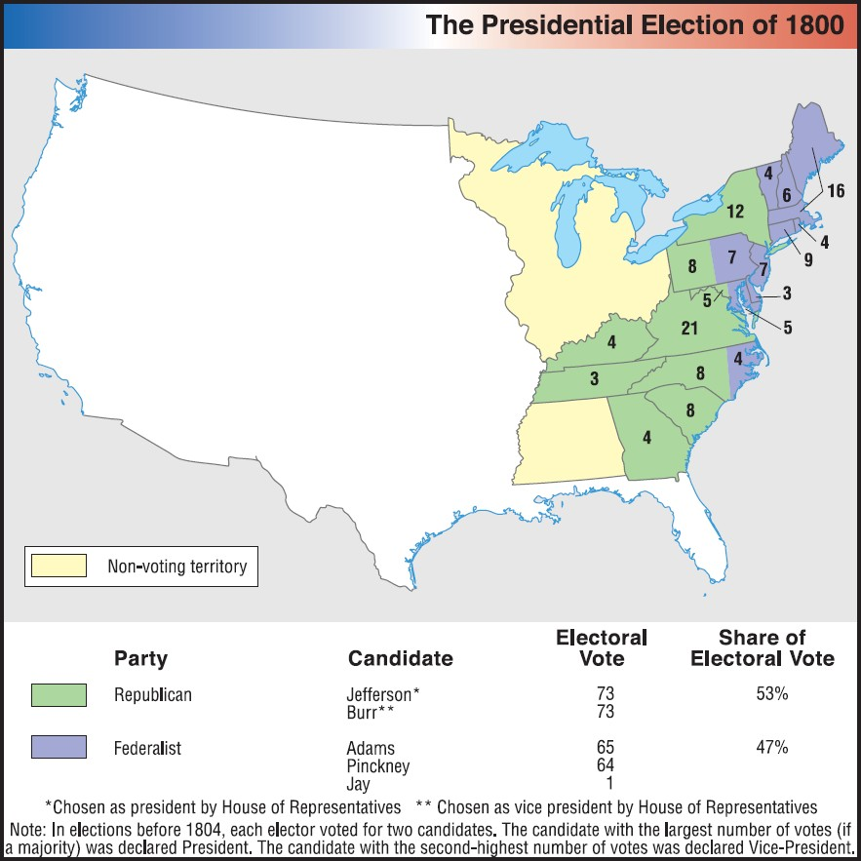
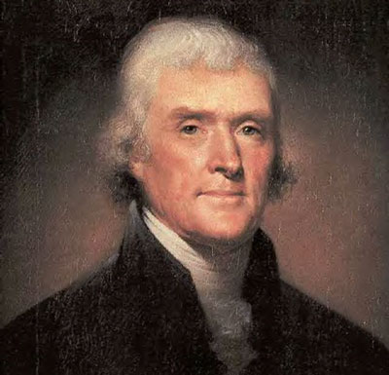
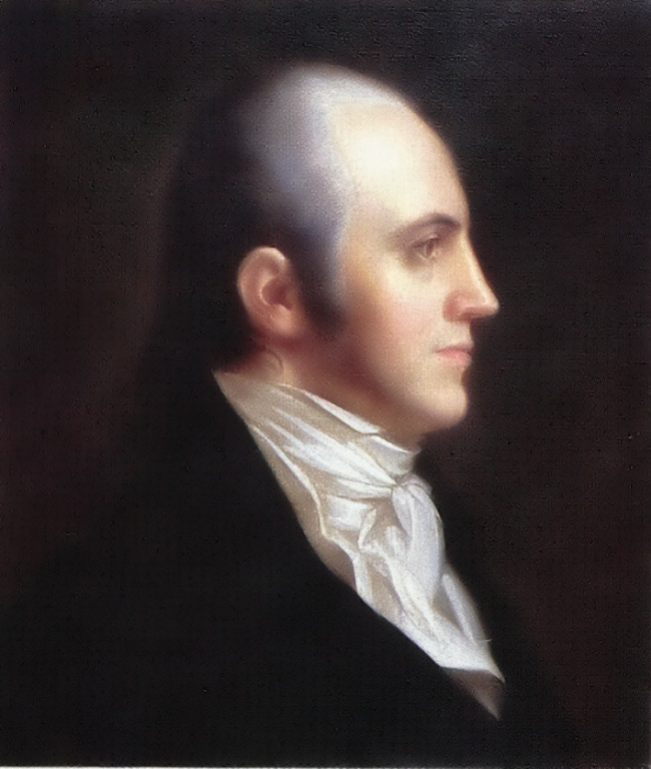
The Election of 1800
Notes:
Deport or jail foreign citizens believed to be threats
Increase Residency Requirement
Criticism of Government Prohibited
VA/KY-Jefferson and Madison: Nullification

Slide 18
1783 – 1800
Impact of the D. of I. and American Revolution?
Revolutions in France, Haiti, and Latin America
Although some called for greater equality (Abigail Adams, PA Emancipation Law), framers of the Constitution postponed the issue of slavery
Constitution:
Built on Compromises: Great, 3/5, Slave Trade
Ratified after Federalists promised Antifederalists a Bill of Rights would be added

