Slide 1
APUSH REVIEW FOR YOU Period 4
Mr. Winchell
Review 2017-2018
Notes:
Approx. 10% of the Exam and covers 1800-1848 and covers the election of 1800 in which Jefferson and the DR’s take power, the Virginia Dynasty Presidents of Jefferson, Madison, Monroe, the War of 1812 and subsequent Market Revolution/ Era of Good Feelings, the Missouri Compromise, the Rise of Jacksonian Democracy and ends with the the Antebellum Reform Movements that stem from the 2nd Great Awakening.

Slide 2
Big Ideas
Democratic Republican Regime
War of 1812 and Consequences
Overlapping Revolutions-Economic, Transportation, Political, Social, Cultural

Slide 3
Election of 1800
Federalists Lose Control of Government
‘Peaceful Revolution of 1800’
Beginning of the end for Federalist Party

Slide 4
Judiciary Act of 1801
Federalists attempt to maintain power and control on their way out of office
‘Midnight’ appointments
Judges serve for life/retirement…hold control on Judicial Branch for a generation
Marbury v. Madison (1803)
Established the precedent of judicial review
HUGE expansion of judicial power (co-equal branch)
Chief Justice John Marshall will continue this legacy into the 1830s

Slide 5
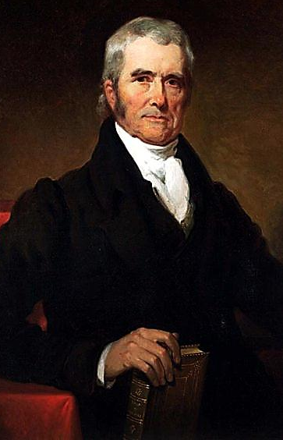
Chief Justice John Marshall served as Chief Justice of the Supreme Court from 1801 to 1835
Over three decades, Marshall’s ruling helped strengthen the power of the national gov’t over the states and protected the rights of citizens
Marbury v. Madison (1803)
Fletcher v. Peck (1810)
McCulloch v. Maryland (1819)
Dartmouth College v. Woodward (1819)
Gibbons v. Ogden (1824)
Cherokee Nation v. Georgia (1831)
Notes:
Marbury Madison-Judicial Review
Fletcher Peck-States can’t change laws to violate contracts
McCulloch Maryland-Bank
Dartmouth v. Woodward-Contract Law-NH can’t take over a private institution
Gibbons Ogden-Regulation of Interstate Commerce
Cherokee Nation v. Georgia-GA Can’t just violate Cherokee contracts

Slide 6
Jefferson’s Presidency
STRICT interpretation ideals/LOOSE-ISH interpretation actions
Louisiana Purchase (implied powers/loose)
Embargo Act of 1807-Banned US trade with ALL foreign nations (violates principles of ind. Liberty and weak central gov.)
ST: US Economy TANKS
LT: New England Industrializes
Legacy: Strengthened Exec. Branch, less ‘aristocratic’ government, kept US out of war, but biggest legacies are non-presidential.
Notes:
LA Purchase doubles the size of the US
Federalists Oppose! PRESIDENT DOESN’T HAVE THAT POWER!
Real reason…worried new lands would attract the farmers and agrarian class that would vote with the DRs

Slide 7
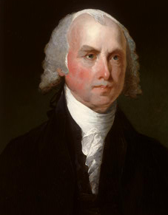
James Madison
1809-1817
“Father of the Constitution”
Federalist Papers
Bill of Rights
Kentucky & Virginia Resolutions
Democratic-Republican
Secretary of State

Slide 8
James Madison (D-R) (1809-1817)
Napoleonic Wars
Impressment continues
Non-intercourse Act of 1809
Macon’s Bill No. 2 (1810)
Western Frontier
Alleged British influence on Natives
Native wars
War of 1812
NE Federalists very anti-war (Hartford Convention)
War declaration: FREE TRADE, IMPRESSMENT, WESTERN INDIAN AGITATION
Treaty of Ghent ends it in 1814-doesn’t address neutrality “Status Quo Antebellum”
Notes:
War Hawks (Webster, Clay, Calhoun)-Young DR leaders, wanted to seize Canada, seize Florida, stop impressment, protect trade, and push westward.
Ghent-scares Florida into Adams-Onis (1819), ends Federalist Party
Impact of War: Nationalism, EGF, Industrial development, infrastructure, international respect, natives weakened, westward expansion.

Slide 9
Overlapping Revolutions
Population
Economic-Agricultural, Technological, Transportation AND Industrial
Democratic
Social

Slide 10
Western Expansion

Slide 11
Western Expansion Causes
Population Growth
Transportation Improvements
Cotton Production
‘Old’ Immigration

Slide 12
Expansion and Slavery
Missouri Compromise (Compromise of 1820)
3 parts:
Above 36º30’ - free, below 36º30’ - slave
MO - Slave
ME - Free
Balance preserved at 12 states each
Eventually, the compromise broke down (Overturned by the KS-NB Act and Dred Scott - Period 5)
Overcultivation of land in the Southeast led to expansion ->
Tensions over slavery

Slide 13
Changes in Agriculture and Manufacturing
New technological innovations increased efficiency and extended markets
Textile machines - Spinning Jenny, increased production (Samuel Slater)
Steam engines - boats could travel against the current
Interchangeable parts - Eli Whitney, mass production of goods
Canals - Erie Canal, goods could be shipped further
Railroads - Expanded rapidly in the 1840s, hurt canals
Telegraph - spread of information (1844 Democratic Convention)
Agricultural inventions - mechanical reaper, steel plow, cotton gin
Production of goods began to replace semi subsistence farming
Lowell System - farmers’ daughters worked in factories in 8 hour shifts, lived in boarding houses, worked OUTSIDE the home
Notes:
Leads to REGIONAL SPECIALIZATION
NE-Industrializes-water powered textile factories
South-Doubles down on cotton
West-Breadbasket

Slide 14
Impacts of Market Revolution
Canals and roads helped encourage westward expansion
European immigrants settled in the:
East - Irish (cities)
Midwest (Germans, as farmers)
Why did immigrants leave Europe?
Economic hardships (Potato famine), not enough land, and economic opportunities in the US
This helped increase interdependence between the Northeast and Old Northwest

Slide 15
Impacts of Market Revolution
The South remained distinctly different from the other regions
Relied on cotton exportation to make $
The Market Revolution changed life in the following ways:
Increased gap between rich and poor
Emergence of middle and working classes
Separation between home and workplace - more goods were produced OUTSIDE the home
Helped change gender and family roles
For many Americans, regional interests were more important than national concerns, as seen through:
Slavery - tensions increased as time went on
National bank (BUS) - disliked in the South
Tariffs - favored in the north (manufacturing), disliked in the South
Internal Improvements - tariffs would pay the cost; favored out West (Henry Clay!)

Slide 16
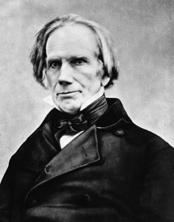
Henry Clay’s American System
AMERICAN SYSTEM
Congress’s attempt to unite the US
National transportation system of roads, canals, steamships and rivers.
1800 to 1850 roads, canals and rivers first forms of transportation---
Provide economic growth
Americans buying American goods
American self-sufficiency.
Protective Tariff to promote infant industry
Tariff of 1816
2nd BUS to promote a stronger economy
Re-chartered in 1816

Slide 17
The Era of Good Feelings: 1817-1825
Death of the Federalist Party
Adoption of many Federalist ideas
Monroe (Demo. Rep.) wins 1816 election
Americans nationalistic following War of 1812
Monroe Doctrine
Panic of 1819
Missouri Compromise
U.S. foreign policy successes
Rush-Bagot Treaty (1817) – limit naval armaments on Great Lakes
Convention of 1818 – allowed joint occupation of Oregon territory with GB
Purchase of Florida (1819) – Adams-Onís Treaty
Notes:
Phrase coined by a Boston reporter
Federalist party dies out after Hartford Convention fiasco (1814)
Leaves Democratic-Republicans as the only major party
Demo-Reps under Madison had adopted Federalist ideas
Federal support for internal improvements (roads, etc.)
Tariff protection of new industries created during embargo
Creation of new national bank
1st Bank of U.S. charter expired in 1811
Monroe elected to two terms of office
Well-liked - even in one-time Federalist stronghold New England
“Victory” in war of 1812 made Americans enthusiastic supporters of the Natl. govt.
Gives Monroe a freer hand in foreign policy matters
Rush-Bagot Treaty between the U.S. & GB called for naval disarmament of the Great lakes
To this day - U.S./Canadian border is unfortified
Convention of 1818 fixes U.S./Canadian border at 49th parallel from Minnesota to Rockies
Florida purchased from Spain with Adams-Onis Treaty for $5 million
U.S. gives up on claim to Texas
Spain recognizes border between Mexico & Oregon Territory at 42nd Parallel
The South benefits most but treaty is widely supported

Slide 18
Notes:
The Election of 1824 effectively ends the ‘Era of Good Feelings’ but the end was already apparent from the Panic of 1819 and the Missouri Compromise. 4 Candidates all from the same party show a divide in the D-R platform, Jackson wins but doesn’t get enough votes, Clay finishes 4th so he uses his platform in Congress to convince Congress to vote for JQA-2 weeks later Clay is named Sec of State… Corrupt Bargain

Slide 19
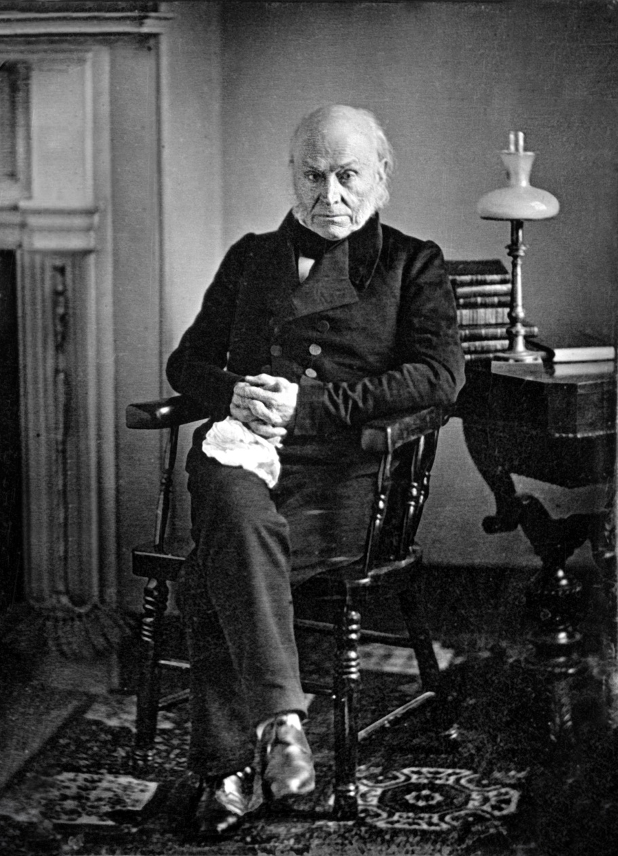
Adams’ Administration
Clay’s American System
1828 “Tariff of Abominations”
Generous Indian policy
All of which angered Jacksonian Democrats

Slide 20
Jacksonian Democracy
When Andrew Jackson was elected president, it represented a new era in American history:
He was the first president that represented the “common man”
His party (the Democrats) took advantage of the extension of suffrage to common white men
He greatly expanded the powers of the presidency
Notes:
Endorsing the view that a fundamental conflict existed between working people and the “non-producing” classes of society, Jackson and his supporters promised to remove any impediments to the ordinary citizen’s opportunities for economic improvement. According to the Jacksonians, inequalities of wealth and power were the direct result of monopoly, favoritism, and special privileges, which made “the rich richer and the powerful more potent.” Only free competition in an open marketplace would ensure that wealth would be distributed in accordance with each person’s “industry, economy, enterprise, and prudence.” The goal of the Jacksonians was to remove all obstacles that prevented farmers, artisans, and small shopkeepers from earning a greater share of the nation’s wealth.

Slide 21
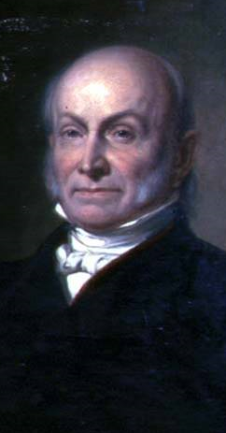
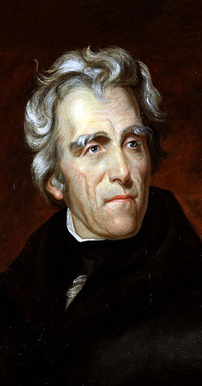
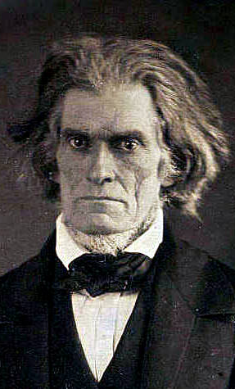
Parties & Leaders
Old Federalists
National Republicans/ Whigs
Jacksonian Democrats
Southern Democrats
John Marshall
John Q. Adams
Henry Clay
Andrew Jackson
Martin Van Buren
John C. Calhoun
National Supremacy States’ Rights

Slide 22
Jackson’s 2 Terms (1829-1837)
3 MAJOR CONFLICTS
Native Americans
Tariffs
The Bank

Slide 24
Native Americans and Jackson
Indian Removal Act (1830)
Worcester v. Georgia 1831-Marshall court rules Cherokee are a sovereign nation and Georgia can’t kick them out.
Trail of Tears

Slide 25
Tariffs and Jackson
Tariffs: Northern states favored tariffs-increased protection for their manuf’d goods
Tariff of Abominations (1828)-PISS SC OFF-Real issue is fear of federal power
Calhoun writes the SC Exposition and Protest-upholding states rights to nullify federal laws
Tariff of 1832-didn’t lower tariff enough-South still pissed, SC threatens secession
Jackson responds with threatened force-Compromise tariff of 1833-CLAY and Force Bill

Slide 26
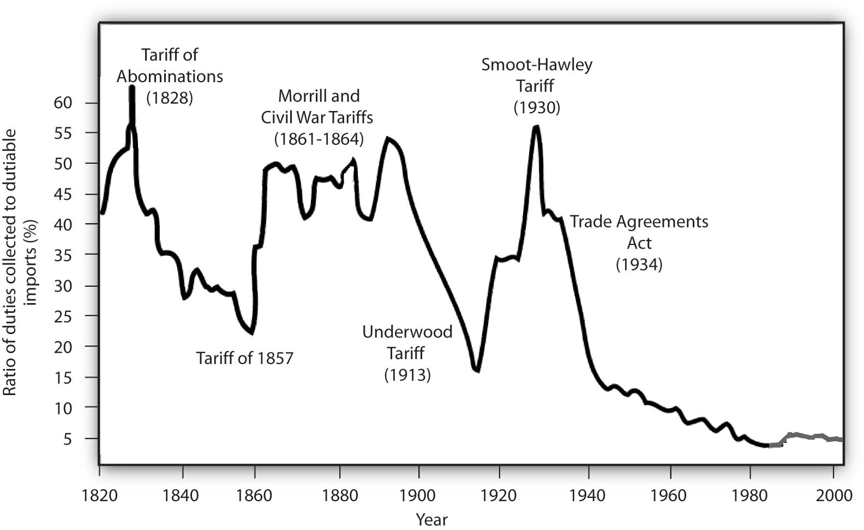
Historical tariff Rates

Slide 27
Bank and Jackson
Jackson hates the B.U.S.
Unconstitutional, aristocratic, only helps the rich.
Henry Clay and Daniel Webster re-charter the B.U.S in Congress-Jackson vetoes the charter.
Election of 1832-Bank centered election and Jackson defeats Clay in a landslide.
Jackson: Mandate to kill the bank-removes all federal deposits to ‘Pet Banks’

Slide 28
The Emergence of the Whigs
In 1834, an anti-Jackson coalition formed a new party, the Whigs:
Supported by ex-Federalists, “Clay Republicans,” commercial farmers in the West & South, industrialists in the North
Supported a strong national gov’t & economic regulation
The Whigs gained support during the Panic of 1837 & the recession
Were strongly opposed to “King Andrew”
Notes:
Although it took a number of years for Jackson’s opponents to coalesce into an effective national political organization, by the mid-1830s the Whig party, as the opposition came to be known, was able to battle the Democratic party on almost equal terms throughout the country.
The Whig party was formed in 1834 as a coalition of National Republicans, Anti-Masons, and disgruntled Democrats, who were united by their hatred of “King Andrew” Jackson and his “usurpations” of congressional and judicial authority, came together in 1834 to form the Whig party. The party took its name from the seventeenth-century British Whig group that had defended English liberties against the usurpations of pro-Catholic Stuart Kings.
Whigs tended to be educators and professionals; manufacturers; business-oriented farmers; British and German Protestant immigrants; upwardly aspiring manual laborers; free blacks; and active members of Presbyterian, Unitarian, and Congregational churches.
The Whig coalition included supporters of Henry Clay’s American System, states’ righters, religious groups alienated by Jackson’s Indian removal policies, and bankers and businesspeople frightened by the Democrats’ anti-monopoly and anti-bank rhetoric.
Whereas the Democrats stressed class conflict, Whigs emphasized the harmony of interests between labor and capital, the need for humanitarian reform, and leadership by men of talent. The Whigs also idealized the “self-made man,” who starts “from an humble origin, and from small beginnings rise[s] gradually in the world, as a result of merit and industry.” Finally, the Whigs viewed technology and factory enterprise as forces for increasing national wealth and improving living conditions.

Slide 29
The Second Two Party System
1
1790-1816 | Federalists | Republicans [Jeffersonian or Democratic]
1816-1824 | “Republicans”
1828-1833
1833-1854
National Republicans
Democratic Republicans
2
“Whigs”
“Democrats”

Slide 30
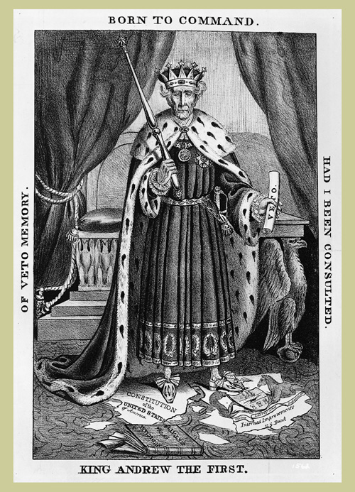

Slide 31
Politics Post-Jackson
Van Buren (1837-1841)
Panic of 1837
Opposed Annexation of Texas
Webster Ashburton Treaty
William Henry Harrison (1841-.......1841)
John Tyler (1841-1844)
A President w/out a Party
Notes:
MVB: Pisses off Ds by opposing Texas, weak compared to Jackson, border conflicts
WHH: Whigs gain power-taking Ds playbook of modern campaign

Slide 32
Social Revolutions of Period 4
2nd Great Awakening
Protestant revivalism-Emotionalism
Inspired perfectionism
Inspired social reform movements
Women and African Americans
Abolitionism
Utopian Societies
Temperance
Education Reform
Prison and Asylum Reform
Press
Transcendentalists
Notes:
Women-Republican Motherhood-Cult of Domesticity
Abolitionism-Gag Rule, 1836
Oneida Community/Shakers/Brook Farm/New harmony
Temperance: American Temperance Society-Women-Anti Immigrant
Education Reform: Enlightenment Philosophy/Political Philosophy/Catherin Beecher/Oberlin College/Horace Mann and MA
Prison Reform: Dorothea Dix
Transcendentalists: Emerson-Self Reliance/Thoreau-Walden, On Civil Disobedience

Slide 33
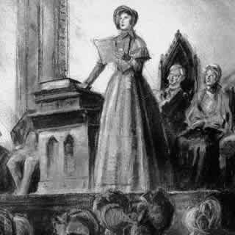
Seneca Falls Declaration of Sentiments
Lucretia Mott & Elizabeth Cady Stanton
Modeled on Declaration of Independence
“All men and women are created equal”
List of grievances against patriarchal society

Slide 34
Quick Recap
Federalists and Democratic-Republicans
Whigs and Democrats
2nd Great Awakening = inspired REFORMS
New technological inventions
Market Revolution and its impact
“Old” Immigration
Missouri Compromise
Era of Jackson and Modern Politics

