Slide 1
APUSH REVIEW FOR YOU Period 5
Mr. Winchell
Review 2017-2018
Notes:
Period 5 is going to begin with the annexation of Texas in 1844 and the onset of the Mexican American War and take us through the turbulent 1850s in which sectionalism is going to increase substantially over new territory, popular sovereignty, and stephen douglas being an idiot all the way to the Civil War and Reconstruction. It weighs approx 13% of the AP test, and is therefore our biggest unit thus far. Once done with today’s video, we’ll be HALFWAY through our review in terms of test percentage.

Slide 2
Big Ideas
New Land, New Problems
The Turbulent 1850s
Lincoln’s Election and Secession
The Civil War: Militarily, Economically, Politically
Reconstruction: Successes, Shortcomings, and Legacies

Slide 3
New Land
Texas via Annexation-1845
Mexican Cession via Treaty of Guadalupe Hidalgo-1848
Gadsden Purchase-1853
Ostend Manifesto (FAILED)
Expansion fueled by:
  Manifest Destiny
  Economic Benefit
  National Security Interest
  US racial superiority

Slide 4
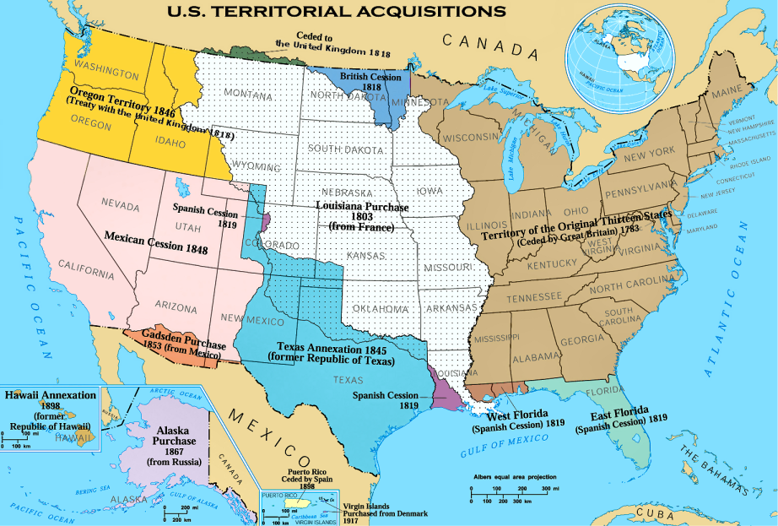

Slide 5
Sectionalism
North doesn’t want expansion of slavery
  Free Soil Party
  Abolition
  Wilmot Proviso
South does want expansion of slavery
  ‘Positive Good’
  Support for MA War
  Popular Sovereignty

Slide 6
Solution
Compromise of 1850
  CA enters Union as a free state
  Slave trade OUTLAWED in DC
  New Fugitive Slave Law in effect in North
  Popular Sovereignty in rest of territory gained from Mexico
  Texas border dispute settled
Notes:
CA tips the balance of power to the free states in the Senate

Slide 7
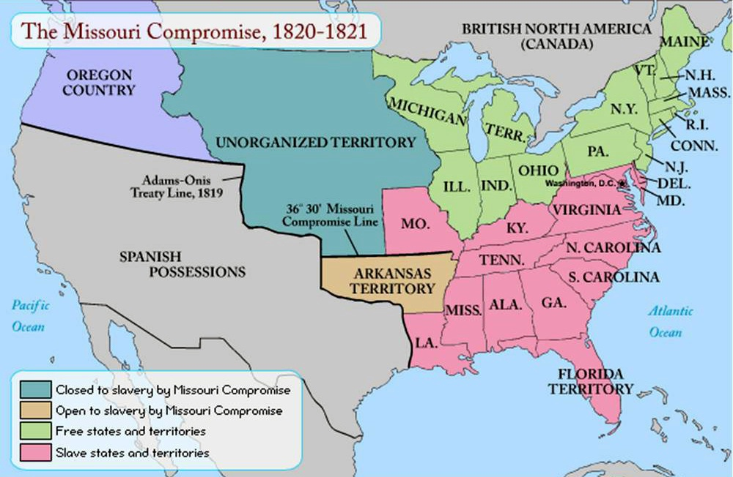

Slide 8
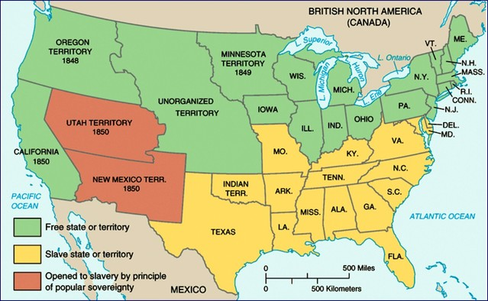

Slide 9
Expansion of Slavery in the 1850s
Kansas-Nebraska Act (1854)
  Stephen Douglas’ brilliant idea to gain Southern support for a transcontinental railroad through HIS state of Illinois
  Repeals Missouri Compromise and OPENS Kansas and Nebraska territories to slavery via popular sovereignty
  HUGE opposition in the North-Republican party forms in opposition
Dred Scott v. Sanford (1857)
  Slaves are property-can’t be taken away w/out due process
  Congress can’t ban slavery from territories
  African Americans aren’t citizens and therefore have no right to sue for freedom in the Supreme Court
John Brown’s raid at Harper’s Ferry (1859)
  Another spark
Notes:
Bleeding Kansas
Caning of Sumner
Missouri Compromise unconstitutional

Slide 10
THIRD PARTY SYSTEM
1860 - 1896
Major Party Comparison
Republicans (GOP)
Democrats
National policies
  Homestead Act
  Land grants and infrastructure (railroads)
  Protective tariffs
Hard money policies/gold standard
Northeast
Pietistic denominations and sects (Methodists, Congregationalists)
Split over civil service reform
  Stalwarts – supported patronage
  Half-breeds – civil service reform
  Mugwumps – frustrated with GOP corruption
Appealed to businessmen, industrialists, professionals, scalawags, carpetbaggers, blacks/freedmen
Laissez-faire policies
Low tariffs
Solid South
Liturgical denominations and sects (Catholics)
Bourbon Democrats – pro-business Democrats
Redeemer Democrats – Southern Democrats return to power in Solid South
Appealed to traditional laissez-faire Democrats, small farmers, unskilled labor, urban immigrants

Slide 11
Societal Differences by 1860
North
South
Economic:
  Manufacturing, free labor, industry
Demographic:
  MORE people, immigration influx
Cultural:
  Education, community, abolitionism
    Garrison, Uncle Tom’s Cabin, Douglass, David Walker
Economic:
  Agricultural, plantation, slave labor
Demographic:
  LESS people, less diversity, less immigration
Cultural:
  Defense of slavery, isolated culturally, more home-based
    Positive Good-Fitzugh and Calhoun
    Nullification Theory

Slide 12
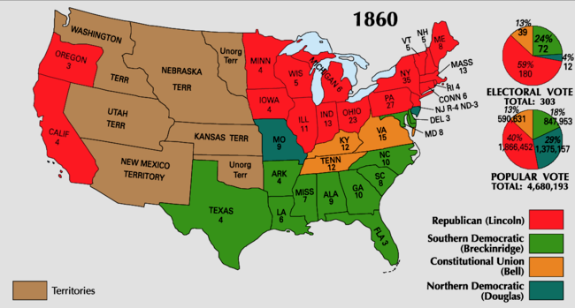
Election of 1860
Notes:
Available Electoral College Votes:
Non-slaveholding North (Including CA): 183
Border South: 32
Middle South: 41 Total Slaveholding South: 120
Deep South: 47
Deep South secedes upon Lincoln’s election, pres. Buchanan does nothing about it
South Carolina, Florida, Georgia, Bama, Mississippi, LA, Texas

Slide 13
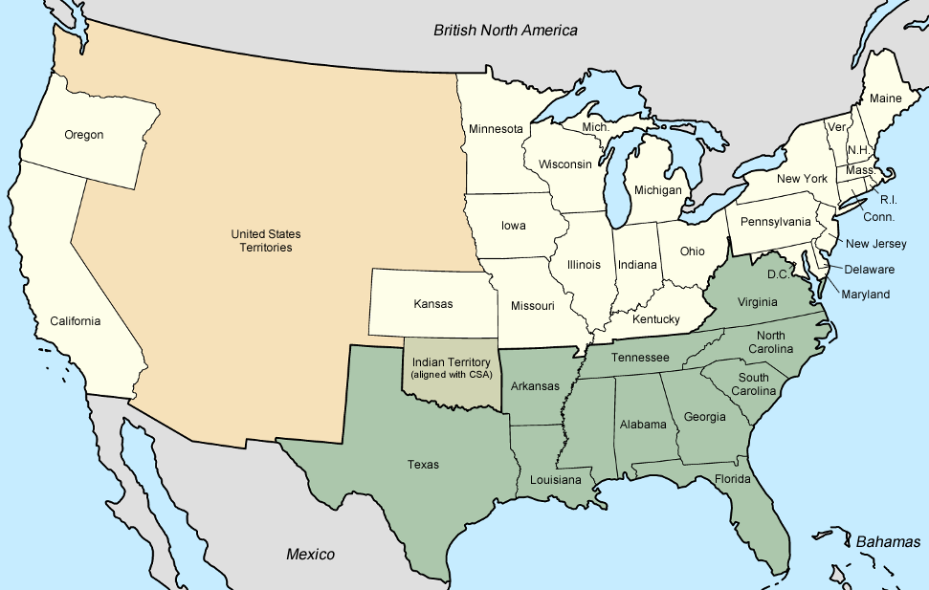
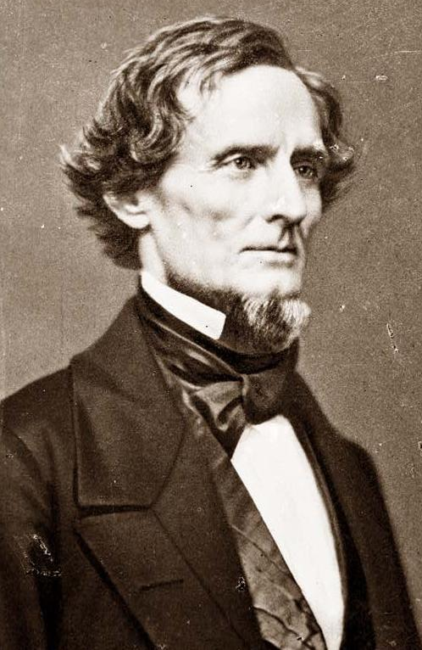
The constitution of the Confederacy was similar
to the U.S. Constitution except that it:
Protected slavery and states’ rights
Outlawed tariffs
Created a weak national government
Elected Jefferson Davis as Confederate president
Notes:
Threats of secession were nothing new. Some Southerners had threatened to leave the Union during a Congressional debate over slavery in 1790, the Missouri Crisis of 1819 and 1820, the Nullification Crisis of 1831 and 1832, and the crisis over California statehood in 1850. In each case, the crisis was resolved by compromise. Many expected the same pattern to prevail in 1861.
No bill of attainder, ex post facto law, or law denying or impairing the right of property in negro slaves shall be passed.

Slide 14
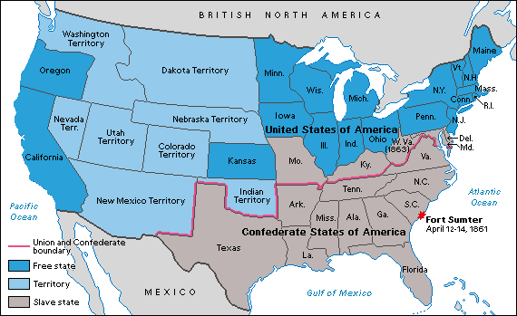

Slide 15
Lincoln and civil liberties
Habeas Corpus
  Lincoln Suspended the right, Taney ruled he couldn’t do that, he did it anyway…
Vallandigham Case
  Congressman, spoke against the war, elected out of office, wouldn’t shut up.
Freedom of the Press
  Closed down 2 newspapers in NY that were publishing fake stories about war and Lincoln. (Journal of Commerce and The World)

Slide 16
Lincoln and the draft
Ongoing problem recruiting Union soldiers
“Cause” of the war was vague – “Preserving the Union?”
Both sides resorted to conscription (draft) by 1863
Union law allowed purchase of a substitute recruit for $300 fee
“Rich man’s war, poor man’s fight”

Slide 17
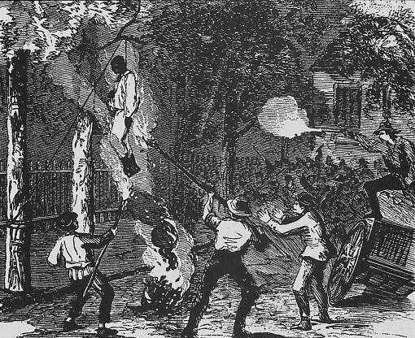
NYC Draft Riots

Slide 18
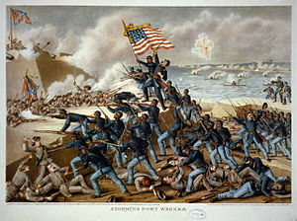
The Union and Blacks/Slaves
The idea of ending slavery was difficult for Lincoln
  Border states were slave states, ex. Kentucky
  Slavery is constitutional
  Racism in the North and among Democrats
  Re-election in 1864?
Emancipation Proclamation (January 1, 1863)
  “freed” slaves in Confederate states
  Slavery became an “official” cause of war
Gettysburg Address
Army of Freedom
  54th Massachusetts (Glory) - unequal pay
  200,000 participants; 37,000 casualties
Thirteenth Amendment (December 1865)
  “If slaves will make good soldiers, our whole theory of slavery is wrong.” - Georgia general

Slide 19
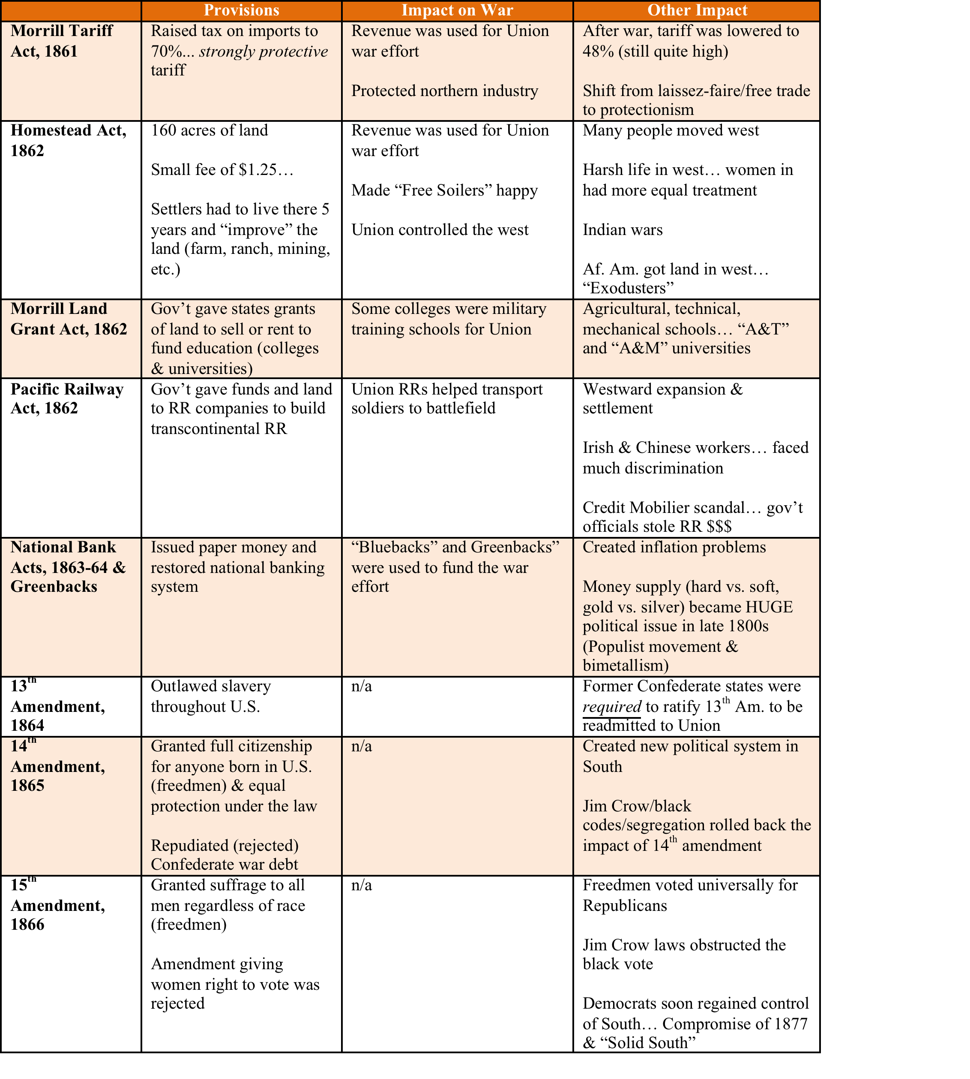

Slide 20
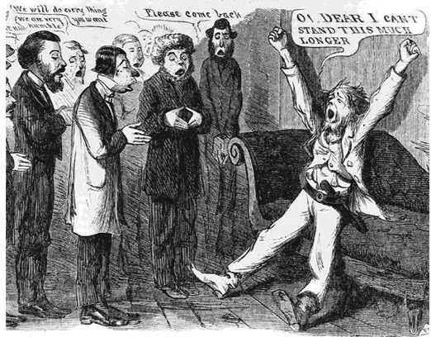
“Peace” Democrats
Opposed emancipation
Wanted immediate end to war
Wanted to restore Confederacy to the Union through negotiation
Nicknamed “Copperheads”

Slide 21
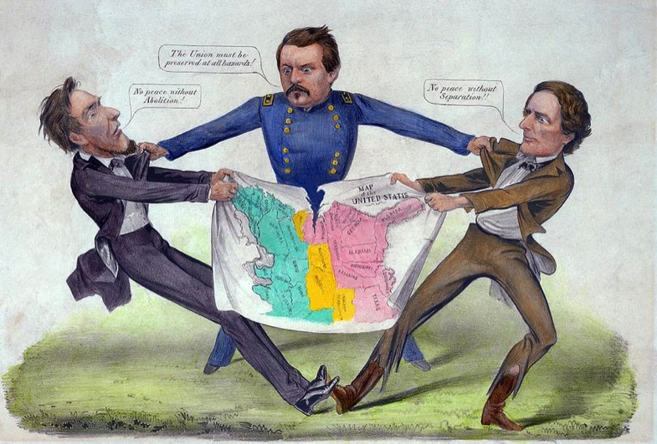
McClellan the Peacemaker?

Slide 22
Sherman Scorches Georgia
  Georgia’s conquest:
    It was entrusted to General William Tecumseh Sherman
    He captured Atlanta in September 1864, burned the city in November 1864
    Sherman with 6000 troops cut a sixty-mile swath of destruction through Georgia
    Major purposes of Sherman’s march:
      destroy supplies destined for the Confederate army
      weaken the morale of the men at the front by waging war on their homes
      Rebuilt public support for the war with election pending

Slide 23
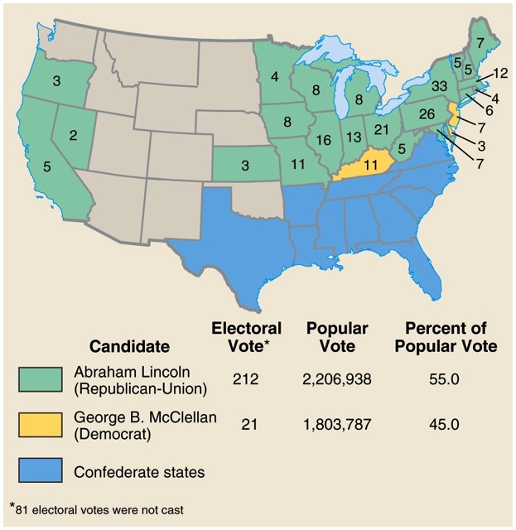
Presidential Election of 1864

Slide 24
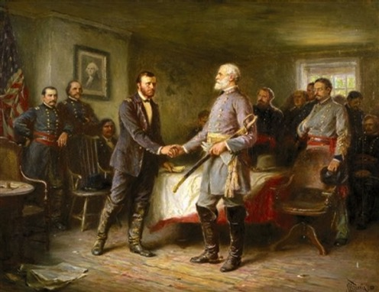
Peace
Appomattox - April 9, 1865
  Lee surrenders to Grant
Confederates until the very end…
  Guerilla tactics and “The South will rise again!”

Slide 25
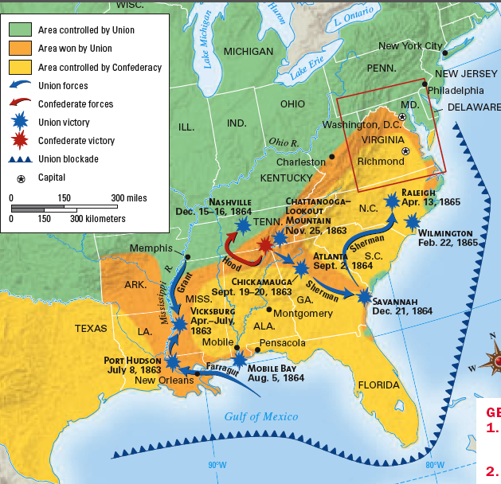
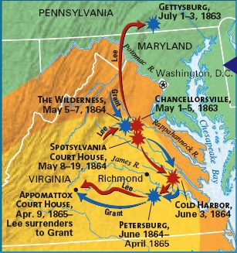
From 1863-1865, the lack of
Southern resources & unity as well as the Northern advances into the South led to the end of the Civil War
Notes:
How did North win; recap 1863-1865 burning richmond? Total war
Lack of unity in south

Slide 26
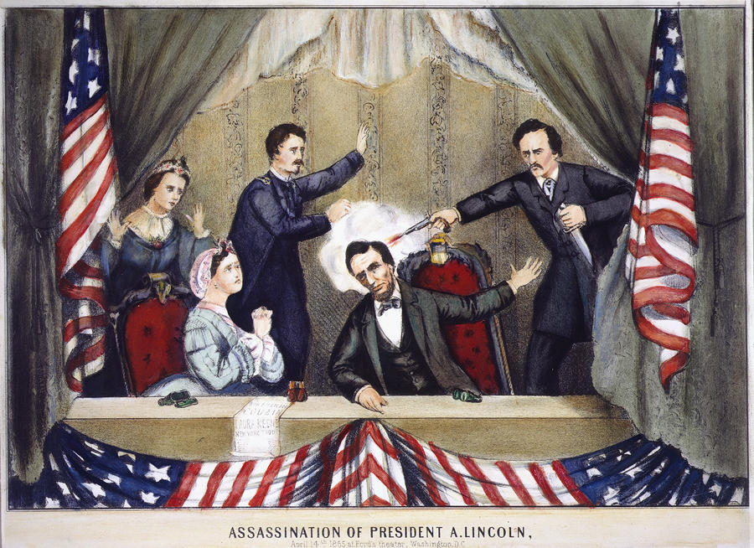

Northern celebration was short lived; On April 14, 1865, Lincoln was shot by John Wilkes Booth ….

Slide 27
Effects of the War
Political
  Northern Republican Control, Southern Power Decimated
Economic
  War is Expensive…rebuilding is also expensive
Social
  Women and African Americans

Slide 28
The Aftermath of the Nightmare
    The extreme states’ righters were crushed
    The national government, tested in the fiery furnace of war, emerged unbroken
    Nullification and secessions were laid to rest
    The Civil War was the supreme test of American democracy
    The preservation of democratic ideals was subconsciously one of the major objectives of the North

Slide 29
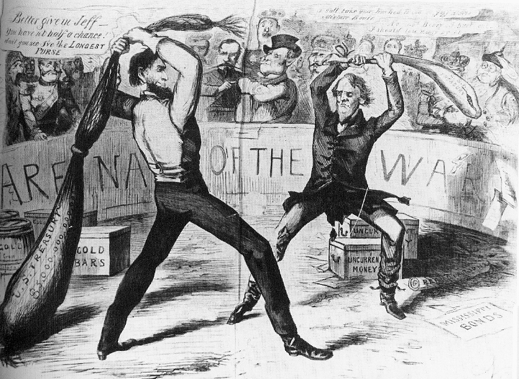
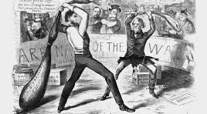

Slide 30
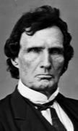
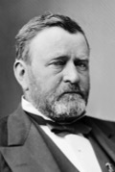
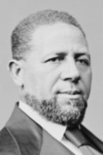
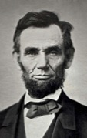
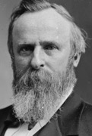
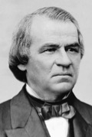
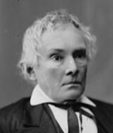
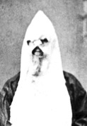


Political Spectrum of Reconstruction
Radicals
Moderates
Unionists
Redeemers
KKK
Federal Supremacy
Black Civil Rights
Military Occupation
States’ Rights
Blacks as Second-Class Citizens
Home Rule

Slide 31
3 Phases of Reconstruction
Presidential Reconstruction (1863-1866)
Congressional (or Radical) Reconstruction (1867-1877)
Redemption (1877-1900)

Slide 32
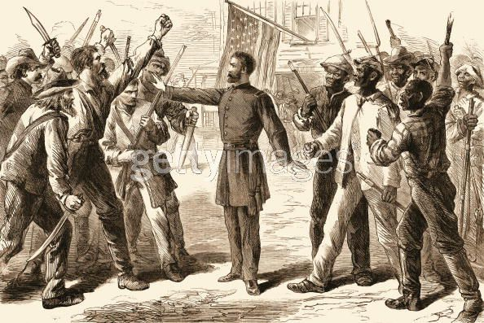
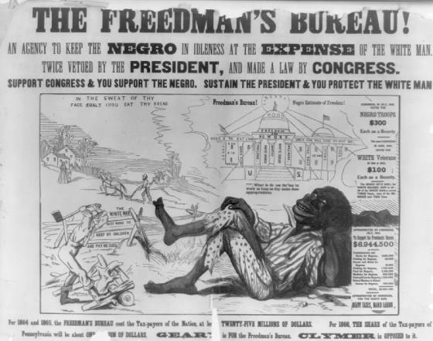
Freedmen’s Bureau
Bureau of Refugees, Freedmen, and Abandoned Lands in March 1865
Food, shelter, medicine for freed blacks and displaced whites
Education of blacks and colleges
Viciously attacked and ridiculed by Northern racists and bitter Southerners

Slide 33
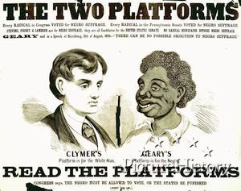
The Radical Republicans
Radicals
  Thaddeus Stevens
  Charles Sumner
Midterm Election of 1866
  “Not every Democrat was a rebel, but every rebel was a Democrat!”
  Won supermajorities in both houses of Congress
  14th and 15th Amendments
Anti-Radical Republican propaganda
Pennsylvania, 1866

Slide 34
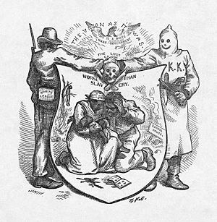
White Southern Resistance
White Supremacy Paramilitary Groups
  The South Will Rise Again!
  White League
  Ku Klux Klan (1867)
    Nathaniel Bedford Forrest
    “invisible empire”
  Enforcement Acts (1870, 1871)
“The Union as it Was”
Thomas Nast, Harper’s Weekly
October 1874

Slide 35
Panic of 1873
US economy goes into a severe recession (2 million unemployed of 36 million)
  Cause: Civil War currency & overextension of industry
    NO DIFFERENT THAN EVERY OTHER PANIC
People increasingly choose Democrats to try to fix the problems

Slide 36
Reconstruction Falls
Panic of 1873
Grant-ism
Waning Support in the North
Concern over Westward Expansion and Indian Wars
Election of 1876-Compromise of 1877
Impact of end of Reconstruction?
  Jim Crow Laws
    Upheld by Plessy v. Ferguson
  Disenfranchisement for blacks

Slide 37
Quick Recap
Manifest Destiny and its impacts
Mexican-American War and debates over slavery
Immigrants and nativism
Abolitionist tactics
Compromise of 1850, Kansas-Nebraska, and Dred Scott
Election of 1860 and Lincoln’s platform
Emancipation Proclamation and how it changed the war
EVERYTHING about the 13 - 15 amendments
End of Reconstruction and waning

