Slide 1
Discussion
What characteristics of British government are the newly independent Americans going to avoid? Why?
Can a nation be too democratic? (OPINION)

Slide 2
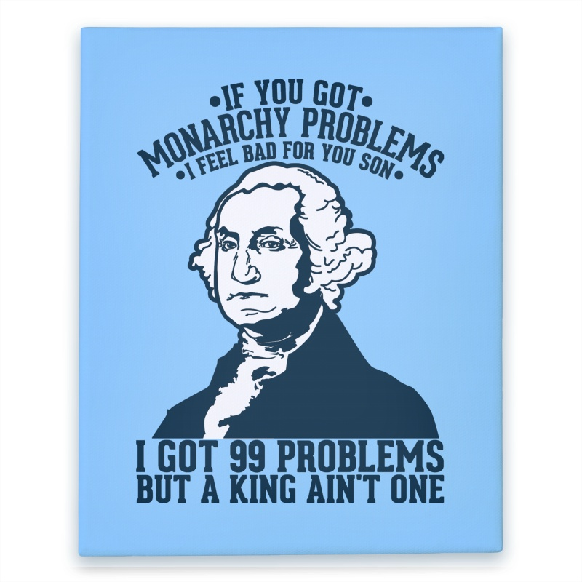

Slide 3
The Articles of Confederation
Mr. Winchell
APUSH Period 3

Slide 4
Essential question Writing Prompt
“Were the social, political, and economic problems of the post-Revolutionary War 1780s due to the national government’s failings or were they simply the result of the continuation of the colonial identity?”

Slide 5
The war is over, now what?
“Which one of us should be the rulers?”
-Philadelphia newspaper during the war

Slide 6
Articles of Confederation 1781-1789
Strengths
Weaknesses
Couldn’t draft soldiers
No power to enforce treaties
No power to collect taxes from the states
No Chief Executive
No national court system
No power to regulate interstate commerce
No national currency
Difficult to pass laws
(2/3 vote)
Declare War, Establish an Army and Navy
Make peace and sign treaties
Borrow Money
Organize a post office system
Notes:
Impossible to amend

Slide 7
Articles of Confederation
Outset of the war, 2nd Continental Congress urged states to create their own constitution.
“Oppose everything that leans to aristocracy or power in the hands of the rich”

Slide 8
Pennsylvania
Pennsylvania Constitution of 1776
Unicameral Legislature
One house with complete power.
No governor
Elementary education provided by state gov.
NO property requirement to serve
John Adams: “TOO MUCH DEMOCRACY!”

Slide 9
Thoughts on Government-Adams
In response to state governments, Adams publishes his thoughts in 1776:
3 branch government (what a concept…)
2 houses in the legislature
Judiciary appointed, not elected.

Slide 10
Thoughts on Gov -Adams Quote 1
“A single assembly is liable to all vices of an individual, subject to fits of humor, starts of passion…and all these errors ought to be corrected and defects supplied by some controlling power.”
What problem with representative government is Adams pointing out? Is his concern legitimate?

Slide 11
Thoughts on Gov -Adams
“A single assembly is apt to grow ambitious, and after a time will not hesitate to vote itself perpetual.”
What problem with representative government is Adams pointing out? Is his concern legitimate?

Slide 12
Thoughts on Gov -Adams
“A representative assembly, although extremely well qualified, and absolutely necessary, as a branch of the legislative, is unfit to exercise the executive power.
What problem with representative government is Adams pointing out? Is his concern legitimate?

Slide 13
PROBLEMS! New or OLD
If the problem is a NEW issue, move to the East side of the room (by the window for the directionally challenged…)
If the problem is an OLD issue, move to the West side of the room
If the problem is something in between, stand in the middle

Slide 14
SOCIAL
Individuals on the frontier and those with a lack of income are rebelling due to lack of political representation (Shays’ Rebellion)

Slide 15
ECONOMIC
The new United States has no means to pay off their war debt because the citizens are not taxed and the US has few manufactured goods to export.

Slide 16
Political
NOBODY IS IN CHARGE! There is no chief executive because the citizens are afraid of centralized power.

Slide 17
Essential question Writing Prompt
“Were the social and political problems of the post-Revolutionary War 1780s due to the Articles of Confederation’s failings or were they simply the result of the continuation of the colonial identity?”

Slide 18
One Success! NW Ordinances
1784:
Written by Jefferson
Established how the territory would become states as populations grew

Slide 19
One Success! NW Ordinances
1785:
Land Ordinance
Mandated a rectangular grid system and cost of land
Mandated half of each town to be sold in small blocks and half in large blocks that were most expensive.

Slide 20
One Success! NW Ordinances
Northwest Ordinance 1787
Created the territories of Ohio, Indiana, Illinois, Michigan, and Wisconsin
Prohibited slavery
Funded schools with land sales
Congress could appoint a governor and judges until there were 5,000 free adult men.
Citizens electing territorial legislature.
At pop. 60,000 citizens could apply to join the Confederation.

Slide 22
Significance: Allowed for orderly settlement of western territories.
Not colonies!
Pros: Outlawed Slavery, allowed for education, created systems for democracy.
Cons: Created a dividing line between slaves and non-slave states, invalidated Native American claims to the land.

