Slide 1
QUIZ TIME!
GO TO bit.ly/quiz223 for your reading quiz

Slide 2
Causes and Responses to the Great Depression
Mr. Winchell
APUSH Period 7

Slide 3
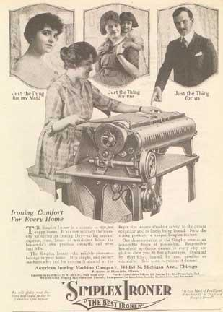
Fundamental Causes of the Depression
Drop in farm prices
Massively uneven distribution of income
“Get rich quick” schemes in real estate and stocks (buying on margin)
Overextension of credit
Increased inventories of goods
Failure of Germany to make war reparation payments to France and Britain. Britain and France then can’t repay debts to US.
Immediate cause: October 1929 stock market crash
Many consumers in the 1920s bought items such as this ironer on credit
Notes:
During the 1920s, few farmers shared in the prosperity that supposedly extended nationwide. This discrepancy in farm prices was a warning sign that the economy was in serious trouble.
Although many viewed the 1920s as an “era of prosperity,” the vast majority of people in America were middle class or poor. Since most of the real wealth in the country lay in the hands of only a few people, most citizens didn’t have the cash to purchase goods.
Many believed that speculation in real estate—and especially in stocks—would result in easy money. People also bought stock “on margin,” putting down 10 percent of the stock’s value and then owing the rest to a broker. If the stock continued to climb in value, the investor was safe. However, if the value of the stock declined the broker would make a “margin call,” demanding payment for the rest of the amount owed. If the investor couldn’t pay the other 90 percent, the broker would sell the stock, hoping to recoup his losses. As the market as a whole declined in value, this process became a vicious circle, further driving down stock prices.
Many consumers in the 1920s overextended themselves financially due to the easy availability of credit. New consumer goods such as washing machines, radios, automobiles, and refrigerators appealed to consumers, even though they might not have had the financial resources to buy them. The ability to pay in installments put these goods in the reach of more people. However, this also led to industries showing only “paper profits,” thereby further creating the illusion of prosperity.
As more people bought products with money they didn’t have, manufacturers continued to produce more and more goods. Soon the supply of goods far exceeded demand, and unsold items piled up in producers’ warehouses.
The October 1929 stock market crash signaled the start of the Depression. While the U.S. economy did not completely and immediately collapse, the crash marked the beginning of a major decline.

Slide 4
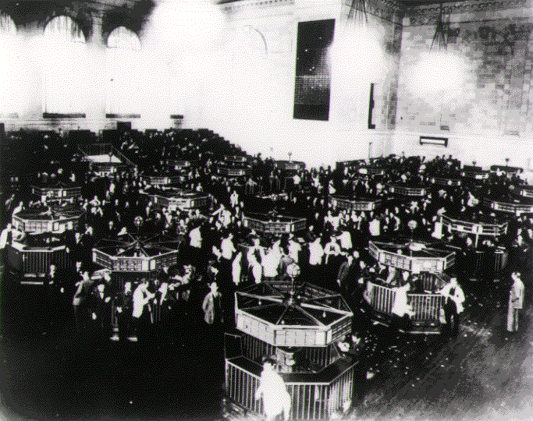
The Day the Bubble Burst
October 29, 1929
More than 16 million shares traded in one day
Stock market lost $30 billion
Beginning of the “Great Depression”
The trading floor of the New York Stock Exchange in 1929
Notes:
While the fundamental causes of the Depression took years to lead to financial calamity, many point to a single day when the Depression began: October 29, 1929, when the stock market crashed. On that day, more than 16 million shares were traded (a record at the time) and the market lost $30 billion—nearly the amount the U.S. had spent fighting World War I. While the market had rapidly increased in value from 1927–1929 (approximately 140 to 360 points), it fell nearly more than 100 points in the months after the crash. As the Depression worsened, the market hit a low of approximately 40 as the election of 1932 loomed, and did not approach the 100 mark again until after Franklin D. Roosevelt’s inauguration.
By the time Roosevelt took office, stocks had lost 80 percent of their total value. Confidence in the market declined sharply as former investors felt betrayed and unwilling to buy stock. Since they refused to purchase shares, much-needed investment and expansion did not occur, which further hampered economic recovery.

Slide 5
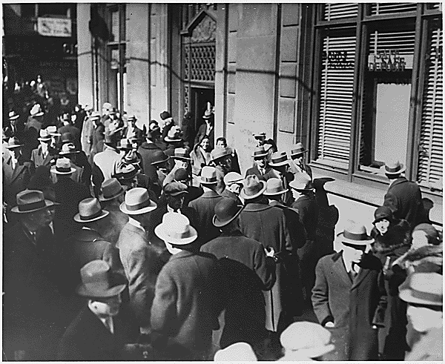
Banking System Collapse
Banks invested heavily in the market
Collapse of market led to bank failures
Many depositors panicked, leading to even more bank failures
Worried depositors wait outside a bank hoping to withdraw their savings
Notes:
While many investors lost their money in the market, many other people found their savings wiped out because banks had irresponsibly invested depositors’ money in the market as well. Therefore, when the crash occurred banks also lost millions.
Banking was already a risky business, with more than 600 banks failing every year from 1920–1929. Following the stock market crash, however, bank failures jumped dramatically. Between 1930 and 1933, nearly 10,000 banks failed nationwide, with 4000 failing in 1933 alone.
Unfortunately for these banks’ depositors, there was no national “safety net” to protect their money. While some states did have insurance programs for bank deposits, bank failures in the period before the crash had essentially wiped out those programs, leaving depositors completely unprotected.

Slide 6
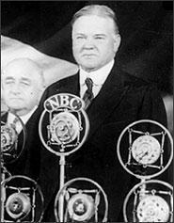
Hoover’s Response
President Hoover overwhelmed
Believed that private charity was best suited to solve problems
Most efforts failed
Reconstruction Finance Corporation achieved some success
President Herbert Hoover
Notes:
As the nation spiraled downward economically, President Herbert Hoover became increasingly frustrated in his efforts to stem the collapse. As a conservative Republican, Hoover was convinced that private charities such as churches and relief agencies were best suited to deal with the effects of the Depression. However, private agencies soon found themselves overwhelmed by the number of relief cases. Hoover was unable to find solutions to reduce unemployment, stop bank failures, eliminate foreclosures, or hasten economic recovery.
However, a few of Hoover’s programs did achieve some success. The Reconstruction Finance Corporation provided loans and grants to railroads, banks, and some other industries in an attempt to provide “trickle-down” relief by keeping those businesses solvent, thereby allowing these companies to keep more workers employed.
As a whole, Hoover’s program to end the Depression was grossly ineffective. Public opinion turned against him, and he was ridiculed and blamed for the Depression’s economic woes, and the Republicans lost control of Congress and the White House in 1932.

Slide 7
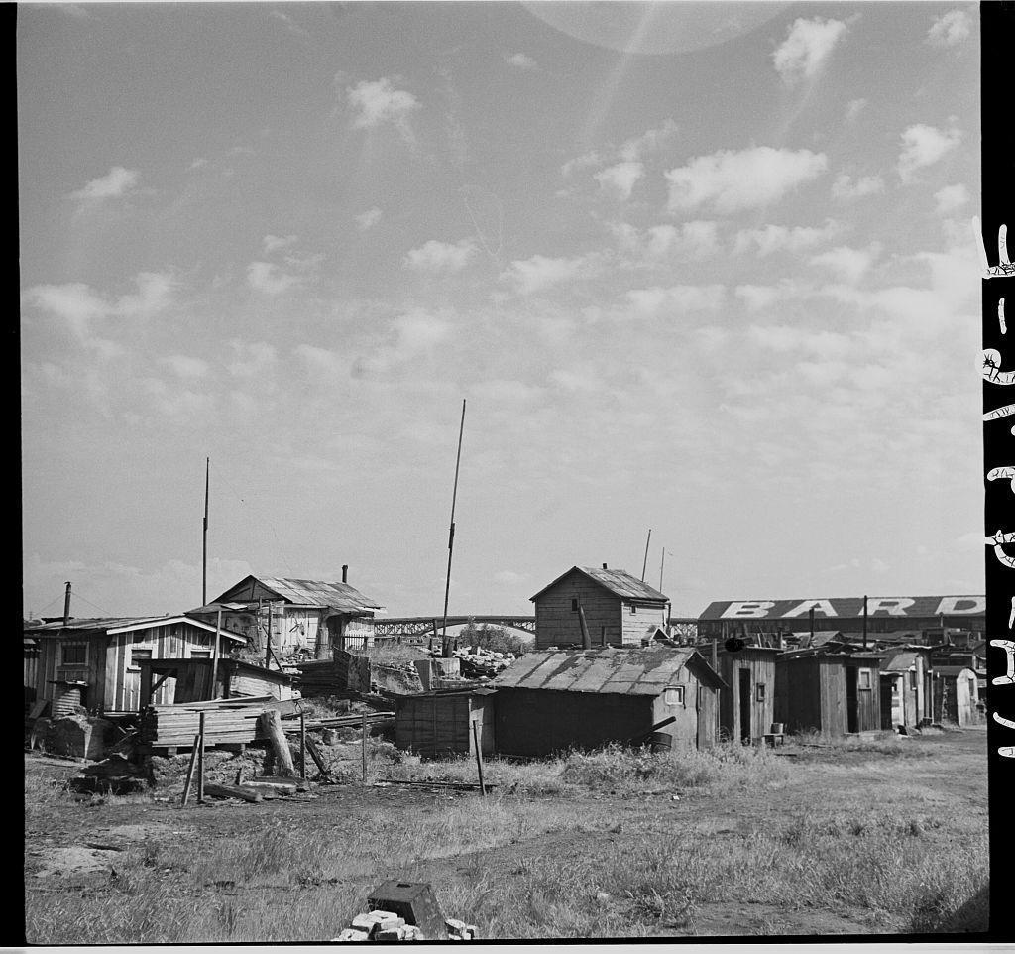
Hoovervilles
Settlements of shacks inhabited by transients and unemployed
Derisively named after President Hoover
Many cities and towns had at least one
Notes:
Nearly anything that was a sign of the Depression or its hardships was linked to the beleaguered Hoover. A “Hoover blanket” was an old newspaper that might be used to cover someone. A “Hoover flag” was a person’s turned-out empty pocket. A piece of cardboard used to cover the hole in a worn-out shoe sole was called “Hoover leather.” An automobile powered by horses because the owner couldn’t afford gasoline might be called a “Hoover wagon.”
Most notable, however, were “Hoovervilles.” Many cities and towns had at least one Hooverville, a settlement of shacks in which many transient and unemployed people lived. “Hoovervillas” might be made out of any sort of material: cardboard, wood scraps, piano boxes, or even stones.
The photo in this slide shows a Hooverville in Portland, Oregon, and was shot by Arthur Rothstein for the Farm Services Organization.

Slide 8
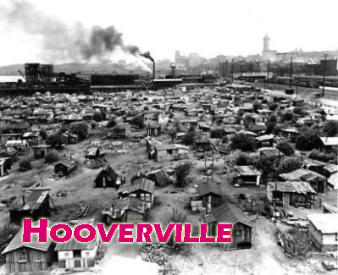

Slide 9
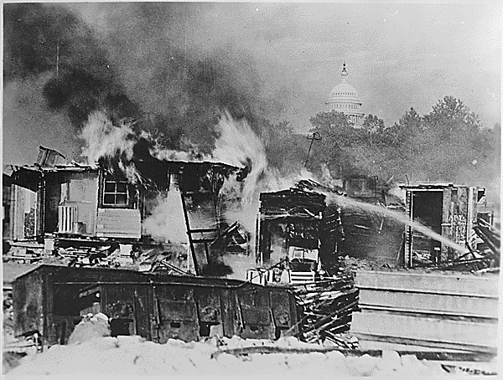
The Bonus Army
Patman Bill was to move up bonus payments from 1945 to 1933
Veterans camped near the Capitol to support the bill
Bill failed in Congress
Hoover’s removal of vets made Hoover appear heartless
With the U.S. capitol visible in the distance, shacks erected by the Bonus Expeditionary Force burn
Notes:
The U.S. government had promised World War I veterans a bonus, to be paid in 1945. Most veterans would have received a payment of approximately $500. However, when the Depression hit, Texas Representative John Wright Patman introduced a bill in Congress that would move the bonus payment up to 1933. In support of the Patman Bill, nearly 10,000 World War I veterans came to Washington D.C. Calling themselves the “Bonus Expeditionary Force,” they were led by a former Army sergeant, Walter W. Waters.
The Patman Bill passed in the House but failed in the Senate. Some marchers left and went home, while others remained in the Anacostia Flats camp near the U.S. capitol. President Herbert Hoover believed that the criminals and political radicals had infiltrated the remaining marchers, so he ordered Douglas MacArthur, the military commander of the District of Columbia, to remove them. MacArthur, along with his second in command Major Dwight D. Eisenhower, sent troops in to disperse the BEF. In the ensuing action, two veterans were shot and killed, tear gas asphyxiated two infants, several others were injured, and the Bonus Army camp burned down. Many people across the country saw Hoover as heartless and unsympathetic to the veterans’ plight because of the excessive force he used to remove the BEF. His actions contributed to his loss in the 1932 presidential election.

Slide 10
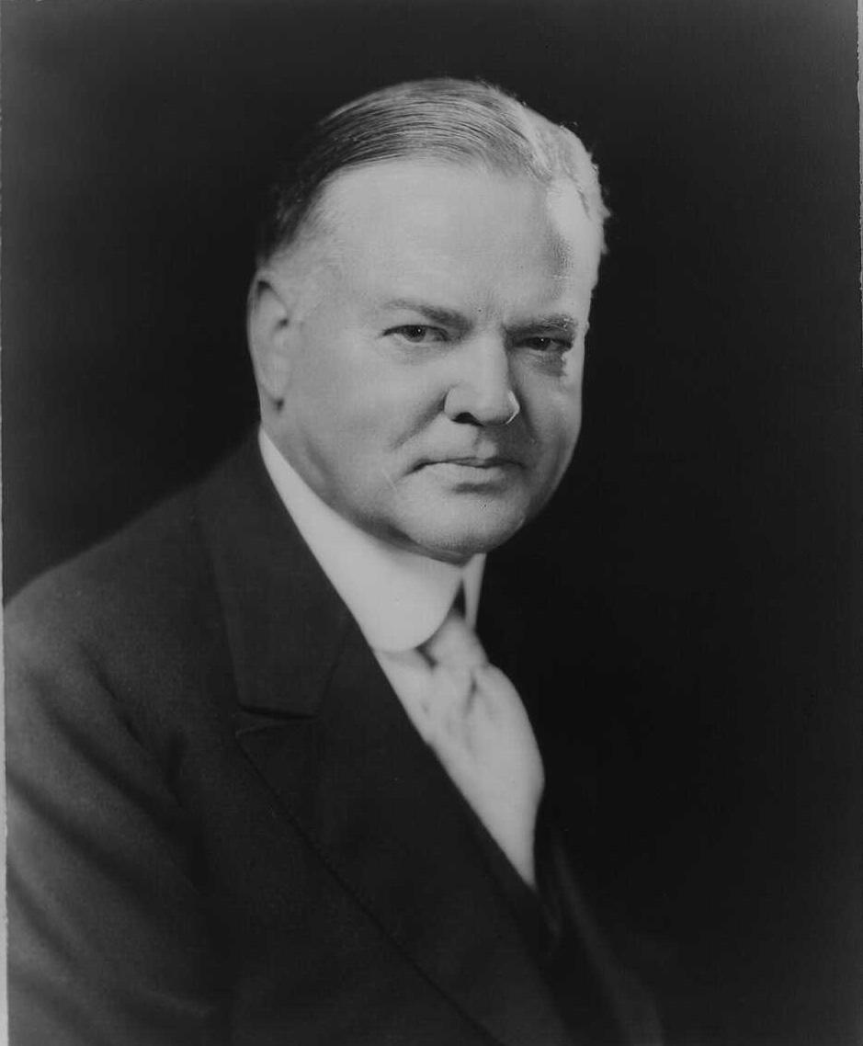
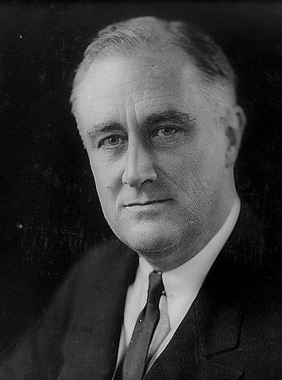
The Election of 1932
Republicans renominated Hoover
Democrats nominated Franklin D. Roosevelt
Hoover’s inability to solve the Depression became the chief issue
FDR won in a landslide
Hoover
Roosevelt
Notes:
The Republicans renominated Herbert Hoover for president in 1932. The Democrats nominated Franklin D. Roosevelt, the governor of New York, as their candidate. Hoover’s inability to effectively tackle the problems of the Depression became the chief issue. In the end, FDR defeated the Republican incumbent in a landslide. In electoral votes, FDR won easily, beating Hoover 472–59. He also garnered nearly 23 million popular votes to Hoover’s 16 million. Roosevelt carried 43 of 48 states and 57 percent of the popular vote. With the exception of parts of the Northeast, he carried every region of the country.

Slide 11
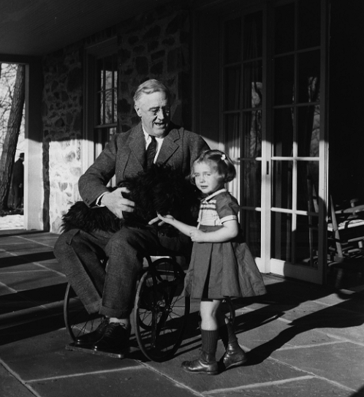
Franklin Delano Roosevelt
Born in 1882
Distant relative of Theodore Roosevelt
Married to Eleanor Roosevelt, TR’s niece
Political career mirrored TR’s
Lost 1920 election for vice president
Paralyzed in 1921
One of only three photos of FDR in a wheelchair, taken in 1941
Notes:
Franklin Delano Roosevelt was born in 1882 to well-to-do parents in Hyde Park, New York. Educated at Groton Preparatory School and Harvard College, he idolized his distant relative President Theodore Roosevelt, and sought to mirror his personality and political career after his more-famous relative. He took to wearing similar eyeglasses and would frequently pepper his sentences with Theodore’s familiar exclamation, “Bully!” In addition, FDR held many of the same offices Theodore did, including New York State assemblyman, undersecretary of the Navy, and governor of New York.
In 1905, FDR married Theodore Roosevelt’s niece, Eleanor, in a White House ceremony. Their relationship eventually deteriorated because of FDR’s affair with Eleanor’s social secretary Lucy Mercer; however, the Roosevelts remained married in order to maintain FDR’s political career.
In 1920, again following his cousin Theodore, FDR was nominated as vice president on the Democratic ticket. He and his presidential running mate, James Cox, were defeated by the Republican ticket of Harding and Coolidge.
The next year, doctors diagnosed FDR with what was then called “infantile paralysis,” or polio. (Experts have since reassessed FDR’s condition as Guillain-Barré syndrome, which has many of the same symptoms.) The disease left him unable to walk and confined him to a wheelchair for the rest of his life. While many believed that his illness signaled the end of his political career, FDR hid the extent of his condition so well that many did not realize he was unable to walk, and he won the office of New York governor, and later, four consecutive terms as President of the United States during the Depression and World War II. Physically exhausted by nearly 13 stressful years in the White House, FDR died of a cerebral hemorrhage in April 1945, just slightly more than two weeks before the end of World War II in Europe.

Slide 12
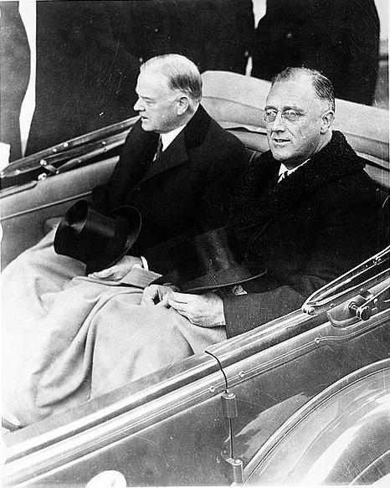
FDR’s First Inaugural Address
Attempted to restore confidence in the American people
“The only thing we have to fear is fear itself.”
Asked for broad executive powers to combat the Depression
FDR and Herbert Hoover on the way to the inauguration
Notes:
By March 1933, the nation’s confidence was at a low. Most people desperately needed some relief from hunger, unemployment, and bank failures. FDR recognized this lack of confidence and sought to restore America’s resolve with his 1933 Inaugural Address. The speech offered such pronouncements as, “The only thing we have to fear is fear itself,” and “This great nation will endure as it has endured, will revive, and will prosper.” Meanwhile, FDR did not minimize the effort it would take to solve the problems that the economic collapse had caused. He stated that in order to remedy the Depression, he would need to ask Congress for “broad executive power, as great as the power that would be given to me if we were in fact invaded by a foreign foe.”
The photo in this slide shows Hoover and FDR traveling from the White House to the U.S. Capitol for the inaugural ceremonies on March 4, 1933. Many accounts note that Hoover still appeared bitter about his loss to FDR in the November 1932 election.

Slide 13
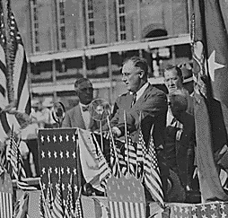
The “New Deal”
Named after a phrase in FDR’s 1932 nomination speech
Became the nickname for FDR’s economic program
Consisted of three separate aspects:
Relief
Recovery
Reform
FDR campaigning in 1932
Notes:
In his speech accepting the 1932 Democratic nomination, Franklin D. Roosevelt announced, “I pledge you, I pledge myself to a ‘new deal’ for the American people.” The words “new deal” soon became the label for Roosevelt’s plan to solve the crises of the Depression. The New Deal had three separate purposes:
Relief: attempting to solve the immediate problems of the Depression. In Roosevelt’s view, the most pressing problem was to find jobs for the large number of unemployed, as well as to curb the number of bank failures. Programs such as the Public Works Administration, the Civilian Conservation Corps, and the Works Progress Administration provided work for millions, while the Emergency Banking Relief Act called for a four-day “bank holiday” to inspect the condition of banks and allow only those banks that could demonstrate solvency to reopen.
Recovery: taking steps to get the economy back to pre-crash levels. The National Industrial Recovery Act formed the centerpiece of the New Deal recovery program.
Reform: ensuring that the conditions that led to the Depression never reoccurred. Regulatory agencies such as the Securities and Exchange Commission, as well as programs such as the Social Security Act, safeguarded the economy from future catastrophes.
In many instances, the programs overlapped in purpose, with some designed both for relief and recovery. Other New Deal programs, such as Social Security and the Tennessee Valley Authority, became permanent parts of the national landscape.

Slide 14
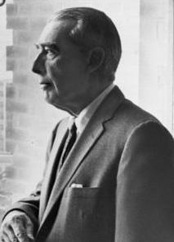
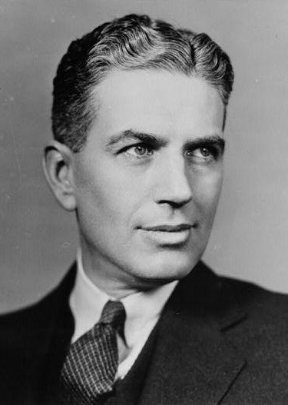
The “Brain Trust”
Group of advisers who assisted FDR in making early economic policy
Members included Profs. Moley, Tugwell, and Berle
Members had varying opinions about jumpstarting the economy
Eventually disbanded to make way for other experts
Adolph Berle
Rexford Tugwell
Notes:
As FDR began to plan the New Deal, he also recognized that he needed the help of experts who could assist in the development of policy to combat the Depression. The group of experts FDR gathered was soon nicknamed the “Brains Trust” (later the “Brain Trust”). Foremost, members of the Brain Trust were three professors from Columbia University: Raymond Moley, Rexford Guy Tugwell, and Adolph Berle, Jr. As the Brain Trust began its work, other members joined, including Hugh Johnson, who later became the head of the National Recovery Administration.
While the Brain Trust had internal debates about what role the federal government should take in regard to economic control, they were instrumental in assisting development of various bills that Congress passed in Roosevelt’s First Hundred Days. Once the focus of the New Deal swung more toward reform, the Brain Trust disbanded in order to make room for other experts to draft follow-up legislation.

Slide 15
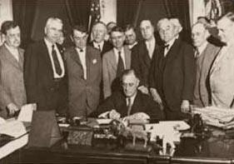
The First Hundred Days
Three-month period after inauguration
Flurry of legislative activity
“Honeymoon” period between FDR and Congress
Saw most of New Deal’s relief/reform program established, including:
Agricultural Adjustment Act
Tennessee Valley Authority
Glass-Steagall Banking Act
FDR signing the TVA into law
Notes:
Almost immediately after his swearing-in, FDR began to send his legislative package to Congress, starting with the Emergency Banking Relief Act, which initiated the bank holiday. He originally planned to allow Congress to adjourn after passing the act, but when Congress passed it quickly, he decided to keep Congress in session and introduce several other pieces of New Deal legislation.
First, FDR introduced the Agricultural Adjustment Act of 1933. Soon after, Congress passed more than 15 major pieces of legislation, including bills to create the Civilian Conservation Corps, the Tennessee Valley Authority, and the Glass-Steagall Banking Act, which created the Federal Deposit Insurance Corporation.

Slide 16
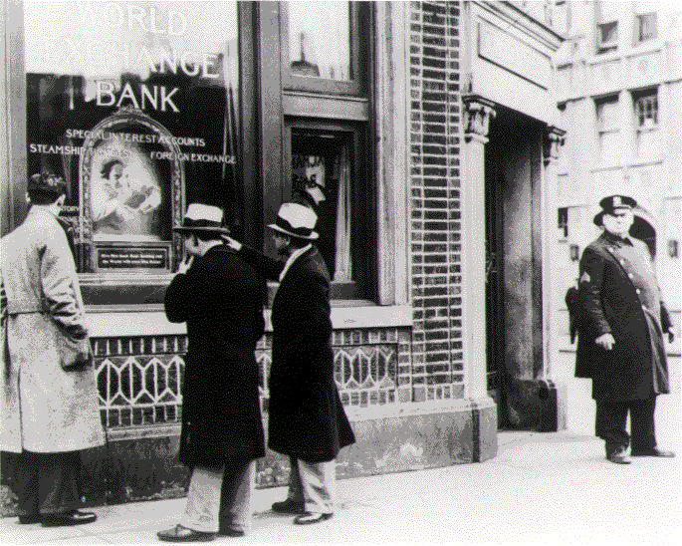
Solving the Banking Crisis
1930–1933: Nearly 10,000 banks closed
Michigan governor ordered banking “moratorium” in state
FDR changed wording to bank “holiday”
Banks closed for four days for inspection
Glass-Steagall Act created FDIC
A policeman stands guard outside a closed New York bank
Notes:
By 1933, the nation’s banking system was in a serious crisis. Between 1930 and 1933, more than 10,000 banks nationwide had failed, with more than 4000 closing in 1933 alone. To stop the continued bank closings in his state, Michigan Governor William Comstock ordered a “banking moratorium” and shut down all banks for a seven-day period in February 1933. However, this did not seem to stop the increased number of bank closings. When FDR took office a few weeks later, he decided to expand the bank moratorium nationally for a four-day period. FDR decided to change the name of the bank closings from “moratorium” to “bank holiday” in order to make it more acceptable to the American public.
During the four days of the bank holiday, all banks across the nation closed. Federal inspectors reviewed each bank’s assets, and if the bank was considered healthy enough, it was allowed to reopen. If not, the inspectors kept the bank closed until a solution to make the bank solvent again could be found.
In the long term, Congress passed the Glass-Steagall Banking Act, which created the Federal Depositors Insurance Corporation (FDIC). The FDIC was designed to make the federal government the insurer of individual bank deposits, thereby safeguarding private accounts from bank failures.

Slide 17
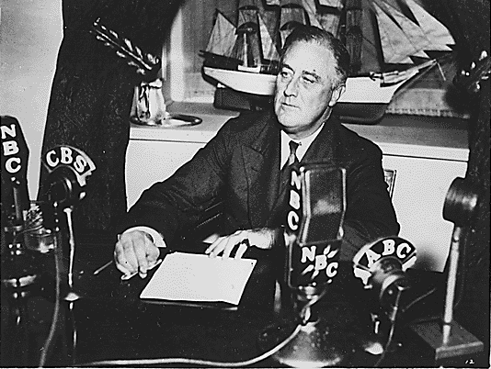
Fireside Chats
Radio “talks”
FDR spoke plainly with audience about issues and concerns
Usually conducted in an informal manner
FDR gave 30 chats while in office
FDR addresses the nation during a 1935 fireside chat
Notes:
Many view FDR as a master at informing the American people about his programs and gaining support for his New Deal legislation. Using a tactic from his years as New York governor, Roosevelt held regular “fireside chats” in which he discussed issues and concerns with the public via the relatively new medium of radio. FDR held 30 such chats during his term, discussing subjects ranging from solutions for the banking crisis to war policy.
Roosevelt tended to use down-to-earth, easily understandable language in his chats, frequently calling his listeners “my friends” rather than using more formal language. Many radio listeners felt that FDR was specifically speaking to them, and the chats did much to allay fears and restore confidence, as well as to gain support for New Deal programs.

Slide 18
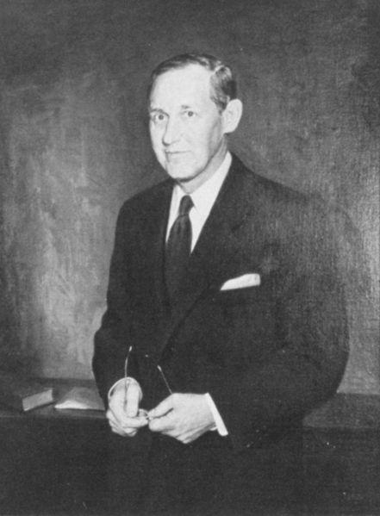
“Pump Priming” and the Dole
Federal Emergency Relief Act passed in 1933
FERA pumped money into the economy for job programs
Also provided relief for the unemployed THROUGH JOBS
Spent billions on public works through Civil Works Administration and Emergency Work Relief programs
Harry Hopkins
Notes:
While Roosevelt grappled with the problems of banking, he also recognized the need to provide relief programs administered by state and local governments. In order to provide funding for relief, the Roosevelt guided the Federal Emergency Relief Act through Congress, and created the Federal Emergency Relief Administration to handle the enormous task of doling out funds.
Harry Hopkins, a nationally known social worker and close advisor to FDR, headed the program. FDR directed FERA to focus on three primary objectives: first, to maintain the “adequacy” of relief efforts; second, to provide work for employable people on the relief rolls; and third, to ensure the diversity of relief programs.
One of the FERA’s hallmark programs was the Civil Works Administration (CWA). The CWA was designed as a short-term program for getting people to work. Within a few months, the CWA had cost the government more than $1 billion, and was replaced by the less costly Emergency Work Relief program.
While Hopkins was concerned about the welfare of people, he also believed that relief was better applied by giving people jobs rather than giving them handouts. In this way, he thought people needing help could keep their dignity and self-respect, rather than be forced to accept charity.

Slide 19
Discussion Questions
Why do you think Hoover had such a difficult time winning the reelection in 1932? If you had been one of his campaign advisors, what strategy would you have suggested?
Do you think that federal spending specifically to create jobs for Depression victims was a good idea, or would it have been better to ask the states and private charities to take a larger role in the relief efforts? Why?
Notes:
It would likely have been an insurmountable task for any president with the amount of “baggage” that Hoover had to overcome the odds and win a second term. However, some students may note that if Hoover had reversed his earlier “pull yourself up by your own bootstraps” philosophy and had pumped a large amount of federal money into the economy to help support it, he could have stood a better chance for reelection.
Hoover indeed did try to put most of the burden of Depression relief on the states and private charities, so most students will probably say that this strategy failed outright. Based on their knowledge of FDR’s policies and the New Deal, most students will likely say that only direct federal intervention could effectively have addressed the problems of the Depression.

Slide 20
Discussion Questions (cont.)
Should the banks and bankers who speculated with depositors’ money have been penalized for their roles in the large number of bank failures between 1930 and 1933? What kinds of punishments would you have recommended?
How do you believe the average American reacted to FDR’s fireside chats? Had it existed then, would Roosevelt have been as effective a communicator on television as he was on radio? Why?
Notes:
Some students may note that since a large number of bank officers had also lost much of their own money when their banks failed, it would have been difficult for the government to hold them financially liable for depositors’ losses. Other students may point out that since the questionable policies that bank officers followed were not illegal at the time, they therefore should not have been prosecuted criminally. However, other students may say that bank officers should have been held financially liable for their depositors’ losses, and should have been required to repay at least some of the losses.
Based on the number of chats and the duration of them throughout FDR’s term, most students would state that the chats were very effective in explaining policy to the wisest possible audience. Moreover, based on their reading or viewing of other resources, they may note that the public had a highly favorable opinion of the chats. Whether FDR would have been as effective coming across on television is debatable: though he had no TV experience, most would say he was personable, direct, or confident enough to come across well. On the other hand, millions of Americans would have been more aware of FDR’s handicap in a television age. Roosevelt took great pains to hide his inability to walk, and he did not want the American people to be constantly reminded of his illness for fear that it would imply weakness in his policies as well.

Slide 21
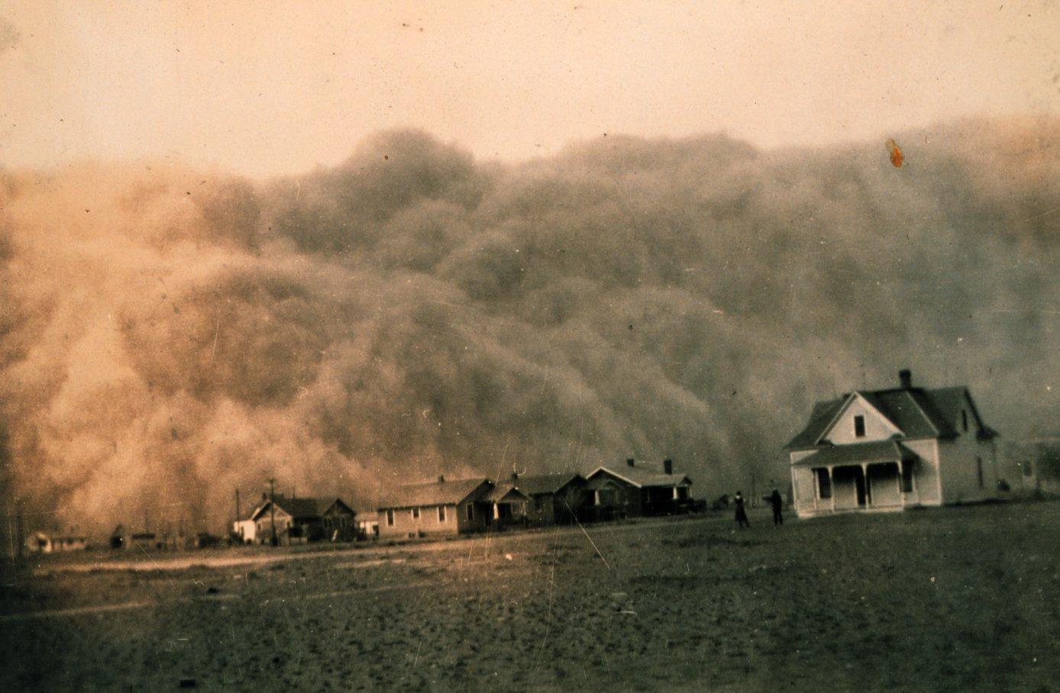
The Dust Bowl: Causes
Overcultivation of land in the Great Plains
Sustained drought throughout region
High winds blew away loose topsoil
A dust cloud approaches the town of Stratford, Texas, in 1935
Notes:
The Dust Bowl had three distinct causes:
Great Plains farmers, in an attempt to recoup losses from drastically declining farm prices, decided to plow more land in order to grow more crops for sale. Unfortunately, they didn’t understand the effect that increased supply and low demand would have on farm prices, and the increased cultivation only served to deplete land that could have been used for other purposes.
A lengthy drought struck the Great Plains, and soil already loosened and broken up from plowing now became even more parched because the smaller soil particles dried out more quickly.
A lack of geographical features to slow down air currents meant that the winds of the Great Plains could easily carry off valuable topsoil. The high winds blew the soil into the upper atmosphere, causing it to be transported over a great distance: soil from the Great Plains was found as far away as New England.
Certainly the state most affected by the dust storms was Kansas, while parts of Colorado, New Mexico, Texas, and Oklahoma were also hit hard.

Slide 22
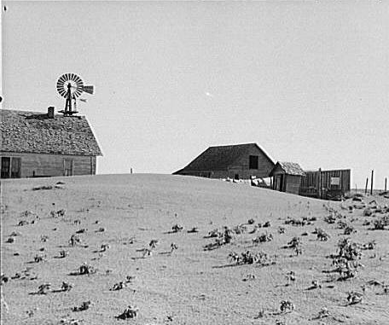
The Dust Bowl: Impact
More than 500,000 left homeless
Storms blew large amounts of dust from the Plains into cities such as Chicago and Buffalo
“Red snow” fell on towns in New England
Notes:
The impact of the Dust Bowl was substantial. Nearly a half-million people were displaced as a result of the catastrophe. Related storms moved large amounts of dust from the Great Plains to the eastern United States. Chicago experienced a greater deluge than any snowstorm, as more than four pounds of dust per person fell on the city in the summer of 1934. Red and black snow fell in New England, as dust mixed with normal precipitation during the winter of 1934–1935. In some instances, persons reported near-blackout conditions with visibility of less than five feet.

Slide 23
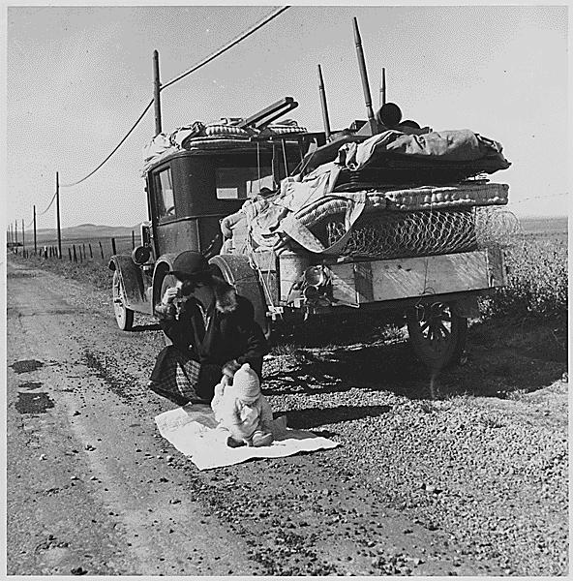
The Plight of the “Okies”
Farmers from Oklahoma fled the Dust Bowl
Went to California for farm jobs
Possibly 15 percent of Oklahoma’s population became migrants
A woman and her child rest beside their car during their trip west
Notes:
As the misery of the Dust Bowl intensified, many farmers in the worst-affected areas left, looking for a fresh start. Many packed everything they owned into cars or trucks and went west to California.
The “Okies,” as they were frequently called, moved en masse toward the West Coast. By some estimates, as much as 15 percent of the population of Oklahoma left in search of a better life.

Slide 24
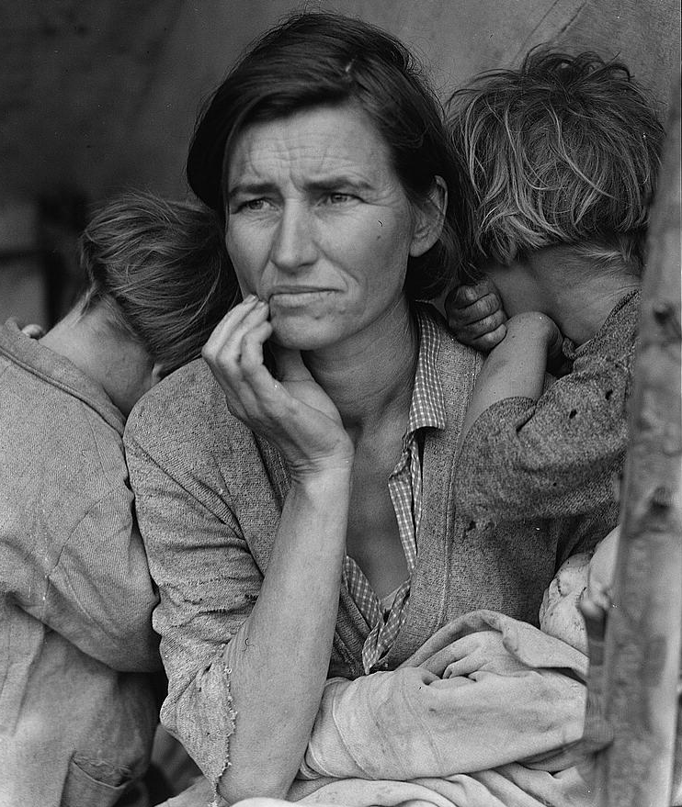
The “Migrant Mother”
One of the most famous New Deal–era photos
Shot for the Resettlement Administration by Dorothea Lange
Taken in California in February or March 1936
Notes:
The “Migrant Mother” is one of the best known of all pictures shot by New Deal agencies, and has come to symbolize the suffering of the Dust Bowl. This photo of a migrant woman with three of her seven children was shot by Dorothea Lange for the Resettlement Administration. Lange commented on the photo:
“I saw and approached the hungry and desperate mother, as if drawn by a magnet. I do not remember how I explained my presence or my camera to her, but I do remember she asked me no questions. I made five exposures, working closer and closer from the same direction. I did not ask her name or her history. She told me her age, that she was 32. She said that they had been living on frozen vegetables from the surrounding fields, and birds that the children killed. She had just sold the tires from her car to buy food. There she sat in that lean-to tent with her children huddled around her, and seemed to know that my pictures might help her, and so she helped me. There was a sort of equality about it” (Popular Photography, Feb. 1960).

Slide 25
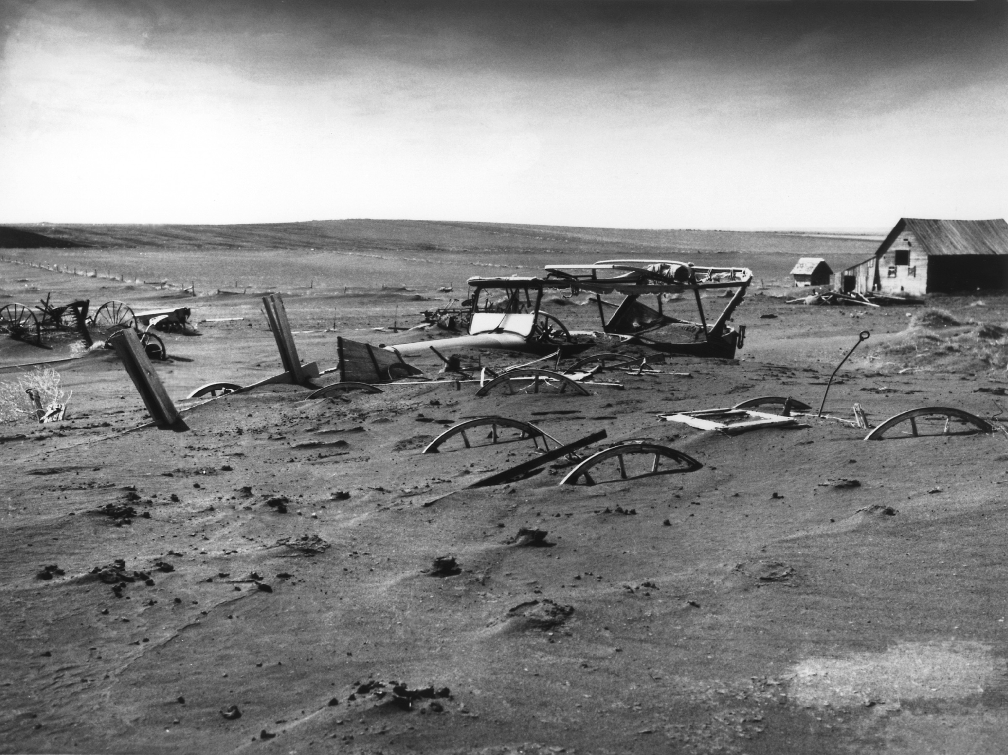
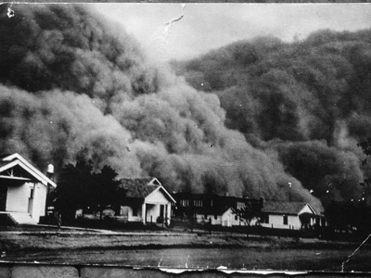
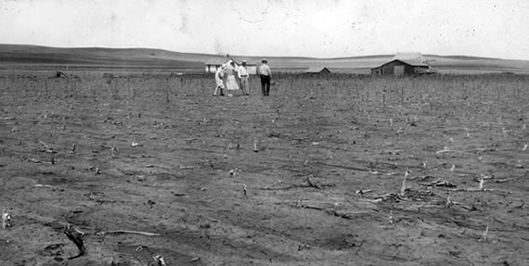

Slide 26
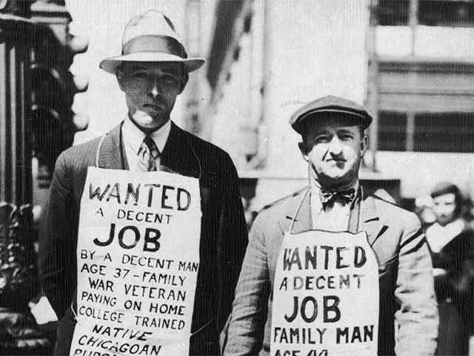
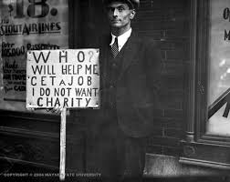
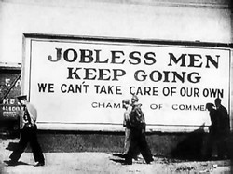

Slide 27
