Slide 1
The Civil War
1861-1865
AP US History
Mr. Winchell
College Board Period 5

Slide 2
DO NOW: Lincoln’s Inaugural Address
Brought to you by the one and only Jackie M
“In your hands, my dissatisfied fellow-countrymen, and not in mine, is the momentous issue of civil war. The government will not assail you. You can have no conflict without being yourselves the aggressors.”
Put this in your own words

Slide 3
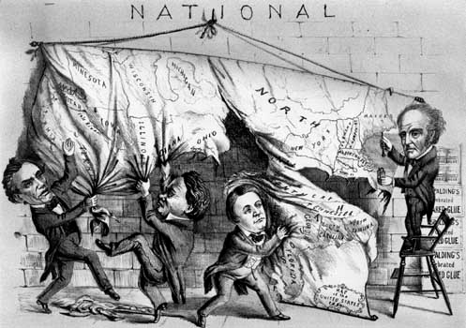

Slide 4
Secession of the Lower South
Upon Lincoln’s election, 7 states of the Deep South seceded.
They set up their government in Montgomery, Alabama and elected Jefferson Davis as president.

Slide 5
Fort Sumter
Fort Sumter was in the harbor of Charleston, South Carolina, in Confederate territory, despite being a federal military fort.
The Confederates controlled the harbor the fort was located in.
Lincoln didn’t want to seem like the aggressor in the war, so he announced that he was sending food to the small fort.
This gave South Carolina the choice of permitting the fort to hold or opening fire from shore.

Slide 6
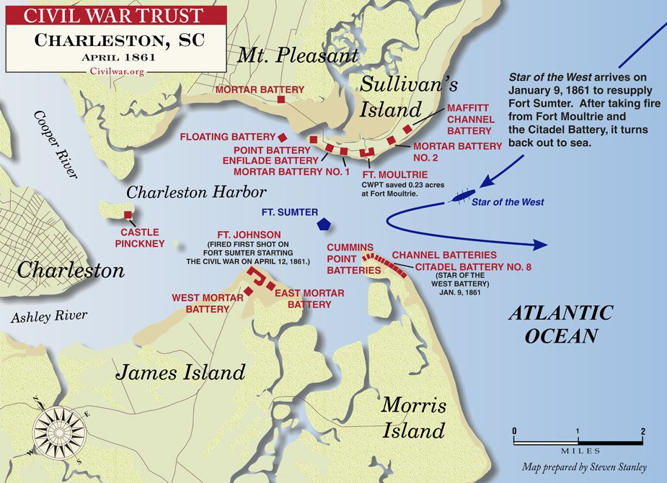

Slide 7
Lincoln’s Use of Executive Power
Right after Fort Sumter, Lincoln called for 75,000 volunteers for the Army to put down the ‘insurrection’ in the Confederacy.
He authorized spending for a war
He suspended the privilege of the writ of habeas corpus.
He did all this without Congress’ approval, saying he had to take extreme measures as ‘indispensible to the public safety.’

Slide 8
Secession of the Upper South
Once it became clear that Lincoln would use troops in the crisis, four states of the Upper South (Virginia, North Carolina, Tennessee, and Arkansas) also seceded and joined the Confederacy.
The Confederates then moved their capitol to Richmond, Virginia to be closer to the action.

Slide 9
Border States in the Union
4 slaveholding states chose to NOT secede (Delaware, Maryland, Missouri, and Kentucky).
This was partly due to military force (martial law in Maryland and US forces other areas) and political strategy.
Keeping these border states in the Union was a primary military and political goal of Lincoln’s.
Losing them would have increased the Confederate population by more than 50% and would have severly limited the North’s strategic positions for conducing war (and lost Washington, D.C.).
This kept Lincoln from freeing the slaves for some time.

Slide 10
Wartime Advantages: Military
Confederacy:
  Defensive War
  Long coastline
  EXPERIENCED MILITARY LEADERSHIP
  High troop morale
    *Fighting an idealistic war (Like the Revolution)
Union:
  22 million people compared to 5.5 million free white people
  US Navy

Slide 11
Wartime Advantages: Economic
Confederates:
  European demand for cotton
Union:
  Most of the banking and capital of the country
  More than 85% of the factories
  More than 70% of the railroads
  65% of the farmland

Slide 12
Wartime Advantages: Political
Confederate:
  Fighting for independence
  Fighting for states’ rights
    Ironic…
Union:
  Well-established central government
  Political parties with well-established representatives
  A popularly elected president.
Notes:
This is ironic, because the Confederacy realized that in order to win the war, they’d need a strong central government and strong public support. They had neither.

Slide 13
1st Bull Run
People on both sides expected the war to be quick and easy.
1st Bull Run: The Union was close to victory until Confederate reinforcements arrived with famous General Stonewall Jackson. The Union troops panicked, scurrying back to Washington, D.C.
Civilian onlookers came out to watch with picnic baskets to watch and had to hurry back to safety with the troops.

Slide 14
Union Strategy
Once it was apparent that the war wouldn’t be quick and easy, General-in-Chief Winfield Scott devised a 3 part strategy.
  Use the US Navy to blockade Southern ports, cutting off essential supplies from reaching the Confederacy (and Southern cotton from leaving), called the Anaconda Plan.
  Take control of the Mississippi River, dividing the Confederacy in two.
  Raise and train an army of 500,000

Slide 15
2nd Bull Run
After some skirmishes in Virginia, General Robert E. Lee (commander of the Confederate troops) tried to seize momentum to turn public opinion against Lincoln.
He destroyed Union troops in Northern Virginia again at Bull Run and moved his troops into enemy territory in Maryland.

Slide 16
Antietam
Lee hoped a major Confederate victory in a Union state would convince Britain to give official recognition and support the Confederacy.
Unfortunately for him, one of his officers had left the battle plans behind. They were found by a Union general.
The Union army surprised the invading Confederate Army at Antietam Creek.
The bloodiest single day of combat in American history commenced. More than 22,000 soldiers were killed or wounded.

Slide 17
Antietam
Unable to break through Union lines, Lee’s army retreated to Virginia.
While it was a draw (tie) on the battlefield, it was a significant political victory for the Union.
  This kept England from interfering on behalf of the Confederacy.
  This encouraged Lincoln that the war could be won, and he issued the Emancipation Proclamation.

Slide 18
Emancipation Proclamation
After the battle of Antietam, on September 22, 1862, Lincoln issued a warning that enslaved people in all states STILL IN REBELLION on January 1, 1863 would be ‘forever free.’
This immediately freed only 1% of slaves, since it only freed slaves in states that were in rebellion, and the owners didn’t follow Lincoln’s directions.

Slide 19
Emancipation Proclamation
The act did strengthen the North cause in other ways.
  It allowed the Union to use escaped slaves as troops.
  It allowed advancing Union armies to physically free the slaves.
  It encourages slaves to escape towards Union armies.
  It forced the South to use valuable bodies to protect slaves, rather than fight the war.

Slide 20
Turning Points: Vicksburg
By Spring of 1863, Union forces controlled most of the Mississippi, as well as the port of New Orleans.
The city of Vicksburg, Mississippi was the last remaining puzzle piece for control of the whole Mississippi.
General Ulysses S. Grant began a siege of the city, bombarding it for 7 weeks with artillery before the Confederates finally surrendered the city on July 4.
Federal warships now controlled the Mississippi River, cutting off Texas, Louisiana, and Arkansas from the rest of the Confederacy.

Slide 21
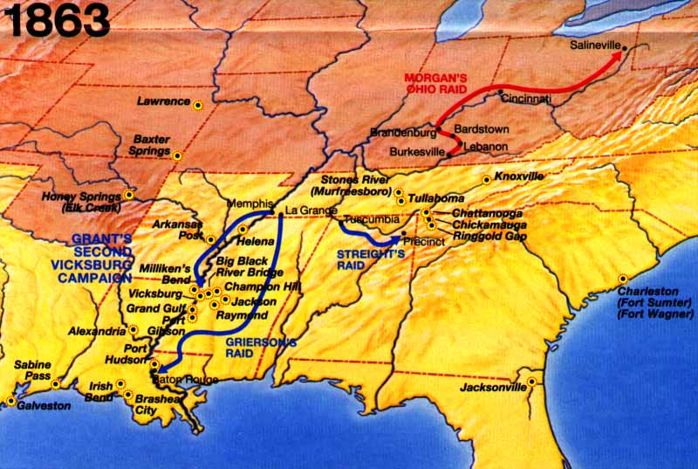

Slide 22
Gettysburg
In the East, Lee again took the offensive by leading an army into enemy territory: Maryland (again) and Pennsylvania.
His goals were to either destroy the Union army or capture a major Northern city.
Lee hoped to force the Union to call for peace or gain foreign intervention.
On July 1, 1863, the invading Confederate army surprised Union units at Gettysburg in southern Pennsylvania.

Slide 23
Gettysburg
Most crucial battle of the war.
Bloodiest battle of the war.
  Over 50,000 casualties.
Lee’s assult on Union lines on the second and third days, including a famous but unsuccessful charge led by George Pickett, proved futile, and destroyed a key part of the Confederate army.
What was left of Lee’s once dominant forces retreated to Virginia, and never again went on the offensive.

Slide 24
Sherman’s March to the Sea
While Grant’s forces in Virginia gradually eroded the Confederate Army, eventually confining them to Richmond, General Sherman went on the aggressive in the Deep South.
Sherman led a force of 100,000 men from Chattanooga, Tennessee on a campaign of deliberate destruction all the way across Georgia and north into South Carolina.
Sherman utilized ‘total war’ tactics, burning cotton fields, barns, houses—everything the enemy might need to survive.
He marched into Savannah in December and completed his campaign in February 1865 by setting fire to Columbia, the capital of South Carolina and cradle of secession.
His march had the intended effect, helping to break the spirit of the Confederacy and destroying its will to fight on.

Slide 25
Surrender at Appomattox
The Confederate government tried to negotiate for peace, but Lincoln would accept nothing short of restoration of the Union, while Jefferson Davis still demanded independence.
General Lee and his army tried escaping from Richmond, but were caught at Appomattox Courthouse on April 9, 1865.
General Grant of the Union took the surrender and treated his old friend Lee with respect, allowing him to and his troops to return home without arrest.

Slide 26
Effects of the War: Political
Secession of the Southern states had created Republican majorities in both houses of Congress.
  Within those ranks were sharp differences.
    Radical: Those who pushed for immediate abolition of slavery
    Moderate: Free-Soilers who were more concerned with economic opportunities for whites

Slide 27
Effects of the War: Civil Liberties
Lincoln focused more on conducting the war than on protecting citizens’ constitutional rights.
  Lincoln had suspended the writ of habeas corpus in Maryland and other border states.
    During the war, 13,000 people were arrested on suspicion of aiding the enemy and held without trial.
Democrats charged that Lincoln had acted as a tyrant, but historians have been far less critical.

Slide 28
Effects of the War: The Draft
When the war began in 1861, the soldiers were volunteers.
The Union’s first Conscription Act (draft) made all men between the ages of 20-45 liable for military service but allowed a draftee to avoid service by either finding a substitute to serve or paying a $300 exemption fee.
In July 1863, riots against the draft erupted in NYC, in which a mostly Irish American mob attacked blacks and wealthy whites. 117 people were killed.

Slide 29
End of Slavery (and the lecture)
Short term and long term, the group whose lives were most profoundly changed by the Civil War were the African Americans who had been born into slavery.
In 1865, 4 million people were freed.
For these individuals and their descendents, the struggle was far from over, but the end of slavery represented a huge step.
While 4 years of total war cost 750,000 lives and an estimated $15 billion in war costs and property losses, far greater changes were set in motion at the conclusion of the war.

