Slide 1
Colonies to Empire: The British Atlantic World
Mr. Winchell
APUSH
Period 2 Day 3

Slide 2
Do Now
Presented by:
What is mercantilism and how did it impact the British Empire?
Why did slavery develop at a greater rate in the Southern colonies than anywhere else in America?

Slide 3
Questions to Consider…
Economy: Work, Exchange, and Technology: How did patterns of exchange shape the societies that emerged in North American between 1607 and 1754?
Peopling: What factors shaped the institution of slavery in the British North American colonies?
Identity: In what ways did African Americans resist slavery?

Slide 4
Colonies in 1660
Pre 1660: Mostly isolated in New England and the Chesapeake.
1660-1750: Colonization takes over the whole Eastern Seaboard of the United States.
Slavery expands significantly
Mercantilism and the Triangle Trade alter the economy approach of both sides of the Atlantic.

Slide 5
Southern Colonial Characteristics
Carolina (1669): Built on European tradition
-Raised cattle, corn, hogs, tobacco on small farms.
-Exported products to the West Indies
-Around 1700, rice production took off, greatly increasing the need for labor.
-By 1740, slaves made up 2/3 of population

Slide 6
Southern Colonies Environment & Culture
ENVIRONMENT
Atlantic and Gulf Coastal Plains.
Long growing season and fertile land.
Warm for most of the year
PRODUCTS
Farmed Tobacco, Rice, Indigo, and Cotton.
Trade “cash crops” farmed on Plantations.
Purchase manufactured goods.

Slide 7
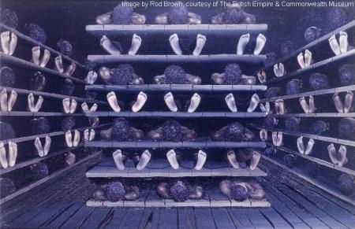
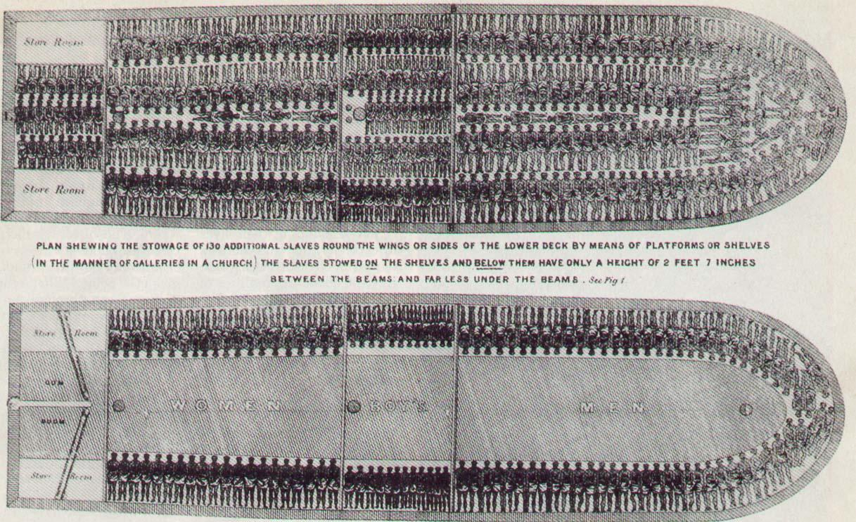
Economic Factors of Slavery
Cash Crops
Tobacco
Rice
Indigo
Slave Trade
Mercantilism
Royal African Company
Triangular Trade
“middle passage”
Plantation System
Volume
Transportation costs
headright system vs. slavery

Slide 8
Geographic Factors of Slavery
Topography
Fertile Soil
Broad Rivers
Climate
Warm, humid
Disease Resistance
Smallpox/malaria
Proximity to Caribbean
West Indies Slave Trade

Slide 9
Social Factors of Slavery
Labor Issues
Bacon’s Rebellion
Population Growth
Demand
Socio-Economic Structure of South
Prestige of planters
Prevailing Racism
slave codes

Slide 10
Nature of Slavery
New England & Middle Colonies
Small Farms
More Housework
domestics
Trade Skills & Artisans
Blacksmiths
Free Blacks
Similar work
Poorer conditions
Limited rights
Laborers, tradesmen, artisans

Slide 11
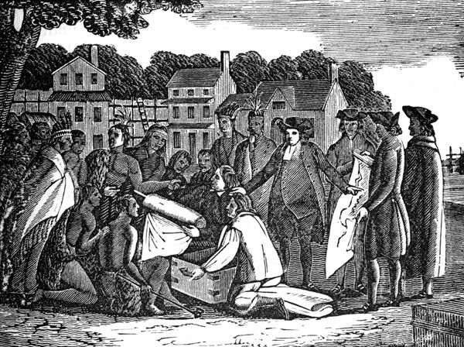
The Middle Colonies
New York
Hostile takeover from the Dutch (1664)
Charles II (Duke of York)
Economy: trade
Extremely diverse
Racially and religiously
New Jersey
Royal (1702)
Pennsylvania (1681)
William Penn & the Quakers
Anti-slavery
Pacifist
Delaware (1704)
Swedish
Captured by Dutch, surrendered to English
Given to Penn
*The most diverse region
Notes:
Depiction of Quaker relationship with Native Americans - peaceful

Slide 12
British Benefits of Expansion
Mercantilist policies extended and enforced in America.
Navigation Acts: Passed to control trade with the colonies.
Some colonists followed, some didn’t, but the passages helped build a colonial economy.

Slide 13
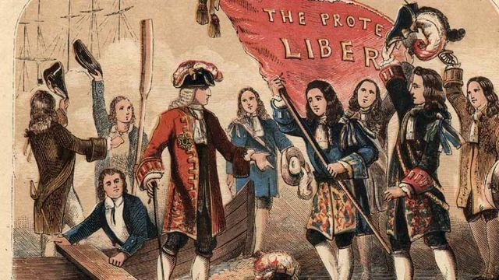
Seeds of Independence
New England Confederation (1643)
Mass Bay, Plymouth, New Haven, and Connecticut
Formed for defense and to solve intercolonial disputes
English Restoration
Charles II
Anti-Puritan
Grants charters to Conn. & R.I. (1662)
Revokes Mass Bay Charter (1684)
James II
Dominion of New England
Edmund Andros
Closed town meetings, restricted schools, the press, and the courts
Enforces British Policy
Navigation Laws**
Secure Colonial Defense
The Glorious Revolution
James II & Andros ousted
Massachusetts granted Royal charter (1691)
Royal governor
Crown appointed officials
Church membership stripped as qualification for voting
Increase in salutary neglect**

Slide 14
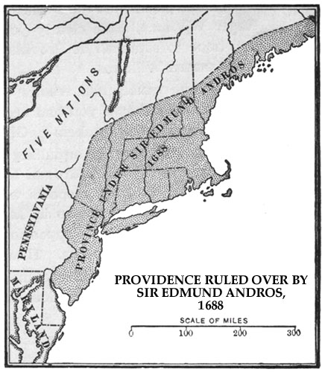
James II & the Dominion of New England
King James II consolidated all northern colonies into Dominion of New England
Viceroy = Edmund Andros
Forced rel. toleration
Stripped local governments of power
Required landowners to pay annual quitrent
James was openly Catholic, but daughters Mary & Anne were Protestant
King James II (1685-88)

Slide 15
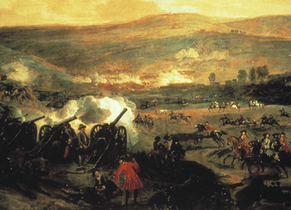
The Glorious Revolution (1688-89)
Parliament invited James’ daughter Mary & husband William of Orange to take throne in 1688
William defeated James at the Battle of the Boyne in Northern Ireland (July 1, 1690)
William & Mary accepted Bill of Rights
New colonial charters granted in 1691
Plymouth merged into Mass. Bay
William III & Mary II
The Battle of the Boyne

Slide 16
Social Contract Theory of Government
John Locke published Two Treatises on Government in 1690
Man originally in state of nature, with natural rights
Life
Liberty
Property
Government = contract between people to protect rights
If gov. doesn’t protect rights, people have right of revolution
John Locke

