Slide 1
Compromise and the Road to Secession
Mr. Winchell
APUSH
Period 5-Civil War and Reconstruction

Slide 2
Do NOW!
Identify 3 significant differences between the North and the South.
Explain how 1 of those differences helped lead to the conflict between North and South.
What was decided in the Missouri Compromise?

Slide 3
Rewind!
Missouri Compromise
Missouri as a Slaveholding state.
Maine as a free state.
No slavery will be allowed North of the 36’30 line.
Mexican American War
Mexican Cession gave American new land.
The question of slavery that had been quieted by the Missouri Compromise arose again.

Slide 4
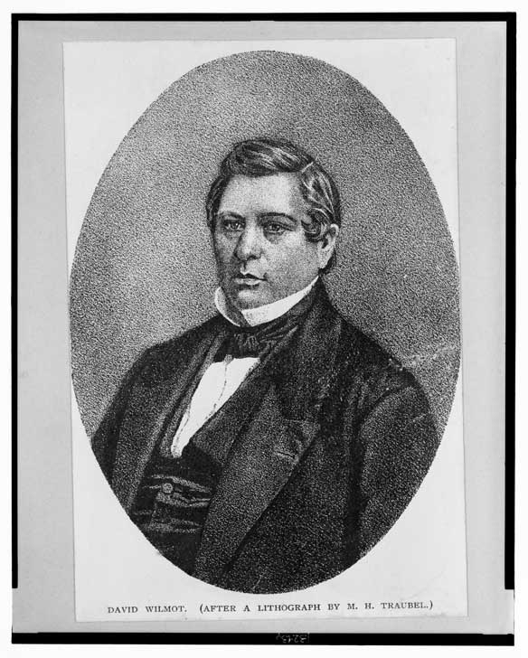
Wilmot Proviso
In 1846, Pennsylvania Congressman David Wilmot proposed legislation that would outlaw slavery in any territory acquired from Mexico.
Whigs and antislavery Democrats quickly passed the bill through Congress, upsetting the North.
The more proslavery Senate (think about numbers and representation)

Slide 5
Compromise of 1850
Rapid settlement of California due to the gold rush.
President Taylor asked the settlers to skip the ‘territory’ phase and immediately apply for statehood.
The bid for admission produced 4 distinct viewpoints on what California should become.

Slide 6
Compromise of 1850 Con’td
John C. Calhoun (HATES the North’s antislavery views): Proposed a dual presidency, permanently dividing executive power between North and South. Argued Congress had no power to regulate slavery in the states.
Many southerners just wanted the Missouri Compromise Line extended to the Pacific. James Buchanan and many northern Democrats supported this plan.
Lewis Cass and Illinois Senator Stephen Douglas pushed for popular sovereignty, letting new states decide for themselves if they wanted slavery or not.
Senators Salmon P. Chase of Ohio and William Seward of New York urged the federal government to immediately restrict slavery to where it existed and eventually end it completely.

Slide 7
Compromise of 1850 Cont’d
Whig leaders Henry Clay (The Great Compromiser) and Daniel Webster and Democrat Stephen A. Douglas pushed for the passage of five separate laws that appeased both sides, collectively known as the Compromise of 1850.
New Fugitive Slave Act (Advantage: South)
California as a free state (Advantage: North)
Resolved a boundary dispute between New Mexico and Texas in favor of New Mexico.
Abolished the slave trade (but not slavery) in the District of Columbia (Advantage: Neutral)
Organized the rest of the Mexican Cession into two territories, NM and UT and put into place popular sovereignty in the territories.

Slide 8
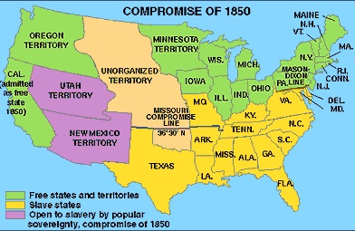

Slide 9
Kansas Nebraska Act
Old friend Stephen Douglas, the proponent of popular sovereignty, pushed for the repeal of the Missouri Compromise.
Organized much of the rest of the land from the Louisiana Purchase into two territories: Nebraska and Kansas, that could use popular sovereignty to decide the issue of slavery.
This led to thousands of settlers rushing into Kansas to vote on the issue of slavery.

Slide 10
