Slide 1
DISCUSS:
Why was a new system of government needed in the US? Why were many states hesitant to embrace a new system?
“Liberty may be endangered by the abuse of liberty, but also by the abuse of power [tyranny].”

Slide 2
The Constitutional Convention
Mr. Winchell
APUSH
Period 3

Slide 3
Unanswered Questions
How can the Articles be fixed? How much power should the national government have?
How will representation be chosen and apportioned?
What will happen to the “peculiar institution?”
Can the national government regulate the states?--SUPREMACY

Slide 4
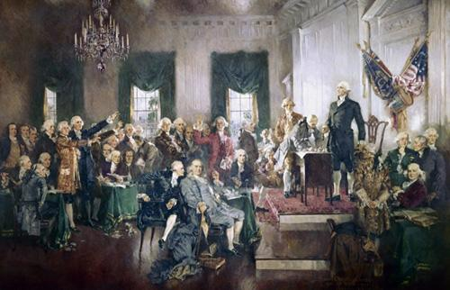
The Delegates
55 Delegates, 12 States
Lawyers, merchants, landowners, and bankers
19 owned slaves
Avg. age = 42
Nationalistic

Slide 5
Spectrum of centralized Power experienced by 18th (1700s) century Americans
King George’s power (w/ Parliament)
Low High
Articles of Confederation
Low High
Constitution
Low High

Slide 6
Constitutional Convention
In early 1787, Congress called for a Constitutional Convention in Philadelphia "for the sole and express purpose of revising the Articles of Confederation.“
In May, the convention met and the Virginia delegation suggested they throw out the Articles and devise a new system of government altogether against their original mandate

Slide 7
Secrecy…
According to Madison’s Notes,
“Nothing spoken in the house be printed, or otherwise published or communicated.”
Adopted this rule of secrecy and debated key problems of the AoC.
Guard against rumor and innuendo from the public.
Similar to a trial

Slide 9
PROCEEDINGS
George Washington elected President of the convention.
Virginia submits their plan, designed by Madison.
Powerful government
Run by men of high character with education.

Slide 10
Virginia Plan
Supreme National Government
Power to overturn state laws.
National Government established by the people, not states.
3 Tier election system.
Everyday people elect only the lower house of the national legislature.
Lower house elects upper house.
Both houses pick executive branch and judiciary branch.
2 Flaws:
States didn’t like nat’l gov supremacy
Representation in lower house based on population

Slide 11
New Jersey Plan
Proposed by small states
Gave nat’l gov power to raise revenue, control commerce/trade.
States could control their own laws
Each state equal.
Each state gets one vote in a one house legislature.
After debate, Virginia Plan gets used as foundation
“We must follow the example of Solon, who gave the Athenians not the best government he could devise but the best they would receive.”

Slide 12
Great (Connecticut) Compromise
Central Problem: State representation.
Big states want it population based
Small states want it equality based
Proposal:
2 house legislative body.
Upper house (Senate) with 2 members from EACH state.
Lower House (House of Reps) with members based on population.
Both sides agreed…moved on. Both houses have to agree in order to pass laws.
Other issues:
State legislatures would pick the senate.
States pick ‘electors’ who vote for the President.
...no state, without its consent, shall be deprived of its equal suffrage in the Senate.

Slide 13
Slavery?
Slavery contradicts republican principles…
Even many slave owners hoped it would die out
Madison and George Mason proposed an ‘end to the Atlantic Slave Trade.’
South Carolina and Georgia: “Nope”
Threatened to leave the union if this was passed.
Convention denied Congress the power to regulate immigration until 1808.
Constitution excluded ‘slaves’ from the Constitution.
What to do about their number in population counts??

Slide 14
3/5 Compromise
Slaves can’t vote.
Why should they count in the census count for representation in H of R?
Southern states demanded they count in population (irony…)
Delegates agree to a 3/5 count, in which every 5 slaves count as 3 people for population purposes.

Slide 15
The Basic Principles of the U.S. Constitution
1) The Constitution is an agreement between the American people and the federal government. It is not an agreement between the states as it was in the Articles of Confederation.
2) “Partly Federal, Partly national” (Federalism) - power is divided among the states and the federal government however the Constitution is the Supreme law of the land.

Slide 16
Federalist #39
“The proposed Constitution, therefore, is, in strictness, neither a national nor a federal Constitution, but a composition of both. In its foundation it is federal, not national; in the sources from which the ordinary powers of the government are drawn, it is partly federal and partly national; in the operation of these powers, it is national, not federal; in the extent of them, again, it is federal, not national; and, finally, in the authoritative mode of introducing amendments, it is neither wholly federal nor wholly national.”
What is Madison saying? Do you agree?

Slide 17
Conclusion
Strong federal government
Congressional legislature is supreme over state laws
New government can:
Tax
Raise an army and navy
Regulate commerce (foreign and interstate)
MAKE ALL LAWS ‘NECESSARY AND PROPER’ TO IMPLEMENT THOSE AND OTHER PROVISIONS
State governments cannot:
Print money
Enact any law impairing the obligation of contracts

Slide 18
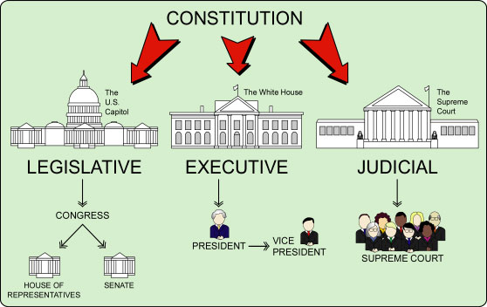

Slide 19
Opposing Viewpoints
The Federalists
The Anti-Federalists
Favored the new Constitution
Favored a strong national government
Supporters:
Washington, Madison, Hamilton
Supported largely by the influential upper class (stability)
The Federalist Papers
No. 10 “Factions”
No. 51 “Separation of Powers”
Opposed the Constitution
Favored states’ rights
Supporters:
Patrick Henry, Samuel Adams, (Thomas Jefferson?), Thomas Paine.
Small Farmers, Small Business Owners, worried the Constitution favored the rich.
Anti-Federalist Papers

Slide 20
Ratification
9/13 states needed to vote to approve in state conventions.
Anti-Federalists insisted on the addition of a ‘Bill of Rights’
Federalists insisted it didn’t need one

