Slide 1
Discuss
What pull factors led settlers to come to America in the early 1600s?
What push factors led settlers to leave England in the early 1600s?

Slide 2
Motives for European Exploration
Crusades → by-pass intermediaries to get to Asia.
Renaissance → curiosity about other lands and peoples.
Reformation → refugees & missionaries.
Monarchs seeking new sources of revenue.
Technological advances.
Fame and fortune.

Slide 3
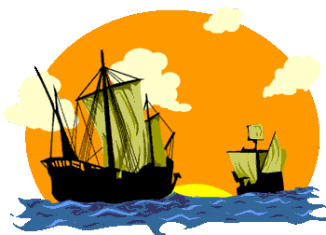
Direct Causes = 3 G’s
Political: Become a world power through gaining wealth and land. (GLORY)
Economic: Search for new trade routes with direct access to Asian/African luxury goods would enrich individuals and their nations (GOLD)
Religious: spread Christianity and weaken Middle Eastern Muslims. (GOD)
The 3 motives reinforce each other

Slide 4
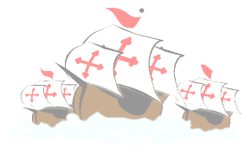
European explore
EUROPEAN EXPLORATION
1400 TO 1600
EFFECTS
Europeans reach and settle Americas
Expanded knowledge of world geography
Growth of trade, mercantilism and capitalism
Indian conflicts over land and impact of disease on Indian populations
Introduction of the institution of slavery
Columbian Exchange

Slide 5
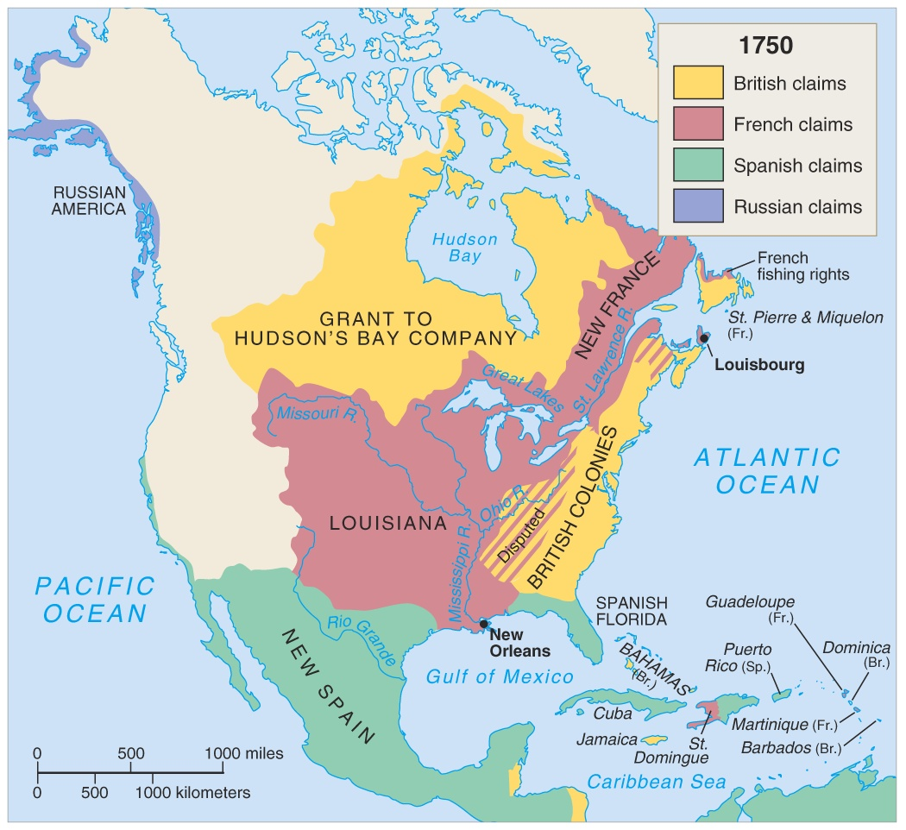
F/I War 1750

Slide 6
Early British Colonization
Mr. Winchell
APUSH
Period 2

Slide 7
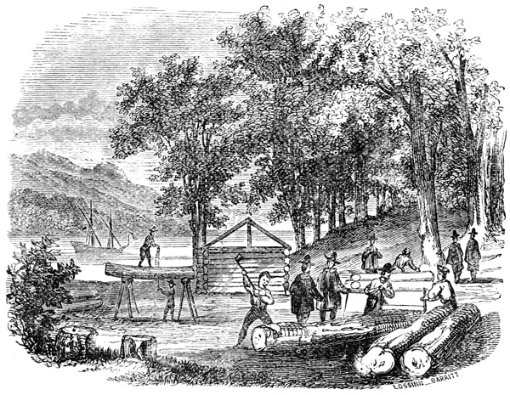
Jamestown - 1607
Primogeniture
Joint-Stock Companies…
Virginia Company of London
Jamestown site…
….awful start

Slide 8
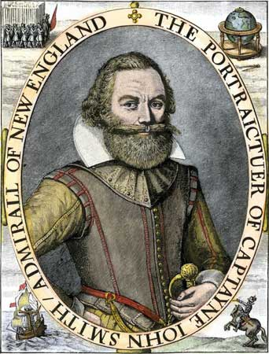
John Smith
Kidnapped…
“He who does not work, does not eat”
“Starving Time”

Slide 9
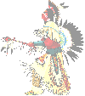
clash
CULTURAL CLASHES
WHITE EUROPEANS
Used the land for economic needs
Clearing the land, destroying hunting areas and fencing it off into private property
Divided the land and selling it for monetary value.
NATIVE AMERICANS
Relationship with environment as part of their religion
Need to hunt for survival
Ownership meant access to the things the land produced, not ownership of the land itself.
VS

Slide 10
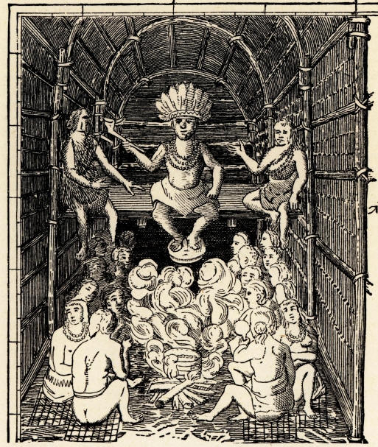
Powhatan
Father of Pocahontas…
His Indian Confederacy falls to the Three “D”s
  Disease
  Disorganization
  Disposability

Slide 11
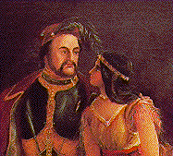
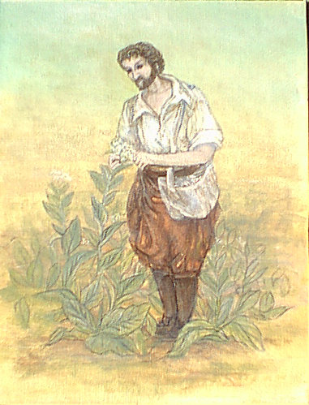
John Rolfe – Tobacco 1612

Slide 12
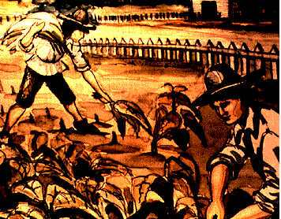
Indentured Servitude
Working for “Freedom Dues”
  A few barrels of corn
  New suit of clothes
  Small piece of land
Headright System
  Pay the passage of a laborer & get 50 acres
  Wealthy amassed huge landholdings
Frustrated Freedmen
  Land becomes scarcer
  Can’t find a wife

Slide 13
Do Now-DISCUSS
Why was indentured servitude an ineffective labor system? Does this correlate to any current problems in today’s society?

Slide 14
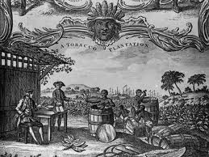
The Tobacco Economy

Slide 15
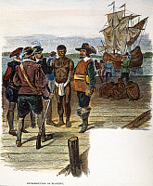
1619
20 Africans sold as slaves in Jamestown…
London Company authorizes the House of Burgesses – 1st Legislature in America

Slide 16
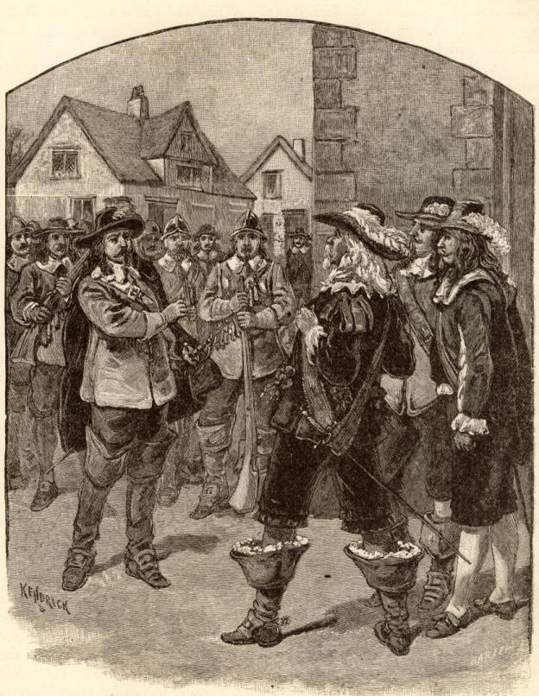
Bacon’s
Rebellion - 1676
1,000 Freedmen…
Put down an Indian Revolt, torched Jamestown & chased Gov. William Berkeley out of town…
**Wealthy planters begin to fear large numbers of landless freedmen**
Notes:
B. Bacon’s Rebellion
1. Frontier War – Poor freeholders and former indentured servants in the Chesapeake wanted lands occupied by Native Americans in Virginia; in 1675, fighting broke out when vigilante Virginia militiamen murdered thirty Indians; intensified when group defied Governor Berkeley’s orders and killed five Susquehannock leaders; Susquehannocks retaliated by killing three hundred whites. Settlers dismissed Berkeley’s proposed defensive strategy as a plot to impose high taxes on the poor.
2. Challenging the Government – Nathaniel Bacon, an English migrant with a position on the governor’s council, emerged as leader of Virginia rebels; disagreed with Berkeley on frontier policy; demanded a military commission but was denied; organized a militia to attack Indians on the frontier. Political struggle began between Bacon and the governor; Bacon issued “Manifesto and Declaration of the People,” calling for death or removal of Indians and an end to rule by wealthy “parasites” in Virginia. Bacon’s army burned Jamestown and plundered the plantations of wealthy. Bacon died suddenly in October 1676 of dysentery; 23 of his followers were hanged. Wealthy leaders in Virginia realized that they had to appease the poor and landless: cut taxes, expelled Indians from the frontier, increased importation of slaves while decreasing use of indentured servants. In 1705, House of Burgesses legalized chattel slavery.

Slide 17
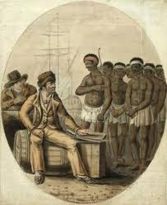
Colonial Slavery
African coastal tribes captured and sold slaves to merchants
More than 20% would die on the “Middle Passage”…
Harsh slave codes passed…
A few slaves eventually become slaveholders themselves…

Slide 18
