Slide 1
Early Industrialization and the Transportation Revolution
Mr. Winchell
APUSH
Period 4

Slide 2
Key Concept 4.2
Innovations in technology, agriculture, and commerce powerfully accelerated the American economy, precipitating profound changes to US society and to national and regional identities.

Slide 3
Questions to Consider
Work, Exchange, and Technology: How did changes in both agriculture and manufacturing change labor systems and affect the lives of American workers?
Work, Exchange and Technology: How did government policies affect the manufacture and distribution of goods in the US?
Peopling: What caused the emergence of nativism in the mid-nineteenth century? In what ways did immigration change the social, economic, and political fabric of America?

Slide 4
The Growing West
9 New Frontier States
The most democratic areas of the country
In order to attract citiznes, they offered many political, social, and economic reforms.
First states to offer voting rights to all white males, not just property owners
Population increases substantially across America
Population boom effects the economy:
-More people for farmers AND manufacturers to sell their goods to.
-More workers to employ, thus giving manufacturers a reason to build MORE factories and expand the American economy.

Slide 5
1st Industrial Revolution
Major industrial breakthroughs in Great Britain
Steam power
Factory system
Industrialization in the US is somewhat delayed
Reasons for the Delay
Land is so abundant (cheap) that most Americans see no reason to work in factories
Not a lot of money (capital) in America
Most people were self-sufficient and bartered for whatever else they needed
Labor scarcity
This is solved by immigration (mainly Irish)
British companies were established and run incredibly efficiently
British protected their industrial advantages
Did not allow mechanics or machines to leave the country
Samuel Slater was smuggled out

Slide 6
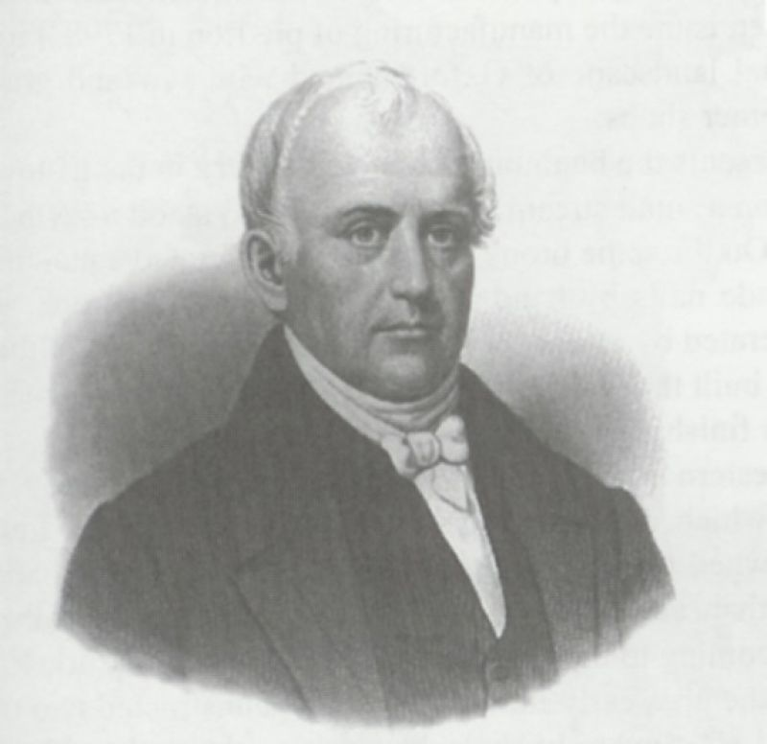
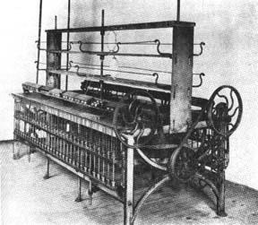
Samuel Slater “Father of the Factory System”
Bounties were paid to industrialists to come to America
Slater disguised himself as a farmer and came to America
Designed the first spinning machinery

Slide 7
Pro-Business Culture
Corporations spur capital investment
1811 NY passes a law allowing business to become corporations
Limited the risk for investors
Supreme Court rulings support a pro-business culture
Fletcher v. Peck (1810)
Dartmouth v. Woodward (1819)
McCulloch v. Maryland (1819)
Gibbons v. Ogden (1824)
Charles Rivers Bridge v. Warren Bridge (1835)
Laissez Faire Attitude, but the gov’t did much to assist capitalism
Disparity of Wealth began to grow
Notes:
Fletcher Peck-Contract Rights
Dartmouth Woodward-Public vs. Private (property rights)
McCulloch Maryland-Bank-State can’t tax feds
Gibbons Ogden-Feds regulate interstate commerce
Charles Rivers Bridge v. Warren Bridge-

Slide 8
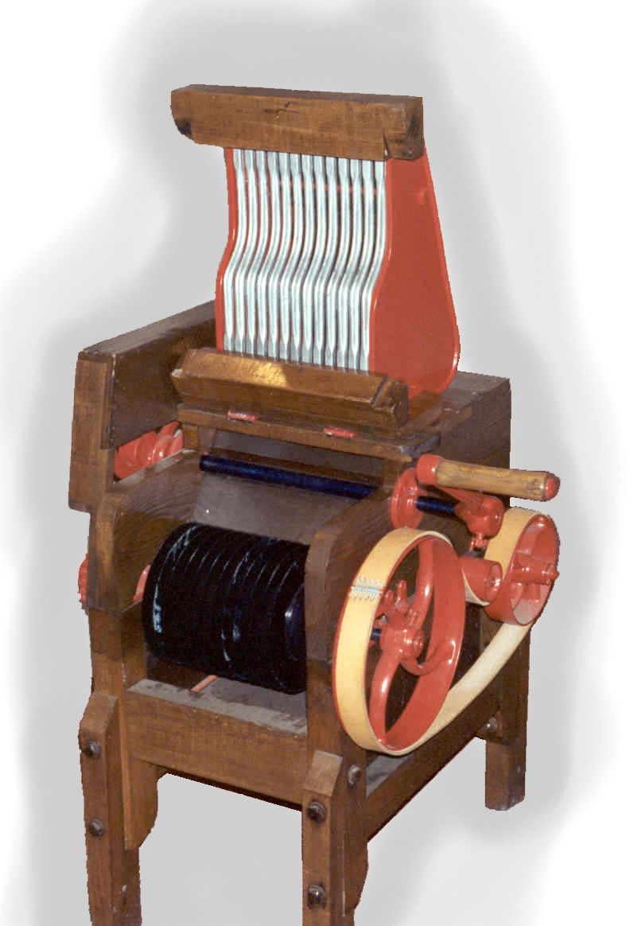
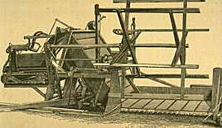
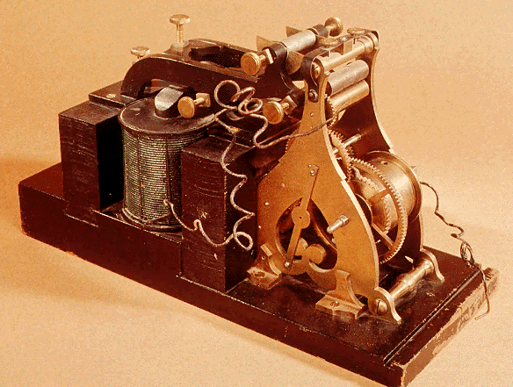
Important Technological Breakthroughs
American Resourcefulness and gov. assistance
1800 there were 41 patents approved
1860 there were 4,357
Technological Innovations
Robert Fulton’s steamboat
Eli Whitney’s Cotton Gin
Made Cotton very profitable and breathes new life into slavery
Interchangeable parts
Cyrus McCormick’s Mechanical Reaper
Samuel Morse’s Telegraph
Vastly improved the speed of communication
Cyrus Field’s Transatlantic Cable
Vastly improved communication between the US and Europe
“Anything new is quickly introduced here, including all of the latest inventions. There is no clinging to old ways. The moment an American hears the word “invention,” he pricks up his ears”

Slide 9
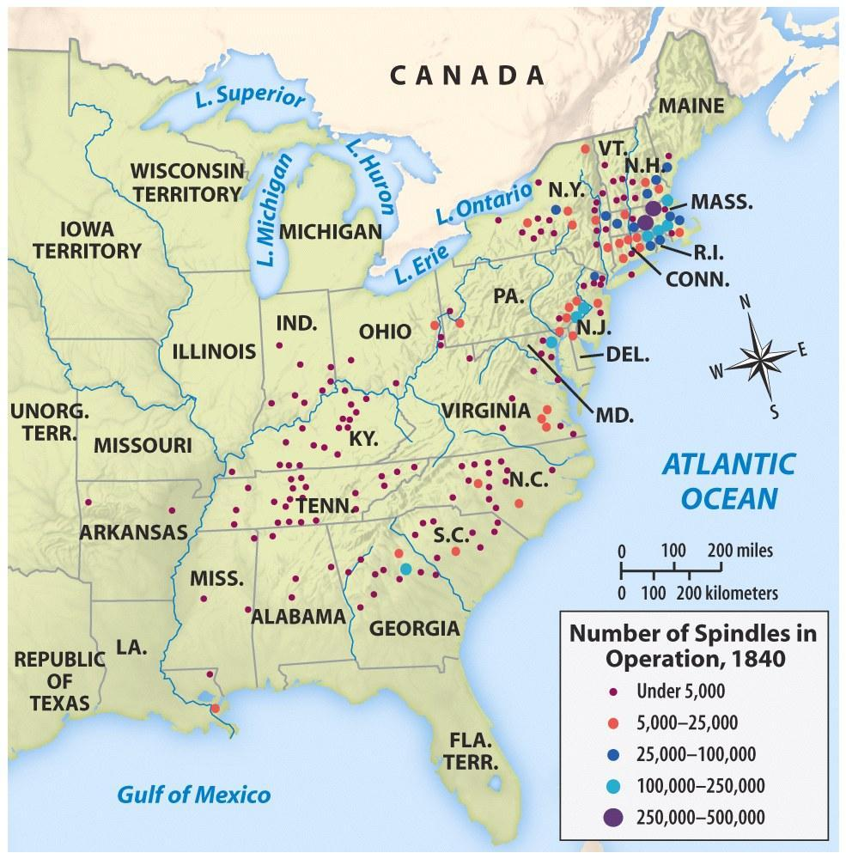
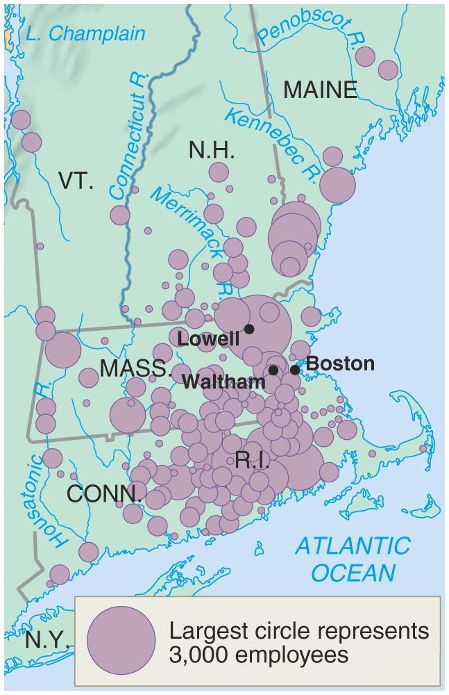
Regional Specialization
Northeast industrializes
Water powers the textile factories
Poor soil convinces many to give up subsistence farming and work in the mills
South Doubles Down on Cotton (and slavery)
Eli Whitney’s Cotton Gin increased production of cotton
More slaves were needed to pick the cotton
Cotton was sent North to fuel the textile industry
West becomes the “Breadbasket” of America
Certain innovations in technology & transportation allow farmers to move from subsistence farming to “cash cropping”
Steamboats, Canals, Railroads, Steel plow, Mechanical reaper
New innovations led farmers to expand and grow more (& borrow more)

Slide 10
Regional Specialization
EAST → Industrial
SOUTH → Cotton & Slavery
WEST → The Nation’s “Breadbasket”

Slide 11
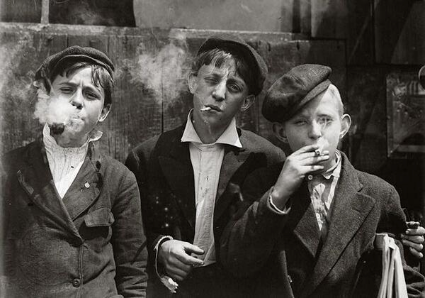
Americans Become Wage Workers
Pre-Industrialization
Industrialization
Almost everything is made at home
Artisans & Craftsman supply what cannot be done at home
Master-Apprentice relationship
Low production rates
Factory System
Long hours in unsanitary factories
Unskilled labor
Women at first then immigrants
Child labor very common
Little is made at home and people work at jobs to buy what they need

Slide 12
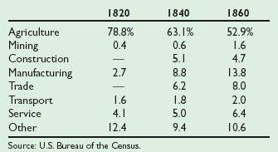
Changing Occupation Distributions: 1820 - 1860

Slide 13
Distribution of Wealth
During the American Revolution, 45% of all wealth in the top 10% of the population.
1845 Boston → top 4% owned over 65% of the wealth.
1860 Philadelphia → top 1% owned over 50% of the wealth.
The gap between rich and poor was widening!

Slide 14
Women and the Workforce
Textile factories forced women out of the home
Lowell Mills and the “Factory Girls”
Many women worked in factories until they were married and then became housewives
Cult of Domesticity
Birth Rates began to consistently fall
Child-centered families

Slide 15
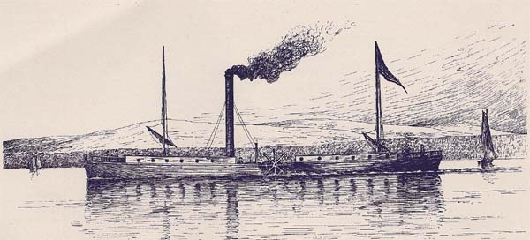
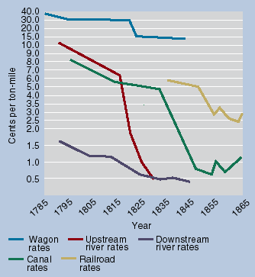
Transportation Revolution
Infrastructure in the US was horrible
Transportation was expensive
The cost for moving goods 30 miles in the US was the same cost for sending goods all the way to Europe!!!
Infrastructure improvements on roads, canals, and railroads (along with advances in technology: steamboat & trains) dropped the price of transportation 90-95%
Price of many goods plummet

Slide 16
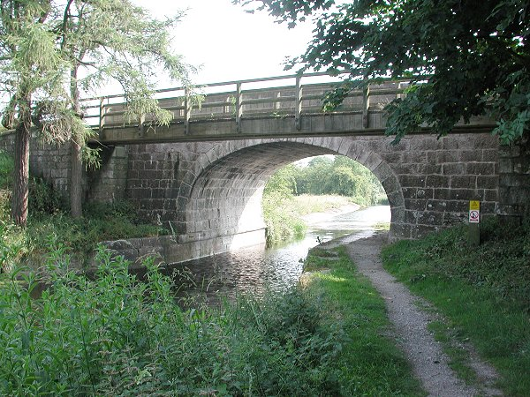
First Turnpike- 1790 Lancaster, PA
By 1832, nearly 2400 mi. of road connected most major cities.

Slide 17
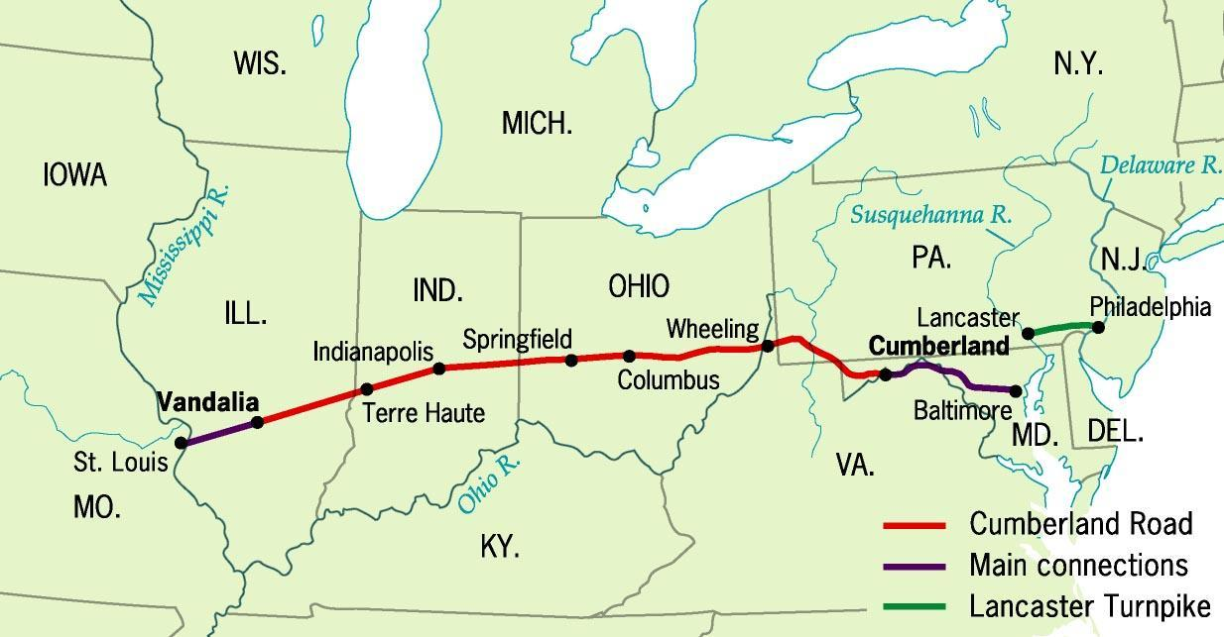
Cumberland (National Road), 1811

Slide 18
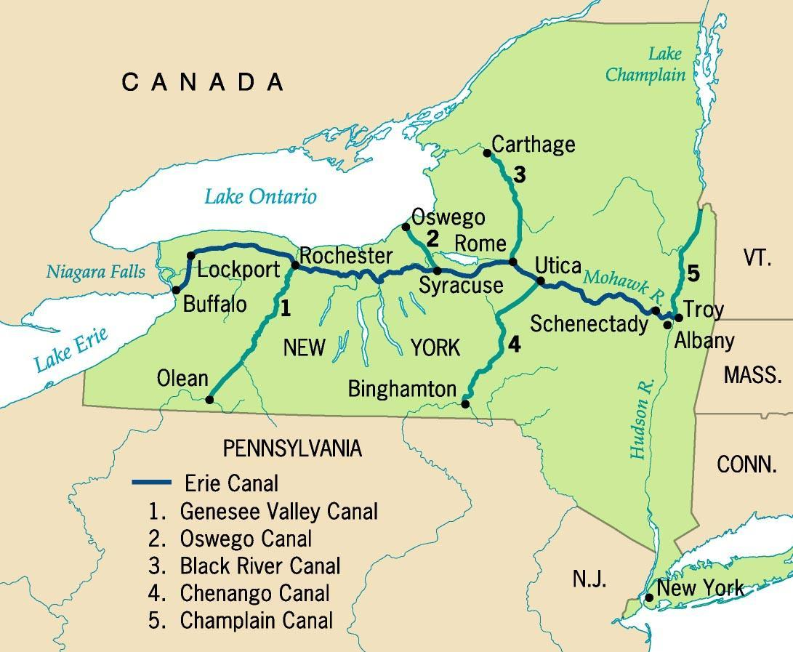
Erie Canal System

Slide 19
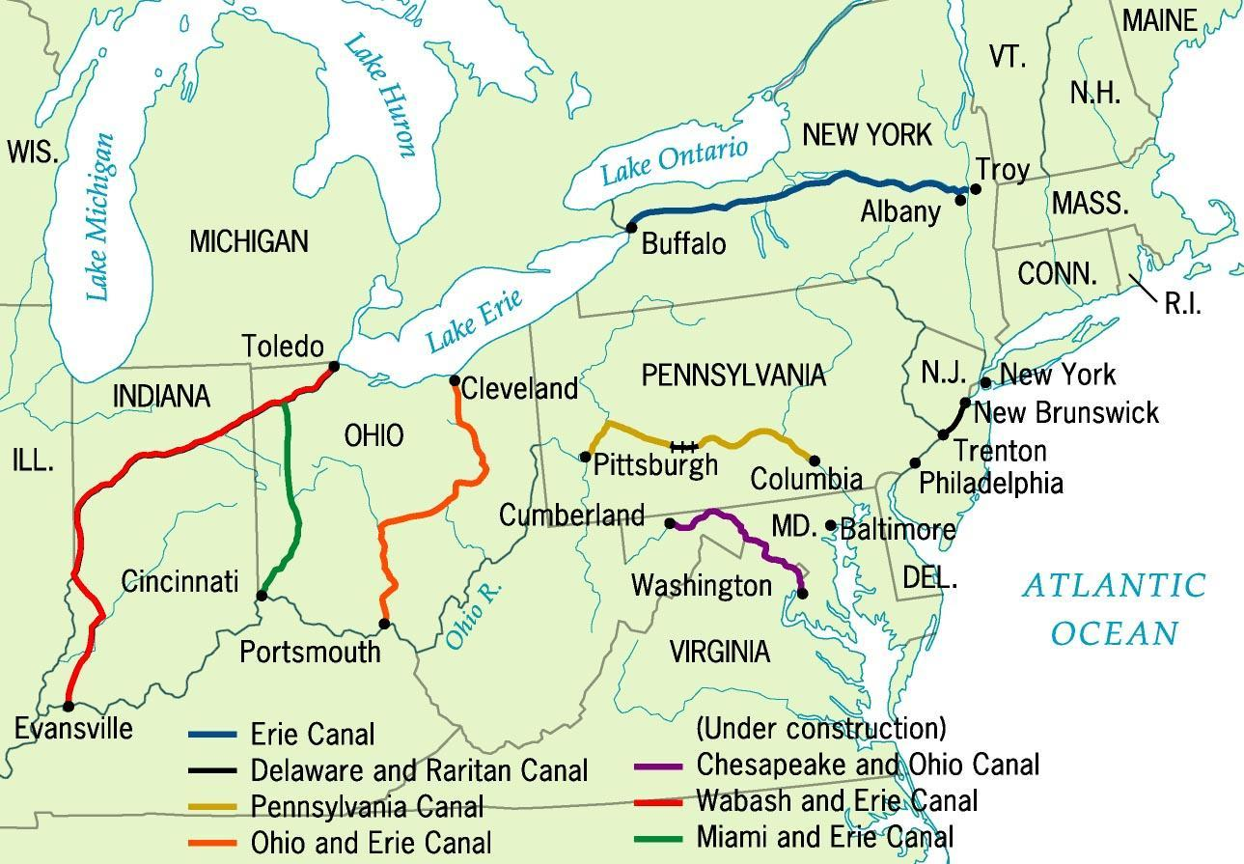
Principal Canals in 1840

Slide 20
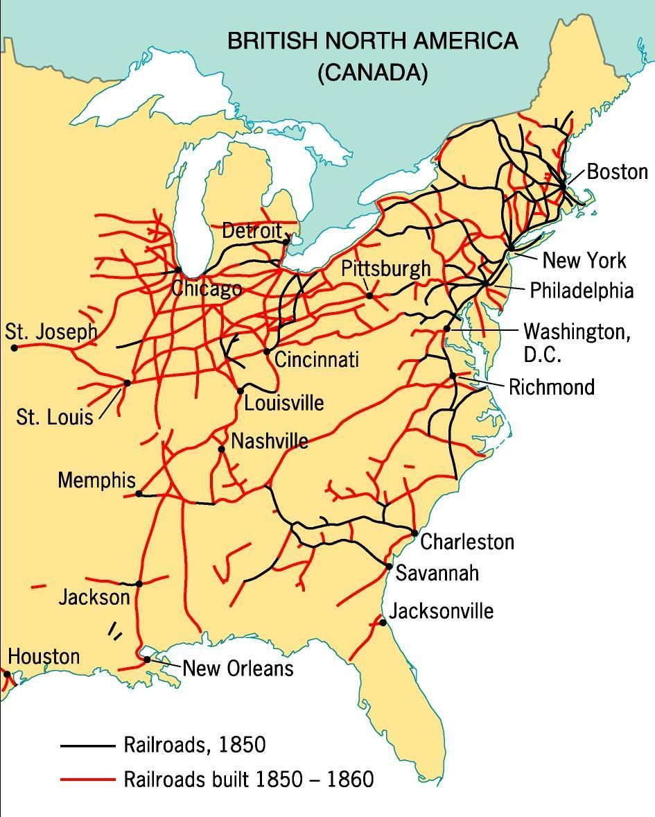
The Railroad Revolution, 1850s
Immigrant labor built the No. RRs.
Slave labor built the So. RRs.
1830 → 13 miles of track
1850 → 9000 mi. of RR track
1860 → 31,000 mi.

Slide 21
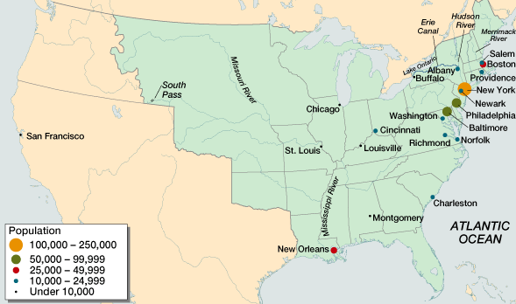
American Population Centers in 1820

Slide 22
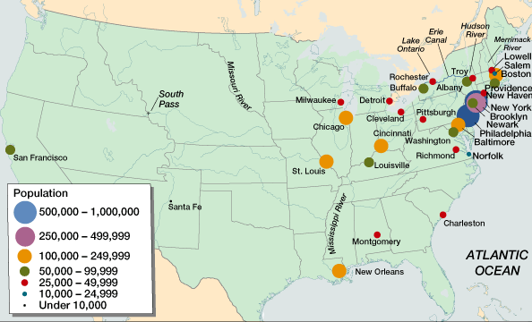
American Population Centers in 1860

Slide 23
Effects of the Market Revolution
Effects on the Social Structure:
The ability for the poor to become wealthy was greatly exaggerated
The gap between the wealthy and the poor increased as the wealthy became industry leaders and large plantation owners
The wages of workers and the overall standard of living in the US DID greatly increase
FAR more economic opportunities in America than in Europe

Slide 24
Effects of the Market Revolution
Effects on Women:
Women no longer had to work alongside their families on farms
Women gained more control over their lives during this period
Arranged marriages far less common
Single women had some opportunities to seek employment in cities (teachers, domestic workers, some factory jobs)

Slide 25
Effects of the Market Revolution
Effects on the Economy:
Though there was a brief panic in 1819, the American economy experienced great growth during the early 1800s
This growth resulted in the development of a NEW American economy
Prior to 1820, many families were self-sufficient
After the 1820’s, the American economy was forever changed
The farmers of the South and West fed the workers of the cities of the Midwest and North and provided them raw materials, who in turn supplied the farmers with manufactured goods

Slide 26
The Early Union Movement
Workingman’s Party (1829) * Founded by Robert Dale Owen and others in New York City.
Early unions were usually local, social, and weak.
Commonwealth v. Hunt (1842).
Worker political parties were ineffective until the post-Civil War period.

Slide 27
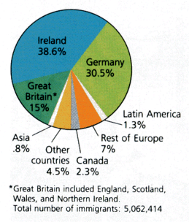
National Origin of Immigrants: 1820 - 1860
Why now?

Slide 28
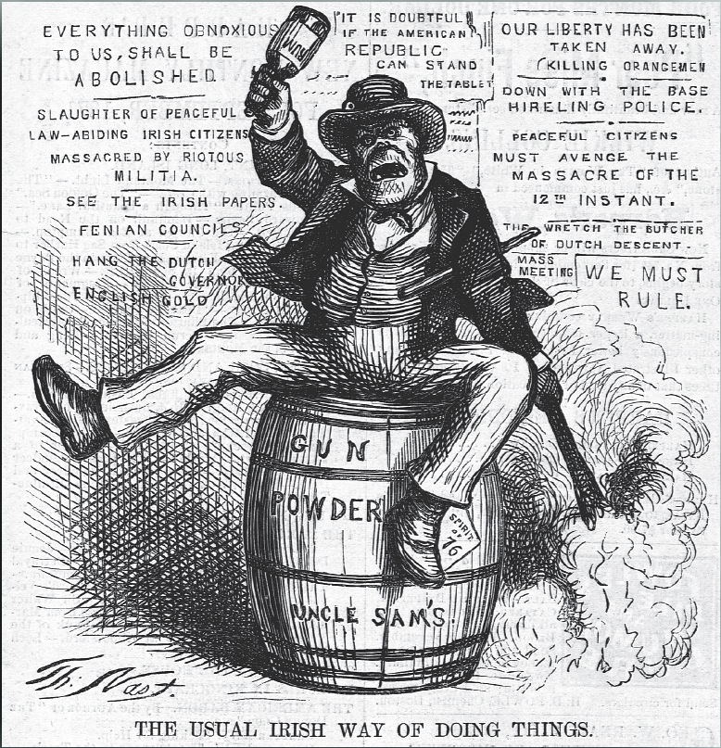
American View of the Irish Immigrant

Slide 29
THESIS PRACTICE
Compare and contrast the United States before and after the Market Revolution, accounting for changes to the American economy, social structure, and political system.

