Slide 1
Do Now
-How did developments during WWII help lead to the Cold War?
-What role did propaganda play in WWII?
-How do Communism and Capitalism differ?

Slide 2
The Effects/Significance of WWII
Mr. Winchell
APUSH
Period 7

Slide 10
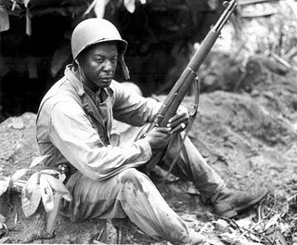
Revolutionary Social Effects of WWII

Slide 11
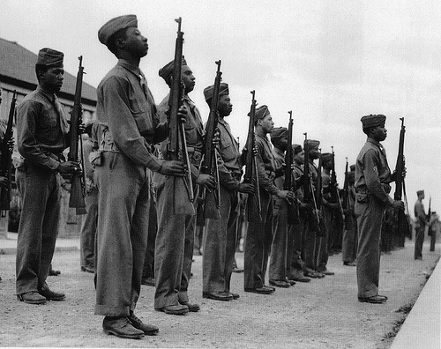
African-Americans & the Origins of the Civil Rights Movement
Discrimination in The Armed Forces & in Factories

Slide 12
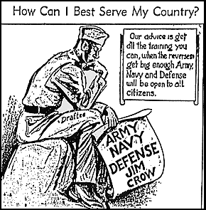
The Double V Campaign: Victory Against Dictators and Racism

Slide 13
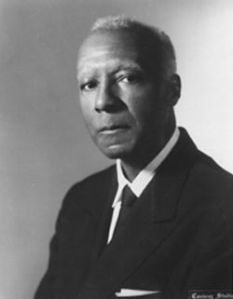
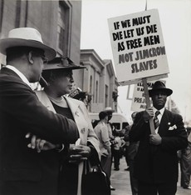
A. Philip Randolph Protests for Equal Employment

Slide 14
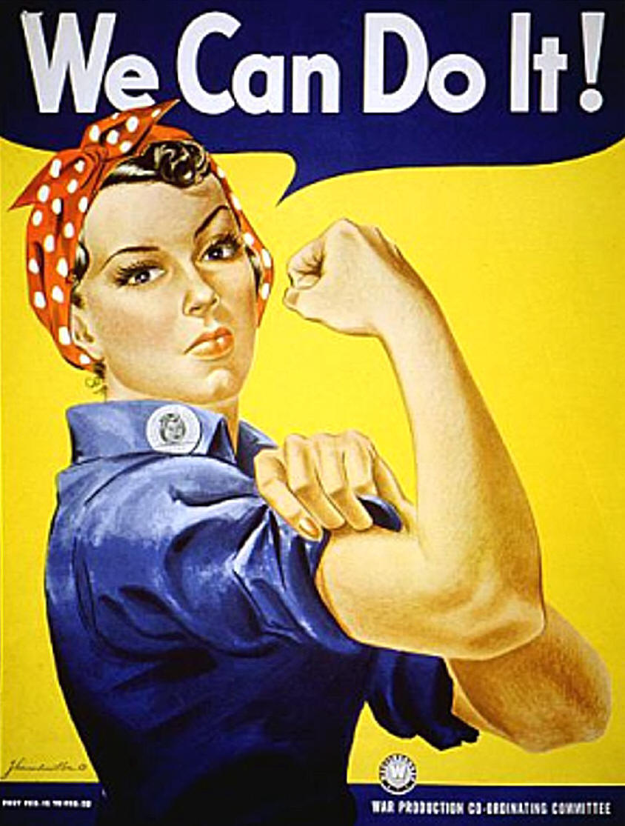
A Small Step Toward Female Equality – Rosie the Riveter and the War

Slide 15
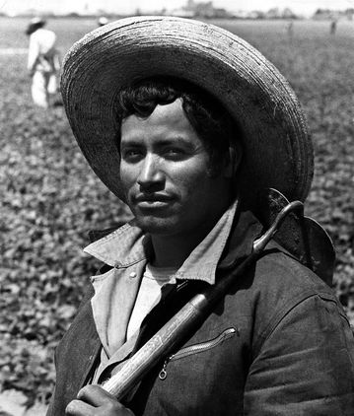
A Growing Latino Presence: The Bracero Program and Guest Workers

Slide 16
“GI Bill of Rights”
GI is the term used for American soldiers in WWII. (G.I. means General Issue)
The Servicemen’s Readjustment Act
Provided veterans a series of benefits:
Low interest loans for homes, business, and farms
Aid for education

Slide 17
Challenges after the War
United Nations
Representatives from 50 countries met to form a new organization, the United Nations.
The UN was meant to encourage cooperation among nations and to prevent wars.
Potsdam Conference
Allied leaders met in the German city of Potsdam to discuss the spread of communism and Soviet influence in the postwar world.
Truman hoped to get Stalin to live up to his promises from Yalta.
Stalin did not do this.
Rebuilding
MacArthur led efforts to help Japan rebuild its government and economy.
Seven Japanese leaders were tried for war crimes.
Rebuilding Europe caused tensions between the U.S and the Soviet Union.

Slide 18
World War II Legacy
World War II was deadlier and costlier than World War I
United Nations established with U.S.A. membership
Superpowers
War devastated old European powers and Japan; China recommenced civil war
UNITED STATES and SOVIET UNION
Capitalism and Communism
Individualism and Collective Society
Soon engage in the Cold War

Slide 19
Wartime Conferences
FDR (and later Truman) will coordinate the effort with Allied leaders Churchill, and later Stalin
Casablanca-1943 FDR, Churchill, agreed on war aims: Sicily invasion, Unconditional Surrender- of Japan and Germany
Cairo-1943- FDR and Churchill, Chiang Kai-shek- discussed war aims in Asia, Japan will lose all islands acquired, Korea independent
Teheran-1943 The “Big Three” discussed 2nd front in Europe (France), Postwar Germany,
Yalta-February 1945 “Big Three” Discussed the fate of Poland, Stalin asserted need for “Buffer Zone” and sphere of influence; Stalin promised to allow free elections; planned for the division of Germany after the war; Stalin promised to declare war on Japan in exchange for Japanese land; (FDR is dying and will be criticized for being manipulated by Stalin and “selling out” Eastern Europe to the Russians.
Potsdam- Germany, July 1945, FDR dead, Truman, Churchill gone, new Brit- Clement Atlee, Stalin- discussed boundaries for Germany, German resources would pay for the war

Slide 20
Suspicions Developed DURING the War
US furious Stalin had been an ally of Hitler.
Stalin upset it took so long to open a western front during war.
Stalin upset that the US had kept the atomic bomb a secret.

Slide 22
Potsdam Conference Summer 1945
Harry S Truman, now US president, took a “hard line” with Stalin
Clement Atlee, now British PM, was not a strong negotiator (largely because his name was ‘Clement’… cmon man)
Conference was a failure
Soviets wanted heavy reparations from Germany
The Allies divided Germany into four sectors, for administration and rehabilitation (US, France, Britain, USSR)
Berlin was also divided into four sectors although it was entirely within the Soviet sector

Slide 23
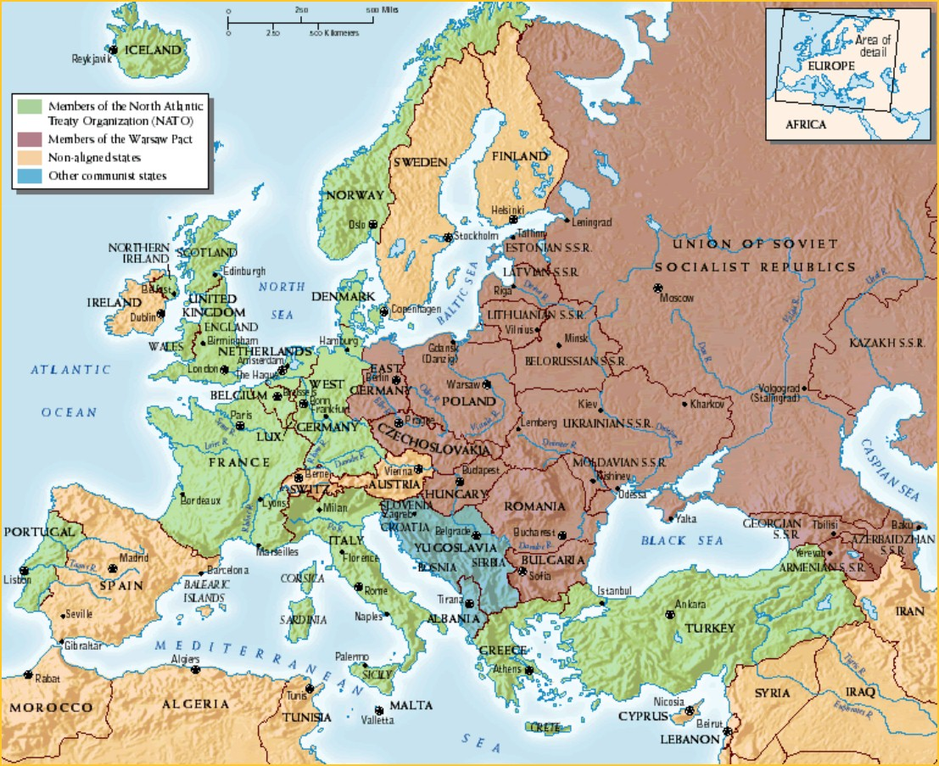

Slide 25
Partition of Germany
Each of the “Big 4” was charged with “rehabilitating” its quarter
GOALS: each Allied nation would
Help reconstitute a “de-Nazified” civil government
See to needs of refugees
Hold trials of Nazi war criminals

Slide 26
Partition of Germany
Berlin was NOT near the crossroads of the four sectors
It was in the East German (Soviet) territory
But it was supposed to be jointly run, and was itself divided into four sectors

