Slide 1
Election of 1860 and South Carolina's Secession
Mr. Winchell
APUSH
Period 5

Slide 2
Questions to Consider
Politics and Power: Was secession the first step in disunion or the last?
Continuity and Change over Time: How was South Carolina’s (and the South’s in general) similar to the justification of the original 13 Colonies? How was it different?
Politics and Power: What caused the Civil War… (Just kidding!)

Slide 3
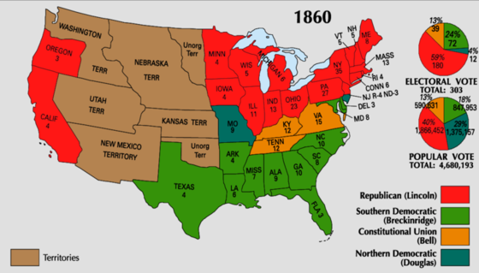

Slide 4
