Slide 1
Do Now
-Why is the French and Indian War seen as a turning point in British relations with the American colonists?
How did the developing American Identity influence how colonists dealt with an increase in attempts by the British to regain control in America?

Slide 2
The End of Salutary Neglect and the Roots of Resistance
Mr. Winchell APUSH
Period 3 Day 2

Slide 3
Today’s Essential Question
To what extent did ECONOMICS and POLITICS in the colonies lead to the colonists’ declaring independence?

Slide 4
An Empire Transformed
A. The Costs of Empire
1. Britain’s national debt:– British national debt soared from £75 million in 1756 to £133 million in 1763; British raised taxes on the poor and middle classes; increased size of British bureaucracy to collect taxes; those with little political power (poor, colonists) appeared most vulnerable to increased taxation.
2. British troops in the colonies: The decision by Britain to keep 7500 soldiers in colonies during peacetime angered colonists; British wanted to maintain control over colonists, Native Americans, and French in Canada.
Notes:
I. An Empire Transformed
A. The Costs of Empire
1. Britain’s national debt – British national debt soared from £75 million in 1756 to £133 million in 1763; British raised taxes on the poor and middle classes; increased size of British bureaucracy to collect taxes; those with little political power (poor, colonists) appeared most vulnerable to increased taxation. John Wilkes (Whig) publicly condemned rotten boroughs as districts controlled by the wealthy who did not face these new fiscal measures.
2. British troops in the colonies –

Slide 5
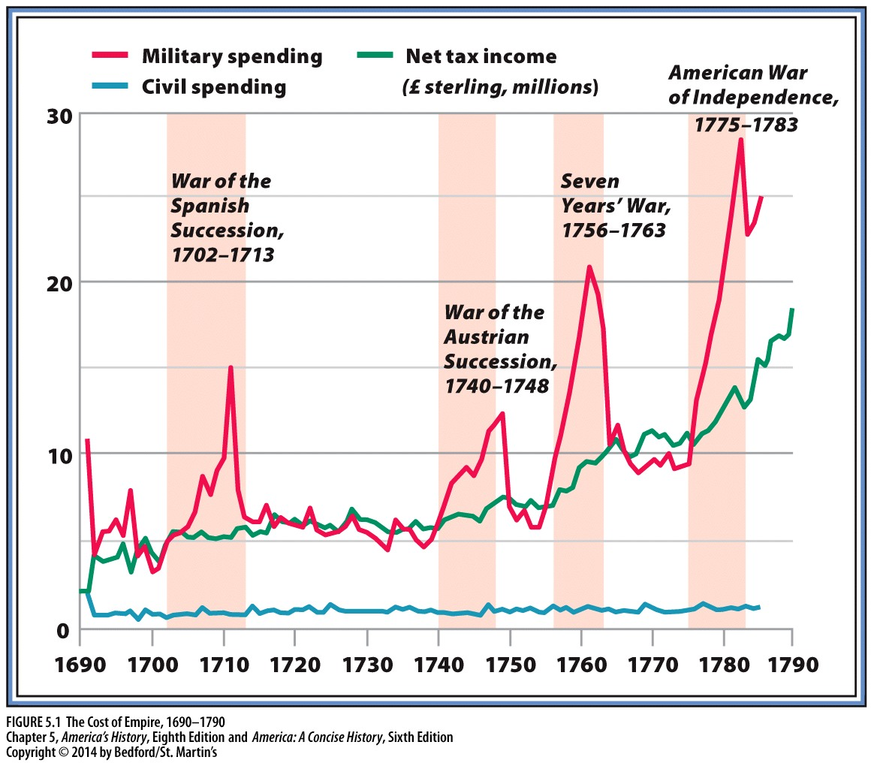

Slide 6
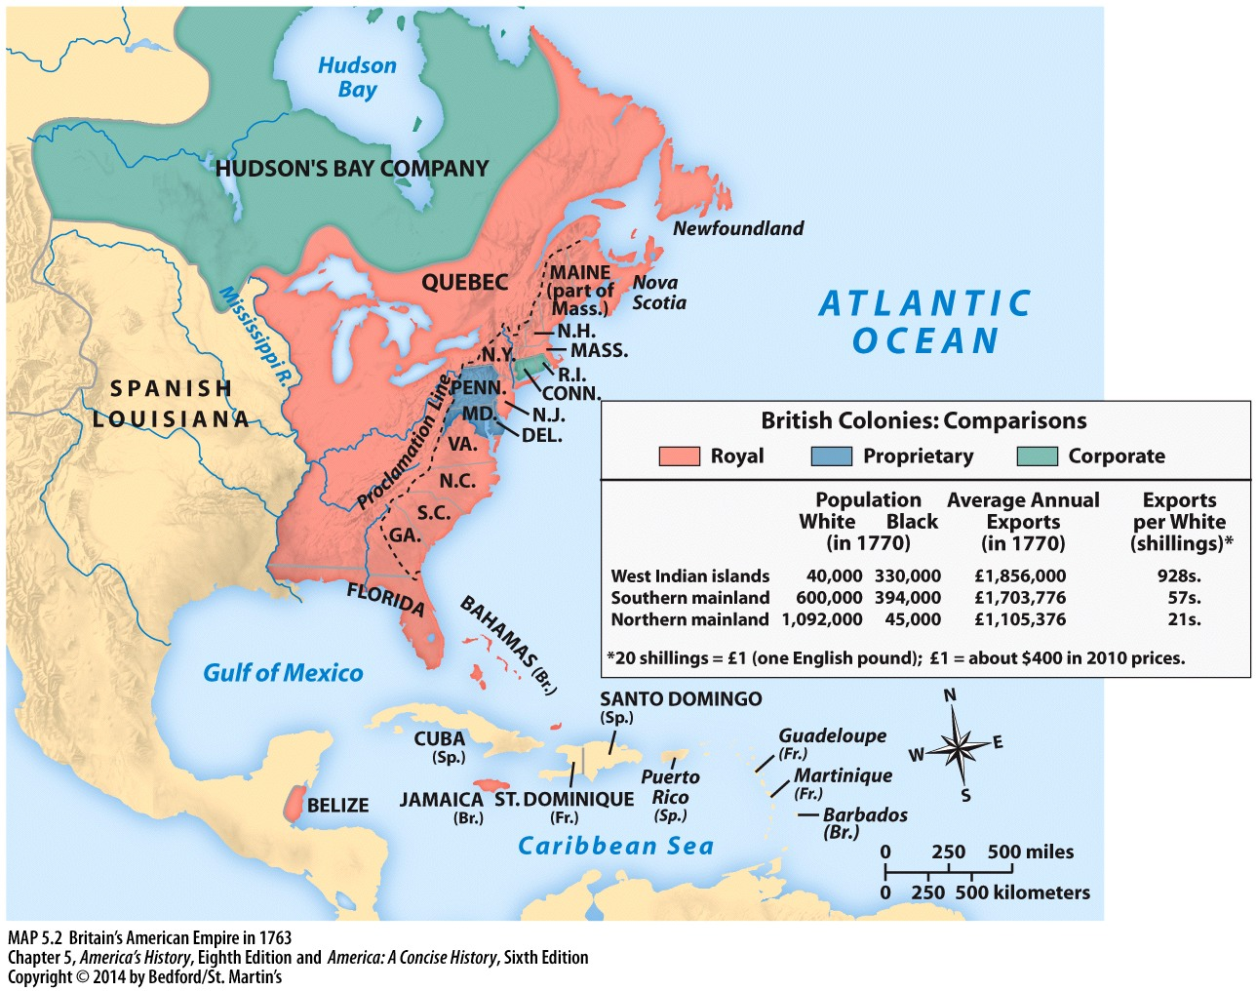

Slide 7
Paying for War
Taxation shift: From land to consumables.
Sales tax on goods approached 20% of income.
War revealed how little power the crown had over the colonies.
Power was shared between Royal Governor and colonial assemblies.
It would take a large military force to keep the land-hungry colonists from violating Proclamation Line (1763).

Slide 8
End of Salutary Neglect
Currency Act of 1764
Banned American colonies from using paper money as legal tender. Ensured British merchants would no longer be paid in colonial money.
Sugar Act of 1764
Tax on imported molasses.
Colonists complained that these taxes did not benefit the people paying them.
Notes:
Currency Act:

Slide 9
Stamp Act
Meant to pay for the cost of keeping troops in America.
Taxed all printed items.
Ben Franklin’s response: If you tax us, include us.
‘No taxation without representation’

Slide 10
Quartering Act 1765
Required colonial governments to provide housing and food for troops.
Britain began ruling the colonies without any input from the colonial assemblies.

Slide 11
Stamp Act Congress
9 Colonial Assemblies sent representatives to NYC to protest the loss of American ‘rights and liberties.’
Delegates wanted compromise, not confrontation.
Petitioned for repeal and boycott of British goods.

Slide 12
Sons of Liberty
Demanded the resignation of stamp-=tax collectors.
Destroyed tax collector’s warehouse.
Destroyed Governor’s mansion.
Stamp Act drew protests from many colonies

Slide 13
3 Reasons for Resistance
English Common Law
Centuries old body of legal rules and procedures.
Magna Carta
Liberties and Privileges
Natural Rights
Enlightenment
Separation of Powers
Glorious Revolution
Constitutional Monarchy took away power from the King to just levy taxes at will.

Slide 14
Townshend Acts
Passed in 1767.
Taxed colonial imports of paper, paint, glass and tea.
Used to pay royal salaries.
Reignited conflict over internal/external taxation

Slide 15
Nonimportation Movement
Spearheaded by the ‘Daughters of Liberty.’
Movement to reduce imports, and therefore reduce the money being brought in by Britain, and therefore reduce reliance on British goods.
Ben Franklin called for a return to the pre-1763 mercantilist system.
“Repeal the laws, renounce the right, recall the troops, refund the money, and return to the old method of requisition.”

Slide 16
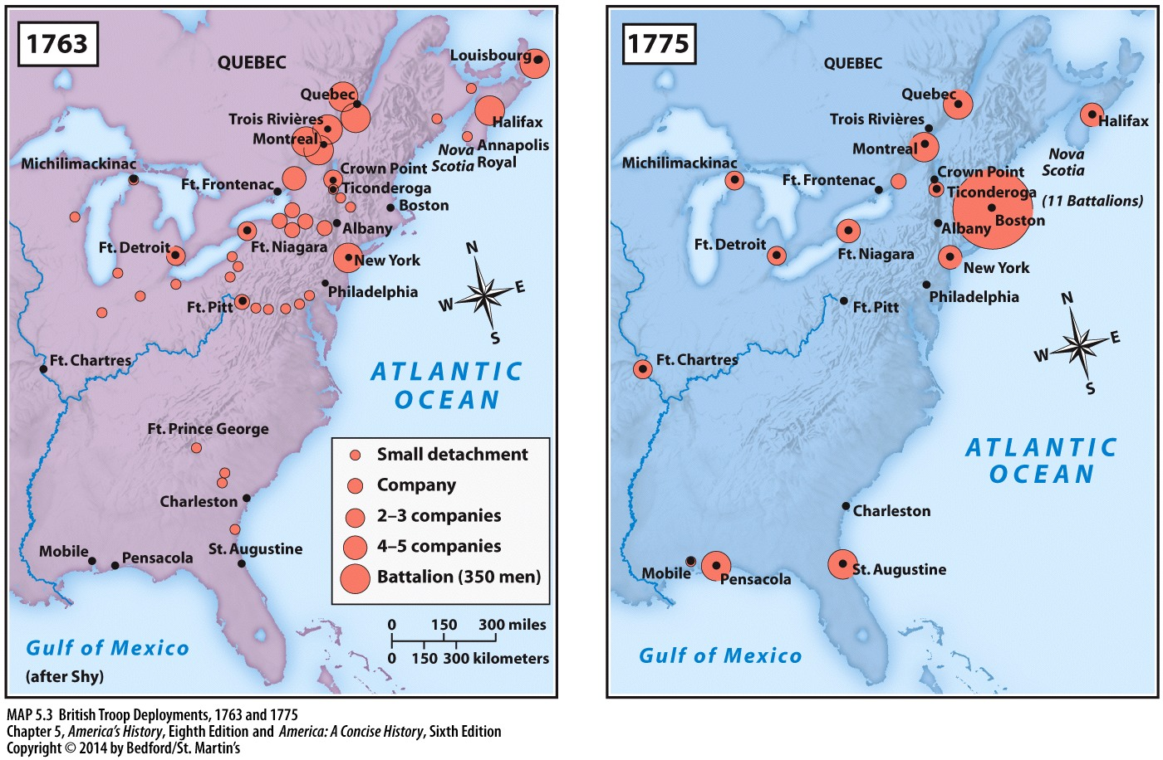

Slide 17
Troops to Boston
Significant Increase in Troops in the Northern Colonies
Boston Massacre
American resistance to the laws only increased British determination.
Approximately 2,000 troops in Boston.
More in New York, Philadelphia, New Jersey, and other outposts.
Boston: Troops 10% of population.
Street fight in origin.
March 5, 1770.
Patriot mob throws ‘snowballs, stones, sticks’ at soldiers.
Soldiers respond by firing into the crowd, killing five.
Once news spread, this united the colonists to more formally resist the crown.

Slide 18
Boston Massacre

Slide 19
Today’s Essential Question
To what extent did ECONOMICS and POLITICS in the colonies lead to the colonists’ declaring independence?

