Slide 1
Era of Good Feelings and the Development of Republican Culture
Mr. Winchell
APUSH Period 4

Slide 2
MONROE'S PRESIDENCY
1. Served two terms: 1817 to 1825
Called the Era of Good Feelings
2. Unite the nation---1816---”promote nationalism”
American System --- link the country together
Expansion of US
Rush/Bagot Treaty
Adams/Onis Treaty or Florida Purchase Treaty
3. Self Defense Doctrine: Monroe Doctrine, 1823
4. Sectional differences
Missouri Compromise---1821
“National oneness” = Nationalism

Slide 3
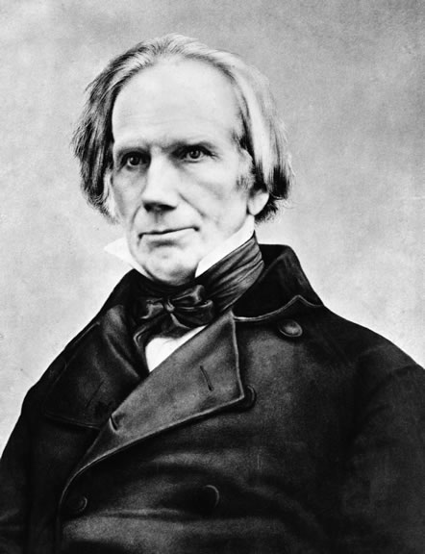
Henry Clay’s American System
AMERICAN SYSTEM
Congress’s attempt to unite the US
National transportation system of roads, canals, steamships and rivers.
1800 to 1850 roads, canals and rivers first forms of transportation---
Provide economic growth
Americans buying American goods
American self-sufficiency.
Protective Tariff to promote infant industry
Tariff of 1816
2nd BUS to promote a stronger economy
Rechartered in 1816

Slide 4
The American System
WEST → got roads, canals, and federal aide.
EAST → got the backing of protective tariffs from the West.
SOUTH → ??

Slide 5
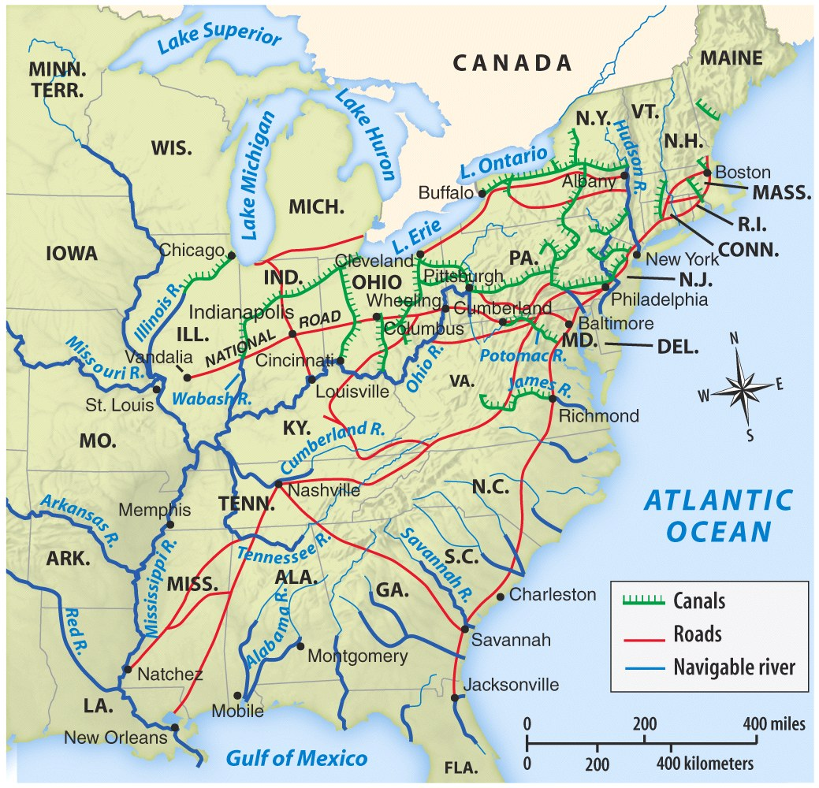
Help unite the country as well as improve the economy and the infant industry….
Because of the British blockade during the War of 1812, it was essential for internal transportation improvements.

Slide 6
ERA OF GOOD FEELINGS
1817 TO 1825
Spirit of Nationalism in US
patriotism or national oneness
Country is united, confident, and growing
1791-1819, 9 states joined the original 13.
One political party---Democratic-Republican party
Respect from Europe
Monroe first president to visit all states.
Boston newspaper declared an “Era of Good Feelings” had began.
But, time period was not free of problems.

Slide 7
ERA OF GOOD FEELINGS
Cultural Nationalism
Patriotic themes infused every aspect of American society from books and paintings of Revolutionary heroes to Noah Webster’s blue-backed speller that promoted patriotism
Economic Nationalism
Running parallel with cultural nationalism was a political movement to support the growth of the nation’s economy--------AMERICAN SYSTEM
Political Nationalism
Movement to bring about the support for national government is over the states. Supreme court decisions support the concept of national government over the states.

Slide 8
ERA OF GOOD FEELINGS
National Transportation system
Cumberland Road and Erie Canal first internal improvements to unite the US
the first steamboat on western waters was in 1811.
1800 to 1850 roads, canals and rivers first forms of transportation
1850 to 1860 the railroad is added
The Land Act of 1820
gave the West its wish by authorizing a buyer to purchase 80 acres of land at a minimum of $1.25 an acre in cash;
the West demanded transportation.

Slide 9
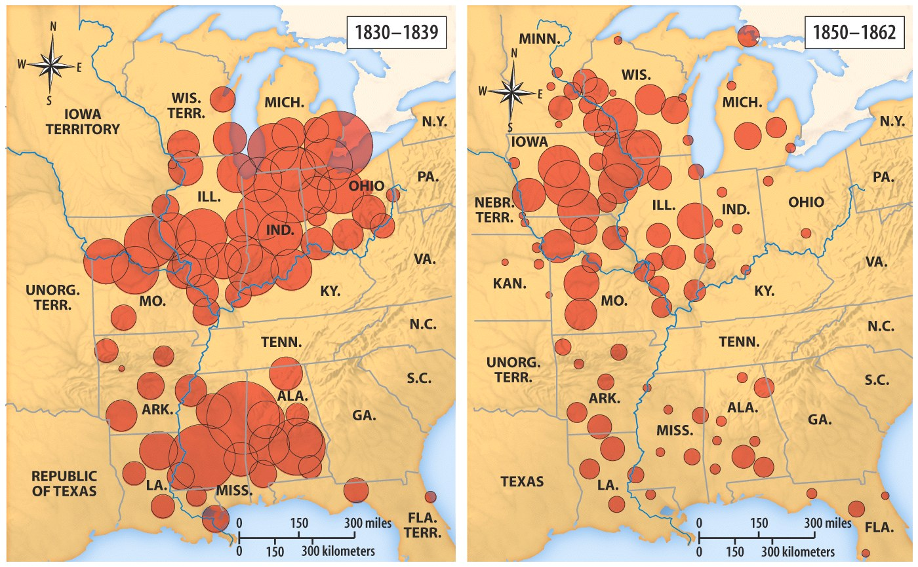
The Land Act of 1820 gave the West its wish by authorizing a buyer to purchase 80 acres of land at a minimum of $1.25 an acre in cash; the West demanded transportation

Slide 10
The Panic of 1819
ERA OF GOOD FEELINGS
Largely the fault of the Second Bank of the United States’ tightening of credit in an effort to control inflation
Many state banks closed
The value of money fell
There were large increases in unemployment, bankruptcies, and imprisonment for debt
Depression was most severe in the West
The economic crisis changed many Western voters’ political outlook

Slide 11
Reasons for
Westward Movement
Population shift from the east to the West
Acquisition of Native Americans’ lands
Land easy to obtain
Economic pressures
Improved transportation
Immigration

Slide 12
New Questions and Issues
ERA OF GOOD FEELINGS
Greatest importance to western states were:
“Cheap money” (easy credit) from state banks rather than from the Bank of the United States
Land made available at low prices by the government
Improved transportation
Westerners could not agree whether to permit slavery or exclude it

Slide 13
Westward Expansion
Rush-Bagot Agreement (1817-18)
Treaty with Great Britain
Shared Oregon Territory for 10 years
the setting of the northern limits of the Louisiana Territory at the 49th parallel
US agreed to cede land above 49th parallel
GB agreed to cede land below 49th parallel

Slide 14
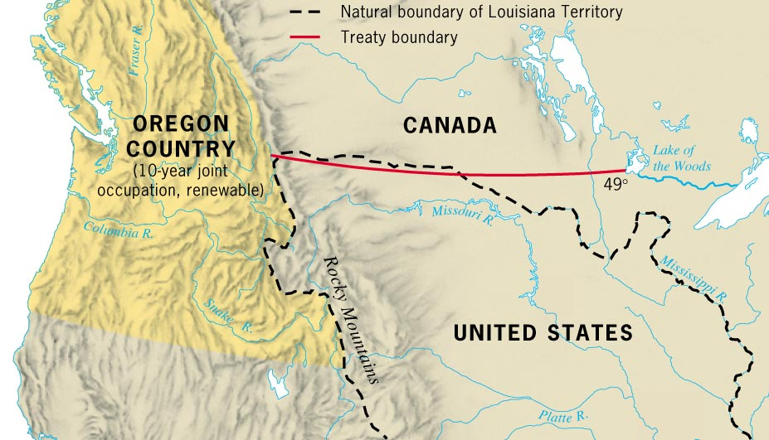

Slide 15
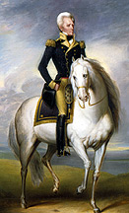
Westward Expansion
Florida Becomes Part of US
After War of 1812, Spain had difficulty governing Florida
Seminole Indians, runaway slaves, and white outlaws conducted raids into U.S. territory and retreated to safety across the Florida border
President Monroe commissioned General Andrew Jackson to stop the raiders
Jackson led a force into Florida, destroyed Seminole villages, and hanged 2 Seminole chiefs
Jackson captured Pensacola and drove out the Spanish governor

Slide 16
Westward Expansion
Adams-Onis Treaty (1818)
Spain turned over
western Florida along with all to the east
Claims in the Oregon Territory to the U.S.
US agreed
to pay $5 million to Spain
to give up any territorial claims to Texas

Slide 17
SECTIONALISM
U.S. was becoming divided into 3 separate sections with each trying to promote their self-interest.
NORTHEAST
Business and Manufacturing Daniel Webster _______________
Wanted Tariffs
Backed internal improvements
End to cheap public land
Increasingly nationalistic
Against Slavery and believed the U.S. Govt. must abolish it.
SOUTH
Cotton-growing John C. Calhoun
_______________
Opposed tariffs and government spending on American System
Increasingly supportive of states’ rights
Pro-slavery and opposed any steps of the U.S. Govt. to try and abolish it.
WEST
Frontier agriculture Henry Clay
______________
Supported internal improvements and American System.
Wanted cheap land
Loyal to the U.S. Govt.
Against slavery but some supported letting the people decide the slavery issue
Economy/
Key Figure
____________
Role of Government

Slide 18
MISSOURI COMPROMISE
In 1819, Missouri, first part of the Louisiana Purchase to apply for statehood
Threatened balance of power in Congress
11 free states
11 slave states
The Tallmadge amendment
prohibited the further introduction of slaves into Missouri
All slaves born in Missouri after the territory became a state would be freed at the age of 25.
Passed by the House, not in the Senate.
The North controlled the House, and the South had enough power to block it in the Senate.

Slide 19
MISSOURI COMPROMISE
After months of heated debate in Congress, Henry Clay won majority support for 3 bills that represented a compromise
Missouri was to be admitted as a slaveholding state
Maine was to be admitted as a free state
In the rest of the Louisiana Territory north of latitude 36°30', slavery was prohibited

Slide 20
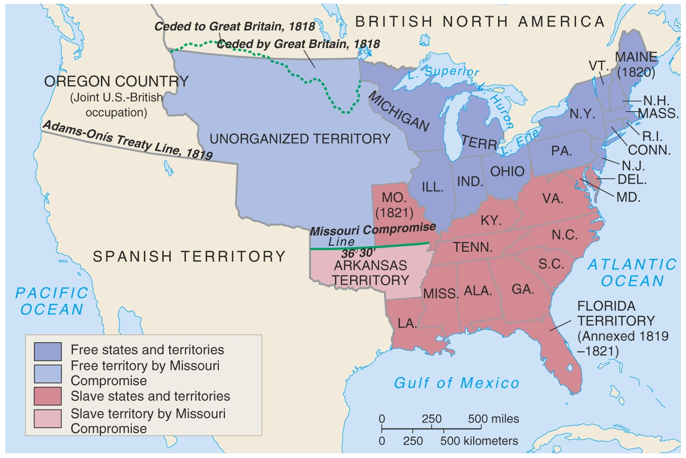

Slide 21
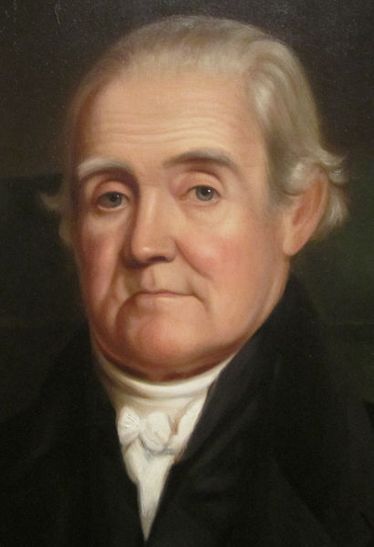
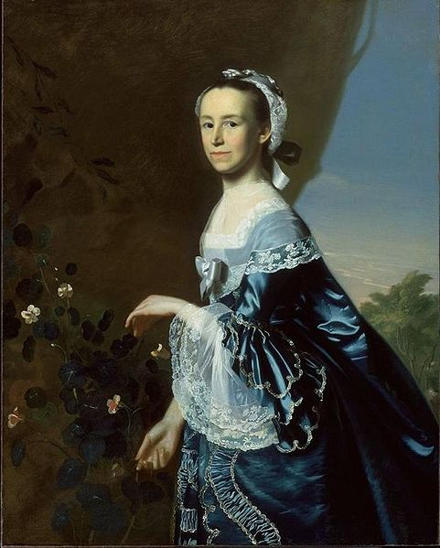
Toward a Democratic Republican Culture
Opportunity and Equality – for White Men:
US was unique in the world – no aristocratic families
However, there were numerous laws that restricted rights based on race and gender
Toward Republican Families:
Mercy Otis Warren – argued against patriarchy
Republican Marriages:
More marriages were based on love, fewer arraigned marriages
Husbands still had more power than wives - property
***Republican Motherhood***:
Mothers would raise their children to be good citizens
Mothers took a more active role in education
Raising Republican Children:
Two Modes of Parenting:
Encouraging independence v. authoritarianism
Debates Over Education:
Jefferson advocated education for Americans
More schools were located in the North – why?
1820s – increase in funding for education
Promoting Cultural Independence:
Noah Webster – helped standardize the English language

Slide 22
Aristocratic Republicanism and Slavery
The North and South Grow Apart
1. Slavery and National Politics
-Slavery and National Politics – Foreign visitors noticed distinct cultural differences between North and South; during Constitution debate, it was accepted that Congress not interfere in slavery; became a growing national issue of debate; slave trade was outlawed by Congress in 1808, but the institution remained.
2. African Americans Speak Out
Notes:
III. Aristocratic Republicanism and Slavery
B. The North and South Grow Apart
1. Slavery and National Politics
2. African Americans Speak Out – Black abolitionists became more vocal after trade ended; used the Haitian Revolution as evidence of the ability of a people to overthrow the institution; for collective support, they joined secret antislavery societies; demand for slaves continued to increase with cotton boom; in 1817, the American Colonization Society was founded by white men with the goal of freeing the slaves and sending them back to Africa; about 6,000 African Americans resettled in Liberia; most free blacks opposed such colonization schemes, as they saw themselves as Americans.
22

Slide 23
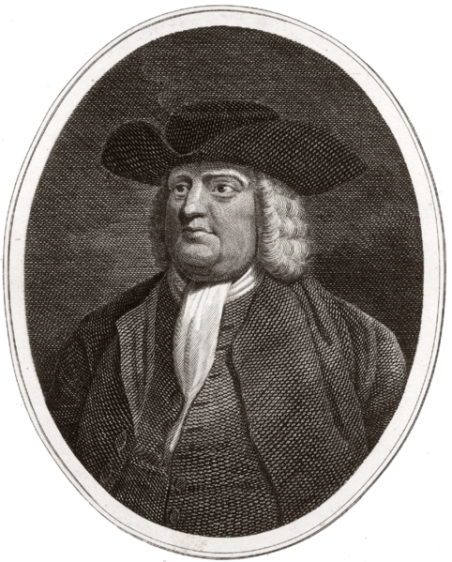
Aristocratic Republicanism and Slavery
The Revolution and Slavery, 1776 – 1800
1,000s of slaves gained freedom via the British during the Rev. War
Manumission and Gradual Emancipation:
Manumission – freeing of slaves by owners (1782)
Quakers and Enlightenment thought challenged slavery
Free blacks still faced significant discrimination
Slavery Defended:
VA legislature passed new manumission law in 1792
Slavery viewed as a “necessary evil”
Gabriel Prosser – planned rebellion, he and 30 others were hanged
As with all slave rebellions, slave laws were more harsh after a rebellion

