Slide 1
FDR and the New Deal
Mr. Winchell
APUSH Period 7

Slide 2
Do Now
How did Roosevelt’s approach to the Great Depression differ from that of Hoover?
How would the framers of the Constitution have felt about the expansion of executive power through the New Deal? Why?

Slide 3
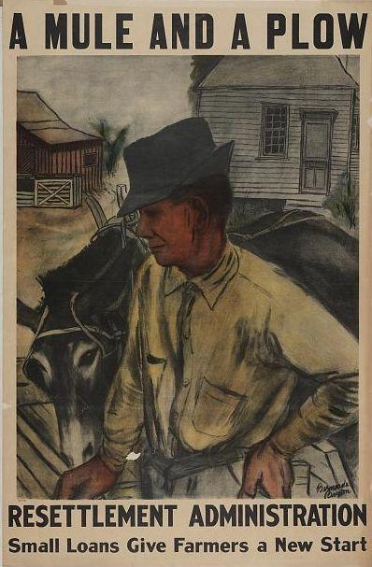
FDR’s Farm Program
Agricultural Adjustment Act of 1933 sought to reduce farm surpluses
Resettlement Administration
Farm Security Administration
Rural Electrification Administration
Agricultural Adjustment Act of 1936
A poster advertises help to farmers available through the Resettlement Administration
Notes:
Like much of the New Deal, the Roosevelt administration’s farm program consisted of several parts, each of which met with varying degrees of success:
The Agricultural Adjustment Act of 1933 was an attempt to reduce farm surpluses by paying farmers subsidies not to grow specific crops. Subsidies were to be paid by the Agricultural Adjustment Administration from revenues collected from a tax on businesses that processed food. The Supreme Court later declared the AAA unconstitutional in United States v. Butler (1936).
The Resettlement Administration aimed to assist struggling urban and rural families by relocating them in planned communities across the United States. The government created resettlement communities near various cities, including Washington D.C., Cincinnati, and Milwaukee. In addition, the Resettlement Administration funded a photography project to document rural poverty during the Depression, and two film documentaries: The Plow That Broke the Plains and The River.
The Farm Security Administration was a radical experiment that attempted to bring farmers together to learn about new technology and farming techniques by working on government-owned farms. This program met with little success because farmers had little interest in working communally, and preferred to own their own farms instead. However, like the Resettlement Administration, the FSA had a robust photographic component that produced many well-known Depression-era photographs.
The Rural Electrification Administration provided electric power to rural areas that would not otherwise have had electricity. Critics of the REA felt it unfair that the federal government was competing with private power companies.
Congress passed the Agricultural Adjustment Act of 1936 to replace the earlier AAA that the Supreme Court had struck down. Since the 1936 AAA did not rely on taxing food processors to pay subsidies, it passed the Supreme Court’s “constitutionality test.”

Slide 4
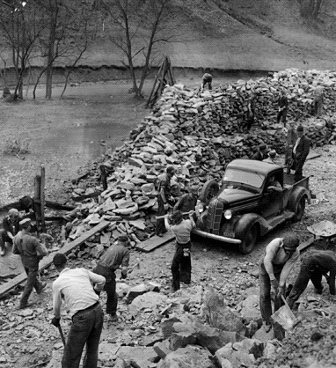
Work-Based Relief Programs
FDR considered unemployment a major, immediate problem
Work-based programs seen as a desirable alternative to handouts
Several programs were created to provide work in various occupations
Some saw the “make work” programs as boondoggles
A New Deal work-based relief program at a Florida rock quarry
Notes:
By the time FDR took office, unemployment had spiked from a low of 3.2 percent in early 1929 to a high of 24.9 percent. Seeing joblessness as a major and immediate problem, Roosevelt instituted various programs to create jobs for the country’s labor force.
The New Deal saw “make-work” relief programs as a suitable alternative to simply putting out-of-work people on the dole. Providing jobs helped maintain workers’ self-esteem while at the same time creating public works that could be used for many years after the Depression. Various make-work programs allowed workers in a variety of occupations (from carpenters and bricklayers to artists and actors) to use their expertise and skills.
However, some critics of the New Deal felt that the make-work projects were no more than a waste of money. Calling New Deal work programs “boondoggles” (after a Boy Scout craft activity meant simply to occupy scouts’ time), they criticized the impact the projects had on local economies and characterized putting people to work as ineffective.

Slide 5
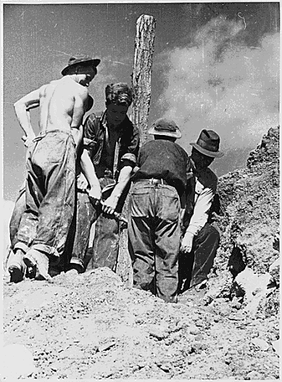
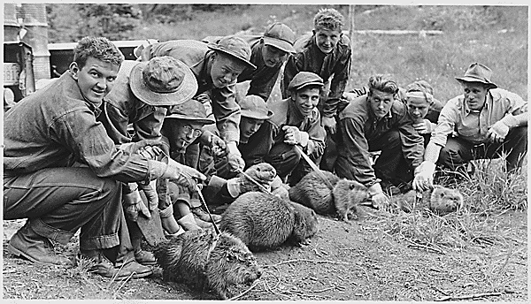
Civilian Conservation Corps
Provided jobs for young men aged 18–25
Jobs included work on environmental projects
One of the most popular New Deal programs
“Enlistees” were paid $30 per month, with $25 of that sent home to their families
Notes:
Designed to solve the problem of unemployment for American youth, the Civilian Conservation Corps soon became one of the New Deal’s most popular and best-known programs. More than 3 million young men aged 18–25 enlisted in the CCC, working in various environmental programs that included reforestation efforts and even animal relocation (such as moving beavers to areas where they would be less likely to cause damage).
The CCC had its roots in various federal departments, including the U.S. army (which ran the camps), and the Departments of Labor, Interior, and Agriculture. Enlistees in the CCC received food and clothing, as well as a monthly wage of $30 (they were required to send $25 of this home to their families).
The CCC lived up to its motto, “We Can Do It,” with various projects nationwide, many of which still exist today. However, the start of World War II made finding recruits more difficult because of the number of young men serving in the armed forces. The CCC finally dissolved in 1942. (Interestingly, some of the CCC camps were later converted to house German prisoners of war or used as relocation camps for Japanese Americans.)

Slide 6
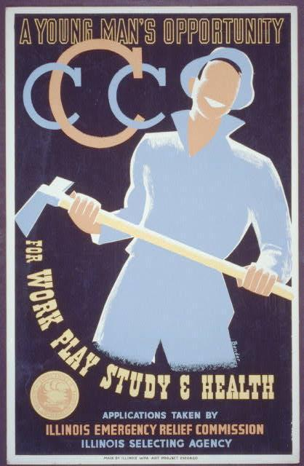
This Illinois CCC recruitment poster highlights “A Young Man’s Opportunity for Work, Play, Study, and Health.”
The artist put special emphasis on the idea that the subject of the poster appears to be having fun while working on an environmental project.
Notes:
Teacher’s note: You may wish to discuss this poster and its impact with the class. For example, you may ask students to point out what advantages and benefits the poster stresses about working for the CCC, as opposed to what isn’t stressed. The poster notes that the CCC is “a young man’s opportunity for work, play study, and health,” but it doesn’t mention that the CCC also provided money, food, and clothing to otherwise destitute and downtrodden young men. You may also ask students to speculate as to whether this poster made for an effective tool to recruit CCC members. Have students compare the impact of this CCC poster with that of other similar “recruitment” posters, including the famous “I Want You” armed forces recruitment poster.

Slide 7
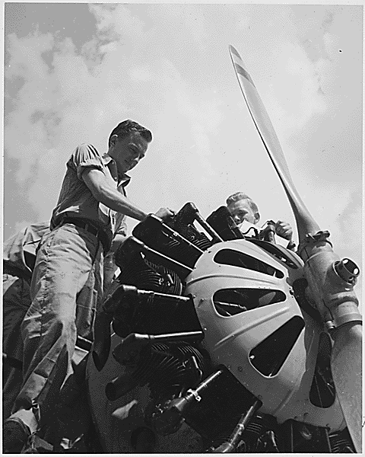
National Youth Administration
Provided part-time jobs for urban youths who wanted to remain in school
Participants paid $6–$40 per month for “work study” jobs
Employed both male and female students
Two young men of the NYA work on an airplane engine
Notes:
While the CCC provided room and board for young men needing full-time jobs, the National Youth Administration provided jobs for urban youths who wanted to earn money while remaining in school. Created in 1935 as part of the Works Progress Administration, the NYA remained in operation well into World War II; it finally ended in 1943.
Nearly 500,000 young Americans participated in NYA programs, with many learning some sort of trade or skill as a result of their experience. Participants were paid similarly to their CCC counterparts. However, while the CCC was designed only for young men, both male and female students participated in NYA activities. Future president Lyndon B. Johnson ran Texas’s NYA program.

Slide 8
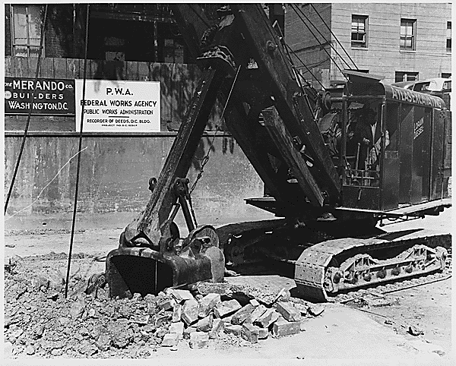
Public Works Administration
Money given to contractors for public works
Administered by Secretary Ickes
Built bridges, schools, airports, roads, Navy ships
Spent more than $6 billion
Notes:
The Public Works Administration, administered by Secretary of the Interior Harold Ickes, aimed to provide a “trickle down” benefit by giving federal money to private contractors for the creation of public works such as bridges, schools, airports, roads, and even ships for the U.S. navy. The great majority of PWA projects were roads, with schools as runner-up.
PWA projects include New York’s Lincoln Tunnel and Triborough Bridge, as well as the Grand Coulee Dam. In total, the PWA contributed approximately $6 billion to help reduce unemployment.

Slide 9
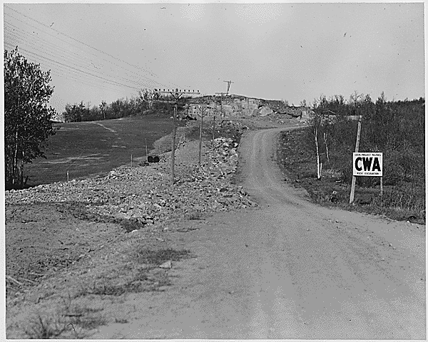
Civil Works Administration
Mainly constructed bridges and buildings
Spent over $1 billion in less than a year
Many considered it a failure
Abandoned in 1934
CWA-built public works projects included this Minnesota highway
Notes:
The Civil Works Administration also undertook significant public works projects. Reformer Harry Hopkins headed the program, but its costs quickly ballooned to more than $1 billion. Immediately, critics complained that the CWA was a “boondoggle,” and that its benefits weren’t worth the expense. One reason the CWA proved so expensive was its scope: more than four million people received jobs. Furthermore, it provided relatively high wages for most people involved in the program, also helping to inflate costs. The federal government quickly found the CWA too costly to maintain, and abandoned it after its first year.

Slide 10
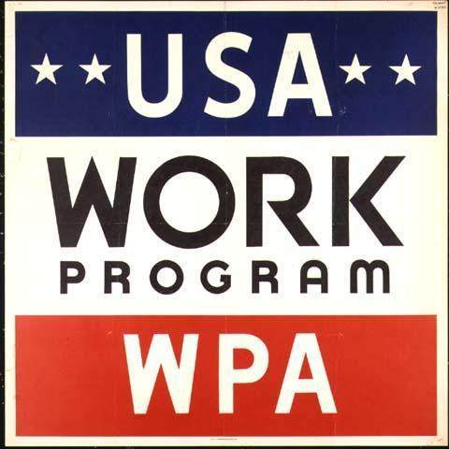
Works Progress Administration
Created in 1935
Headed by Harry Hopkins
Focused on public works such as bridges, roads, runways
Also included arts projects
Some projects famous (Camp David, Dealey Plaza)
Signs similar to this one alerted the public that a site was a WPA works project
Notes:
Perhaps the best-known of all the New Deal relief agencies was the Works Progress Administration (WPA). Created in 1935 by presidential order, funded annually by Congress, and headed by Harry Hopkins, it soon became the largest New Deal agency, and even coordinated other New Deal programs.
Most of the WPA expenditures went toward building projects, but the WPA included a significant arts component, employing artists, actors, and writers. By the time the agency was disbanded in 1943, it had spent more than $11 billion.
Many WPA projects still remain in use. Camp David, the presidential retreat, was built by the WPA, as was Dallas’s Dealey Plaza, the site of the 1963 assassination of President John F. Kennedy.

Slide 11
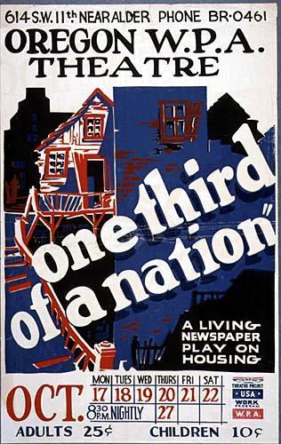
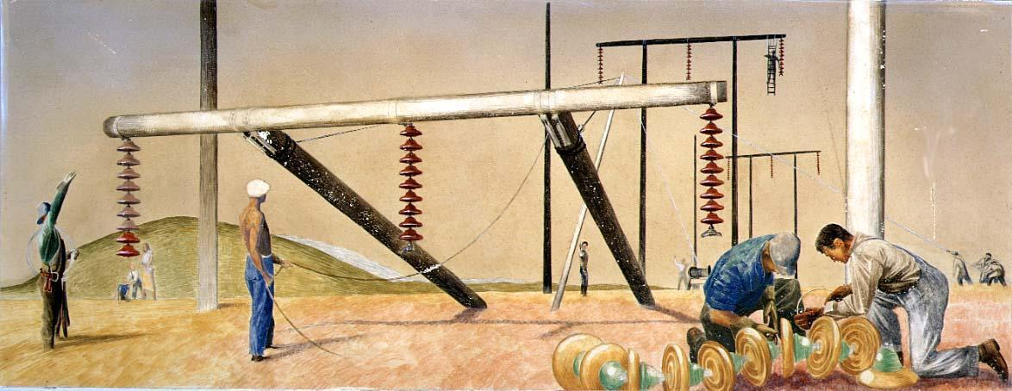
WPA: Supporting the Arts
WPA also provided funding for various arts programs
Writing, theater, photography, and painting programs
Notes:
While the WPA focused on public works projects, it also provided assistance for the arts with programs such as the Federal Writers Project, the Federal Theater Project, and the Federal Art Project. These projects assisted many struggling artists who might not have been able to make a living otherwise. In addition, the New Deal arts program brought cultural events to thousands in rural areas and small towns who might otherwise never have been exposed to such events.

Slide 12
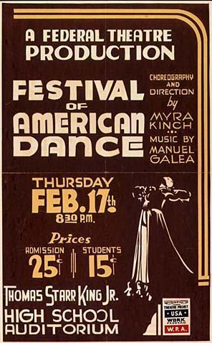
Federal Theater Project
Part of the “Federal One” project
Headed by Hallie Flanagan
“Living Newspapers”
Included Orson Welles, John Houseman, and Arthur Miller
Ran into several controversies
Notes:
The Federal Theater Project, like the Federal Art Project and Federal Writers Project, was part of the WPA’s “Federal Project Number One” (nicknamed “Federal One”). Hallie Flanagan, a theater professor at Vassar College, was named director of the FTP. Many alumni of the FTP were already (or would later become) famous in film, theater, or television. Orson Welles, who later directed the film Citizen Kane; actor John Houseman; and playwright Arthur Miller, who would later write Death of a Salesman and The Crucible, were all involved in the Federal Theater Project.
One theater innovation of the FTP was “Living Newspapers,” in which researchers for the FTP would write plays about the era’s hot-button issues. Triple A Plowed Under, for example, was a commentary on the Supreme Court’s U.S. v. Butler decision, which declared the Agricultural Adjustment Act of 1933 unconstitutional.
The FTP was a popular program, but also sparked some controversy. Critics decried some of its productions as “too left-wing.” The FTP eventually met with significant congressional criticism and ended in 1939 when its funding was cut.

Slide 13
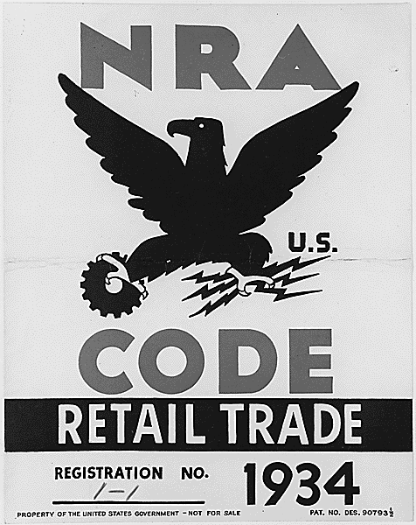
National Industrial Recovery Act
Centerpiece of New Deal recovery program
Sought to promote fair competition, raise wages and prices, and institute collective bargaining
Created “codes of fair competition”
Enforced by the NRA
Notes:
A main goal of the New Deal was to spark industrial recovery—that is, to bring business back to a pre-crash level. The centerpiece of the New Deal recovery plan was the National Industrial Recovery Act. In order for the NIRA to be effective, the government suspended antitrust laws in favor of “codes of fair competition,” which artificially inflated wages and prices. The codes also required businesses and industries to meet certain quality requirements so that consumers knew they were getting a good product for the price. In addition, section 7a of the NIRA allowed collective bargaining for workers. Through collective bargaining, workers could band together to negotiate with management for raises and benefits.
Responsibility for enforcing the codes fell to the National Recovery Administration (NRA), headed by Hugh Johnson. The NRA aimed to ensure that businesses didn’t engage in price gouging or other unfair practices. Consumers knew that a particular business subscribed to the codes if it posted the NRA’s “Blue Eagle” emblem and its slogan, “We Do Our Part.”
One of the main drawbacks to the NRA was its bureaucracy. The administration created literally thousands of pages of codes and orders, which made it difficult for NRA agents to fully know and understand all the provisions.

Slide 14
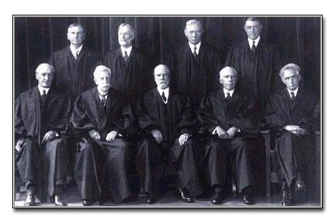
The “Nine Old Men”
Supreme Court dominated by conservatives
FDR unable to make appointments to Court
Court declared several New Deal programs unconstitutional
FDR believed that the Court was hampering needed relief and reform
Notes:
The Schechter case was just one example of conflict between the Executive Branch and the Supreme Court over the New Deal. The 1930s Court took a conservative view of the Constitution, and believed that several New Deal programs violated this interpretation.
Elected by a wide margin in 1932, FDR believed that he had a mandate from the American people to do whatever was necessary to solve the problems of the Depression, including innovative economic programs. The Supreme Court felt otherwise, and began to reject New Deal legislation, frequently by a 5–4 vote. Not only did the Supreme Court declare the NIRA unconstitutional, but it also ruled against the Agricultural Adjustment Act of 1933 in U.S. v. Butler, rejected a law guaranteeing pensions for railroad employees, and invalidated several New Deal–supported state laws that provided reforms such as a minimum wage. At the time, the Court was on the verge of hearing cases on two other centerpiece programs: the 1935 Social Security Act and the National Labor Relations Act (also know as the Wagner Act).
Roosevelt felt that the Supreme Court was unfairly attacking the New Deal. In his first term, he was not able to make any appointments to the Court, but believed that some sort of extraordinary action was needed in order to protect the remainder of the New Deal programs.

Slide 15
FDR’s “Court-Packing” Plan
FDR determined to preserve New Deal reforms
Introduced legislation for revamping the judiciary
Law would allow him to appoint one new judge for every Supreme Court member over age 70½
Would increase Supreme Court to a maximum of 15 members
Plan soundly defeated; FDR lost political support
Court-packing battle ended as a draw
Notes:
The actions of the conservative Supreme Court convinced FDR that his New Deal was in danger of being wiped out in a flurry of judicial decisions. He decided to take action, and in 1937 he announced that he wanted to revamp the federal judiciary. His plan would allow him to appoint an additional Supreme Court justice for each sitting justice over the age of 70½, increasing the size of the Court from nine to 15 justices. While his public rationale was to help the “old, overworked” judges, it became evident that he was targeting the six conservative members of the Court who consistently voted against New Deal legislation.
However, several changes made the court-packing plan unnecessary. Some of the conservative members decided to retire. In addition, the Court became more flexible in regard to New Deal legislation, and upheld several of its programs. Nonetheless, FDR continued to push for the court revamping, and his insistence to do so cost him politically. Eventually, the Senate killed the court-packing plan. Energized by their apparent victory over FDR, Congressional conservatives capitalized on anti-FDR sentiments and blocked many Roosevelt-sponsored economic bills.
In the end, the court-packing fight was essentially a draw. Roosevelt did ultimately manage to change the direction of the court (he appointed eight justices during his remaining years in office) and protected much of the existing New Deal. However, he lost a large amount of public support and political collateral by pushing his judiciary-reform program.

Slide 16
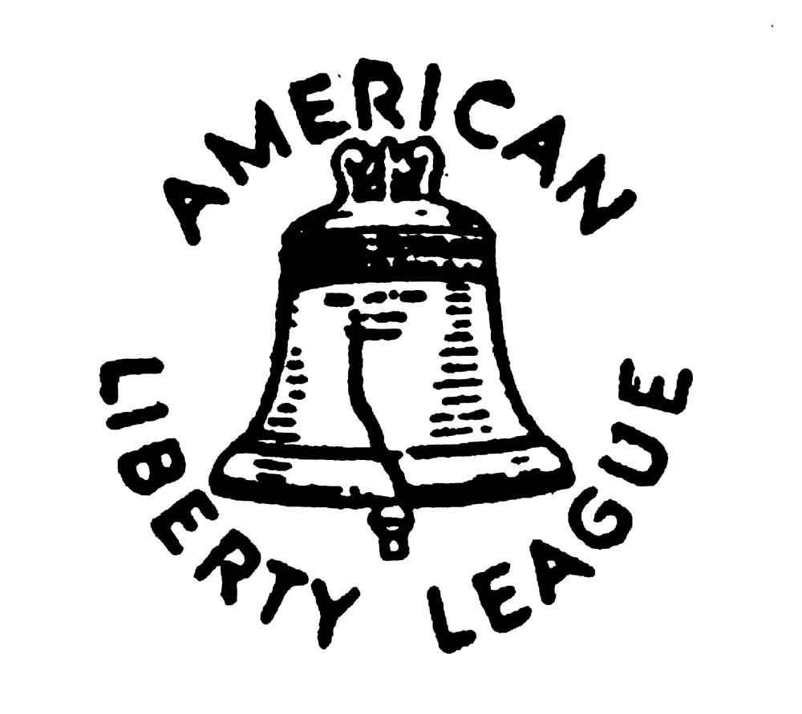
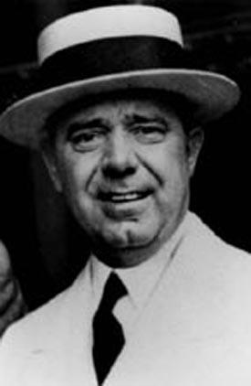
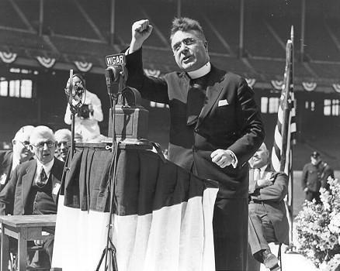
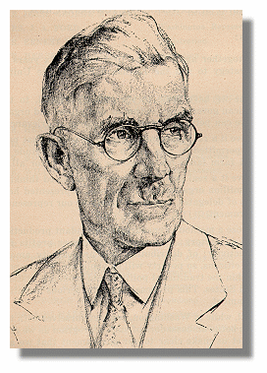
New Deal “Agitators”
Opposed New Deal before a national audience
All felt FDR had gone too far, or not far enough
None had much influence on the 1936 election or on the New Deal in general
Notes:
While FDR had a great deal of public support for his reelection campaign, some felt that the New Deal had not adequately addressed the problems of the Depression. Some “fringe” groups and individuals believed that the New Deal needed to be radically changed, or even abolished. However, none of these groups had much of an effect on the New Deal or on how the government confronted the problems of the Depression, nor did they affect the 1936 election. FDR won in a landslide, and it became apparent (at least for a while) that the nation approved of the New Deal.

Slide 17
The American Liberty League
Saw FDR as a “traitor to his class”
Believed the New Deal was leading the country toward socialism
Several famous members
Challenged the legality of the Wagner Act
Disappeared by 1940
Notes:
One group that opposed FDR and his policies called itself the “American Liberty League,” and held that the New Deal had gone too far in trying to solve the problems of the Depression. The League claimed that the Roosevelt Administration was leading the country toward socialism; noting FDR’s wealthy background, they called him a “traitor to his class.”
The Liberty League boasted several famous members, including 1928 Democratic presidential nominee and FDR’s mentor, Al Smith; 1924 Democratic presidential nominee John Davis; future Secretary of State Dean Acheson; as well as several members of the DuPont family. The League supported Republican candidates in the 1936 election and also challenged the legality of the National Labor Relations Act (i.e., the Wagner Act). However, when the Supreme Court upheld the Wagner Act, the Liberty League lost its credibility and completely disappeared by 1940.

Slide 18
Father Charles Coughlin
Catholic priest who used radio to reach mass audience
First a New Deal supporter; later a critic
Sympathetic to anti-Semitic policies of Hitler and Mussolini
Federal broadcast rules eventually forced Coughlin off the air
Father Charles Coughlin speaks at a stadium
Notes:
Another agitator against the New Deal was Father Charles Coughlin, a Catholic priest based at the National Shrine of the Little Flower Church in Royal Oak, Michigan. At first an FDR supporter (he remarked frequently in his early radio broadcasts, “Roosevelt or ruin”), he became an extremely vocal critic of the New Deal. Coughlin founded the National Union of Social Justice, an anti–New Deal organization, and targeted the Federal Reserve System, which he blamed as largely responsible for the Depression.
While attempts by the Roosevelt Administration to have the Catholic Church silence Coughlin failed, Coughlin hurt his own cause with his increasingly anti-Semitic broadcasts, hinting that Hitler and Mussolini’s anti-Jewish policies were acceptable. Several radio stations refused to broadcast his weekly shows, and the National Association of Broadcasters put stricter limits on broadcasting controversial shows after the beginning of World War II.
Finally, in 1942, the Catholic Church ordered Coughlin to end his political activities and concentrate on parish work. He returned as pastor of the Little Flower Church until he retired in 1966, although he continued to write anti-Communist pamphlets until his death in 1979.

Slide 19
Huey Long: “The Kingfish”
Louisiana governor and senator
Believed New Deal hadn’t done enough
Proposed “Share the Wealth” program
Assassinated in 1935
Revenue Act of 1935 incorporated some of Long’s ideas
Senator Huey P. Long
Notes:
Next to FDR, perhaps no politician was as popular as the colorful Huey P. Long of Louisiana. First as governor, then as senator, Long was a man people either loved or hated: some considered him a great humanitarian, others saw him as a dictator. Calling himself “The Kingfish” (after a popular Amos and Andy character), Long believed that the New Deal hadn’t done enough to solve the problems of the Depression—particularly the unequal distribution of wealth. He proposed a “Share the Wealth” plan, which would redistribute wealth across the nation by heavily taxing large personal incomes. Using the slogan, “Every Man a King,” Share the Wealth clubs grew nationwide.
Predictably, Long’s ideas and tactics made him many enemies in Louisiana as well as in Washington. In his years in the Senate, no bills that he introduced were passed into law. Still, many (including FDR) believed that Long would make a run for the White House in 1936. However, in 1935 he was assassinated by the son-in-law of a political opponent. After Long’s death, Gerald L.K. Smith unsuccessfully attempted to keep the Share the Wealth movement alive.
FDR, realizing the popular support that the Share the Wealth movement had, incorporated many of Long’s ideas into the Revenue Act of 1935, which placed a high tax rate on large personal incomes.

Slide 20
The Townsend Plan
Proposed a monthly pension of $200 for all citizens over 60
To be paid for by a national sales tax
Recipients required to spend entire payment each month
Townsend Plan groups spread across nation
Social Security Act
Dr. Francis Townsend
Notes:
Retired California physician Francis Townsend also believed the New Deal had not done enough to solve the problems of the Depression. After observing two elderly women picking through his garbage for food, he realized that something had to be done to help the nation’s retired citizens. He proposed a plan: all U.S. citizens over age 60 would receive a pension of $200 per month, paid for by a national sales tax. Recipients would be required to spend the entire $200 each month, and this influx of money would help other segments of the economy. His ideas gained support as groups dedicated to the “Townsend Plan” sprang up across the country.
However, most economists and government officials believed the Townsend Plan to be unworkable and impossible to fund. The New Deal later put forward its own old-age pension plan—Social Security. Once Social Security became a reality, Townsend and his plan faded into memory.

Slide 21
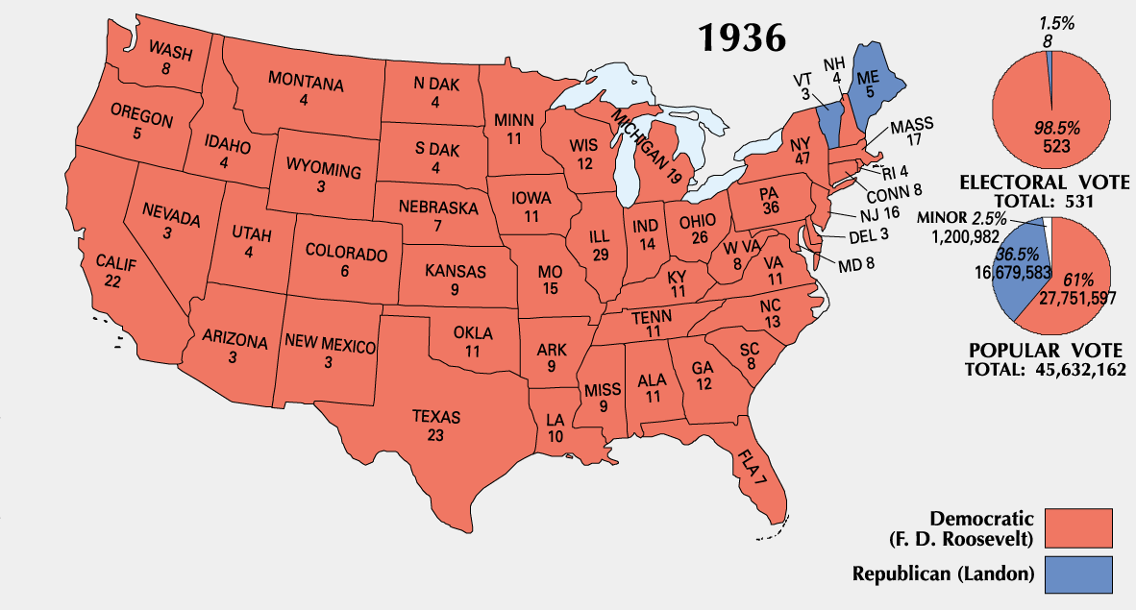
Election of 1936: Results
Notes:
This election map demonstrates FDR’s overwhelming victory in 1936. He won nearly 61 percent of the popular vote, a record that would stand until Lyndon B. Johnson’s 1964 victory against Barry Goldwater. His Electoral College triumph was even more dramatic: FDR carried 523 of 531 electoral votes—a margin of 97 percent. Landon was only able to carry the New England states of Maine and Vermont.
While FDR’s eventual victory was readily apparent to most, one source had predicted a different outcome: the Literary Digest, a nationally known publication, predicted a landslide victory for Alf Landon. Unfortunately for the Digest, it used seriously flawed logic to reach its conclusion. First, its polling relied on automobile registrations and telephone listings for its sampling. Most owners of automobiles and telephones belonged to the economic upper class, which was tended to vote Republican. Furthermore, the Literary Digest used Maine as its “bellwether” state, believing that its poll results indicated a national electoral trend. At any rate, the Digest was embarrassed and discredited by its conclusions, and soon ceased publication.

Slide 22
“New Deal Coalition”
Diverse coalition of various groups who supported FDR in 1936:
Labor unions
Urban political machines
Racial and religious minorities
Southern whites
Groups agreed on little besides the New Deal
Based on this framework, Democrats dominated the federal legislature from 1932–1980
Notes:
FDR enjoyed the support of a diverse coalition of various interest groups throughout his presidency, including labor unions, Democratic political machines in major cities, a range of minorities (such as African Americans, Catholics, and Jews), and Southern whites; outside of the New Deal, these groups agreed on little. This “New Deal Coalition” not only helped reelect FDR three times, but it also kept Democrats in control of Congress almost continually from 1933 to 1980 (losing only twice, in 1946 and 1952) and elected Democrats to the White House seven times during the period 1932–1980.

Slide 23
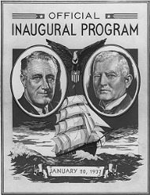
FDR’s Second Inaugural Address
“I see millions of families trying to live on incomes so meager that the pall of family disaster hangs over them day by day.
I see millions whose daily lives in city and on farm continue under conditions labeled indecent by a so-called polite society half a century ago.
I see millions denied education, recreation, and the opportunity to better their lot and the lot of their children.
I see one-third of a nation, ill-clad, ill-housed, ill-nourished…”
Franklin D. Roosevelt January 20, 1937
The cover of the program for FDR and Vice President Garner’s inauguration
Notes:
In his Second Inaugural Address, FDR reminded the audience of the work still needed to solve the problems of the Depression. His “I see one-third of a nation” statement became nearly as famous as his “The only thing we have to fear is fear itself” line from his 1933 inauguration.
Teacher’s note: You may want to take a few minutes and ask students to compare the tone of the two speeches to determine if FDR’s message about dealing with the Depression had changed dramatically since the beginning of his first term.

Slide 24
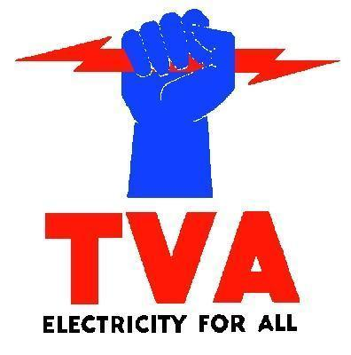
New Deal Reform Measures
Sought to ensure that conditions leading to Depression did not reoccur
Many reforms radically changed American society
Several New Deal programs and reforms still in effect today
Social Security
Pure food and drug laws
Tennessee Valley Authority
FDIC
Notes:
While much of the New Deal focused on relief and recovery during the Depression, the Roosevelt Administration also focused on reform—that is, ensuring that the conditions leading to the Depression would not occur again. In addition, FDR wanted to provide progressive reforms that would improve Americans’ lives and protect them far beyond the scope of the New Deal. Many of these programs—including Social Security, pure food and drug laws, the Tennessee Valley Authority, and the Federal Deposit Insurance Corporation—are still in effect today, nearly three-quarters of a century after the Depression.

Slide 25
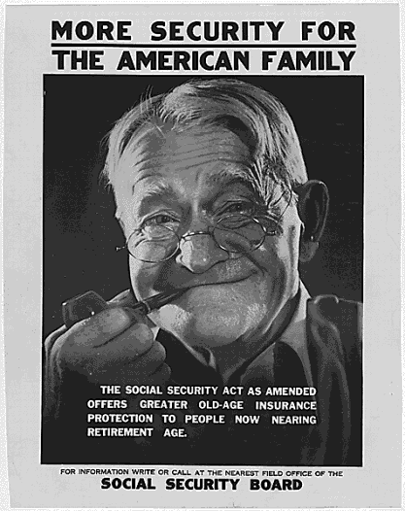
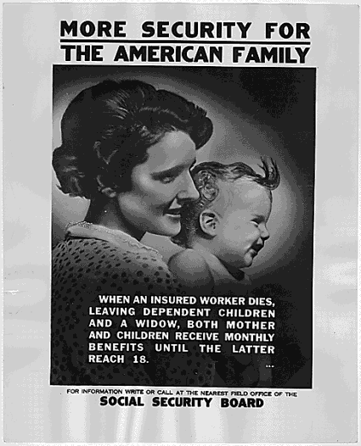
Social Security Act of 1935
First suggested by Frances Perkins
Provided for
Old-age pensions
Unemployment insurance
Aid to dependents
Funded by a payroll tax
Notes:
One of the longest lasting New Deal reform programs became law in 1935. First proposed by Secretary of Labor Frances Perkins, the Social Security Act became possibly the most important legacy of the New Deal. While the Townsend Plan would have given pensions to those 60 and older, the Social Security Act provided for this and more—unemployment insurance and aid to widows, dependents of covered workers, and disabled workers.
Unlike the Townsend Plan, which called for a national sales tax, Social Security was funded by a payroll tax called the Federal Insurance Contribution Act (FICA). Most workers nationwide were required to participate in the program, with a percentage of their salary going to the fund and their employer matching the contribution. Money contributed by workers would go to pay benefits for current beneficiaries.
With the passage of the Social Security Act, the United States was placed firmly on the road to becoming a “welfare state,” in which the government took care of its citizens from cradle to grave. In addition to old-age pensioners, dependents of disabled or deceased workers could expect benefit payments, as could those who had lost their jobs.
In the early 1960s, Social Security was expanded to include Medicare, which provides medical insurance for elderly Americans. However, as the growing number of retirees and cost-of-living increases for pensions has put strain on the system, many presidents (and presidential candidates) have wrestled with the issue of maintaining Social Security’s solvency, as well as ensuring its availability for generations to come.

Slide 26
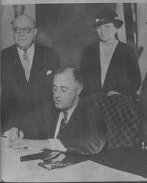
National Labor Relations Act
Also known as the “Wagner Act”
Allowed for collective bargaining
Protected rights of laborers to form unions
Also created the NLRB
FDR signs the Wagner Act as Labor Secretary Perkins looks on
Notes:
Section 7a of the NIRA had guaranteed the rights of labor to bargain collectively, but in Schechter Brothers v. U.S. (1935), the Supreme Court had declared the NIRA unconstitutional. However, that year’s National Labor Relations Act reestablished labor’s right to bargain collectively and to form unions. Sponsored by New York Senator Robert F. Wagner, this legislation soon became known as the “Wagner Act.” The NLRA also created the National Labor Relations Board, which was charged with investigating charges of unfair labor practices and ensuring fair elections to decide whether workers would join a union.
Early on, however, many unions simply chose to strike rather than utilize the NLRB to settle labor disputes. The Wagner Act passed a major hurdle in 1937 when the U.S. Supreme Court upheld the law as constitutional in the case National Labor Relations Board v. Jones & Laughlin Steel Corporation.
Businesses resented the measure and worked to undermine it. In 1947, over the veto of President Harry Truman, Congress passed the Taft-Hartley Act, which limited the power of the Wagner Act.

Slide 27
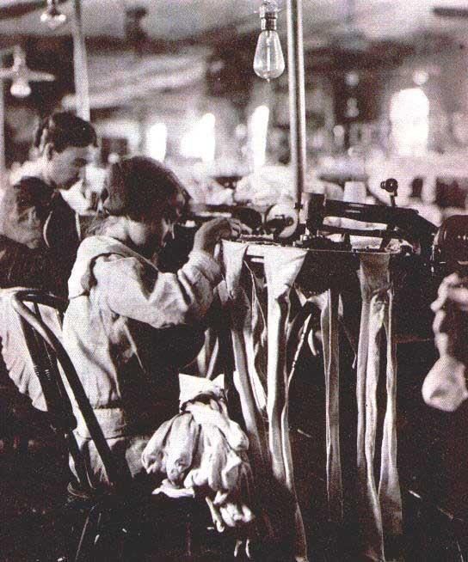
Fair Labor Standards Act
Guaranteed a federal minimum wage
Set at 25 cents per hour in 1938
Guaranteed overtime pay at “time and a half”
Prohibited “oppressive child labor”
The FLSA prohibited children (such as the one shown in this photo) from working in hazardous jobs
Notes:
Another law that protected the rights of workers was the 1938 Fair Labor Standards Act. The law guaranteed the first federal minimum wage—set at 25 cents per hour—and ensured “time and a half” overtime pay in most instances. The minimum wage jumped to 40 cents per hour during the World War II. In addition, the FLSA prohibited “oppressive child labor,” which included most employment of minors. The FLSA also provided a framework for underpaid workers to collect back wages, as well as damages against their employer for underpayment.

Slide 28
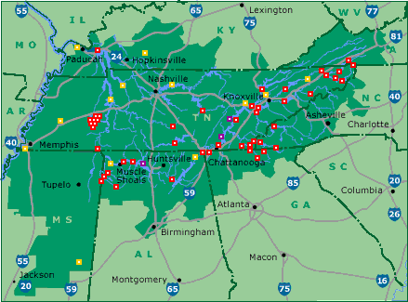
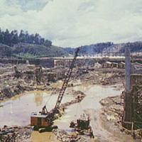
Tennessee Valley Authority
Created to assist Tennessee Valley area
Headed by David Lilienthal
Provided flood control and cheap hydroelectric power
Also protected the social and economic welfare of people in the area
Notes:
Another controversial New Deal reform program was the Tennessee Valley Authority, created in 1933 to benefit those living in the Tennessee River Valley area. Under the direction of David Lilienthal, the TVA built dams for flood control, provided cheap hydroelectric power for people in the region, and also created several recreational lakes. The first dam along the Tennessee River was completed in 1936. By the end of the 20th century, the TVA was the nation’s largest producer of hydroelectric power.
The TVA was not without controversy. Building the dams and diverting rivers meant displacing more than 15,000 farmers. In addition, many private power companies criticized the TVA’s ability to sell hydroelectric power at a reduced rate. In the case of Ashwander v. TVA (1936), the Supreme Court upheld the TVA’s constitutionality, ruling that the regulation of streams and waterways fell under legal use of the commerce power. In regard to the contention that the federal government competed unfairly with power companies, the Court ruled that the production of electricity was a byproduct of waterway regulation and was therefore legal.

Slide 29
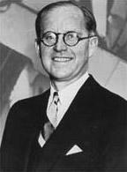
Securities and Exchange Commission
Created through Securities Act of 1933 and Securities Exchange Act of 1934
Laws required truth in sales of securities and fair treatment of investors
SEC’s purpose to provide market stability and protect investors
Joseph P. Kennedy, the first head of the SEC
Notes:
The Securities and Exchange Commission resulted from the passage of two laws: the Securities Act of 1933 and the Securities Exchange Act of 1934. The laws were designed to protect investors against fraud by requiring sellers of securities to tell the truth about what exactly they were selling and to treat investors fairly and honestly, to keep the market more stable than it had been in pre-Depression years, and to compel investment companies to put the interests of investors first. The SEC was created to enforce the newly passed security laws, promote stability in the market, and protect investors. As the first head of the new SEC, FDR selected banker and financier Joseph P. Kennedy, the father of the future President John F. Kennedy.

Slide 30
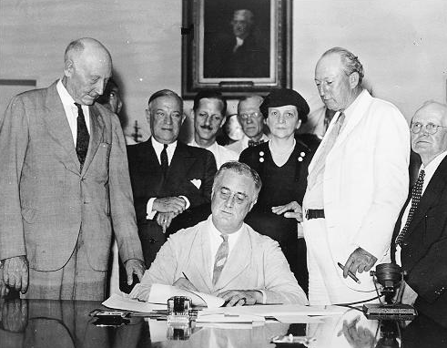
Creation of the “Welfare State”
New Deal signaled the beginning of the “welfare state”
Government became the overseer of citizens’ welfare from “cradle to grave”
Many New Deal reform programs still greatly affect American life
Some see the costs and level of government involvement as drawbacks
FDR signing the Social Security Act into law
Notes:
As the New Deal attempted to solve the problems of the Depression, it began to change the relationship between government and citizen in an arrangement known as a “welfare state.” In such a system, the government takes responsibility for the health and safety—i.e., the welfare—of the individual citizen “from cradle to grave.”
Many of the New Deal’s reform programs carried out functions of a welfare state and are still evident today: The Social Security Administration not only furnishes pensions for the elderly and retired, but also offers compensation to the unemployed and payments to dependents of deceased and disabled persons. Dams created by the Tennessee Valley Authority still control flooding and generate hydroelectric power for the region. The Food and Drug Administration (acting under the Food, Drug, and Cosmetic Act) acts as a watchdog for the health and safety of consumers. The Federal Deposit Insurance Corporation insures bank deposits up to a certain amount.
Such a system does have its drawbacks, however. While the government does provide “cradle to grave” protection for citizens, it does so at a significant cost. Due to the increasing number of retirees, the financial health of Social Security has been a major concern of the government for some time, and the possibility exists that the system may go bankrupt. Other welfare state programs have put a significant financial burden on the federal government as well as state governments. Some physicians and seriously ill people have voiced concerns that the FDA has become overcautious in approving drug treatments for various diseases.
All in all, most Americans look at many of the programs related to the New Deal as “birthrights,” and resist any attempt to significantly reduce the scope of or eliminate these programs.

Slide 31
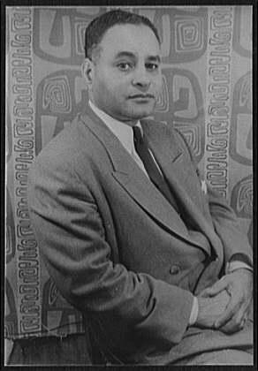
FDR and Civil Rights
Significant debate regarding FDR’s civil rights record
Refused to support anti-lynching law
Did not work to integrate armed forces
FEPC ensured equal opportunity for African Americans in government and defense-industry jobs
Appointed African Americans to government positions
Ralph Bunche
Notes:
Many historians have debated FDR’s record regarding civil rights. Some find fault with his failure to support an anti-lynching bill and laws that would have given African Americans increased employment rights and integrate the armed forces. Others look at the necessity of protecting New Deal legislation, as well as of maintaining the New Deal coalition, as the rationale behind his reluctance to support civil rights legislation. Favoring civil rights for African Americans would likely have led influential Southern senators to withdraw their crucial support for New Deal programs.
On the other hand, FDR’s administration did support some civil rights legislation, such as the executive order creating the Fair Employment Practices Committee (FEPC), which gave equal opportunity to African Americans in the defense industry and government jobs. He also included African Americans in higher-level New Deal positions, including Mary McLeod Bethune and Ralph Bunche.
However, FDR’s lack of support for the anti-lynching measure, as well as his reluctance to integrate the armed forces during World War II, lead many to rate his civil rights record mixed at best.
Picture note: Photograph in this slide by Carl Van Vechten, housed at the Library of Congress.

Slide 32
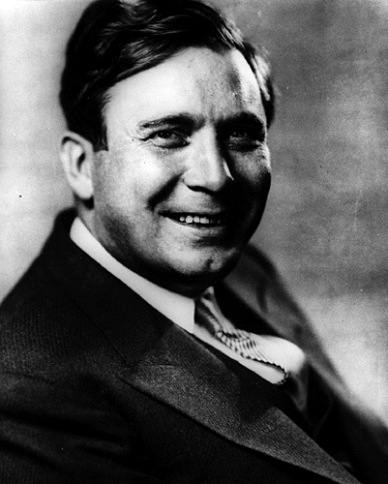
The Election of 1940
Wendell Willkie, the “dark horse” GOP candidate
FDR allows himself to be drafted for third term
FDR wins, but with a smaller margin of victory than in 1932 and 1936
Wendell Willkie
Notes:
The Election of 1940 pitted Wendell Willkie, an Indiana corporate attorney, versus FDR, who had decided to allow himself to be drafted for an unprecedented third term. With American involvement in World War II looming, some Americans felt it would be unwise to “change horses in midstream,” and chose to keep Roosevelt in office.
Both candidates were internationalists who believed that the United States should take an active role in world affairs. Willkie, previously a Democrat and a New Deal supporter, became a critic of FDR after the creation of the Tennessee Valley Authority. As a “dark horse” candidate for the GOP nomination, Willkie won on the sixth ballot against several better-known candidates, including Thomas E. Dewey and Robert Taft.
On election day, FDR defeated Willkie, but with a smaller margin of victory than in the elections of 1932 and 1936. Roosevelt received nearly 27 million votes to Willkie’s 22 million. Willkie, for his part, did manage to carry 10 states.
Willkie later became a strong proponent of U.S. involvement in European affairs leading up to World War II. However, his sudden death in 1944 ended any thought of a repeat run for the Republican nomination.

Slide 33
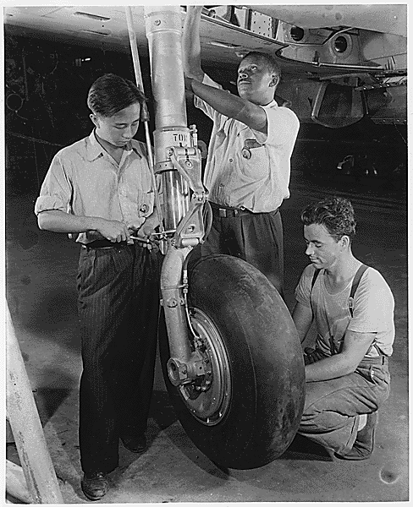
The End of the New Deal
A recession and jump in unemployment raised concerns about the New Deal
Several New Deal agencies continued into the early 1940s
Full employment and the end of the Depression only occurred with U.S. involvement in World War II
Workers assemble a military aircraft
Notes:
Although the New Deal had made inroads in solving the problems of the Depression, many Americans still saw economic recovery as a far-off goal. A recession and a four-percent jump in unemployment in 1937 and 1938 caused many to doubt that Roosevelt had actually solved the economic crisis.
Several relief agencies created in the early days of the New Deal, such as the CCC and WPA, continued into the 1940s. Many economists note that while the New Deal didn’t fix all the problems caused by the Depression, it did make them less severe. However, other economists believe that the New Deal policies actually prolonged the Depression.
If the New Deal did not actually end the Depression, the onset of World War II did. Long before Japanese attacked Pearl Harbor, the United States had begun to mobilize for an eventual war with Germany and Japan. To accomplish this, millions of new jobs had to be created, along with the institution of the nation’s first peacetime draft. For the first time in years, the U.S. was at full employment, and with the increase in war-related manufacturing the nation’s GNP rose significantly.

Slide 34
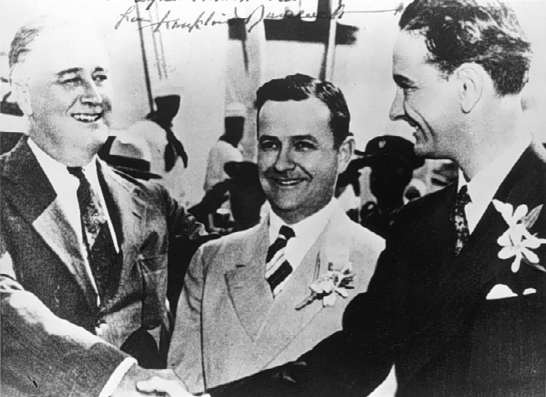
The Legacy of the New Deal
Enlargement of government
Deficit spending
Welfare state
Inspiration for future welfare programs, such as LBJ’s “Great Society”
FDR shakes hands with Texas NYA director—and future president—Lyndon Johnson
Notes:
The New Deal changed American life more than any other set of programs in the nation’s history. While it did not completely solve the problems of the Depression, it did expand government influence by regulating banking, the stock market, and food and drug companies, as well as protecting millions from joblessness and starvation.
Another lasting legacy of the New Deal is the beginning of the welfare state, in which the government takes care of its citizens over their whole lives. Programs such as Social Security, the Tennessee Valley Authority, and the Federal Deposit Insurance Corporation have became fixtures of the American landscape.
Furthermore, FDR’s example has guided other presidents toward enacting their own social welfare programs. Probably the best-known of these programs was Lyndon B. Johnson’s “Great Society,” which sought to extend the New Deal’s welfare programs even further through programs such as Medicare, which brought low-cost health insurance to millions of elderly persons.
Assessing the New Deal’s legacy has proven controversial. Many point to the New Deal and its social welfare programs as the beginning of runaway government spending because of its large number of entitlement programs. Others believe that the New Deal led to the federal government becoming too involved in Americans’ lives. No one, however, disputes the influence that the New Deal exerted—and continues to exert—upon Americans’ lives.

Slide 35
WHAT HAS BEEN THE LEGACY OF THE NEW DEAL?
1. An acceptance by society that the government has a responsibility to financial take care of its citizens- the emergence of the so-called “welfare state.”
2. An acceptance of Keynesian economic theory in times of economic trouble.
3. An acceptance of the government’s role in business.
4. An acceptance of maintaining a national debt

