Slide 1
Federalist Party Falls
Mr. Winchell
APUSH Period 3

Slide 2
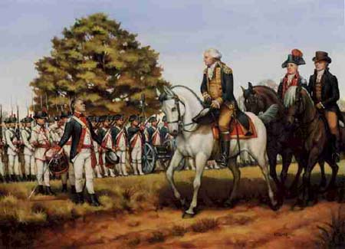
Whiskey Rebellion
SW Penn ppl hit hard by excise tax
“Whiskey Boys” torched bldgs, tarred and feathered tax collectors, talked of “secession”
GW summoned militia of several states (13,000) – escorted by GW and A Ham themselves
First display of fed’l gov’t “ensuring domestic tranquility”
Jeffersonians condemned
action as a “brutal display of force” and gained more followers.

Slide 3
The Whiskey Rebellion
Many praised the fact that this government could defend the nation from rebellion
The Articles had failed to stop Shays’ Rebellion
Anti-Federalists instead feared the growing power of the central government
Federalists supported Washington’s actions, Republicans condemned the federal government’s actions

Slide 4
The French Question
During Washington’s first term (1788-1792), the French Monarchy was overthrown by the people in an attempt to establish their own republic.
French declared themselves a “republic” but carnage heavier than in American Rev.
Jeffersonians thought it unfortunate, but probably necessary
Hamiltonians thought it downright frightening
During the Revolution, the US formed an alliance with the French monarchy
The British attempted to take advantage of the situation and began a war with France also

Slide 5
The French Question
Republicans pushed for the US gov to honor the alliance and come to the aid of the French
The Federalists stated that the alliance had been formed with the French Monarchy, and therefore no longer existed.
They actually openly supported the British as they did not want to support a bloody and violent revolution in fears of it happening again in the US

Slide 6
Neutrality
Instead of siding with either nation, Washington issued the Proclamation of Neutrality
He did not believe that the US was strong enough to become involved in a foreign conflict
The proclamation stated that the US would support neither in the war and wanted to stay neutral
Washington himself urged the American people to remain neutral as well

Slide 7
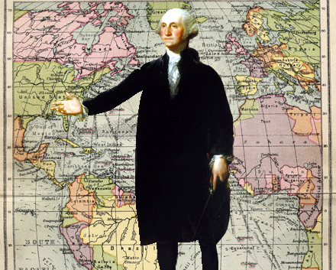
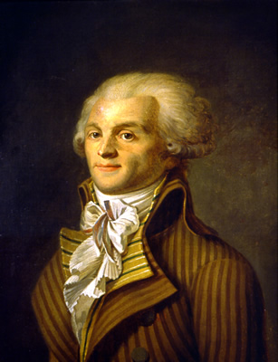
Washington’s Neutrality Proclamation (1793)
US would be neutral
Warned US citizens to be impartial to both sides.
Jefferson furious – GW did not consult Congress
Hamilton supported it.
Citizen Genet
French diplomat in US who felt Neutrality Proclamation not a true reflection of US feelings towards France
Went to ppl directly to ask for money and supplies for war cause
GW booted him out of country.

Slide 8
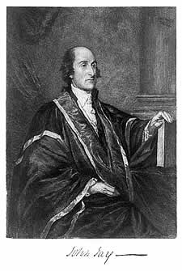
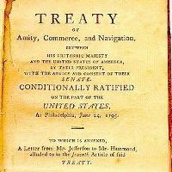
Second Test: Jay’s Treaty
GB a thorn in US side
constantly harrassing US frontier settlers
Seized 300 US ships and impressed (stole) US sailors.
GB stayed in posts in violation of 1783 peace treaty
Sold firearms and alcohol to Natives who attacked US settlers.
Feds did NOT want war with GB (75% of import duties from GB trade)
Jeffersonians wanted embargo

Slide 9
Jay’s Treaty
In order to avoid war with the British, Washington sent John Jay to England to negotiate a new treaty:
He was instructed to:
Have the British abandon forts on American lands
Have the British pay for damages to American shipping
Have the British abandon its practice of seizing American shipping and impressing American sailors

Slide 10
Jay’s Treaty
Jay’s Expectations >>>>>>>> Jay’s Treaty
The British agreed to abandon the forts, BUT did not say when
The British agreed to pay for SOME of the American shipping losses
BUT it said the Americans would have to pay the British debts owed to them from the Revolution
BUT said nothing about further seizures of US cargoes and impressment of American soldiers

Slide 11
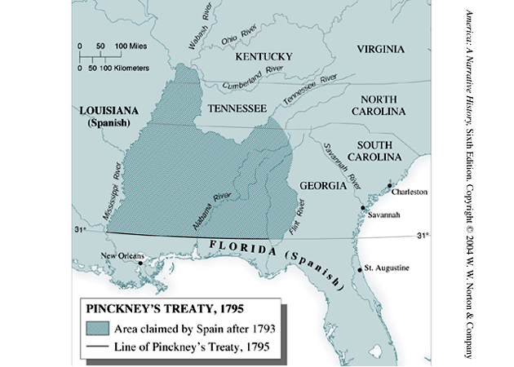
Pinckney Treaty
Now Spain??
Spain worried about Anglo-American alliance – ready to give up some rights in North America
Granted US rights to navigate Mississippi and port of New Orleans
Yielded large tract of land north of Florida (north of 31st parallel)

Slide 12
Washington’s Precedents
Two terms
“Mr. President”
Cabinet
Neutrality
Special Relationship with Great Britain
Farewell Address

Slide 13
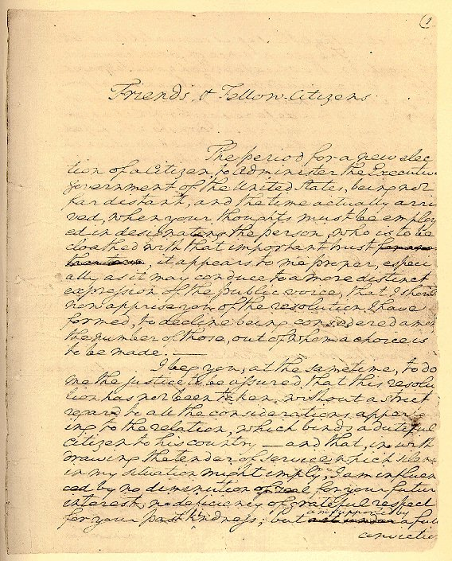
F. Washington’s Farewell Address
Refused third term
Set precedent for two-term presidency
GW exhausted physically and tired of verbal abuse from TJ for becoming partisan
Farewell Address
Warned of evils of political parties
Warned of entangling alliances (like treaty with France)
Isolationism became dominant foreign policy for next 100 yrs.

Slide 14
Washington’s Farewell
Washington’s Farewell Address
Retired after two terms
Preserve treaties and avoid alliances
Condemned political parties and partisan conflicts
Warned of sectionalism and to preserve unity
Religion and morality and diffusion of knowledge (education)

Slide 15
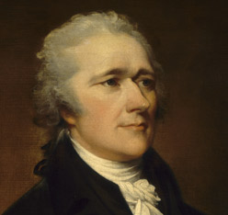
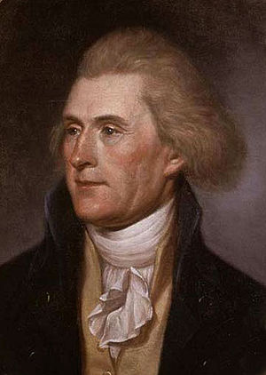
First Political Party System (1789-1824)
Alexander Hamilton
Thomas Jefferson
Federalists
National policies
Strong central government
Loose constructionists
Commerce and manufacturing
Urban
The rich, the well-born, the able; merchants, bankers
Pro-British
Anti-French revolution
Northeast
Democratic-Republicans
States rights
Strong local/state governments
Strict constructionists
Agricultural
Rural
Small farmers, plantation owners, artisans
Anti-British
Pro-French Revolution
West and South

Slide 16
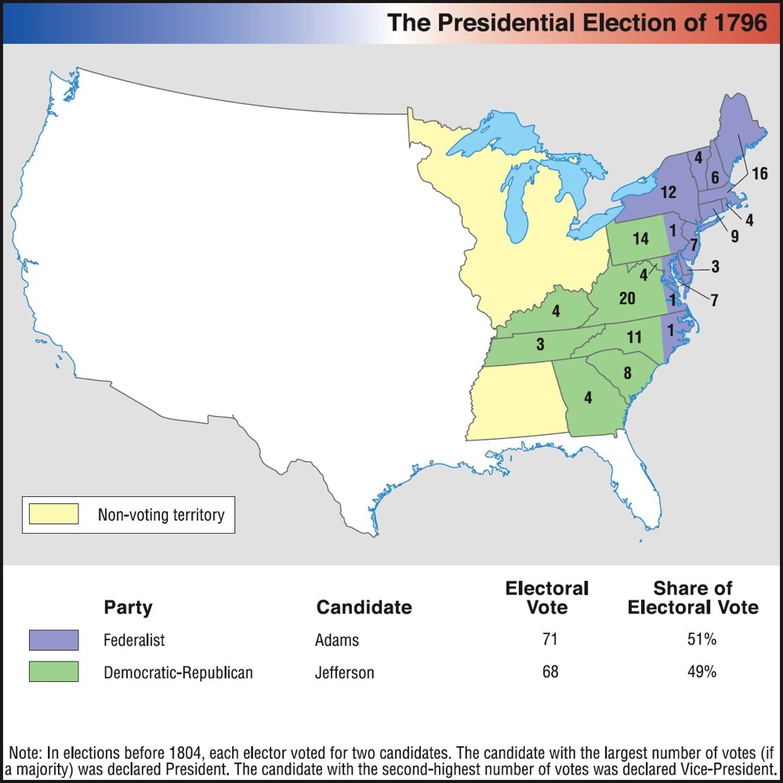
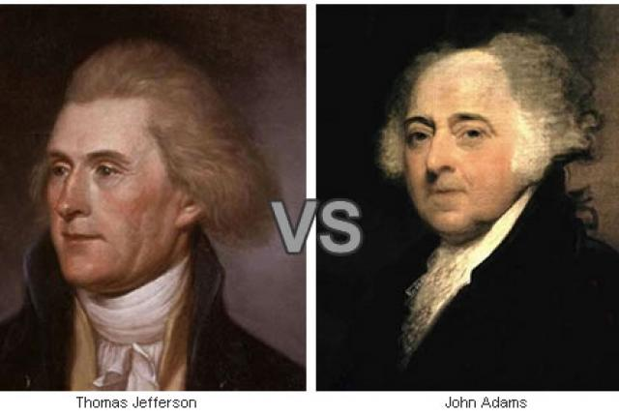
Election of 1796

Slide 17
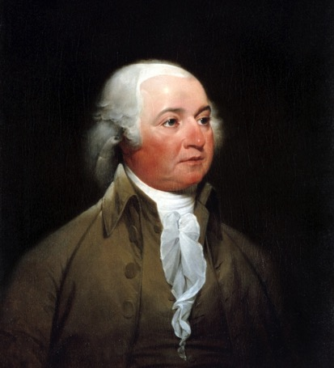
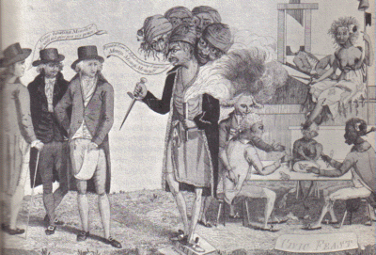
John Adams
Election
1796 - Defeats TJ 71 -66 in Electoral College
TJ becomes VP
Foreign Flare-Ups
France
Saw Jay’s Treaty as a violation of 1778 Franco-American Treaty
Seized 300 merchant vessels by mid-1797.
XYZ Affair
John Adams sent delegation to France to work it out
Approached by 3 French agents (“X, Y and Z”) who demanded loan and bribe of 250,000 to talk to French foreign minister Talleyrand.
US delegates scoffed, “Millions for defense, but not one cent for tribute (bribes)”
Negotiations broke down
Undeclared Hostilities with France 1798-99
US expanded its 3 ship Navy
US Marine Corps established
Embargo with France imposed
Adams tried to avoid full-blown war

Slide 18
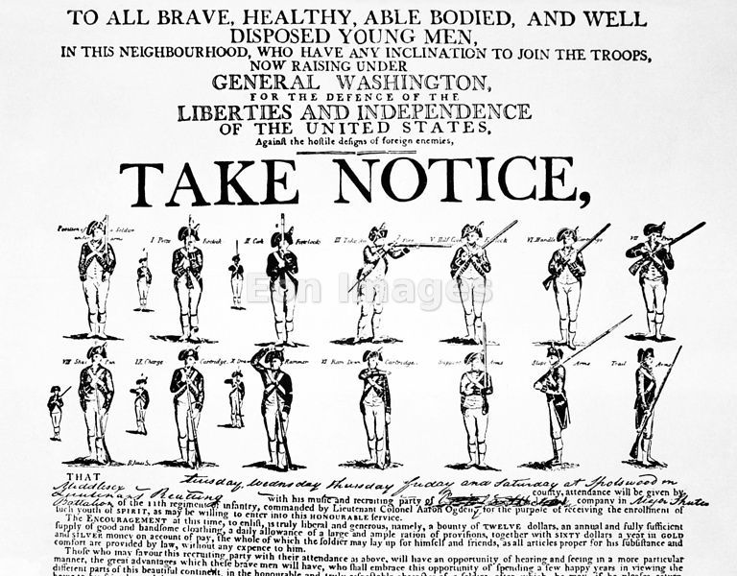
War Avoided
John Adams sent new envoy to France in 1800
Napoleon accepted – more bent on European conquest, not war with US
Improved Relations made Louisiana Purchase possible 3 years later.
Adams felt dodging this bullet was his finest achievement.

Slide 19
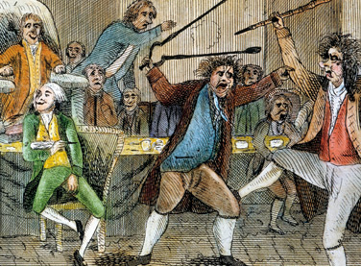
Alien and Sedition Acts (1798)
Purpose: to reduce power of Jeffersonians and silence anti-war opposition
Alien Act
Attack on pro-Jeffersonian “aliens”
Raised residency requirements for US citizenship from 5 yrs to 14 yrs.
President could deport “dangerous” foreigners.
Sedition Act
Anyone who impeded policies of the gov’t or falsely criticized its officials would get heavy fine and imprisonment.
Direct violation of 1st Amendment
Expired day before Adams left office.

Slide 20
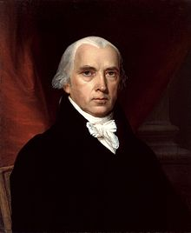
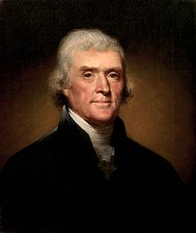
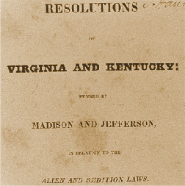
Virginia and Kentucky Resolutions (1798)
Republicans felt Alien and Sedition Acts were unconstitutional
Jefferson and Madison secretly penned two resolutions that asserted that states have the right to nullify unconstitutional laws passed by Congress.
Federalists retorted that the people, not states created Constitution and that the Supreme Court and not states determined the constitutionality of laws.
No other states but VA and KY adopted resolutions, but southern states would use this later in 19th century to support nullification and secession.

Slide 21
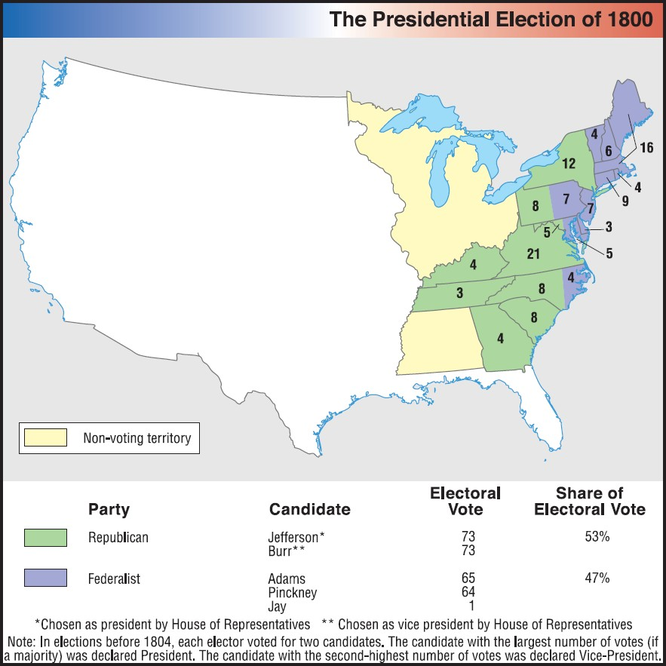
Revolution of 1800

Slide 22
The End of the Federalist Era
Jefferson wins in 1800.
Strengthened the national government.
Established a solid financial system
Encouraged American industry growth
Avoided war with both Britain and France
Though their time in power was a brief 12 years, the Federalist Party left a significant legacy

