Slide 1
Fighting Communism in Korea and Home
Mr. Winchell
APUSH
Period 8

Slide 2
Do Now
What were the circumstances surrounding the first Red Scare? How did they differ from the second?
How did attempting to contain Communism abroad lead to an evolution of society within America? Be specific.

Slide 3
US Foreign Policy during the Cold War
Containment – keep Communism where it is, don’t let it spread to other countries
Why was the US afraid of communism?
Why did the US want capitalism?
Domino Theory – if one nation becomes communist, other nations around it might be communist

Slide 4
1940s Cold War Developments
1945 – US invents and uses nuclear bombs
1948 – Czechoslovakia becomes Communist
1948-49 – Berlin Blockade and Airlift
1949 – US forms the North Atlantic Treaty Organization (NATO) to defend Western Europe from Communist countries
1949 – Soviet Union creates nuclear bomb
1949 – Mao Ze Dong wins Communist Revolution in China

Slide 5
North vs South
The North Koreans Kim Il Sung (a communist) and the South Koreans elected Syngman Rhee (a capitalist)
They were supposed to negotiate a unification by 1949. But then the superpowers got involved.
US gave $ to South Korea, USSR gave $ and weapons to North Korea, and Kim Il Sung, with Stalin’s permission, invaded the South

Slide 6
Truman & Containment (1945-1953) Korean Conflict (1950-1953)
North Korean Invasion (1950)
Advised by Soviet Union and China
Truman and United Nations Intervention
General Douglas MacArthur launched successful counterattack
Repulsed to 38th parallel by Chinese support troops
Armistice (1953)
38th parallel: Communist North and Democratic South
Truman win/lose
Containment worked
“soft on Communism”

Slide 7
Nuclear Arms Race
Nuclear weapon development
United States develops weapons with higher yields
Soviet Union
Detonated first nuclear weapon (August 1949)
United Kingdom
Detonated first nuclear weapon (October 1952)
France
Detonated first nuclear weapon (February 1960)
China
Detonated first nuclear weapon (October 1964)

Slide 8
Second Red Scare (1947-1957)
Government Policies
Loyalty Review Board
McCarran Internal Security Act (1950)
House Un-American Activities Committee (HUAC)
Investigate Americans for pro-communist beliefs and blacklisting
Senator Joseph McCarthy (R)
McCarthyism
Espionage
Alger Hiss
Klaus Fuchs
Julia and Ethel Rosenberg

Slide 9
The Cold War at Home
Height of WWII, 80,000 Americans claimed membership in the Communist Party
Some feared that the first loyalty of these American Communists was to the Soviet Union

Slide 10
Government Actions
March 1947: Truman sets up the Loyalty Review Board.
Investigate federal employees and dismiss those disloyal to the US government.
The US Attorney General created a list of 91 ‘subversive’ organizations-membership in any of these was ground for suspicion.

Slide 11
The House Un-American Activities Committee (HUAC)
Committee made headlines in 1947 for investigating communist influence in the movie industry.
Committee believed that Communists were sneaking propaganda into films.
HUAC subpoenaed witnesses from Hollywood to discuss their involvement

Slide 12
Hollywood Ten
Ten witnesses refused to cooperate because they believed the proceedings were unconstitutional.
Put in jail
The committee blacklisted 500 actors, directors, writers, and producers whom they believed had ‘communist connections’

Slide 13
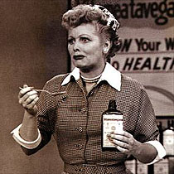
Lucille Ball
1953-Investigated by HUAC for registering to vote as a communist in the 1930’s at the urging of her Grandfather.

Slide 14
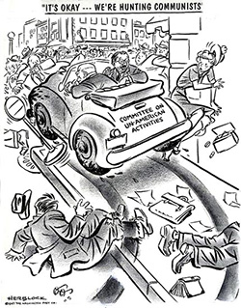

Slide 15
Espionage!
Alger Hiss: Accused of being a spy for the Soviets.
Young Republican named Richard Nixon gained fame by tirelessly prosecuting Hiss.
Found guilty and jailed…less than 4 years later, Nixon was VP

Slide 16
The Rosenbergs!
Accused of providing information to the Soviets which enabled them to produce the atomic bomb in 1949.
Found guilty and executed.

Slide 17
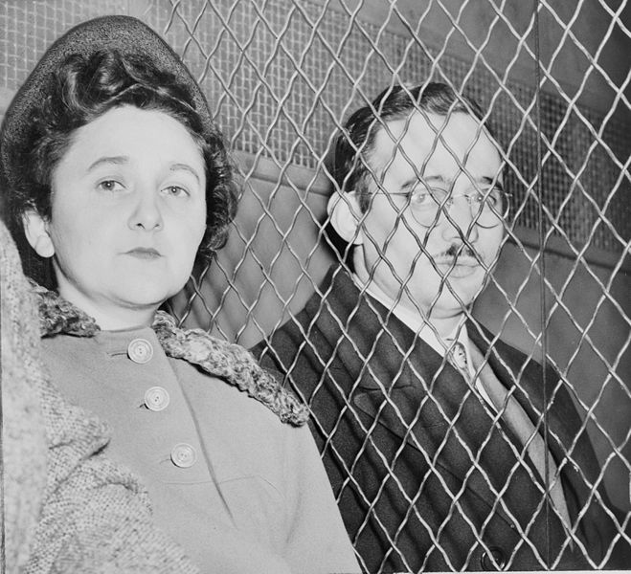
Judge in the Rosenberg case, when handing down his sentence
“I consider your crime worse than murder... I believe your conduct in putting into the hands of the Russians the A-Bomb years before our best scientists predicted Russia would perfect the bomb has already caused, in my opinion, the Communist aggression in Korea, with the resultant casualties exceeding 50,000 and who knows but that millions more of innocent people may pay the price of your treason. Indeed, by your betrayal you undoubtedly have altered the course of history to the disadvantage of our country. No one can say that we do not live in a constant state of tension. We have evidence of your treachery all around us every day for the civilian defense activities throughout the nation are aimed at preparing us for an atom bomb attack.”

Slide 18
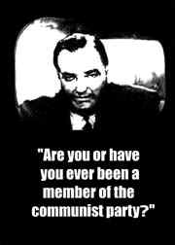
The Second Red Scare

Slide 19
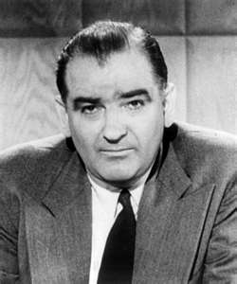
Witch Hunts
Joe McCarthy
Republican senator from Wisconsin
Felt he was unlikely to win reelection
Decided to use fear of communism to boost his career
McCarthyism
McCarthy went on a rampage, announcing that the government was stuffed with ‘reds’
Made claims that he had inside knowledge and proof (for example, he’d say ‘I have a list of 205 people in the government who are members of the communist party’, but then would refuse to produce the names.
Senators, when speaking in the senate, are immune from the charge of slander (knowingly telling lies to hurt another person’s reputation)
Successful strategy
McCarthy won reelection and became famous
However, when he accused the army of having tons of communist subversives, and called hearings on this issue, army officials blasted McCarthy and burst his imaginary bubble. He became a national disgrace
http://www.youtube.com/watch?v=lAur_I077NA

Slide 20
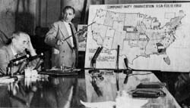
McCarthyism- The use of unproven
accusations to label someone as a communist.

Slide 21
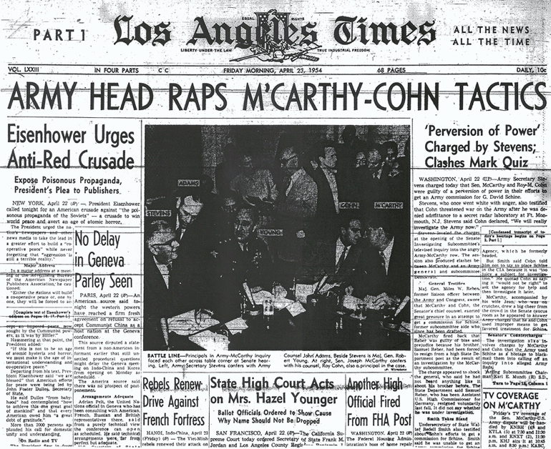
A “Witch Hunt”.
1954- McCarthy is censured by the US Senate
for conduct unbecoming his office.

Slide 22
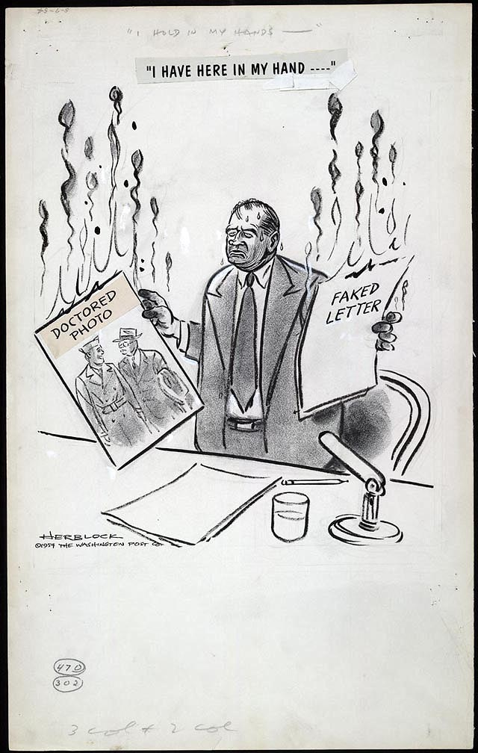

Slide 23
Impact of the Red Scare on American People
bomb shelters in suburbia
Duck and cover drills in schools
Demand for conformity (doing the same thing everyone else is doing) to prove loyalty
Same clothes, same haircut, same lifestyle and goals, etc.

Slide 24
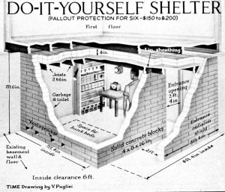

Slide 25
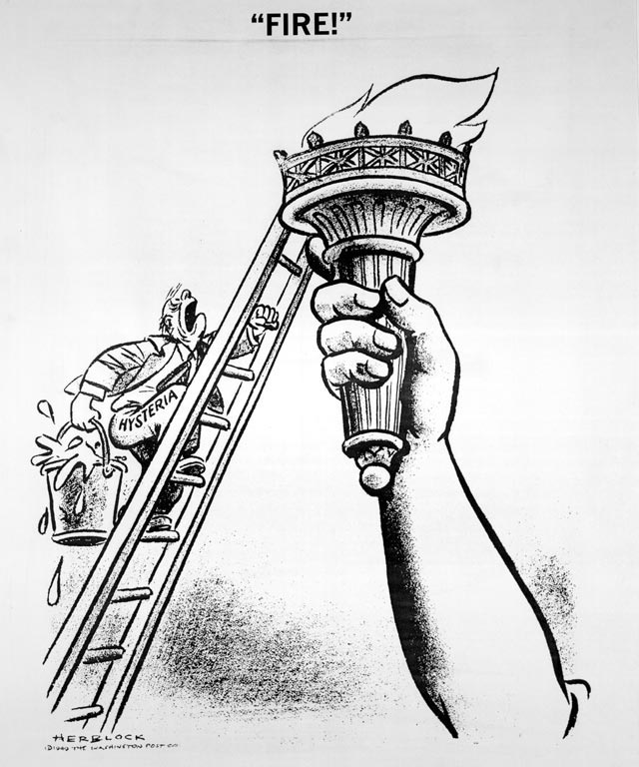
-June 1949-
What is the Washington Post cartoonist portraying in his drawing?

Slide 26
