Slide 1
Urbanization and Immigration
Mr. Winchell
APUSH
Period 6

Slide 2
Do Now
What specific factors led to an increase in immigration into the United States towards the end of the 19th century?
From what regions did most immigrants come from in this time period of ‘new immigration’? How did this differ from ‘old immigration’?

Slide 3
Rockefeller
“The growth of large business is merely the survival of the fittest. This is not an evil tendency in business. It is merely the working out of the law of nature and a law of god.”

Slide 4
Sumner and Social Darwinism
William Graham Sumner, Yale professor supported Social Darwinism
Said “Millionaires are the product of Natural Selection”
Pro-Business View of society
Used to defend the power of new corporate elites.
Only the fittest survived
Pro Capitalism/Laissez Fair
Anti-Socialism
Anti-Government Interference in Economy
Anti Reform
Aide to the poor hinders natural process of progress

Slide 5
Due to Excessive Capitalism, Social Critics Emerge 1880s
Edward Bellamy
Looking Backward: 2000-1887
Socialist view
Suggested a socialist society would emerge- and class divisions would disappear and all would be equal
Henry George
Progress and Poverty
Saw excesses of Industrialization
Offered a solution- tax on land to create a social state- to solve poverty

Slide 6
Henry George Explained why poverty existed.
“This association of poverty with progress is the great enigma of our times. So long as all the increased wealth which modern progress brings goes but to build up great fortunes, to increase luxury and make sharper the contrast between the house of have & the house of want…
Progress is not real and cannot be permanent.”
From Poverty and Progress

Slide 7
Gap Between Rich and Poor
10% of population owns 90% of wealth
2/3 of the population were working class, employed by someone else.
Included skilled and unskilled workers
Skilled workers were paid more
Women and children work in factories

Slide 8
Safety and Unemployment
No employment insurance- if down turn in economy, people suffered
No help if hurt on the job
No retirement
No minimum wage
No safety requirements
1890-1900- 3,500 workers killed on the job
500,000 injured
Miners- Black Lung Disease

Slide 9
Rise of Cities
Between 1830-1860 Urban population of the US grew by 552%
1830- 1.1 million
1860 6.2 million
Cities grow because of
Immigration
Rural to urban migration- people leave the farm due to decreased opportunity- mechanization of agriculture, more opportunity in cities

Slide 10
Cities
African Americans begin to move, not large movement North until after WWI.
Move to the city in response to limited opportunities in rural areas
Mechanization of Agriculture
Problems
Overcrowding
Crime
Disease
Poverty
Exploitation
Water-Sanitation
Pollution

Slide 11
Immigration
The United States is a nation of immigrants. By 1860 1/4 of population was born in another country.
Immigration to the United States occurs in waves.
The First Wave of Immigrants: 1820-1860-
Irish- 2 million
German- 1.5 million
British- 750,000
Scandinavia
1825- 10,000 immigrants
1845- 100,000 per year
1854- 428,000
Second Wave of Immigration 1860-1920
1865-1890- 9 million arrive
1890-1915 16 million arrive
1910 ½ the people of cities are Immigrants

Slide 12
New Immigrants Second Wave of Immigration 1870-1914, 25 million European Immigrants by 1920, 40% of pop-foreign born
1870- 1 in 7 were Irish Immigrants (New York)
Southern and Eastern Europe
Italians 3.6 million come.
Greeks
Russian (Jews)
Turks
Polish
Serbian
In the West- Chinese and then Japanese
1880- 457,000 Immigrants landed in Boston, New York, Philadelphia, Baltimore, New Orleans
Most were unskilled:
Worked in Factories
Construction
Docks
Warehouses
Domestic Servants

Slide 13
Emma Lazarus- Poet
“Give me your tired, your poor,Your huddled masses yearning to breathe free, The wretched refuse of your teeming shore. Send these, the homeless, tempest-tossed, to me: I lift my lamp beside the golden door.”

Slide 14
Immigration
Push Factors
Factors that pushed immigrants out of their native lands to America:
Poverty-
Lack of Economic Opportunity
Political Repression - No freedom
Ethnic conflict-
War- conscription
No jobs
No hope of a future
Famine/ starvation/drought
Pull Factors
Factors that pulled immigrants out of their native lands to America:
Economic Opportunity
Jobs/ workers were needed
Land
$
A future of land ownership
Peace and stability
Freedom to make a better life

Slide 15
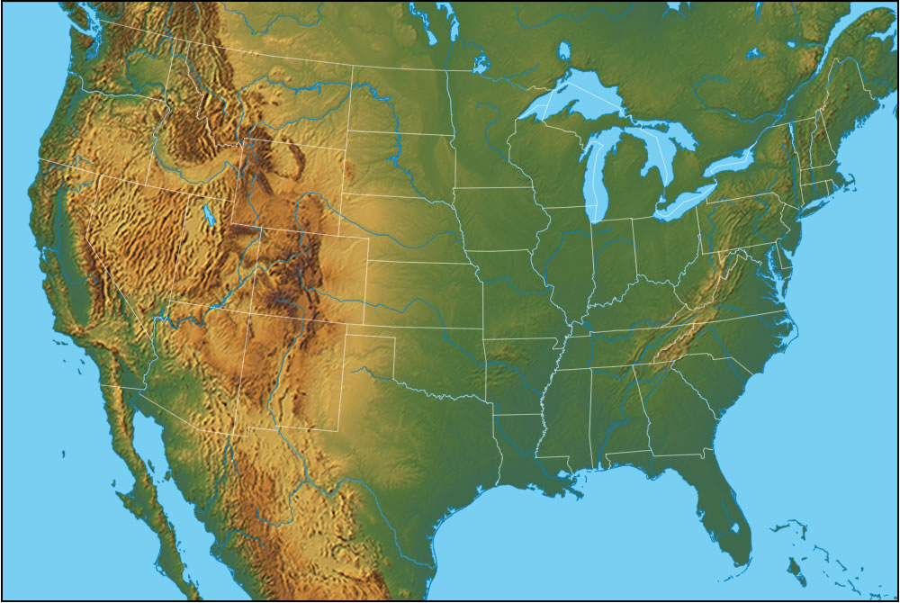
Arrival
Ellis Island in the East (New York City)- This is where most people from Europe arrived.
Angel Island in the West (San Francisco)- This is were most people from Asia arrived.

Slide 16
Ellis Island
*In 1890, Congress designated low-laying, three- acre Ellis Island in Upper New York Bay as an immigration station. By the end of 1910, six million immigrants had come through Ellis Island.

Slide 17
Immigration Stations
Once immigrants arrived in the U.S., they went through immigration stations, such as Ellis Island in New York Harbor. Government workers questioned them about where they planned to work & live. Doctors also examined them to make sure they didn’t have any diseases. Almost all European immigrants were allowed to enter the U.S. initially.

Slide 18
How did/do people react to immigrants coming to America?
They were looked down upon and discriminated against. See cartoons.
Xenophobia- anti foreigner attitudes
Nativism- The idea of blaming immigrants for problems.
Established groups blamed the new groups for problems:
Taking Jobs, Lazy -Famous Slogan: “No Irish Need Apply”
People said they were responsible for: Crime
Immorality- alcohol abuse
Catholics- not loyal to America
Dirty-
Inferior, Damaging to the United States
Whenever a new group enters into an established community tension is caused and a pattern of development can be seen.
Examples:
When the Irish came in the 1840’s the established groups of British and Germans did not like the new Irish.
Irish where different:
Language- Irish
Religion Roman Catholic
Culture different from British
Lifestyles-

Slide 19
City life for Immigrants
The “New” group usually congregates together and forms an almost isolated community and institutions in the giant and growing cities of America.
The Irish came together in great neighborhoods and sections of all Eastern Cities.
They formed their own political groups and parties.
They used their large numbers to build powerful political groups that dominated some large Cities and industries in those cities.
Example: Police and Firemen in New York, Boston, Chicago, Philadelphia.
They set up:
Churches, Hospitals, Welfare Organizations, Schools, Social Clubs, Political Organizations
They helped each other in exchange for loyalty during the voting season.
Jobs, security,

Slide 20
“FIVE CENTS A SPOT” ROOMS
Many immigrants had no home and slept in 5 cents a spot rooms where people paid for a small space to spend the night.
Can you imagine sleeping crowded against strangers?

Slide 21
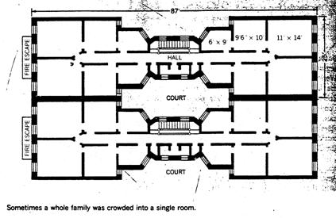
Tenement Housing
The resulting slums and tenement apartments could cram more than 4,000 people into one city block.
NYC passed a law in 1879 that required each bedroom to have a window.
The cheapest way for landlords to respond to the law was to build dumbbell tenements, with ventilation shafts in the center of the building.
Overcrowding and filth in these tenements continued to promote the spread of deadly diseases.

Slide 22
Political Machine:
The best example of ethnic group organization was called the Political Machine.
This was an organization of political and community leaders that manipulated democracy for material gain. Leaders of an ethnic community would use their influence to raid public funds and offer rewards to loyal community members.
Boss Tweed and Tammany Hall of New York City, were infamous for their political strength and corruption. They were reputed to have stolen millions in public funds.

Slide 25
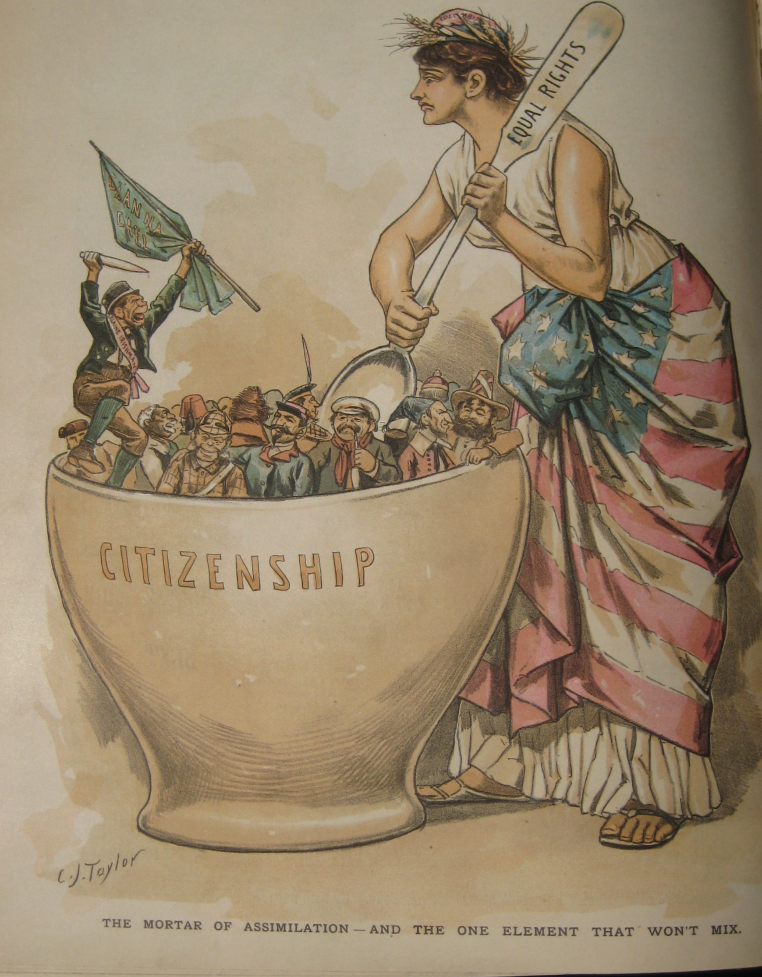

Slide 26
