Slide 1
Immigration, Urbanization, and Machine Politics
Mr. Winchell
APUSH
Period 6 (1865-1898)

Slide 2
Do Now (Brought to you by Gaby!)
Give me your tired, your poor,
Your huddled masses yearning to breathe free,
The wretched refuse of your teeming shore,
Send these, the homeless, tempest-tossed to me:
I lift my lamp beside the golden door.
-Emma Lazarus, “The New Colossus,” 1883
Inscription on the base of the Statue of Liberty
What does this inscription mean? Is this accurate to the treatment

Slide 3
Objective
Students will be able to:
Analyze how debates over political values (such as democracy, freedom, and citizenship) contributed to the ideological clashes of the late 19th century. (In the College Board’s words…)
Analyze how differing viewpoints on how government should be run contributed to clashes between the upper and middle/lower classes in the late 1800’s. (In my words)
In Gaby’s words…

Slide 4
Objective Continued
…by completing guided notes, analyzing political cartoons, and answer primary source based questions on the pros and cons of mass urbanization.

Slide 5
A Nation of Immigrants
In the last half of the 19th century, the US population more than tripled, from 23.2 million in 1850 to 76.2 million in 1900.
The arrival of 16.2 million immigrants fueled the growth.
An additional 8.8 million more arrived during the following decade, from 1901-1910.

Slide 6
Growth of Immigration
Push Factors (Reasons Immigrants LEFT their homes) | Pull Factors (Reasons Immigrants CAME to America)
Poverty of displaced farmworkers driven from their land by political turmoil. Mechanization of farm work (thanks industrialization). Overcrowding and joblessness in cities as a result of a population boom. Religious persecution (particularly with Jews in Eastern Europe). | Reputation for political and religious freedom. Economic opportunities by settling in the new West (farming, mining, etc.) Abundance of industrial jobs in US cities. Large steamships and inexpensive 1-way trips made it easier for poor people to come.

Slide 7
Old vs. New Immigration
Old Immigration | New Immigration
Northern and Western Europe British Isles, Germany, Scandinavia (Norway, Sweden, etc.). Protestants Mostly English-speaking. High levels of literacy. Occupational skills (farming, sewing, etc.) Fit EASILY into American rural society. Did not stand out as different. Immigration was more expensive, so the lowest class largely did not come. | Southern and Eastern Europe. Italy, Greece, Croatia, Poland, Russia. Many were poor and illiterate peasants. Came from autocratic countries, and were unfamiliar with democracy. Largely Roman Catholic, Greek Orthodox, Russian Orthodox, and Jewish. Upon arrival, most crammed into poor ethnic neighborhoods in NYC, Chicago, and other major US cities. 25% were ‘birds of passage.’

Slide 8
Restricting Immigration
When the Statue of Liberty was crafted in the 1870s, there were very few legal restrictions on immigration. By the time it was placed in New York Harbor, Congress had passed a number of new laws restricting immigration.

Slide 9
Restricting Immigration
Chinese Exclusion Act of 1882
Ban on all new immigrants from China.
Support came largely from Western States, who feared Chinese competition for jobs.
1st major act of Congress to restrict immigration on the basis of race and nationality.
Immigration from China was severely restricted until 1965.
Restrictions also came in 1882 on the immigration of ‘undesirable’ people, like the very poor, criminals, convicts, and mentally ill.
Contract Labor Law of 1885
Restricted temporary workers to protect American workers.
Literacy Test for immigrants (vetoed by President Cleveland but passed in 1917)
Medical examinations and a tax became a part of the immigrant centers in Ellis Island (NYC) and Angel Island (SF)

Slide 10
Who Restricted Immigration?
Labor Unions
Feared employers would use immigrants to depress wages and break strikes.
Nativist Society
The American Protective Association was openly prejudiced against Roman Catholics.
Social Darwinists
Viewed new immigrants as biologically inferior to English and Germanic individuals.
Severe economic depression in the 1890s
Foreigners became a convenient scapegoat for jobless workers as well as employers

Slide 11
Urbanization
Urbanization and Industrialization developed simultaneously.
Cities provided laborers to work in factories and a market to sell mass-produced goods.
By 1900, almost 40% of Americans lived in cities.
Both immigrants and internal migrants moved to cities in this time period, leaving farms for industrial and commercial jobs.

Slide 12
Urban Changes
Improvements in urban transportation made the growth of cities possible.
Electric trolleys, elevated railways, subways transported people from urban jobs to suburban residences.
This allowed the upper class to move out of residences near factories and other business centers, which poor immigrants than inhabited.
This created ethnic neighborhoods with terrible living conditions.

Slide 13
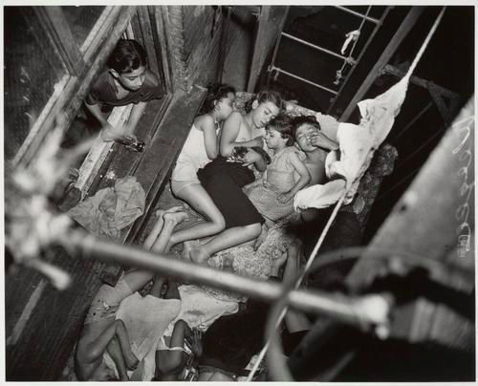
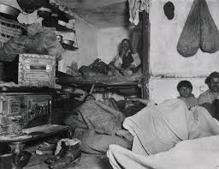
Tenement Housing
To increase profits, landlords took advantage of demand for urban housing by dividing up inner-city housing into small, windowless rooms.

Slide 14
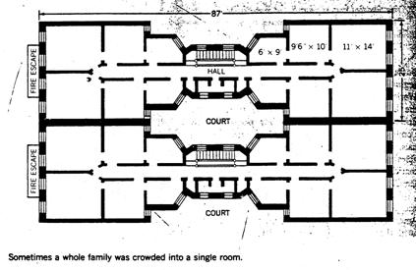
Tenement Housing
The resulting slums and tenement apartments could cram more than 4,000 people into one city block.
NYC passed a law in 1879 that required each bedroom to have a window.
The cheapest way for landlords to respond to the law was to build dumbbell tenements, with ventilation shafts in the center of the building.
Overcrowding and filth in these tenements continued to promote the spread of deadly diseases.

Slide 15
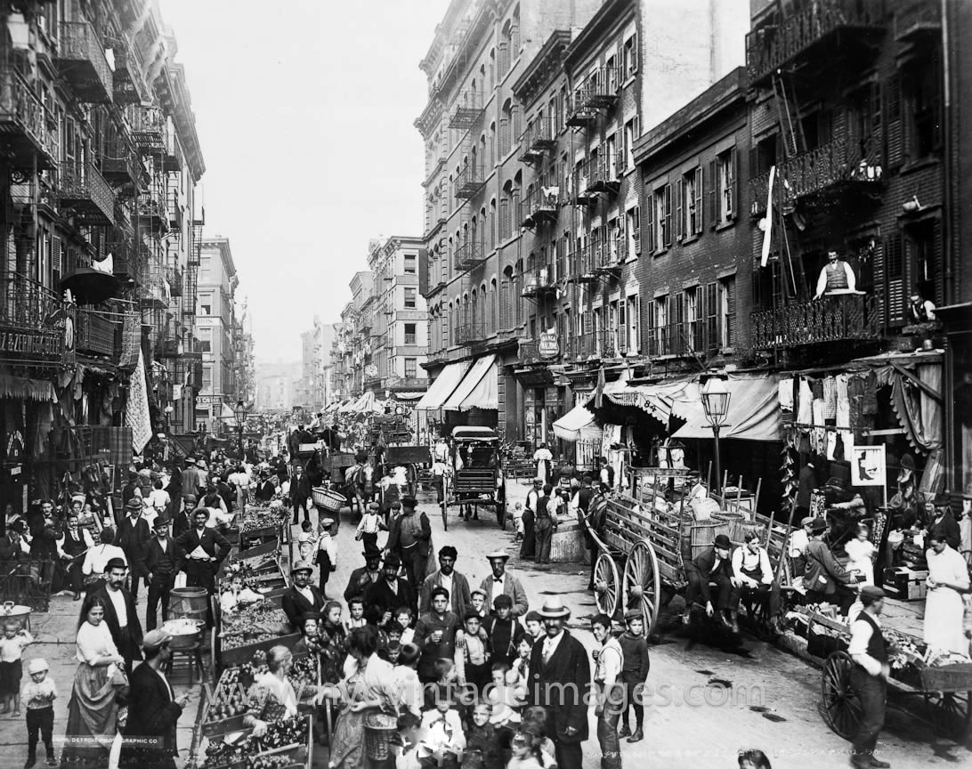
Ethnic Neighborhoods
Different immigrant groups created distinct ethnic neighborhoods.
Here, each group could maintain its own language, culture, church, temple, and social clubs.
Many groups supported their own newspapers and schools.
While often crowded, unhealthy, and crime-ridden, these neighborhoods (often called ghettos) often served as springboards for ambitious and hardworking immigrants and their children to achieve the American Dream.

Slide 16
Machine Politics
As power consolidated in the hands of few with businesses (monopolies, vertical and horizontal integration), the same happened with urban politics.
Political parties in major cities came under the control of tightly organized groups of politicians, known as political machines.
Each machine had its boss, the top politician who gave orders to the others and gave out government jobs to loyal supporters.
Several political machines, like Tammany Hall in NYC, started as social clubs and later developed into power centers to coordinate the needs of businesses, immigrants, and the underprivileged, in return for votes on election day.

Slide 17
Machine Politics
Political machines brought modern services to cities, including a crude form of welfare for urban newcomers.
The political organization would find jobs and apartments for recently arrived immigrants and show up at a poor family’s door with baskets of food during hard times.
On the negative side, machine politics negatively impacted democracy and often stole money from taxpayers in the form of graft and fraud.

