Slide 1
Do Now
Go to the following link and complete the quiz. When completed, please discuss your responses with your table partner.
bit.ly/quiz310

Slide 2
Question to Consider
America in the World: “In what ways did WWII set the stage for the Cold War?”
America in the World: “What specific actions did the US government take to combat communism?”

Slide 3
Today’s Guiding Question/Criteria for Success
TO WHAT EXTENT was containment an effective and realistic plan for US foreign policy post WWII?

Slide 4
Containment: Early Cold War
Mr. Winchell
APUSH
Period 8: Day 1!

Slide 5
Post-WWII Relationships
Relationships between Soviet Union & other Allies worsen.
PRIOR KNOWLEDGE: WHY?
Cold War: an era of high tension & bitter rivalry between the United States & the Soviet Union in the decades following WWII

Slide 6
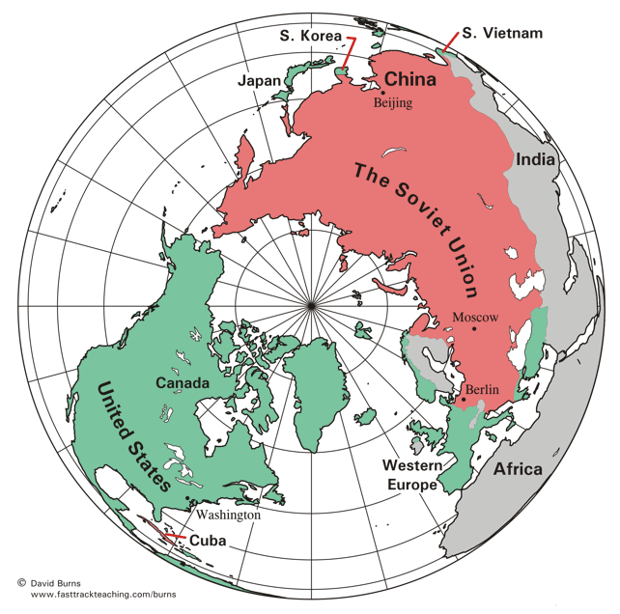
Understanding the Cold War
Superpower nations after WWII
Soviet Union = communism, police state
United States = capitalism, democracy
Cold War meant a “war of words” rather than outright conflict
However, the Cold War includes episodes of “hot” conflicts in various regions around the world.

Slide 7
Struggle Begins
Military rivalry
-technology of weapons
-number of weapons
Political rivalry
-influence in world
-best government, economic policies
-best societies for its people

Slide 8
Struggle Begins
Pro-Soviet Communist governments established in Eastern Europe nations
-possible because of Soviet military influence in those nations
PRIOR KNOWLEDGE:
Why did the Soviet Union have influence in Eastern Europe?

Slide 9
Iron Curtain Speech by Churchill 3/5/1946
…From Stettin in the Baltic to Trieste in the Adriatic an iron curtain has descended across the Continent. Behind that line lie all the capitals of the ancient states of Central and Eastern Europe. Warsaw, Berlin, Prague, Vienna, Budapest, Belgrade, Bucharest and Sofia; all these famous cities and the populations around them lie in what I must call the Soviet sphere, and all are subject, in one form or another, not only to Soviet influence but to a very high and in some cases increasing measure of control from Moscow…

Slide 10
Stalin’s Response
... Mr. Churchill now stands in the position of a firebrand of war. And Mr. Churchill is not alone here. He has friends not only in England but also in the United States of America.
…One can ask therefore, what can be surprising in the fact that the Soviet Union, in a desire to ensure its security for the future, tries to achieve that these countries should have governments whose relations to the Soviet Union are loyal? How can one, without having lost one’s reason, qualify these peaceful aspirations of the Soviet Union as “expansionist tendencies” of our Government?. .

Slide 11
The West Resists
Democracies in West wanted to contain Communism in East Europe
Early 1947 → Greece & Turkey threatened by Soviet-backed Communists
Great Britain too broke to help!
-What will the US’ response be?

Slide 12
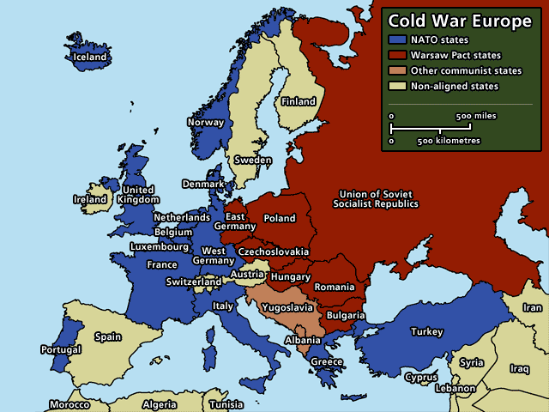

Slide 13
Truman Doctrine
Created in 1947
Pledge to provide military & economic aid to countries threatened by communism
US Congress sent millions of dollars to Greece & Turkey, both fighting the expansion of Communism
“I believe that it must be the policy of the US to support free peoples who are resisting attempted subjugation by armed minorities or by outside pressures,” Truman.
Notes:
$300 mil to Greece, $100 mil to Turkey

Slide 14
The West Resists
Post-WWII economics in Europe = bad. No credit, no food, no money, no market for goods.
Truman feared if conditions worsened, Europeans might turn to communism
Mid-1947 → US Congress launched program for economic aid to Europe

Slide 15
Marshall Plan
Huge plan for the economic reconstruction of Europe after WWII
Provided money for rebuilding & preserving political stability in Europe
$13 billion provided to Europe under this policy
Europe’s economy surged, markets grew for American goods, further linked Western Europe and the US economically.

Slide 16
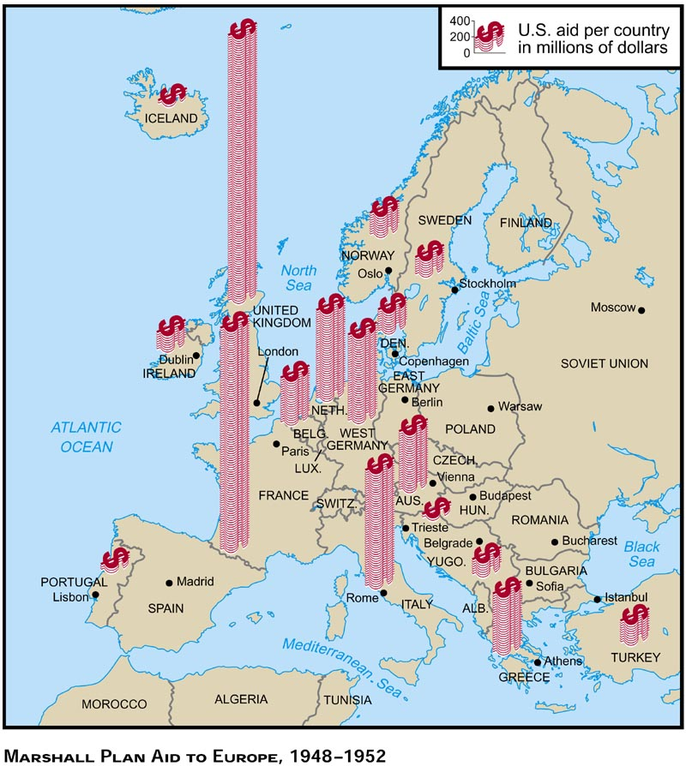
Truman & Containment (1945-1953) Marshall Plan
European Recovery Program
$13 billion in grants
Rebuild and develop European infrastructure
Designed to prevent communist uprisings or infiltration in vulnerable nations

Slide 17
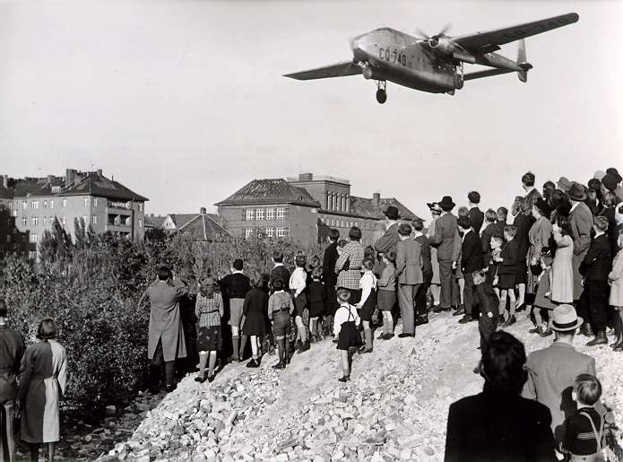
Truman & Containment (1945-1953) Berlin Airlift
Soviet Union establishes blockade of West Berlin
Why?
U.S. and allies launch aerial campaign from 1948-1949
Drop food and fuel to citizens
Extremely successful
Over 200,000 flights
47,000 tons daily
Stalin backs down

Slide 18
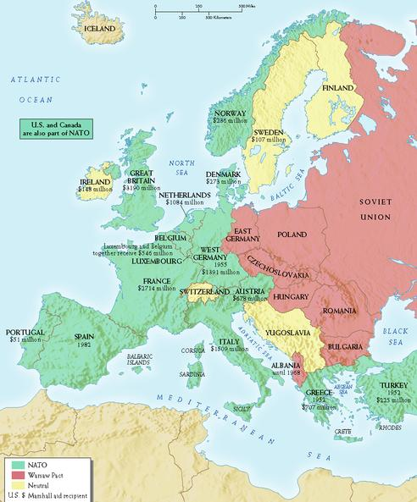
Truman & Containment (1945-1953) Cold War Alliances
North Atlantic Treaty Organization (NATO)
Permanent alliance between U.S., Canada, and Western Europe
If one member is attacked, all treaty nations will defend
Warsaw Pact
Soviet Union’s version of NATO
Eastern European satellite nations

Slide 19
Before your quiz…
With your partner, discuss how the Truman Doctrine and Marshall Plan promoted the policy of Containment. BE SPECIFIC.

