Slide 1
Do Now-Presented by William
IGNORE THE DO NOW ON YOUR DISCUSSION QUESTIONS…INSTEAD,
Read the Jacksonian Impulse and identify 3 key points that were appealing/intriguing about Andrew Jackson.

Slide 2
Jacksonian Democracy
Mr. Winchell

Slide 3
Questions to Consider
Politics and Power: What were the similarities and differences between the Jeffersonian Republicans and the Jacksonian Democrats? Account for these similarities and differences.
Politics and Power: Why and how did many Americans attempt to expand democratic ideals in the early and mid-nineteenth century?

Slide 4
The “Era of Good Feelings”
James Monroe (1817-1825) was the last Founder to serve as President
Federalist party had been discredited after War of 1812
Monroe unopposed for reelection in 1820
Foreign policy triumphs:
Adams-Onís Treaty (1819) settled boundary with Mexico & added Florida
Monroe Doctrine warned Europeans against further colonization in Americas
James Monroe,
By Gilbert Stuart

Slide 5
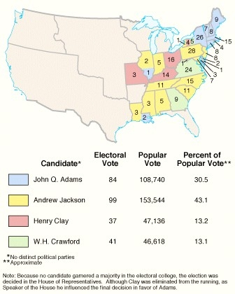
The Election of 1824 & the Split of the Republican Party
“Era of Good Feelings” collapsed under weight of sectional & economic differences
New generation of politicians
Election of 1824 saw Republican party split into factions
Andrew Jackson received majority of popular & electoral vote
House of Representatives chose John Quincy Adams to be president
Henry Clay became Secretary of State – accused of “corrupt bargain”
John Quincy Adams’ Inaugural Address called in vain for return to unity

Slide 6
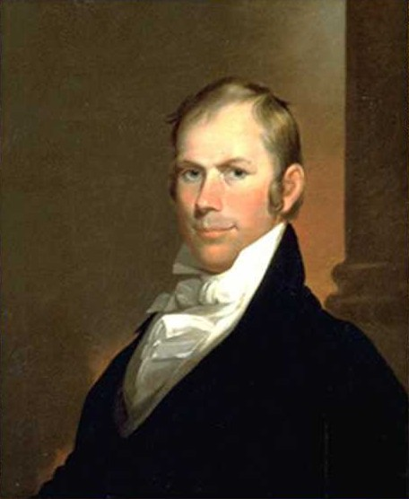
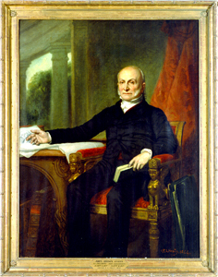
The National Republicans (Whigs)
The leaders:
Henry Clay
John Quincy Adams
Daniel Webster
The followers:
Middle class
Educated
Evangelical
Native-born
Market-oriented
Henry Clay
John Quincy Adams

Slide 7
Whig Issues
Conscience Whigs – abolition, temperance, women’s rights, etc.
Cotton Whigs – internal improvements & protective tariffs to foster economic growth (the “American System”)

Slide 8
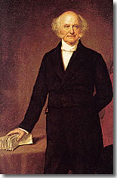
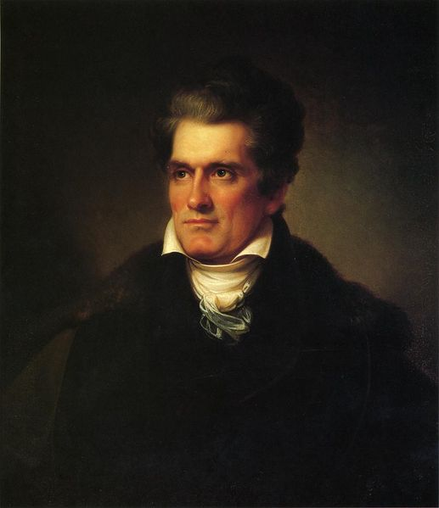
The Democratic Republicans (Democrats)
The leaders:
Martin Van Buren
Andrew Jackson
John C. Calhoun
The followers:
Northern working class & Southern planter aristocracy
Not well-educated
Confessional churches
Immigrants
Locally-oriented
Martin Van Buren
John C. Calhoun

Slide 9
The Tariff Battle
The tariffs of 1816 and 1824 taxed imports of cheap English cotton cloth and imports of iron goods/more expensive woolen and cotton textiles respectively.
Tariff of 1828, raised duties on raw materials, textiles, and iron goods.
This tariff enraged the South. They did need a tariff to protect its main industry as the world’s cheapest producer of cotton. Tariffs caused prices of manufactures to increase, southern planters lost about $100 million a year.----→ “Tariff of Abominations”

Slide 12
Election of 1828
Jackson’s message of equal rights, and popular rule appealed to many social groups.
His open hostility to business corporations and Henry Clay’s American System also won support among northeastern artisans and workers who felt threatened by industrialization.
In the Midwest, he was popular for his open hostility toward Native Americans.
56% of Americans voted for “OLD HICKORY”

Slide 13
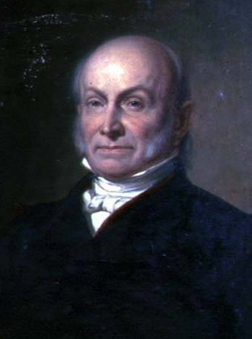
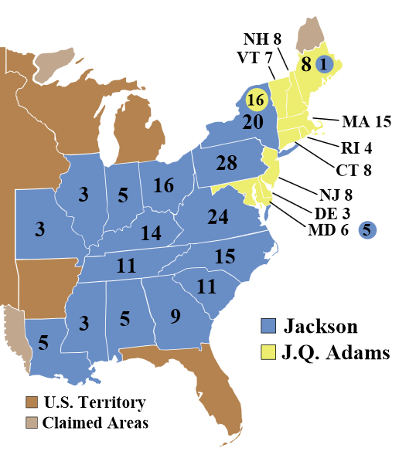
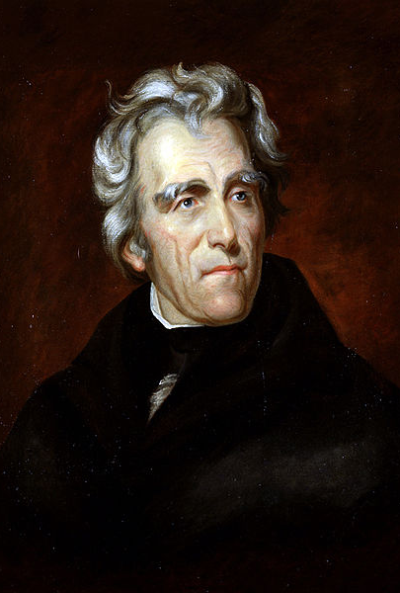
Election of 1828
John Quincy Adams
National-Republican
Andrew Jackson
Democrat

Slide 14
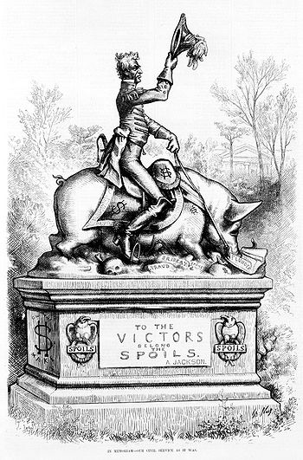
Spoils System
Spoils System: introduced the practice of removing all officeholders and replacing them with loyal supporters
“To the victor belong the spoils of the enemy.”
Jackson argued that spoils system brought in new blood
Argued against the career bureaucrat
Effects of the Spoils System
Crooks and inexperienced people get government positions
Some even steal as much as million dollars
Promoted party loyalty over all else

Slide 15
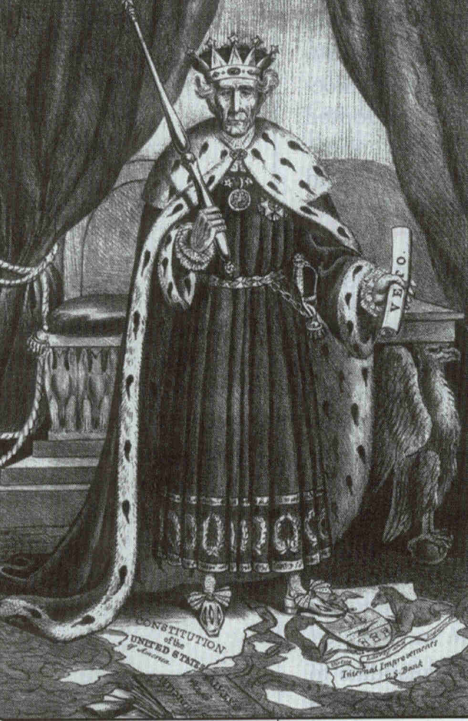
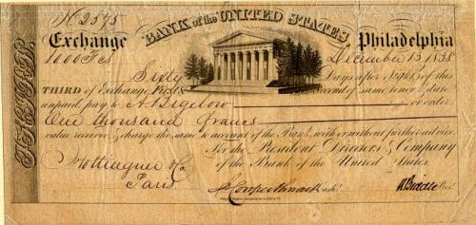
“King Andrew” & the “Monster Bank”
Marshall’s decision in McCulloch v. Maryland (1819) upheld 2nd Bank of the U.S.
Constitutional under “necessary & proper” clause
States can’t impede or nullify federal laws
Nicholas Biddle & other directors openly boasted of their power
Jackson vetoed bank recharter bill in 1832
“King Andrew”
Bank of the U.S. note

Slide 16
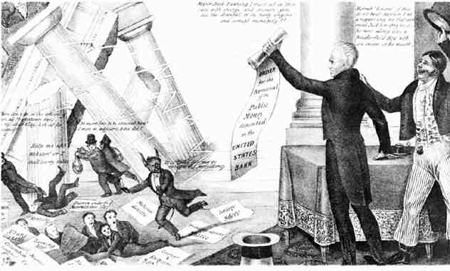
Jackson Destroys the “Monster Bank”

Slide 17
The Bank Destroyed
Jackson had all federal silver and gold (specie)removed from the bank and deposited into “pet banks”…without federal money the bank was destroyed.
The destruction of the bank will consequentially lead to the Panic of 1837.

Slide 18
The Bank War
The effect of Jackson’s banking policies remains a subject of debate.
Initially, land sales, canal construction, cotton production, and manufacturing boomed following Jackson’s decision to divert federal funds from the bank.
At the same time, however, state debts rose sharply and inflation increased dramatically. Prices climbed 28 percent in just three years.
Then in 1837, just after the election of Jackson’s successor Democrat Martin Van Buren, a deep financial depression struck the nation. Cotton prices fell by half.

Slide 19
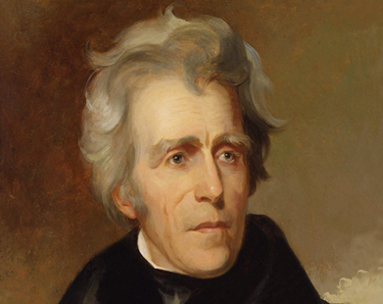
Nullification Crisis
“Tariff of Abominations” (1828) set very high protective tariffs
Southern states opposed because exported cotton & imported manufactured goods
John Calhoun anonymously wrote South Carolina Exposition & Protest (1829) asserting states’ right to nullify federal laws & secede from union
South Carolina passed nullification ordinance in Nov. 1832
Daniel Webster’s “2nd Reply to Hayne” (1830) refuted state sovereignty & nullification
Andrew Jackson’s Proclamation (Dec. 1832) vowed to enforce law & warned, “Disunion by armed force is treason”
Sen. Daniel Webster (W-Mass.)
Pres. Andrew Jackson (D-Tenn.)

Slide 20
Tariff and Nullification
Used the example of the Kentucky and Virginia Resolutions from the 1798 crisis with France
1830, April 13: Jackson attends Jefferson birthday dinner and makes toast “Our federal union, it must be preserved."
1833, Jackson has Congress pass the Force Bill – gave Jackson the authority to use military to enforce Federal law
Meanwhile Jackson negotiated a compromise tariff act which would lower the Tariffs by 1842

Slide 21
Enforcing the Tariff
Revenue cutter McLane enforcing
tariff in Charleston harbor, 1833

Slide 22
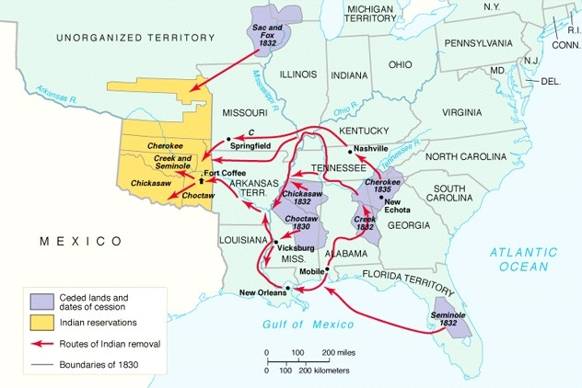
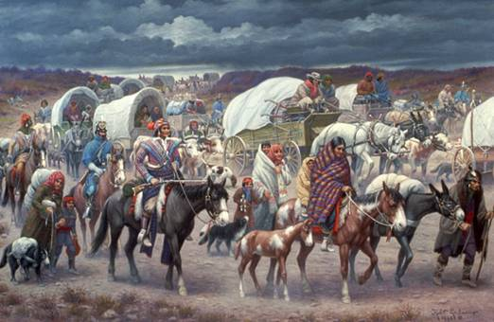
Removal of the Southern Indians
Removal Act (1830) began relocation of tribes on western reservations
Supreme Court ruled in Cherokee Nation v. Georgia & Worcester v. Georgia (1832) that states had no authority over tribes
‘He made his decision, now let him enforce it.’
Remaining Cherokees forced out on “Trail of Tears” in 1838

Slide 23
The Whig Party
The Whig party was formed in 1834 as a coalition of National Republicans, Anti-Masons, and disgruntled Democrats, who were united by their hatred of “King Andrew” Jackson and his “usurpations” of congressional and judicial authority.
Came together in 1834 to form the Whig party. The party took its name from the seventeenth-century British Whig group that had defended English liberties against the usurpations of pro-Catholic Stuart Kings.

Slide 27
Jackson Legacy
Expanded the authority of the presidency.
Upheld national authority by threatening the use of military force.
Curbed the reach of the national government.
Reinvigorated the Jeffersonian tradition of a limited and frugal central government.

Slide 28
Jacksonian Democracy
Jacksonian Democracy: more democracy for the common man
Andrew Jackson was the first president from humble origins even though he became very wealthy
Principles of Jacksonian Democracy
Universal suffrage for all white men
Voting restrictions were dropped
Spoils system promoted and allowed the “common man” to be part of the government (for good or bad)
Manifest Destiny: the expansion of the American people all the way to the Pacific Ocean
Nominating Conventions: the people would have more of say in who was nominated for office
Popular election of State Electors
Popular Campaiging: politicians running for office should focus their campaigns on how they could help the “common man”

Slide 29
