Slide 1
DO NOW QUIZ!
No quiz…read!

Slide 2
Jacksonian Democracy
Mr. Winchell
APUSH
Period 4

Slide 3
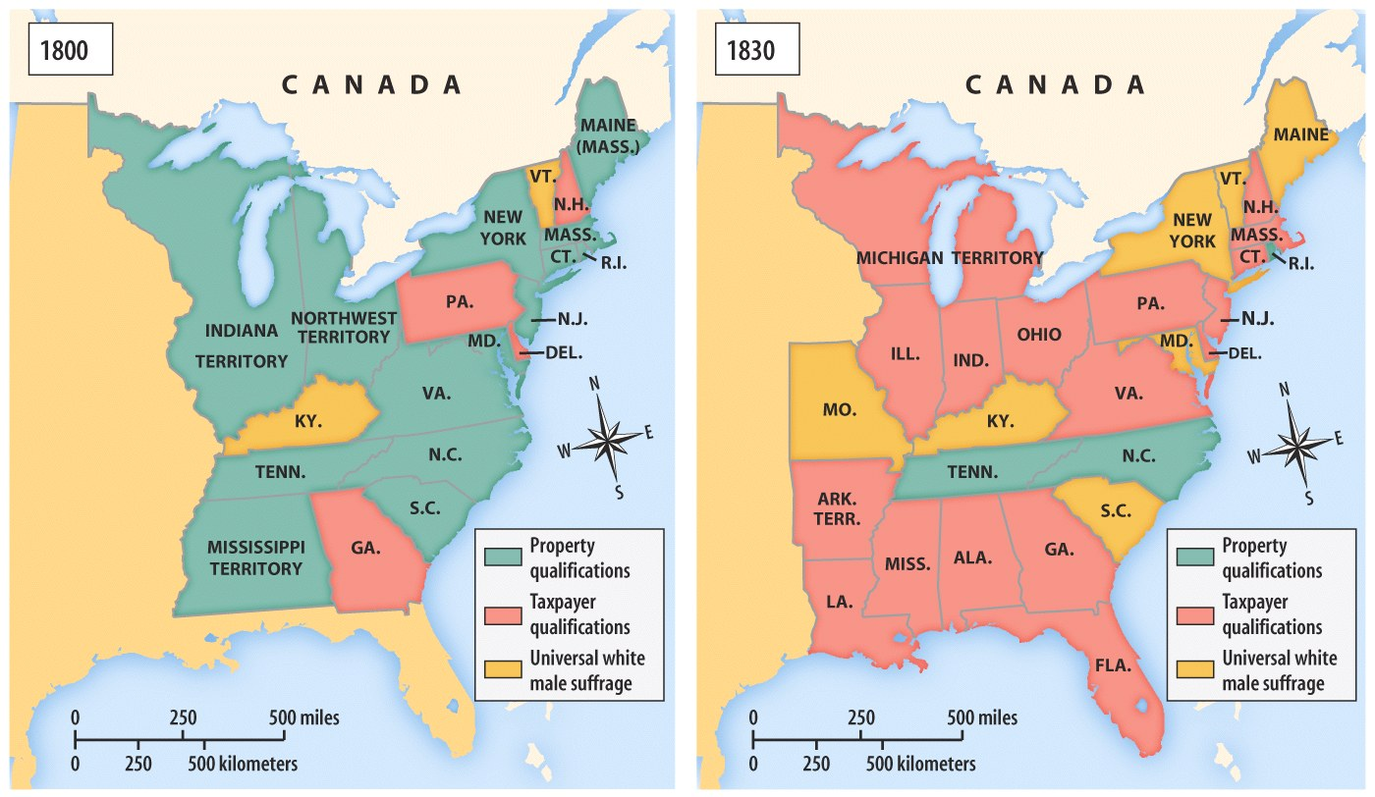
Universal White Male Suffrage

Slide 4
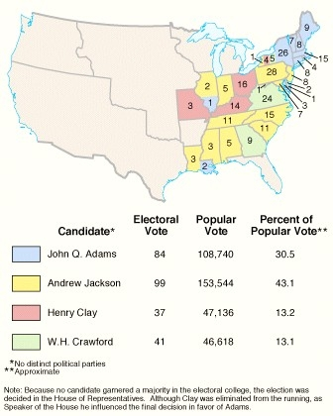
The Election of 1824 & the Split of the Republican Party
“Era of Good Feelings” collapsed under weight of sectional & economic differences
New generation of politicians
Election of 1824 saw Republican party split into factions
Andrew Jackson received majority of popular & electoral vote
House of Representatives chose John Quincy Adams to be president
Henry Clay became Secretary of State – accused of “corrupt bargain”
John Quincy Adams’ Inaugural Address called in vain for return to unity

Slide 7
Election of 1828
Jackson’s message of equal rights, and popular rule appealed to many social groups.
By 1828, only 2 states had a property requirement for suffrage, allowing more ‘common folks’ to vote.
His open hostility to business corporations and Henry Clay’s American System also won support among northeastern artisans and workers who felt threatened by industrialization.
In the Midwest, he was popular for his open hostility toward Native Americans.
56% of Americans voted for “OLD HICKORY”

Slide 8
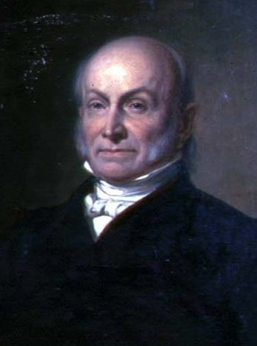
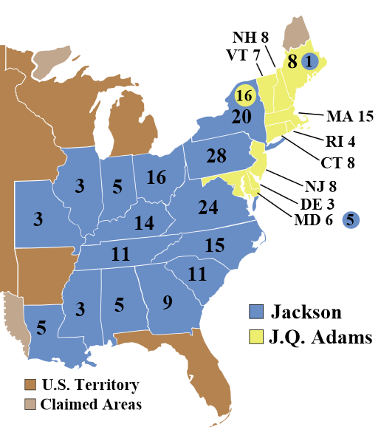
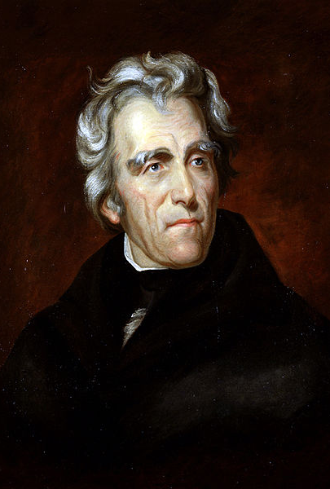
Election of 1828
John Quincy Adams
National-Republican
Andrew Jackson
Democrat

Slide 9
Jacksonian Democracy
When Andrew Jackson was elected president, it represented a new era in American history:
He was the first president that represented the “common man”
His party (the Democrats) took advantage of the extension of suffrage to common white men
He greatly expanded the powers of the presidency
Notes:
Endorsing the view that a fundamental conflict existed between working people and the “non-producing” classes of society, Jackson and his supporters promised to remove any impediments to the ordinary citizen’s opportunities for economic improvement. According to the Jacksonians, inequalities of wealth and power were the direct result of monopoly, favoritism, and special privileges, which made “the rich richer and the powerful more potent.” Only free competition in an open marketplace would ensure that wealth would be distributed in accordance with each person’s “industry, economy, enterprise, and prudence.” The goal of the Jacksonians was to remove all obstacles that prevented farmers, artisans, and small shopkeepers from earning a greater share of the nation’s wealth.

Slide 10
Spoils System
When Jackson was elected, he rewarded loyal supporters with gov’t jobs (the spoils system)
Massive turnover in the civil service had not yet occurred
Rotation in office began to be seen as a very democratic way to reduce gov’t corruption & incompetence
Jackson was not the 1st to do this… he just extended it to more people!
“Get their rascals out…and our rascals in”

Slide 11
Maysville Road Project
Kentucky was home of Henry Clay, who Jackson never forgave for the “Corrupt Bargain”
The “National” Republicans led by Clay & JQ Adams split with the old-style Democratic-Republicans
President Jackson dealt a blow to the American System:
He was OK with national projects but did not like spending federal money for state projects
In 1830, Jackson vetoed funds for the Maysville Road because it was exclusively in Kentucky
Jackson vetoed 7 other bills of public works projects, including roads and canals

Slide 12
The Nullification Crisis
Southerners hated tariffs for 2 main reasons: tariffs increase the costs of foreign industrial goods (which are usually cheaper than those made in America) so goods are more expensive AND countries reciprocate with high tariffs on American cotton
By 1820, the South was anxious about federal powers over states:
VP Calhoun became the defender of “states’ rights”
He wanted to protect slavery & hated industrial protective tariffs
After the Tariff of 1828 passed, the South affirmed nullification (the right of an individual state to ignore federal laws)
“Tariff of Abominations”
Calhoun (SC) led the argument for nullification in Exposition & Protest in 1828 to protect Southern rights against Northern self-interest

Slide 13
The Nullification Crisis
In 1833, Henry Clay presented a compromise which severely lowered the tariff, SC withdrew nullification, & Jackson did not have to enforce the Force Act
4 years later, Congress passed the Tariff of 1832; South Carolina invoked nullification & refused to collect tariff duties
Jackson viewed nullification as a treasonous threat to the Union
Congress passed the Force Bill to make S.C. collect tariff taxes
Jackson threatened to “hang Calhoun from the nearest tree”
This 1832 tariff actually intended to lower the Tariff of Abominations, but Southerners viewed the tariff as an unconstitutional violation of states’ rights

Slide 14
The Nullification Crisis
Significance of Nullification Crisis:
Nullification implied that states had the right to declare federal laws void & the right to secede from the Union
More than any other president, Jackson asserted that the central gov’t is supreme over the states & was willing to use force to preserve federal authority

Slide 15
Webster-Hayne Debate
Daniel Webster presented one of the most significant arguments against states’ rights & nullification
The U.S. was more than just a compact of states…it was a creation of the people
The Constitution gave the national gov’t ultimate power & supremacy over the states
Nullification would lead to anarchy & civil war

Slide 16
Indian Removal
Southerners were disappointed with JQ Adams’ slow movement in dealing with Indians
Jackson promised to act quickly but the Cherokee were a problem:
They were not “uncivilized” because they had a republican gov’t, an agrarian lifestyle, & a formal alphabet (Sequoyah)
They refused to move from GA

Slide 17
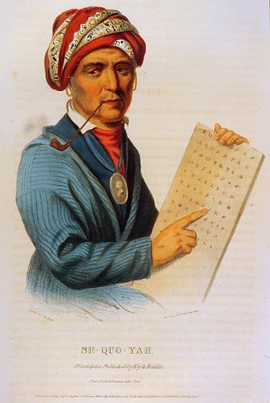
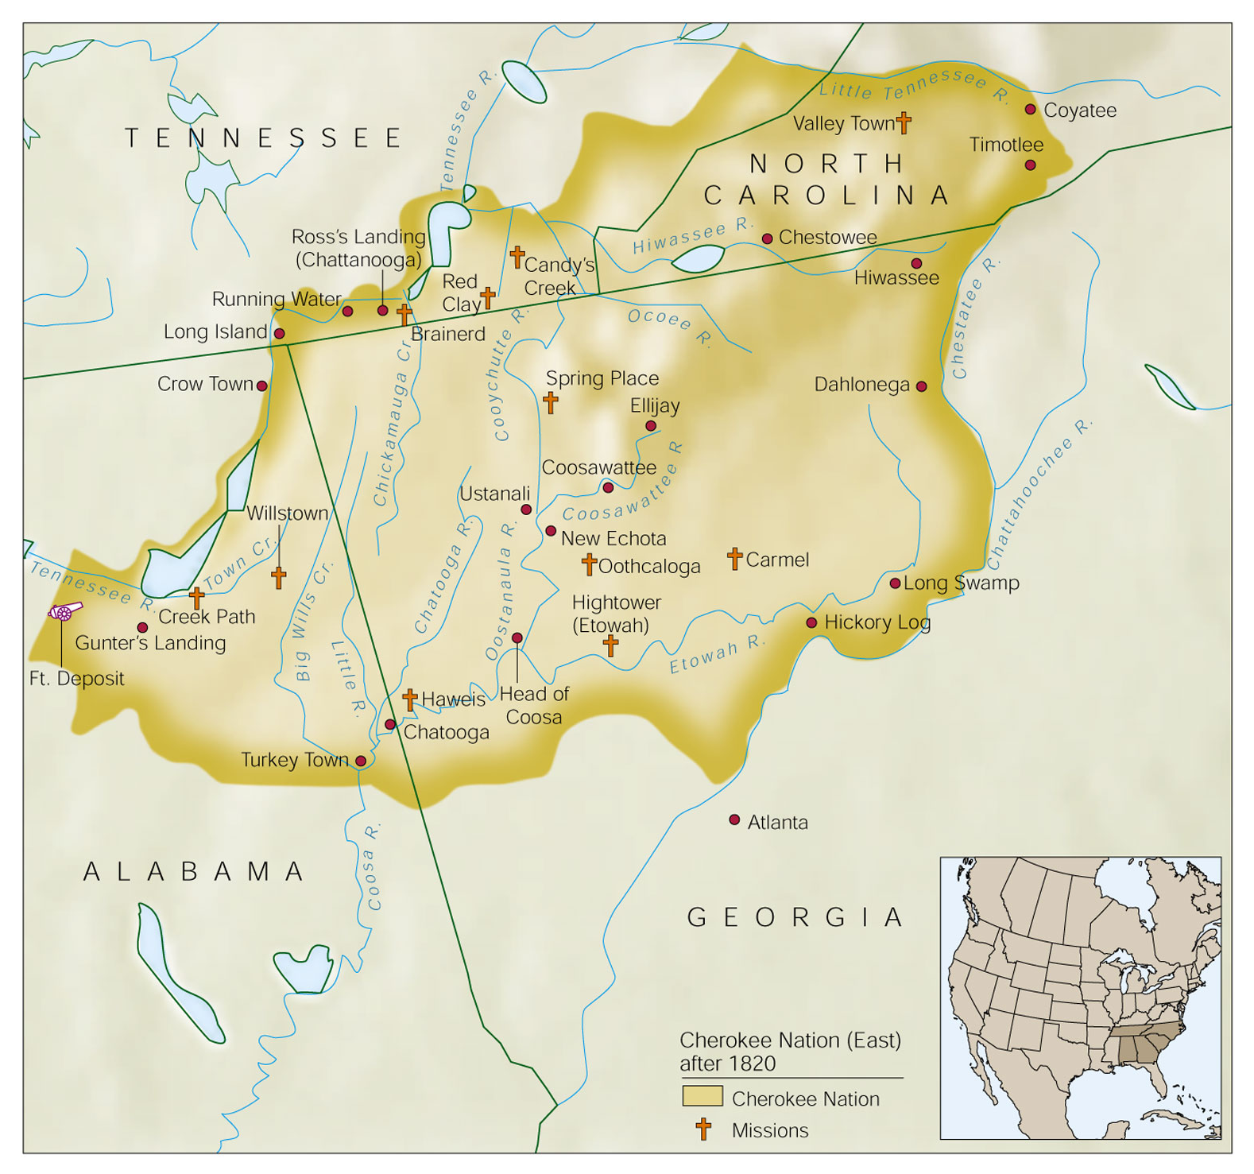
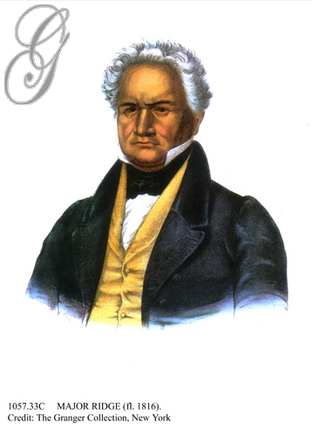
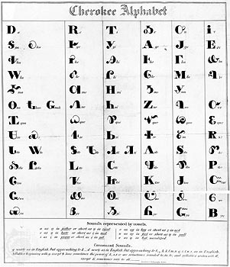
The Cherokee Nation by 1820
Cherokee Chief “Major Ridge”

Slide 18
Indian Removal
When gold was discovered in GA, the GA gov’t abolished Cherokee tribal rule & defied the Constitution
Jackson supported the states & asked Congress for the Indian Removal Act of 1830
But…the Supreme Court ruled in Cherokee Nation v GA (1831) & Worcester v GA (1832) that the states have no power over tribes
Two more John Marshall decisions!!
GA defied the Supreme Court’s decisions & continued to take Cherokee lands
Jackson supported GA’s defiance: “Marshall has made his decision, now let him enforce it”

Slide 19
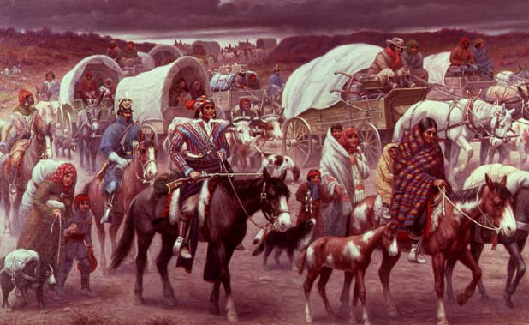
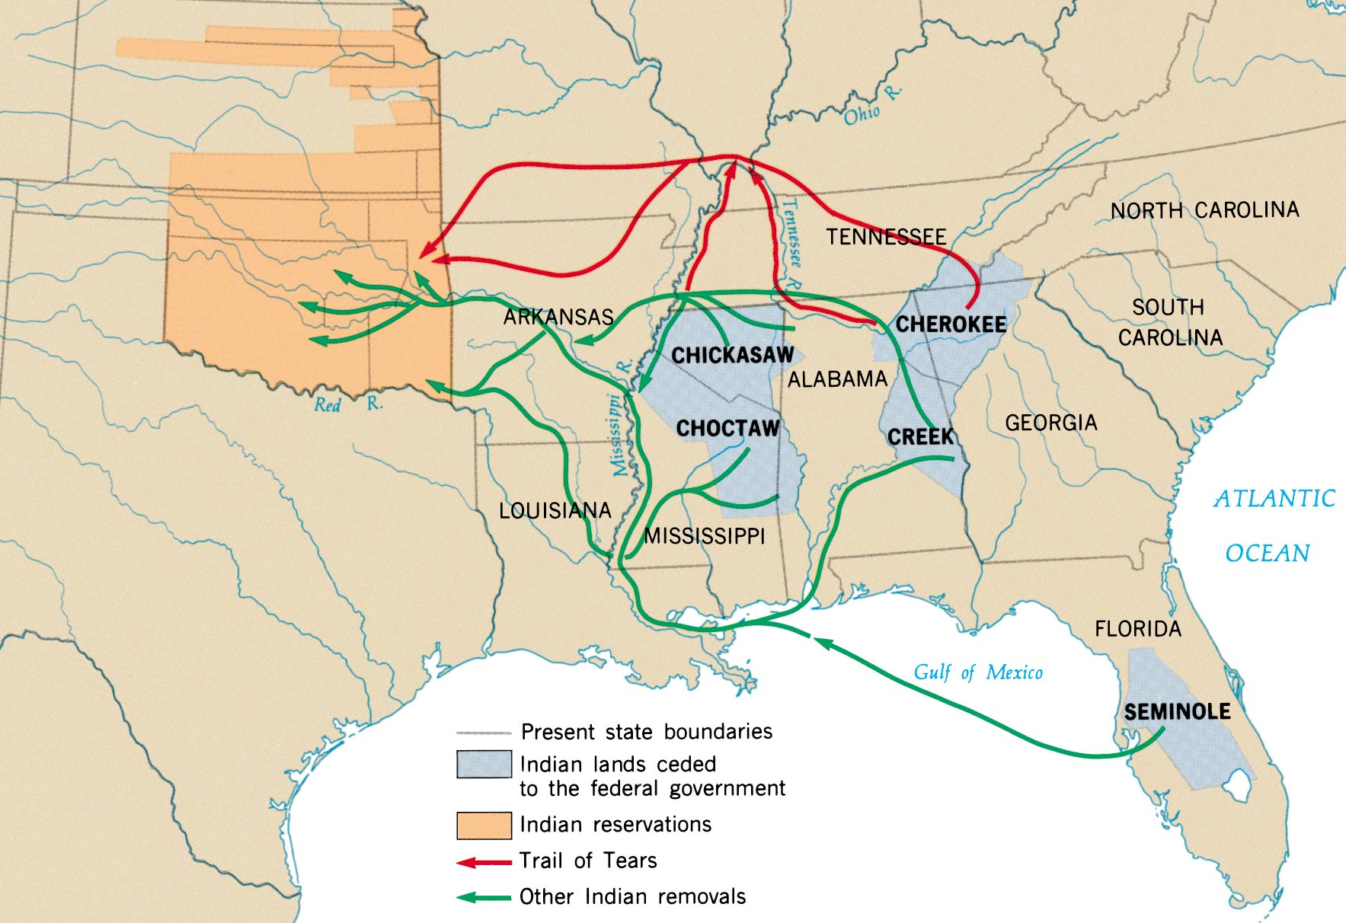
In 1838, the U.S. Army forced the Cherokees west on the “Trail of Tears”

Slide 20
The Bank War & the Second Two-Party System

Slide 21
The Bank War
In 1828, the national gov’t coined only a limited supply of hard money & printed no paper money at all
These state-chartered banks had tendency to issue more loans than they could support with their “hard currency” reserves
The major political issue of Jackson’s reign was his killing of the Second Bank of the U.S.:
The BUS held ~$10 million in gov’t money & made loans to people & businesses
The BUS helped control America’s 329 private, state-chartered banks by forcing them to be smart when issuing loans
All of America’s paper bank notes which financed land purchases, businesses, & economic growth came from these private, state-chartered banks
The 2nd BUS had 30 branches & was biggest bank in America
Notes:
The banking system at the time Jackson assumed the presidency was completely different than it is today. At that time, the federal government coined only a limited supply of hard money and printed no paper money at all. The principal source of circulating currency, paper bank notes, was private commercial banks (of which there were 329 in 1829), chartered by the various states. These private, state-chartered banks supplied the credit necessary to finance land purchases, business operations, and economic growth. The notes they issued were promises to pay in gold or silver, but they were backed by a limited amount of precious metal and they fluctuated greatly in value. In 1816, the federal government had chartered the Second Bank of the United States partly in an effort to control the notes issued by state banks. By demanding payment in gold or silver, the national bank could discipline over-speculative private banks. But the very idea of a national bank was unpopular for various reasons. Many people blamed it for causing the Panic of 1819. Others resented its political influence. For example, Senator Daniel Webster was both the bank’s chief lobbyist and a director of the bank’s Boston branch. Wage earners and small-business owners blamed it for economic fluctuations and loan restrictions. Private banks resented its privileged position in the banking industry.

Slide 22
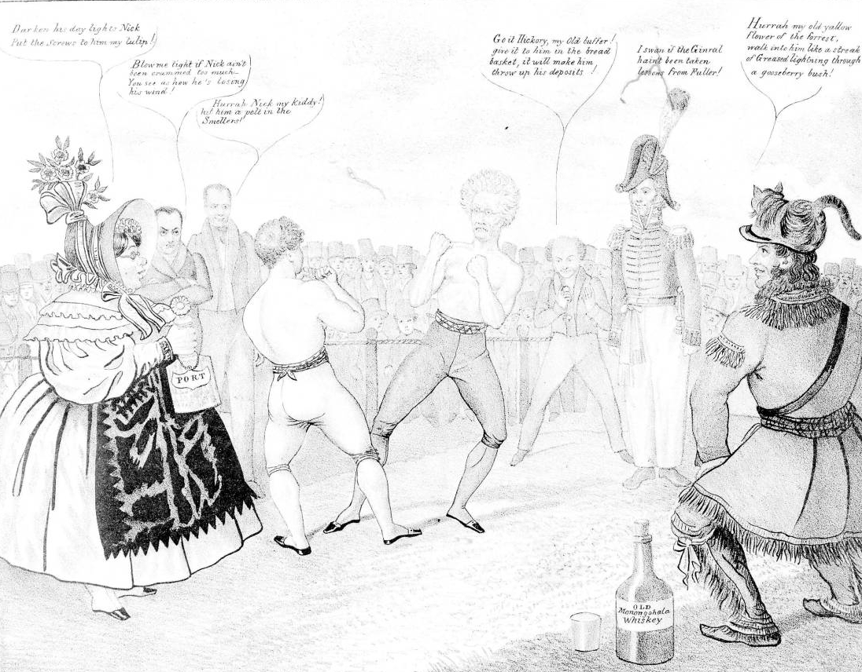
National Bank Crisis
Upper classes
Military Veterans
Andrew Jackson
Lower classes
Daniel Webster
Nicholas Biddle
Martin Van Buren

Slide 23
The Bank War
But the BUS was controversial:
Many blamed it for a depression in 1819 by overextending credit & too quickly calling in loans
Many people still viewed the BUS as an unconstitutional monopoly that gave too much power to the upper class
BUS manager Nicholas Biddle was effective, but seen as arrogant, vain, & “aristocratic”

Slide 24
The Bank Veto
Since entering office in 1828, Jackson disliked the BUS
Clay, Webster, & Biddle worried about the future of the BUS whose expiration was up in 1836
Congress re-chartered the BUS in 1832 but Jackson vetoed it:
Claimed it unconstitutional, a violation of states’ rights, & “dangerous to people’s liberties”
Congress was unable to override the veto
Jackson’s veto did not immediately kill the BUS…its charter would not end for 4 years
Jackson frequently attacked the bank as an agency through which speculators & monopolists cheated honest farmers
Notes:
In 1832, Henry Clay, Daniel Webster, and other Jackson opponents in Congress, seeking an issue for that year’s presidential election, passed a bill rechartering the Second Bank of the United States. The bank’s charter was not due to expire until 1836, but Clay and Webster wanted to force Jackson to take a clear pro-bank or anti-bank position. Jackson had frequently attacked the bank as an agency through which speculators, monopolists, and other seekers after economic privilege cheated honest farmers and mechanics. Now, his adversaries wanted to force him either to sign the bill for recharter, alienating voters hostile to the bank, or veto it, antagonizing conservative voters who favored a sound banking system.
Jackson vetoed the bill in a forceful message that condemned the bank as a privileged “monopoly” created to make “rich men...richer by act of Congress.” The bank, he declared, was “unauthorized by the Constitution, subversive of the rights of the States, and dangerous to the liberties of the people.” In the presidential campaign of 1832, Henry Clay tried to make an issue of Jackson’s bank veto, but Jackson swept to an easy second-term victory, defeating Clay by 219 electoral votes to 49.

Slide 25
The Election of 1832
Jackson’s veto surprised the financial community but was very popular in the South & West
Jackson made the BUS a key issue in the election of 1832:
Jackson defeated Henry Clay
Jackson viewed his win as a mandate by the people to continue his war against the BUS

Slide 26
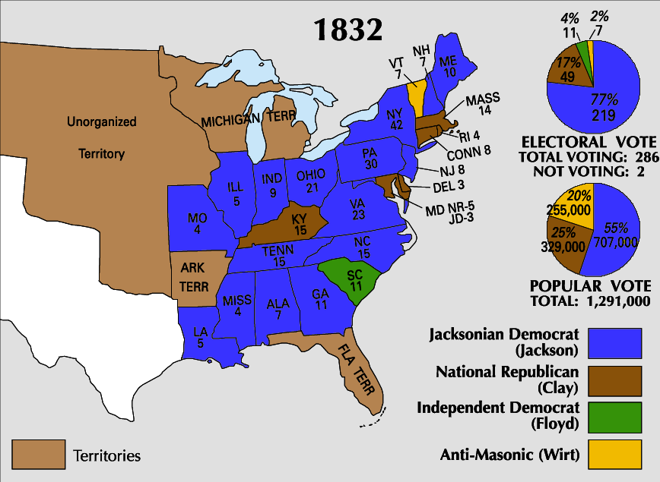

Slide 27
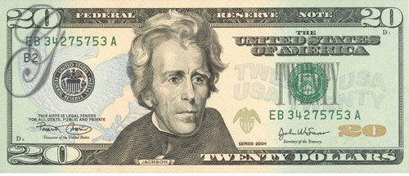
The Bank War
Jackson attacked the BUS by withdrawing all federal money & moved the funds to 23 state banks
Jackson’s opponents argued that he overstepped his authority:
Unpopular in Jackson’s cabinet
Some who supported his veto of the re-charter now questioned whether Jackson had gone too far & overstepped his powers
Favorable state banks were called “pet” or “wildcat” banks
Irony?
This move effectively ended Henry Clay’s American System
Notes:
Jackson interpreted his reelection as a mandate to undermine the bank still further. In September 1833, he ordered his Treasury secretary to divert federal revenues from the Bank of the United States to selected state banks, which came to be known as “pet” banks. The secretary of the Treasury and his assistant resigned rather than carry out the president’s order. It was only after Jackson appointed a second new secretary that his order was implemented. Jackson’s decision to divert federal deposits from the national bank prompted his adversaries in the Senate to formally censure the president’s actions as arbitrary and unconstitutional. The bank’s president, Nicholas Biddle, responded to Jackson’s actions by reducing loans and calling in debts. “This worthy President,” said Biddle, “thinks that because he has scalped Indians and imprisoned Judges he is to have his way with the Bank. He is mistaken.” Jackson retorted: “The Bank...is trying to kill me, but I will kill it.”

Slide 28
Killing the Bank
Jackson issued the Specie Circular in 1836 to move U.S. away from paper money by accepting only gold or silver (specie) for land sales
The economy sank & Panic of 1837 led to a 6-year recession due to:
Price inflation & the inconsistent extension of credit by “pet” banks
Drop in worldwide cotton prices
…and Jackson’s successor, Martin Van Buren, will have to deal with
Notes:
Jackson’s decision to divert funds drew strong support from many conservative businesspeople who believed that the bank’s destruction would increase the availability of credit and open up new business opportunities. Jackson, however, hated all banks, and believed that the only sound currencies were gold and silver. Having crippled the Bank of the United States, he promptly launched a crusade to replace all bank notes with hard money. Denouncing “the power which the moneyed interest derives from a paper currency,” the president prohibited banks that received federal deposits from issuing bills valued at less than $5. Then, in the Specie Circular of 1836, Jackson prohibited payment for public lands in anything but gold or silver. That same year, in another anti-banking measure, Congress voted to deprive pet banks of federal deposits. Instead, nearly $35 million in surplus funds was distributed to the states to help finance internal improvements.
To Jackson’s supporters, the presidential veto of the bank bill was a principled assault on a bastion of wealth and special privilege. His efforts to curtail the circulation of bank notes was an effort to rid the country of a tool used by commercial interests to exploit farmers and working men and women. To his critics, the veto was an act of economic ignorance that destroyed a valuable institution that promoted monetary stability, eased the long-distance transfer of funds, provided a reserve of capital on which other banks drew, and helped regulate the bank notes issued by private banks. Jackson’s effort to limit the circulation of bank notes was a misguided act of a “backward-looking” president, who failed to understand the role of a banking system in a modern economy.
The effect of Jackson’s banking policies remains a subject of debate. Initially, land sales, canal construction, cotton production, and manufacturing boomed following Jackson’s decision to divert federal funds from the bank. At the same time, however, state debts rose sharply and inflation increased dramatically. Prices climbed 28 percent in just three years. Then in 1837, just after the election of Jackson’s successor Democrat Martin Van Buren, a deep financial depression struck the nation. Cotton prices fell by half. In New York City, 50,000 people were thrown out of work and 200,000 lacked adequate means of support. Hungry mobs broke into the city’s flour warehouse. From across the country came “rumor after rumor of riot, insurrection, and tumult.” Not until the mid-1840s would the country fully pull out of the depression.
Who was to blame for the Panic of 1837? One school of thought holds Jackson responsible, arguing that his banking policies removed a vital check on the activities of state-chartered banks. Freed from the regulation of the second Bank of the United States, private banks rapidly expanded the volume of bank notes in circulation, contributing to the rapid increase in inflation. Jackson’s Specie Circular of 1836, which sought to curb inflation by requiring that public land payments be made in hard currency, forced many Americans to exchange paper bills for gold and silver. Many private banks lacked sufficient reserves of hard currency and were forced to close their doors, triggering a financial crisis.

Slide 29
The Emergence of the Whigs
In 1834, an anti-Jackson coalition formed a new party, the Whigs:
Supported by ex-Federalists, “Clay Republicans,” commercial farmers in the West & South, industrialists in the North
Supported a strong national gov’t & economic regulation
The Whigs gained support during the Panic of 1837 & the recession
Were strongly opposed to “King Andrew”
Notes:
Although it took a number of years for Jackson’s opponents to coalesce into an effective national political organization, by the mid-1830s the Whig party, as the opposition came to be known, was able to battle the Democratic party on almost equal terms throughout the country.
The Whig party was formed in 1834 as a coalition of National Republicans, Anti-Masons, and disgruntled Democrats, who were united by their hatred of “King Andrew” Jackson and his “usurpations” of congressional and judicial authority, came together in 1834 to form the Whig party. The party took its name from the seventeenth-century British Whig group that had defended English liberties against the usurpations of pro-Catholic Stuart Kings.
Whigs tended to be educators and professionals; manufacturers; business-oriented farmers; British and German Protestant immigrants; upwardly aspiring manual laborers; free blacks; and active members of Presbyterian, Unitarian, and Congregational churches.
The Whig coalition included supporters of Henry Clay’s American System, states’ righters, religious groups alienated by Jackson’s Indian removal policies, and bankers and businesspeople frightened by the Democrats’ anti-monopoly and anti-bank rhetoric.
Whereas the Democrats stressed class conflict, Whigs emphasized the harmony of interests between labor and capital, the need for humanitarian reform, and leadership by men of talent. The Whigs also idealized the “self-made man,” who starts “from an humble origin, and from small beginnings rise[s] gradually in the world, as a result of merit and industry.” Finally, the Whigs viewed technology and factory enterprise as forces for increasing national wealth and improving living conditions.

Slide 30
Second Two Party System and the Whigs
Mid-1830s sparked creation of a second national party-the Whigs
Whigs
Evangelical Protestants
Wanted a world dominated by men of ability and wealth (sound familiar?)
Supported Henry Clay’s American System
Supported high tariffs (except Southern Whigs)
Many former Anti-Masons supported Whigs
Supported temperance, equality of opportunity and evangelical moralism

Slide 31
Conclusions
Andrew Jackson ushered in a new form of politics by embracing the surge in democratic suffrage:
Forming the Democratic Party, active campaigning, the spoils system, & “common man” image
Jackson’s liberal use of the veto strengthened presidential power
Opposition to Jackson led to the permanent two-party system

Slide 32
Jackson Legacy
Expanded the authority of the presidency.
Upheld national authority by threatening the use of military force.
Curbed the reach of the national government.
Reinvigorated the Jeffersonian tradition of a limited and frugal central government.

Slide 36
